Slide 1
Architectures

Slide 2
02: Architectures
2.1 Architectural styles
2.2 System architectures
2.3 Architectures versus middleware
2.4 Self-management in distributed systems

Slide 3
What is a Distributed System?
You know when you have one …
… when the failure of a computer you’ve never heard of stops you from getting any work done
(L.Lamport)
A distributed system is:
a collection of independent computers that appears to its users as a single coherent system

Slide 4
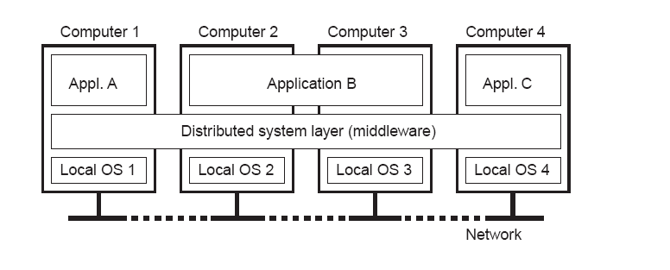
Definition of a Distributed System (II)
1.1
Independent hardware installations
Uniform software layer (middleware)
Note: the middleware layer extends over multiple machines

Slide 5
Architectural Style
A architectural style is formulated in terms of components,
  the way that components are connected to each other,
  the data exchanged between components, and finally
  show these elements are jointly configured into a system.
A component is a modular unit with
  well-defined required and provided interfaces
  that is replaceable within its environment.
A connector is a mechanism that mediates communication, coordination, or cooperation among components.
  E.g., a connector can be formed by the facilities for remote procedure call, Message passing, or streaming data
2.1 Architectural styles

Slide 6
Several Architecutre Styles
Using components and connectors, we can come to various configurations, in turn have been classified into architectural sytles.
Layered architectures
Object-based architectures
Data-centered architectures
Event-based architectures

Slide 7
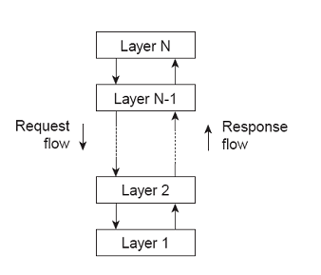
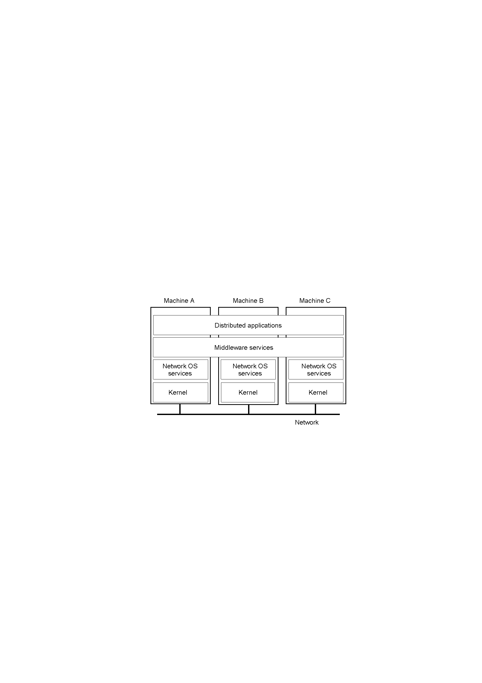
Architectural styles(1/4): Layered style
Observation: Layered style is used for client-server system;
2.1 Architectural styles
Notes:
An key observation is that control generally flows from layer to layer: requests go down the hierarchy where as the results flow upward.

Slide 8
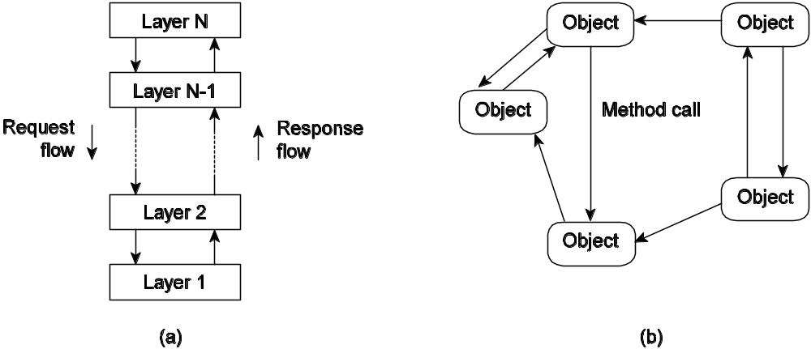
Architectural styles (2/4): object based
Basic idea: Organize into logically different components, and subsequently distribute those components over the various machines.
Observation: object-based style for distributed object systems.
  In essence, each object corresponds to what we have defined as a component and
  these components are connected through a (remote) procedure call mechanism.
2.1 Architectural styles
Notes:
A far looser organization is followed in object-based architectures.

Slide 9
Architectural styles (3/4): data-centered
Basic idea: Processes communicate through a common (passive or active) repository.
As important as the layered and object-based architectures
  E.g., a wealth of networked applications have been developed that rely on a shared distributed file system
    in which virtually all communication takes place through files.
2.1 Architectural styles

Slide 10
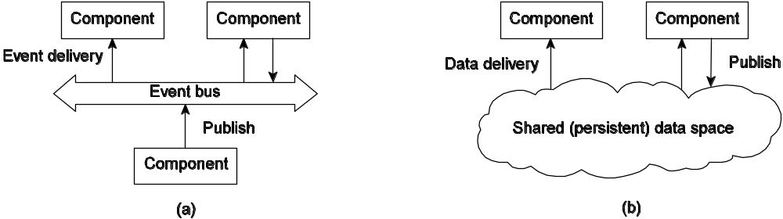
Architectural Styles (4/4): event-based
Observation: Decoupling processes in space (“anonymous”) and also time (“asynchronous”) has led to alternative styles:
(a) Publish/subscribe [decoupled in space] and
(b) Shared dataspace [decoupled in space and time]
2.1 Architectural styles
Notes:
In principle, components need not explicitly refer to each other. This is also referred to as being decoupled in space, or referentially decoupled.
Many shared data spaces use a SQL-like interface to the shared repository.
Distribution transparency requires making trade-offs between performance, fault tolerance, ease-of-programming, and so on.
http://www.hadoop.org.cn/hadoop/pig-language/
Pig是yahoo捐献给apache的一个项目,目前还在Apache孵化器中,但是基本功能已经可用了.今天我就给大家介绍这个好用的Pig.Pig 是SQL-like语言,是在MapReduce上构建的一种高级查询语言,把一些运算编译进MapReduce模型的Map和Reduce中,并且用户 可以定义自己的功能.Yahoo网格运算部门开发的又一个克隆Google的项目:Sawzall.

Slide 11
Outline
2.1 Architectural styles
2.2 System architectures
  2.2.1 Centralized architectures
  2.2.2 Decentralized architectures
  2.2.3 Hybrid architecures
2.3 Architectures versus middleware
2.4 Self-management in distributed systems

Slide 12
System architecture
Deciding on software components, their interaction, and their placement leads to an instance of a software architecture, also called a system architecture.
2.2 System architecture

Slide 13
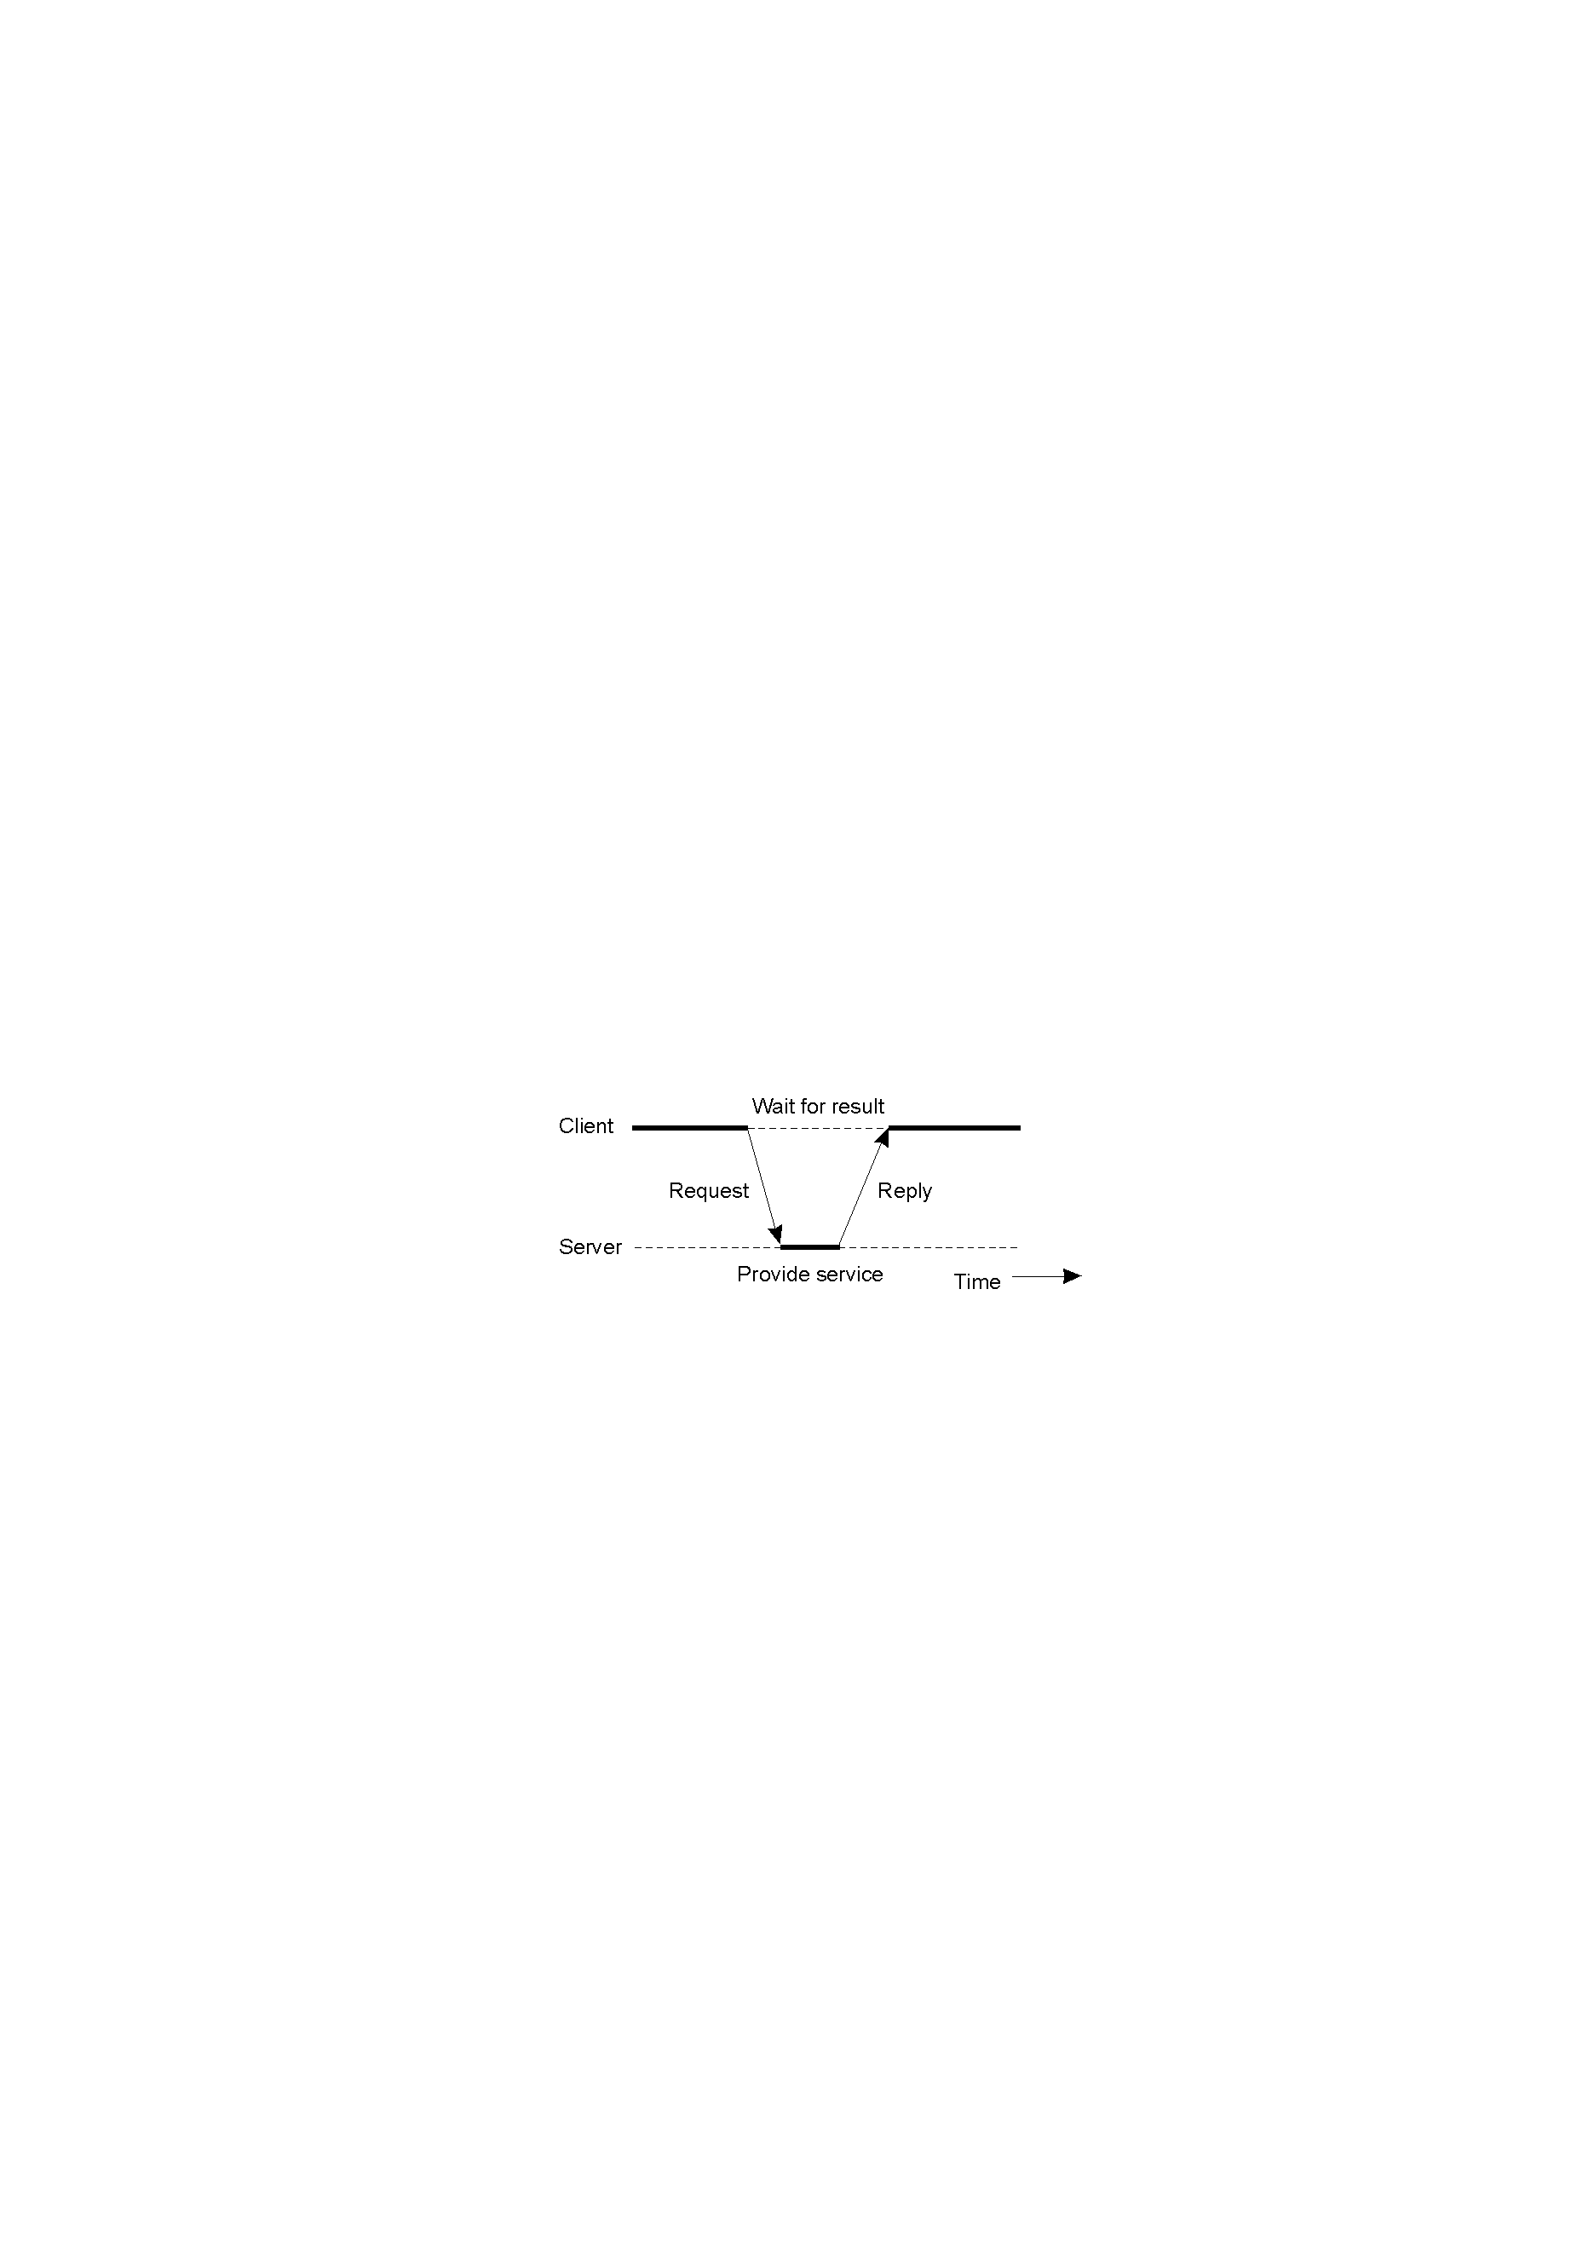
2.2.1 Centralized Architectures
Basic Client-Server Model:
Server: a process implementing a certain service.
  E.g., a file system service or a database service
Client: uses the service by sending a request and waiting for the reply
Clients and servers can be distributed across different machines
This client-server interaction, also known as request-reply behaviror
Main problem to deal with: unreliable communication
Note: often both roles simultaneously for different services
2.2 System architecture

Slide 14
Delivery Failures
How can a client tell that a request message was lost?
  Timeout is one approach.
How can a client detect the difference between a request message that was lost, and a reply message that was lost?
  No great answer, usually can offer only “at most once” service, or “at least once” service.
Does using a connection-oriented protocol like TCP help?
  Book is misleading.
2.2 System architecture

Slide 15
What guarantees does TCP provide?
  Ordered, reliable, byte-sequence.
When a TCP write call returns, can you discard the data?
  int important_data[100];
  while (some_condition) {
  // Call below overwrites array.
  prep_important_data(important_data);
  write(connfd, important_data,
  100*sizeof(int));
  }
If you do discard immediately, what bad things might happen?
2.2 System architecture

Slide 16
TCP provides guarantees only in the absence of faults.
  Packets can be lost, but this can be thought of as “normal” operation.
If you want to make sure that the data actually got there, and got processed, you need wait for an application-level acknowledgement from the receiver.
  Why doesn’t TCP do this for you?
    Because it requires too much application knowledge. Do you want the ack when it gets to the app, or when written to disk, or RDBMS, etc.?
2.2 System architecture

Slide 17
Idempotency
Can you categorize these into two categories?
  Read my account balance.
  Transfer $100 from savings to checking.
  Change block 100 of file A to read: “abcdef…”.
  Copy block 100 of file A to block 200.
2.2 System architecture

Slide 18
Idempotent
An operation can be repeated multiple times without harm, it is said to be idempotent.
Since some requests are idempotent and others are not
  it should be clear that there is no single solution for dealing with lost messages.
2.2 System architecture
Notes:
idempotent [ˈaidəmˌpəutənt]

Slide 19
2.2.1.1 Application Layering
Traditional three-layered view:
  User-interface layer contains units for an application’s user interface
  Processing layer contains the functions of an application, i.e. without specific data
  Data layer contains the data that a client wants to manipulate through the application components
Observation: This layering is found in many distributed information systems,
  using traditional database technology and accompanying applications.
2.2 System architecture

Slide 20
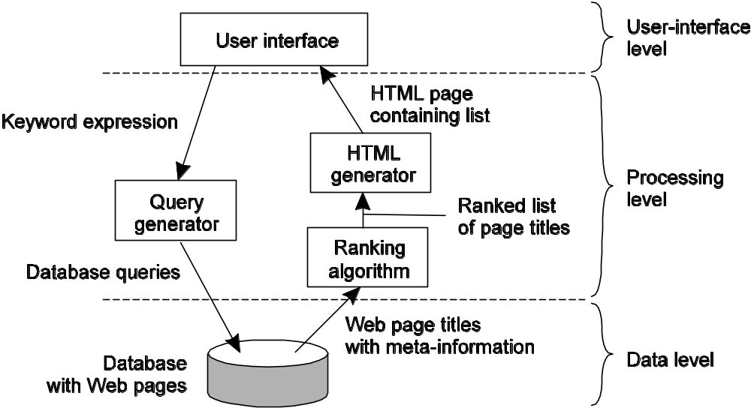
E.g., Internet Search Engine
2.2 System architecture

Slide 21
Other examples:
  Stock brokerage decision support:
    User interface
    Analysis
    Financial database
Data level is typically an RDBMS, so will include replication and consistency functionality.
2.2 System architecture

Slide 22
Logical Architecture vs. Physical Architecture
Physical architecture may or may not match the logical architecture.
Could have just two types:
  Client machine containing interface
  Server machine running all else
Or could have other partitionings.
2.2 System architecture

Slide 23
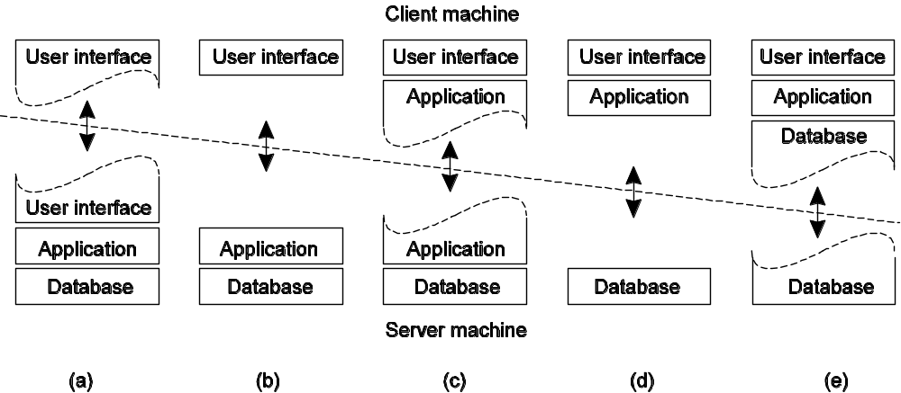
2.2.1.2 Multi-Tiered Architectures
Single-tiered: dumb terminal/mainframe configuration
Two-tiered: client/single server configuration
Three-tiered: each layer on separate machine
Traditional two-tiered configurations:
2.2 System architecture

Slide 24
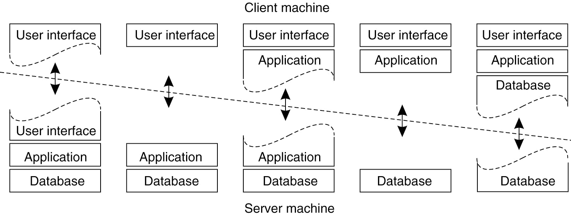
(a)
(b)
(d)
(e)
(c)
Examples:
  a: server-side has some control over UI.
  c: form checking.
  d: banking application just uploads transaction.
  e: Local cache
What’s good about moving things out to desktop machines? What’s bad?
  Thin clients are popular, why?
    Less management.
2.2 System architecture

Slide 25
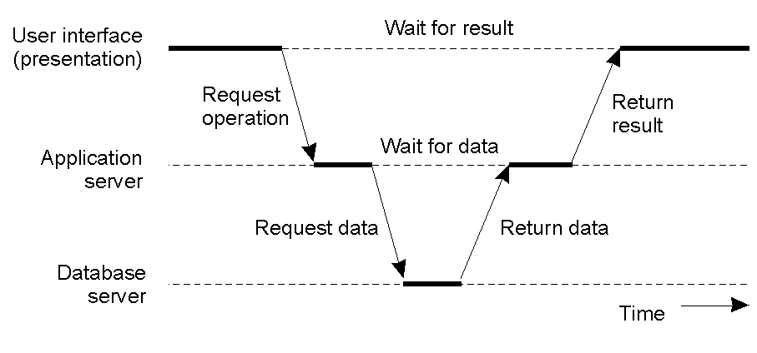
Physical 3-Tiered architecure
Observation: server-side solutions are becoming increasingly more distributed as a single server is being replaced by multiple servers running on different machines. A server may sometimes need to act a client.
An example of a server acting as a client.
  Web server, TPM
2.2 System architecture

Slide 26
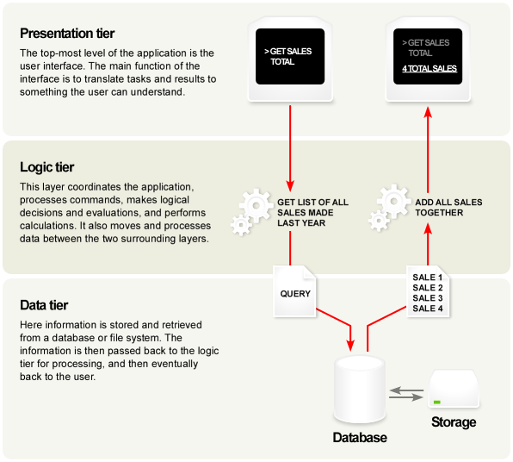
Another Description of 3-Tier Architecture
2.2 System architecture

Slide 27
3-Tier Example: Web Proxy Server
Client
Web
server
Proxy
server
Client
Web
server
Process:
Computer:
2.2 System architecture

Slide 28
3-Tier Example: Clients Invoke Individual Servers
Client
Invocation
Server
Invocation
Result
Server
Result
Client
Process:
Computer:
2.2 System architecture

Slide 29
2.2.2 Decentralized Architectures
2.2 System architecture

Slide 30
Horizontal vs. Vertical Distribution
Previously, we have looked at what is known as vertical distribution.
  The different tiers correspond directly with the logical organization of applications.
    Multitiered client-server architectures are a direct consequence of dividing applications into a user-interface, processing components, and a data level.
    vertical fragmentation as used in distributed relational databases
We can also have horizontal distribution, what is that?
  A client or server may be physically split up into logically equivalent parts,
  but each part is operating on its own share of the complete data set, thus balancing the load.
  A class of modern architectures that support horizontal distribution, known as peer-to-peer
  Things like replication and clusters.
2.2 System architecture
Notes:
vertical distribution is related to the concept of vertical fragmentation as used in distributed relational databases, where it means that tables are split column-wise, and subsequently distributed across multiple machines.
BigTable，顾名思义，就是一张“大表”，由稀疏多维表组成的面向列存储的数据管理系统。Google于2004年初开始研发，到现在它已经运行了四年多，基本上能够满足Google的需求：处理海量数据，实现高速存储与查找。

Slide 31
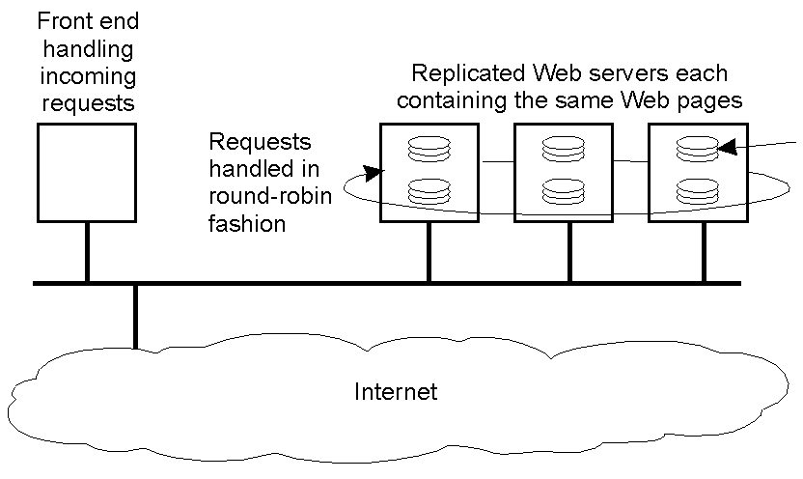
An example of horizontal distribution of a Web service.
Disks
2.2 System architecture

Slide 32
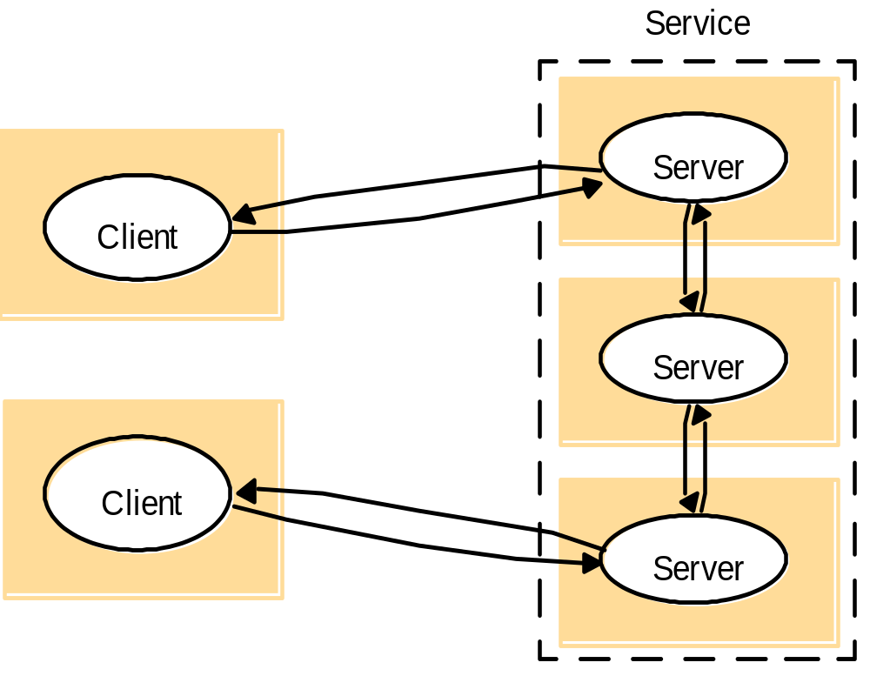
Horizontally distributed servers may talk to each other.
2.2 System architecture

Slide 33
Peer-to-Peer
How does it differ from previous?
Can all apps be done as P2P?
Generally, always on an overlay network.
What is an overlay network?
  An overlay network is a logical network.
  Are neighbors in the overlay network connected by a real link?
  Are nodes that are close in the overlay network close in the physical network?
Overlay network, that is , a network in which the nodes are formed by processes and the links represent the possible communication channels (which are usually realized as TCP connections). In general, a process cannot communicate directly with an arbitrary other process, but is required to send messages through the available communication channels.
2.2 System architecture

Slide 34
Distributed Hash Tables (1/2)
Let’s say that you have a lot of data things that you want to distribute over a P2P network.
  Assume that for each data object, there is an associated key that is an integer.
How do you find something? It’s on some node out there somewhere.
  Basic operation: map a key to a node.
2.2 System architecture

Slide 35
Distributed Hash Table (2/2)
In a DHT-based system, data items are assigned a random key from a large identifier space, such as a 128-bit or 160-bit identifier.
  By far the most-used procedure is to organize the processes through a DHT.
the nodes are logically organized in a ring such that a data item with key k is mapped to the node with the smallest identifier id>=k.
  This node is refered to as the successor of key k and denoted as succ(k),
2.2 System architecture

Slide 36
Decentralized Architectures
Observation: In the last couple of years we have been seeing a tremendous growth in peer-to-peer systems:
  Structured P2P: nodes are organized following a specific distributed data structure
  Unstructured P2P: nodes have randomly selected neighbors
  Hybrid P2P: some nodes are appointed special functions in a well-organized fashion
Note: In virtually all cases, we are dealing with overlay networks:
  data is routed over connections setup between the nodes (cf. application-level multicasting).
2.2 System architecture
Notes:
Overlay network, that is , a network in which the nodes are formed by processes and the links represent the possible communication channels (which are usually realized as TCP connections). In general, a process cannot communicate directly with an arbitrary other process, but is required to send messages through the available communication channels.

Slide 37
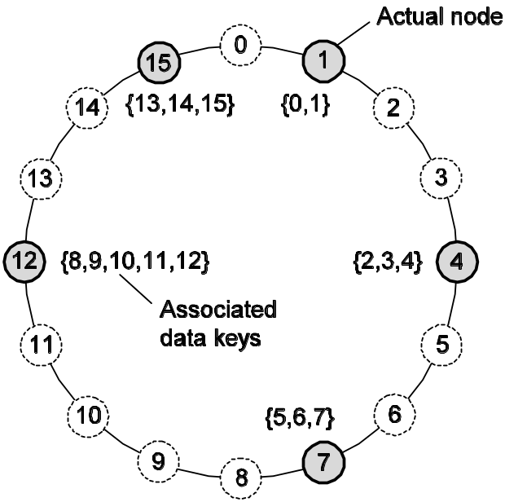
Structured P2P : DHTs
Basic idea: Organize the nodes in a structured overlay network such as a logical ring, and make specific nodes responsible for services based only on their ID:
Note: The system provides an operation LOOKUP(key) that will efficiently route the lookup request to the associated node.
2.2 System architecture
Notes:
For example, in the Chord system (Stoica et al., 2003) the nodes are logically organized in a ring such that a data item with key k is mapped to the node with the smallest identifier id>=k. This node is refered to as the successor of key k and denoted as succ(k), as shown in Fig. 2-7.
It is important to realize that looking up a key does not follow the logical organization of nodes in the ring form Fig. 2-7. Rather, each node will maintain shortcuts to other nodes in such a way that lookups can generally be done in O(log(N)) number of steps, where N is the number of nodes participating in the overlay.
How to join?
Generate key
Lookup
Collisions?
2¹²⁸ = 3³⁸

Slide 38
Membership Management @Chord
How nodes organize themselves into an overlay network.
Joining the system
  Generate a random identifier id
  Contact succ(id) and its predecessor and
  Insert itself in the ring
  each data items whose key is now associated with node id, is transferred from succ(id)
Leaving the system
  Node id informs its departure to its predecessor and successor,
  and transfers its data items to succ(id)
2.2 System architecture
Notes:
We will not go into algorithms for looking up a key now, but defer that discussion until Chap. 5 where we describe details of various naming systems. Instead, let us concentrate on how nodes organize themselves into an overlay network, or in other words, membership management.

Slide 39
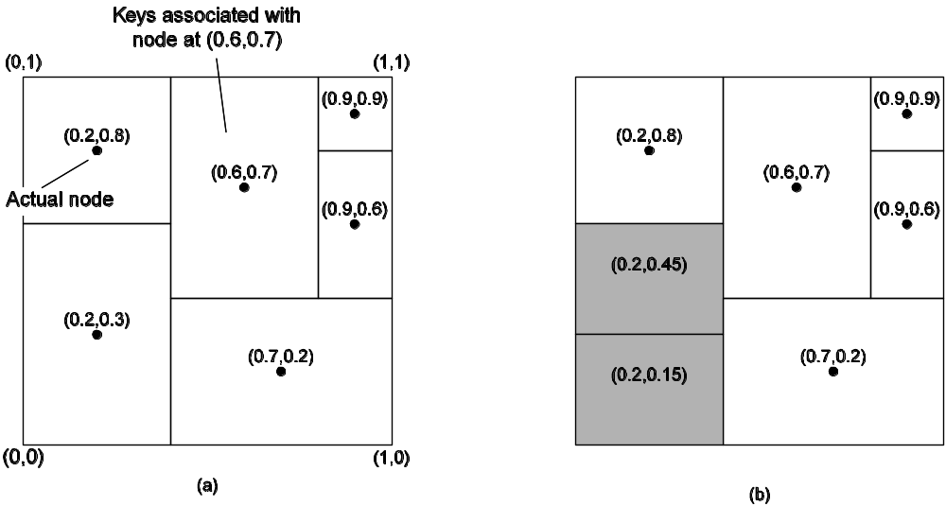
Structured P2P Systems: Content Addressable Network (CAN)
Other example: Organize nodes in a d-dimensional space and let every node take the responsibility for data in a specific region. When a node joins ⇒ split a region.
2.2 System architecture

Slide 40
Membership Management @CAN
How nodes organize themselves into an overlay network.
A node P wants to join the system
  Pick an arbitrary point form the coordinate space
  Contact node Q in whose region that point falls
  Q splits its region into two halves, and one half is assigned to the node P
Leaving the system
  Assign to one of its neighbors
  A background process is periodically started to reparation the entire space.
2.2 System architecture

Slide 41
Unstructured P2P Systems
Observation: Many unstructured P2P systems attempt to maintain a random graph:
Basic principle: Each node is required to be able to contact a randomly selected other node:
  Let each peer maintain a partial view of the network, consisting of c other nodes
  Each node P periodically selects a node Q from its partial view
  P and Q exchange information and exchange members from their respective partial views
Observation: It turns out that, depending on the exchange, randomness, but also robustness of the network can be maintained.
2.2 System architecture
Notes:
robust [rəˈbʌst]

Slide 42
Actions by active thread (periodically repeated)
Actions by passive thread:
select a peer P from the current partial view;
if PUSH_MODE {
mybuffer = [(MyAddress, 0)];
permute partial view;
move H oldest entries to the
end;
append first c/2 entries to
mybuffer;
send mybuffer to P;
} else { // empty view to trigger response
send trigger to P;
}
if PULL_MODE {
receive P’s buffer;
}
construct a new partial view from
the current one and P’s buffer;
increment the age of every entry in
the new partial view;
receive buffer from any process Q;
if PULL_MODE {
mybuffer = [(MyAddress, 0)];
permute partial view;
move H oldest entries to the
end;
append first c/2 entries to the
end;
send mybuffer to P;
}
construct a new partial view from
the current one and P’s buffer;
increment the age of every entry in
the new partial view;
2.2 System architecture

Slide 43
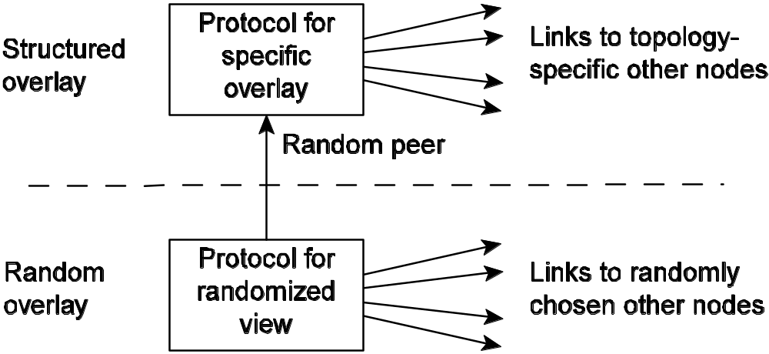
Hybrid Approaches
Basic idea: Distinguish two layers: (1) maintain random partial views in lowest layer; (2) be selective on who you keep in higher-layer partial view.
Note: lower layer feeds upper layer with random nodes; upper layer is selective when it comes to keeping references.
2.2 System architecture

Slide 44
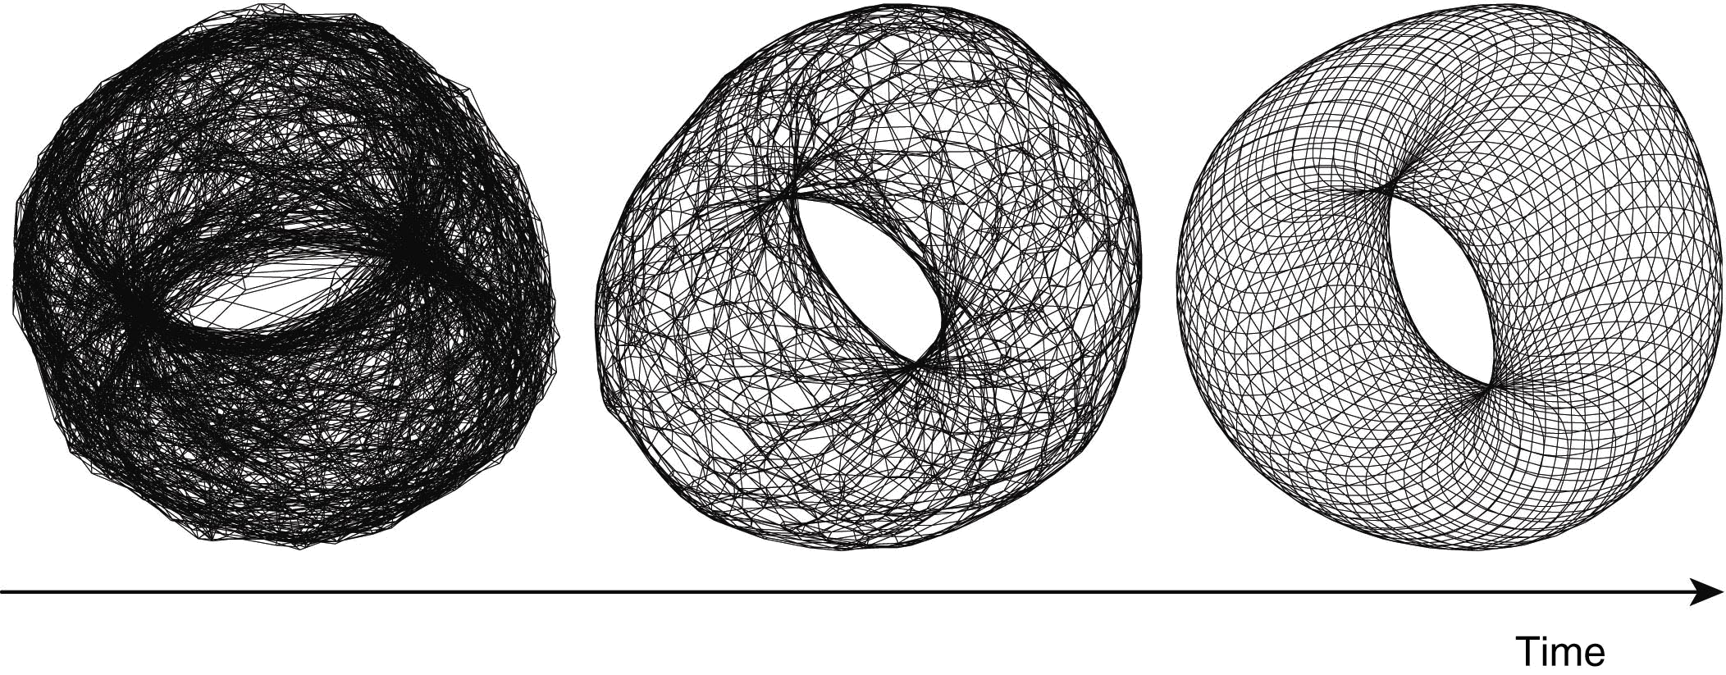
Interesting behaviors.
  Nodes on a grid.
  Each node maintains a list of nearest neighbors, using the Manhattan distance.
  Initially, the links are random.
Complete different ranking functions can be used, such as those based on semantic distance, to form semantic overlay networks.
2.2 System architecture
Notes:
Example: Consider a N × N grid. Keep only references to nearest neighbors:
|| (a1, a2) − (b1, b2) || = d1 + d2
di = min{N − |ai − bi|, |ai − bi|}
Result: a nice torus will appear after a while:

Slide 45
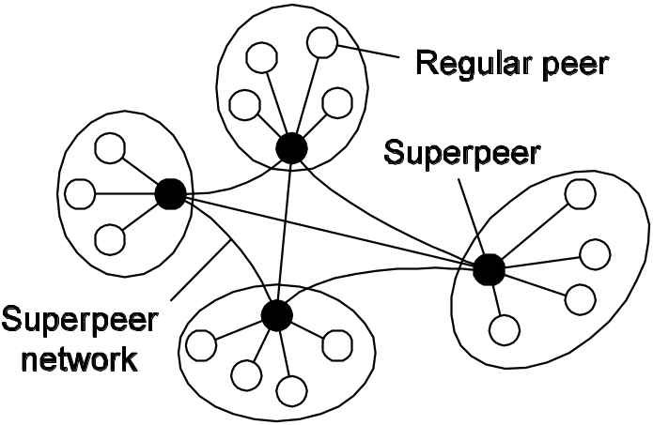
Superpeers
Observation: Sometimes it helps to select a few nodes to do specific work: superpeer
Examples:
  Peers maintaining an index (for search)
  Peers monitoring the state of the network
  Peers being able to setup connections
2.2 System architecture
Notes:
Notably in unstructured peer-to-peer systems, locating relevant data items can become problematic as the network grows.
In that case, making use of a broker that collects resource usage for a number of nodes that are in each other’s proximity will allow to quickly select a node with sufficient resources.

Slide 46
Superpeers can be static, or selected dynamically from the other peers.
How do you pick a superpeer? Can use leader election.
  We discuss in Chap. 6
2.2 System architecture

Slide 47
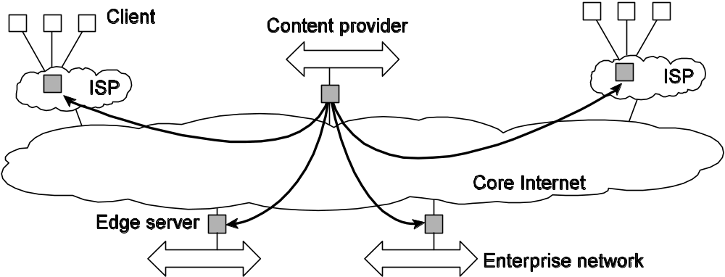
2.2.3 Hybrid Architectures (1/2)
Observation: In many cases, client-server architectures are combined with peer-to-peer solutions
Example: Edge-server architectures, which are often used for Content Delivery Networks:
2.2 System architecture
Notes:
Edge servers connect users to internet.
Can collaborate

Slide 48
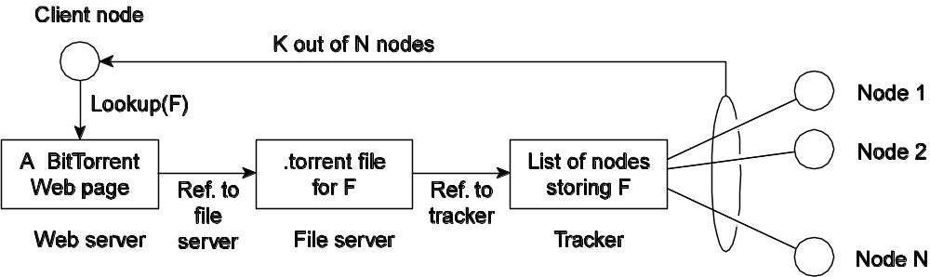
Hybrid Architectures (2/2)
Example: Combining a P2P download protocol with a client-server architecture for controlling the downloads: Bittorrent
Basic idea: Once a node has identified where to download a file from, it joins a swarm of downloaders who in parallel get file chunks from the source, but also distribute these chunks amongst each other.
2.2 System architecture
Notes:
Collaborative Distributed Systems

Slide 49
Outline
2.1 Architectural styles
2.2 System architectures
2.3 Architectures versus middleware
  2.3.1 Interceptor
  2.3.2 General Approaches to adaptive software
  2.3.3 Discussion
2.4 Self-management in distributed systems

Slide 50
We have talked about the physical architecture.
Does middleware also have an architectural style?
  If it does, how does it affect flexibility, extensibility?
  Sometimes, the “native” style may not be optimal.
    Can we build messaging over RPC?
    Can we build RPC over messaging?
2.3 Architectures vs. middleware
Notes:
Problem: In many cases, distributed systems/applications are developed according to a specific architectural style. The chosen style may not be optimal in all cases ⇒ there is a need to (dynamically) adapt the behavior of the middleware when needed.
Interceptors: Intercept the usual flow of control when invoking a remote object:

Slide 51
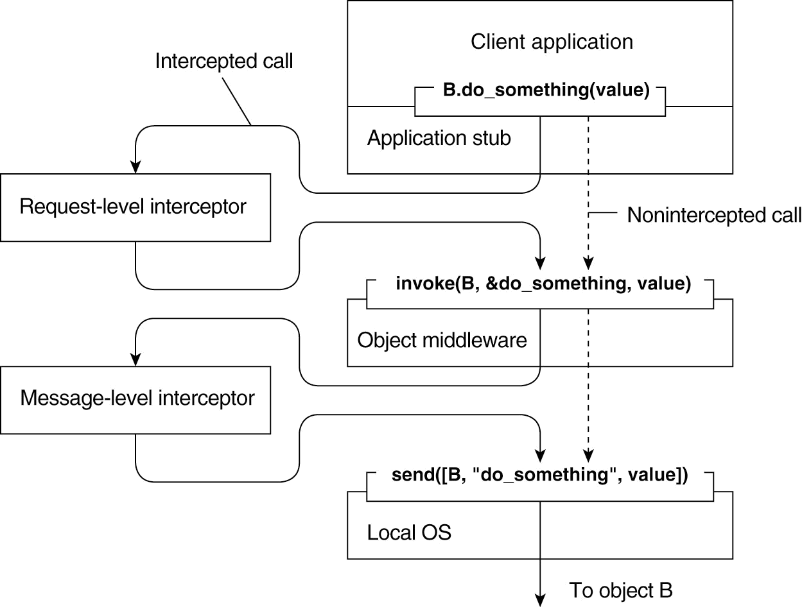
Interceptors
Request level could handle replication.
Message-level could handle fragmentation.
2.3 Architectures vs. middleware

Slide 52
Adaptive Middleware
Separation of concerns: Try to separate extra functionalities and later weave them together into a single implementation ⇒ only toy examples so far.
Computational reflection: Let a program inspect itself at runtime and adapt/change its settings dynamically if necessary ⇒ mostly at language level and applicability unclear.
Component-based design: Organize a distributed application through components that can be dynamically replaced when needed ⇒ highly complex, also many intercomponent dependencies.
Observation: Do we need adaptive software at all, or is the issue adaptive systems?
2.3 Architectures vs. middleware

Slide 53
Outline
2.1 Architectural styles
2.2 System architectures
2.3 Architectures versus middleware
2.4 Self-management in distributed systems

Slide 54
Self-managing Distributed Systems
Observation: Distinction between system and software architectures blurs when automatic adaptivity needs to be taken into account:
  Self-configuration
  Self-managing
  Self-healing
  Self-optimizing
  Self-*
Note: There is a lot of hype going on in this field of autonomic computing.
2.4 Self-management in distributed systems
Notes:
hype [haip] n. <美俚> 皮下注射, 骗局,大肆宣传,大做广告,瘾君子

Slide 55
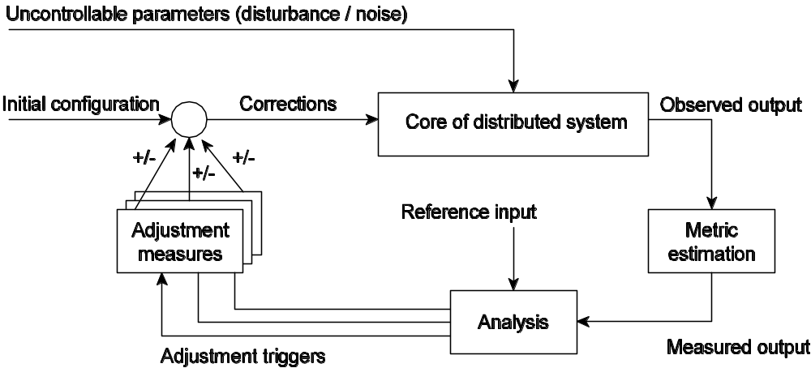
Feedback Control Model
Observation: In many cases, self-* systems are organized as a feedback control system:
2.4 Self-management in distributed systems

Slide 56
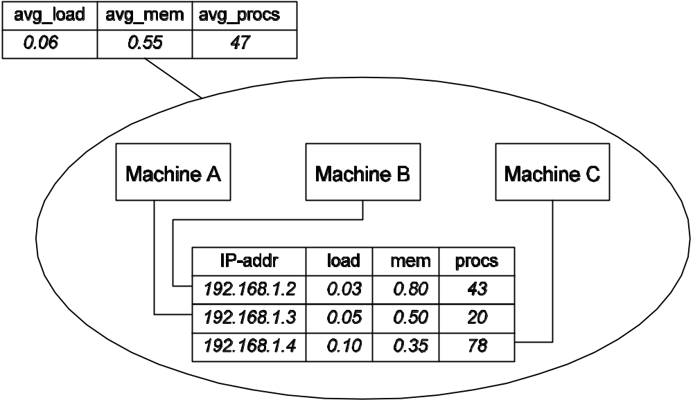
Example: Systems Monitoring with Astrolabe
Data collection and information aggregation in Astrolabe
2.4 Self-management in distributed systems
Notes:
astrolabe n. 古代的天体观测仪, 星盘

Slide 57
Each upper zone aggregated the lower zone.
Most interesting part is how to query. An SQL model is adopted. For example, an average:
  SELECT AVG(procs) AS avg_procs FROM hostinfo
Such a query would be running on a node.
Information needs to be propagated. Done through gossiping.
2.4 Self-management in distributed systems

Slide 58
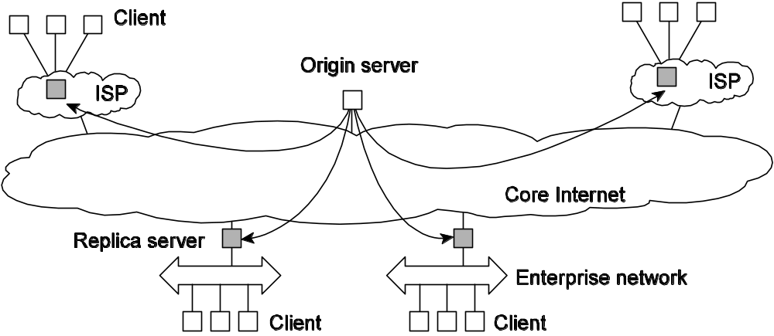
Example: Differentiating Replication Strategies in Globule
Globule: Collaborative CDN that analyzes traces to decide where replicas of Web content should be placed. Decisions are driven by a general cost model:
    cost = (w1 × m1) + (w2 × m2) + · · · + (wn × mn)
  Globule origin server collects traces and does what-if analysis by checking what would have happened if page P would have been placed at edge server S.
  Many strategies are evaluated, and the best one is chosen.
2.4 Self-management in distributed systems
Notes:
what-if n. 假设分析, 作假定推测
globule n. 小球, 水珠

Slide 59
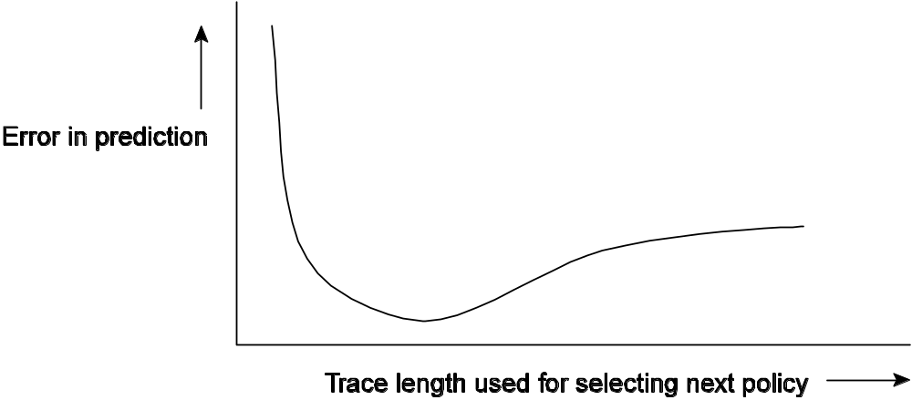
The dependency between prediction accuracy and trace length
2.4 Self-management in distributed systems

Slide 60
Summary
Architectural styles
System architectures
Architectures versus middleware
Self-management in distributed systems

Slide 61
References on peer-to-peer
Eng Keong Lua, Jon Crowcroft, Marcelo Pias, Ravi Sharma and Steven Lim, "A survey and comparison of peer-to-peer overlay network schemes", IEEE Communications Surveys & Tutorials, (7)2: 22-73, Apr., 2005
  An excellent survey of modern peer-to-peer systems, covering structured as well as unstructured networks.
  This paper forms a good introduction for those wanting to get deeper into the subject but do not really know where to start.
[Androutsellis-Theotokis and Spinellis,2004] S. Androutsellis-Theotokis and D. Spinellis, "A survey of peer-to-peer content distribution technologies," ACM Comput. Surv., vol. 36, pp. 335-371, 2004.

