Slide 1

Processes
<number>/N

Slide 2
03: Processes
3.1 Threads
3.2 Virtualization
3.3 Clients
3.4 Servers
3.5 Code Migration
<number>/N

Slide 3
3.1 Threads
3.1.1 Introduction to Threads
3.1.2 Threads in Distributed Systems
<number>/N

Slide 4
Basic ideas
We build virtual processors in software, on top of physical processors:
Processor: Provides a set of instructions along with the capability of automatically executing a series of those instructions.
Thread: A minimal software processor in whose context a series of instructions can be executed. Saving a thread context implies stopping the current execution and saving all the data needed to continue the execution at a later stage.
Process: A software processor in whose context one or more threads may be executed. Executing a thread, means executing a series of instructions in the context of that thread.
<number>/N

Slide 5
Context Switching
Processor context: The minimal collection of values stored in the registers of a processor used for the execution of a series of instructions (e.g., stack pointer, addressing registers, program counter).
Thread context: The minimal collection of values stored in
registers and memory, used for the execution of a series of
instructions (i.e., processor context, state).
Process context: The minimal collection of values stored in registers and memory, used for the execution of a thread (i.e., thread context, but now also at least MMU register values).
<number>/N
Notes:
Switch execution between caller and callee: The minimal collection of values stored in the registers of a processor.
Switch execution between threads: The minimal collection of values stored in registers plus maybe some thread state.
Switch between processes: Thread context plus address space values.

Slide 6
Observation 1: Threads share the same address space. Do we need OS involvement?
Observation 2: Process switching is generally more expensive. OS is involved.
  e.g., trapping to the kernel.
Observation 3: Creating and destroying threads is cheaper than doing it for a process.
<number>/N
Notes:
Thread context switching can be done entirely independent of the operating system.

Slide 7
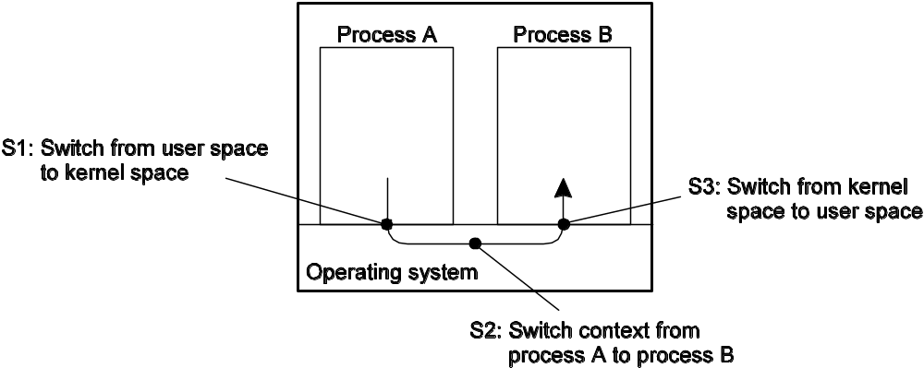
Context Switching in Large Apps
A large app is commonly a set of cooperating processes, communicating via IPC, which is expensive.
<number>/N

Slide 8
Threads and OS (1/2)
Main Issue: Should an OS kernel provide threads or should they be implemented as part of a user-level package?
User-space solution:
  Nothing to do with the kernel. Can be very efficient.
  But everything done by a thread affects the whole process. So what happens when a thread blocks on a syscall?
  Can we use multiple CPUs/cores?
<number>/N
Notes:
All operations can be completely handled within a single process => implementations can be extremely efficient.
All services provided by the kernel are done on behalf of the process in which a thread resides => if the kernel decides to block a thread, the entire process will be blocked.
Threads are used when there are lots of external events: threads block on a per-event basis => if the kernel can’t distinguish threads, how can it support signaling events to them?

Slide 9
Threads and OS (2/2)
Kernel solution: Kernel implements threads. Everything is system call.
  Operations that block a thread are no longer a problem: kernel schedules another.
  External events are simple: the kernel (which catches all events) schedules the thread associated with the event.
  Less efficient.
Conclusion: Try to mix user-level and kernel-level threads into a single concept.
7
<number>/N
Notes:
Multicore works.

Slide 10
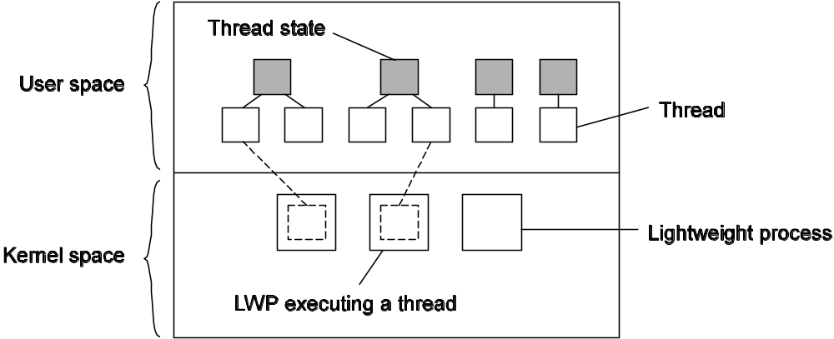
Hybrid (Solaris)
Use two levels. Multiplex user threads on top of LWPs (kernel threads).
<number>/N

Slide 11
When a user-level thread does a syscall, the LWP blocks. Thread is bound to LWP.
Kernel schedules another LWP.
Context switches can occur at the user-level.
When no threads to schedule, a LWP may be removed.
Note
  This concept has been virtually abandoned – it’s just either user-level or kernel-level threads.
<number>/N
Notes:
Not very well. Sun got rid of it.

Slide 12
Threads and Distributed Systems
Multithreaded clients: Main issue is hiding network latency.
Multithreaded web client:
  Browser scans HTML, and finds more files that need to be fetched.
  Each file is fetched by a separate thread, each issuing an HTTP request.
  As files come in, the browser displays them.
Multiple request-response calls to other machines (RPC):
  Client issues several calls, each one by a different thread.
  Waits till all return.
  If calls are to different servers, will have a linear speedup.
<number>/N

Slide 13
Fetching Images
Suppose there are ten images in a page. How should they be fetched?
  Sequentially
    fetch_sequential() {
    for (int i = 0; i < 10; i++) {
    int sockfd = ...;
    write(sockfd, "HTTP GET ...");
    n = read_till_socket_closed(sockfd, jpeg[i], 100K);
    }
    }
  Concurrently
    fetch_concurrent() {
    int thread_ids[10];
    for (int i = 0; i < 10; i++) {
    thread_ids[i] = start_read_thread(urls[i], jpeg[i]);
    }
    for (int i = 0; i < 10; i++) {
    wait_for_thread(thread_ids[i]);
    }
    }
Which is faster?
<number>/N

Slide 14
A Finite State Machine
A state machine consists of
  state variables, which encode its state, and
  commands, which transform its state.
  Each command is implemented by a deterministic program;
    execution of the command is atomic with respect to other commands and
    modifies the state variables and/or produces some output.
[Schneider,1990] F. B. Schneider, "Implementing fault-tolerant services using the state machine approach: a tutorial," ACM Comput. Surv., vol. 22, pp. 299-319, 1990.
<number>/N
Notes:
http://en.wikipedia.org/wiki/Finite_state_machine

Slide 15
A FSM implemented
Using a single process that awaits messages containing requests and performs the actions they specify, as in a server.
  Read any available input.
  Process the input chunk.
  Save state of that request.
  Loop.
<number>/N

Slide 16
Threads and Distributed Systems: Multithreaded servers:
Improve performance:
  Starting a thread to handle an incoming request is much cheaper than starting a process.
  Single-threaded server can’t take advantage of multiprocessor.
  Hide network latency. Other work can be done while a request is coming in.
Better structure:
  Using simple blocking I/O calls is easier.
  Multithreaded programs tend to be simpler.
This is a controversial area.
<number>/N

Slide 17
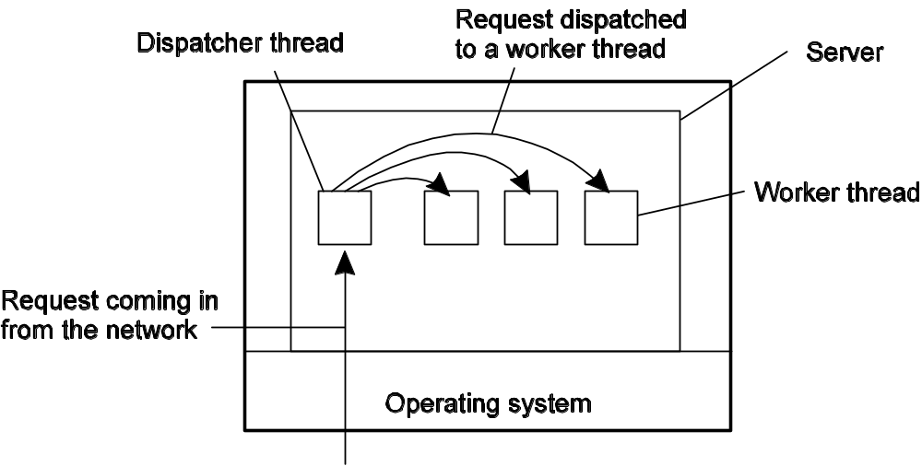
Multithreaded Servers
A multithreaded server organized in a dispatcher/worker model.
<number>/N

Slide 18
Multithreaded Servers
Three ways to construct a server.
Model | Characteristics
Threads | Parallelism, blocking system calls
Single-threaded process | No parallelism, blocking system calls
Finite-state machine | Parallelism, nonblocking system calls
<number>/N

Slide 19
3.2 Virtualization
3.2.1 The Role of Virtualization in Distributed Systems
3.2.2 Architectures of Virtual Machines
<number>/N

Slide 20
Intuition About Virtualization
Make something look like something else.
Make it look like there is more than one of a particular thing.
<number>/N

Slide 21
Virtualization
Observation: Virtualization is becoming increasingly important:
  Hardware changes faster than software
  Ease of portability and code migration
  Isolation of failing or attacked components
A virtual machine can support individual processes or a complete system depending on the abstraction level where virtualization occurs. Some VMs support flexible hardware usage and software isolation, while others translate from one instruction set to another.
[James and Ravi,2005] E. S. James and N. Ravi, "The Architecture of Virtual Machines," Computer, vol. 38, pp. 32-38, 2005.
<number>/N

Slide 22
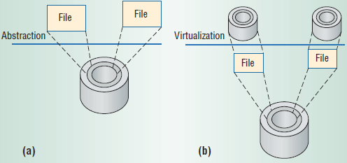
Abstraction and Virtualization applied to disk storage
(a) Abstraction provides a simplified interface to underlying resources.
(b) Virtualization provides a different interface or different resources at the same abstraction level.
<number>/N
Notes:
Figure 1a shows an example of abstraction applied to disk storage. The operating system abstracts hard-disk addressing details—for example,that it is comprised of sectors and tracks—so that the disk appears to application software as a set of variable-sized files. Application programmers can then create, write, and read files without knowing the hard disk’s construction and physical organization.
This lack of interoperability can be confining, especially in a world of networked computers where it is advantageous to move software as freely as data.
Virtualization provides a way of getting around such constraints. Virtualizing a system or component—
such as a processor, memory, or an I/O device—at a given abstraction level maps its interface
and visible resources onto the interface and resources of an underlying, possibly different, real
system. Consequently, the real system appears as a different virtual system or even as multiple virtual
Systems. Unlike abstraction, virtualization does not necessarily aim to simplify or hide details. For example,
in Figure 1b, virtualization transforms a single large disk into two smaller virtual disks, each of which
appears to have its own tracks and sectors. Virtualizing software uses the file abstraction as an
intermediate step to provide a mapping between the virtual and real disks. A write to a virtual disk
is converted to a file write (and therefore to a real disk write). Note that the level of detail provided at
the virtual disk interface—the sector/track addressing—is no different from that for a real disk; no
abstraction takes place.

Slide 23
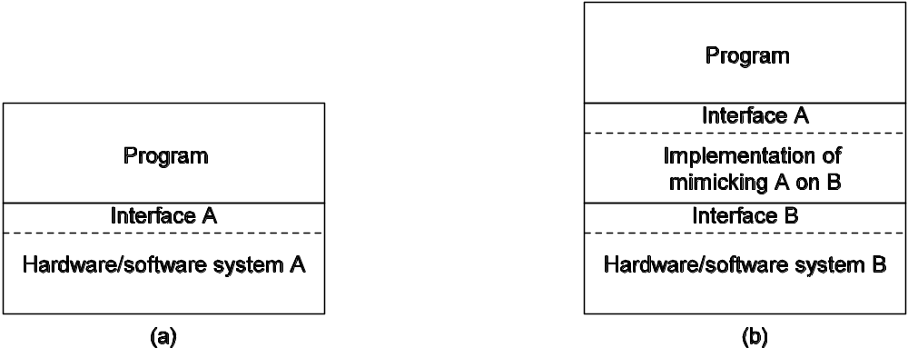
Virtualization
Originally developed by IBM.
Virtualization is increasingly important.
  Ease of portability.
  Isolation of failing or attacked components.
  Ease of running different configurations, versions, etc.
  Replicate whole web site to edge server.
General organization between a program, interface, and system.
General organization of virtualizing system A on top of system B.
<number>/N

Slide 24
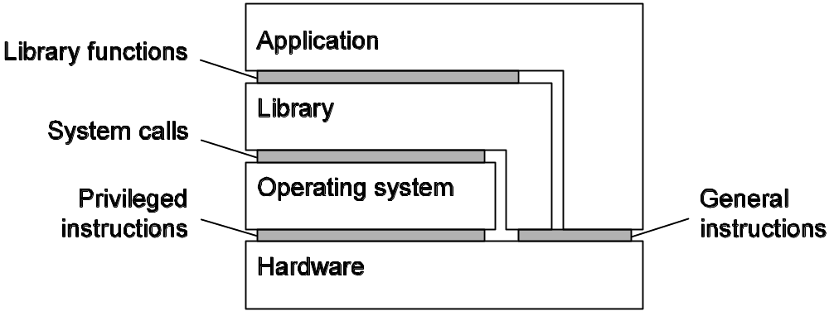
Interfaces offered by computer systems
Computer systems offer different levels of interfaces.
  Interface between hardware and software, non-privileged.
  Interface between hardware and software, privileged.
  System calls.
  Libraries.
Virtualization can take place at very different levels, strongly depending on the interfaces as offered by various systems components:
<number>/N

Slide 25
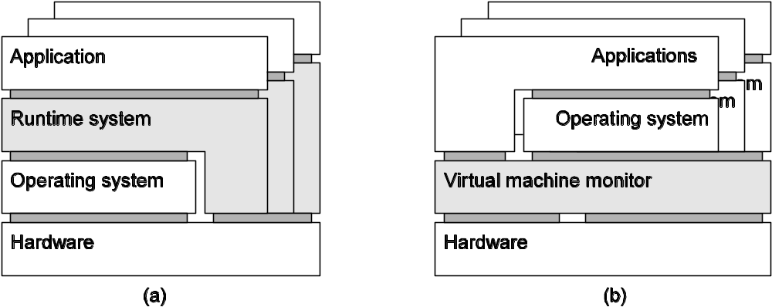
Two kinds of VMs
Process VM: A program is compiled to intermediate (portable) code, which is then executed by a runtime system. (Example: Java VM)
VMM: A separate software layer mimics the instruction set of hardware: a complete OS and its apps can be supported. (Example: VMware, VirtualBox)
<number>/N
Notes:
The process or system that runs on a VM is the guest, while the underlying platform that supports
the VM is the host. The virtualizing software that implements a process VM is often termed the runtime,
short for “runtime software.” The virtualizing software in a system VM is typically referred
to as the virtual machine monitor (VMM).

Slide 26
3.3 Clients
3.3.1 Networked User Interfaces
3.3.2 Client-Side Software for Distributed Systems
<number>/N
Notes:
As we argued in Chap. 2, client-server organizations are important in distributed systems. In this chapter, we take a closer look at typical organizations of both clients and servers. We also pay attention to general design issues for servers.

Slide 27
Networked User Interfaces
Two approaches to building a client.
  For every application, create a client part and a server part.
    Client runs on local machine, such as a PDA.
  Create a reusable GUI toolkit that runs on the client. GUI can be directly manipulated by the server-side application code.
    This is a thin-client approach.
<number>/N

Slide 28
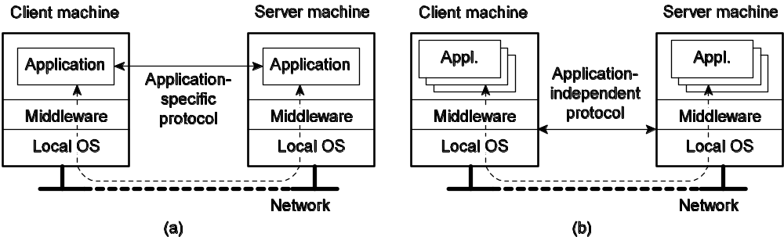
Thick client
The protocol is application specific.
For re-use, can be layered, but at the top, it is application-specific.
<number>/N
Notes:
Figure 3-8 (a) A networked application with its own protocol. (b) A general solution to allow access to remote applications.

Slide 29
Thin-client
<number>/N
Notes:
Figure 3-8 (a) A networked application with its own protocol. (b) A general solution to allow access to remote applications.

Slide 30
X Window System
The X Window System (commonly referred to as X or X11) is a network-transparent graphical windowing system based on a client/server model.
  Primarily used on Unix and Unix-like systems such as Linux,
  versions of X are also available for many other operating systems.
  Although it was developed in 1984, X is not only still available but also is in fact the standard environment for Unix windowing systems.
<number>/N
Notes:
http://www.linuxdevcenter.com/pub/a/linux/2005/08/25/whatisXwindow.html
The X Window System is a graphical windowing system that was developed at MIT in 1984. X was developed as part of Project Athena, a cooperative effort between MIT, IBM, and Digital Equipment Corporation to develop a network of heterogeneous engineering terminals that could be used for teaching purposes. The current version, X11, was released in 1987 and is now up to X11 release 6, known as X11R6.
http://www.cbbrowne.com/info/x.html

Slide 31
The X Client/Server Model
It's the server that runs on the local machine, providing its services to the display based on requests from client programs that may be running locally or remotely.
it was specifically designed to work across a network.
  The client and the server communicate via the X Protocol,
  a network protocol that can run locally or across a network.
<number>/N
Notes:
The client/server model, as it is implemented by X, may seem backward at first glance. Generally, we think of servers as remote machines like file servers, news servers, or mail servers, with local clients accessing the servers. For X, however, it's the server that runs on the local machine, providing its services to the display based on requests from client programs that may be running locally or remotely. The server also manages the input devices (usually a keyboard and mouse), and it manages the display of colors and fonts on the screen, all based on requests from a client.
One of the most significant features of X is that it was specifically designed to work across a network. The client and the server communicate via the X Protocol, a network protocol that can run locally or across a network. Regardless of whether a client program is local or remote, it communicates with the server through the X Protocol.

Slide 32
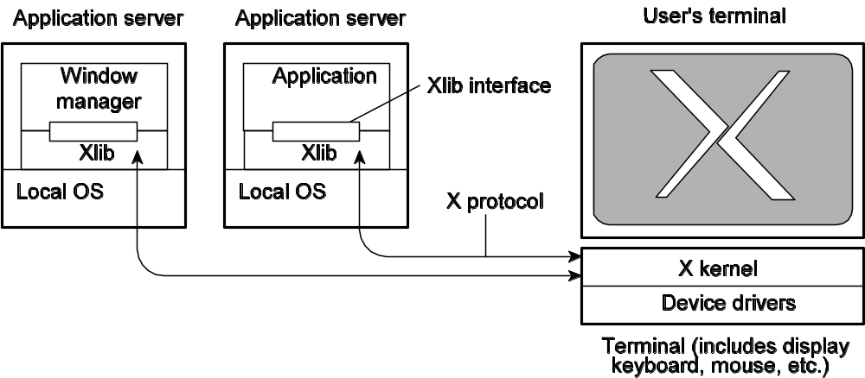
The XWindow System
Protocol tends to be heavyweight.
Other examples of similar systems?
  VNC
  Remote desktop
<number>/N
Notes:
http://en.wikipedia.org/wiki/X_Window_System
X uses a client-server model: an X server communicates with various client programs. The server accepts requests for graphical output (windows) and sends back user input (from keyboard, mouse, or touchscreen).
This client-server terminology — the user's terminal as the "server", the remote or local applications as the "clients" — often confuses new X users, because the terms appear reversed. But X takes the perspective of the program, rather than that of the end-user or of the hardware: the local X display provides display services to programs, so it acts as a server; any remote program uses these services, thus it acts as a client.
Practical examples of remote clients include:
administering a remote machine graphically
running a computationally intensive simulation on a remote Unix machine and displaying the results on a local Windows desktop machine
running graphical software on several machines at once, controlled by a single display, keyboard and mouse.

Slide 33
Scalability problems of X
Too much bandwidth is needed.
  By using compression techniques, bandwidth can be considerably reduced.
There is a geographical scalability problem
  as an application and the display generally need to synchronize too much.
  By using cachinng techniques by which effectively state of the display is maintained at the application side
<number>/N
Notes:
There are essentially two scalability problems. First, numerical scalability is problematic in the sense that too much bandwidth is needed. By using compression techniques, bandwidth can be considerably reduced.
Second, there is a geographical scalability problem as an application and the display generally need to synchronize too much. By using caching techniques by which effectively state of the display is maintained at the application side, much synchronization traffic can be avoided as the application can inspect the local cache to
find out what the state of the display is.

Slide 34
Compound documents
User interface is applicationaware => interapplication communication
  drag-and-drop: move objects across the screen to invoke interaction with other applications
  in-place editing: integrate several applications at user-interface level (word processing + drawing facilities)
<number>/N

Slide 35
Client-Side Software
Often tailored for distribution transparency.
  Access transparency: client-side stubs for RPCs.
  Location/migration transparency: Let client-side software keep track of actual location.
  Replication transparency: Multiple invocations handled by client-side stub.
  Failure transparency: Can often be placed only at client.
<number>/N
Notes:
Besides the user interface and other application-related software, client software comprise componets for achieving distribution transparency.
Concurrency transparency can be handled through special intermediate servers, notably transaction monitors, and requires less support from client software. Likewise, persistence transparency is often completely handled at the server.

Slide 36
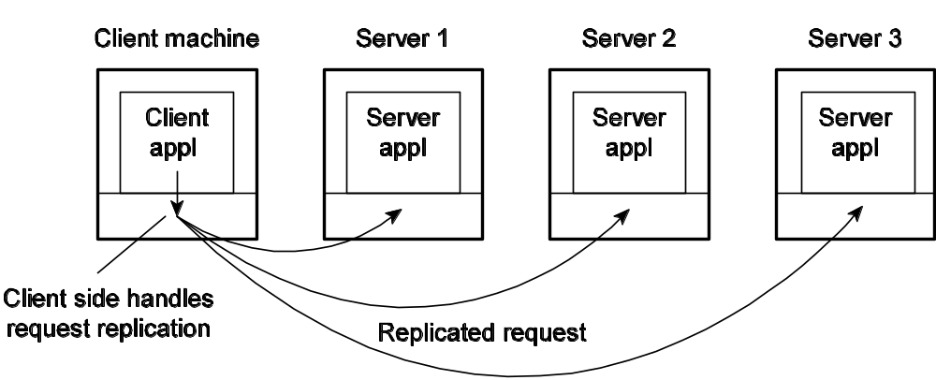
Transparent replication of a server using a client-side solution.
<number>/N

Slide 37
3.4 Servers
3.4.1 General Design Issues
3.4.2 Server Clusters
3.4.3 Managing Server Clusters
<number>/N

Slide 38
Servers: General Organization
Basic model: A server is a process that waits for incoming service requests at a specific transport address.
In practice, there is a one-to-one mapping between a port and a service.
ftp-data 20 File Transfer [Default Data]
ftp 21 File Transfer [Control]
telnet 23 Telnet
24 any private mail system
Smtp 25 Simple Mail Transfer
login 49 Login Host Protocol
Sunrpc 111 SUN RPC (portmapper)
Courier 530 Xerox RPC
<number>/N

Slide 39
Servers: General Organization
Types of servers
Iterative vs. Concurrent: Iterative servers can handle only one client at a time, in contrast to concurrent
Superservers: Listen to multiple end points, then spawn the right server.
<number>/N
Notes:
Superservers: Servers that listen to several ports, i.e., provide several
independent services. In practice, when a service request comes
in, they start a subprocess to handle the request (UNIX inetd)

Slide 40
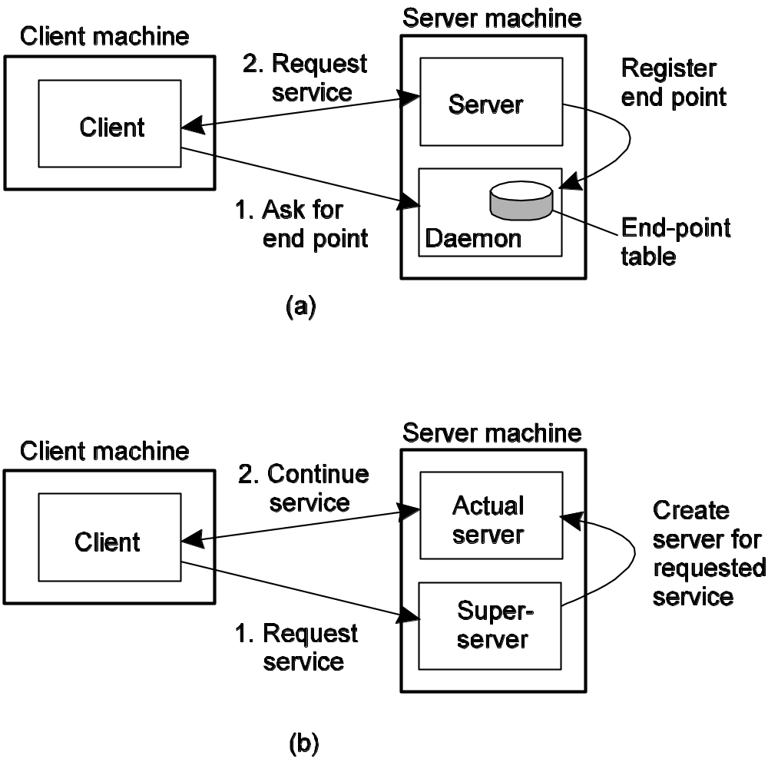
(a) Binding Using Registry.
(b) Superserver
<number>/N

Slide 41
Out-of-Band Communication
Issue: Is it possible to interrupt a server once it has accepted (or is in the process of accepting) a service request?
Solution 1: Use a separate port for urgent data (possibly per service request):
  Server has a separate thread (or process) waiting for incoming urgent messages
  When urgent message comes in, associated request is put on hold
  Note: we require OS supports high-priority scheduling of specific threads or processes
Solution 2: Use out-of-band communication facilities of the transport layer:
  Example: TCP allows to send urgent messages in the same connection
  Urgent messages can be caught using OS signaling techniques
<number>/N

Slide 42
Stateless Servers
Never keep accurate information about the status of a client after having handled a request:
  Don’t record whether a file has been opened (simply close it again after access)
  Don’t promise to invalidate a client’s cache
  Don’t keep track of your clients
Consequences:
  Clients and servers are completely independent
  State inconsistencies due to client or server crashes are reduced
  Possible loss of performance
    because, e.g., a server cannot anticipate client behavior (think of prefetching file blocks)
<number>/N

Slide 43
Stateful Servers
Keeps track of the status of its clients:
  Record that a file has been opened, so that prefetching can be done
  Knows which data a client has cached, and allows clients to keep local copies of shared data
Observation: The performance of stateful servers can be extremely high, provided clients are allowed to keep local copies.
  Session state vs. permanent state
  As it turns out, reliability is not a major problem.
<number>/N

Slide 44
Cookies
A small piece of data containing client-specific information that is of interest to the server
Cookies and related things can serve two purposes:
  They can be used to correlate the current client operation with a previous operation.
  They can be used to store state.
    For example, you could put exactly what you were buying, and what step you were in, in the checkout process.
<number>/N

Slide 45
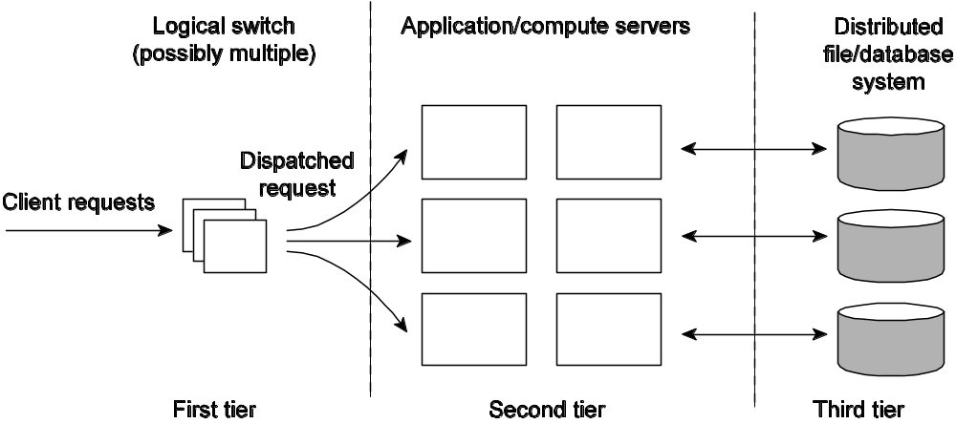
Server Clusters
Observation: Many server clusters are organized along three different tiers, to improve performance.
  Typical organization below, into three tiers. 2 and 3 can be merged.
Crucial element: The first tier is generally responsible for passing requests to an appropriate server.
<number>/N

Slide 46
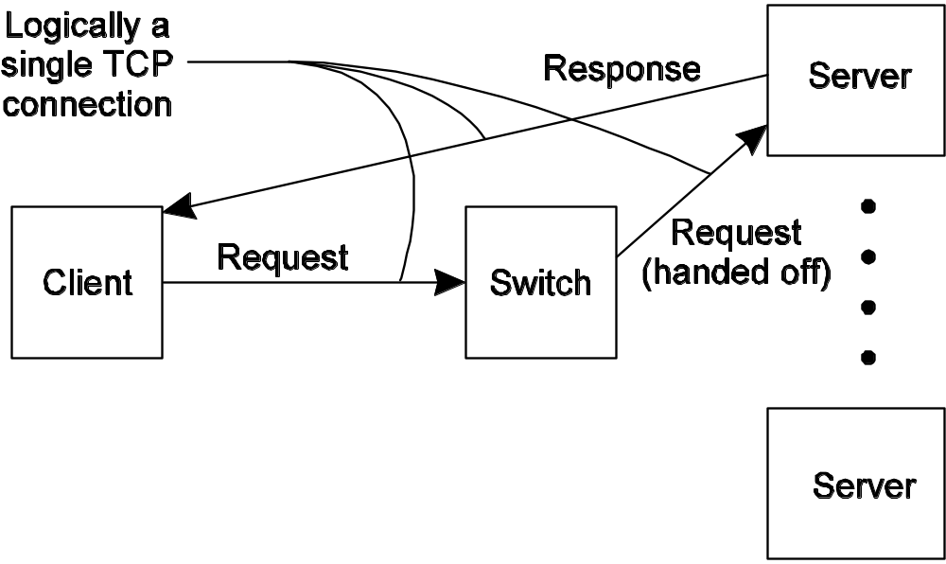
Request Handling
Observation: Having the first tier handle all communication from/to the cluster may lead to a bottleneck.
Solution: Various, but one popular one is TCP-handoff:
<number>/N

Slide 47
Distributed Servers
We can be even more distributed.
  But over a wide area network, the situation is too dynamic to use TCP handoff.
  Instead, use Mobile IP.
  Are the servers really moving around?
Mobile IP
  A server has a home address (HoA), where it can always be contacted.
  It leaves a care-of address (CoA), where it actually is.
  Application still uses HoA.
<number>/N
Notes:
It also dsesirable to have a high degree of flexibility in configuring a server cluster.

Slide 48
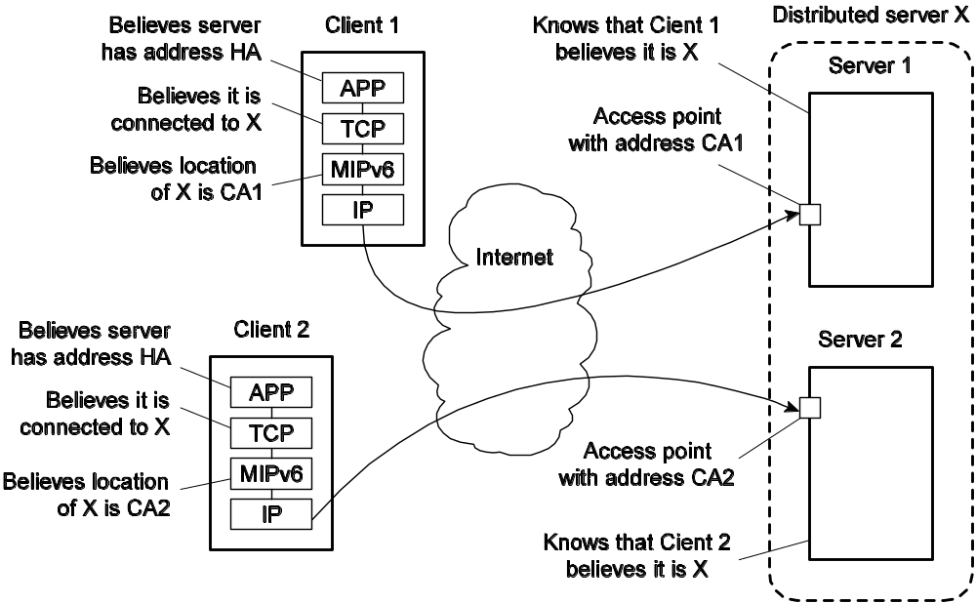
Route optimization in a distributed servers
<number>/N

Slide 49
Managing Server Clusters
Most common: do the same thing as usual.
  Quite painful, if you have a 128 nodes.
Next step, provide a single management framework that will let you monitor the whole cluster, and distribute updates en masse.
  Works for medium sized. What if you have a 5,000 nodes?
  Need continuous repair, essentially autonomic computing.
<number>/N
Notes:
en masse
adv.
一齐，一块儿

Slide 50
Example: PlanetLab
Essence: Different organizations contribute machines, which they subsequently share for various experiments.
Problem: We need to ensure that different distributed applications do not get into each other’s way => virtualization
<number>/N

Slide 51
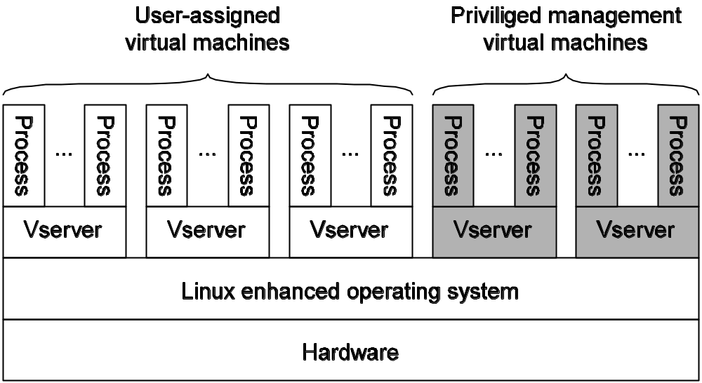
PlanetLab
Vserver: Independent and protected environment with its own libraries, server versions, and so on. Distributed applications are assigned a collection of vservers distributed across multiple machines (slice).
<number>/N
Notes:
[Bavier, et al.,2004] A. Bavier, M. Bowman, B. Chun, D. Culler, S. Karlin, S. Muir, L. Peterson, T. Roscoe, T. Spalink, and M. Wawrzoniak, "Operating system support for planetary-scale network services," in Proceedings of the 1st conference on Symposium on Networked Systems Design and Implementation - Volume 1. San Francisco, California: USENIX Association, 2004.
PlanetLab is a geographically distributed overlay network designed to support the deployment and evaluation of planetary-scale network services. Two high-level goals shape its design. First, to enable a large research community to share the infrastructure, PlanetLab provides distributed virtualization, whereby each service runs in an isolated slice of PlanetLab's global resources. Second, to support competition among multiple network services, PlanetLab decouples the operating system running on each node from the network-wide services that define PlanetLab, a principle referred to as unbundled management. This paper describes how Planet-Lab realizes the goals of distributed virtualization and unbundled management, with a focus on the OS running on each node.

Slide 52
PlanetLab Management Issues
Nodes belong to different organizations.
  Each organization should be allowed to specify who is allowed to run applications on their nodes,
  And restrict resource usage appropriately.
Monitoring tools available assume a very specific combination of hardware and software.
  All tailored to be used within a single organization.
Programs from different slices but running on the same node should not interfere with each other.
<number>/N

Slide 53
Node manager
  Separate vserver
  Task: create other vservers and control resource allocation
  No policy decisions
Resource specification (rspec)
  Specifies a time interval during which a specific resource is available.
  Identified via a 128-bit ID, the resource capability (rcap).
    Given rcap, node manager can look up rspec locally.
  Resources bound to slices.
Slice associated with service provider.
  Slice ID’ed by (principal_id, slice_tag), which identifies the provider and the slice tag which is chosen by the provider.
Slice creation service (SCS) runs on node, receives creation requests from some slice authority.
  SCS contacts node manager. Node manager cannot be contacted directly. (Separation of mechanism from policy.)
To create a slice, a service provider will contact a slice authority and ask it to create a slice.
Also have management authorities that monitor nodes, make sure running right software, etc.
<number>/N
Notes:
Node manager: central to managing PlanetLab resources.
Service provider: can be seen as an entity having an account on PlanetLab.

Slide 54
Management relationships between PlanetLab entities:
  A node owner puts its node under the regime of a management authority, possibly restricting usage where appropriate.
  A management authority provides the necessary software to add a node to PlanetLab.
  A service provider registers itself with a management authority, trusting it to provide well-behaving nodes.
  A service provider contacts a slice authority to create a slice on a collection of nodes.
  The slice authority needs to authenticate the service provider.
  A node owner provides a slice creation service for a slice authority to create slices. It essentially delegates resource management to the slice authority.
  A management authority delegates the creation of slices to a slice authority.
Management
authority
2
3
Node owner
1
7
4
Service provider
6
Slice authority
<number>/N

Slide 55
3.5 Code Migration
3.5.1 Approaches to Code Migration
3.5.2 Migration and Local Resources
3.5.3 Migration in Heterogeneous Systems
<number>/N
Notes:
http://www.sti.uniurb.it/events/sfm05moby/slides/sfm05-picco%5B1%5D.pdf

Slide 56
Approaches
Why code migration?
  Moving from heavily loaded to lightly loaded.
  Also, to minimize communication costs.
  Moving code to data, rather than data to code.
  Late binding for a protocol. (Download it.)
<number>/N
Notes:
Thinking in C++
early binding, means the compiler generates a call to a specific function name, and the linker resolves
this call to the absolute address of the code to be executed.

Slide 57
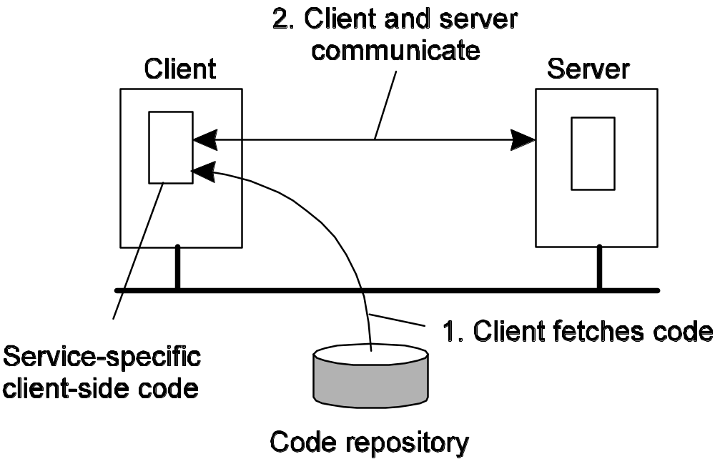
Dynamic Client Configuration
The principle of dynamically configuring a client to communicate to a server. The client first fetches the necessary software, and then invokes the server.
<number>/N

Slide 58
A framework of Code Migration
A process consists of three segments
Code segment: contains the actual code
Resource segment: contains references to external resources needed by the process
  E.g., files, printers, devices, other processes
Execution segment: store the current execution state of a process, consisting of private data, the stack, and the program counter
<number>/N
Notes:
To get a better understanding of the different models for code migration, we use a framework described in Fuggetta et al. (1998).

Slide 59
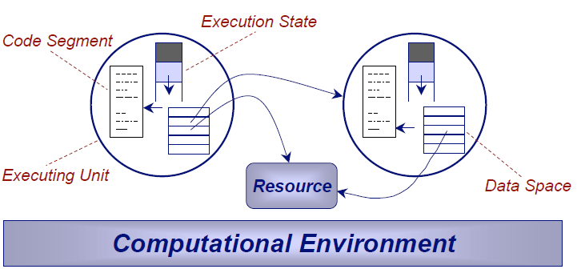
A Reference Model
<number>/N
Notes:
Execution State (stack and instruction pointer)

Slide 60
Two Notions of Code Mobility
Weak mobility: only code, plus maybe some init data (and start execution from the beginning) after migration:
  Examples: Java applets
Strong mobility: Code and execution segment are moved
  Migration: move the entire object from one machine to the other
  Cloning: simply start a clone, and set it in the same execution state.
Initiation
  Sender-initiated migration
  Receiver-initiated migration
<number>/N
Notes:
Both migration and remote cloning can be:
 proactive
– time and destination of the migration are determined
autonomously by the executing unit
 reactive
– movement is triggered by some other executing unit

Slide 61
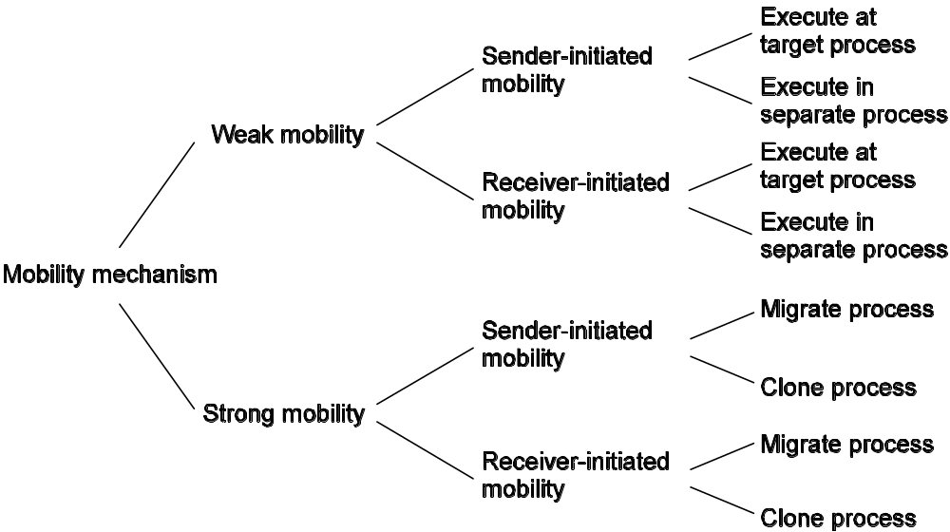
Alternatives for code migration
<number>/N

Slide 62
Migrating Local Resources (1/3)
Problem: A process uses local resources that may or may not be available at the target site.
Process-to-resource binding
  Binding by identifier: the process refers to a resource by its identifier (e.g., a URL)
  Binding by value: the object requires the value of a resource (e.g., a library)
  Binding by type: the object requires that only a type of resource is available (e.g., local devices, such as monitors, printers, and so on)
<number>/N
Notes:
Binding by identifier
at any time, the executing unit that owns the binding must be bound to a given, uniquely identified resource
■ Binding by value although the actual instance can change, its value must not change as a consequence of
migration
■ Binding by type at any time, the resource bound must be compliant with a given type

Slide 63
Migrating Local Resources (2/3)
Resource-to-machine binding
  Unattached: the resource can easily be moved along with the object (small files, e.g. a cache)
  Fastened: the resource can, in principle, be migrated but only at high cost (possibly larger)
    E.g., local databases and complete Web sites
  Fixed: the resource cannot be migrated, such as local hardware (bound to the machine)
    E.g., a local communication end point
<number>/N

Slide 64
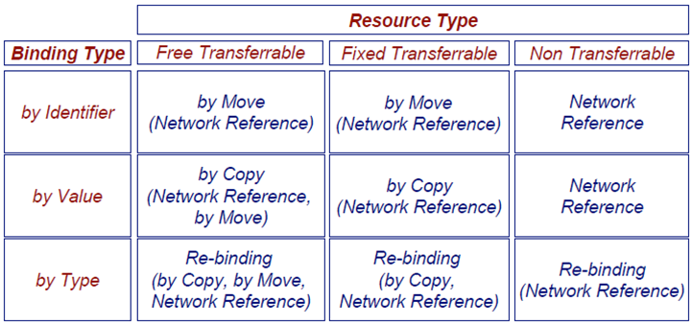
The Space of Alternatives (3/3)
<number>/N

Slide 65
Migrating Local Resources (3/3)
Actions to be taken with respect to the references to local resources when migrating code to another machine.
Process-to-resource binding | Resource-to-machine binding
 | Unattached | Fastened | Fixed
By identifier By value By type | MV (or GR) CP ( or MV, GR) RB (or GR, CP) | GR (or MV) GR (or CP) RB (or GR, CP) | GR GR RB (or GR)
GR: Establish a global system-wide reference
MV: Move the resource
CP: Copy the value of the resource
RB: Rebind the process to a locally available resource
<number>/N

Slide 66
Migration in Heterogeneous Systems
Main problem:
  The target machine may not be suitable to execute the migrated code
  The definition of process/thread/processor context is highly dependent on local hardware, operating system and runtime system
Only solution: Make use of an abstract machine that is implemented on different platforms
<number>/N

Slide 67
Current Solustions
Interpreted languages running on a virtual machine
  E.g., Java/JVM; scripting languages
Virtual machine monitors, allowing migration of complete OS + apps.
<number>/N

Slide 68
Live Migration of Virtual Machines
Involves two major problems:
  Migrating the entire memory image
    Push phase
    Stop-and-copy phase
    Pull phase
  Migrating bindings to local resources
    There is a single network, announce the new network-to-MAC address binding
<number>/N
Notes:
http://net.pku.edu.cn/~course/cs501/2009/reading/2005-NSDI-Live%20Migration%20of%20Virtual%20Machines.pdf

Slide 69
Three ways to handle memory migration (which can be combined)
  Pushing memory pages to the new machine and resending the ones that are later modified during the migration process.
  Stopping the current virtual machine; migrate memory, and start the new virtual machine.
  Letting the new virtual machine pull in new pages as needed, that is, let processes start on the new virtual machine immediately and copy memory pages on demand.
<number>/N

