Slide 1
Communication

Slide 2
Outline
Layered Protocols
Remote Procedure Call
Message-oriented Communication
Stream-oriented Communication
Multicast Communication

Slide 3
Interprocess Communication
The “heart” of every distributed system.
Question: how do processes on different machines exchange information?
Answer: with difficulty … ☹
Established computer network facilities are too primitive, resulting in DSs that are too difficult to develop – a new model is required
Four IPC models are popular:
RPC; RMI; MOM and Streams

Slide 4
Layered Protocols
Layered Protocols
  Low-level layers
  Transport layer
  Application layer
  Middleware layer
Type of Communication

Slide 5
Layered Protocols
Communications are often handled by layered protocols
  Layers are for encapsulation
  Real world example
    Consider an airline company and a meal-service company.
      Decision as to which meal to order is handled by manager.
      Decision as to how to communicate the order is handled by secretary.
Lower layers might handle things like how to turn electrical voltages into 1s and 0s.
  You don’t want to be dealing with that when implementing the HTTP protocol.
Agreements and specifications are needed at each level.
Notes:
Layers are for encapsulation.
Mailing something via post office is another example of layered protocol.
To make it easier to deal with the numerous levels and issues involved in communication, the International Standards Organization (ISO) developed a reference model that clearly identifies the various levels involved, gives them standard names, and points out which level should do which job. This model is called the Open System Interconnection Reference Model (Day and Zimmerman, 1983) usually abbreviated as ISO OSI or sometimes just the OSI model.

Slide 6
Two general types of protocols
Protocols are formal set of rules that govern the format, contents, and meaning of the messages send and received.
Connection oriented and connectionless protocols.
  Connection oriented does some initial work to set up a “virtual circuit”. Connectionless does not.
  Examples?
    Phone is connection-oriented.
    Mail is connectionless.
  Pros and cons
    Connection-oriented are usually more efficient.
    Connectionless are usually more efficient for one-off messages.

Slide 7
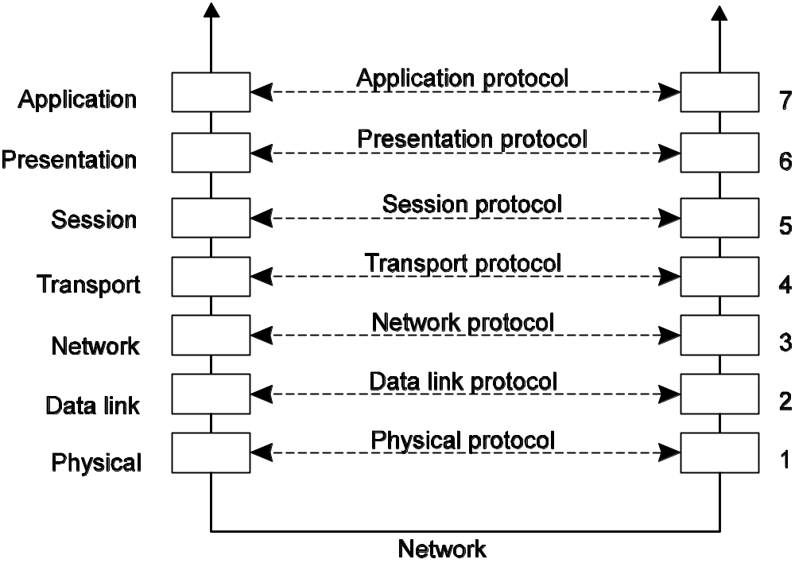
Basic Networking Model
Drawbacks:
  Focus on message-passing only
  Often unneeded or unwanted functionality
Notes:
OSI is an example of over-engineering. Still useful as a reference, though.
Each layer prepares message, then hands off the lower layer.
Process is reversed on receipt.

Slide 8
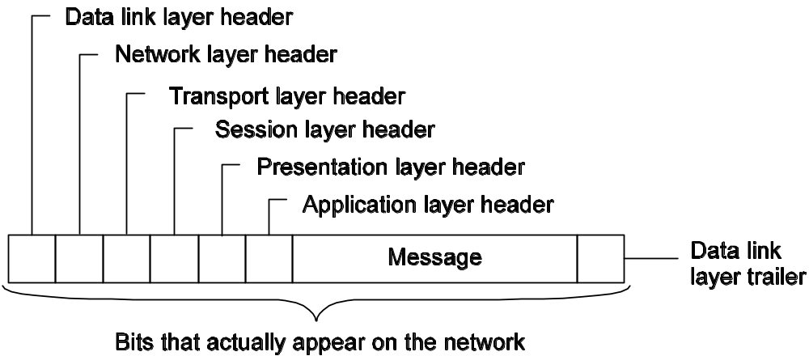
Message Headers/Trailers
Each layer will typically add its own header/trailer.
Notes:
http://www.idevelopment.info/data/Networking/Networking_Basics/BASICS_Understanding_OSI_Model.shtml
OSI Model Layers and Information Exchange
The seven OSI layers use various forms of control information to communicate with their peer layers in other computer systems. This control information consists of specific requests and instructions that are exchanged between peer OSI layers.
Control information typically takes one of two forms: headers and trailers. Headers are prepended to data that has been passed down from upper layers. Trailers are appended to data that has been passed down from upper layers. An OSI layer is not required to attach a header or trailer to data from upper layers.
Headers, trailers, and data are relative concepts, depending on the layer that analyzes the information unit. At the network layer, an information unit, for example, consists of a Layer 3 header and data. At the data link layer, however, all the information passed down by the network layer (the Layer 3 header and the data) is treated as data.
In other words, the data portion of an information unit at a given OSI layer potentially can contain headers, trailers, and data from all the higher layers. This is known as encapsulation. Figure 1-6 shows how the header and data from one layer are encapsulated into the header of the next lowest layer.
When is a header better than a trailer? When is a trailer better than a header?
Usually, a header is more convenient for the sender, such as router. But usually a trailer is more convenient for the sender, since often the information that goes in the trailer might be something that the recipient does not know until it has actually seen all the data, such as a checksum.

Slide 9
Low-level Layers
Physical Layer
  contains the specification and implementation of bits, and their transmission between sender and receiver
  Examples:
    RS-232-C standard for serial communication lines
Data Link Layer
  Prescribes the transmission of a series of bits into a frame.
  Physical layers are unreliable. Main job of this layer is to detect and correct errors. How?
    Checksum of some kind
Network layer
  Describes how packets in a network of computers are to be routed.
  Examples: connectionless IP (Internet Protocol)
Observation: for many distributed systems, the lowest level interface is that of the network layer.

Slide 10
Transport Layer
Important: The transport layer provides the actual communication facilities for most distributed systems.
Standard Internet protocols:
  TCP: connection-oriented, reliable, stream-oriented communication
  UDP: unreliable (best-effort) datagram communication
Note: IP multicasting is generally considered a standard available service.
Notes:
Transport layer
Reliability
Examples: TCP (Transmission Control Protocol), RTP (Real-time Transport Protocol)

Slide 11
Higher-level Layers
Session layer
  Dialog control, checkpoints for long transfers
Presentation layer
  Meaning of bits, define records, etc.
Application layer
  Protocols for things like mail, file transfer, communication terminals.
  Examples: FTP (File Transfer Protocol), HTTP (HyperText Transfer Protocol)

Slide 12
Middleware Protocols
Observation: Middleware logically at application layer, but provides common services and protocols that can be used by many different applications.
  A rich set communication protocols to allow different apps. to communiate
  Naming protocols, so that different apps. can easily share resources
  Security protocols, to allow different apps. to communicate in a secure way
  Scaling mechanisms, such as support for replication and caching
What remains are truly application-specific protocols

Slide 13
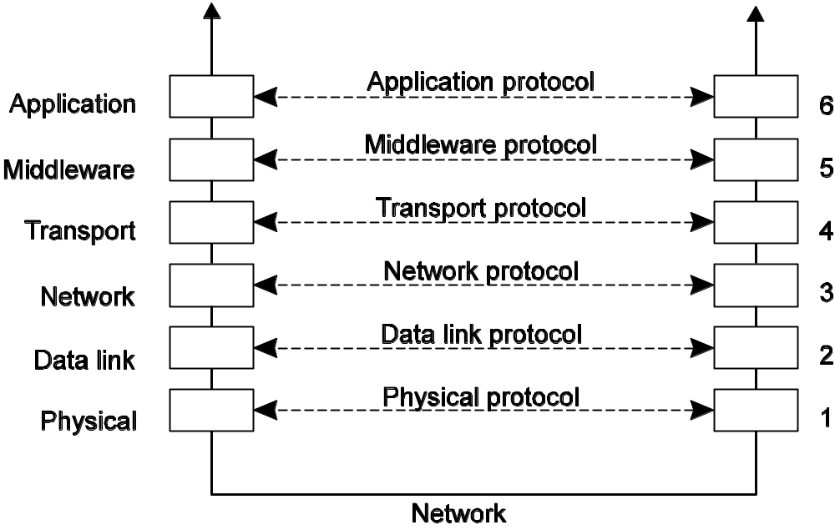
An adapted reference model for networked communication

Slide 14
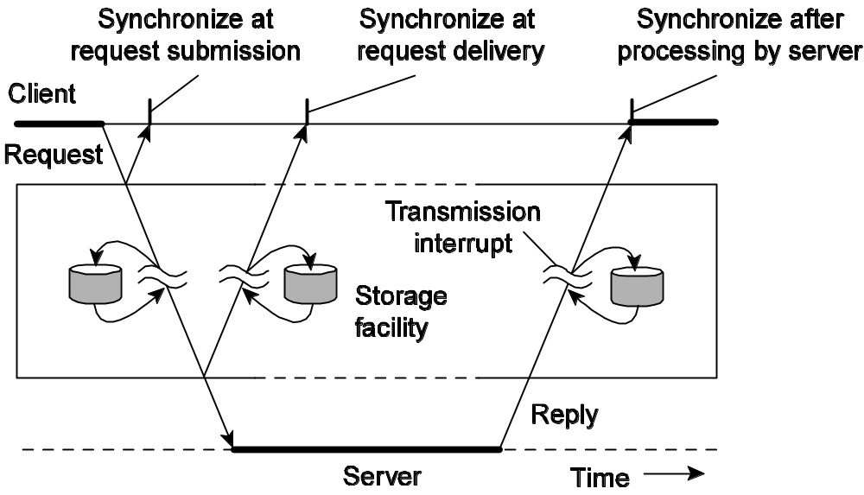
Type of Communications (1/3)
Distinguish:
  Transient versus persistent communication
  Asynchronous versus synchronous communication

Slide 15
Type of Communications (2/3)
Transient communication: A message is discarded by a communication server as soon as it cannot be delivered at the next server, or at the receiver.
Persistent communication: A message is stored at a communication server as long as it takes to deliver it at the receiver.

Slide 16
Type of Communications (3/3)
Places for synchronization:
  At request submission
  At request delivery
  After request processing

Slide 17
Message-queuing systems
  Persistence in combination with synchronization at request submission
Remote procedure calls
  Transient communication with synchronization after the request has been fully processed
Discrete
  The parties communicate by messages,
  Each message forming a complete unit of information
Streaming communication
  Involves sending multiple message, one after the other, where the message are related to each other by the order they are sent
  Or because there is a temporal relationship.
<number>/N

Slide 18
Client/Server
Some observations: Client/Server computing is generally based on a model of transient synchronous communication:
  Client and server have to be active at the time of communication
  Client issues request and blocks until it receives reply
  Server essentially waits only for incoming requests, and subsequently processes them
Drawbacks synchronous communication:
  Client cannot do any other work while waiting for reply
  Failures have to be dealt with immediately (the client is waiting)
  In many cases the model is simply not appropriate (mail, news)

Slide 19
Messaging
Message-oriented middleware: Aims at high-level persistent asynchronous communication:
  Processes send each other messages, which are queued
  Sender need not wait for immediate reply, but can do other things
  Middleware often ensures fault tolerance

Slide 20
Remote Procedure Call
Basic RPC Operation
Parameter Passing
Variations

Slide 21
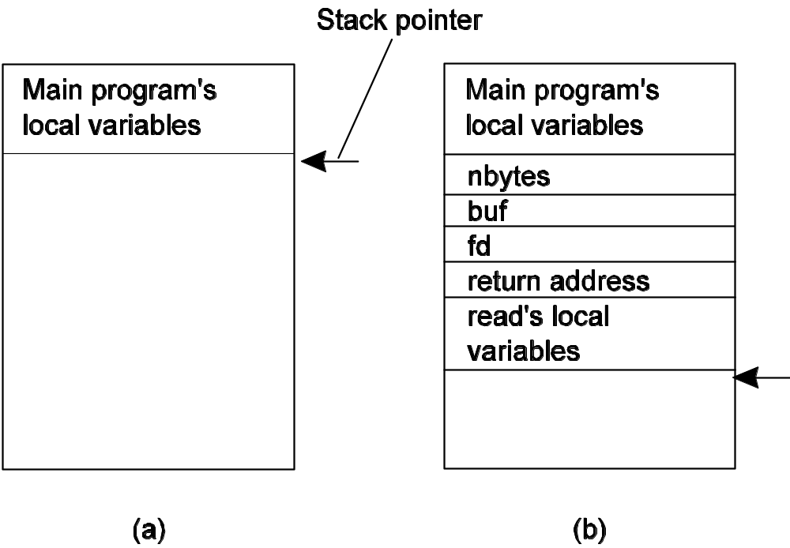
Conventional Procedure Call
Consider count = read(fd, buf, nbytes).
Parameter passing in a local procedure call: the stack before the call to read
The stack while the called procedure is active
Notes:
To make the call, the caller pushes the parameters onto the stack in order, last one first, as shown in Fig. 4-5(b). After the read procedure has finished running, it puts the return value in a register, removes the return address, and transfers control back to the caller. The caller then removes the parameters from the stack, returning the stack to the original state it had before the call.

Slide 22
Call Methods
Call-by-value
Call-by-reference
Call-by-copy/restore
  Under most conditions, same effect as call-by-reference
  But in some situations, such as the same parameter being present multiple times in the parameter list, the semantics are different

Slide 23
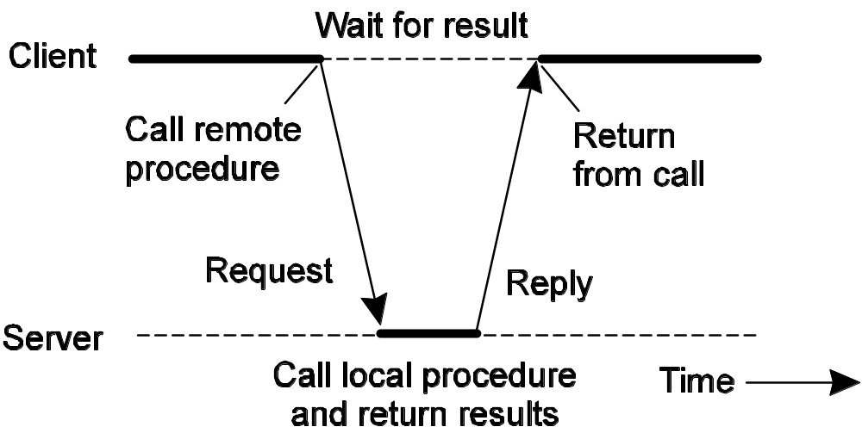
Basic RPC Operation
Observations:
  Application developers are familiar with simple procedure model
  Well-engineered procedures operate in isolation (black box)
  There is no fundamental reason not to execute procedures on separate machine
Conclusion: communication between caller & callee can be hidden by using procedure-call mechanism.

Slide 24
Remote Procedure Call
Turn a normal looking procedure call
a = my_func(i, x);
and make it happen on a remote machine.
What needs to happen?
  Pack parameters and other information into a message (marshalling).
  Send message to process on remote machine.
  Unpack message on remote machine (unmarshalling).
  Call the appropriate remote procedure, locally.
  Get the return value, send back.

Slide 25
Stubs
Client stub
  Piece of code responsible for proxying the remote call as a local call, and packaging the call up as a message.
Server stub (skeleton)
  Piece of code responsible for unpacking the message on the server, and invoking the actual server-side, application-level implementation.
In addition, there is a runtime that is often not considered part of the stub, because it is not type-specific.

Slide 26
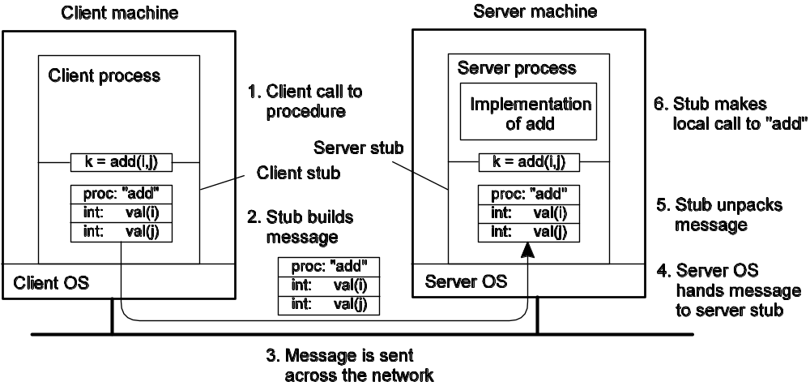
Steps of a Remote Procedure Call
Client procedure calls client stub in normal way.
Client stub builds message, passes to runtime, which calls local OS.
Client’s OS sends message to remote OS.
Remote OS gives message to runtime, which does some initial processing, then passes it to the server stub (skeleton).
Server stub unpacks parameters, calls server.
Server does work, returns result to the stub.
Server stub packs it in message, passes to runtime, which calls local OS.
Server’s OS sends message to client’s OS.
Client’s OS gives message to runtime, which does some initial processing, and then passes to client stub.
Stub unpacks result, returns to client.

Slide 27
Passing Value Parameters
How do you handle different representations for integers?

Slide 28
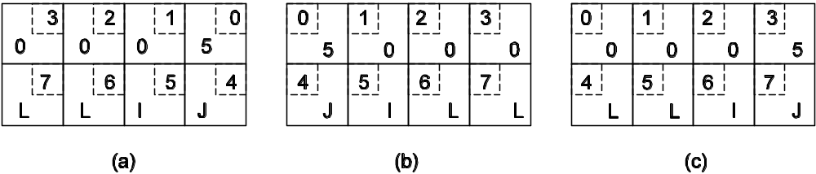
Original message on the Pentium. The little numbers in boxes indicate the address of each byte.
The message after receipt on the SPARC.
The message after inverting each word, without regard for type.

Slide 29
How about reference parameters, or pointers?
  Can use copy/restore.
  Suppose there is a 500 integer array being passed:
    int a[500];
    remote_call(a, 500);
    This would copy the array into the message, send it over, the array would be sent back, and then the contents of the message would be copied back over the original array.
    Efficient?
Notes:
One optimization makes this mechanism twice as efficient. If the stubs know whether the buffer is an input parameter or an out put parameter to the server, one of the copies can be eliminated. If the array is input to the server (e.g., in a call to write) it need not be copied back. If it is output, it need not be sent over in the first place.

Slide 30
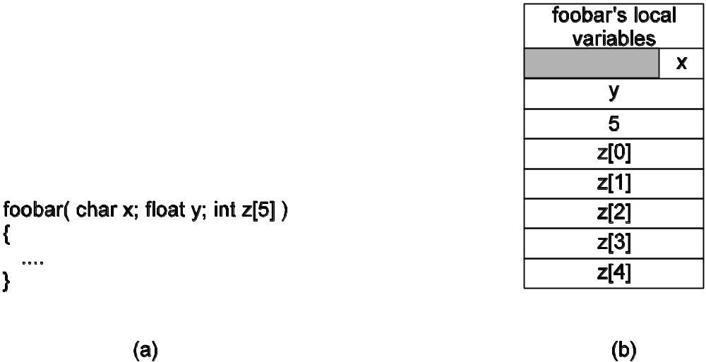
Parameter Specification and Stub Generation
Consider a call like:
  foobar(char x, float y, int z[5])
  {
  …
  }
Assume that the message should be as to the right.
How do we generate the message?
  IDL (Interface Definition Language)
Notes:
Defining the message format is one aspect of an RPC protocol, but it is not sufficient. What we also need is the client and the server to agree on the representation of simple data structures, such as integers, characters, Booleans, etc. For example, the protocol could prescribe that integers are represented in two’s complement, characters in 16-bit Unicode, and floats in the IEEE standard #754 format, with everything stored in little endian. With this additional information, messages can be unambiguously interpreted.

Slide 31
IDL (Interface Definition Language)
An interface description language (or alternately, interface definition language), or IDL for short, is a specification language used to describe a software component's interface. IDLs describe an interface in a language-neutral way, enabling communication between software components that do not share a language – for example, between components written in C++ and components written in Java.
IDLs are commonly used in remote procedure call software. In these cases the machines at either end of the "link" may be using different operating systems and computer languages. IDLs offer a bridge between the two different systems.
Software systems based on IDLs include Sun's ONC RPC, The Open Group's Distributed Computing Environment, IBM's System Object Model, the Object Management Group's CORBA, Facebook's Thrift and WSDL for Web services.
Notes:
http://en.wikipedia.org/wiki/Interface_description_language
http://en.wikipedia.org/wiki/Specification_language
A specification language is a formal language used in computer science. Unlike most programming languages, which are directly executable formal languages used to implement a system, specification languages are used during systems analysis, requirements analysis and systems design.
Specification languages are generally not directly executed. They describe the system at a much higher level than a programming language. Indeed, it is considered as an error if a requirement specification is cluttered with unnecessary implementation detail, because the specification is meant to describe the what, not the how.

Slide 32
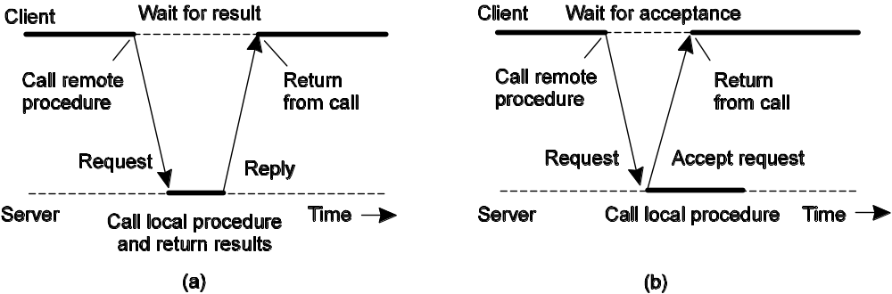
Asynchronous RPC
Essence: Try to get rid of the strict request-reply behavior, but let the client continue without waiting for an answer from the server.
The interconnection between client and server in a traditional RPC
The interaction using asynchronous RPC
Notes:
One way of overlapping is with async RPC.

Slide 33
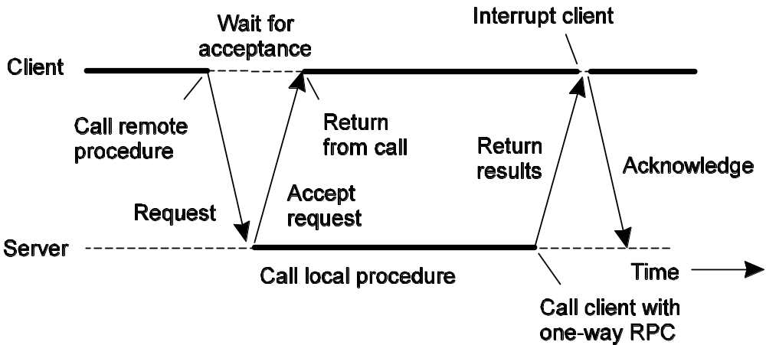
Variation: Deferred Synchronous RPC
Can be thought of as either a kind of callback, or as interacting through two asynchronous RPCs.
Could also do the interaction as one-way calls.
Notes:
It should be noted that variants of asynchronous RPCs exist in which the client continues executing immediately after sending the request to the server. In other words, the client does not wait for an acknowledgement of the server’s acceptance of the request. We refer to such RPCs as one-way RPCs.

Slide 34
Example: DCE RPC
Popular, and canonical.
MS DCOM is based on it.
Has been eclipsed, but still useful as a model.
Interfaces defined in IDL language (resembles C).
Interfaces are immutable, use a UUID (universally unique identifier) to ensure.
Notes:
canonical D.J.[kəˈnɔnɪkəl] 权威的,公认的

Slide 35
Writing a Client and a Server
Three files output by the IDL compiler:
  A header file
    e.g., interface.h, in C terms.
  The client stub.
  The server stub.

Slide 36
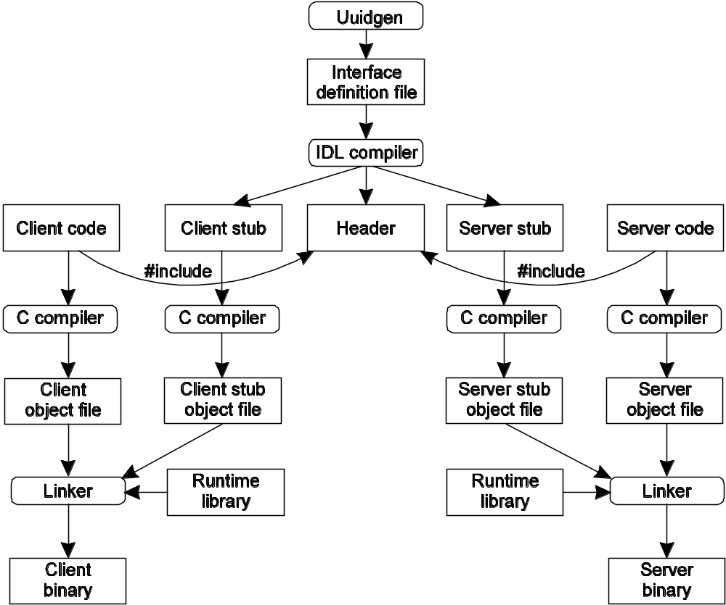
Writing a Client and a Server

Slide 37
Binding a Client to a Server
Registration of a server makes it possible for a client to locate the server and bind to it.
Server location is done in two steps:
  Locate the server’s machine.
  Locate the server (process end point) on that machine.

Slide 38
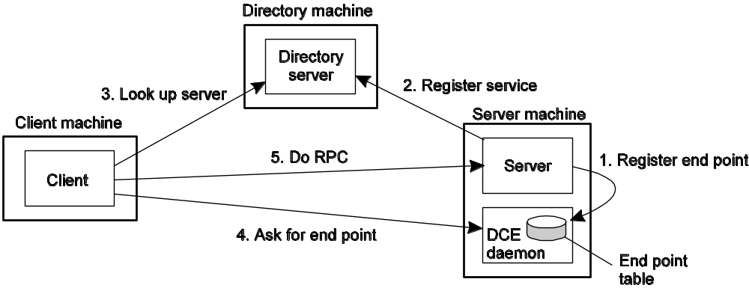
Example: /local/multimedia/video/movies
  Contact directory server, passing the logical name, to find the server machine.
  Query DCE daemon on machine to get end point.

Slide 39
Binding a Client to a Server
Default is at most once.
  If a server crashes during an RPC and then recovers quickly, the client does not repeat the operation, for fear that it might already have been carried out once.
Some operations can be labeled as idempotent (in the IDL file).
  It can be repeated multiple times without harm.

Slide 40
Message-Oriented Communication
Transient Messaging
Message-Queuing System
Example: IBM WebSphere

Slide 41
Transient Messaging: Sockets
Example: Consider the Berkeley socket interface, which has been adopted by all Posix systems, as well as Windows 95/NT/2000/XP/Vista:
Berkeley socket, most popular API for TCP/IP.
  Designed for generality, though.
  Can be used for more, though not as common.
A socket is an endpoint.

Slide 42
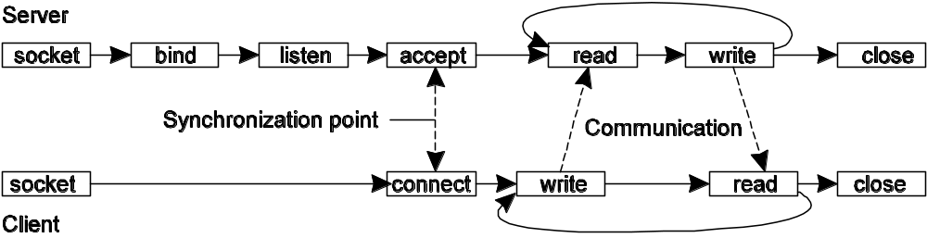
Primitive | Meaning
Socket | Create a new communication endpoint
Bind | Attach a local address to a socket
Listen | Announce willingness to accept connections
Accept | Block caller until a connection request arrives
Connect | Actively attempt to establish a connection
Send | Send some data over the connection
Receive | Receive some data over the connection
Close | Release the connection
Socket primitives for TCP/IP.
Connection-oriented communication pattern using sockets.

Slide 43
Message Passing Interface (MPI)
Sockets are too low level for scientific computing.
  No data types.
  No collective operations.
  No “message” abstraction.
MPI was written to address that.
  Provides communication among multiple concurrent processes
  Includes several varieties of point-to-point communication, as well as collective communication among groups of processes
  Implemented as library of routines callable from conventional programming languages such as Fortran, C,and C++
  Has been universally adopted by developers and users of parallel systems that rely on message passing
  Includes more than 125 functions, with many different options and protocols
  Small subset suffices for most practical purposes
Notes:
Collective operation
From Wikipedia, the free encyclopedia
Jump to: navigation, search
A collective operation is a concept in parallel computing in which data is simultaneously sent to or received from many nodes.
Common examples of collective operations are gather (in which data is collected from all nodes), scatter (in which a set of data is broken up into pieces, and a different piece is sent to all nodes), and broadcast (in which the same data is sent to all nodes).
Parallel computing frameworks with collective operations
Collective operations are present in the following parallel programming frameworks:
Google's MapReduce framework
MPI^{[1]}
Reference

Slide 44
Where Did MPI Come From?
Early vendor systems (NX, EUI, CMMD) were not portable.
Early portable systems (PVM, p4, TCGMSG,Chameleon) were mainly research efforts.
  Did not address the full spectrum of message-passing issues
  Lacked vendor support
  Were not implemented at the most efficient level
The MPI Forum organized in 1992 with broad participation by vendors, library writers, and end users.
MPI Standard (1.0) released June, 1994; many implementation efforts.
MPI-2 Standard (1.2 and 2.0) released July, 1997.
MPI-2.1 being defined now to remove errors and ambiguities.

Slide 45
MPI Sources
The Standard itself:
  at http://www.mpi-forum.org
  All MPI official releases, in both postscript and HTML
Books on MPI and MPI-2:
  MPI: The Complete Reference, volumes 1 and 2, MITPress, 1999.
  Using MPI: Portable Parallel Programming with the Message-Passing Interface (2nd edition), by Gropp, Lusk, and Skjellum, MIT Press, 1999.
  Using MPI-2: Extending the Message-Passing Interface, by Gropp, Lusk, and Thakur, MIT Press, 1999
Other information on Web:
  at http://www.mcs.anl.gov/mpi, pointers to lots of stuff, including other talks and tutorials, a FAQ, other people’s MPI pages
  Freeware versions available for clusters and similar environments include
    MPICH: http://www.mcs.anl.gov/mpi/mpich
    OpenMPI: http://www.open-mpi.org
Notes:
Freeware versions available for clusters and similar environments include
MPICH: www.mcs.anl.gov/mpi/mpich
OpenMPI: www.open-mpi.org

Slide 46
Some of the basic message-passing operations of MPI
Primitive | Meaning
MPI_bsend | Send and wait till copied to local buffer.
MPI_ssend | Send a message and wait until receipt starts.
MPI_send | Send a message and wait until copied to local or remote buffer (either).
MPI_sendrecv | Send a message and wait for reply.
MPI_isend | Pass reference to outgoing message, and continue.
MPI_issend | Pass reference to outgoing message, and wait until receipt starts.
MPI_recv | Receive a message; block if there are none.
MPI_irecv | Check if there is an incoming message, but do not block.

Slide 47
Message-Queuing Model
MPI and sockets are both transient models.
Often it is useful to have persistence, to handle servers being down, network interruptions, etc.

Slide 48
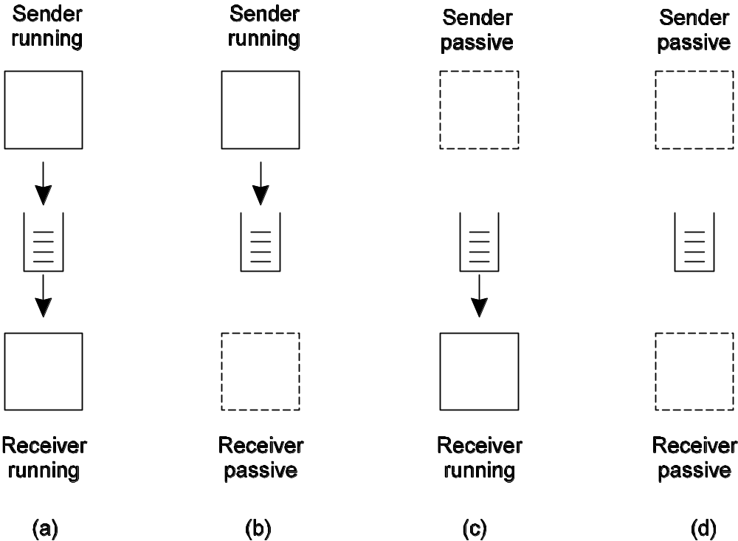
Four basic combinations for loosely-coupled communications using queues.
Destination queue

Slide 49
Basic interface to a queue in a message-queuing system.
Primitive | Meaning
Put | Append a message to a specified (local) queue
Get | Block until the specified (local) queue is nonempty, and remove the first message
Poll | Check a specified queue for messages, and remove the first. Never block.
Notify | Install a handler to be called when a message is put into the specified queue.

Slide 50
General Architecture of a Message-Queuing System
Messages can only be put into queues that are local.
  Why?
  There are both send (outgoing) queues and receive (incoming) queues.
  Generally, a send (outgoing) queue is wired to a specific, remote, receive (incoming) queue.
Queues managed by queue managers.
Some queue managers function as relays.
Message queuing systems are generally not very scalable in terms of management.
Queue names are generally low-level, transport-related.
  Need to maintain another level of mapping.
Notes:
Can only be put on local queue because otherwise will need to handle distributed issues earlier in the transmission process. Idea is that you assume the PUT operation can’t fail, no delays, etc.

Slide 51
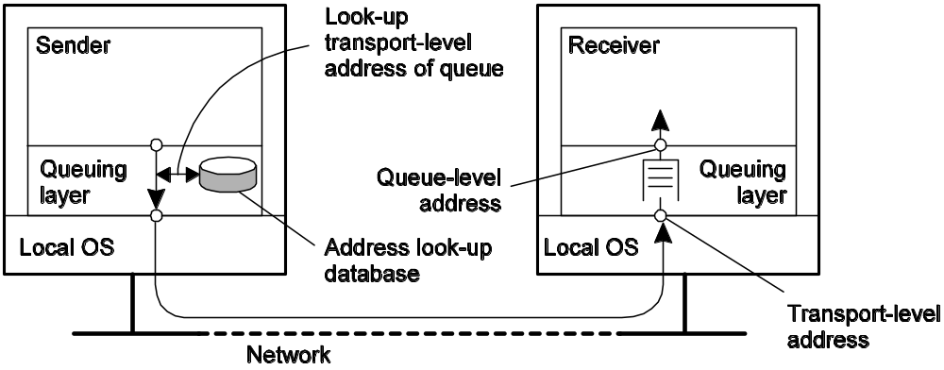
Queue-level addressing and network-level addressing.

Slide 52
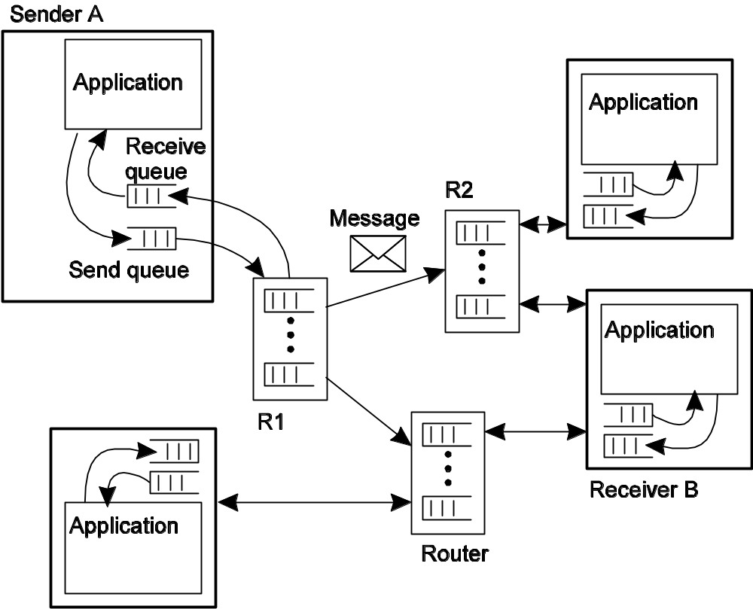
The general organization of a message-queuing system with routers. A sends message to B.

Slide 53
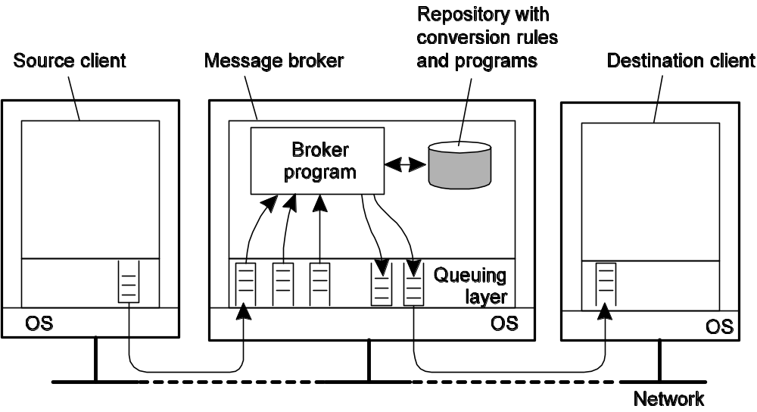
Message Brokers
Observation: Message queuing systems assume a common messaging protocol: all applications agree on message format (i.e., structure and data representation)
Message broker: Centralized component that takes care of application heterogeneity in an MQ system. Sometimes functions higher-level than that typically done by a router are required.
  Converting formats, acting as a kind of gateway.
  Matching topics in a publish/subscribe like system.
Notes:
Message broker 消息转换器

Slide 54
IBM WebSphere MQ
Basic concepts:
Application-specific messages are put into, and removed from queues
Queues always reside under the regime of a queue manager
Processes can put messages only in local queues, or through an RPC mechanism
Message transfer:
Messages are transferred between queues
Message transfer between queues at different processes, requires a channel
At each endpoint of channel is a message channel agent
Message channel agents are responsible for:
  Setting up channels using lower-level network communication facilities (e.g., TCP/IP)
  (Un)wrapping messages from/in transport-level packets
  Sending/receiving packets

Slide 55
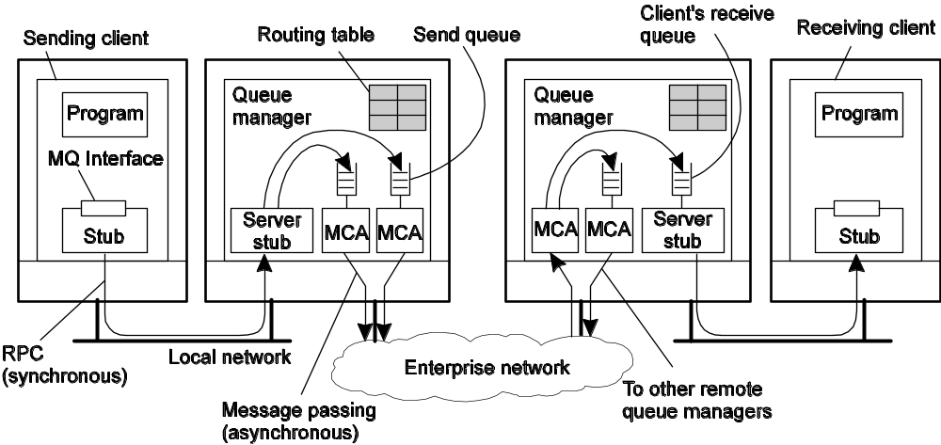
General Organization of IBM’s MQ System
Channels are inherently unidirectional
MQ provides mechanisms to automatically start
MCAs when messages arrive, or to have a receiver set up a channel
Any network of queue managers can be created; routes are set up manually (system administration)

Slide 56
Some attributes associates with MCAs
MCAs must match on both sides (there is a sending MCA and a receiving MCA).
Attribute | Description
Transport type | Determines the transport protocol to be used
FIFO delivery | Indicates that messages are to be delivered in the order they are sent
Message length | Maximum length of a single message
Setup retry count | Specifies maximum number of retries to start up the remote MCA
Delivery retries | Maximum times MCA will try to put received message into queue

Slide 57
Addressing
Addresses are a combination of queue manager name, and destination queue.
Routing can be done using routing tables.
Local aliases can provide a degree of indirection, to avoid too much dependency on a “transport-level” name.

Slide 58
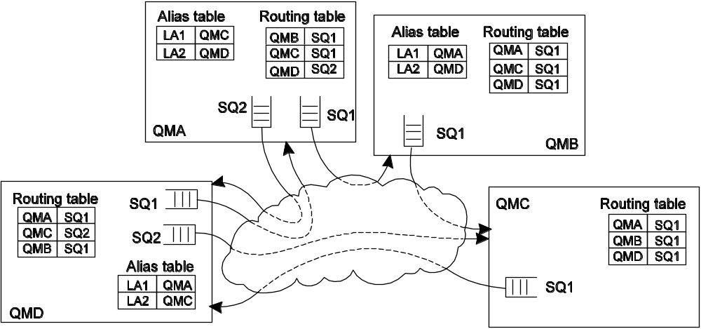
Message Routing
Routing: By using logical names, in combination with name resolution to local queues, it is possible to put a message in a remote queue
Example: sending from QMA to LA1.
Question: What’s a major problem here?

Slide 59
Message Queue Interface
Primitives available in an IBM Message Queue Interface (MQI)
Primitive | Description
MQopen | Open a (possibly remote) queue
MQclose | Close a queue
MQput | Put a message into an opened queue
MQget | Get a message from a (local) queue

Slide 60
Stream-Oriented Communication
Support for Continuous Media
Streams and Quality of Service
Stream Synchronization

Slide 61
Continuous Media
Observation: All communication facilities discussed so far are essentially based on a discrete, that is time-independent exchange of information
Continuous media: Characterized by the fact that values are time dependent:
  Audio
  Video
  Animations
  Sensor data (temperature, pressure, etc.)
Transmission modes: Different timing guarantees with respect to data transfer:
  Asynchronous: no restrictions with respect to when data is to be delivered
  Synchronous: define a maximum end-to-end delay for individual data packets
  Isochronous: define a maximum and minimum end-to-end delay (jitter is bounded)
Notes:
Isochronous [aI5sRkrEnEs] 同步的 [计] 等时的

Slide 62
Stream
Definition: A (continuous) data stream is a connection oriented communication facility that supports isochronous data transmission
Some common stream characteristics:
  Streams are unidirectional
  There is generally a single source, and one or more sinks
  Often, either the sink and/or source is a wrapper around hardware (e.g., camera, CD device, TV monitor, dedicated storage)
Stream types:
  Simple: consists of a single flow of data, e.g., audio or video
  Complex: multiple data flows, e.g., stereo audio or combination audio/video

Slide 63
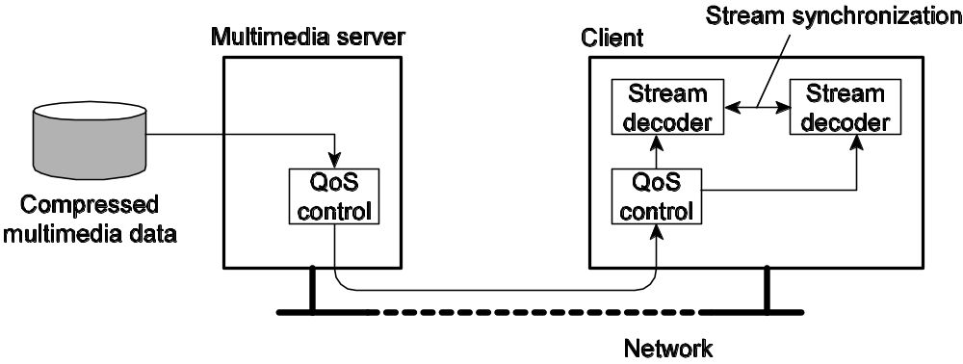
A general architecture for streaming stored multimedia data over a network.
Notes:
In the first place, the multimedia data, notably video and to a lesser extent audio, will need to be compressed substantially in order to reduce the required storage and especially the network capacity. More important from the perspective of communication are controlling the quality of the transmission and synchronization issures.

Slide 64
Streams and QoS
Essence: Streams are all about timely delivery of data. How do you specify this Quality of Service (QoS)? Basics:
  The required bit rate at which data should be transported.
  The maximum delay until a session has been set up (i.e., when an application can start sending data).
  The maximum end-to-end delay (i.e., how long will it take until a data unit makes it to a recipient).
  The maximum delay variance, or jitter.
  The maximum round-trip delay.
Notes:
连续数据的QoS主要关注时间、容量以及可靠性。从应用程序的角度看，在很多情况下，可以简化为指定如下一些特性（Halsall 2001）

Slide 65
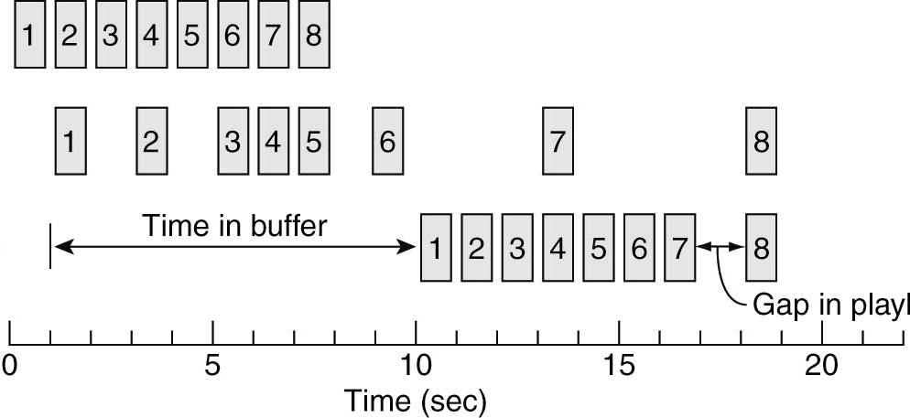
Enforcing QoS (1/2)
Observation: There are various network-level tools, such as differentiated services by which certain packetscan be prioritized.
Also: use buffers to reduce jitter:
Packet arrives at buffer
Packet removed from buffer for playback
Packet departs source
Gap in playback (or dropout?)

Slide 66
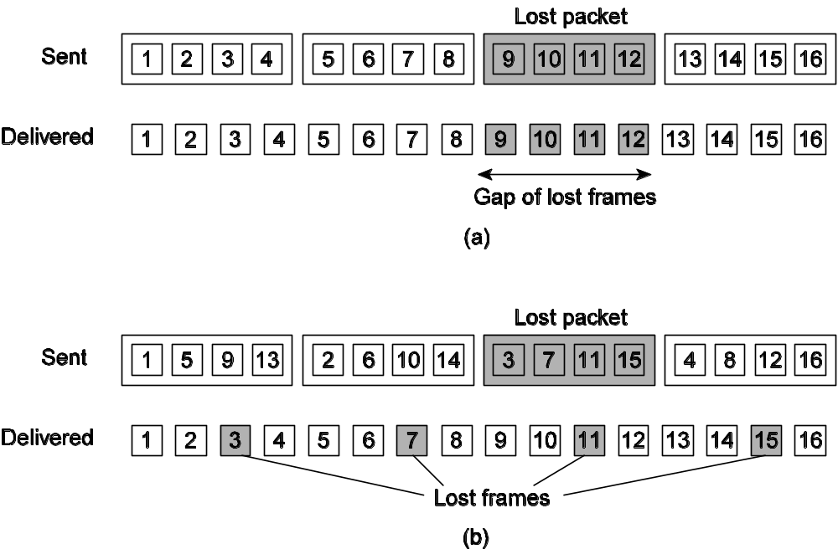
Enforcing QoS (2/2)
Problem: How to reduce the effects of packet loss (when multiple samples are in a single packet)?
Solution: simply spread the samples:
Without interleaving
With interleaving
Disadvantage of interleaving?
Notes:
To play the first four frames, the receiver will need to have four packets delivered, instead of only one packet in comparison to noninterleaved transmission.

Slide 67
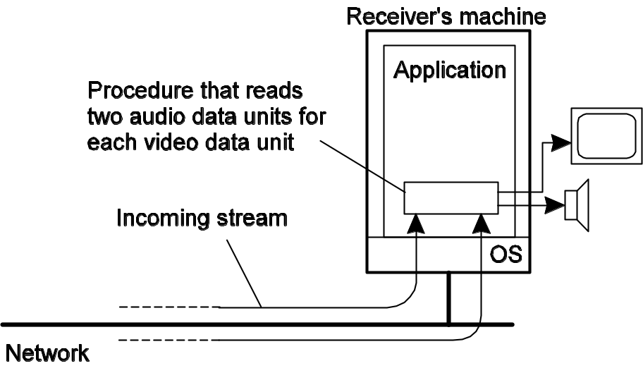
Stream Synchronization
Problem: Given a complex stream, how do you keep the different substreams in synch?
Example: Think of playing out two channels, that together form stereo sound. Difference should be less than 20–30 μsec!
Alternative: multiplex all substreams into a single stream, and demultiplex at the receiver. Synchronization is handled at multiplexing/demultiplexing point (MPEG).
Notes:
Example: If complex streams, time across the substreams must be synchronized. Can be done explicitly by the application.
Alternative: Delays for both channels are now identical.

Slide 68
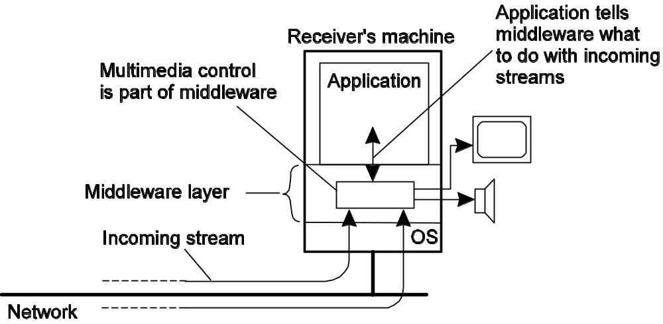
Can be done by the middleware, and controlled by the application using high-level interfaces.

Slide 69
Multicast Communication
Application-Level Multicasting
Gossip-Based Data Dissemination

Slide 70
IP multicasting works in IP layer.
  Why not just use that?
    Often difficult to configure, requires too much administrative support, agreement, etc.
Application-level seeks to address those issues.
Notes:
Suppose a sender S wants to send a message to N receivers, R₁ to R_{N}. How?
Can try to send across long distance first, then split out.

Slide 71
Application-Level Multicasting
Essence: Organize nodes of a distributed system into an overlay network and use that network to disseminate data.
Example: Consider a Chord-based peer-to-peer system:
  1. Initiator generates a multicast identifier mid.
  2. Lookup succ(mid), the node responsible for mid.
  3. Request is routed to succ(mid), which will become the root.
  4. If P wants to join, it sends a join request to the root.
  5. When request arrives at Q:
    Q has not seen a join request before => it becomes forwarder; P becomes child of Q. Join request continues to be forwarded.
    Q knows about tree => P becomes child of Q. No need to forward join request anymore.
Notes:
More generally, can organize into a tree, or a mesh.
Pros/cons?

Slide 72
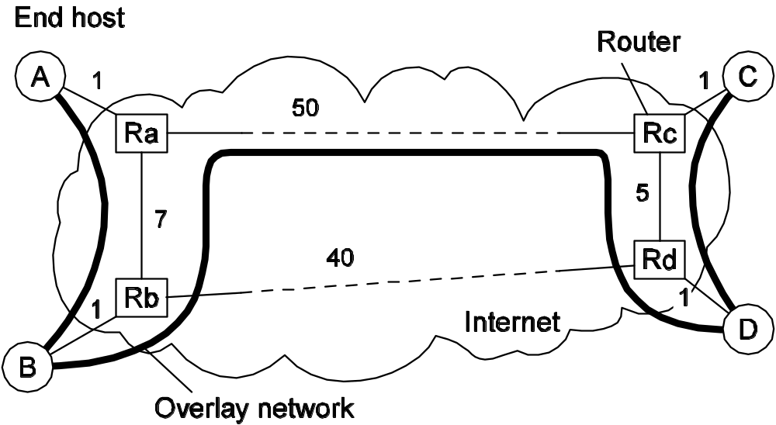
Overlay Construction
Overlays may be very inefficient.
  Multicasting from A will traverse <B, Rb>, <Ra, Rb>, <Rc, Rd>, and <D, Rd> twice.
  It would have been better to make an overlay link between A and C instead of B and D.

Slide 73
A number of metrics can be used to indicate the quality of an overlay network.
  Link stress (defined per link): How often a packet crosses a link. Example: message from A to D needs to cross <Ra,Rb> twice.
  Stretch (relative delay penalty (RDP)): ratio between the delay in the overlay network, and delay in the underlying network. Example: messages B to C follow path of length 59 at ALM, but 47 at network level => stretch = 59/47.
  Tree cost: Minimizing some metric of a tree, such as delays.
    Minimal delay spanning tree.

Slide 74
Let’s say a new node wants to join? What does it do?
  Contacts a well-known rendezvous node.
  This node returns a list of possible parents. What should be chosen?
    There are many alternatives and different proposals often follow different solutions.
Notes:
rendezvous D.J.[ˈrɑ:ndeɪˌvu:, -də-] K.K.[ˈrɑndeˌvu, -də-] n. 约会, 幽会 a secret rendezvous 秘密的约会

Slide 75
Switch Trees
One family is to assume that periodically, a node will seek to switch parents.
Periodically check other nodes, see if any of them have a shorter path.

Slide 76
Gossip-Based Data Dissemination
General background
Update (Information Dissemination) models
Removing objects
Applications

Slide 77
Epidemic Algorithms
Easy to deploy, robust, and resilient to failure, epidemic algorithms are a potentially effective mechanism
  for propagating information in large peer-to-peer systems deployed on Internet or ad hoc networks.
The term epidemic protocol is sometimes used as a synonym for a gossip protocol,
  because gossip spreads information in a manner similar to the spread of a virus in a biological community.

Slide 78
Epidemics
Epidemic protocols: Node are one of:
  Infected: Holds data that it is willing to spread.
  Susceptible: Not yet seen this data.
  Removed: Not able or willing to spread data.
Anti-entropy:
  Node P picks another node Q at random, and exchanges updates.
  Three approaches to the exchange:
    P only pushes to Q.
    P only pulls from Q.
    P and Q do an exchange.

Slide 79
When it comes to rapidly spreading updates, only pushing updates turns out to be a bad choice.
A pull-based approach works much better when many nodes are infected.
A round is a period of time when each node will have had a chance to be active.
It will take O(lg N) rounds to propagate a single update to all nodes.
Notes:
If pushing, may not pick a susceptible node.
If pulling, must be susceptible.
Number of rounds is O(lg N).

Slide 80
Gossiping
How do you gossip?
  If someone tells you a hot piece of gossip, you’ll try to tell other people.
  If you tell one person, and they didn’t know it beforehand, you’ll feel some satisfaction, and want to tell another person.
  If you tell N people, and they all know it, you lose interest in telling more people.

Slide 81
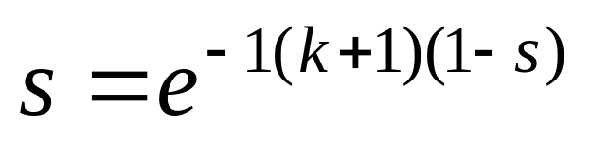
In information dissemination:
  If P has just been updated, it will contact an arbitrary node Q.
  If Q was already updated, P will lose interest (become removed), with probability 1/k.
Very good at rapid spreading.
  Same in this. Fraction s always remains ignorant of an update, that is, remain susceptible, satisfies the equation:
Notes:
In real life, are there some people that just never heard some piece of gossip?

Slide 82
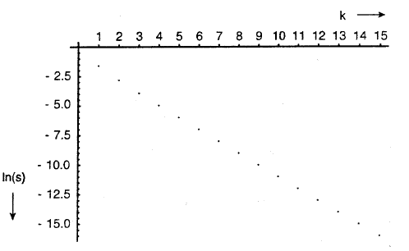
k = 4, s = .7%
Solutions to guarantee that those nodes will also be updated?
Notes:
Figure 4-32. The relation between the fraction s of update-ignorant nodes and the parameter k in pure gossiping. The graph display ln(s) as a function of k.

Slide 83
Solutions
Combining anti-entropy with gossiping
Directional gossiping, nodes that are connected to only a few other nodes are contacted with a relatively high probability.
By regularly updating the partial view of each node, random selection is no longer a problem.

Slide 84
Deleting Data
How do you delete data using gossiping?
  If you completely erase a datum, how do you remember that you forgot it, so that you don’t receive it again via gossiping/epidemic?
Use a record of deletion.These are known as death certificates.
  But how do you prevent them from accumulating?
Timestamp the death certificates, then discard after a certain time period has passed.
How secure is this? What if you need to be absolutely sure that something does not come back?
  A few nodes will maintain a dormant death certificate, which will “reawaken”, if it is reinfected.

Slide 85
Applications (1/2)
Data dissemination: Perhaps the most important one. Note that there are many variants of dissemination.
Aggregation: Let every node i maintain a variable xi. When two nodes gossip, they each reset their variable

Slide 86
Applications (2/2)
Say you have a zillion nodes, and each node has a number. How do you quickly compute the average of the numbers?
  x_{i},x_{j} ← (x_{i} + x_{j})/2
Can you use this to estimate the number of nodes in the system?
  All nodes zero except one. What is the average?
How about picking a random node?
  Each node generates a random number. Disseminate the max.
Notes:
进行信息的收集

