Slide 1
Consistency & Replication

Slide 2
Outline
Introduction (what’s it all about)
Data-centric consistency
Client-centric consistency
Replica management
Consistency protocols

Slide 3
Replication
Replication: Creating and using multiple copies of data or services
It could be data replication if the same data is stored on multiple storage devices
    Eg, Web site mirror, browser cache, DNS
or computation replication if the same computing task is executed many times.
Notes:
http://en.wikipedia.org/wiki/Replication_(computer_science)
Replication is the process of sharing information so as to ensure consistency between redundant resources, such as software or hardware components, to improve reliability, fault-tolerance, or accessibility. It could be data replication if the same data is stored on multiple storage devices, or computation replication if the same computing task is executed many times. A computational task is typically replicated in space, i.e. executed on separate devices, or it could be replicated in time, if it is executed repeatedly on a single device.
The access to a replicated entity is typically uniform with access to a single, non-replicated entity. The replication itself should be transparent to an external user. Also, in a failure scenario, a failover of replicas is hidden as much as possible.
It is common to talk about active and passive replication in systems that replicate data or services. Active replication is performed by processing the same request at every replica. In passive replication, each single request is processed on a single replica and then its state is transferred to the other replicas. If at any time one master replica is designated to process all the requests, then we are talking about the primary-backup scheme (master-slave scheme) predominant in high-availability clusters. On the other side, if any replica processes a request and then distributes a new state, then this is a multi-primary scheme (called multi-master in the database field). In the multi-primary scheme, some form of distributed concurrency control must be used, such as distributed lock manager.
Load balancing is different from task replication, since it distributes a load of different (not the same) computations across machines, and allows a single computation to be dropped in case of failure. Load balancing, however, sometimes uses data replication (esp. multi-master) internally, to distribute its data among machines.
Backup is different from replication, since it saves a copy of data unchanged for a long period of time. Replicas on the other hand are frequently updated and quickly lose any historical state.
Contents
[hide]
1 Replication in distributed systems
1.1 Replication models in distributed systems
2 Database replication
3 Disk storage replication
4 Distributed shared memory replication
5 Primary-backup and multi-primary replication
6 See also
7 External links
[edit] Replication in distributed systems
Replication is one of the oldest and most important topics in the overall area of distributed systems.
Whether one replicates data or computation, the objective is to have some group of processes that handle incoming events. If we replicate data, these processes are passive and operate only to maintain the stored data, reply to read requests, and apply updates. When we replicate computation, the usual goal is to provide fault-tolerance. For example, a replicated service might be used to control a telephone switch, with the objective of ensuring that even if the primary controller fails, the backup can take over its functions. But the underlying needs are the same in both cases: by ensuring that the replicas see the same events in equivalent orders, they stay in consistent states and hence any replica can respond to queries.
[edit] Replication models in distributed systems
A number of widely cited models exist for data replication, each having its own properties and performance:
Transactional replication. This is the model for replicating transactional data, for example a database or some other form of transactional storage structure. The one-copy serializability model is employed in this case, which defines legal outcomes of a transaction on replicated data in accordance with the overall ACID properties that transactional systems seek to guarantee.
State machine replication. This model assumes that replicated process is a deterministic finite state machine and that atomic broadcast of every event is possible. It is based on a distributed computing problem called distributed consensus and has a great deal in common with the transactional replication model. This is sometimes mistakenly used as synonym of active replication.
Virtual synchrony. This computational model is used when a group of processes cooperate to replicate in-memory data or to coordinate actions. The model defines a new distributed entity called a process group. A process can join a group, which is much like opening a file: the process is added to the group, but is also provided with a checkpoint containing the current state of the data replicated by group members. Processes can then send events (multicasts) to the group and will see incoming events in the identical order, even if events are sent concurrently. Membership changes are handled as a special kind of platform-generated event that delivers a new membership view to the processes in the group.
Levels of performance vary widely depending on the model selected. Transactional replication is slowest, at least when one-copy serializability guarantees are desired (better performance can be obtained when a database uses log-based replication, but at the cost of possible inconsistencies if a failure causes part of the log to be lost). Virtual synchrony is the fastest of the three models, but the handling of failures is less rigorous than in the transactional model. State machine replication lies somewhere in between; the model is faster than transactions, but much slower than virtual synchrony.
The virtual synchrony model is popular[citation needed] in part because it allows the developer to use either active or passive replication. In contrast, state machine replication and transactional replication are highly constraining and are often embedded into products at layers where end-users would not be able[citation needed] to access them.
[edit] Database replication
Database replication can be used on many database management systems, usually with a master/slave relationship between the original and the copies. The master logs the updates, which then ripple through to the slaves. The slave outputs a message stating that it has received the update successfully, thus allowing the sending (and potentially re-sending until successfully applied) of subsequent updates.
Multi-master replication, where updates can be submitted to any database node, and then ripple through to other servers, is often desired, but introduces substantially increased costs and complexity which may make it impractical in some situations. The most common challenge that exists in multi-master replication is transactional conflict prevention or resolution. Most synchronous or eager replication solutions do conflict prevention, while asynchronous solutions have to do conflict resolution. For instance, if a record is changed on two nodes simultaneously, an eager replication system would detect the conflict before confirming the commit and abort one of the transactions. A lazy replication system would allow both transactions to commit and run a conflict resolution during resynchronization. The resolution of such a conflict may be based on a timestamp of the transaction, on the hierarchy of the origin nodes or on much more complex logic, which decides consistently on all nodes.
Database replication becomes difficult when it scales up. Usually, the scale up goes with two dimensions, horizontal and vertical: horizontal scale up has more data replicas, vertical scale up has data replicas located further away in distance. Problems raised by horizontal scale up can be alleviated by a multi-layer multi-view access protocol. Vertical scale up runs into less trouble when the internet reliability and performance are improving.
[edit] Disk storage replication
Active (real-time) storage replication is usually implemented by distributing updates of a block device to several physical hard disks. This way, any file system supported by the operating system can be replicated without modification, as the file system code works on a level above the block device driver layer. It is implemented either in hardware (in a disk array controller) or in software (in a device driver).
The most basic method is disk mirroring, typical for locally-connected disks.
Notably, the storage industry narrows the definitions, so mirroring is a local (short-distance) operation. A replication is extendable across a computer network, so the disks can be located in physically distant locations. The purpose is to avoid damage done by, and improve availability in case of local failures or disasters. Typically the above master-slave theoretical replication model is applied. The main characteristic of such solutions is handling write operations:
Synchronous replication - guarantees "zero data loss" by the means of atomic write operation, i.e. write either completes on both sides or not at all. Write is not considered complete until acknowledgement by both local and remote storage. Most applications wait for a write transaction to complete before proceeding with further work, hence overall performance decreases considerably. Inherently, performance drops proportionally to distance, as latency is caused by speed of light. For 10 km distance, the fastest possible roundtrip takes 67 μs, whereas nowadays a whole local cached write completes in about 10-20 μs.
An often-overlooked aspect of synchronous replication is the fact, that failure of remote replica or even just the interconnection stops by definition any and all writes (freezing the local storage system). This is the behaviour that guarantees zero data loss. However, many commercial systems at such potentially dangerous point do not freeze, but just proceed with local writes, losing the desired zero recovery point objective.
Asynchronous replication - write is considered complete as soon as local storage acknowledges it. Remote storage is updated, but probably with a small lag. Performance is greatly increased, but in case of losing a local storage, the remote storage is not guaranteed to have the current copy of data and most recent data may be lost.
Semi-synchronous replication - introduced by some vendors, probably as a sales pitch; exact meaning varies.
Point-in-time replication - introduces periodic snapshots that are replicated instead of primary storage.
Most important implementations:
DRBD module for Linux.
EMC SRDF
IBM PPRC and Global Mirror (known together as IBM Copy Services)
Hitachi TrueCopy
Symantec Veritas Volume Replicator (VVR)
FalconStor Replication & Mirroring (sub-block heterogeneous point-in-time, async, sync)
[edit] Distributed shared memory replication
Another example of using replication appears in distributed shared memory systems, where it may happen that many nodes of the system share the same page of the memory - which usually means, that each node has a separate copy (replica) of this page.
[edit] Primary-backup and multi-primary replication
Many classical approaches to replication are based on a primary/backup model where one device or process has unilateral control over one or more other processes or devices. For example, the primary might perform some computation, streaming a log of updates to a backup (standby) process, which can then take over if the primary fails. This approach the most common one for replicating databases, despite the risk that if a portion of the log is lost during a failure, the backup might not be in a state identical to the one the primary was in, and transactions could then be lost.
A weakness of primary/backup schemes is that in settings where both processes could have been active, only one is actually performing operations. We're gaining fault-tolerance but spending twice as much money to get this property. For this reason, starting in the period around 1985, the distributed systems research community began to explore alternative methods of replicating data. An outgrowth of this work was the emergence of schemes in which a group of replicas could cooperate, with each process backup up the others, and each handling some share of the workload.
Jim Gray, a towering figure within the database community, analyzed multi-primary replication schemes under the transactional model and ultimately published a widely cited paper skeptical of the approach ("The Dangers of Replication and a Solution"). In a nutshell, he argued that unless data splits in some natural way so that the database can be treated as n disjoint sub-databases, concurrency control conflicts will result in seriously degraded performance and the group of replicas will probably slow down as a function of n. Indeed, he suggests that the most common approaches are likely to result in degradation that scales as O(n³). His solution, which is to partition the data, is only viable in situations where data actually has a natural partitioning key.
The situation is not always so bleak. For example, in the 1985-1987 period, the virtual synchrony model was proposed and emerged as a widely adopted standard (it was used in the Isis Toolkit, Horus, Transis, Ensemble, Totem, Spread, C-Ensemble, Phoenix and Quicksilver systems, and is the basis for the CORBA fault-tolerant computing standard; the model is also used in IBM Websphere to replicate business logic and in Microsoft's Windows Server 2008 enterprise clustering technology). Virtual synchrony permits a multi-primary approach in which a group of processes cooperate to parallelize some aspects of request processing. The scheme can only be used for some forms of in-memory data, but when feasible, provides linear speedups in the size of the group.
A number of modern products support similar schemes. For example, the Spread Toolkit supports this same virtual synchrony model and can be used to implement a multi-primary replication scheme; it would also be possible to use C-Ensemble or Quicksilver in this manner. WANdisco permits active replication where every node on a network is an exact copy or replica and hence every node on the network is active at at one time; this scheme is optimized for use in a wide area network.
[edit] See also
Cloud computing
Cluster
Cluster manager
Failover
Fault tolerant system
Log Shipping
Optimistic replication
Process group
Transaction
Transparency (computing)
Virtual synchrony
[edit] External links
"The Dangers of Replication and a Solution"

Slide 4
Why Replication?
Improve reliability
  Data survival, availability
  Increase confidence: e.g. deal with byzantine failures
Improve performance
  Scaling in numbers
  Reduce access times in geographical area

Slide 5
What are the issues?
Updating replicas
Consistency (how to deal with updated data)
  (luckily) applications do not always require strict consistency
How are updates distributed?
Replica management
How many replicas?
Where to place them?
When to get rid of them?
Redirection/Routing
Which replica should clients use?
Scalability ←--CONFILCT---→ management overheads

Slide 6
Example: Costs
As a scaling technique, may not always be applicable.
Update replica M times per second
Access replica N times per second
P
As a scaling technique, may not always be applicable. What if N << M?
Notes:
Assume synchronous replication
A dilemma:
Scalability can be alleviated by replication and caching.
But consistency requires global synchronization!
Only real solution is to relax consistency requirements.

Slide 7
Performance and Scalability
Main issue: To keep replicas consistent, we generally need to ensure that all conflicting operations are done in the same order everywhere
Conflicting operations: From the world of transactions:
  Read–write conflict: a read operation and a write operation act concurrently
  Write–write conflict: two concurrent write operations
Problem: Guaranteeing global ordering on conflicting operations may be a costly operation, downgrading scalability
Solution: weaken consistency requirements so that hopefully global synchronization can be avoided

Slide 8
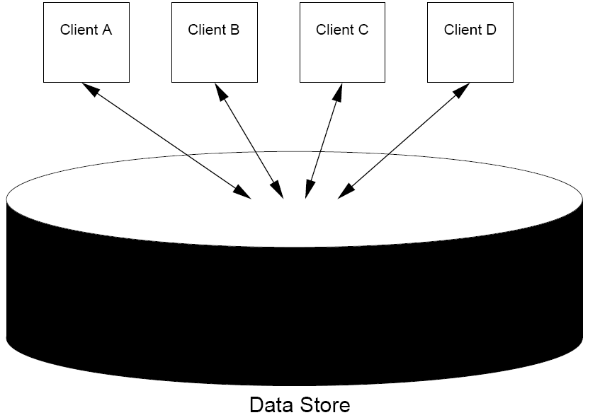
Client’s view of data-store
Ideally: black box -- complete ‘transparency’ over how data is stored and managed
Notes:
Traditionally, consistency has always been discussed in the context of read and write operations on shared data, available by means of (distributed) shared memory, a (distributed) shared database, or a (distributed) file system. In this section, we use the broader term data store.
The access to a replicated entity is typically uniform with access to a single, non-replicated entity. The replication itself should be transparent to an external user. Also, in a failure scenario, a failover of replicas is hidden as much as possible.

Slide 9
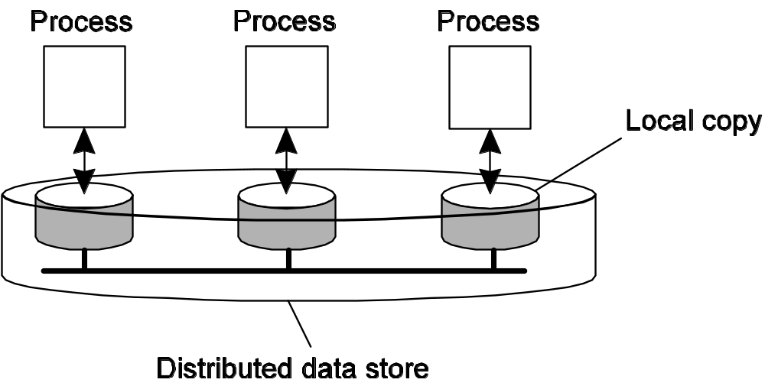
Management system’s view on data store
Management system: Controls the allocated resources and aims to provide transparency
Essence: A data store is a distributed collection of storages accessible to clients:

Slide 10
In the Following
Consistency model: contract between the data store and the clients
  the data store specifies precisely what the results of read and write operations are in the presence of concurrency.
Protocols
  To manage replicas: creation, placement
  To manage updates: propagation
  To assign client requests to replicas
Notes:
Enforcing absolute ordering is too expensive, especially with replication and caching.
So we need to allow for “mis-ordering”.
We could just do it casually. Tell programmers, “Well, you always see things in exact order”.
They would say, “What do you mean?”
So we need an exact, very precise way of specifying the kinds of inconsistencies that the application might see.
That is the purpose and point of having consistency models.

Slide 11
Data Centric Consistency Models

Slide 12
Continuous Consistency
Observation: We can actually talk about a degree of consistency:
  replicas may differ in their numerical value
  replicas may differ in their relative staleness
  there may be differences with respect to (number and order) of performed update operations
Conit: consistency unit => specifies the data unit over which consistency is to be measured.
Notes:
Yu and Vahdat (2002) take a general approach by distinguishing three independent axes for defining inconsistencies: deviation in numerial values between replicas, deviation in stale ness between replicas, and deviation with respect to the ordering of update operations.

Slide 13
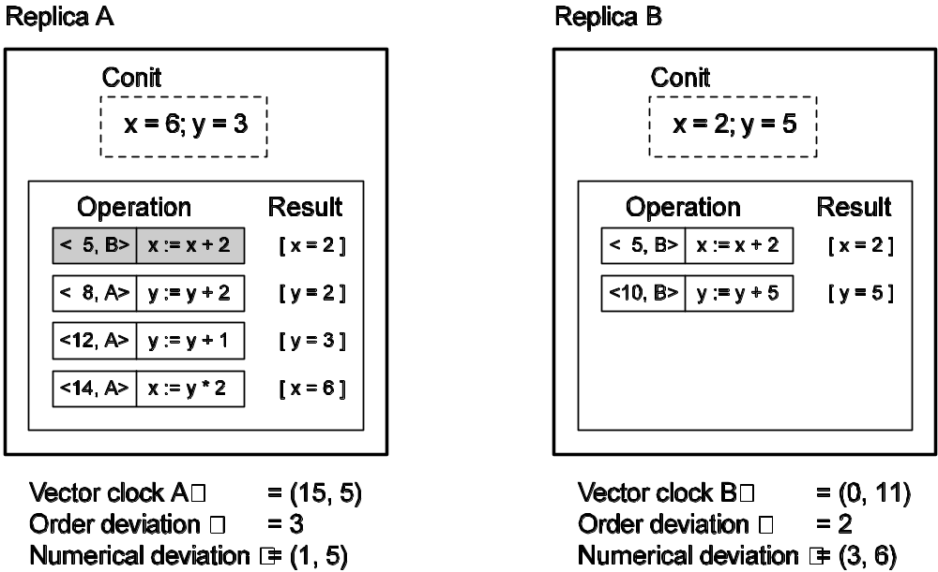
Example: Conit
Conit: contains the variables x and y:
  Each replica maintains a vector clock
  B sends A operation [<5,B>: x := x + 2]; A has made this operation permanent (cannot be rolled back)
  A has three pending operations => order deviation = 3
  A has missed one operation from B, yielding a max diff of 5 units => (1,5)

Slide 14
Operations on a Data Store
Notations:
Write: W_{i}(x) a -- a write by process P_{i} to data item x with the value a
Read: R_{i}(x) b -- a read from data item x by process P_{i} return b

Slide 15

Strict Consistency
Any read on a data item X returns a value corresponding to the result of the most recent write on X.
  Implicitly assumes the existence of absolute global time.
  Naturally available in uni-processor systems, but impossible to implement in distributed systems.
Behavior of two processes, operating on the same data item.
Notes:
We assume that each data item is initially NIL. When there is no confusion concerning which process is accessing data, we omit the index from the symbols W and R.

Slide 16

Sequential Consistency
The result of any execution is the same as if
operations by all processes on the data store were executed in some sequential order, and
the operations of each individual process appear in this sequence in the order specified by its program.
Still expensive: R + W > T
Notes:
Still expensive: R + W > T
Lipton & Sandberg (1998) 证明了：如果执行读操作的时间是r,执行写操作的时间是w,节点间最小的数据包传送时间是t,那么始终存在r + w > t.换句话说，对于任何的顺序一致性存储，改变协议以提高读操作性能必然降低写操作性能，反之亦然。
Note: we talk about interleaved execution – there is some total ordering for all operations taken together

Slide 17
Causal Consistency
Writes that are potentially causally related must be seen by all processes in the same order. Concurrent writes may be seen in a different order by different processes.
Causally related relationship:
A read is causally related to the write that provided the data the read got.
A write is causally related to a read that happened before this write in the same process.
If write1 → read, and read → write2, then write1 → write2.
Concurrent <=> not causally related

Slide 18

Causal Consistency (Example)
This sequence is allowed with a causally-consistent store, but not with sequentially consistent store.
Note: W₁(x)a → W₂(x)b, but not W₂ (x)b → W₁(x)c

Slide 19

Causal Consistency (More Examples)
A violation of a causally-consistent store.
A correct sequence of events in a causally-consistent store.

Slide 20
Grouping Operations (1/2)
As viewed by an external, data-centric process, what do locks do?
  They turn non-atomic operations into atomic ones (functionally).
  In other words, they group them.
Synchronization Variables
  Operations are grouped via synchronization variables (locks).
  Each sync var protects an associated data.
  Each kind of sync var has some associated properties.
Notes:
Each synchronization variable has a current owner, namely, the process that last acquired it.

Slide 21
Grouping Operations (2/2)
Intuition: You don't care that reads and writes of a series of operations are immediately known to other processes. You just want the effect of the series itself to be known.
Weak consistency properties
Accesses to synchronization variables associated with a data store are sequentially consistent.
No operation on a synchronization variable is allowed to be performed until all previous writes have been completed everywhere.
No read or write operation on data items are allowed to be performed until all previous operations to synchronization variables have been performed.
Notes:
“synchronisation flushes the pipeline”

Slide 22

Weak Consistency (Example)
A valid sequence of events for weak consistency.
An invalid sequence for weak consistency.
Notes:
S waits for writes
Only processes that have synchronised have a guarantee of what they see!

Slide 23
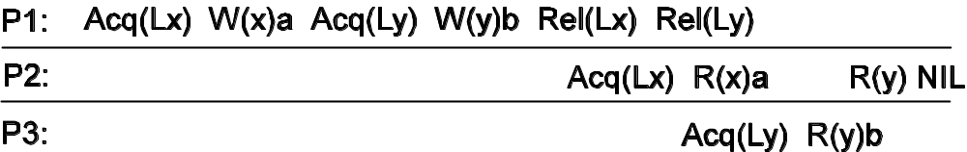
Entry Consistency (Example)
Observation: Weak consistency implies that we need to lock and unlock data (implicitly or not).
Question: What would be a convenient way of making this consistency more or less transparent to programmers?
Notes:
P2 reads NIL for y because it has not acquired a lock for y.

Slide 24
Client-Centric Consistency Models
System model
Monotonic reads
Monotonic writes
Read-your-writes
Write-follows-reads
Goal: Show how we can perhaps avoid system wide consistency, by concentrating on what specific clients want, instead of what should be maintained by servers.
Notes:
Weaker Models
Sometimes strong models are needed, if the result of race conditions are very bad.
Banks
Sometimes the result of races are just inefficiency, or inconvenience, etc.
How strong is Orbitz’s model?
If it shows a ticket available, is it really?
How does it prevent two people from reserving the same seat?
One kind of weaker model is eventual consistency
It eventually becomes consistent

Slide 25
Eventual Consistency
If no updates take place for a long enough period time, all replicas will gradually (i.e., eventually) become consistent.
Situations where eventual consistency models may make sense
  Mostly read-only workloads
  No concurrent updates
Notes:
只要客户总是访问同一副本，最终一致的数据存储就会工作得很好。但是，当客户访问不同的副本时，问题就出现了。

Slide 26
Consistency for Mobile Users
Example: Consider a distributed database to which you have access through your notebook. Assume your notebook acts as a front end to the database.
  At location A you access the database doing reads and updates.
  At location B you continue your work, but unless you access the same server as the one at location A, you may detect inconsistencies:
    your updates at A may not have yet been propagated to B
    you may be reading newer entries than the ones available at A
    your updates at B may eventually conflict with those at A
Note: The only thing you really want is that the entries you updated and/or read at A, are in B the way you left them in A. In that case, the database will appear to be consistent to you.
Notes:
Idea: the database will appear to be consistent to the user

Slide 27
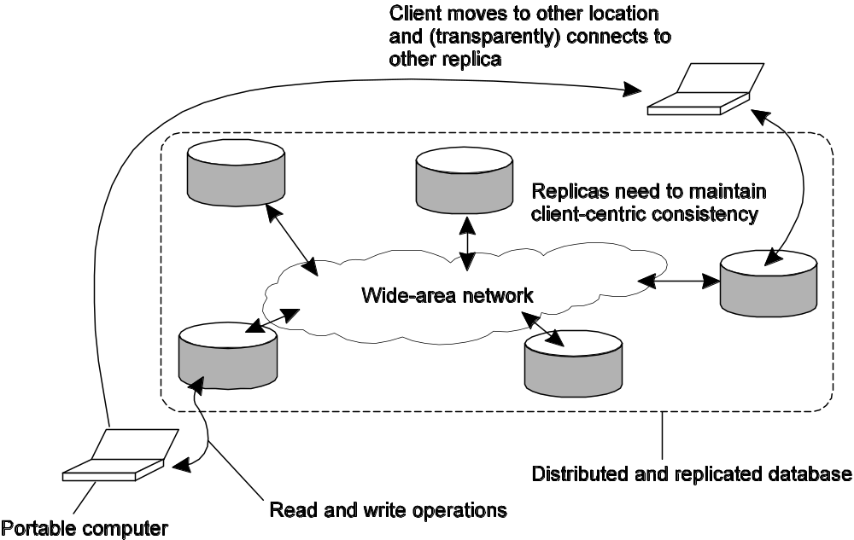
Basic Architecture
How well does eventually consistent (EC) work for mobile clients?
Client-centric is for this. Consistent for a single client.
Notes:
Data stores that are eventually consistent thus have the property that in the absence of updates, all replicas converge toward identical copies of each other.
The example is typical for eventually consistent data stores and is caused by the fact that users may sometimes operate on different replicas. The problem can be alleviated by introducing client-centric consistency.

Slide 28
Client-centric Consistency
Idea: Guarantees some degree of data access consistency for a single client.
Notations:
X_{i}[t] → Version of data item x at time t at local copy L_{i}
WS(x_{i} [t]) → all write operations at L_{i} since init
WS(x_{i} [t₁], x_{j} [t₂]) → If operations in WS(x_{i}[t₁]) have also been performed at local copy L_{j} at a later time t₂, it is known that WS(x_{i} [t₁]) is part of WS(x_{j} [t₂])
Notes:
x_{i}[t] is the version of x at local copy L_{i} at time t.
Version x_{i}[t] is the result of a series of write operations at L_{i} that took place since initialization. This is WS(x_{i}[t]).
If operations in WS(x_{i}[t]) have also been performed at local copy L_{j} at a later time t₂, we write WS(x_{i}[t₁];x_{j}[t₂]).

Slide 29
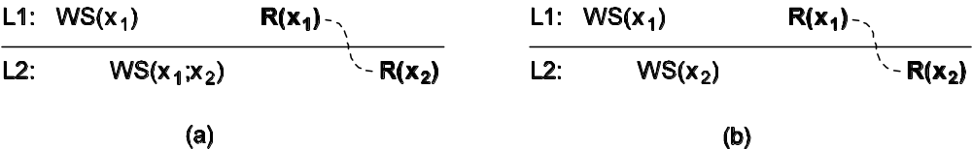
Monotonic-Read Consistency
Def: If a process reads the value of a data item x, any successive read operation on x by that process will always return that same or a more recent value.
Intuition: Client “sees” only same or newer version of data.
Notes:
Along the vertical axis, two different local copies of the data store are shown L1 and L2. Time is shown along the horizontal axis as before. In all cases, we are interested in the operations carried out by a single process P.

Slide 30
Monotonic reads – Examples
Automatically reading your personal calendar updates from different servers.
  Monotonic Reads guarantees that the user sees all updates, no matter from which server the automatic reading takes place.
Reading (not modifying) incoming e-mail while you are on the move.
  Each time you connect to a different e-mail server, that server fetches (at least) all the updates from the server you previously visited.

Slide 31
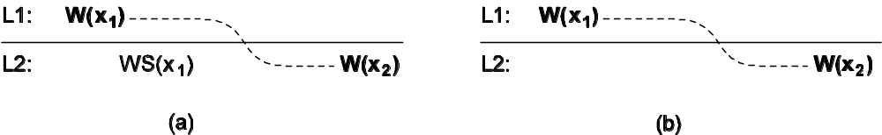
Monotonic-Write Consistency
Def: A write operation by a process on a data item x is completed before any successive write operation on x by the same process.
Intuition: Write happens on a copy only if it’s brought up to date with preceding write operations on same data (but possibly at different copies)

Slide 32
Monotonic writes – Examples
Updating a program at server S2, and ensuring that all components on which compilation and linking depends, are also placed at S2.
Maintaining versions of replicated files in the correct order everywhere (propagate the previous version to the server where the newest version is installed).

Slide 33
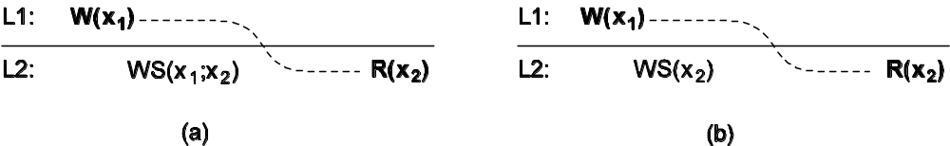
Read-Your-Writes Consistency
Def: The effect of a write operation by a process on data item x, will always be seen by a successive read operation on x by the same process.
Intuition: All previous writes are always completed before any successive read

Slide 34
Read-Your-Writes - Examples
Updating your Web page and guaranteeing that your Web browser shows the newest version instead of its cached copy.
Password database

Slide 35

Writes-Follow-Reads Consistency
Def: A write operation by a process on a data item x following a previous read operation on x by the same process, is guaranteed to take place on the same or a more recent value of x that was read.
Intuition: Any successive write operation on x will be performed on a copy of x that is same or more recent than the last read.

Slide 36
Writes-Follow-Reads - Examples
Examples: news groups
  See reactions to posted articles only if you have the original posting (a read “pulls in” the corresponding write operation).

Slide 37
Implementation of monotonic-read consistency
Sketch:
globally unique identifier for each write operation
each client has two sets:
  write ids relevant to the read operations
  write ids relevant to the write operations
the server updates x according to the client’s read set before the operation
Notes:
Problems? Solutions to improve.

Slide 38
Summary – client centric consistency
Main take
  We can avoid system-wide consistency, by concentrating on what specific clients want, instead of what should be maintained by servers. Relax consistency requirements even further
Only concerned about single client-view
Notes:
requirements even further
Only concerned Client centric consistency models
Relax consistency about single client-view

Slide 39
Replica Management
Replica server placement
Content replication and placement
Content distribution

Slide 40
Replica Server Placement
Essence: Figure out what the best K places are out of N possible locations.
Select best location out of N - k for which the average distance to clients is minimal. (Note: The first chosen location minimizes the average distance to all clients.) Computationally expensive.
Select the k-th largest autonomous system and place a server at the best-connected host. Computationally expensive.
Position nodes in a d-dimensional geometric space, where distance reflects latency. Identify the K regions with highest density and place a server in every one. Computationally cheap.

Slide 41
Clustering
One idea, identify the K largest clusters, then put one server in each cluster.
How do you find clusters?
  One way, divide the entire space into cells, pick K most populated ones.

Slide 42
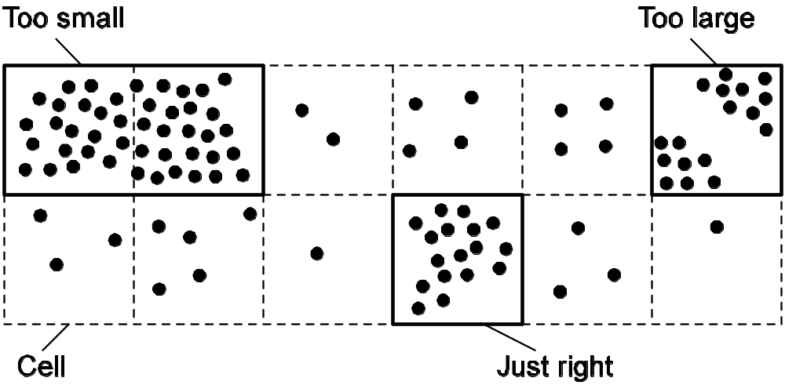
Replica-Server Placement
Choosing a proper cell size for server placement.
Turns out that an appropriate cell size can be computed from average distance between two nodes and the number of replicas works well.

Slide 43
Content replication (1/2)
Model: We consider objects (and don't worry whether they contain just data or code, or both)
Distinguish different processes: A process is capable of hosting a replica of an object or data:
Permanent replicas: Process/machine always having a replica
Server-initiated replica: Process that can dynamically host a replica on request of another server in the data store
Client-initiated replica: Process that can dynamically host a replica on request of a client (client cache)

Slide 44
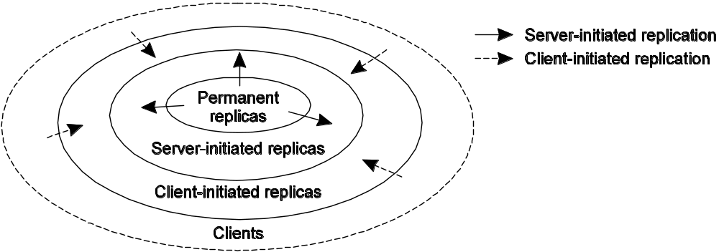
Content Replication (2/2)
The logical organization of different kinds
of copies of a data store into three concentric rings.

Slide 45
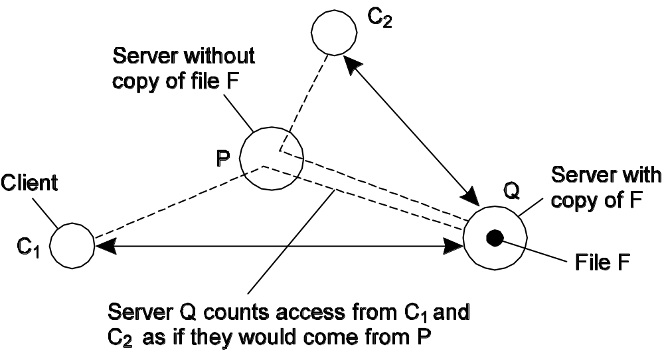
Content Replication: Server-Initiated Replicas
Keep track of access counts per file, aggregated by considering server closest to requesting clients
Number of accesses drops below threshold D → drop file
Number of accesses exceeds threshold R → replicate file
Number of access between D and R → migrate file

Slide 46
Content distribution (1/3)
Model: Consider only a client-server combination:
Propagate only notification/invalidation of update (often used for caches)
Transfer data from one copy to another (distributed databases)
Propagate the update operation to other copies (also called active replication)
Observation: No single approach is the best, but depends highly on available bandwidth and read-to-write ratio at replicas.
Notes:
For simplicity, consider a client-server system consisting of a single, nondistributed server, and a number of client processes, each having their own cache.

Slide 47
Content distribution (2/3)
Pushing updates: server-initiated approach, in which update is propagated regardless whether target asked for it.
Pulling updates: client-initiated approach, in which client requests to be updated.
Issue | Push-based | Pull-based
State of server | List of client replicas and caches | None
Messages sent | Update (and possibly fetch update later) | Poll and update
Response time at client | Immediate (or fetch-update time) | Fetch-update time
Notes:
A comparison between push-based and pull-based protocols in the case of multiple-client, single-server systems.

Slide 48
Content distribution (3/3)
Observation: We can dynamically switch between pull and push using leases:
  Lease: A contract in which the server promises to push updates to the client until the lease expires.
Issue: Make lease expiration time dependent on system's behavior (adaptive leases):
Age-based leases: An object that hasn't changed for a long time, will not change in the near future, so provide a long-lasting lease
Renewal-frequency based leases: The more often a client requests a specific object, the longer the expiration time for that client (for that object) will be
State-based leases: The more loaded a server is, the shorter the expiration times become

Slide 49
Consistency Protocols
Consistency protocol: describes the implementation of a specific consistency model.
  Continuous consistency
  Primary-Based Protocols
  Replicated-Write Protocols

Slide 50
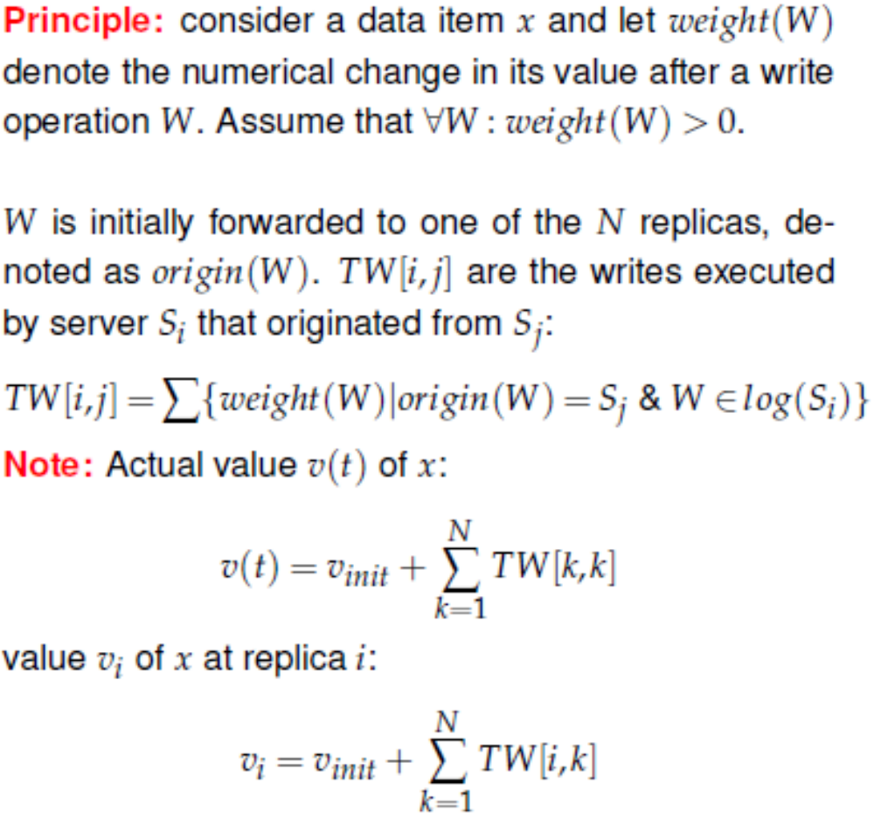
Continuous Consistency: Numerical Errors (1/2)

Slide 51
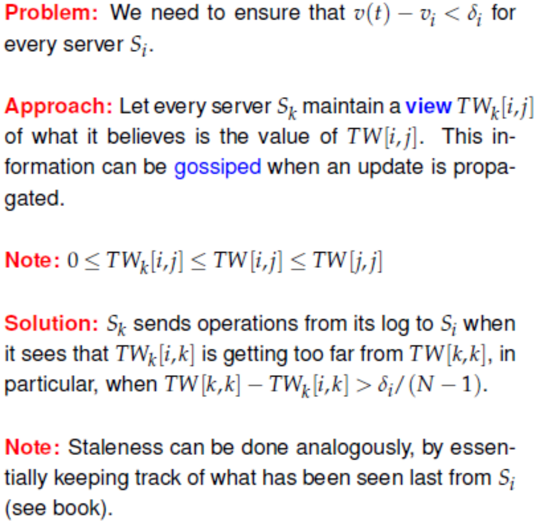
Continuous Consistency: Numerical Errors (2/2)

Slide 52
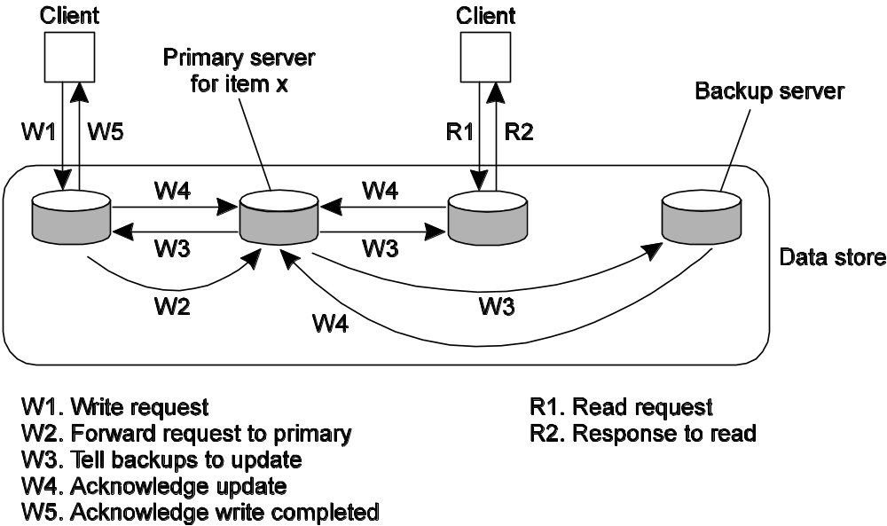
Primary-Based Protocols (1/2)
Primary-backup protocol :
Example: Traditionally applied in distributed databases and file systems that require a high degree of fault tolerance. Replicas are often placed on same LAN.
Notes:
with remote writes

Slide 53
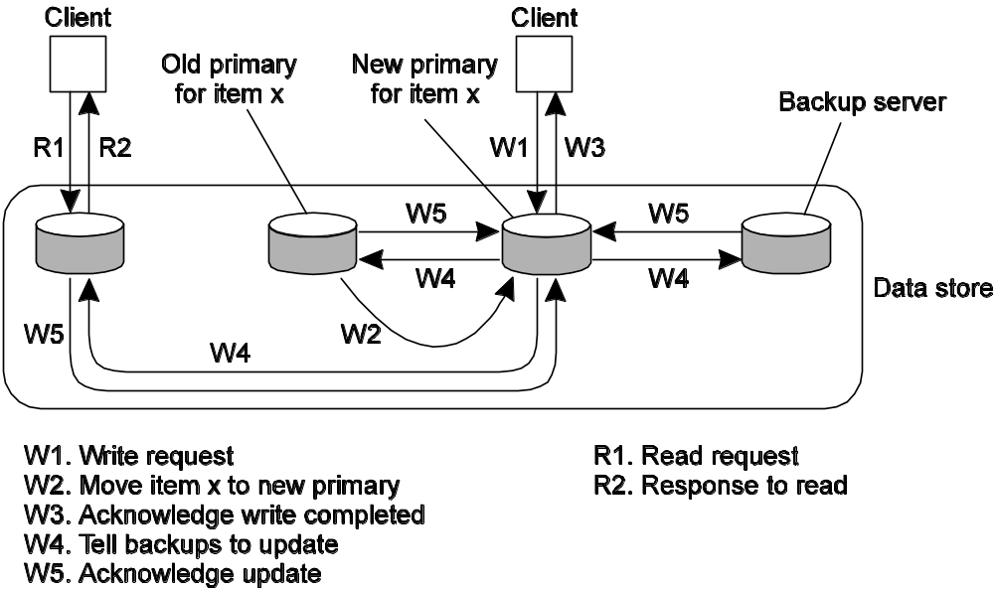
Primary-Based Protocols (2/2)
Primary-Backup protocol with local writes:
Example: Mobile computing in disconnected mode (ship all relevant files to user before disconnecting, and update later on).
Notes:
Primary-backup protocol in which the primary migrates to the process wanting to perform an update.

Slide 54
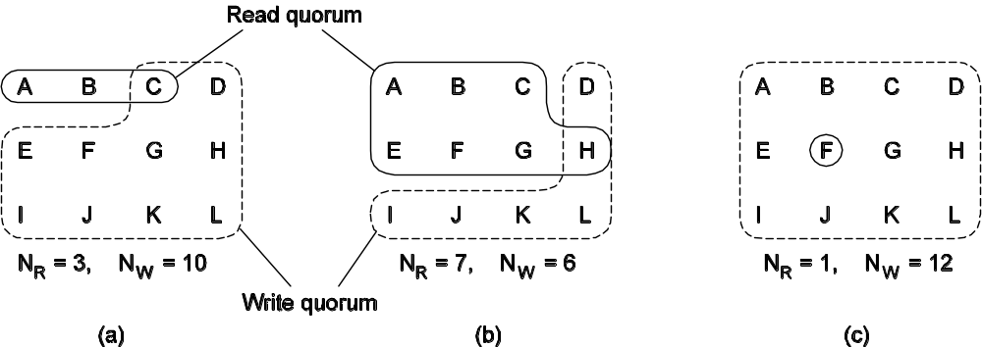
Replicated-Write Protocols
Quorum-based protocols: Ensure that each operation is carried out in such a way that a majority vote is established: distinguish read quorum and write quorum:
  N_{R} + N_{W} > N
  N_{W} > N/2
Notes:
Three examples of the voting algorithm. (a) A correct choice of read and write set. (b) A choice that may lead to write-write conflicts. (c) A correct choice, known as ROWA (read one, write all).

