Slide 1

Don’t break apart the circuit board for the workshop!

Slide 3
Lilypad Arduino Workshop
By Venkat Venkataraju and Jeremiah Wuenschel

Slide 4

Blinking Lights
Controlling LED lights

Slide 5
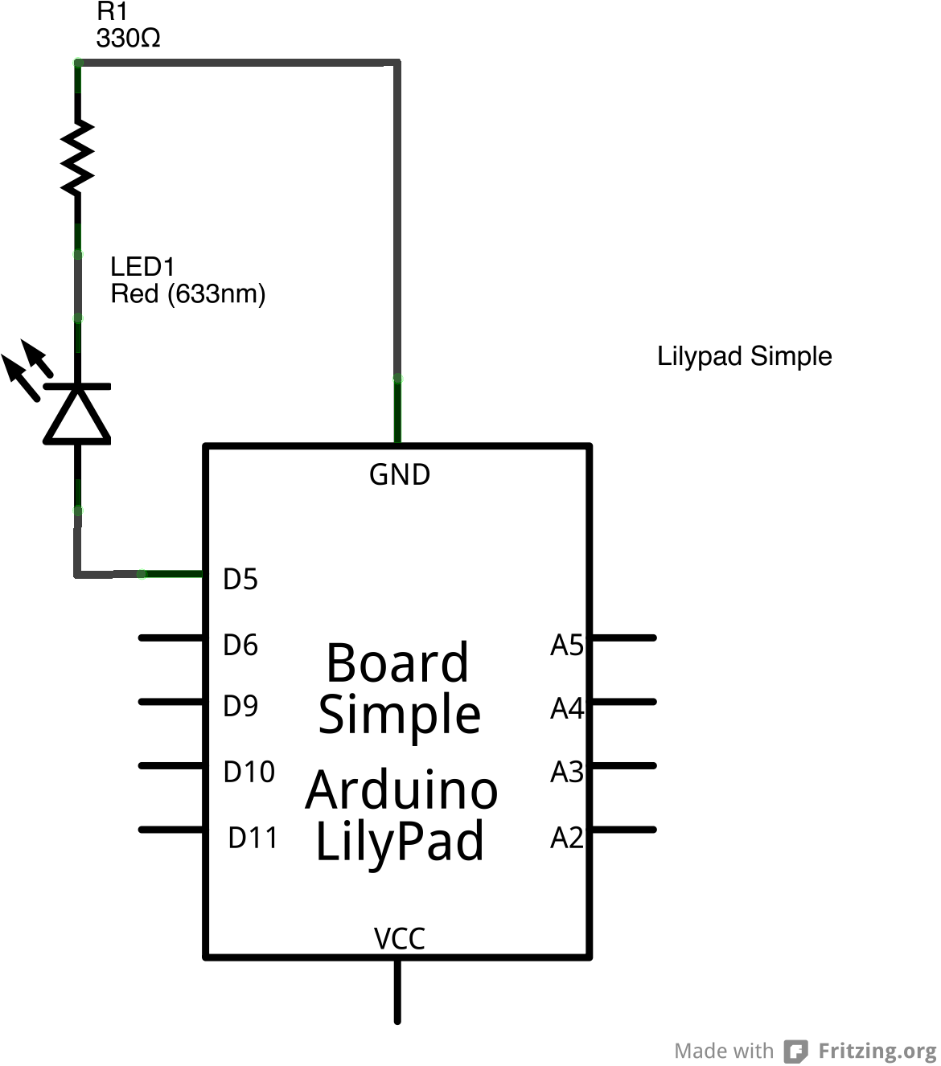
Wiring an LED

Slide 6

A Touch Of Color
Controlling the color of the multi color LED

Slide 7
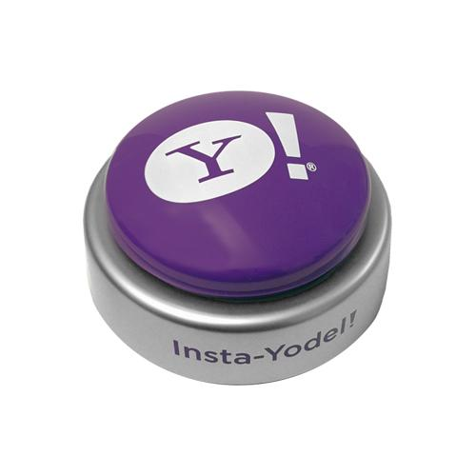
Pushing Buttons
Responding to a push button

Slide 8
Why Debounce?
Switches are not perfect
The contact connection and disconnect are not clean
Produces a period of instability in the signal

Slide 9
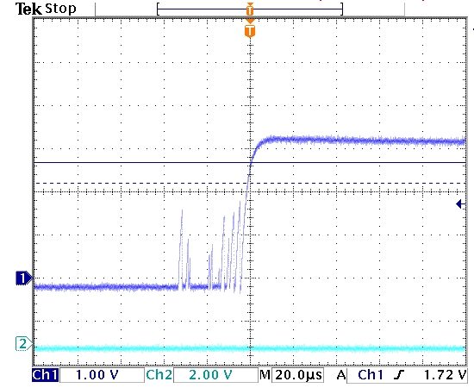
Debouncing an Input

Slide 10
Solution - from Adafruit
void loop() {
int switchstate;
reading = digitalRead(inPin);
if (reading != previous) {
time = millis();
}
if ((millis() - time) > debounce) {
switchstate = reading;
if (switchstate == HIGH)
LEDstate = LOW;
else
LEDstate = HIGH;
}
digitalWrite(outPin, LEDstate);
previous = reading;
}

Slide 11
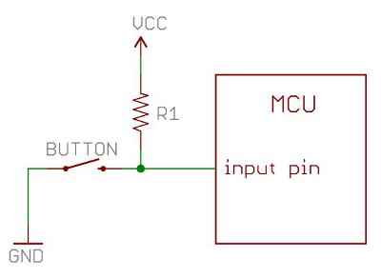
Pull-up Resistor

Slide 12
Fading Lights
Changing the brightness of the LED

Slide 13
Pulse-width Modulation
Microcontrollers can only output 0 or 1
By toggling the pin “on” 50% of the time, we can reduce the total power output to 50%
By varying the % of time the pin is on, we can simulate analog output
For a cleaner signal, the PWM output can be passed thru a RC filter circuit

Slide 14
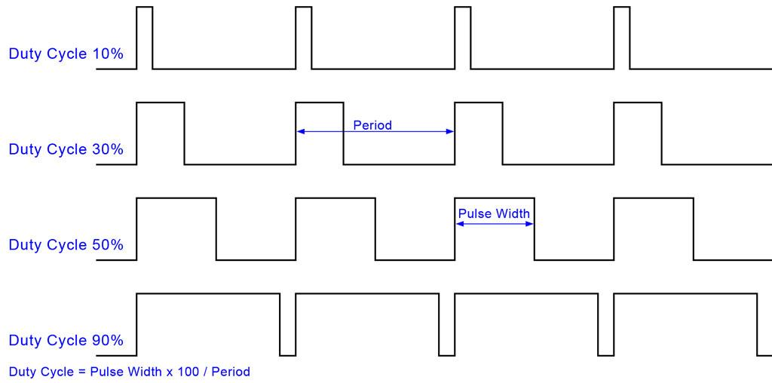
Pulse-width Modulation

Slide 15
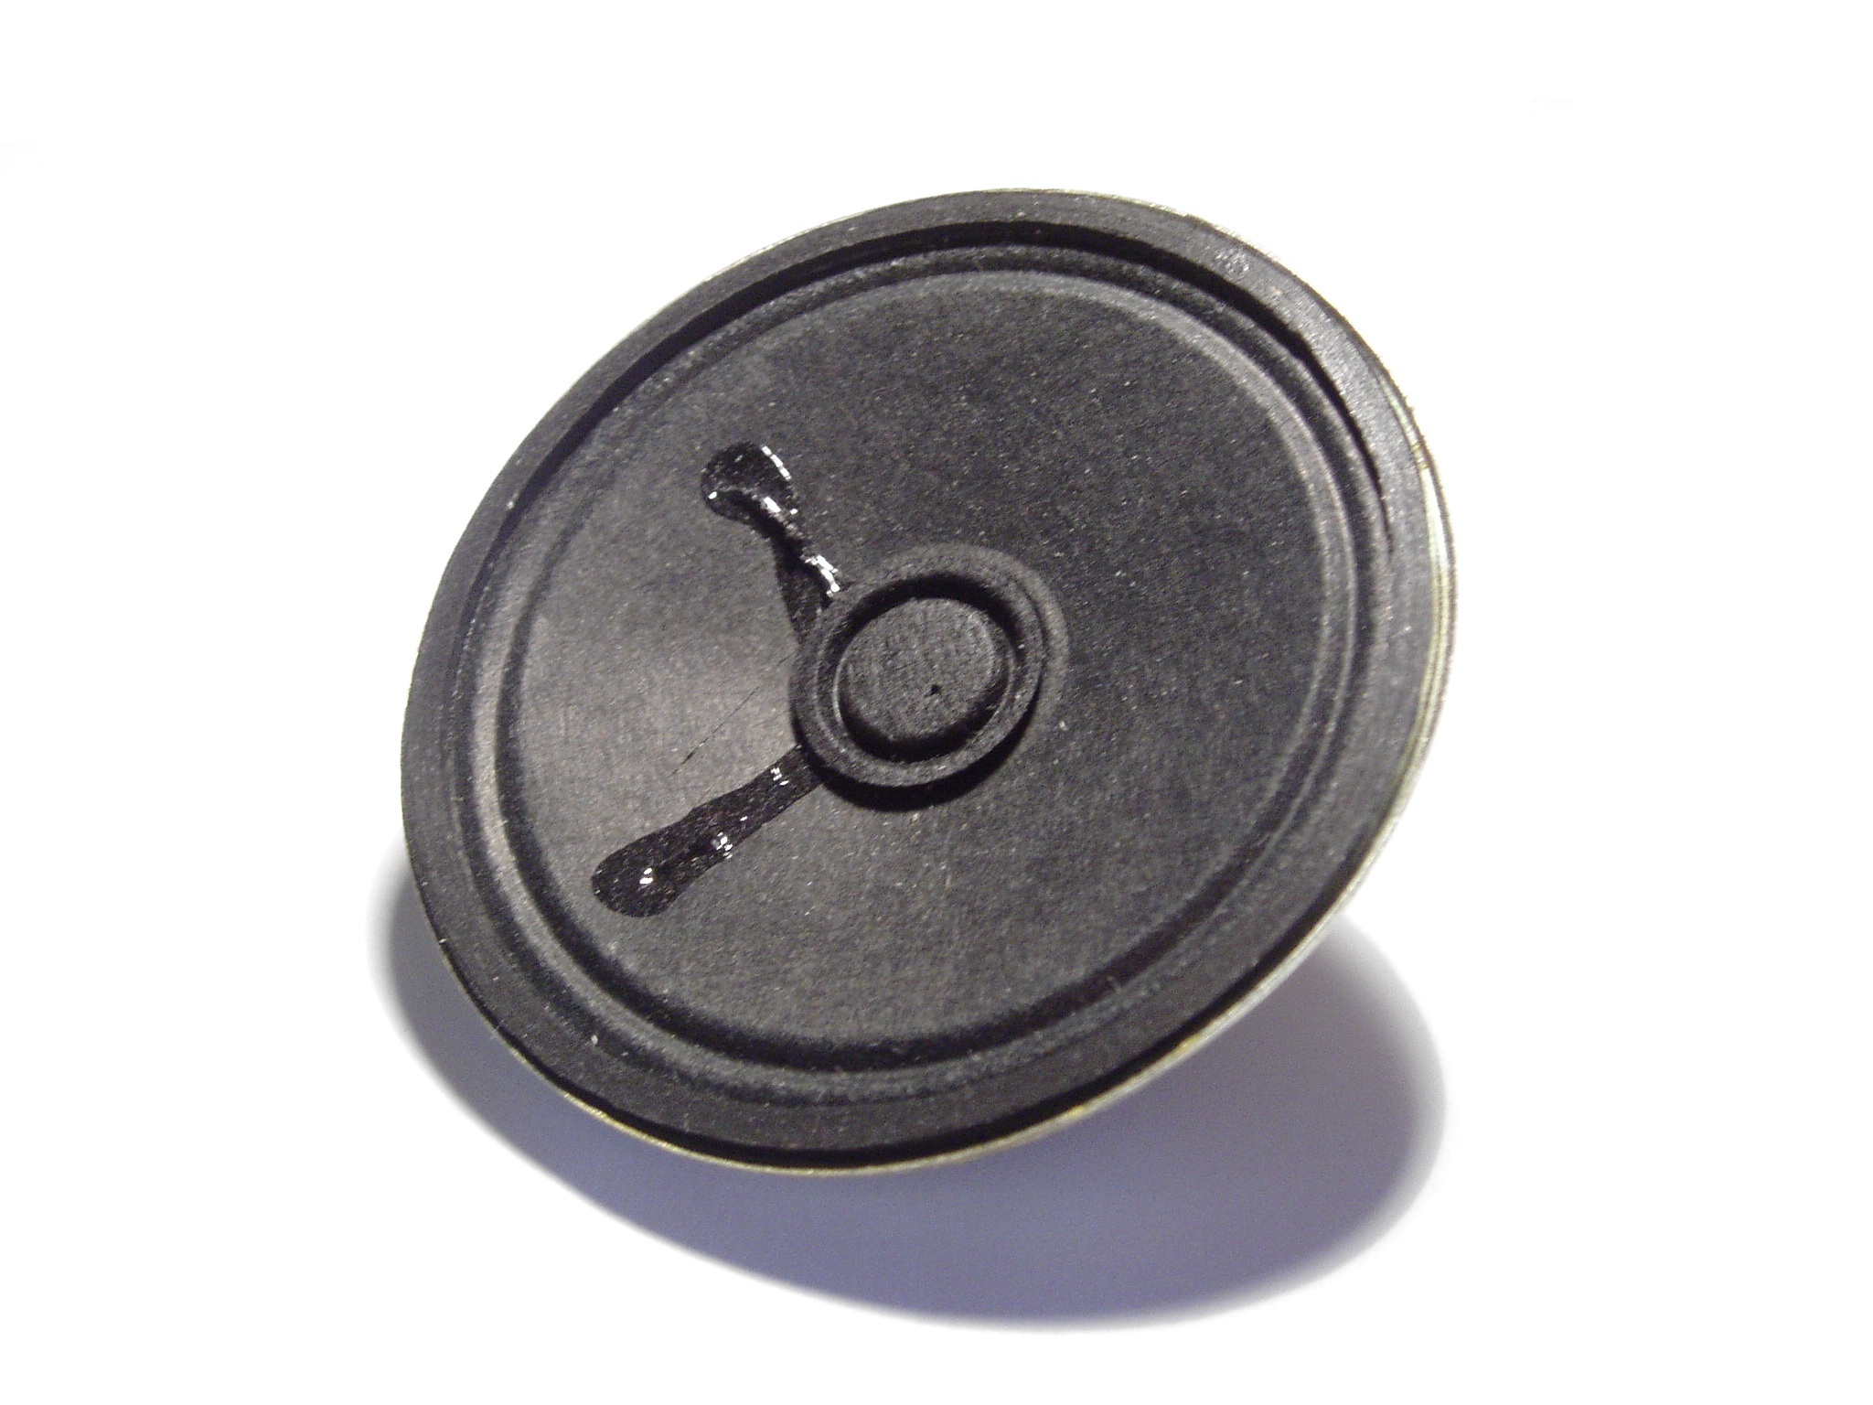
Making Noise
Generating Sound

Slide 16
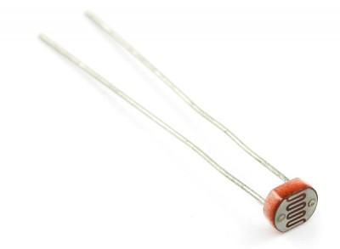
Sensing Light
Responding to ambient light

Slide 17
More…
Slide Switch (Pin D2)
Temperature sensor (Pin A1)
Vibe Board (Pin 3)

Slide 18
Resources
Arduino Documentation
http://arduino.cc/en/Reference/HomePage
Lilypad Arduino Reference
http://lilypadarduino.org/
Lilypad ProtoSnap Schematics
http://dlnmh9ip6v2uc.cloudfront.net/datasheets/E-Textiles/Lilypad/LilyPad-Dev-v34b.pdf
Debouncing
http://arduino.cc/en/Tutorial/Debounce
http://www.engscope.com/pic-example-codes/basic-io-button-debounce/
http://learn.adafruit.com/tilt-sensor/using-a-tilt-sensor
Pulse-width modulation
http://arduino.cc/en/Tutorial/PWM
http://www.protostack.com/blog/2011/06/atmega168a-pulse-width-modulation-pwm/
Pull-up and pull-down resistors
https://learn.sparkfun.com/tutorials/pull-up-resistors

