Slide 1

Don’t break apart the circuit board for the workshop!

Slide 3
Lilypad Arduino Workshop
By Venkat Venkataraju and Jeremiah Wuenschel

Slide 4
Setup
Install Arduino IDE from http://arduino.cc/en/Main/Software
Install FTDI drivers from http://www.ftdichip.com/Drivers/VCP.htm
Program Arduino with example blink sketch

Slide 5

Blinking Lights
Controlling LED lights

Slide 6
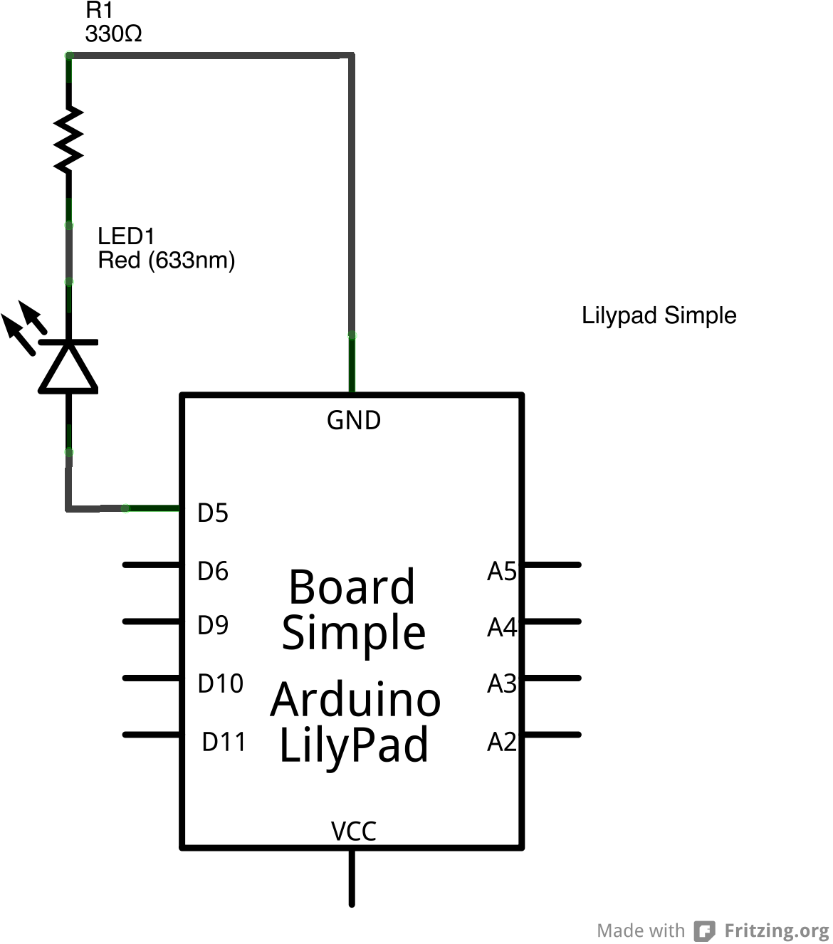
Wiring an LED

Slide 7

A Touch Of Color
Controlling the color of the multi color LED

Slide 8

Pushing Buttons
Responding to a push button

Slide 9
Why Debounce?
Switches are not perfect
The contact connection and disconnect are not clean
Produces a period of instability in the signal

Slide 10
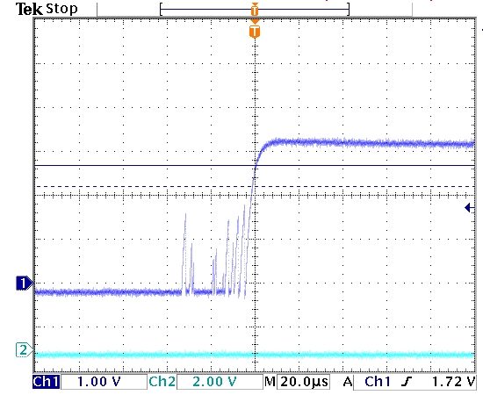
Debouncing an Input

Slide 11
Solution - from Adafruit
void loop() {
int switchstate;
reading = digitalRead(inPin);
if (reading != previous) {
time = millis();
}
if ((millis() - time) > debounce) {
switchstate = reading;
if (switchstate == HIGH)
LEDstate = LOW;
else
LEDstate = HIGH;
}
digitalWrite(outPin, LEDstate);
previous = reading;
}

Slide 12
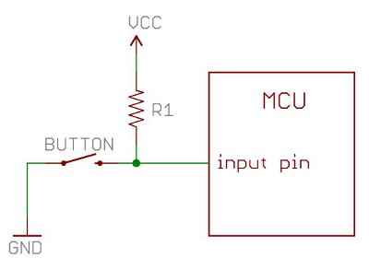
Pull-up Resistor

Slide 13
Fading Lights
Changing the brightness of the LED

Slide 14
Pulse-width Modulation
Microcontrollers can only output 0 or 1
By toggling the pin “on” 50% of the time, we can reduce the total power output to 50%
By varying the % of time the pin is on, we can simulate analog output
For a cleaner signal, the PWM output can be passed thru a RC filter circuit

Slide 15
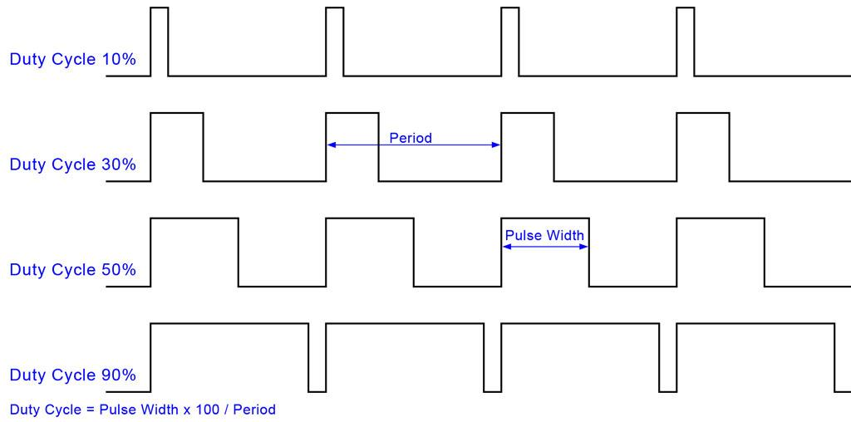
Pulse-width Modulation

Slide 16
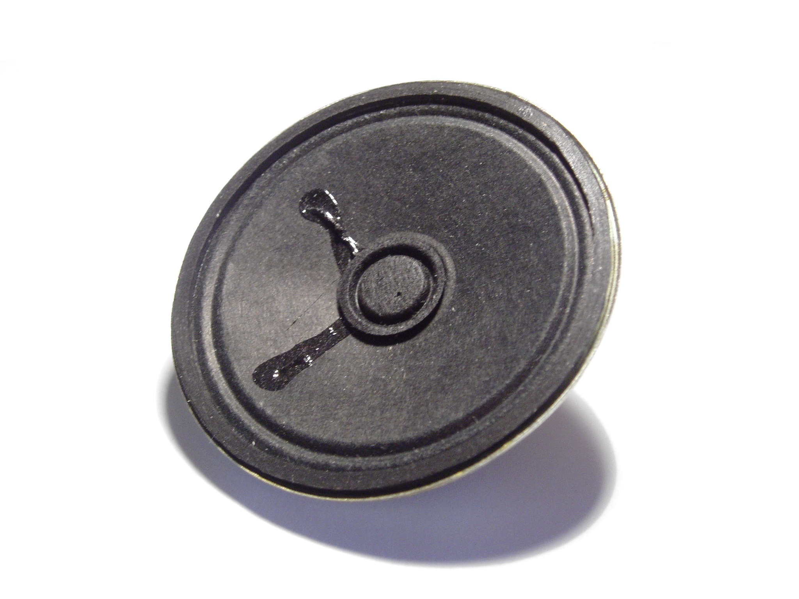
Making Noise
Generating Sound

Slide 17
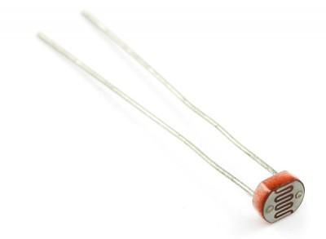
Sensing Light
Responding to ambient light

Slide 18
More…
Slide Switch (Pin D2)
Temperature sensor (Pin A1)
Vibe Board (Pin 3)

Slide 19
Resources
Github link with code and slides
https://github.com/outofjungle/YahooOpenHack2013
Arduino Documentation
http://arduino.cc/en/Reference/HomePage
Lilypad Arduino Reference
http://lilypadarduino.org/
Lilypad ProtoSnap Schematics
http://dlnmh9ip6v2uc.cloudfront.net/datasheets/E-Textiles/Lilypad/LilyPad-Dev-v34b.pdf

Slide 20
Resources (cont.)
Debouncing
http://arduino.cc/en/Tutorial/Debounce
http://www.engscope.com/pic-example-codes/basic-io-button-debounce/
http://learn.adafruit.com/tilt-sensor/using-a-tilt-sensor
Pulse-width modulation
http://arduino.cc/en/Tutorial/PWM
http://www.protostack.com/blog/2011/06/atmega168a-pulse-width-modulation-pwm/
Pull-up and pull-down resistors
https://learn.sparkfun.com/tutorials/pull-up-resistors

