Slide 1
NYC 311 Service Requests in the 2020 Pandemic
December 9, 2022

Slide 2

The Team
Ryan Norman Senior Data Analyst
https://www.linkedin.com/in/ryannorman/
https://github.com/outofthenorm27/NYC-OpenData

Slide 3
Target audience
City Officials
Law Enforcement
Health Department
Real Estate Professionals

Slide 4
Analysis Approach
The “Ask”
Identify Data Sources
Data Retrieval Plan
Data Cleaning
Analyze for Trends
Tell the Story

Slide 5
Questions Asked
Which agencies were called the most?
What were the most common service request types during the 2020 Covid-19 pandemic?
Which area of the city did requests occur most frequently?

Slide 6
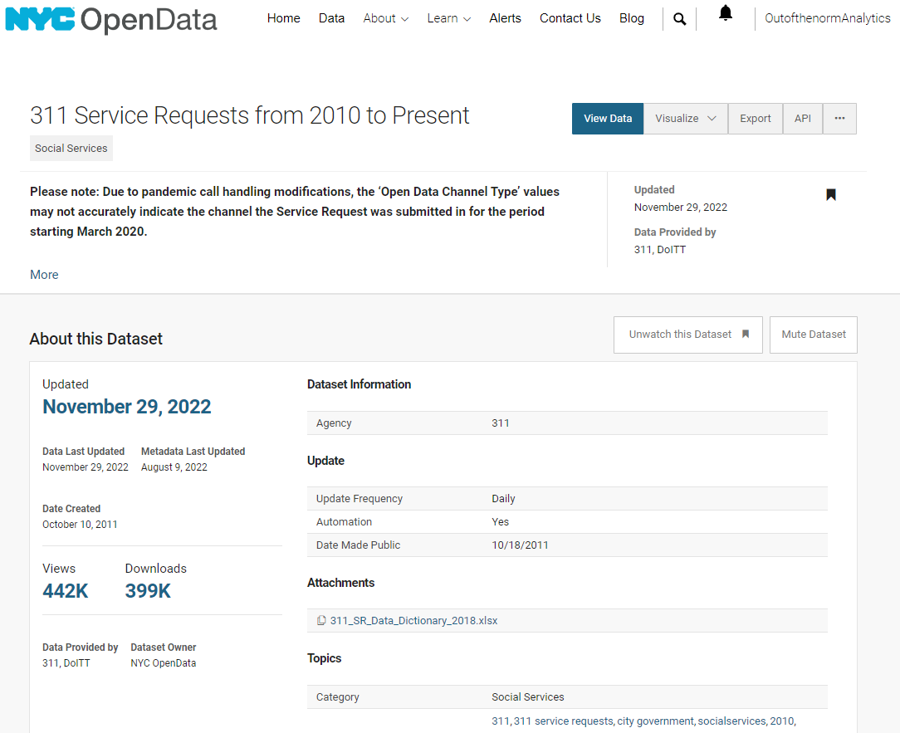
The Data Source
NYC 311 Service Requests from 2010 to Present
Spans over 10 years of requests for access to non-emergency municipal services
Updated Daily
https://data.cityofnewyork.us/

Slide 7

What's in this Dataset?

Slide 8
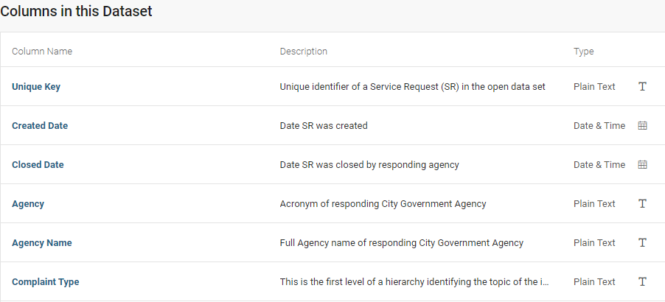
What's in this Dataset?

Slide 9
Data Pipeline
NYC OpenData
Data Cleaning
Data Analysis
JSON
Website API
Python GET requests
Filtered data
2 JSONs
Drop columns
Remove NaN
Format data types

Slide 10
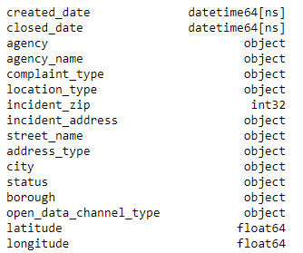
Exploratory Data Analysis
Reduced 41 columns to 16

Slide 11
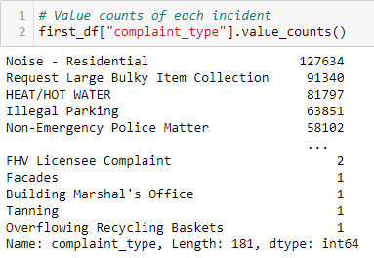
Exploratory Data Analysis
181 total different complaints
Noise most common

Slide 12
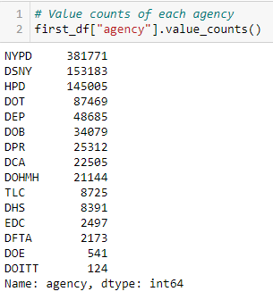
Exploratory Data Analysis
15 Agencies
New York City Police Department is the most active
*Full descriptions available online

Slide 13
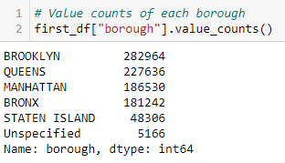
Exploratory Data Analysis
Most requests coming from Brooklyn

Slide 14

Exploratory Data Analysis
Most requests were submitted to 311 by phone

Slide 15
Visualizations

Slide 16
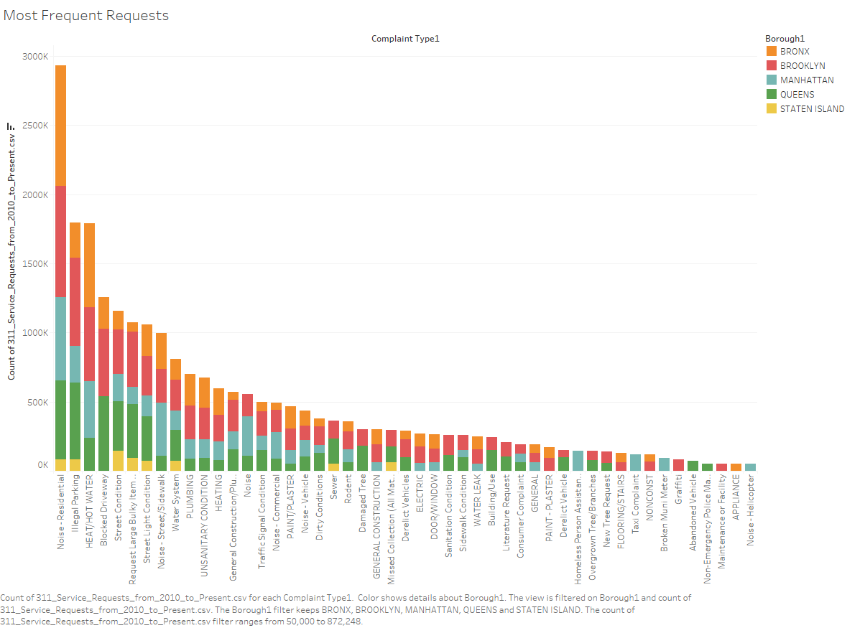

Slide 17
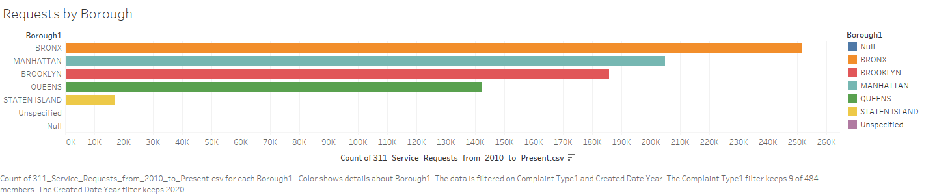

Slide 18
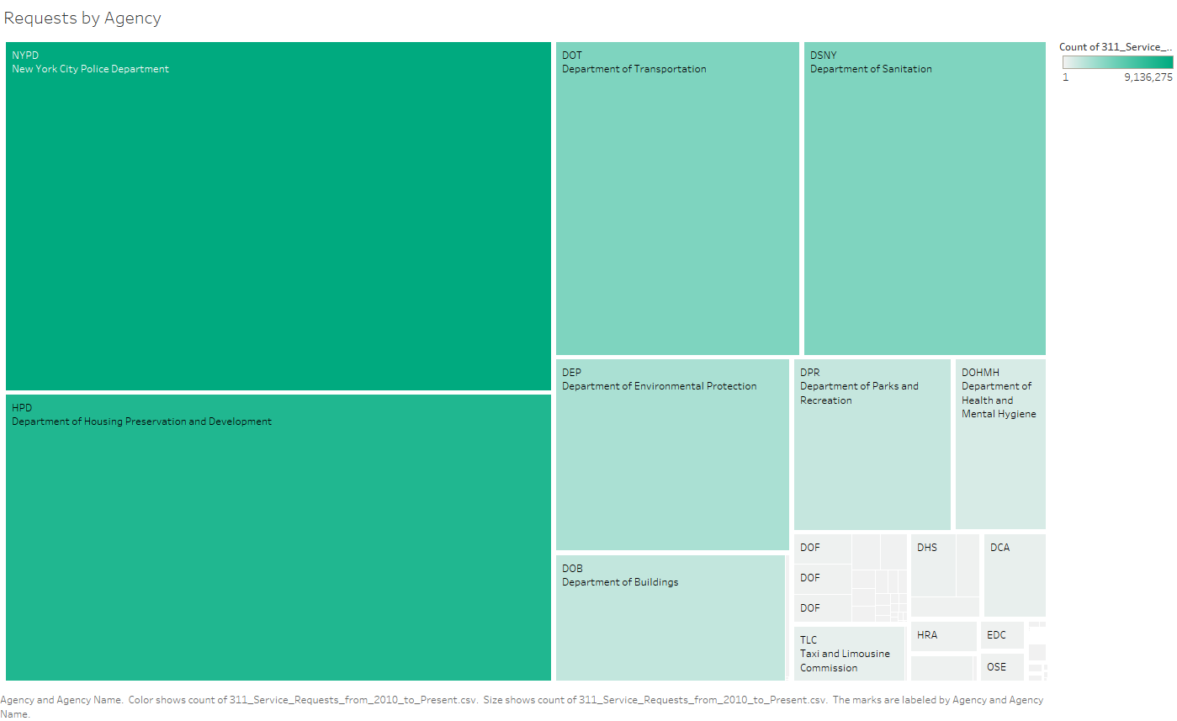

Slide 19
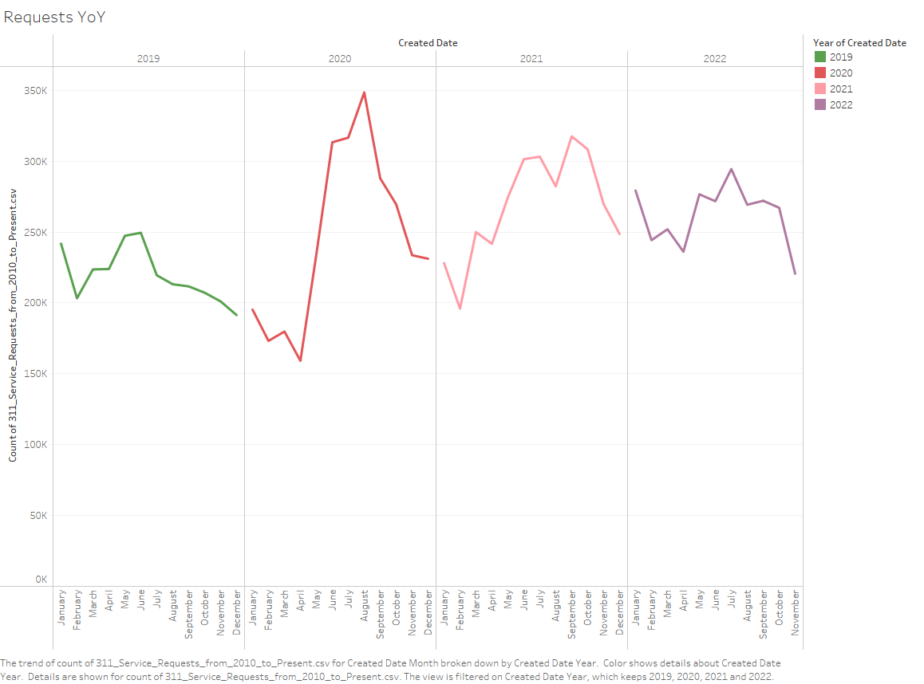

Slide 20
