Slide 1
NYC 311 Service Requests During the 2020 Pandemic
December 9, 2022

Slide 2

The Team
Ryan Norman Senior Data Analyst
https://www.linkedin.com/in/ryannorman/
https://github.com/outofthenorm27/NYC-OpenData

Slide 3
Target audience
City Officials
Law Enforcement
Health Department
Real Estate Professionals

Slide 4
Analysis Approach
The “Ask”
Identify Data Sources
Data Retrieval Plan
Data Cleaning
Analyze for Trends
Tell the Story

Slide 5
Questions Asked
Which agencies were called the most?
What were the most common service request types during the 2020 Covid-19 pandemic?
Which area of the city did requests occur most frequently?

Slide 6
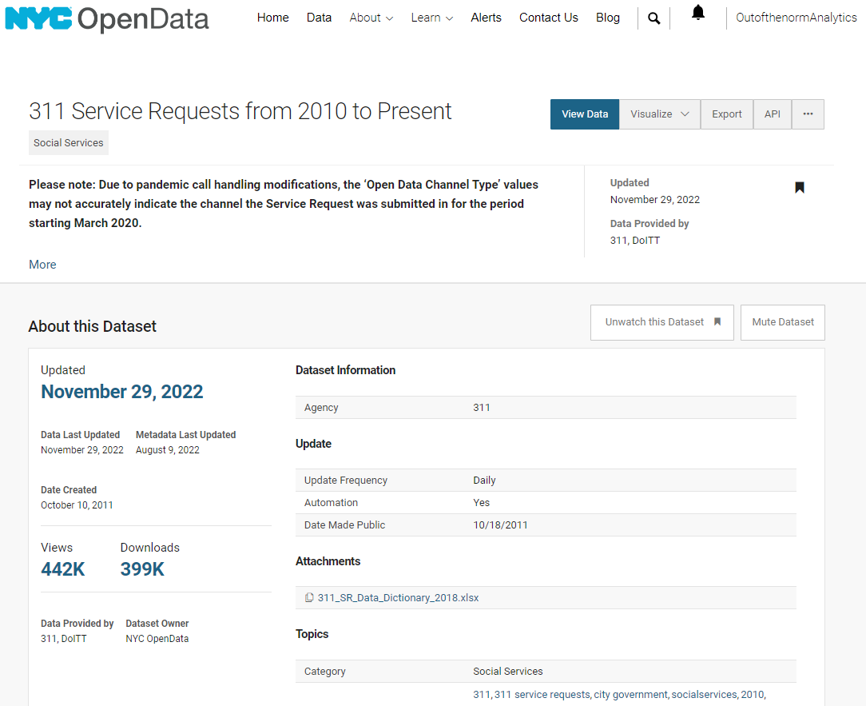
The Data Source
NYC 311 Service Requests from 2010 to Present
Spans over 10 years of requests for access to non-emergency municipal services
Updated Daily
https://data.cityofnewyork.us/

Slide 7
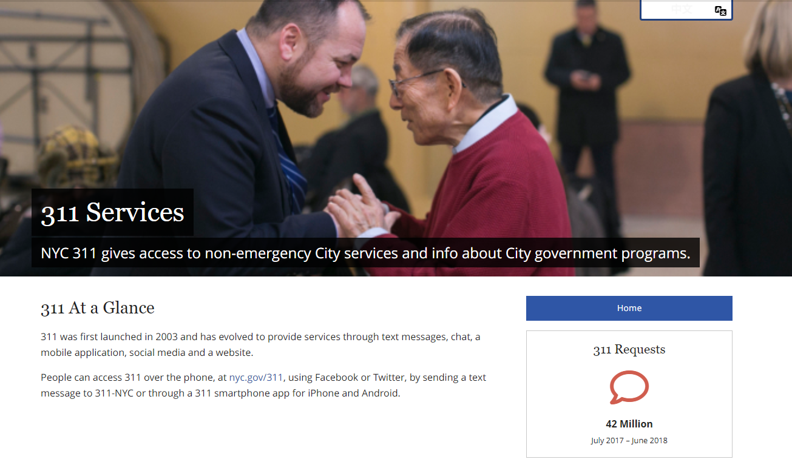
What is a 311 Service Request?

Slide 8

What's in this Dataset?

Slide 9
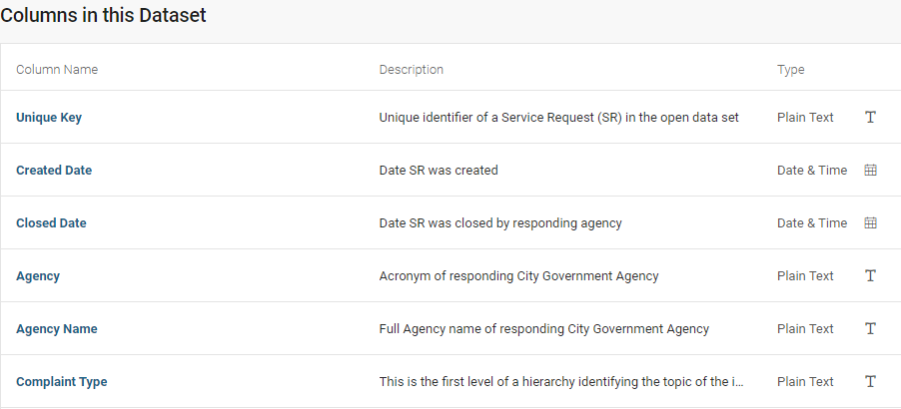
What's in this Dataset?

Slide 10
Data Pipeline
NYC OpenData
Data Cleaning
Data Analysis
JSON
Website API
Python GET requests
Filtered data
2 JSONs
Drop columns
Remove NaN
Format data types

Slide 11
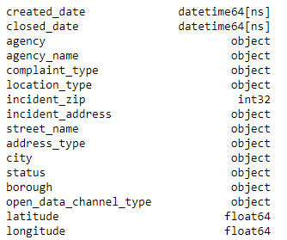
Exploratory Data Analysis
Reduced 41 columns to 16

Slide 12
Exploratory Data Analysis
181 total different complaints
Notes:
Ask audience if they guess what’s the most common complaint?

Slide 13
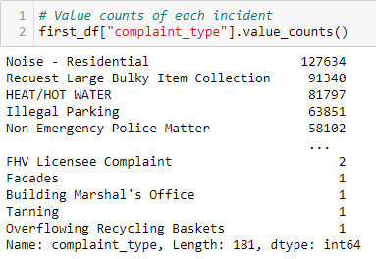
Exploratory Data Analysis
181 total different complaints
Noise most common
Notes:
Ask the audience what are some complaints they’ve experienced? Does this surprise you?

Slide 14
Exploratory Data Analysis
15 Agencies

Slide 15
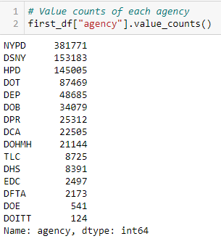
Exploratory Data Analysis
15 Agencies
New York City Police Department is the most active
*Full descriptions available online

Slide 16
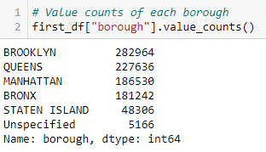
Exploratory Data Analysis
Most requests coming from Brooklyn

Slide 17

Exploratory Data Analysis
Most requests were submitted to 311 by phone

Slide 18
Visualizations

Slide 19
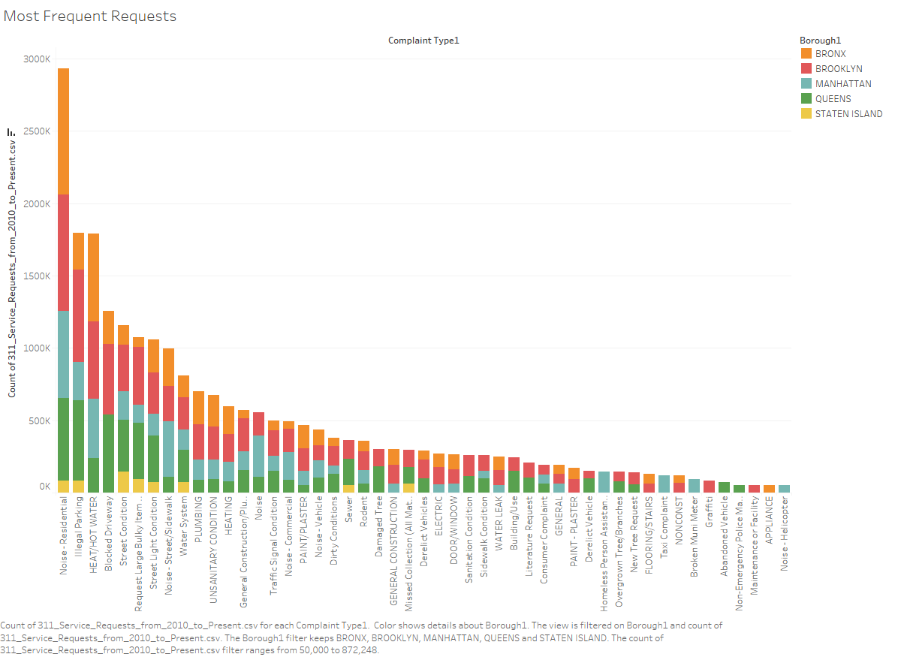

Slide 20
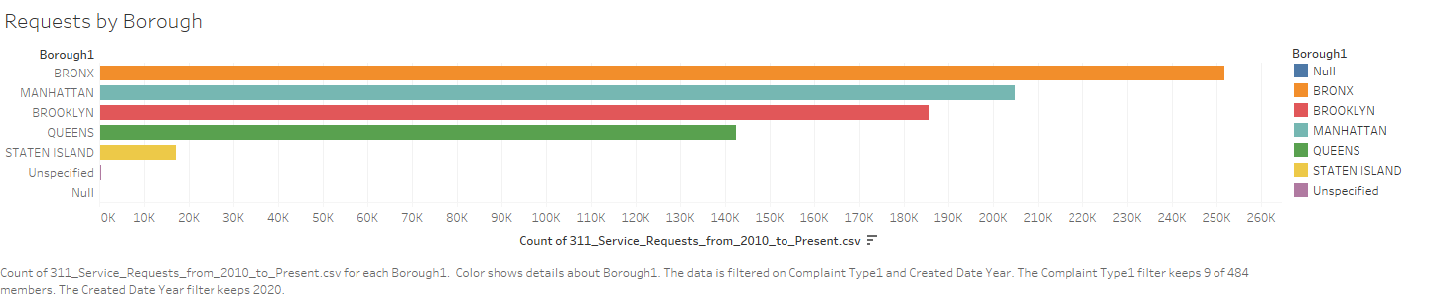

Slide 21
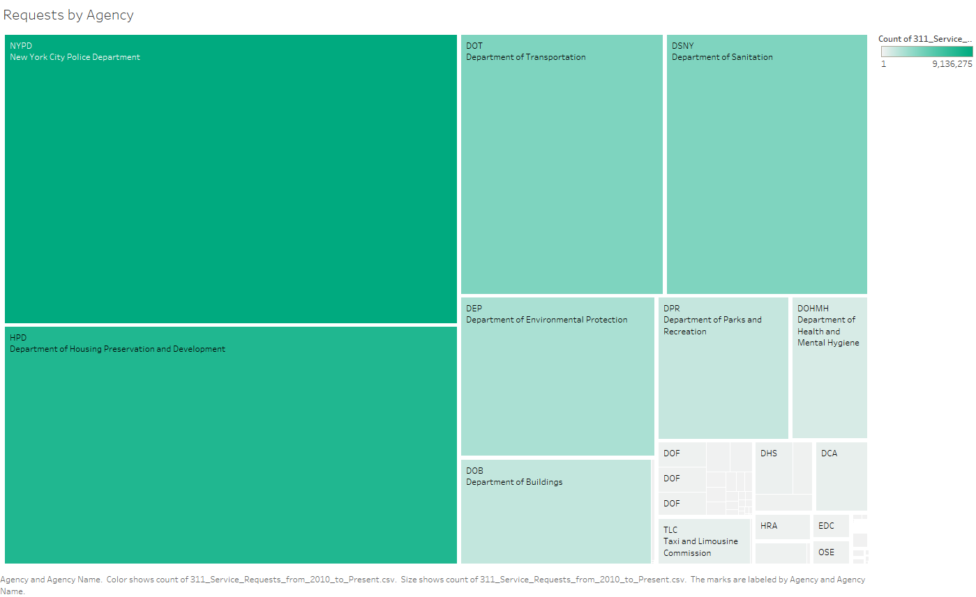

Slide 22
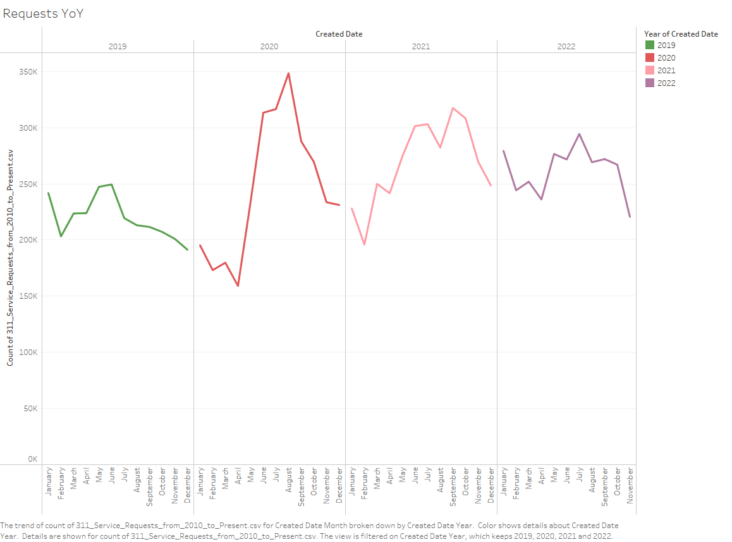

Slide 23
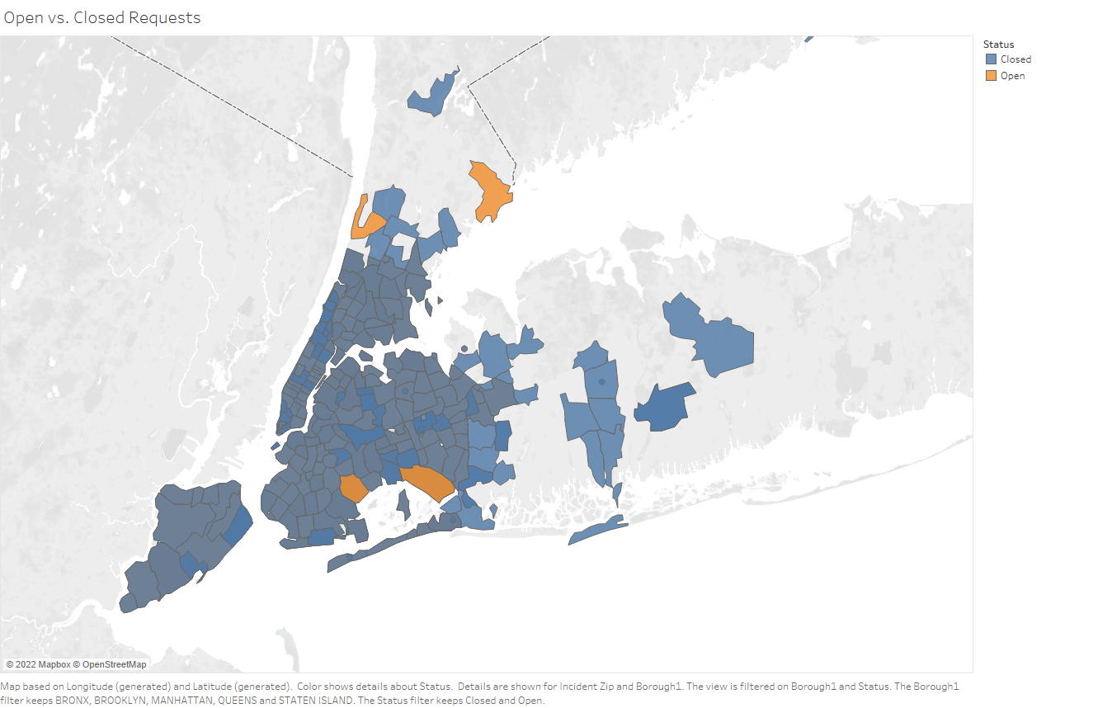

Slide 24
Conclusion

Slide 25
Takeaways
The New York City Police Department was the most called agency
Noise, Large Item Collection, Heat/Hot Water, Illegal Parking, Non-Emergency
Brooklyn, Queens had the most requests
Most of the requests were reported via Phone and Online
Requests spiked during the summer months of 2020
Over 98% of service requests reported in 2020 remain open

Slide 26
Q & A

Slide 27
Notes

Slide 28
THANK YOU!!
Ryan Norman Senior Data Analyst
https://www.linkedin.com/in/ryannorman/
https://github.com/outofthenorm27/NYC-OpenData

