Slide 1

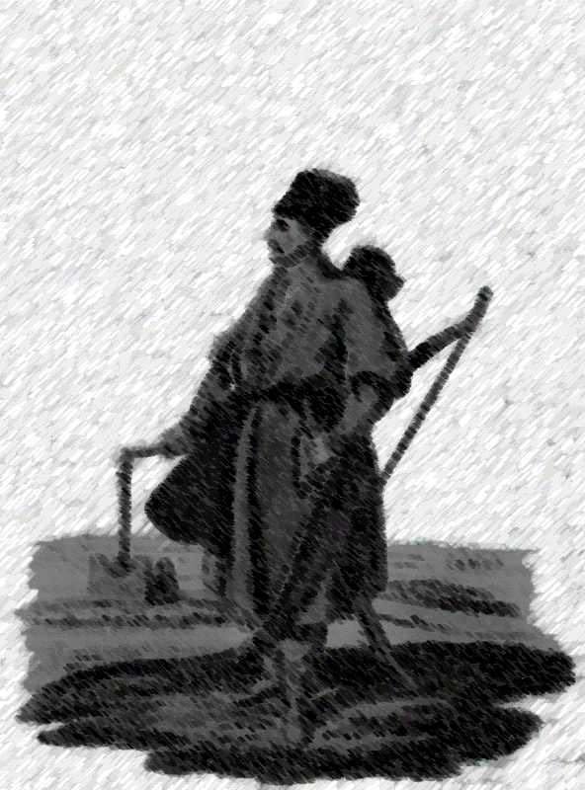
This is a Turcoman. He can be your enemy or your friend. I don’t know.
This text can be your enemy, too. I don’t know.
What the hell do I know.
Damn, but I gotta know something.

Slide 2
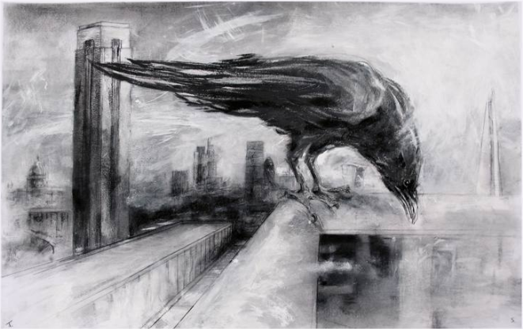

Slide 3
