Slide 1


Outreachy internships are:
3 months long
Fully remote
Paid ($7,000 total stipend)
Outreachy provides internships to
people subject to systemic bias and
impacted by underrepresentation
in the technology industry
of the country where they live
Outreachy intern,
May 2020

Slide 2
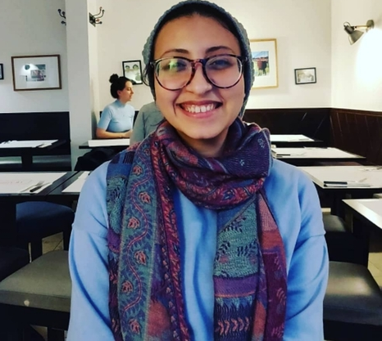
Sponsors help Outreachy support
70 to 120 Outreachy interns per year
Outreachy retains open source talent
Outreachy past interns:
80%* continue to contribute to open source
44%* work on open source as part of their job
Outreachy intern,
May 2020
* Percentages are based on the 2019 Outreachy longitudinal study. 219 out of 590 past interns responded.

Slide 3
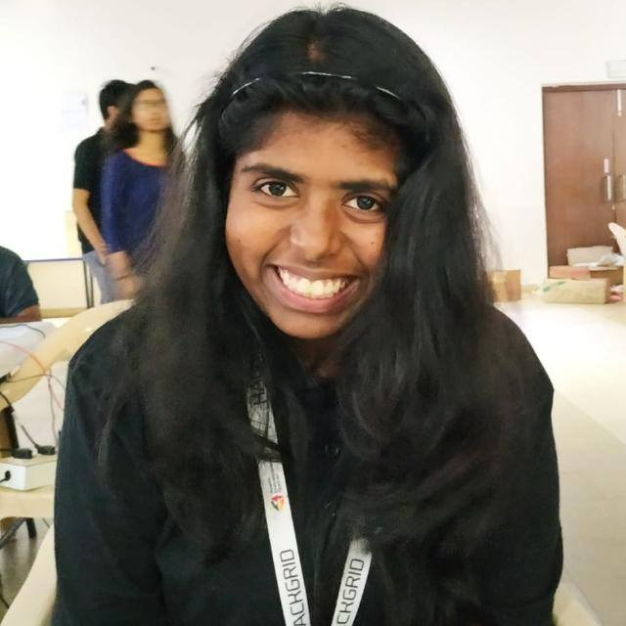
Outreachy interns receive deep support:
Dedicated mentorship
(1:1 mentor to intern ratio)
Real-world project experience
with an open source community
Coaching on how to build a career
through six intern chats
Networking opportunities
with past interns, mentors, and
sponsor employees who work on open source
Outreachy organizer team advocates for interns
Outreachy intern,
May 2020

Slide 4

Outreachy annual sponsorship levels
$ 150,000 - Ceiling Smasher
$ 100,000 - Equalizer
$ 50,000 - Promoter
$ 20,000 - Includer
$ 10,000 - Welcomer
Sponsors will be credited for 1 year
6 month sponsorships also available
Outreachy interns and sponsor

Slide 5
Outreachy sponsor benefits
Outreachy is proud to:
Include the sponsor's logo on our website
Thank the sponsor on social media
Advertise sponsor jobs to our interns and alums
Connect sponsor employees who work on open source
with current interns for informal career chats
Email <organizers@outreachy.org> to sponsor Outreachy

Slide 6
Outreachy May to August sponsor timeline
Jan 1 - call for sponsors begins
Apr 1* - sponsors invoiced
May 1 - deadline for sponsorship
commitment
Aug - sponsor employees connected
to Outreachy interns for informal
career chats
Aug 23 - internship ends, great time for
sponsors to send job postings
*Sponsors can be invoiced sooner, if they need to meet quarterly deadlines. Invoices can also be sent as late as June 15.
Outreachy interns and sponsor

Slide 7
Outreachy December to March sponsor timeline
Aug 1 - call for sponsors begins
Oct 1* - sponsors invoiced
Nov 1 - sponsorship commitment
deadline
Feb - sponsor employees connected
to Outreachy interns for informal
career chats
Mar 1 - internship ends, great time for
sponsors to send job postings
*Sponsors can be invoiced sooner, if they need to meet quarterly deadlines. Invoices can also be sent as late as Jan 15.
Outreachy interns and sponsor

Slide 8
Success Metrics

Slide 9

Outreachy history:
Running since 2010
875 interns total
96% internship completion rate
Outreachy intern,
May 2020

Slide 10

Outreachy is a global internship program:
39%* Asian interns
22%* European interns
21%* North American interns
11%* South American interns
5%* African interns
Outreachy intern,
May 2021
* Percentages are based on the 2019 Outreachy longitudinal study. 219 out of 590 past interns responded. Past interns were asked what region of the world they were located in during their internship.

Slide 11

Outreachy supports diversity in open source:
92%* of interns are women
4%* of interns are transgender or non-binary
64%* of interns are people of color
12%* of interns are from a historically disadvantaged caste or tribe
Outreachy intern,
May 2021
* Percentages are based on the 2019 Outreachy longitudinal study. 219 out of 590 past interns responded.

Slide 12
Stories of
Outreachy Impact

Slide 13
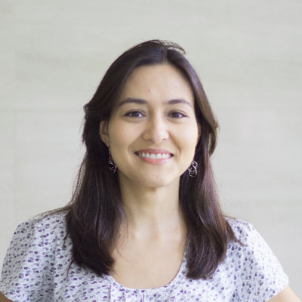
Experiences from Outreachy interns:
"After Outreachy, I got a full time job at the most desired startup to work for in Brazil. At my job, I work with open source software.
I became a maintainer for the Outreachy project I contributed to. I also mentored for Google Summer of Code.
I have helped organize open source events, including FISL in Brazil."
- Luciana Fujii, Dec 2010 intern

Slide 14

Experiences from Outreachy interns:
"Before Outreachy, I was a stay at home mom of 15 years.
Now I have a full-time job at Intel as a Linux Kernel Developer."
- Alison Schofield, May 2016 intern

Slide 15
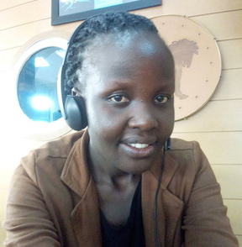
Experiences from Outreachy interns:
"Recently, I was promoted to be a
Core Python Developer.
I also wrote a book on Python 2 and 3 compatibility.
I can't believe that the open source journey I started with Outreachy has brought me this far."
- Joannah Nanjekye, May 2017 intern

Slide 16
Detailed Statistics

Slide 17
Common countries Outreachy interns live in*:
31% India
20% Nigeria
8% European countries
  Albania, Austria, France, Germany, Portugal, Spain, Sweden, Turkey, United Kingdom
5% Cameroon
4% Pakistan
4% United States
3% Canada
2% Kenya
* Percentages based on 132 interns total in the May 2021 and Dec 2021 cohorts. Location based on information publicly displayed on Outreachy alums page - https://www.outreachy.org/alums

Slide 18
Countries Outreachy May 2021 and Dec 2021 interns live in*:
1 Albania
2 Argentina
2 Australia
1 Austria
2 Bangladesh
1 Benin
2 Brazil
6 Cameroon
4 Canada
2 Egypt
1 France
1 Germany
41 India
3 Kenya
1 Kazakhstan
1 Montenegro
26 Nigeria
5 Pakistan
1 Palestine
2 Peru
1 Portugal
2 Russia
1 South Africa
2 Spain
1 Sweden
2 Sri Lanka
1 Turkey
2 Uganda
1 United Kingdom
5 United States
1 Uzbekistan
1 Venezuela
* 132 interns total in the May 2021 and Dec 2021 cohorts - location based on information publicly displayed on Outreachy alums page - https://www.outreachy.org/alums

Slide 19
Outreachy alum racial statistics details*:
44% Asian
36% White
16% Hispanic or Latinx
12% from a historically disadvantaged caste or tribe
6% Black
3% Middle Eastern
1% Indigenous
* Percentages are based on the 2019 Outreachy longitudinal study. 219 out of 590 past interns responded.

