Slide 1
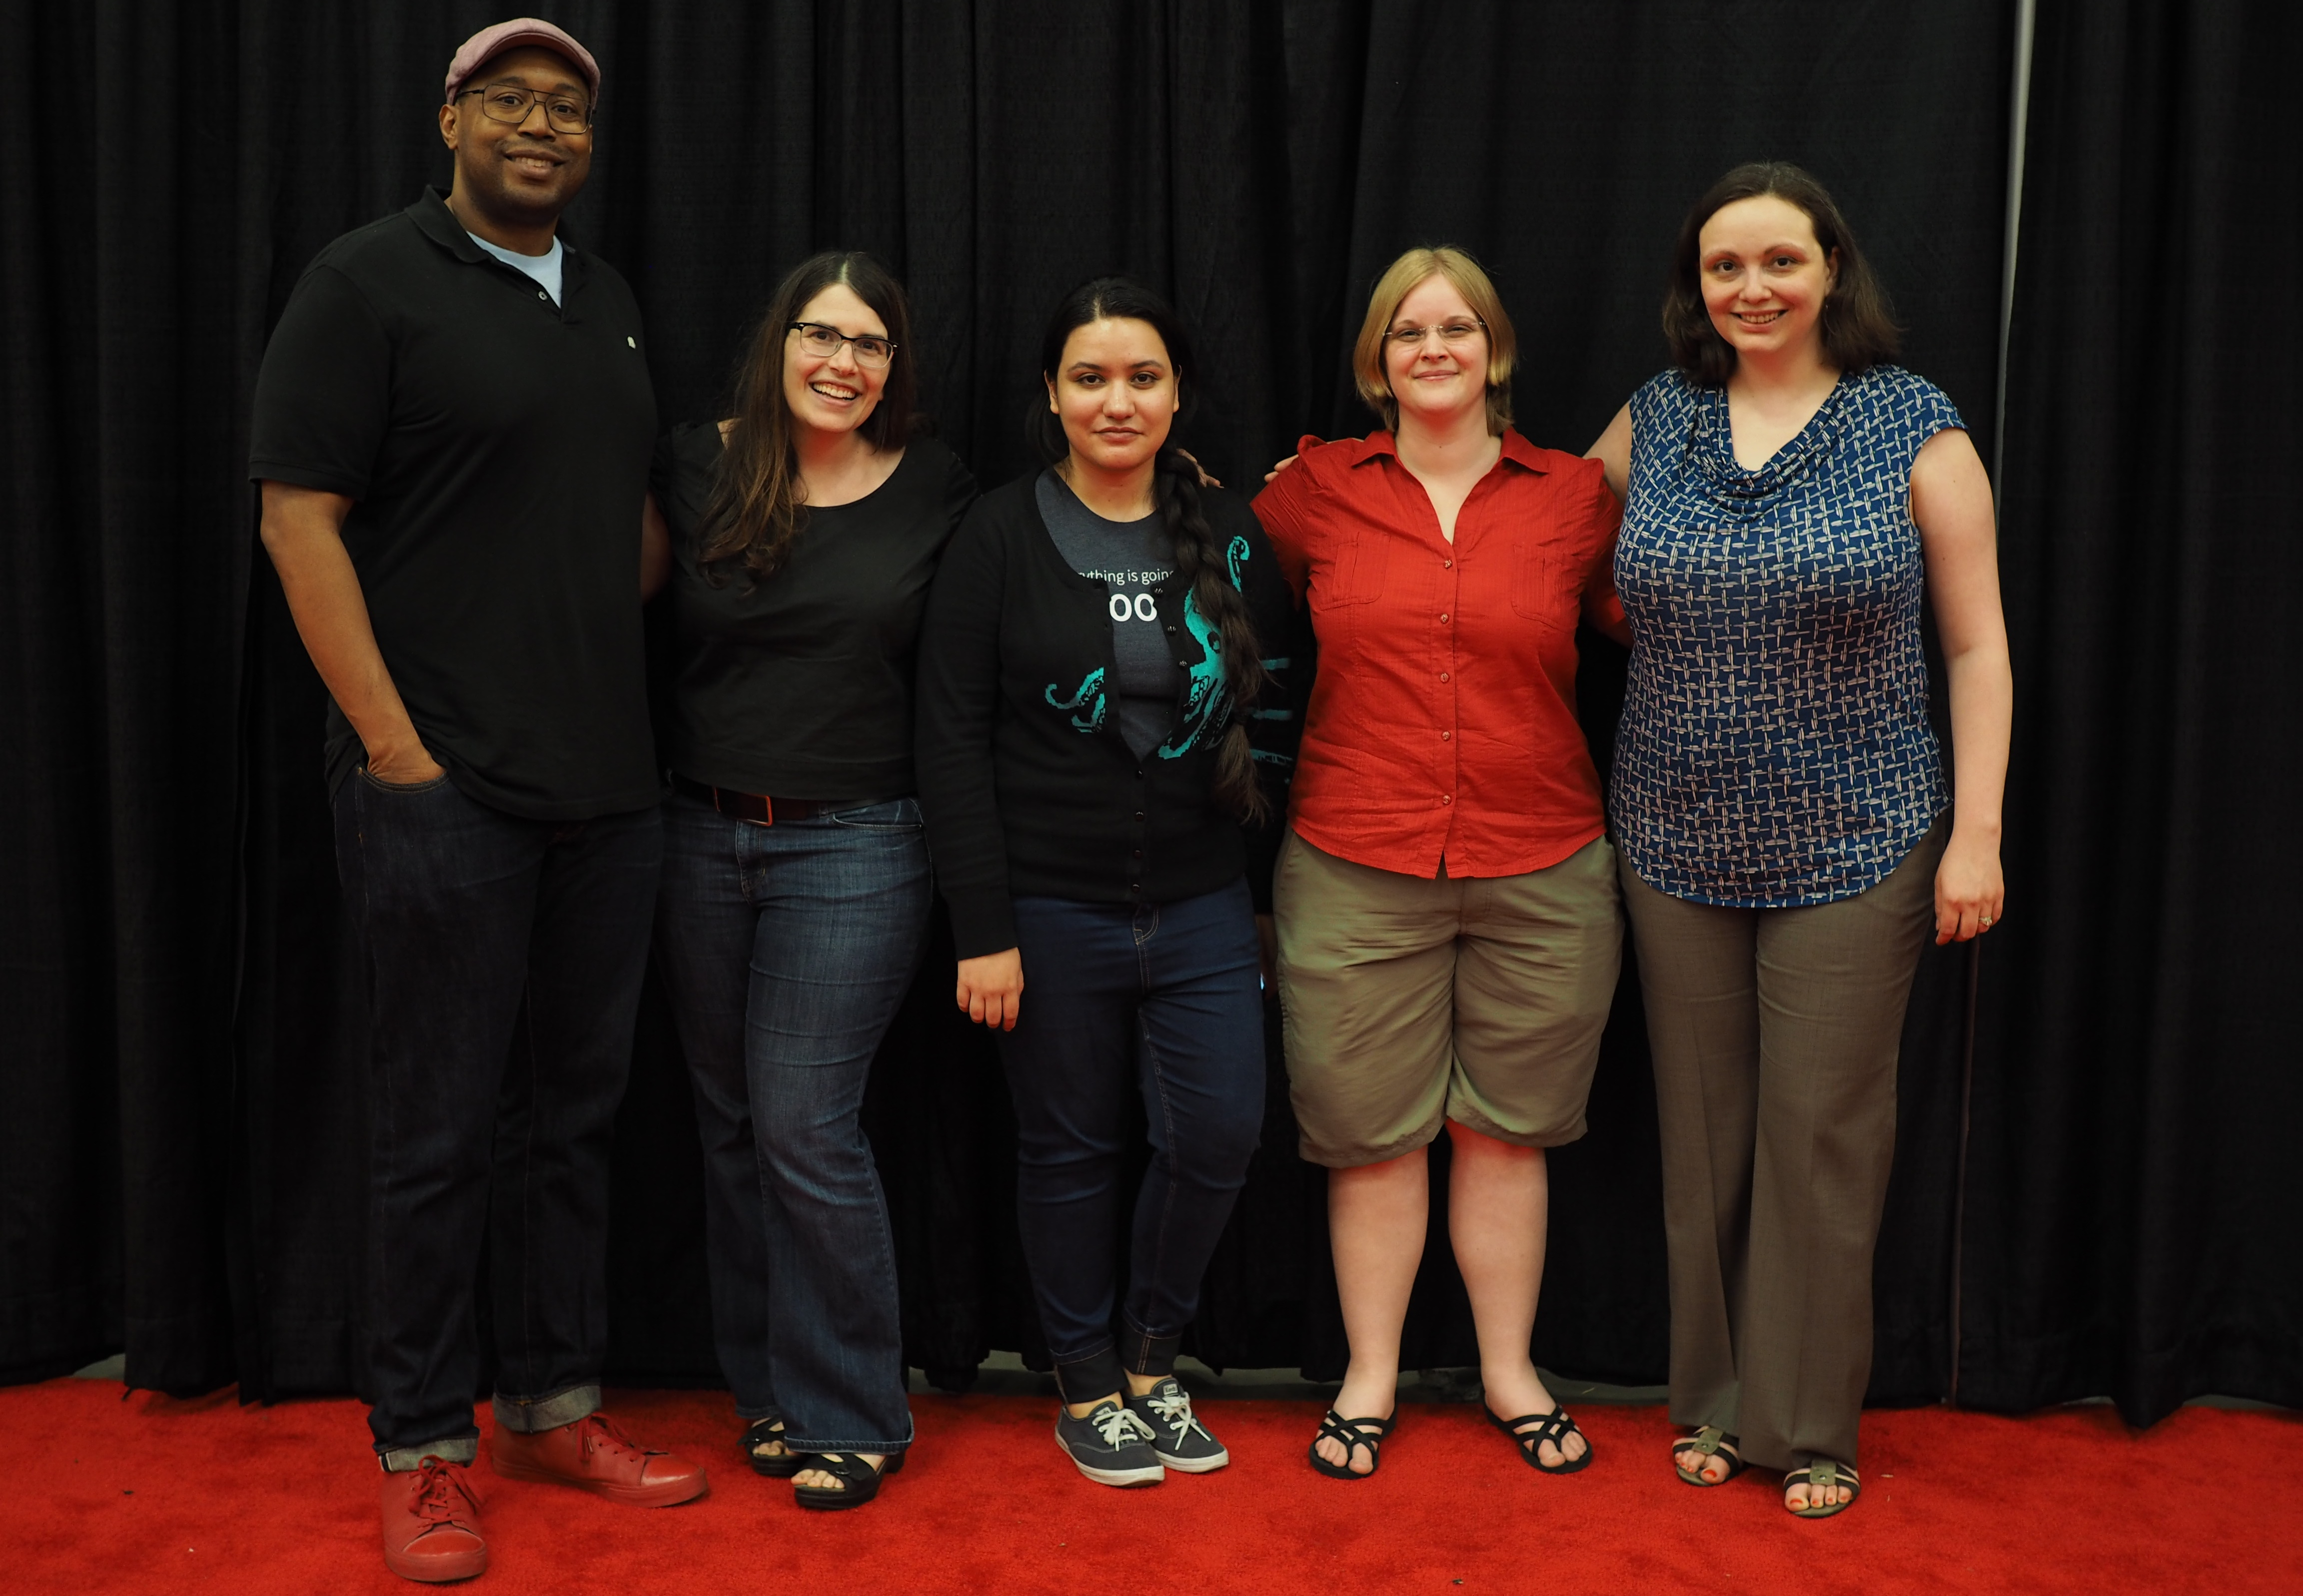
Outreachy Intro
Notes:
These are Outreachy organizers

Slide 2


Slide 3







Ceiling Smasher Sponsor
Equalizer Sponsor
Promoter Sponsors
Notes:
These are the top sponsors of the May 2017 round

Slide 4
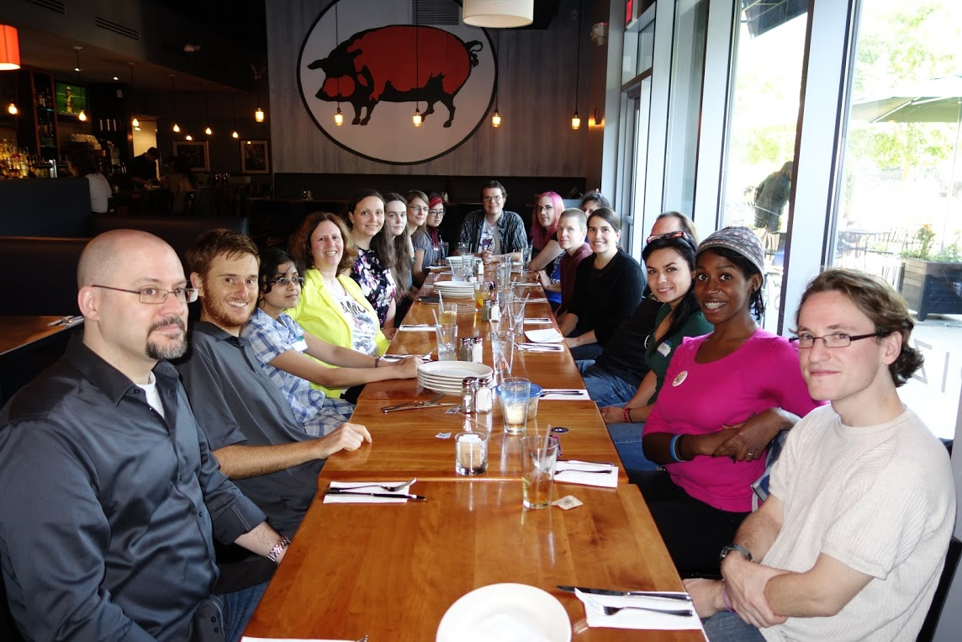
Participation
407 participants since 2010
39 participants with 16 communities in May 2017

Slide 5

How to Apply
Select an organization
Select a project idea
Work with a mentor to make contributions
Research the project idea
Write up your application
Flickr:wocintechchat

Slide 6

Learn More
https://outreachy.org
@outreachy on Twitter
organizers@outreachy.org
Notes:
Questions can be sent to organizers@outreachy.org , which is a private mailbox that reaches several program organizers

