Slide 1
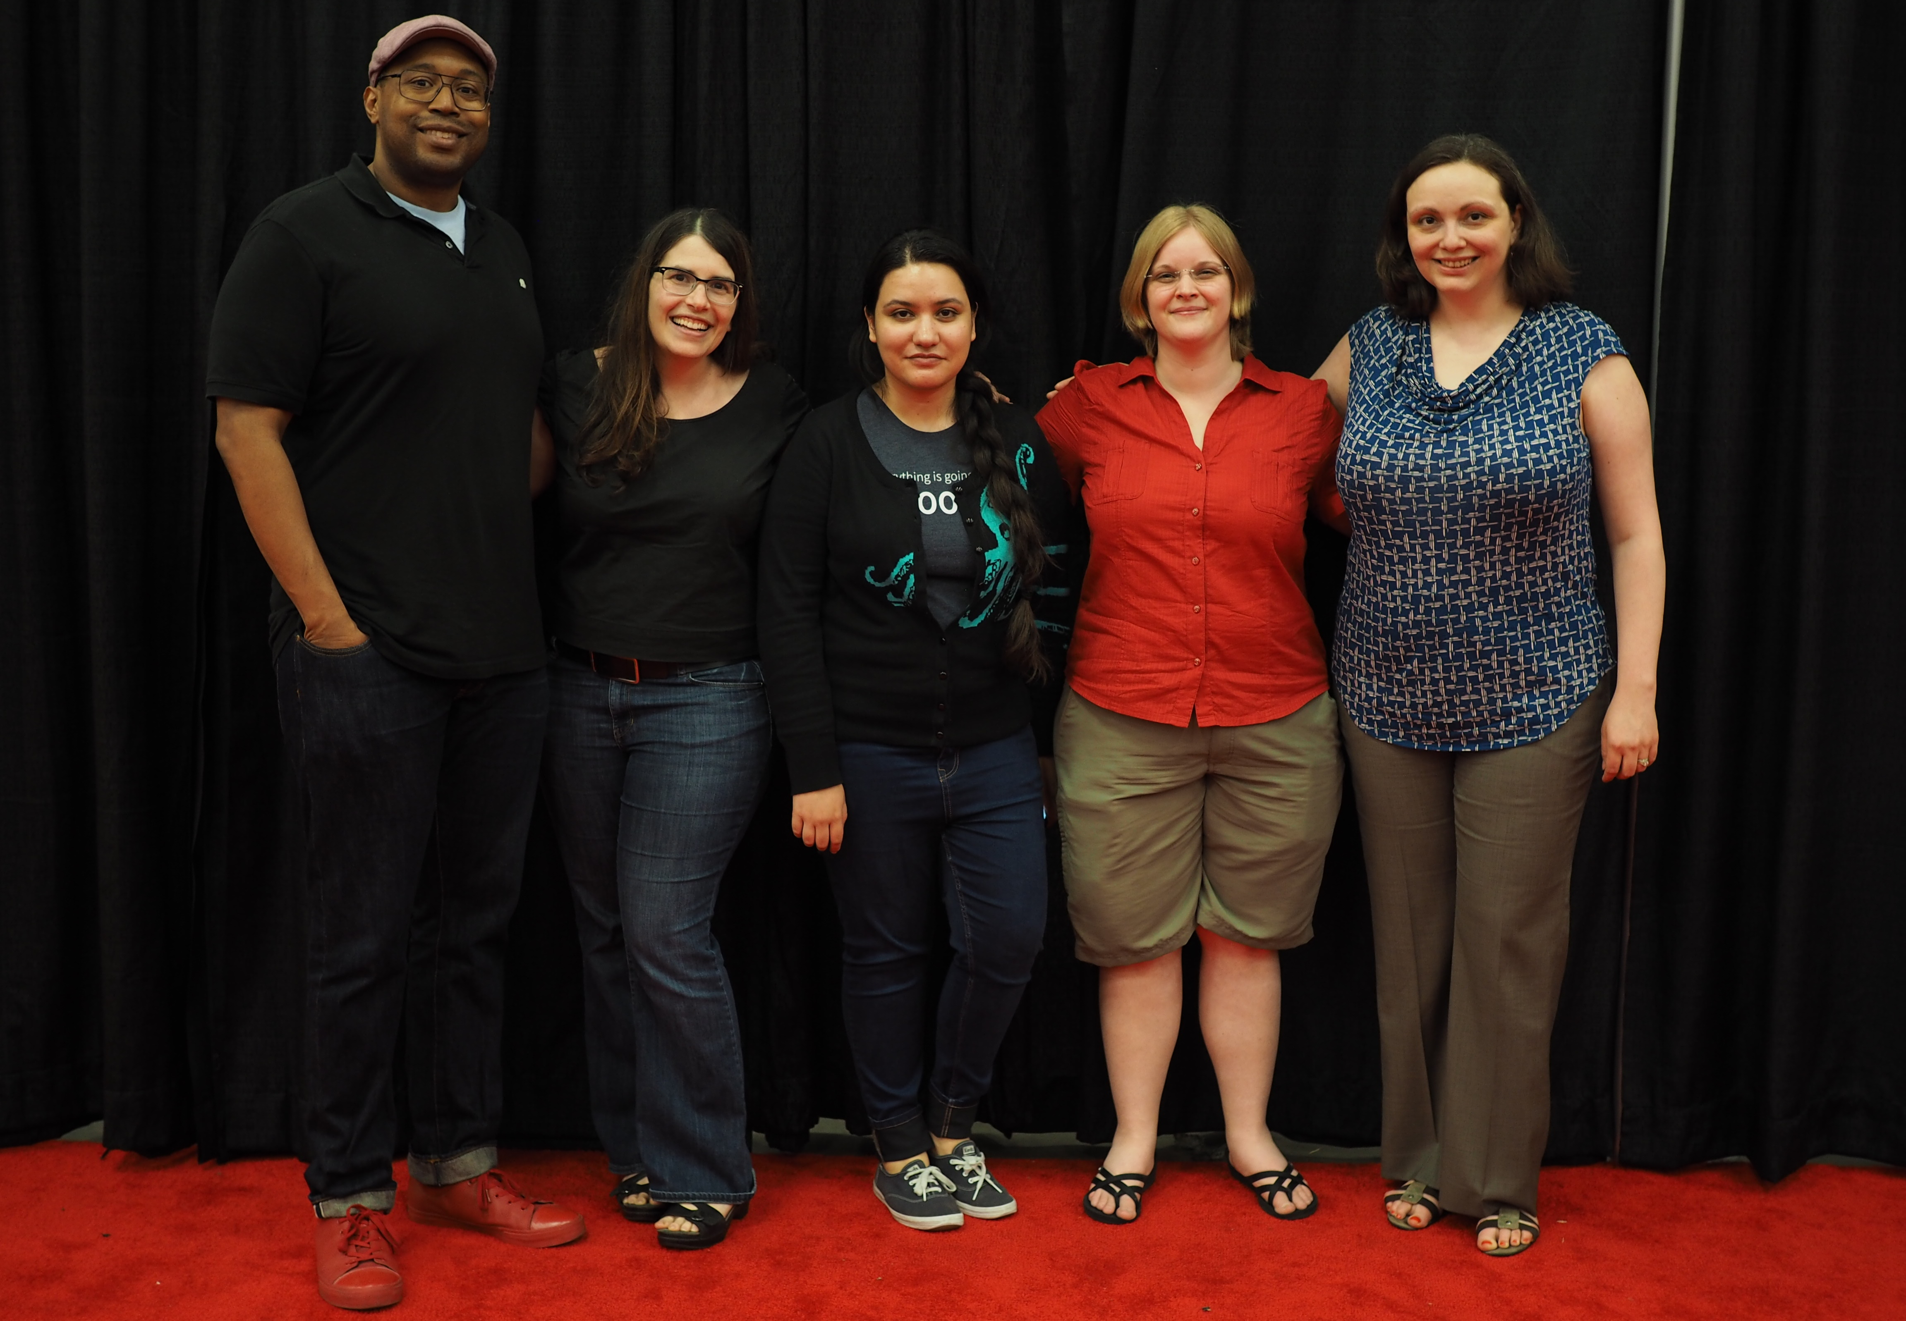
Outreachy Intro
Notes:
These are Outreachy organizers

Slide 2


Slide 3





Ceiling Smasher Sponsor
Equalizer Sponsor
Promoter Sponsors
Notes:
These are the top sponsors of the May 2017 round

Slide 4
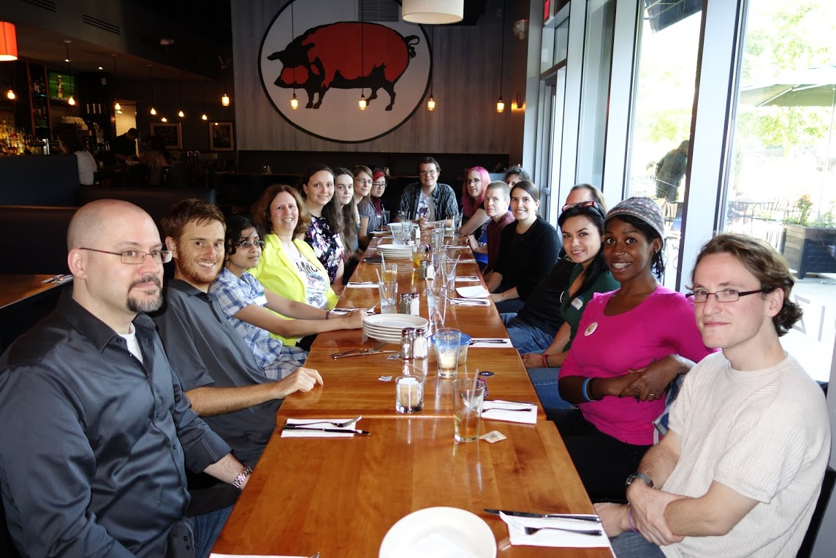
Participation
499 participants since 2010
41 participants with 19 communities in May 2018

Slide 5

How to Apply
Fill out an initial application
Select 1-2 projects
Work with a mentor to make contributions
Submit a final application
Flickr:wocintechchat

Slide 6

Learn More
https://outreachy.org
@outreachy on Twitter
applicant-help@outreachy.org
Notes:
Questions can be sent to organizers@outreachy.org , which is a private mailbox that reaches several program organizers

