Slide 1


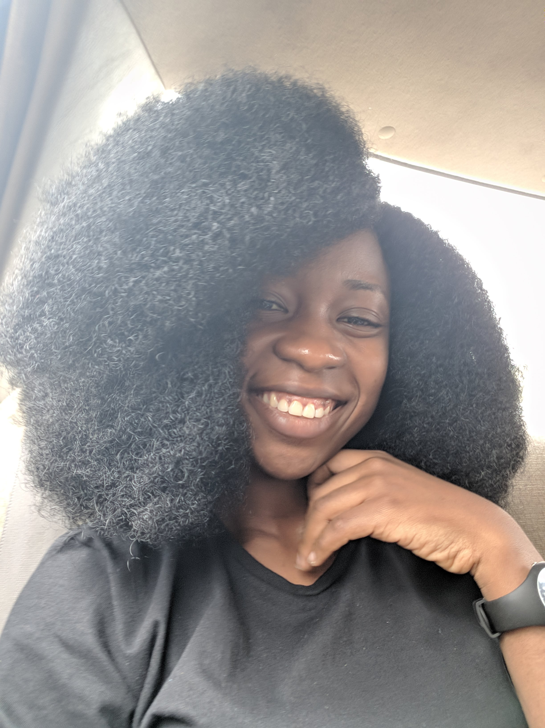
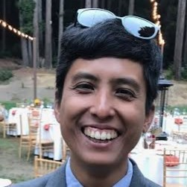
Outreachy
What is Outreachy?
Internships for people who are
subject to systemic bias and
impacted by underrepresentation in
the technology industry of their country

Slide 2
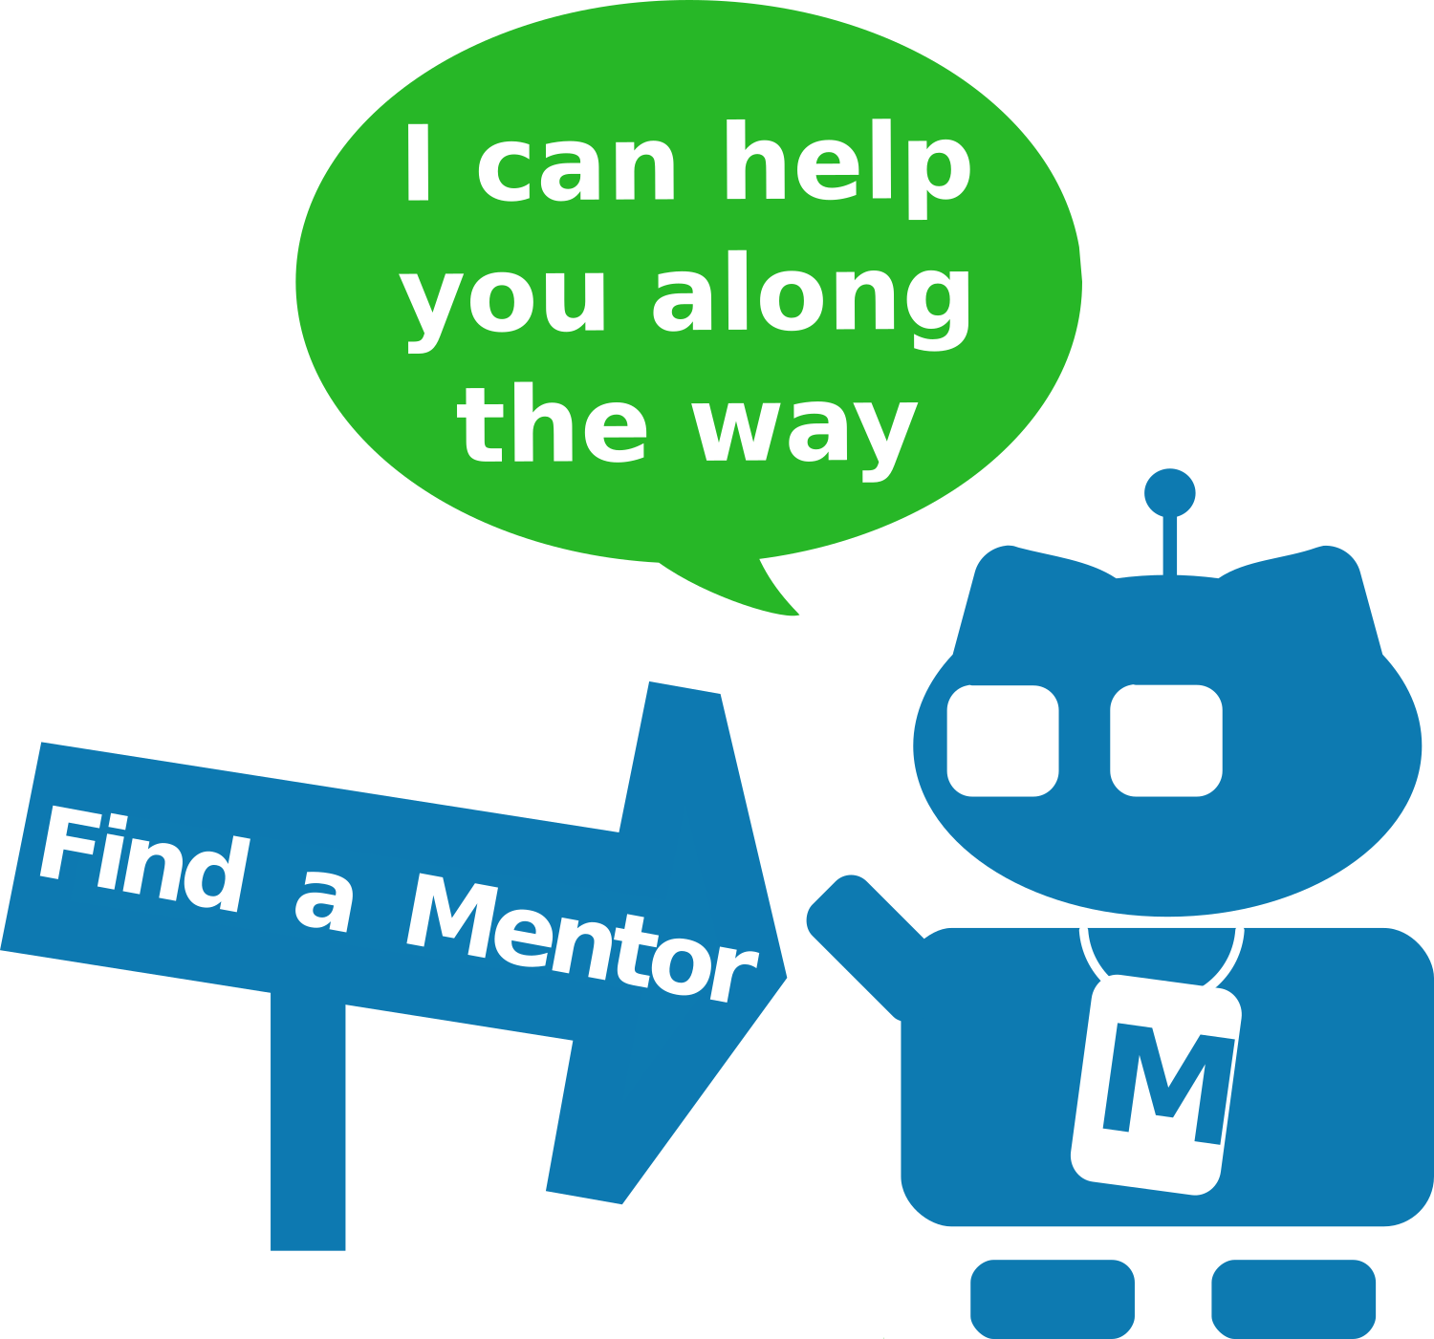
Outreachy
Remote internship
1:1 mentoring for interns
3 months
$6,000 USD stipend
Internships twice a year:
  May to August
  December to March

Slide 3
Outreachy
Eligibility:
  Not a coding school student during the internship
  Eligible to work 40 hours per week
  Cannot work another full-time job
  Cannot live in or send internship stipend to
  regions under U.S. sanctions: Crimea, Cuba, Iran, North Korea, or Syria

Slide 4
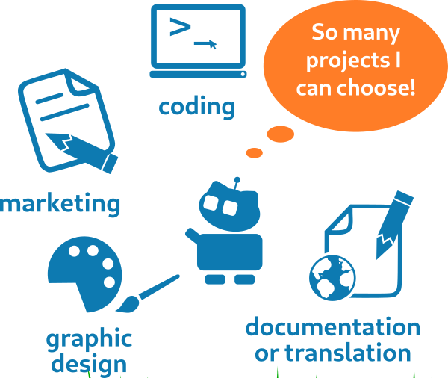
Outreachy
65+ projects to choose from:
  Programming: HTML, JavaScript, Python, C,
  C++, Rust, OCaml, and many more
  Data Science
  UX / UI
  Documentation
  Project marketing
  User advocacy
  Event planning

Slide 5



Open Source
Internship Projects
An open source license ensures you can
  change the code
  share those changes
Community
Collaboration
Co-design
Open source
newcomers welcome!

Slide 6







Outreachy
Application process:
Fill out an initial application
Work on project tasks (contributions)
Fill out a final application for the project

Slide 7
Outreachy
Important dates for May to August interns:
February 22 - initial application deadline
April 15 - final applications due
  Both due at due at 4pm UTC / 4pm GMT

Slide 8
Outreachy
Important dates for December to March interns:
September 7 - initial application deadline
October 31 - final applications due
  Both due at due at 4pm UTC / 4pm GMT

Slide 9

Tips for
Initial Application Essays
Be honest
Share personal stories
Assume reviewer lives in a
different country and culture
Be detailed
500 to 900 characters per answer
Grammar & spelling doesn't matter

Slide 10
Tips for
Picking Projects
Project list finalized March 7
Research communities
Make a list of projects
Apply to 1 or 2 projects
Notes:
github is designed to be all this
source: self-hosted repo
conversation: IRC, Jabber, slack, mattersmost, forums
design discussion: mailing lists, gerrit
bug trackers: bugzilla, launchpad, JIRA, trac

Slide 11
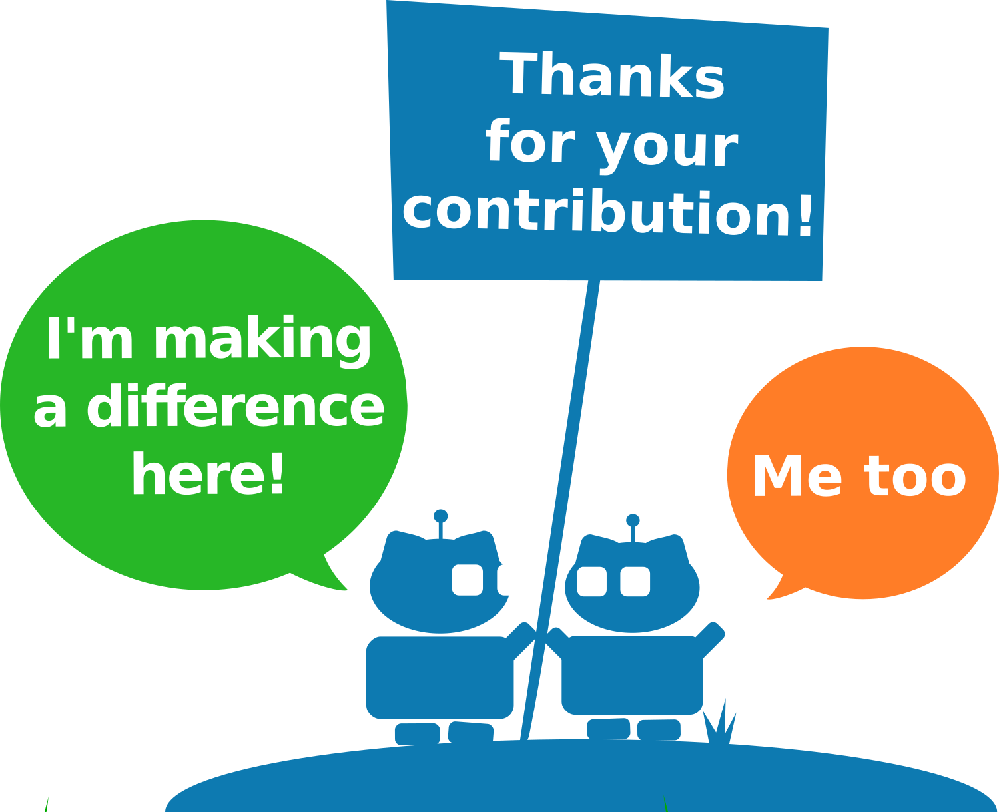
Tips for
Contribution Period
March 15 to April 15:
"Contribution Period"
Applicants work on project tasks
Start on simple tasks
Move to more complex tasks
Focus on quality over quantity
Start early!
Notes:
github is designed to be all this
source: self-hosted repo
conversation: IRC, Jabber, slack, mattersmost, forums
design discussion: mailing lists, gerrit
bug trackers: bugzilla, launchpad, JIRA, trac

Slide 12

Community = Collaboration
Get to know your mentors
Ask questions when
stuck for > 3 hours
Communicate your progress
Respond to feedback
Talk on community chat or forums
Help other applicants
CC-BY mcgarrybowen london
https://www.flickr.com/photos/dentsulondon/5758707051/
Notes:
github is designed to be all this
source: self-hosted repo
conversation: IRC, Jabber, slack, mattersmost, forums
design discussion: mailing lists, gerrit
bug trackers: bugzilla, launchpad, JIRA, trac

Slide 13

Tips for
Asking Questions
Do your research (< 3 hours)
Document where you looked
in the question
Be concise and precise
  "I don't understand what X is"
  "I see Y error when I do Z"
Always ask on public forums
Ping or Cc the mentor
CC-BY Marco Bellucci
https://www.flickr.com/photos/marcobellucci/3534516458

Slide 14

Tips for
Contribution Review
Keep a list of feedback
Make changes
Send the revised contribution
Note what feedback you've fixed in each revision
Note what feedback is not yet addressed
Get more feedback, go to 1
CC-BY-SA Nic McPhee
https://www.flickr.com/photos/nics_events/2349631515

Slide 15
Apply by February 22
  http://www.outreachy.org/apply
Need help? Contact us:
  applicant-help@outreachy.org

