Slide 1




Why open source?
Open source runs:
  Android phones
  Facebook & Twitter servers
  Tiny IoT and wearables
  Large Hadron Collider

Slide 2



What is open source?
License ensures source code is available for
  distribution
  modification
Sharing
Collaboration
Communication
Co-design

Slide 3
What can open source do for you?
For jobs seekers, 86% of tech professionals say open source has advanced their careers
Open source will help you:
  Create a portfolio
  Find mentors
  Demonstrate collaboration skills
  Network and find jobs

Slide 4

Google Summer of Code
3 month remote paid internship
$6,000 stipend for U.S. interns
Open to all students 18+
Multiple projects
Contact mentors
Fill out project proposal

Slide 5

Outreachy
3 month remote paid internship
$5,500 stipend, $500 travel
Goal to increase diversity in tech:
  Open internationally to women (cis & trans),
  trans men, genderqueer folks
  U.S. residents & nationals who are Black/African American, Hispanic/Latin@, American Indian, Alaska Native, Native Hawaiian, or Pacific Islander

Slide 6








Outreachy
Internship: May 14 - August 14
Application: February 12 - March 22

Slide 7

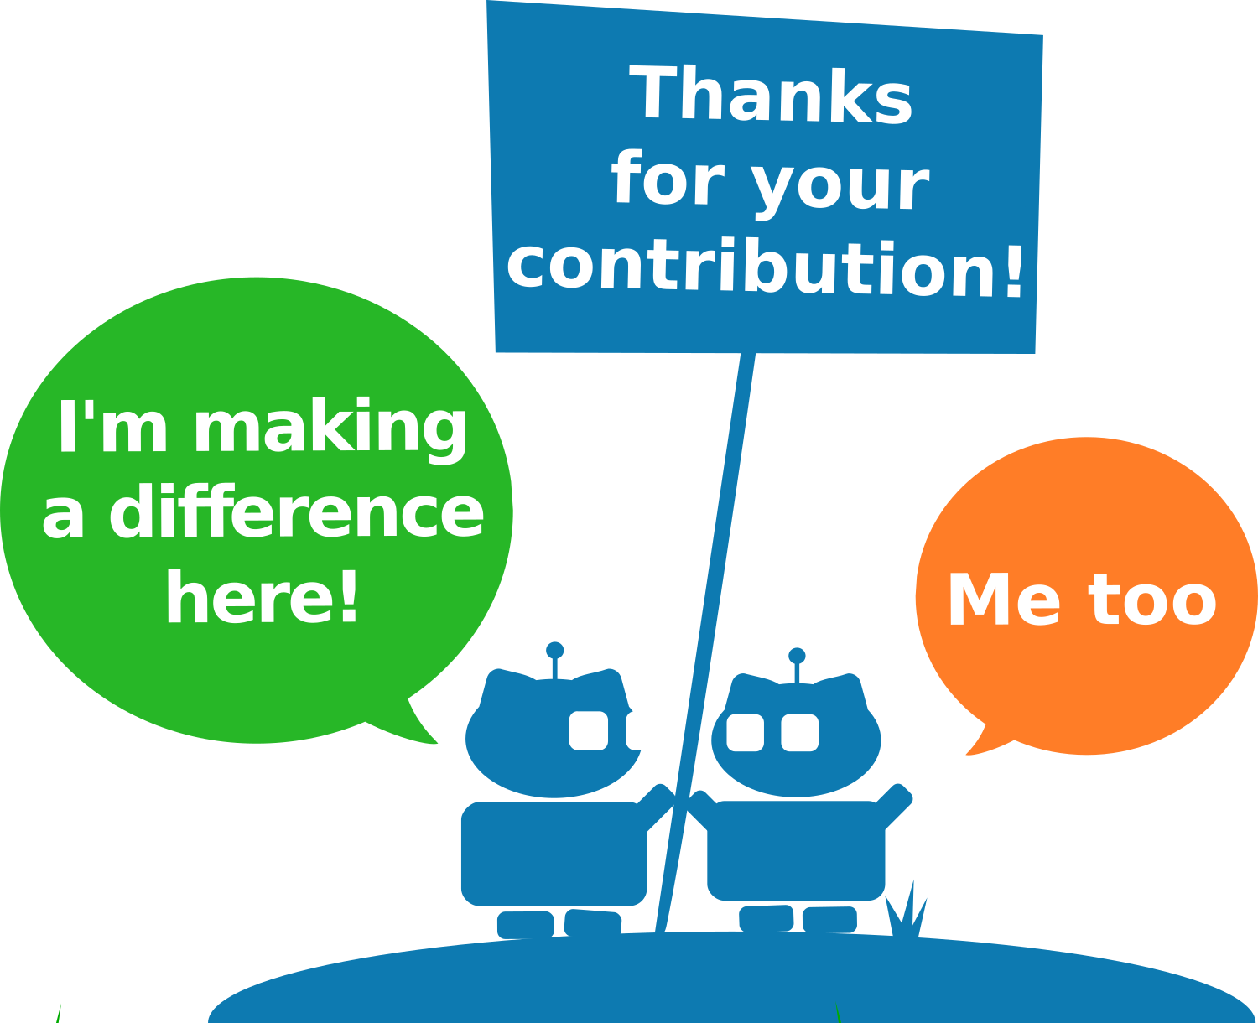

Outreachy Application
Fill out your eligibility check
Find a project
Contact mentors & ask lots of questions!
Make multiple contributions
Fill out an application

Slide 8
Is open source scary?
“Anyone can see my code!”
“What if I break something?”
“I've heard some communities are mean...”

Slide 9
Signs of a welcoming community
Has a detailed Code of Conduct
“Getting started” tutorials
Communication channels
Participates in Outreachy or GSoC
http://sarah.thesharps.us/2015/10/06/what-makes-a-good-community/

Slide 10

What can I contribute?
Code
Tests & test frameworks
Bug reports
Answering questions
Documentation & tutorials
Graphics
User Experience (UX)
Marketing
CC-BY-2.0 Hey Paul Studios
https://www.flickr.com/photos/hey__paul/8292524381/

Slide 11
How do I contribute?
Find your passion
Find a project associated with your passion
Talk to project maintainers
Find newcomer-friendly bugs/features
Integrate into the community

Slide 12
Community Norms
Patches vs pull requests
git vs mercurial (vs svn vs cvs…)
Coding style
Code freeze & release etiquette
May not be documented...

Slide 13
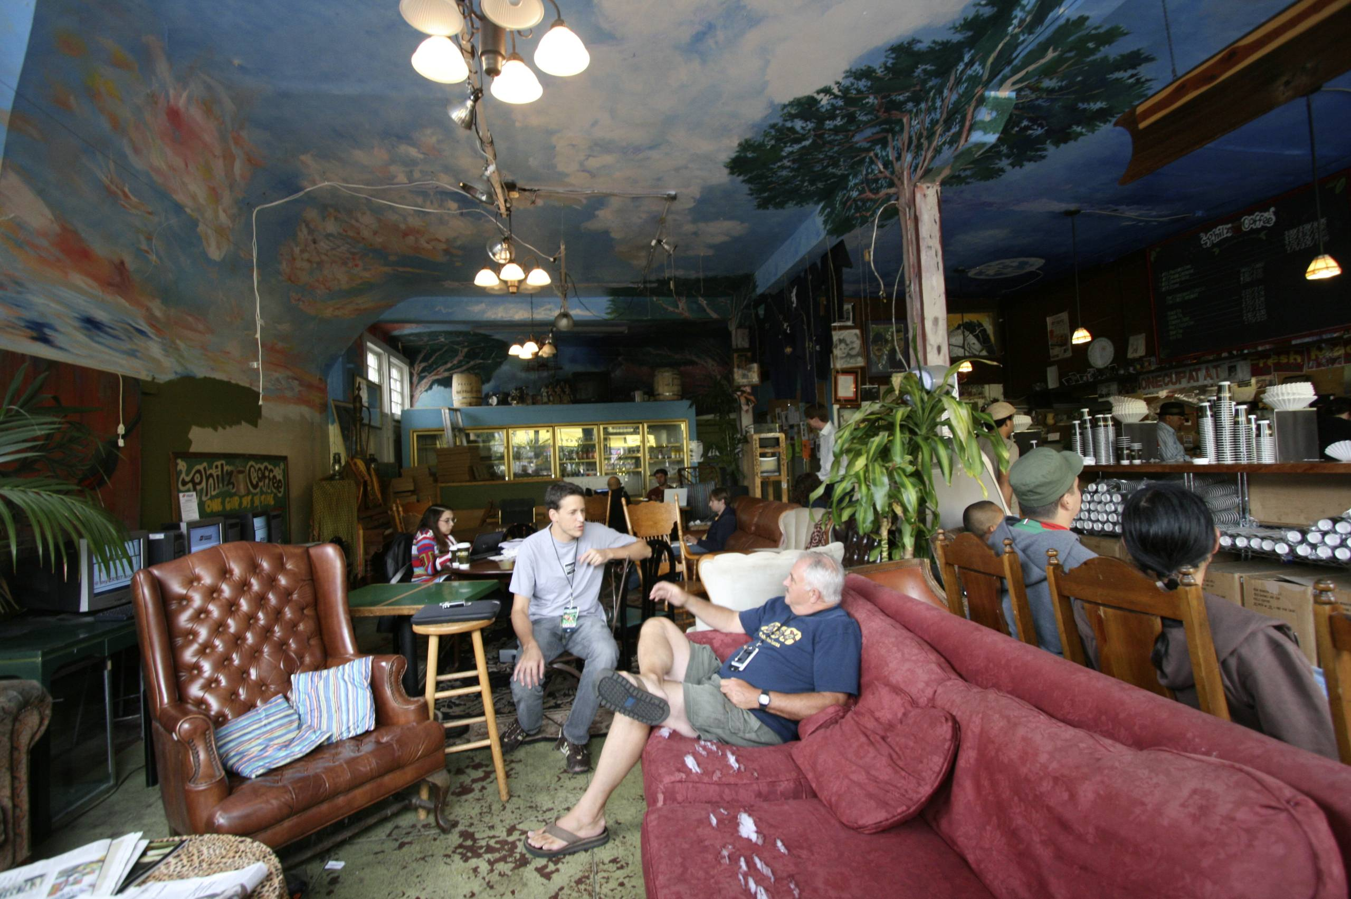
Open Source Communities
Tight knit
Different backgrounds
  Hobbyists, pros,
  students, lurkers
Common norms
Friendly sub-groups
Not everyone agrees
CC-BY-SA Ed Schipul https://www.flickr.com/photos/eschipul/749496905/

Slide 14
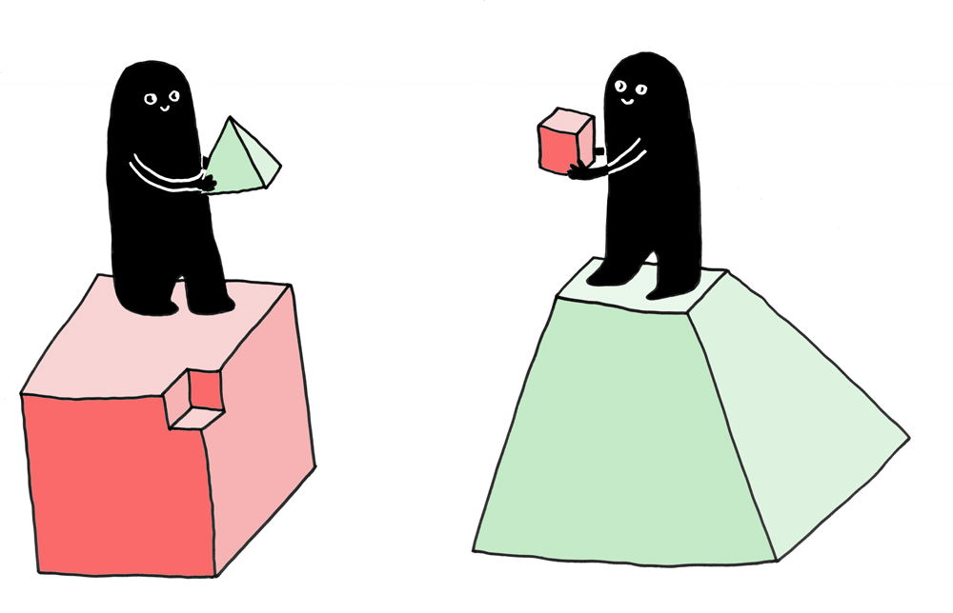
Community = Collaboration
Many different collaboration tools for:
  Source code hosting
  Short conversations
  Design discussions
  Continuous integration
  Bug tracking
  Documentation
CC-BY mcgarrybowen london
https://www.flickr.com/photos/dentsulondon/5758707051/
Notes:
github is designed to be all this
source: self-hosted repo
conversation: IRC, Jabber, slack, mattersmost, forums
design discussion: mailing lists, gerrit
bug trackers: bugzilla, launchpad, JIRA, trac

Slide 15
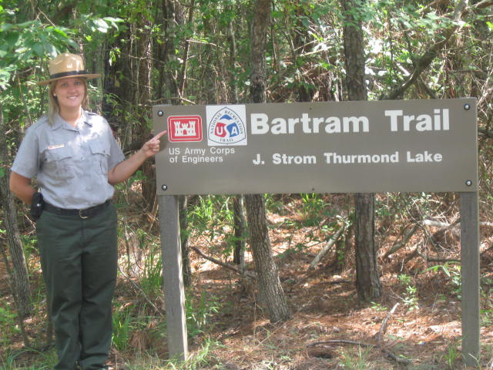
What is a maintainer?
Kind of like a park ranger
Answers questions
Fixes bug reports
Protects project long-term health
Reputation is on the line
Project may have one or many maintainers
CC-BY U.S. Army Corps of Engineers
https://www.flickr.com/photos/usacehq/7610790608/

Slide 16

Community Trust and
Social Engineering
Build a trust relationship with the community
  Review patches
  Ask questions
  Submit small bug fixes
Learn community norms
  Email format
  Coding style
  Testing
CC-BY-NC . ..
https://www.flickr.com/photos/dobs/10726756606

Slide 17

Tips for
Asking Questions
Always add the code owner and project mailing list
Do your research
Document where you looked
Be concise and precise
CC-BY Marco Bellucci
https://www.flickr.com/photos/marcobellucci/3534516458

Slide 18

Tips for
Bug Reporting
Always add the code owner
System information is crucial
Reproducibility thinking
Be responsive
Hold onto hardware
CC-BY Gido
https://www.flickr.com/photos/103499652@N04/14232715868

Slide 19

Tips for
Code Review
Keep a list of the feedback
Address ALL feedback in revisions
Track changes in your cover letter or github comments on the PR
If you disagree with a maintainer,
back yourself up with facts
CC-BY-SA Nic McPhee
https://www.flickr.com/photos/nics_events/2349631515

Slide 20
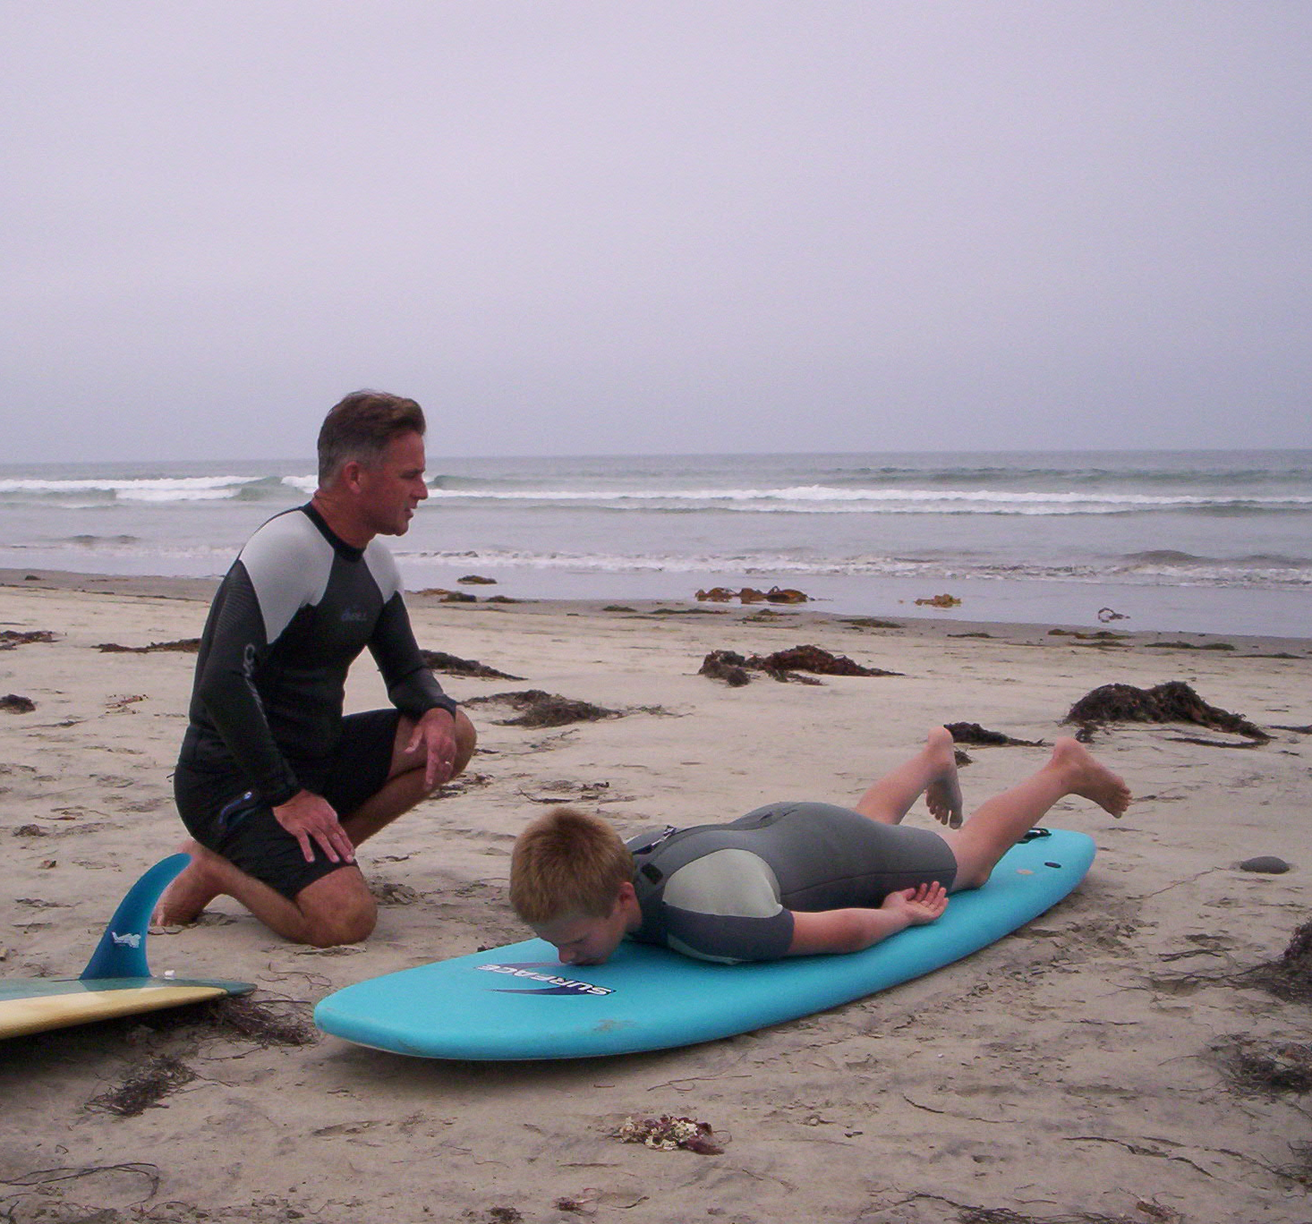
Successful On-boarding
Don't code in a corner
Do ask for feedback
Ask lots of questions
Take small bites
Keep a list of new terms
Contribute that list back!
CC-BY-SA Wendy Owens
https://www.flickr.com/photos/weburtow/349149876/

Slide 21
https://developers.google.com/open-source/gsoc/
http://www.outreachy.org/apply
organizers@outreachy.org

