Slide 1
Celebrating
1,000
Outreachy interns

Slide 2
What is Outreachy?
Outreachy provides internships in free and open source and open science.
Internships for people subject to systemic bias and impacted by underrepresentation in the technical industry where they are living.
Outreachy internships are:
  💵 Paid - $7,000 USD total internship stipend
  🌍 Remote - both interns and mentors work remotely
  🕰 3 months - internships run May to August, or December to March

Slide 3
Celebrate 🥳
1,097
internships
December 2023 cohort

Slide 4
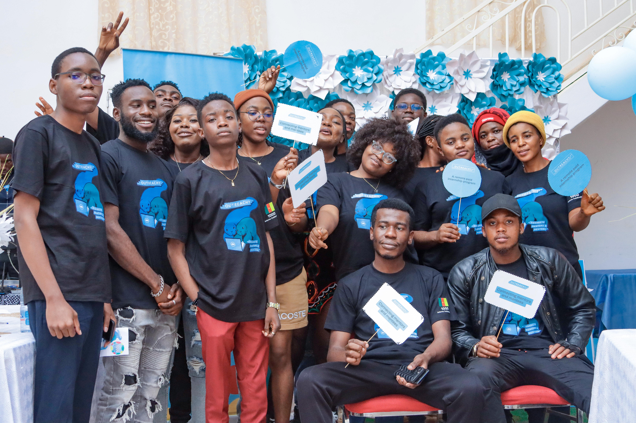
Cameroon celebration

Slide 5
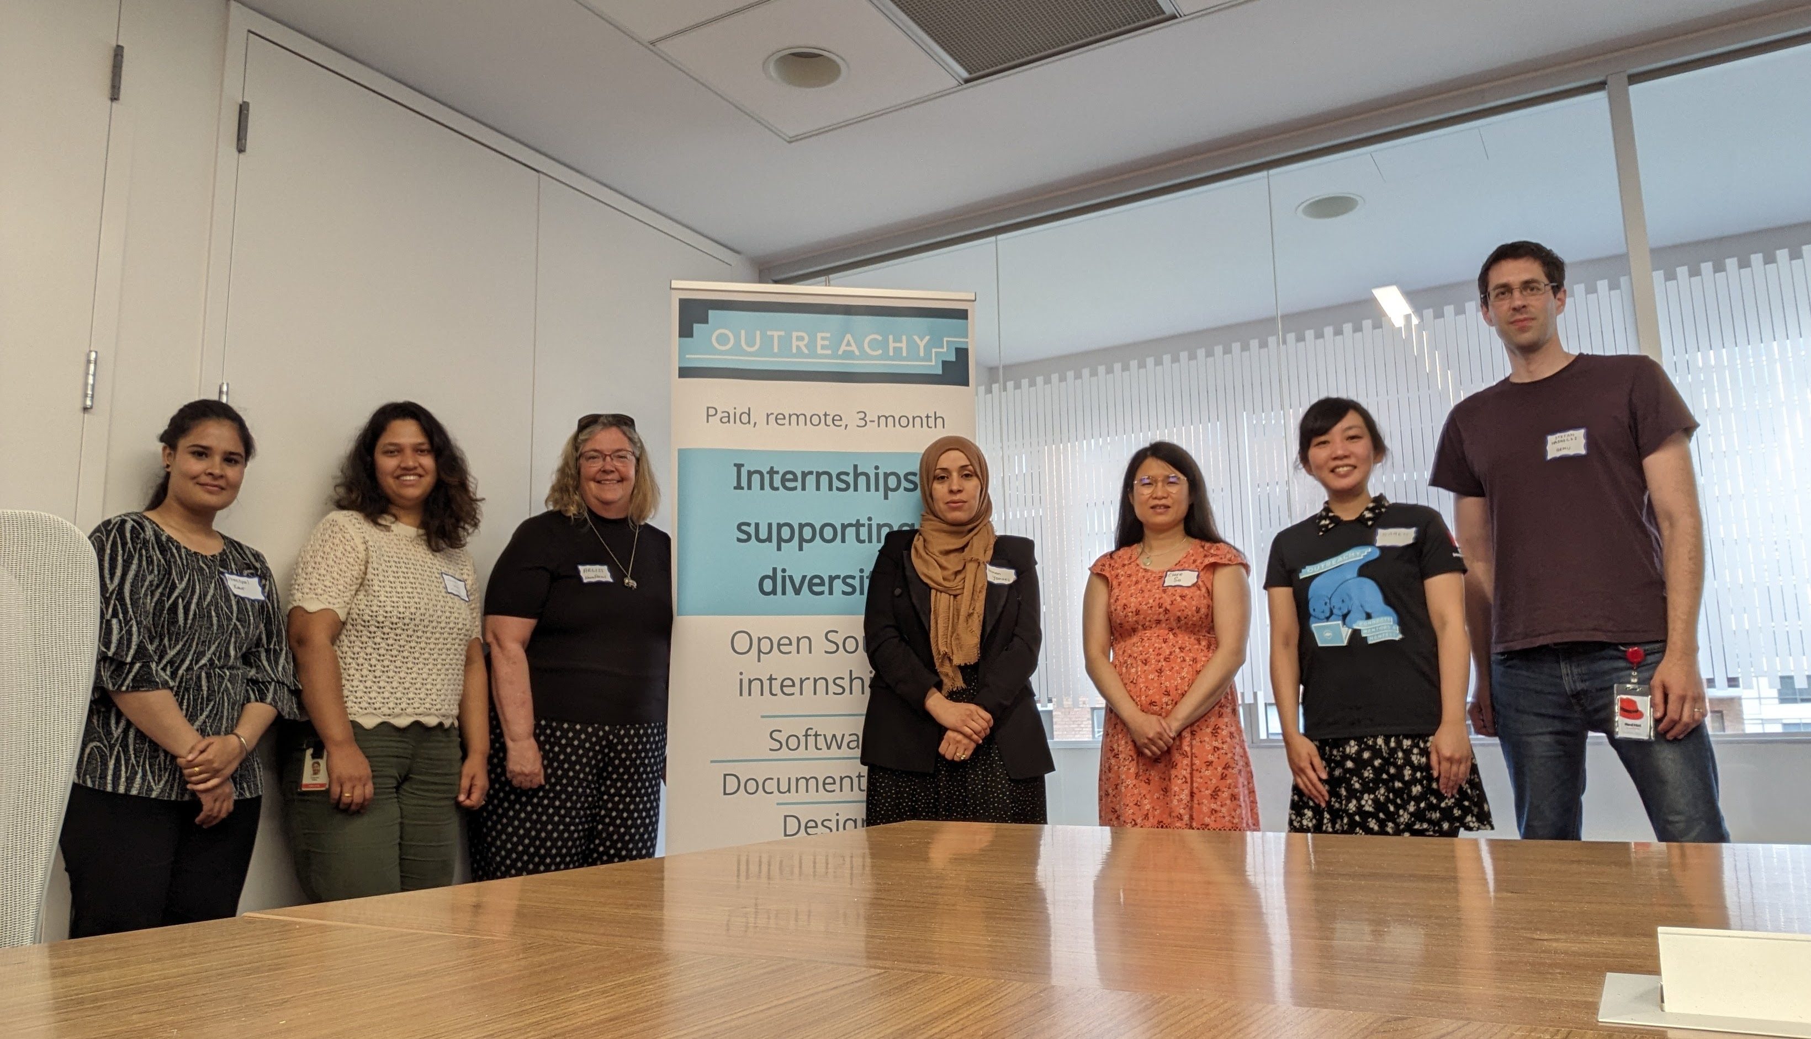
Canada celebration

Slide 6
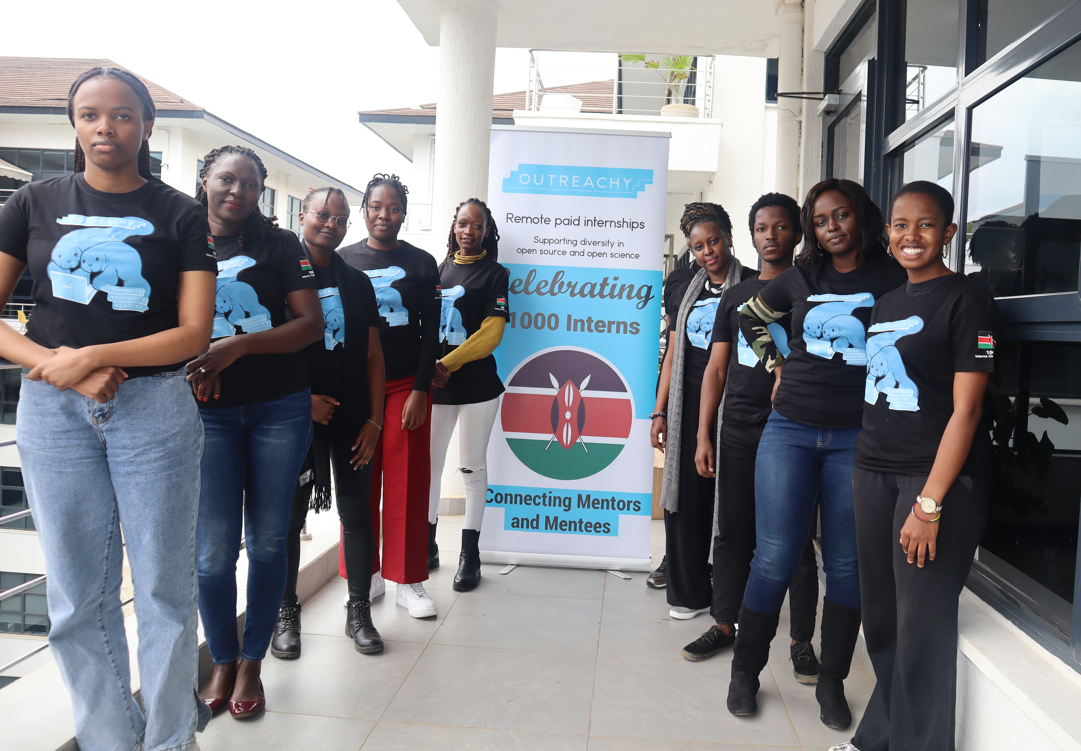
Kenya celebration

Slide 7
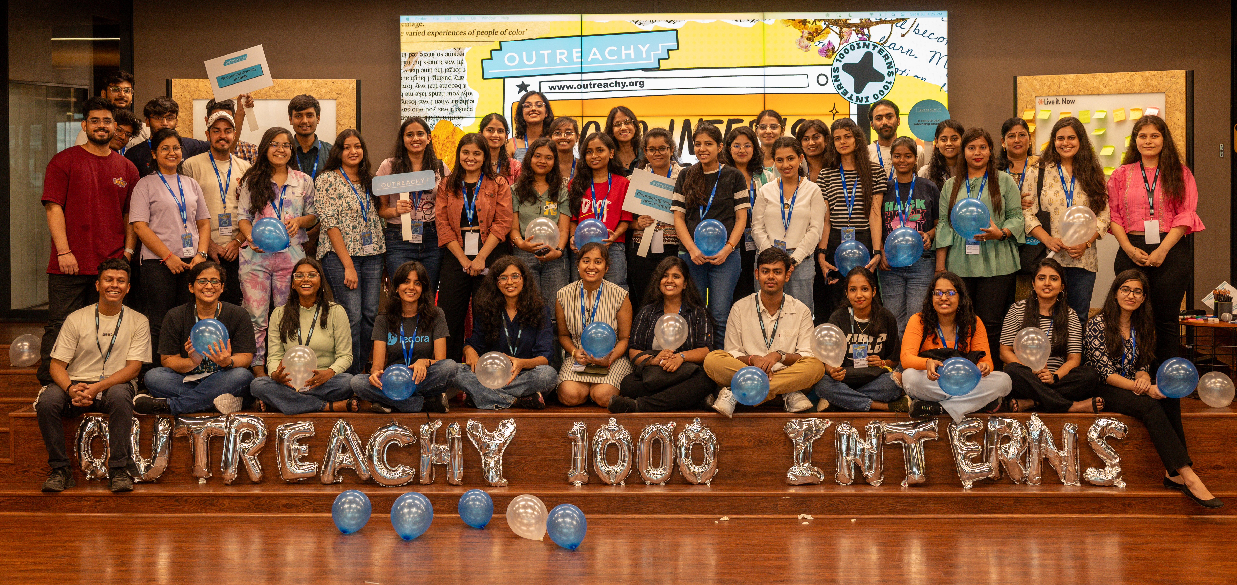
India celebration

Slide 8
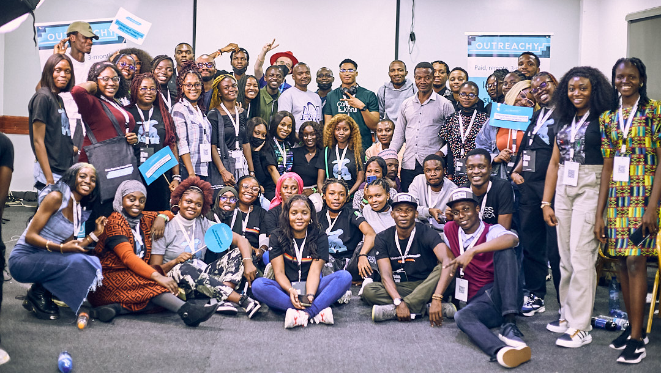
Nigeria celebration

Slide 9
Outreachy accomplishments
96% internship completion rate
80% of alums continue to contribute to FOSS
44% of employed alums contribute to
open source as part of their job

Slide 10
How did Outreachy
get here?

Slide 11
Outreachy:
Early History

Slide 12
Karen has a big heart

Slide 13
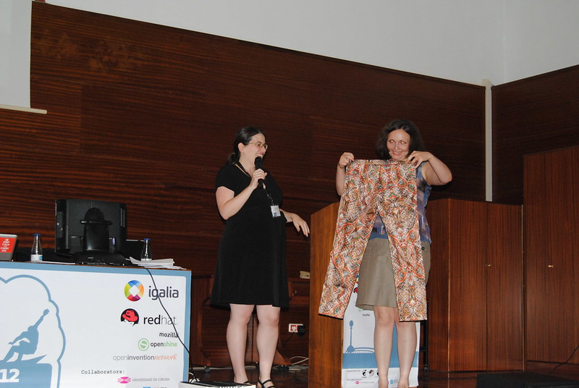
Marina wins the
"Pants" Award

Slide 14
Outreachy started for women
Low number of women in tech:
  25% women in USA
  34% in India
  10-28% in Europe
3% women in FOSS
GNOME GSoC 2006:
0 out of 181 applicants were women

Slide 15

2006: GNOME Women's
Summer Outreach Program
CC BY 2.0 Máirín Duffy

Slide 16
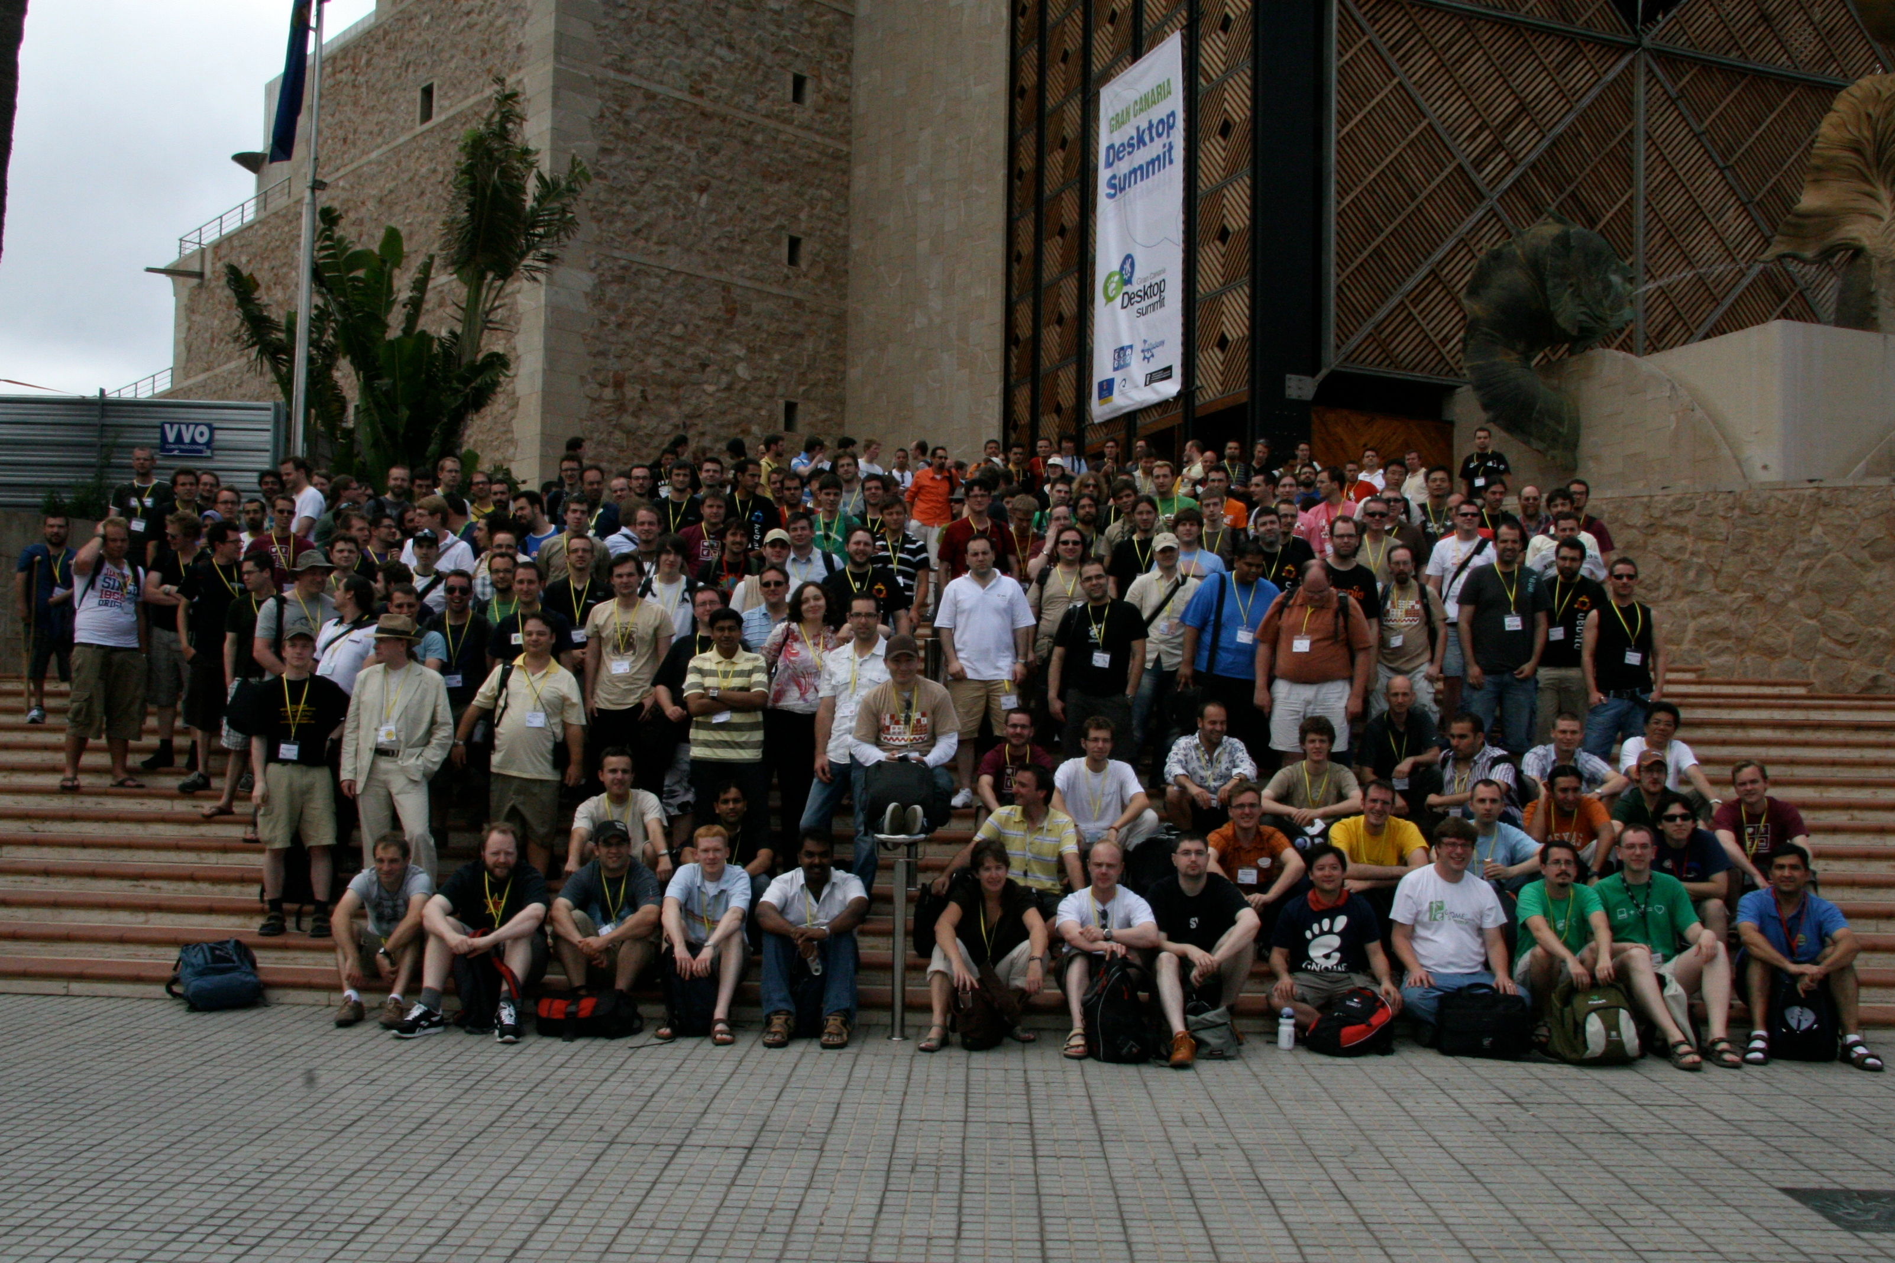
2009 GUADEC
Few women attendees

Slide 17
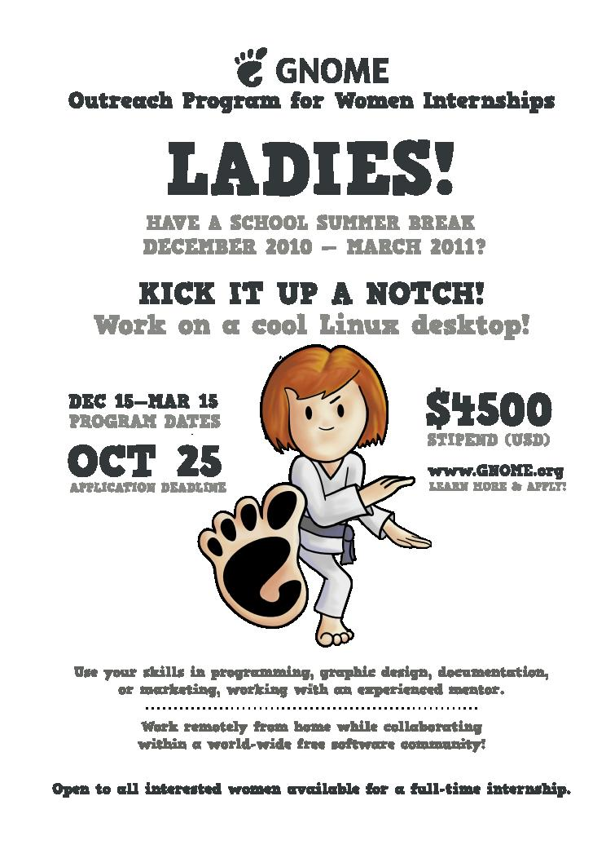
2010: GNOME Outreach Program for Women
CC BY 3.0 Máirín Duffy

Slide 18
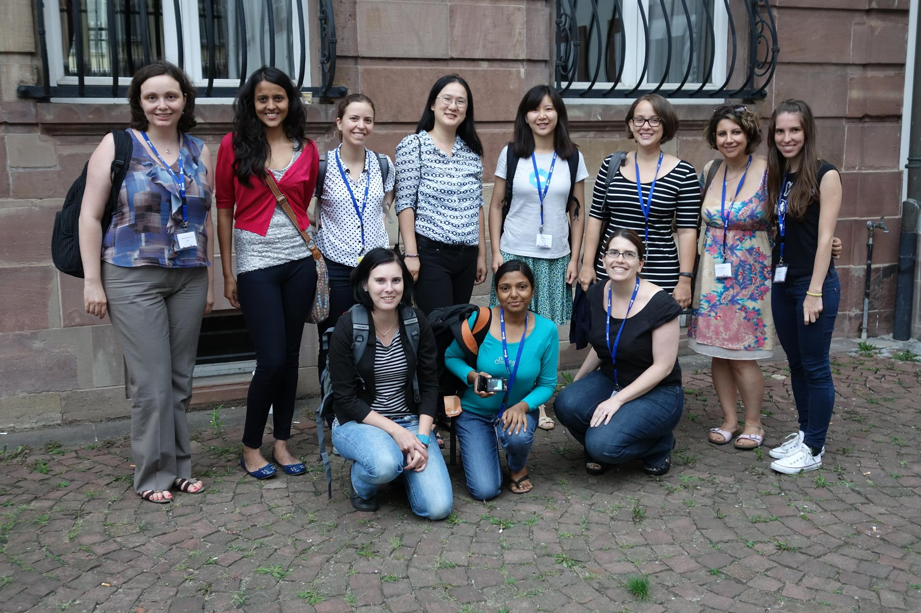
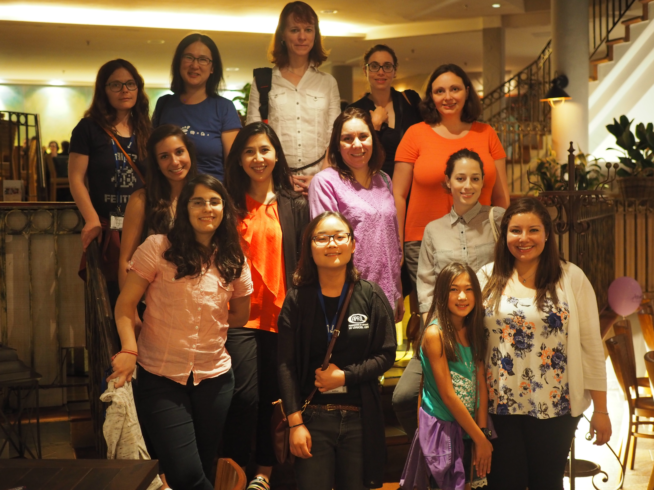
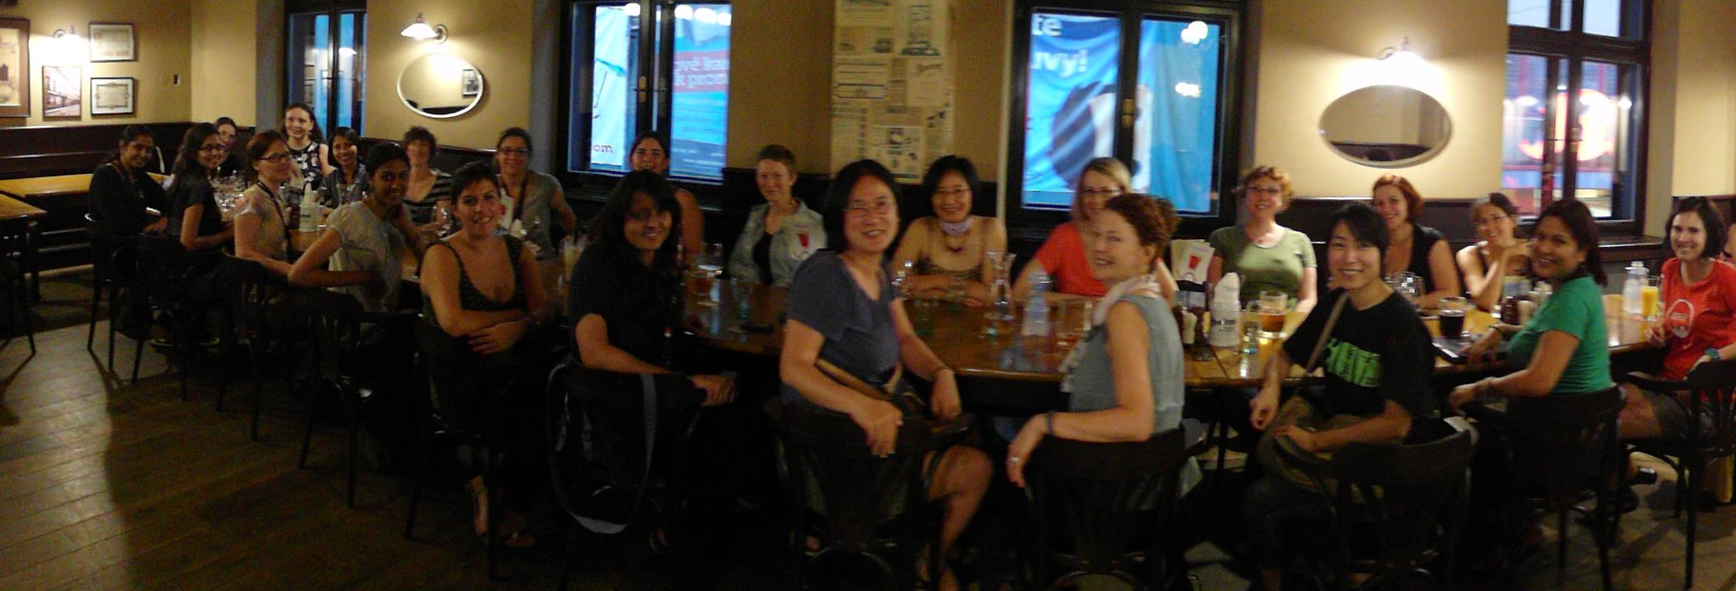
2010:
8 interns

Slide 19

2012: More FOSS Communities

Slide 20
2010 intern criteria
"Anyone who identifies as a woman"

Slide 21
2013 intern criteria
"women (cis and trans), trans men, and genderqueer people"

Slide 22
2015 intern criteria
Anyone who faces under-representation, systemic bias, or discrimination in the tech industry of their country.

Slide 23
Applicant Essays
What country will you be living in during the internship?
Are you part of an underrepresented group (in the technology industry of the country listed above)? How are you underrepresented?
Does your learning environment have few people who share your identity or background? Please provide details.
What systemic bias or discrimination have you faced while building your skills?
What systemic bias or discrimination would you face if you applied for a job in the technology industry of your country?

Slide 24
Outreachy:
Middle History

Slide 25
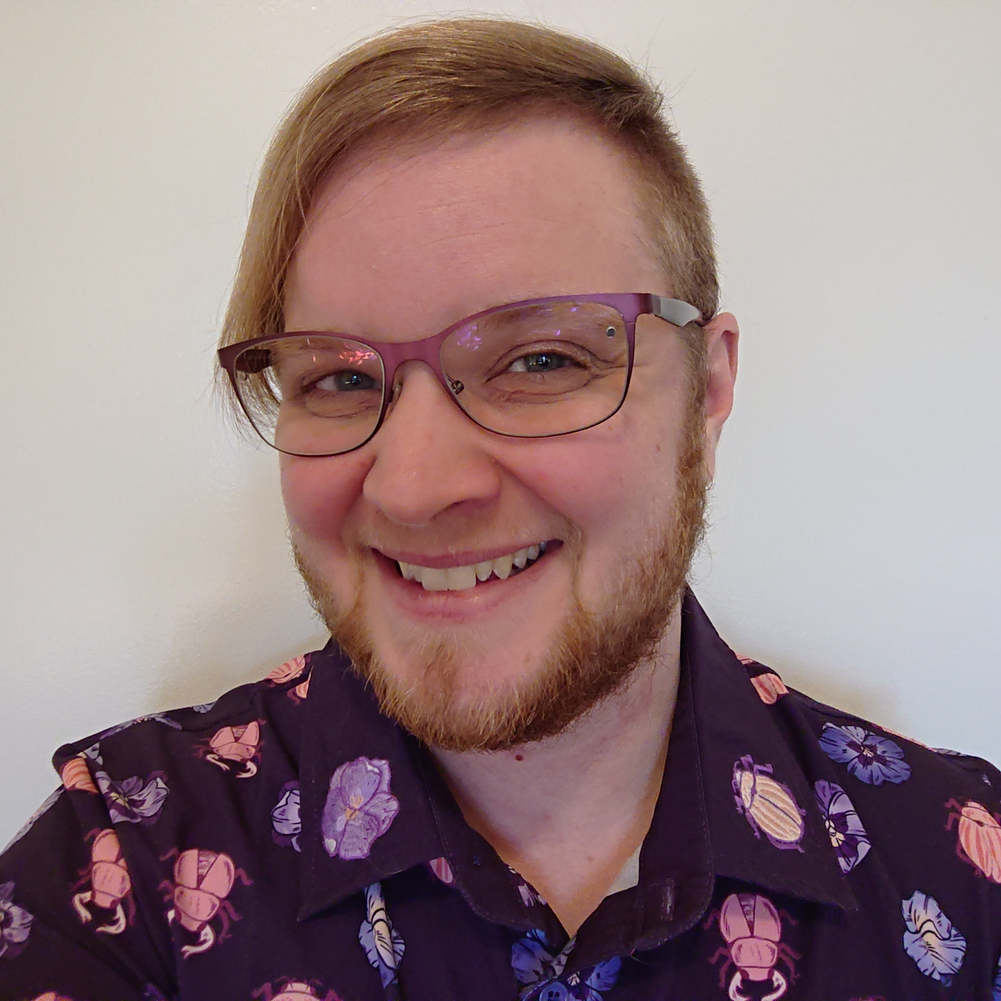
2016: Sage Sharp new Outreachy organizer
CC-BY 4.0 Sage Sharp

Slide 26
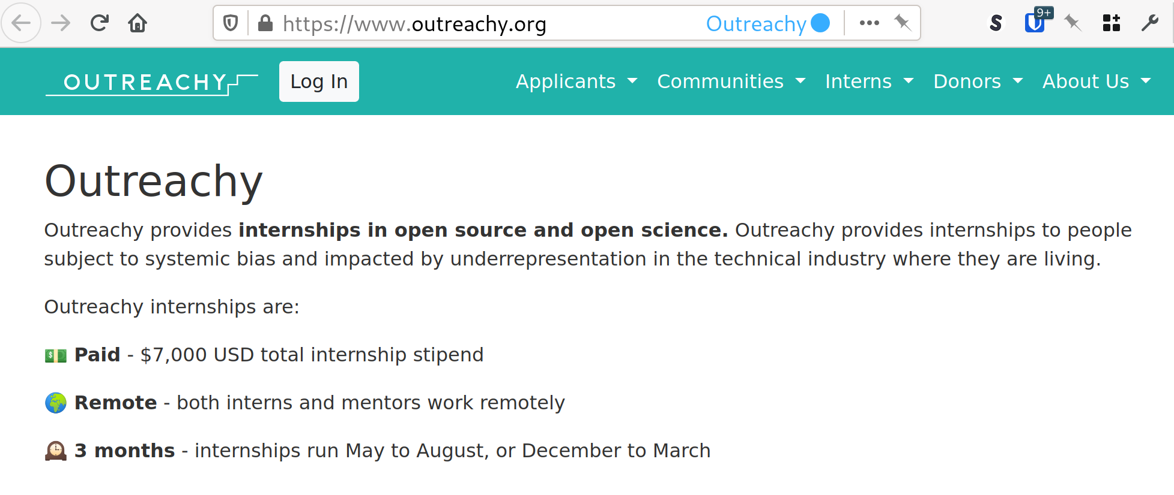
2017: Django-based
Outreachy website

Slide 27
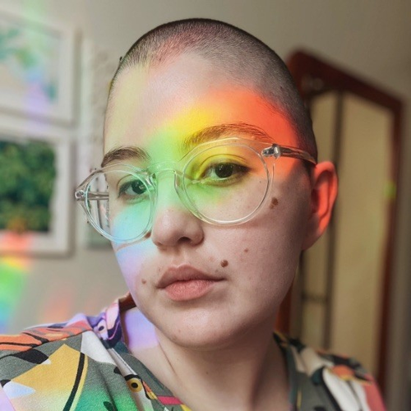
2018: Anna e so new Outreachy organizer

Slide 28
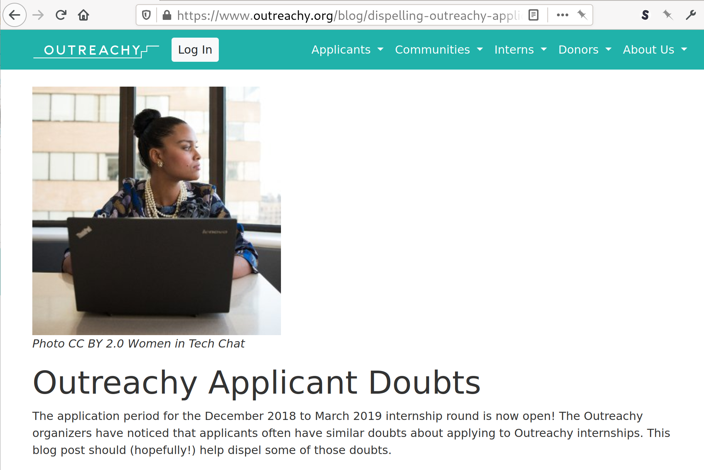

2018: Outreachy itself becomes a community

Slide 29
2019: Documentation
Applicant guide
Community guide
Sponsorship

Slide 30
Outreachy:
Present day

Slide 31



2019-2023: Shift to grant funding

Slide 32
2020: Funding for humanitarian open source
Citizen science
Climate change
Privacy for all
Disaster mapping
Early education

Slide 33
2021: Funding for open science
Citizen science
Climate change
Scientific research -- including COVID research
Tools and libraries for scientists

Slide 34

2022: Omotola new Outreachy organizer

Slide 35
2022:
Connecting and promoting
Real-time Q&A for applicants
Office hours for interns
Increasing awareness of Outreachy
Social media: Mastodon, PeerTube

Slide 36
Increased open source presence in Africa
Outreachy African interns:
  0 interns in 2010
  44 African interns in December 2023 cohort

Slide 37
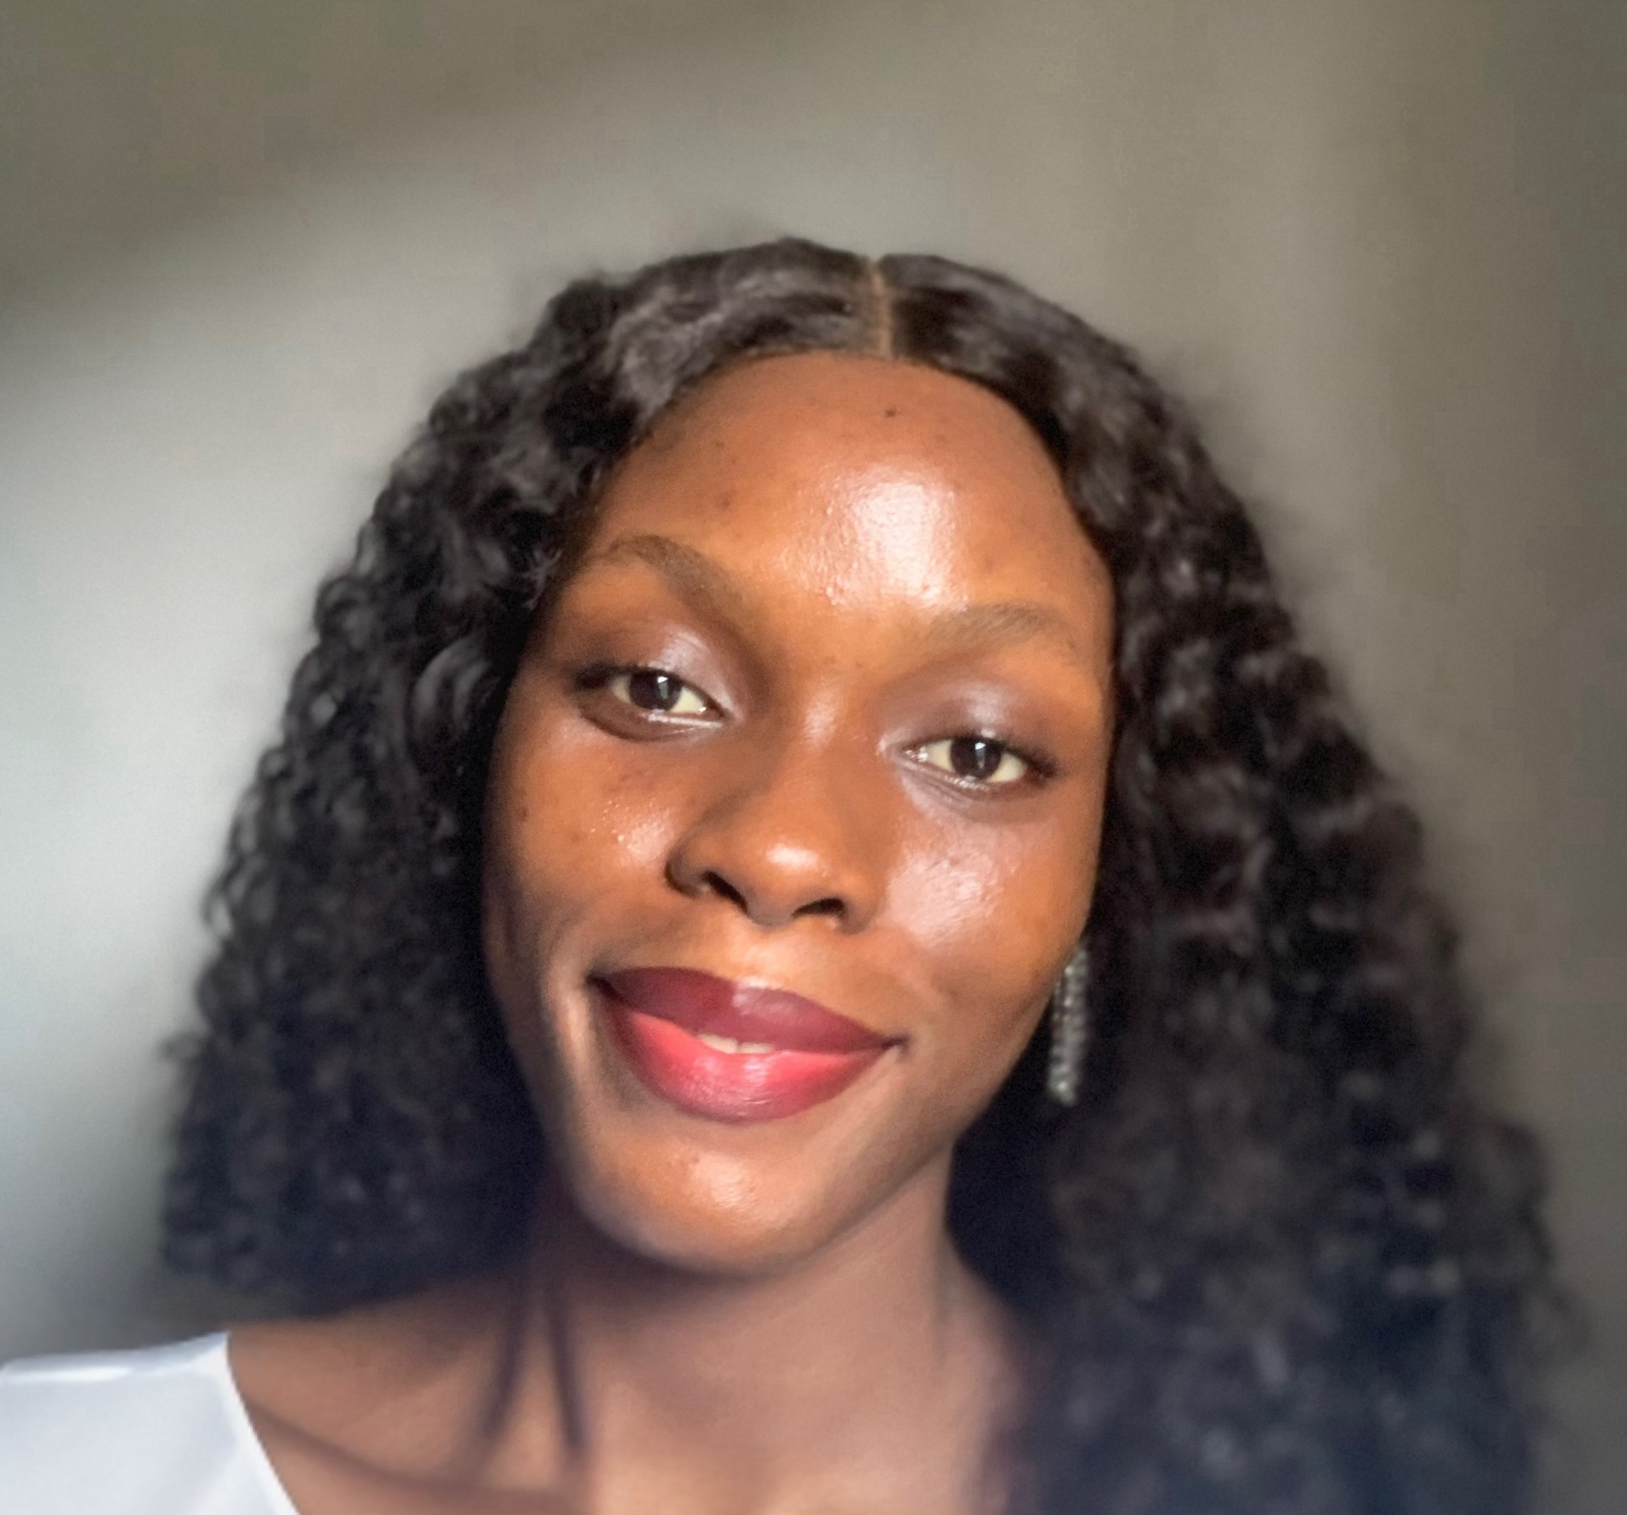
2023: Tilda Udufo new Outreachy Organizer

Slide 38
2023
Dedicated mentor and coordinator support
Office hours for mentors
Interns are giving back: 16 alums were mentors (Dec 2023 cohort), coordinators, volunteers

Slide 39
Future of Outreachy?

Slide 40
Future of Outreachy?
You

Slide 41
Future of Outreachy?
You
Call for FOSS communities
February 15

Slide 42
Thank you!
Omotola Omotayo
Outreachy celebration event organizers
Outreachy application reviewers
Volunteers who helped interns with networking skills and career chats
Conservancy staff including Bradley Kuhn and Rosanne Dimesio
Zana, GNOME board
Outreachy Project Leadership Committee - Tony Sebro and Cindy Pallares
Justin Colannino
Ropes & Grey
Red Hat
Otter Tech
Owen Taylor
Jamey Sharp

Slide 43
Outreachy interns per year

