Slide 1
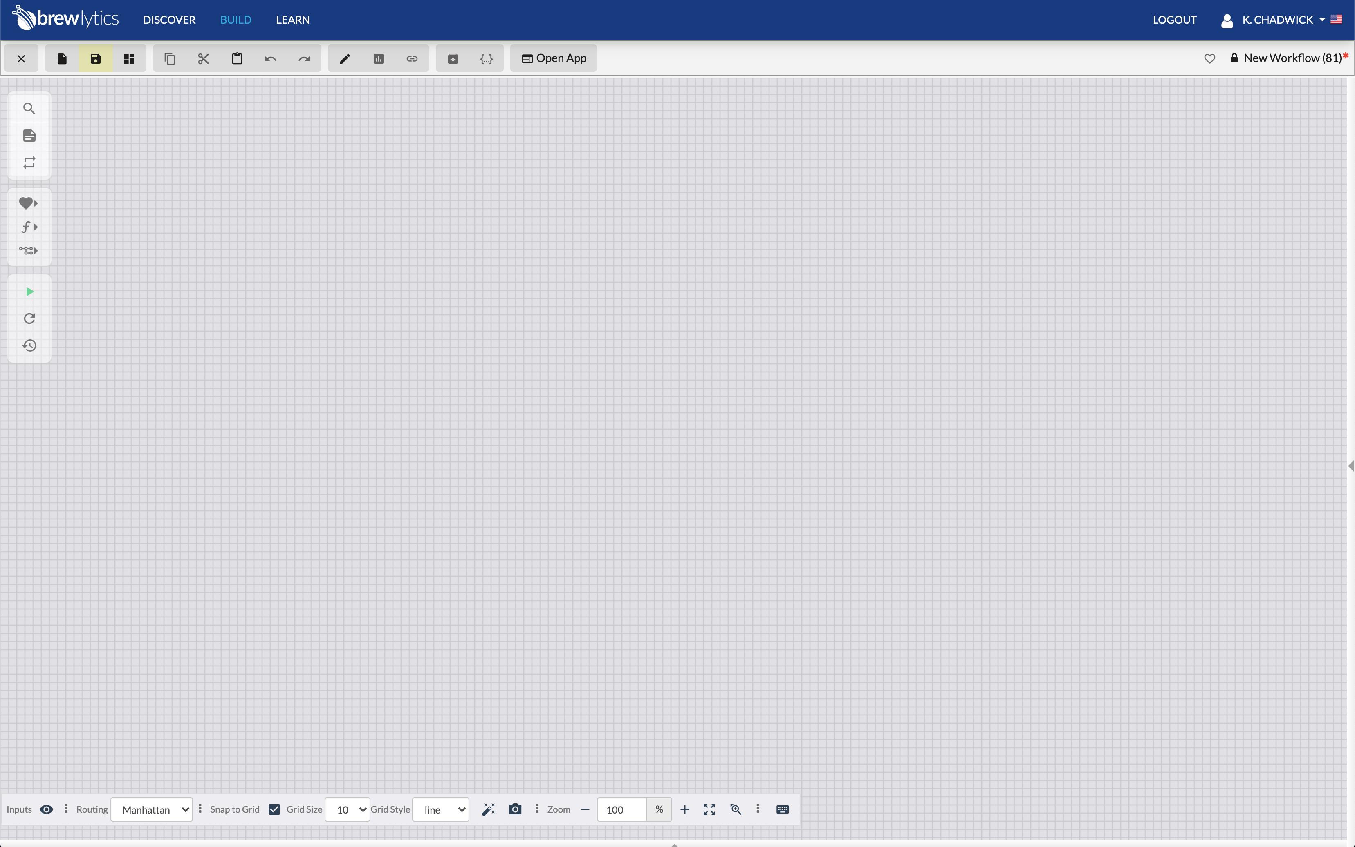

Brewlytics: Creating a Rest API URL
June 15, 2020

Slide 2
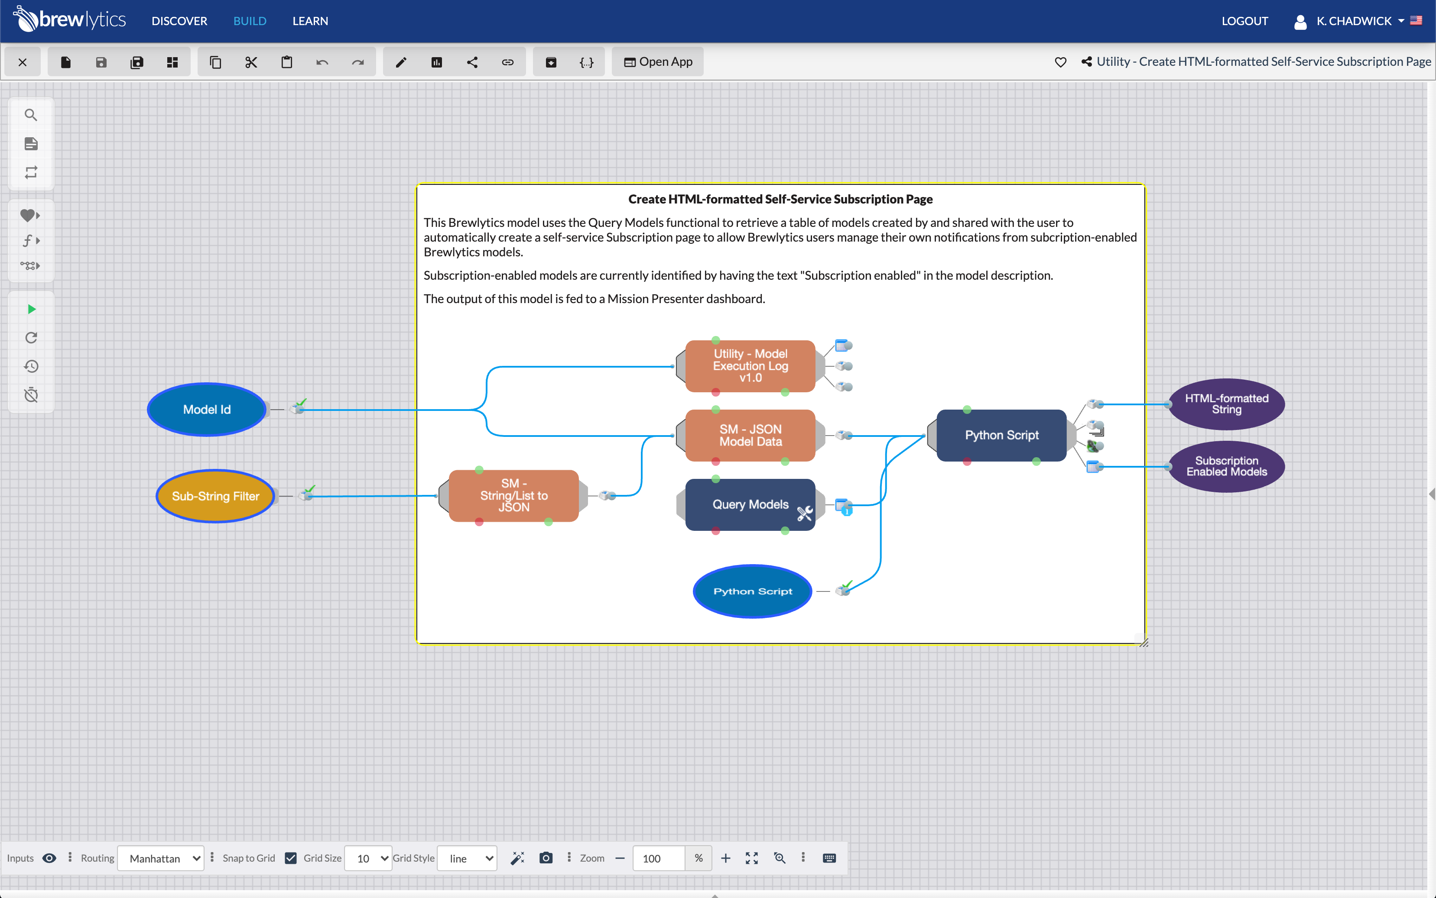
To generate a Rest API for a Brewlytics model:
Select the Get REST URL from the icon bar

Slide 3

To generate a Rest API for a Brewlytics model:
Select the Get REST URL from the icon bar

Slide 4
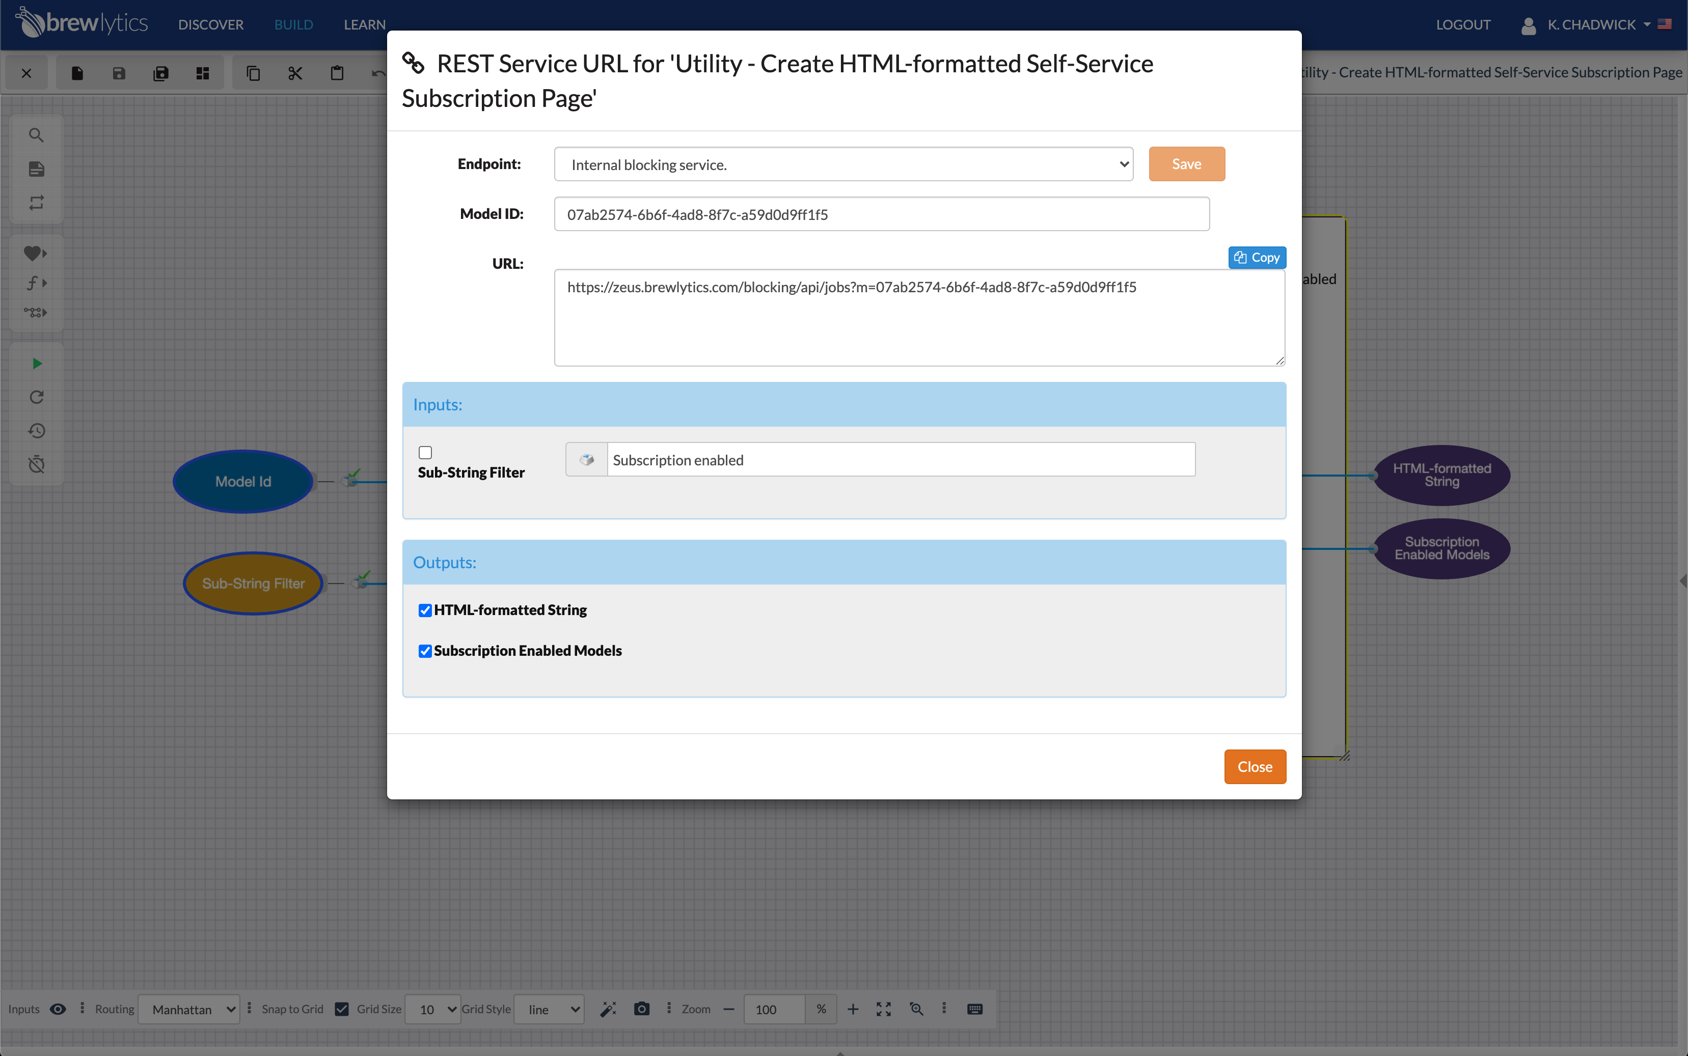
To generate a Rest API for a Brewlytics model:
Select the Get REST URL from the icon bar
Select inputs and outputs
Copy the auto-generated Rest API URL using the ”copy” button

Slide 5
The generated Rest API:
https://zeus.brewlytics.com/blocking/api/jobs?m=07ab2574-6b6f-4ad8-8f7c-a59d0d9ff1f5&Sub-StringFilter_e6941b1b-2485-40f9-b5ed-87c2775253f2=Subscription enabled

Slide 6
Brewlytics Rest API URL Explained
The generated Rest API:
https://zeus.brewlytics.com/blocking/api/jobs?m=07ab2574-6b6f-4ad8-8f7c-a59d0d9ff1f5&Sub-StringFilter_e6941b1b-2485-40f9-b5ed-87c2775253f2=Subscription enabled
Root Rest API URL
Model Id
Model
Model Id
Input Variable:
Name
Resource UUID
Value

