Slide 1
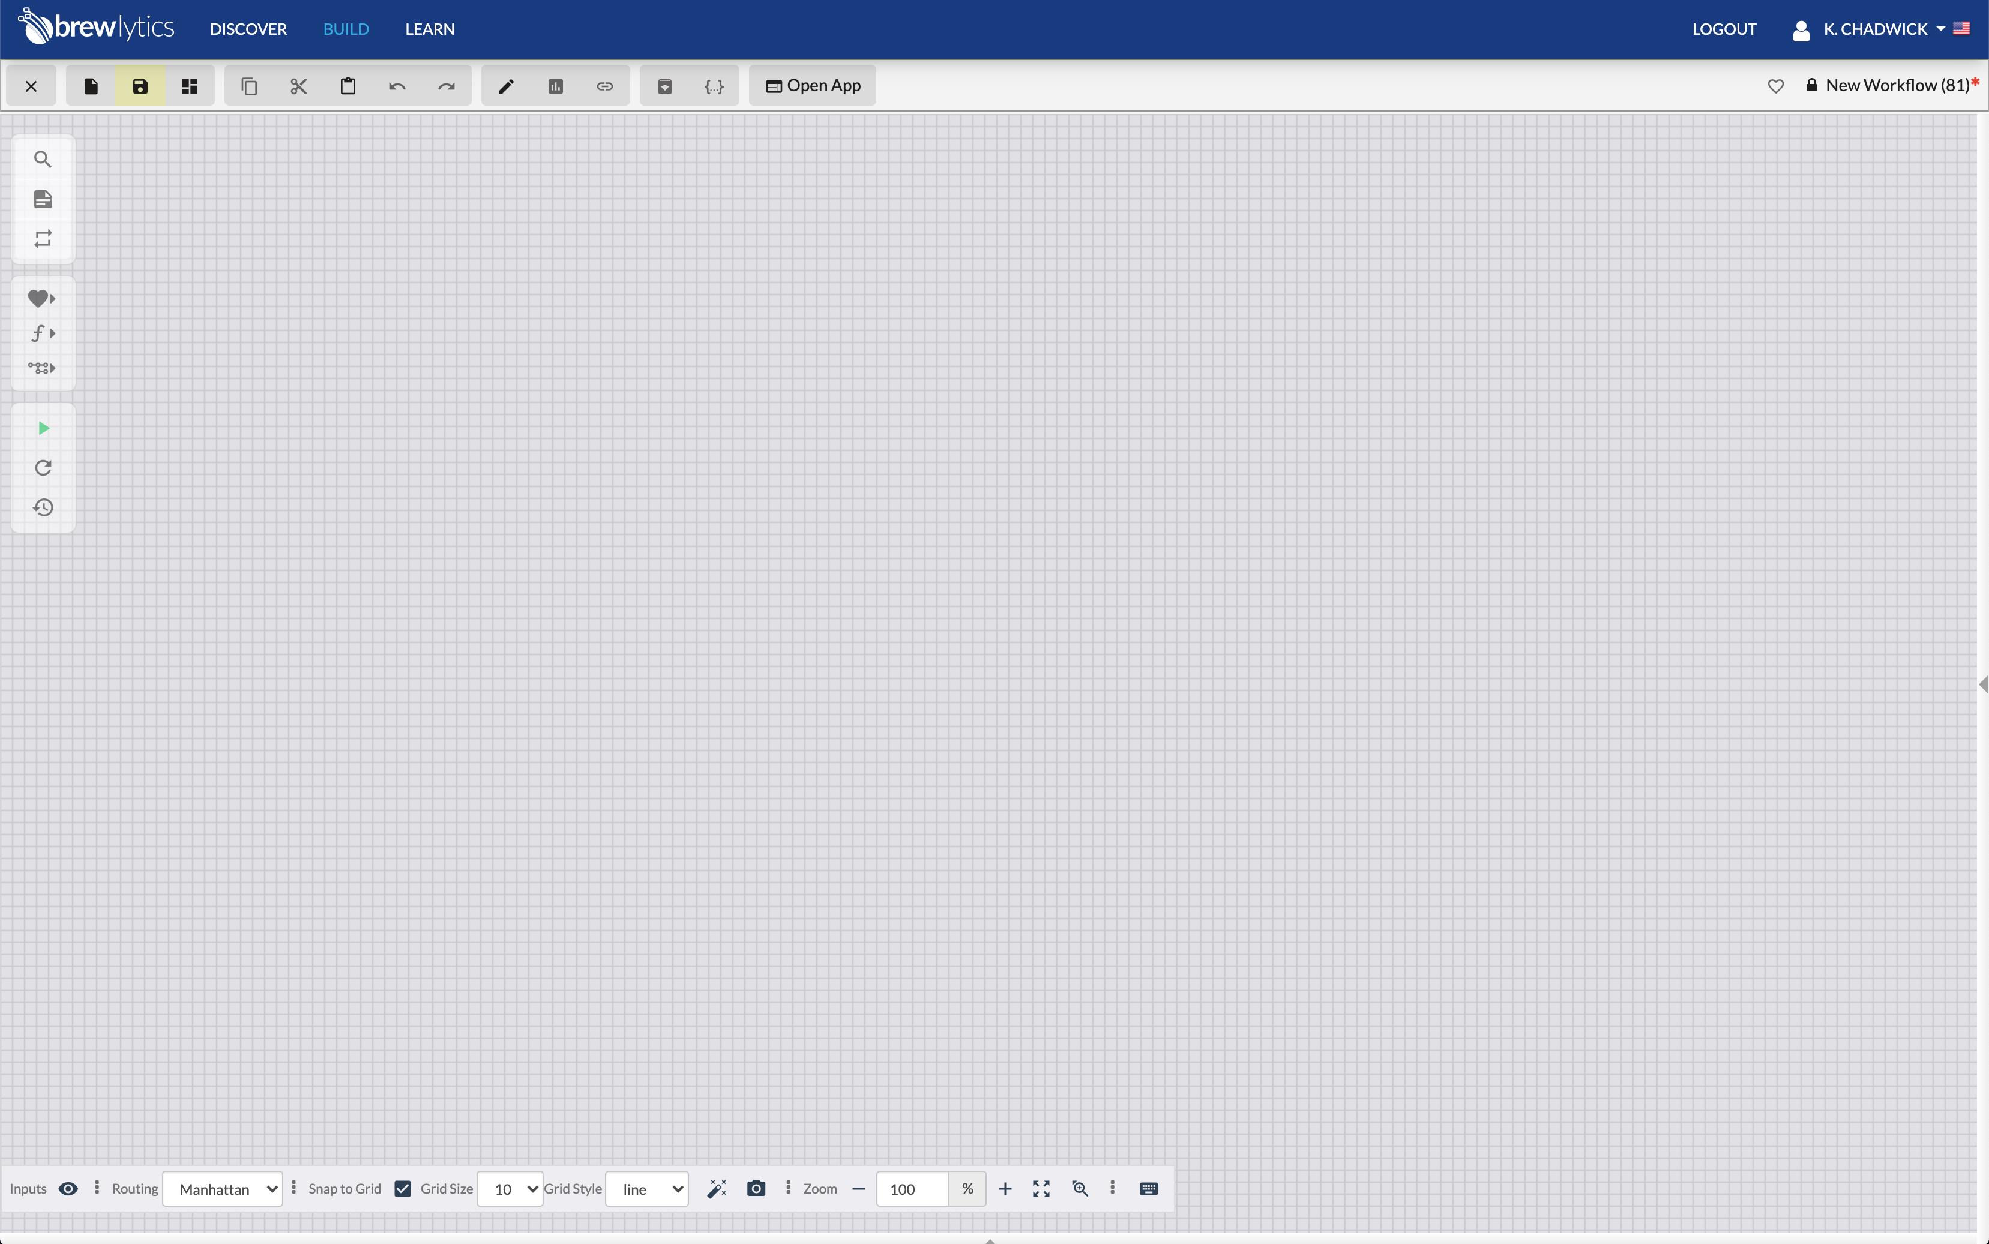

Brewlytics: Creating Tokens How-to
June 15, 2020

Slide 2
Tokens can be used to allow Brewlytics users to access models remotely
Tokens are unique to each user
Authenticate remote API access to Brewlytics, allowing users to:
Run models
Retrieve Data

Slide 3
To create a private token:
Save the current model if one is opened
Click on the User Name in the upper right corner of the Brewlytics window

Slide 4
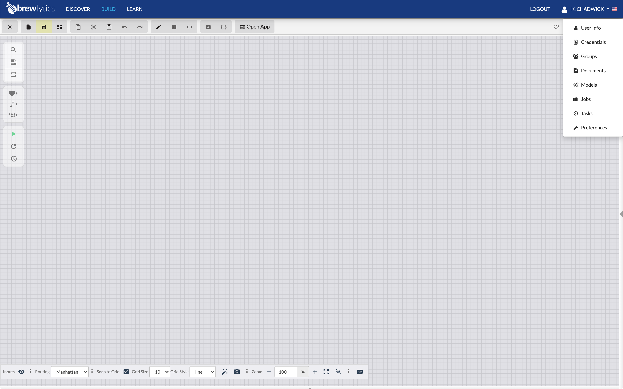
To create a private token:
Save the current model if one is opened
Click on the User Name in the upper right corner of the Brewlytics window
Select “Credentials” from the drop-down menu

Slide 5
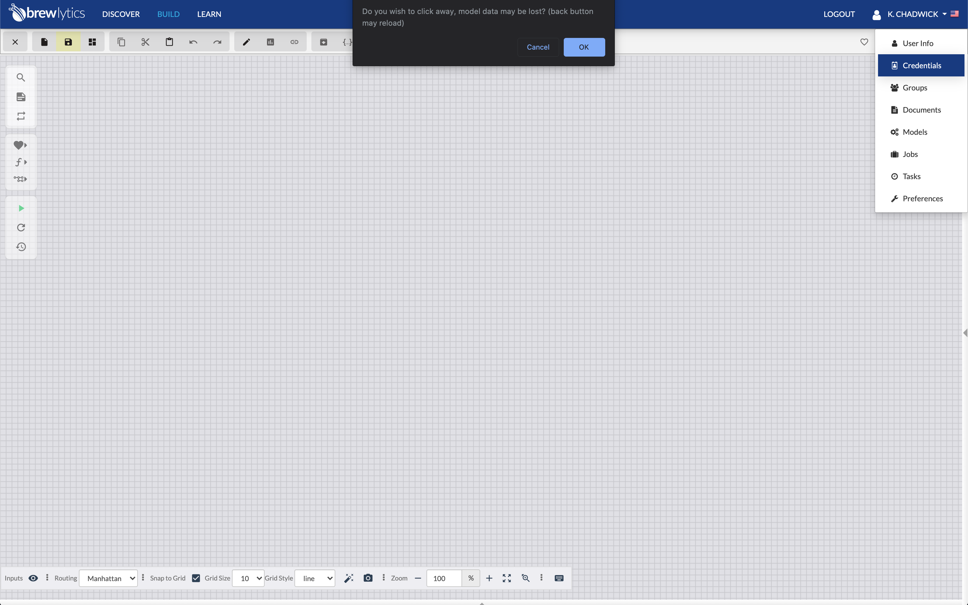
To create a private token:
Save the current model if one is opened
Click on the User Name in the upper right corner of the Brewlytics window
Select “Credentials” from the drop-down menu
Select “Ok” in the pop-up

Slide 6
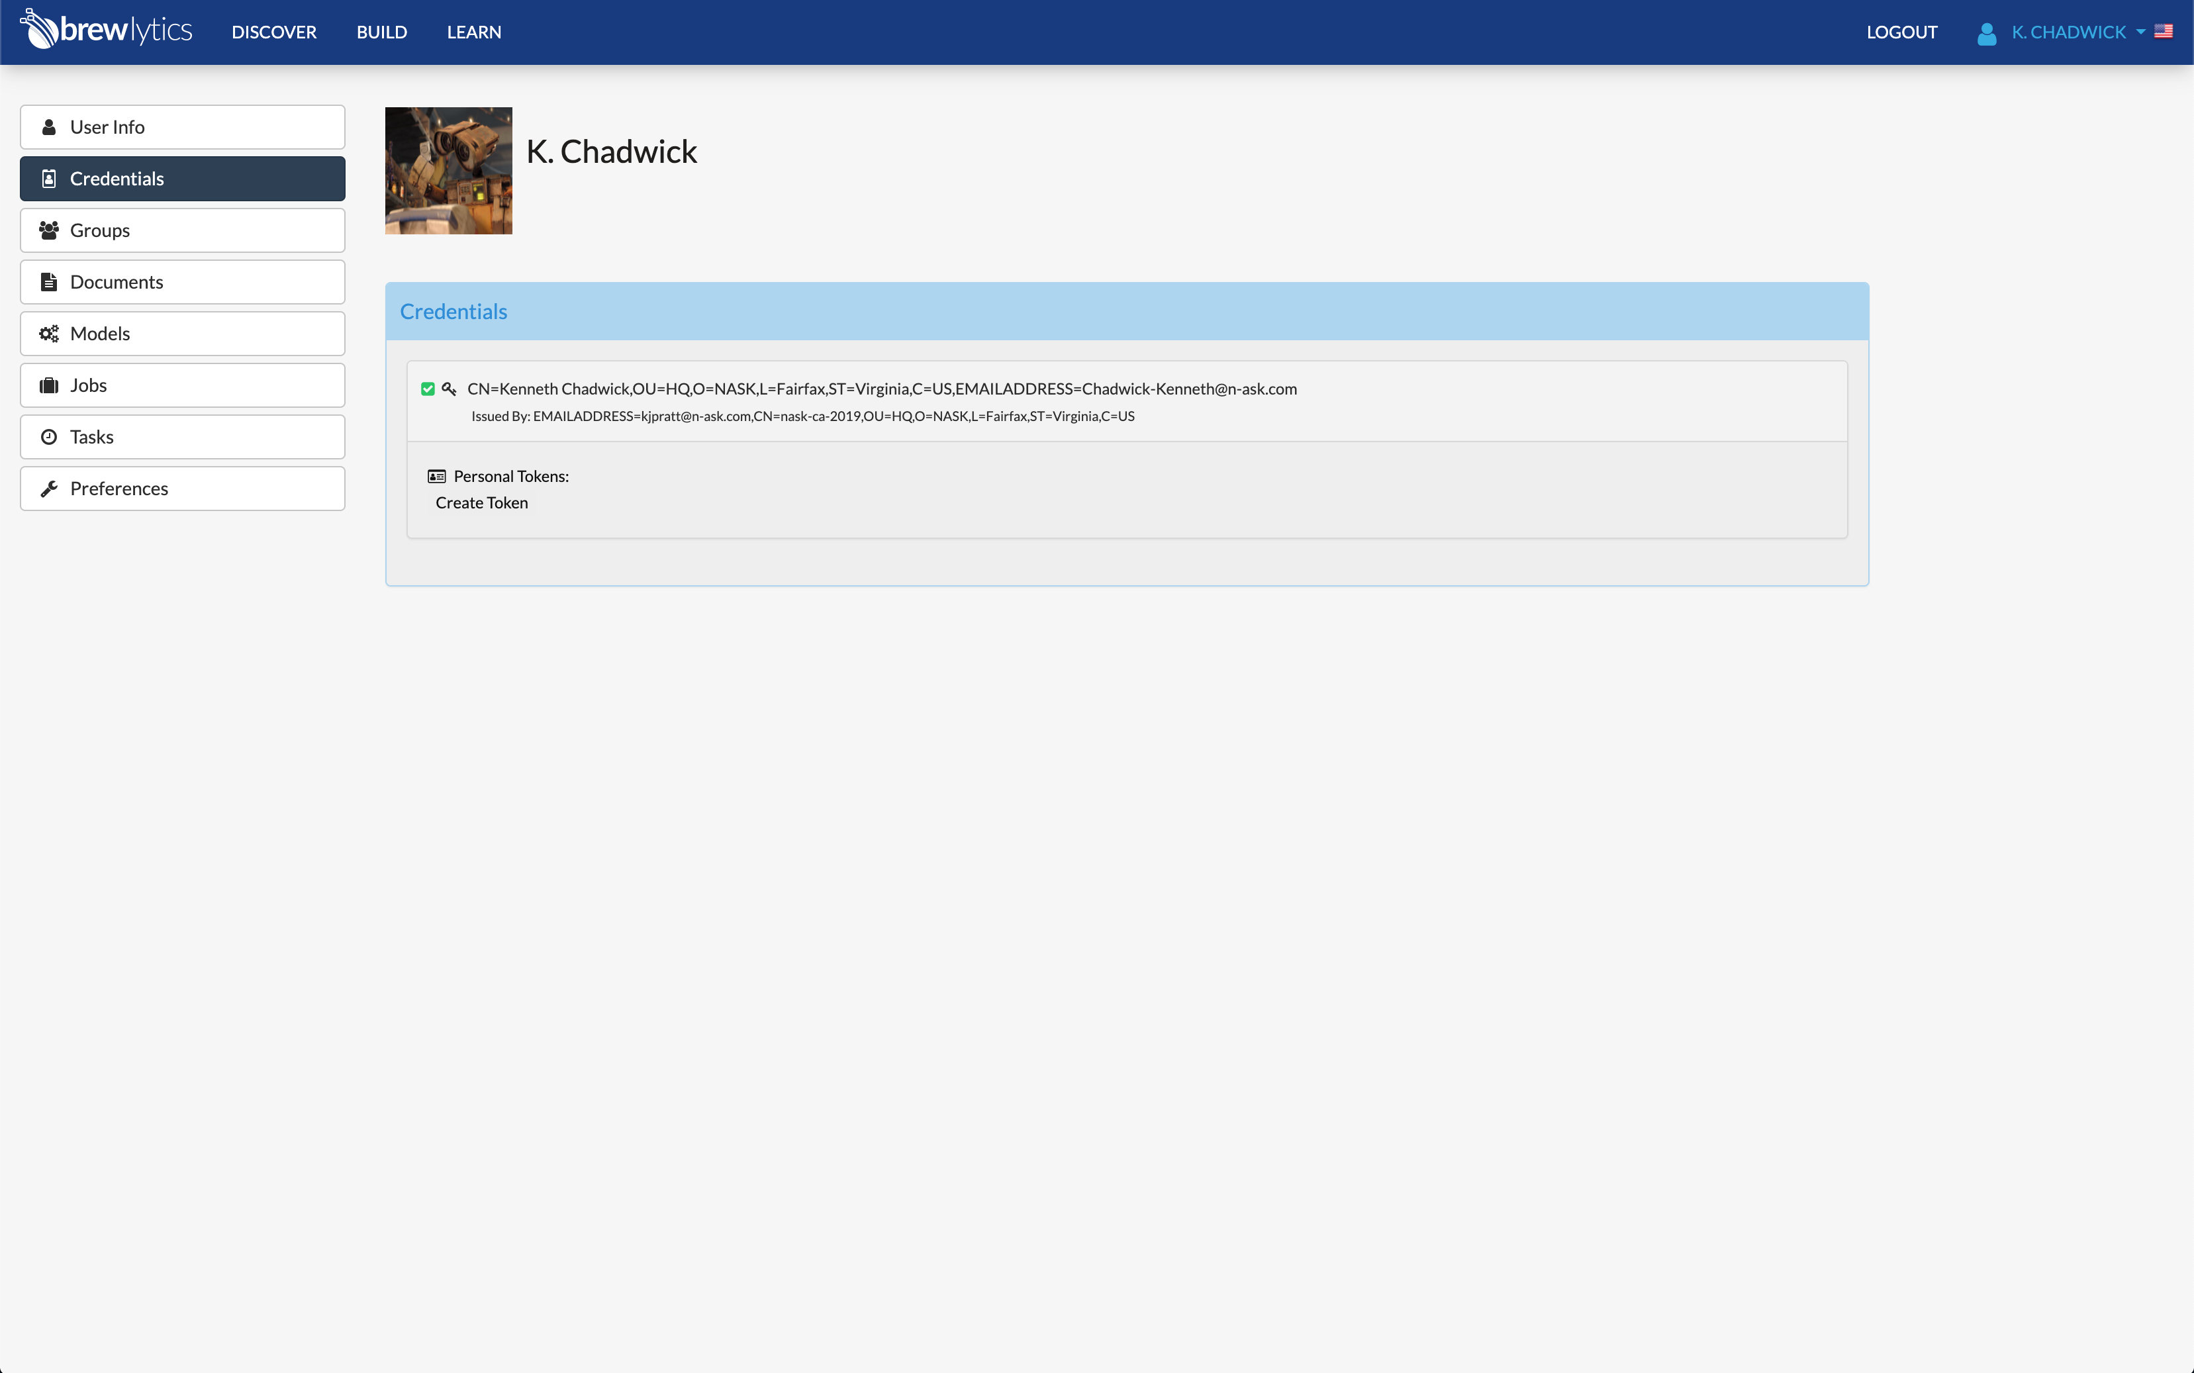
To create a private token:
Save the current model if one is opened
Click on the User Name in the upper right corner of the Brewlytics window
Select “Credentials” from the drop-down menu
Select “Ok” in the pop-up
Select “Create Token”

Slide 7
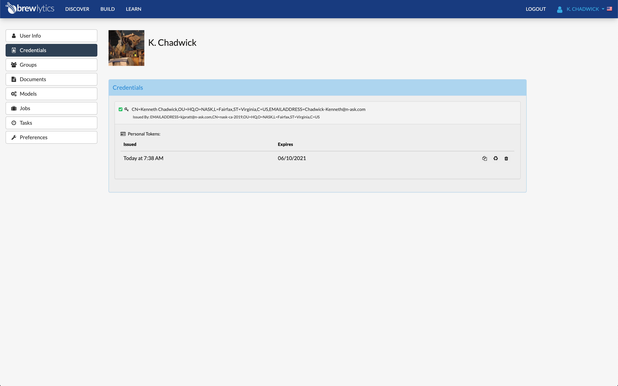
To create a private token:
Save the current model if one is opened
Click on the User Name in the upper right corner of the Brewlytics window
Select “Credentials” from the drop-down menu
Select “Ok” in the pop-up
Select “Create Token”
Manage token using using icons to the right
Copy token
Recycle token
Delete current token

