Slide 1
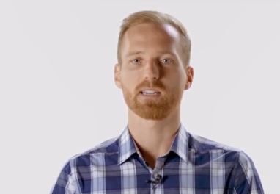


Credits to:
Kirill Eremenko
Hadelin de Ponteves
Adil Moujahid
https://github.com/adilmoujahid/blockchain-python-tutorial

Slide 2


Build a Blockchain & Cryptocurrency using Python Zakwan Jaroucheh

Slide 3
Motivation
The global exponentially-growing demand for blockchain engineers
Building a blockchain yourself demonstrates your deep understanding of the technology
It is fascinating and fun!

Slide 4
Topics
What is a Blockchain?
Hash Cryptography (SHA256)
Immutable Ledger
Distributed P2P Network
How Mining Works
Consensus Protocol

Slide 5
Course Roadmap - Part 1
What is a Blockchain?
Hash Cryptography (SHA256)
Immutable Ledger
Distributed P2P Network
How Mining Works
Consensus Protocol

Slide 6
Course Roadmap - Part 2
Create the core Blockchain
Build an API around the Blockchain
Create a P2P network of nodes
Implement a Proof-of-Work system
Create a transaction system for a cryptocurrency
Create a nice Web interface

Slide 7
Build a Blockchain & Cryptocurrency using Python

Slide 8
Topics
What is a Blockchain?
Hash Cryptography (SHA256)
Immutable Ledger
Distributed P2P Network
How Mining Works
Byzantine Fault Tolerance
Consensus Protocol

Slide 9
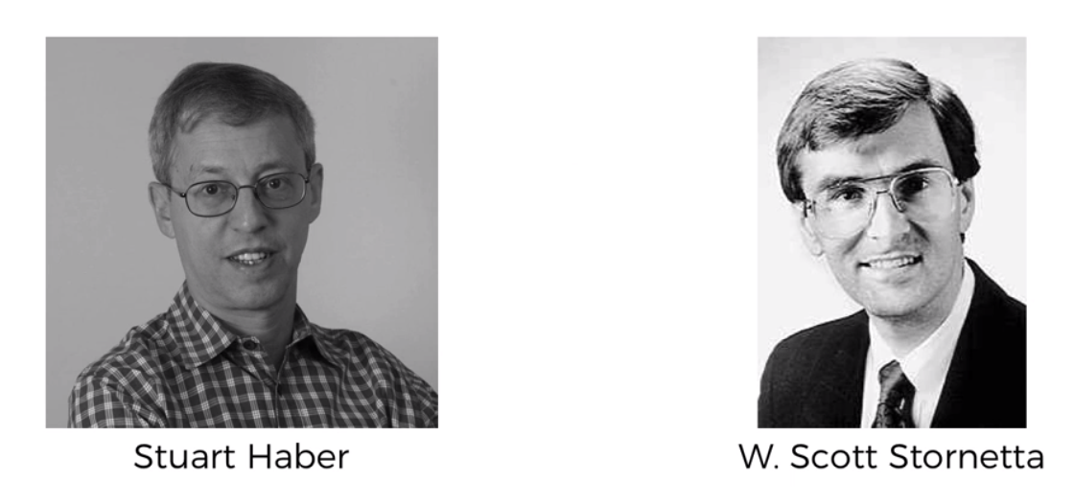
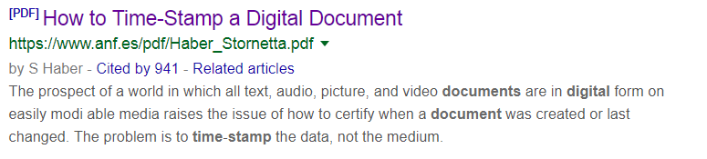
What is Blockchain?
How to Time-Stamp a Digital Document, In Journal of Cryptology, Vol. 3, No. 2, pp. 99-111, 1991.

Slide 10

What is Blockchain?
block
1. Data: "Example data"
2. Prev. Hash: 087E2A6C9F
3. Hash: FA672A7CD8

Slide 11

What is Blockchain?
Genesis block
1
2
3
Data: "..."
Prev. Hash: 0000000000
Hash: FA672A7CD8
Data: "..."
Prev. Hash: FA672A7CD8
Hash: AB45F3108C
Data: "..."
Prev. Hash: AB45F3108C
Hash: 72DE4910CB
Blocks are cryptographically linked together

Slide 12
Topics
What is a Blockchain?
Hash Cryptography (SHA256)
Immutable Ledger
Distributed P2P Network
How Mining Works
Consensus Protocol

Slide 13
Hash Cryptography

Slide 14







SHA256 Hash Algorithm
f34eb07cfe1888f9327eb13bcd53c4035dc31dc49e1b3bb33c0eea8541120c1c
SHA256 → 256bits
64 hexadecimal characters

Slide 15
Demo

Slide 16


5 Requirements for Hash Algorithms
One-Way
Deterministic
Fast Computation
The Avalanche Effect
Must withstand collision
f34eb07cfe1888f9327eb13bcd53c4035dc31dc49e1b3bb33c0eea8541120c1c
f34eb07cfe1888f9327eb13bcd53c4035dc31dc49e1b3bb33c0eea8541120c1c
+a
1cb17e7561b6e84fdf2d0032dd32b71999ed007895bbb616596b311ee37f2272

Slide 17
Topics
What is a Blockchain?
Hash Cryptography (SHA256)
Immutable Ledger
Distributed P2P Network
How Mining Works
Consensus Protocol

Slide 18
Immutable Ledger

Slide 19
What is Blockchain?
Genesis block
1
2
3
Data: "..."
Prev. Hash: 0000000000
Hash: FA672A7CD8
Data: "..."
Prev. Hash: FA672A7CD8
Hash: AB45F3108C
Data: "..."
Prev. Hash: AB45F3108C
Hash: 72DE4910CB
Blocks are cryptographically linked together

Slide 20






Immutable Ledger
Traditional Ledger
Blockchain

Slide 21
Topics
What is a Blockchain?
Hash Cryptography (SHA256)
Immutable Ledger
Distributed P2P Network
How Mining Works
Consensus Protocol

Slide 22
Distributed P2P Network

Slide 23
Immutable Ledger
Traditional Ledger
Blockchain

Slide 24

Distributed P2P Network

Slide 25
Topics
What is a Blockchain?
Hash Cryptography (SHA256)
Immutable Ledger
Distributed P2P Network
How Mining Works
Consensus Protocol

Slide 26
How mining works

Slide 27
How Mining Works
Block #5
Nonce:
11
10
12
Data:
Alice → Bob 100 bitcoins
John → John 500 bitcoins
Bob → John 50 bitcoins
Prev. Hash: 0000FA8713C1
Hash: 7E87ABC1A4EF
Hash: 07A341FE72DE
Hash: 4A5601AD127B
Hash: C6091E152901

Slide 28



How Mining Works
A Hash is a number
All Possible Hashes
Largest
5150595EA25B9224C40A7B5200D124E04A99A1938630322A692786283D37BB85
=36779305307184960599665499101938058563851722211342943425522830506957959838597
00000000000BD67E5DBF038F43C64B6E39E764159C31CEC36AD6853E8B8D6254
=4869815487572261399113666509671675559287782613930894432244949588
00000000000000000000000000A0BE8A436DC84B999FBD6DA52B1FD75C4FDB32
Target
=3584717614686867785763430268046580136536955698
Target is expressed with leading zeros e.g. ‘00000’
Smallest

Slide 29
How Mining Works
All Possible Hashes
Block #5
Largest
3206
Nonce:
5673
203
8903
Data:
Alice → Bob 100 bitcoins
John → John 500 bitcoins
Bob → John 50 otccoins
Nonce=3206
Nonce=203
Prev. Hash: 0000FA8713C1
Nonce=5673
7E87ABC1A4EF
0000ABC1A4EF
0032BA527CAD
Hash:
E651BFA1410F
Target
Target is expressed with leading zeros e.g. ‘0000’
Nonce=8903
Smallest

Slide 30
Topics
What is a Blockchain?
Hash Cryptography (SHA256)
Immutable Ledger
Distributed P2P Network
How Mining Works
Byzantine Fault Tolerance
Consensus Protocol

Slide 31
Byzantine Fault Tolerance

Slide 32




Byzantine Fault Tolerance
This slide has been designed using resources from Freepik.com

Slide 33
Byzantine Fault Tolerance
This slide has been designed using resources from Freepik.com

Slide 34
Topics
What is a Blockchain?
Hash Cryptography (SHA256)
Immutable Ledger
Distributed P2P Network
How Mining Works
Consensus Protocol

Slide 35
Consensus Protocol
Proof-of-Work (POW)
Proof-of-Stake (POS)
Others

Slide 36
How Mining Works
All Possible Hashes
Block #5
Largest
Nonce:
8903
Data:
Alice → Bob 100 bitcoins
Caren → John 500 bitcoins
Bob → John 50 bitcoins
Prev. Hash: 0000FA8713C1
Hash:
0000ABC1A4EF
Target
Target is expressed with leading zeros e.g. ‘0000’
Nonce=8903
Smallest

Slide 37
Consensus Protocol

Slide 38
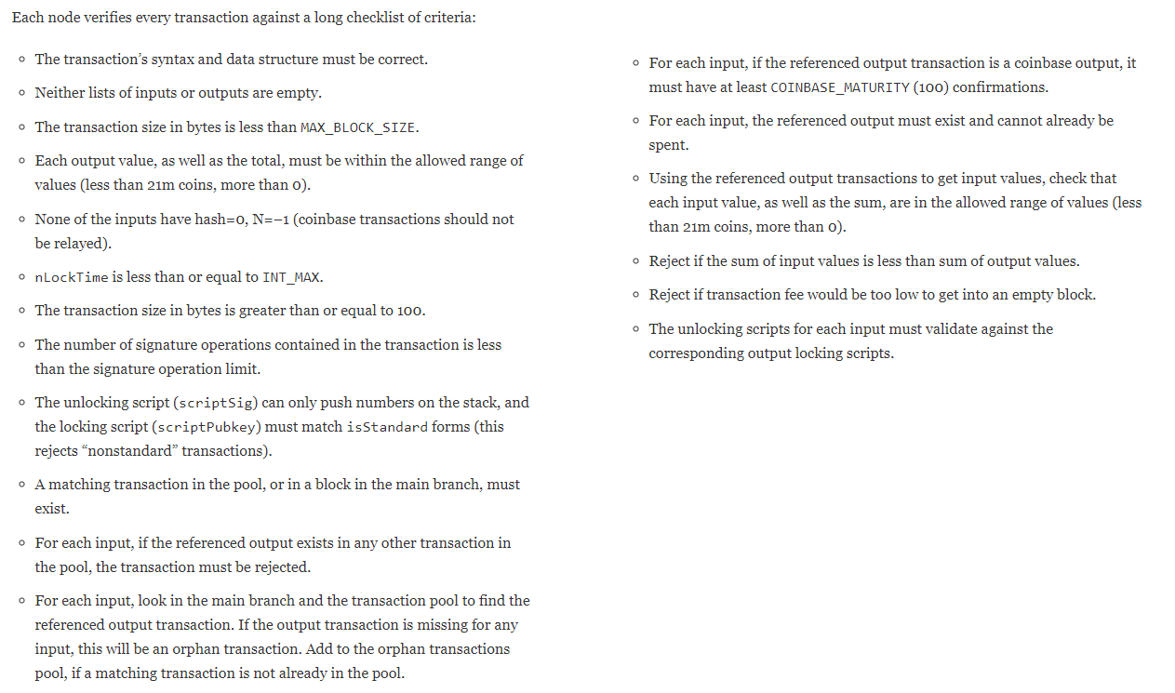
Consensus Protocol
Cryptographic Puzzles:
Hard to solve – Easy to verify

Slide 39
Consensus Protocol
Orphaned Blocks

Slide 40



Distributed P2P Network

Slide 41
Tutorial setting
Port: 5001
Port: 8082
Port: 8081
Port: 5003
Bob
Alice
Port: 5002

Slide 42

Thanks!
Any questions?
Find me at z.jaroucheh@napier.ac.uk

Slide 43

Distributed Ledger
Traditional Ledger
Blockchain

