Slide 1
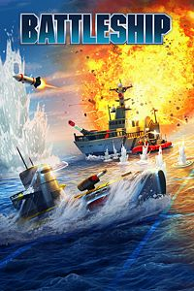
Battleship
By Tyler Gross, Kashyap Kandikonda, Dilshawn Sahi, and Sultan Adil

Slide 2
Creating a GUI interface
Currently testing and researching different Python GUI interfaces
Tkinter
Wx
Kivy
Pyforms

Slide 3
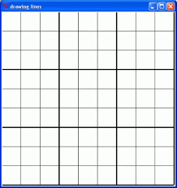
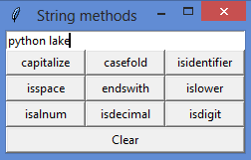
Interface Example
Notes:
Our board will be composed of buttons instead of typing out coordinates

Slide 4
Game Modes
Player vs Computer
Player vs Player ?
Old Vs Classic style Battleship

Slide 5
Game Modes
Old style: One shot per turn, GUI declares hit or miss
New style: n shots per turn based on the number of ships left, GUI declares after the n shots are selected

Slide 6
Battleship Ships
Carrier = 5 spaces
Battleship = 4 spaces
Cruiser = 3 spaces
Submarine = 3 spaces
Destroyer = 2 spaces

