Slide 1
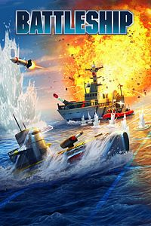
Battleship
By Tyler Gross, Kashyap Kandikonda

Slide 2
Creating a GUI interface
Currently testing and researching different Python GUI interfaces
Tkinter
Wx
Kivy
Pyforms

Slide 3
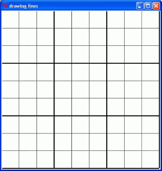
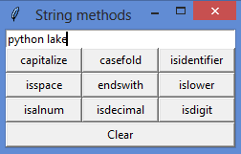
Interface Example

Slide 4
Game Modes
Player vs Computer
Player vs Player ?

Slide 5
Battleship Ships
Carrier = 5 spaces
Battleship = 4 spaces
Cruiser = 3 spaces
Submarine = 3 spaces
Destroyer = 2 spaces

