Slide 1
Ai Roadmap

Slide 2




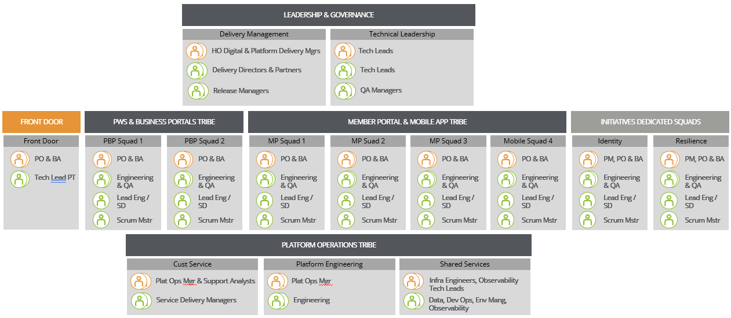
Member Domain Current State
VALUE |  | What this means in Practice
Embedded Partner with Deep Business & Platform Knowledge |  | We work seamlessly as an embedded partner with your business and technology teams to shape, design, and deliver efficiently, utilising our institutional knowledge and expertise across your entire digital ecosystem, which we have built over the past 10+ years.
End-to-End Accountability for outcomes |  | We take end-to-end accountability for outcomes, shaping the business and technical solution from early ambiguity and complexity through build, release, and 24/7 managed services, reducing hand-offs and delivery risk.
Flexible Scale |  | We provide flexible, tier-one scale, giving you access to a broad range of capabilities, both onshore and offshore, in a cost-effective way, while delivering with quality and accountability. We move with your business, whether that means ramping up, scaling down, or pivoting as plans change.
Member Outcomes with Proven Delivery |  | We provide strong, outcomes-focused people—not extra bodies or staff augmentation. Our core focus is on Member outcomes with proven delivery cadences.
Overview of Deloitte Scope within Member Domain
Scope – Channels (use Icons)
Member Portal | Mobile App (IOS & Android) | Public Website | Employer Portal | Advisor Portal
Services
Front Door Support
Delivery Management
Technical Leadership
Solution Design
Engineering
QA / Testing
Capabilities | Aus | Offshore
Delivery Management | 6 | 2
Technical Leadership | 6 | 1
Sitecore & Front End Engineers |  | 10
Microservice Engineers |  | 15
Mobile Engineers | 2 | 7
QA & QA Managers | 1 | 35
Service Delivery Managers | 1 | 1
Data Engineers | 1 | 3
Dev Ops Engineers |  | 2
Observability |  | 2
Environment Manager |  | 1
Other |  | 20
Total | 15 | 115
 | Scope – Applications / Infrastructure within Member Domain
Member Experience | Domain Microservices | Sitecore | Forgerock | Axway: Gateway
Legacy | Domain Microservices | Sitecore | Forgerock | Axway: Gateway
Shared | Jams Scheduler | Axway: MFT | Logic Apps | Azure Functions | Atlassian

