Slide 1









GLOBAL ARCHITECTURE
@velinfo1
Twitter account
www.velinfo.fr
Angular website
Velinfo’
AWS Cloud
eu-west-3
Content Delivery
CloudFront distribution
Public API
API Gateway
DNS
Route53
Static website content
S3 Bucket
API endpoints
Lambdas
Stations states and statistics
DynamoDB tables
Locked stations detection
and statistics aggregation
Lambdas
Current stations content and characteristics
DynamoDB tables
Stations’ content
and characteristics polling
Lambdas
Velib official API
Depends on

Slide 2

PIPELINE #1
STATIONS’ CONTENT AND CHARACTERISTICS POLLING
CurrentAvailability
The current available bikes and docks of each station
CurrentCharacteristics
The current name and geolocation of each station
FetchStationsAvailabilities
Poll the Velib endpoint to get the current content of each station. Compute the diff compared to the previous content.
FetchStationsCharacteristics
Poll the Velib endpoint to get each station name and geolocation
Every minutes
Every hours
Velib official API
/station_status.json
Velib official API
/station_information.json
Call / Read data from
Push data into
Consume DynamoDb stream

Slide 3
PIPELINE #2
@velinfo1
Twitter account
LOCKED STATIONS DETECTION AND STATISTICS AGGREGATION
PublishStateChangeTweet
Publish a tweet each time the official status of a station change
MedianUsage
The median activity for each station on a given weekday and 5 minutes window
StationStateChanges
Change in a station’s state
ComputeMedianUsage
Compute the median activity for each station for each weekday with a 5 minutes window accuracy
Every 5 minutes
StationState
Each station current state (locked, cold or in use)
StationUsageStatistics
The past activity of each station with a 5 minutes window accuracy
GlobalDailyStatistics
The whole network activity per hour
ComputeStationsStates
Compute missing activity on each station and detect locked stations based on past median activity
ComputeUsage
For each station compute the total activity for each 5-minutes window
ComputeGlobalDailyStatistics
For the whole network, compute the total activity for each 1-hour window
CurrentCharacteristics
The current name and geolocation of each station
CurrentAvailability
The current available bikes and docks of each station
Call / Read data from
Push data into
Consume DynamoDb stream

Slide 4
PIPELINE #3
API ENDPOINTS
Public API
API Gateway
GET /stations
GET
/global-statistics
GET
/state-changes
GET
/activities/actual
GET
/activities/expected
GetStations
Get the current content and characteristics of all the stations
GetGlobalStatistics
Get the global networks statistics (activity per hour)
GetStateChanges
Get the last 10 station state changes over the past week
GetActualActivities
Return today’s activity for each station with a 15 minutes window accuracy
GetExpectedActivities
Return this weekday expected activity for each station with a 15 minutes window accuracy
GlobalDailyStatistics
The whole network activity per hour
StationStateChanges
Change in a station’s state
StationUsageStatistics
The past activity of each station with a 5 minutes window accuracy
MedianUsage
The median activity for each station on a given weekday and 5 minutes window
CurrentAvailability
The current available bikes and docks of each station
CurrentCharacteristics
The current name and geolocation of each station
StationState
Each station current state (locked, cold or in use)
Call / Read data from
Push data into
Consume DynamoDb stream

Slide 5
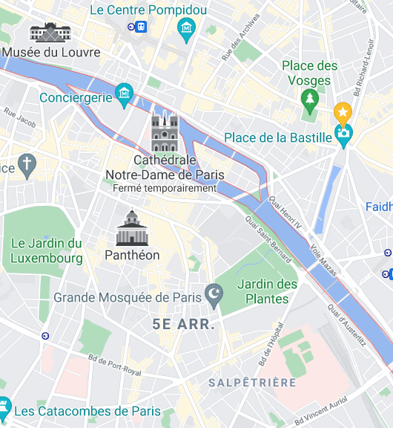
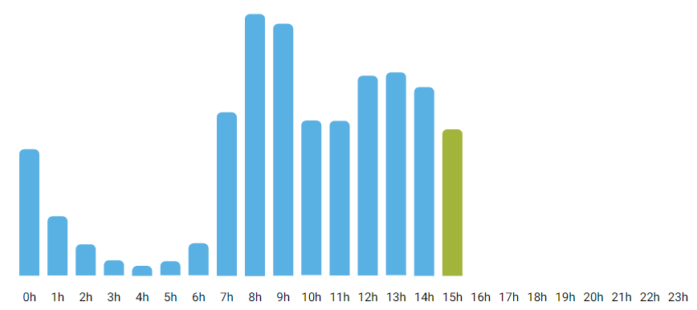

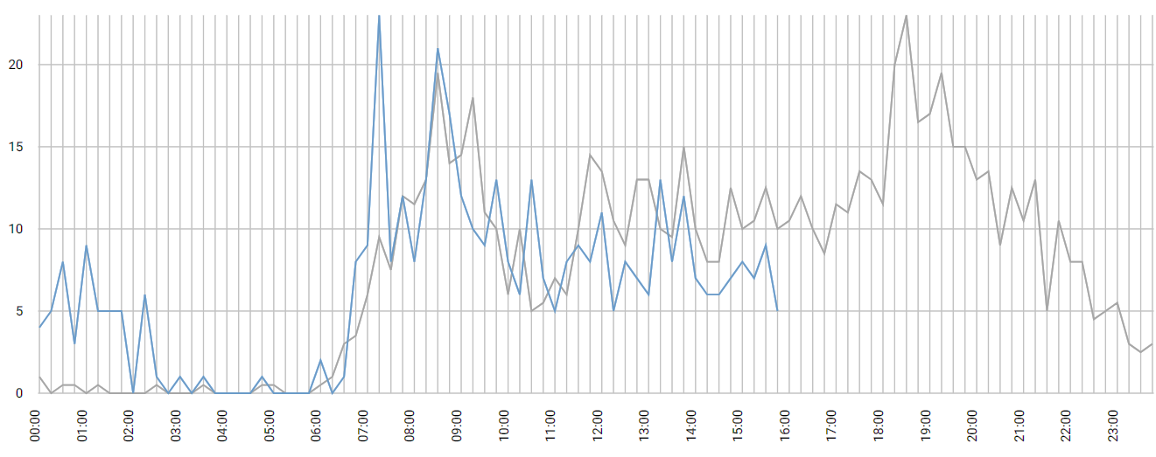
WIREFRAMES
Home page
Map
Stations list
Favorites
Station details
Home Favorites Map Stations
Home Favorites Map Stations
Home Favorites Map Stations
Home Favorites Map Stations
Home Favorites Map Stations
Main features
List of stations
List of favorites
Stations name
Today’s global statistics
Last station changes
Stations details
Activity vs expected
About
: link to a station’s details page

Slide 6

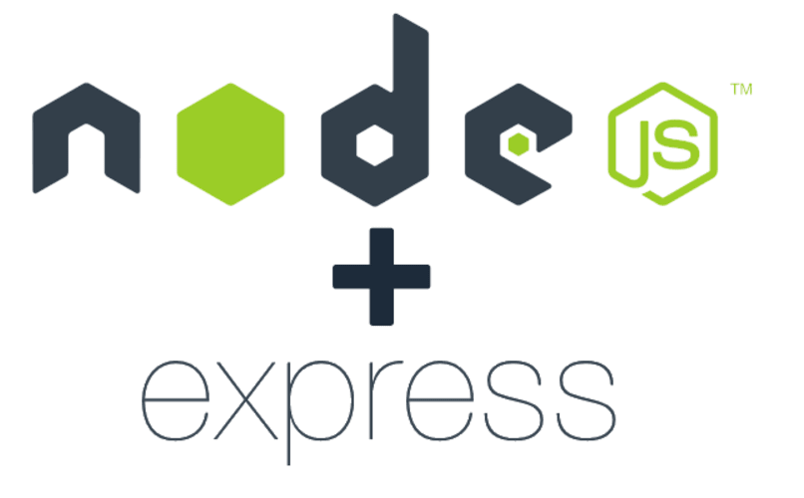

Server #1
app.js
Public API
API Gateway
GET /client/{id}
POST /client
GetClient
Controller
CreateClient
Controller
GetClient
Lambda that fetch a client in database
CreateClient
Lambda that validate the input and create the client in database.
Server #2
ClientTable
DynamoDb table containing the clients’ information
ClientCollection
MongoDb collection containing the clients’ information
CLASSIC ARCHITECTURE
SERVLESS ARCHITECTURE

Slide 7





AWS Cloud
Availability zone
Private subnetwork
VPC
Load balancer
ELB
Server
EC2
Server
EC2
SELF MANAGED

Slide 8

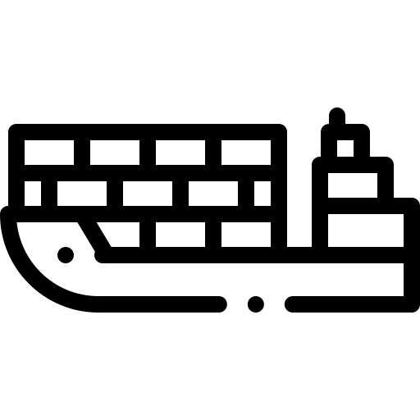
AWS Cloud
Availability zone
Private subnetwork
VPC
Load balancer
ELB
Container Service
ECS
Server
EC2
Server
EC2
Container
Container
CONTAINER PLATFORM

Slide 9

AWS Cloud
Load balancer
Api Gateway
Source code
S3 Bucket
Function Lambda
Code
Runtime
Shared compute resources
Compute
SERVERLESS

Slide 10
Cost for a year | 100% used | 50% used | 0% used
EC2 (t4g.nano) | $36 | $36 | $36
Lambda (128M) | $66 | $33 | $0

Slide 11

A day later, a new consumer (C) is created for a new use case.
It received every events published.
Consumer A is online when the new event is published.
It received it right away.
One hour after, consumer B wakes up.
It received every events that it has not already consumed.
Bike Station #1
producer
StateManagement
consumer A
…
producer
Bike rental events topic
Accounting
consumer B
C
B
A
Bike Station #1500
producer
Reporting
consumer C

Slide 12
Consumer / Producer
Create thumbnail
Topic C
Video thumbnails
Consumer / Producer
Downscale video
Topic B
Low fidelity video
Producer
Import video
Topic A
Raw videos
Consumer / Producer
Create preview
Topic D
Video previews
Consumer
Notify subscribers
Consumer
Detect licensed music

Slide 13
