Slide 1









GLOBAL ARCHITECTURE
@velinfo1
Twitter account
www.velinfo.fr
Angular website
Velinfo’
AWS Cloud
eu-west-3
Content Delivery
CloudFront distribution
Public API
API Gateway
DNS
Route53
Static website content
S3 Bucket
API endpoints
Lambdas
Stations states and statistics
DynamoDB tables
Locked stations detection
and statistics aggregation
Lambdas
Current stations content and characteristics
DynamoDB tables
Stations’ content
and characteristics polling
Lambdas
Velib official API
Depends on

Slide 2
GLOBAL ARCHITECTURE
Velinfo’
velinfo.fr
Website
AWS Cloud
global
DNS velinfo.fr
Route53
DNS api.velinfo.fr
Route53
AWS Cloud
eu-west-3
Static website content
S3 Bucket
Public API
API Gateway
API endpoints
Lambdas
Database
DynamoDB tables
Data integration
and detection algorithm
Lambdas
Velib official API
Depends on

Slide 3

PIPELINE #1
FECHING THE STATIONS’ CONTENT AND CHARACTERISTICS
StationsContent
The available bikes and docks and official status of each station
StationsCharacteristics
The current name and geolocation of each station
Every minute
EventBridge
FetchStationsContent
Poll the Velib endpoint to get the current content of each station. Compute the diff compared to the previous content.
Every hour
EventBridge
FetchStationsCharacteristics
Poll the Velib endpoint to get each station name and geolocation
Velib official API
/station_status.json
Velib official API
/station_information.json
DynamoDb stream trigger
Trigger
Read data from
Push data into

Slide 4
PIPELINE #2
@velinfo1
Twitter account
LOCKED STATIONS DETECTION AND STATISTICS AGGREGATION
PublishStateChangeTweet
Publish a tweet each time the official status of a station change
MedianUsage
The median activity for each station on a given weekday for a given 10 minutes window
GlobalDailyStatistics
The whole network activity per hour
StationStateChanges
Change in a station’s state
Every 5 minutes
EventBridge.
ComputeMedianUsage
Compute the median activity for each station for each weekday for a given 10 minutes window
ComputeGlobalDailyStatistics
For the whole network, compute the total activity for each 1-hour window
StationState
Each station current state (locked, cold or in use)
StationUsageStatistics
The past activity of each station for a given 10 minutes window
ComputeStationsStates
Compute missing activity on each station and detect locked stations based on past median activity
ComputeUsage
For each station compute the total activity for a given minutes window
StationsCharacteristics
The current name and geolocation of each station
StationsContent
The current available bikes and docks of each station
DynamoDb stream trigger
Trigger
Read data from
Push data into

Slide 5
PIPELINE #2
STATISTICS, MEDIAN ACTIVITY AND LOCKED STATIONS DETECTION
MedianActivity
The median activity for each station for each weekday for each 10 minutes timeslot
StationStateChanges
Each change of a station’state
Every 10 minutes
EventBridge
ComputeMedianActivity
Compute the median activity for each station for each weekday for each 10 minutes timeslot
StationsState
Each station current state (locked or in use) and its missing activity
StationsStatistics
The past activity of each station for each 10 minutes timeslot
ComputeStationsStates
Compute the missing activity for each station and deduce if it is locked
ComputeStatistics
For each station compute the total activity for the current 10 minutes timeslot
StationsContent
The current available bikes and docks of each station
DynamoDb stream trigger
Trigger
Read data from
Push data into

Slide 6
PIPELINE #2
MEDIAN USAGE COMPUTATION
MedianActivity
The median activity for each station on a given weekday for a given 10 minutes window, based on the 4 last weeks
Every 10 minutes
EventBridge.
ComputeMedian
Compute the median activity for each station for each weekday for a given 10 minutes window , based on the 4 last weeks
StationStatistics
The past activity of each station for a given 10 minutes window
ComputeActivity
For each station compute the total activity for a given 10 minutes window
StationsContent
The current available bikes and docks of each station
DynamoDb stream trigger
Trigger
Read data from
Push data into

Slide 7
PIPELINE #2
LOCKED STATIONS DETECTION AND STATISTICS AGGREGATION
StationState
Each station current state (locked, cold or in use)
MedianUsage
The median activity for each station on a given weekday for a given 5 minutes window
ComputeStationsStates
Compute missing activity on each station and detect locked stations based on past median activity
Every 5 minutes
EventBridge.
ComputeMedianUsage
Compute the median activity for each station for each weekday for a given 5 minutes window
StationUsageStatistics
The past activity of each station for a given 5 minutes window
ComputeUsage
For each station compute the total activity for a given 5 minutes window
StationsContent
The current available bikes and docks of each station
DynamoDb stream trigger
Trigger
Read data from
Push data into

Slide 8
API ENDPOINTS
DNS api.velinfo.fr
Route 53
Public API
API Gateway
GET /stations
GET /state-changes
GET /activity
GET /activity/by-station
GET /prediction
GET /prediction/by-station
GetStations
Get the current content and characteristics of all stations
GetStateChanges
Get the last 10 station state changes
GetNetworkActivity
Get today’s ‘10 minutes by 10 minutes’ activity for the whole network
GetActivityByStation
Get today’s ‘10 minutes by 10 minutes’ activity for each station
GetNetworkPrediction
Get today’s ‘10 minutes by 10 minutes’ prediction for the whole network
GetPredictionByStation
Get today’s ‘10 minutes by 10 minutes’ prediction for each station
StationStateChanges
Change in a station’s state
StationUsageStatistics
The past activity of each station with a 10 minutes window accuracy
MedianUsage
The median activity for each station on a given weekday and 10 minutes window
StationContent
The current available bikes and docks of each station
DailyNetworkUsageStatistics
Today’s 10 minutes by 10 minutes activity for the whole network
DailyNetworkUsagePredictions
Today’s 10 minutes by 10 minutes prediction for the whole network
StationCharacteristics
The current name and geolocation of each station
StationState
The current state (locked, cold or in use) of each station
Call / Read data from

Slide 9



Server #1
app.js
Public API
API Gateway
GET /client/{id}
POST /client
GetClient
Controller
CreateClient
Controller
GetClient
Lambda that fetch a client in database
CreateClient
Lambda that validate the input and create the client in database.
Server #2
ClientTable
DynamoDb table containing the clients’ information
ClientCollection
MongoDb collection containing the clients’ information
CLASSIC ARCHITECTURE
SERVERLESS ARCHITECTURE

Slide 10





AWS Cloud
Availability zone
Private subnetwork
VPC
Load balancer
ELB
Server
EC2
Server
EC2
SELF MANAGED

Slide 11


AWS Cloud
Availability zone
Private subnetwork
VPC
Load balancer
ELB
Container Service
ECS
Server
EC2
Server
EC2
Container
Container
CONTAINER PLATFORM

Slide 12

AWS Cloud
Load balancer
Api Gateway
Source code
S3 Bucket
Function Lambda
Code
Runtime
Shared compute resources
Compute
SERVERLESS

Slide 13
Cost for a year | 100% used | 50% used | 0% used
EC2 (t4g.nano) | $36 | $36 | $36
Lambda (128M) | $66 | $33 | $0

Slide 14

A day later, a new consumer (C) is created for a new use case.
It received every events published.
Consumer A is online when the new event is published.
It received it right away.
One hour after, consumer B wakes up.
It received every events that it has not already consumed.
Bike Station #1
producer
StateManagement
consumer A
…
producer
Bike rental events topic
Accounting
consumer B
C
B
A
Bike Station #1500
producer
Reporting
consumer C

Slide 15
Consumer / Producer
Create thumbnail
Topic C
Video thumbnails
Consumer / Producer
Downscale video
Topic B
Low fidelity video
Producer
Import video
Topic A
Raw videos
Consumer / Producer
Create preview
Topic D
Video previews
Consumer
Notify subscribers
Consumer
Detect licensed music

Slide 16
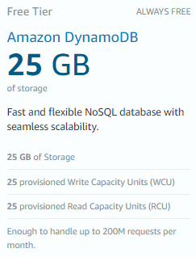
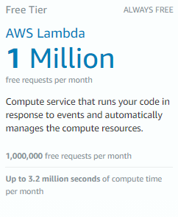

Slide 17
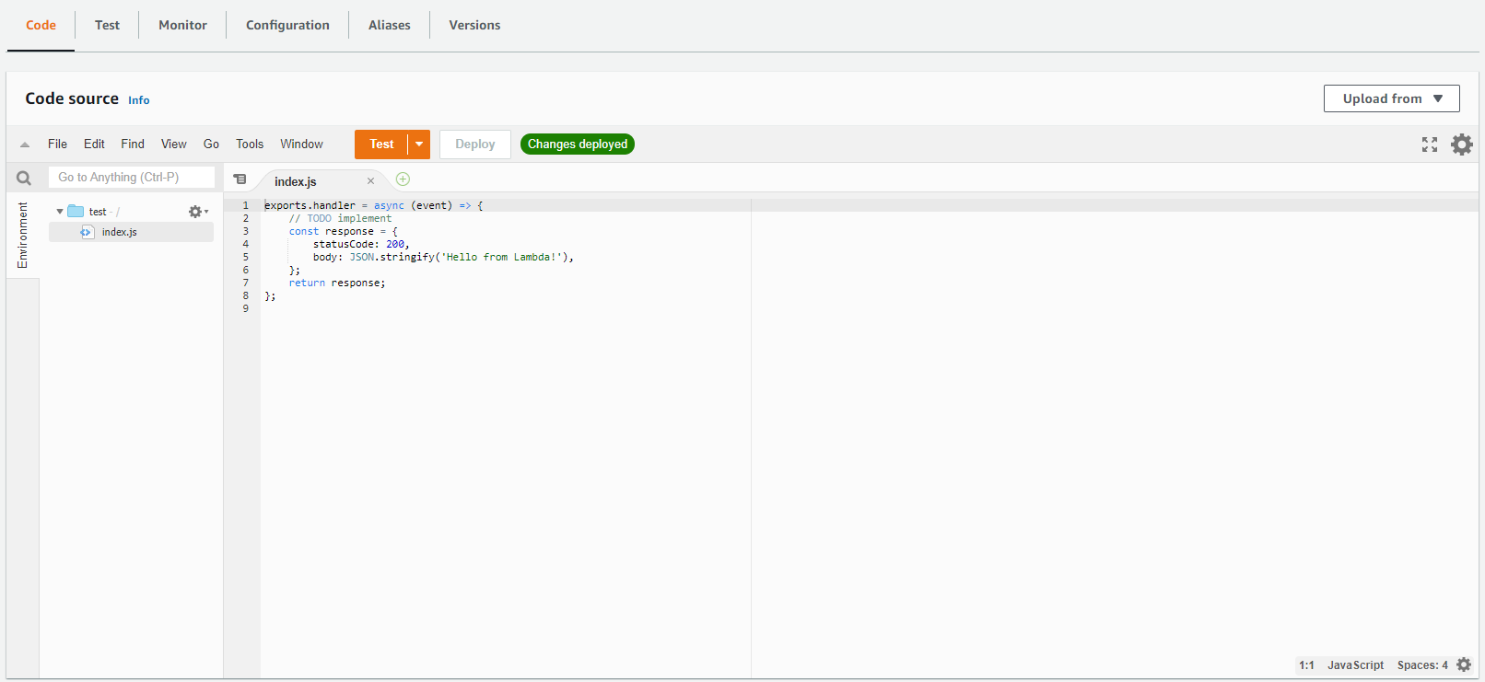

Slide 18
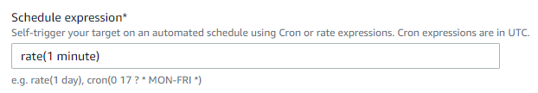
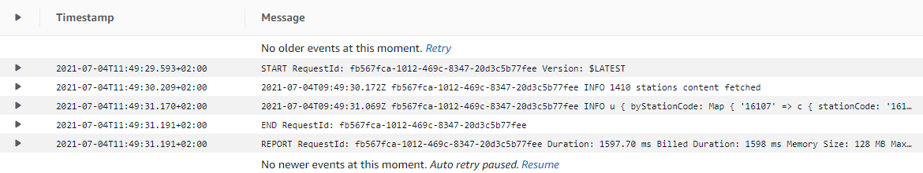

Slide 19


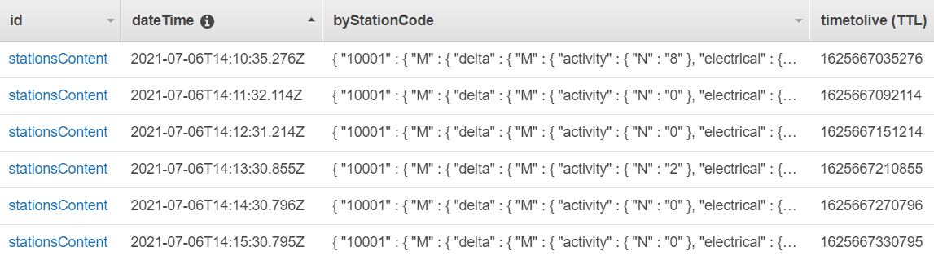
Symbol (Partition key) | Date (Sort key) | Name | Closing quote | Time to live
‘AMZN’ | ‘2021-06-30’ | ‘Amazon.com, Inc.’ | { ‘quote’:3440,’currency’:’USD’} | 1654041600
‘AMZN’ | ‘2021-07-01’ | ‘Amazon.com, Inc.’ | { ‘quote’:3433,’currency’:’USD’} | 1656633600
‘AMZN’ | ‘2021-07-02’ | ‘Amazon.com, Inc.’ | { ‘quote’:3511,’currency’:’USD’} | 1656720000
 | Partition key | Sort key | Easy sort ? | Number of items | Items’ size | RCUs | RCUs (with burst) | WCUs | WCUs (with burst)
#1 | Station code | DateTime |  | 1.500 | 160 b | 1.500 | 25 | 1.500 | 25
#2 | DateTime |  |  | 1 | 230 Kb | 58 | 1 | 230 | 4
#3 | - | DateTime |  | 1 | 230 Kb | 58 | 1 | 230 | 4

Slide 20
StationCode (Partition key) | DateTime (Sort key) | Data (The content of a single station)
10001 | 2021-07-03T17:11:31.204Z | {mechanicalBikes: 2, electricBikes: 4, …
10001 | 2021-07-03T17:11:30.201Z | {mechanicalBikes: 1, electricBikes: 4, …
10001 | 2021-07-03T17:11:29.145Z | {mechanicalBikes: 1, electricBikes: 4, …
DateTime (Partition key) | - (Sort key) | Data (The content of a all the stations)
2021-07-03T17:11:31.204Z |  | {1001: {mechanicalBikes: 2, electricBikes: 4, …
2021-07-03T17:11:30.201Z |  | {1001: {{mechanicalBikes: 1, electricBikes: 4, …
2021-07-03T17:11:29.145Z |  | {1001: {{mechanicalBikes: 1, electricBikes: 4, …
Constant (Partition key) | DateTime (Sort key) | Data (The content of a all the stations)
‘stationsContent’ | 2021-07-03T17:11:31.204Z | {1001: {mechanicalBikes: 2, electricBikes: 4, …
‘stationsContent | 2021-07-03T17:11:30.201Z | {1001: {{mechanicalBikes: 1, electricBikes: 4, …
‘stationsContent | 2021-07-03T17:11:29.145Z | {1001: {{mechanicalBikes: 1, electricBikes: 4, …

Slide 21
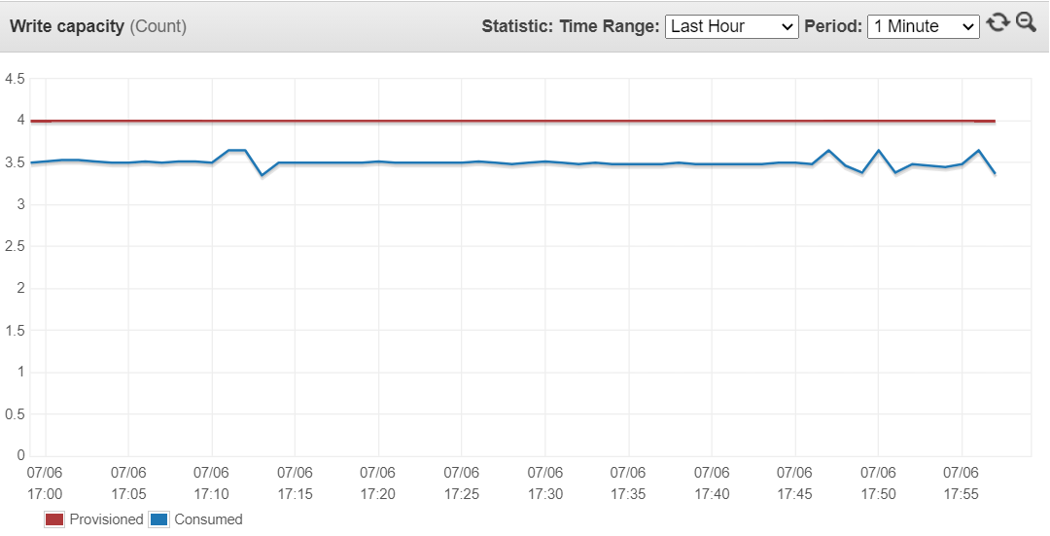


Slide 22




1
The TypeScript code is transpiled into JavaScript and the SAM template is transformed into a full CloudFormation template
2
The code and template is uploaded to an S3 bucket and used by CloudFormation
3
CloudFormation compare the provided template to the current state of the application and create or remove the resources as necessary
The TypeScript code is transpiled into JavaScript and the SAM template is transformed into a full CloudFormation template
AWS Cloud
CloudFormation Application
JS
TS
JS
JavaScript functions code
TypeScript functions code
Transpiler
JavaScript functions code
CloudFormation
DynamoDb Table
SAM
deploy
YAML
Lambda Function
YAML
YAML
SAM S3 configuration bucket
CloudFormation template
SAM template
SAM
CloudFormation template
EventBridge Rule

Slide 24
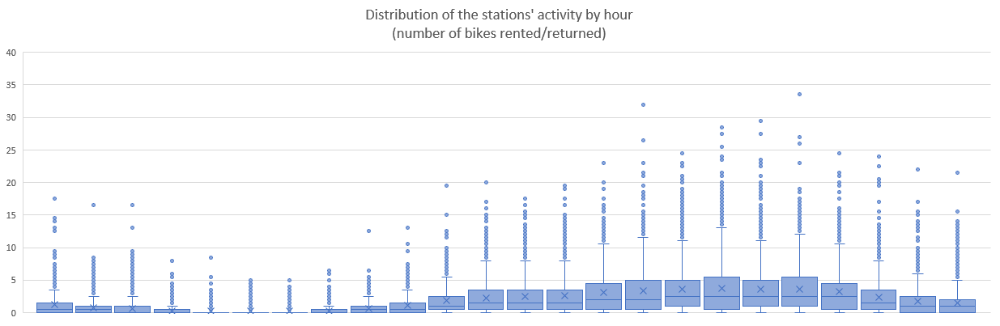
12 PM
1 AM
2 AM
3 AM
4 AM
5 AM
6 AM
7 AM
8 AM
9 AM
10 AM
11 AM
12 AM
1 PM
2 PM
3 PM
4 PM
5 PM
6 PM
7 PM
8 PM
9 PM
10 PM
11 PM

Slide 25
Median activity computation
Naïve solution
StationsContent table
Lock detection function
StationsState table
Date | Time | Activity
… | …
1 week ago | 1:07 PM to 2.34 PM | 13
… | …
2 weeks ago | 1:07 PM to 2.34 PM | 24
… | …
3 weeks ago | 1:07 PM to 2.34 PM | 17
… | …
4 weeks ago | 1:07 PM to 2.34 PM | 26
… | …
Missing Activity | Locked
19 20.5 | Yes No
348 reads
Median activity
between 1.07 and 2.34 PM
21.5
348 reads
348 reads
348 reads

Slide 26
Median activity computation
Compounding solution
StationsContent table
Lock detection function
StationsState table
Date | Time | Activity
… | …
1 week ago | 2.34 PM | 1
… | …
2 weeks ago | 2.34 PM | 0
… | …
3 weeks ago | 2.34 PM | 0
… | …
4 weeks ago | 2.34 PM | 2
… | …
Missing activity
(1.07 to 2.33 PM)
Missing Activity | Locked
19 20.5 | Yes No
1 read
19
1 read
+
Median activity
2.34 PM
1 read
1.5
=
1 read
Missing activity
(1.07 to 2.34 PM)
1 read
21.5

Slide 27
Median activity computation
Compounding + precomputing solution
StationsContent table
MedianActivity table
Lock detection function
StationsState table
Date | Time | Activity
Today | 2.34 PM | 0
Today | 2.33 PM | 0
Today | 2.32 PM | 0
… | …
Date | Timeslot | Activity
Monday | 2.30 PM | 15
… | …
Missing activity
(1.07 to 2.33 PM)
Missing Activity | Locked
19 20.5 | Yes No
1 read
1 read
1 read
19
+
Median activity
2.30 PM / 10
1.5
StationsStatistics table
=
Date | Timeslot | Activity
Today | 2.30 PM | 0
… | …
1 week ago | 2.30 PM | 15
… | …
2 weeks ago | 2.30 PM | 17
… | …
3 weeks ago | 2.30 PM | 15
… | …
4 weeks ago | 2.30 PM | 8
Missing activity
(1.07 to 2.34 PM)
21.5
1 read
1 read
1 read
1 read

Slide 28
$$Station missing activity= ∆time ∗station median activity$$
$$Station missing activity= ∆time ∗station median activity ∗network activity ratio$$
$= ∆time ∗station median activity ∗\frac{network activity}{network median}$

Slide 29
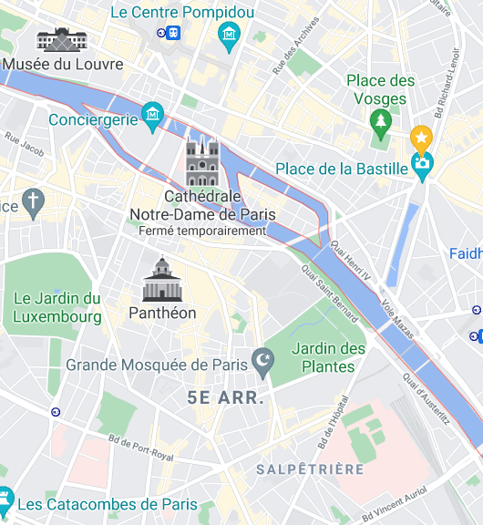
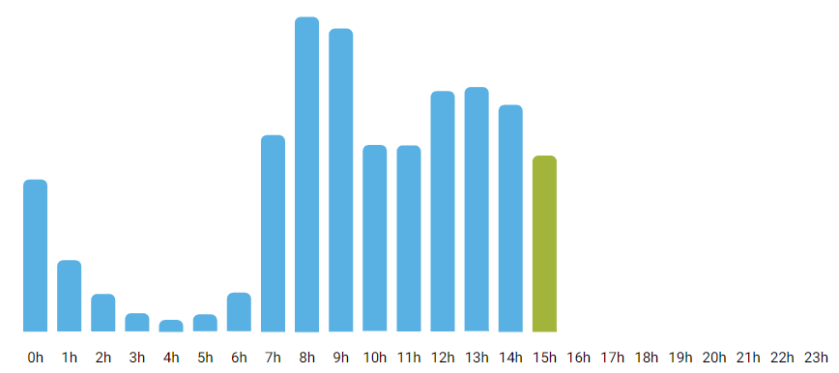

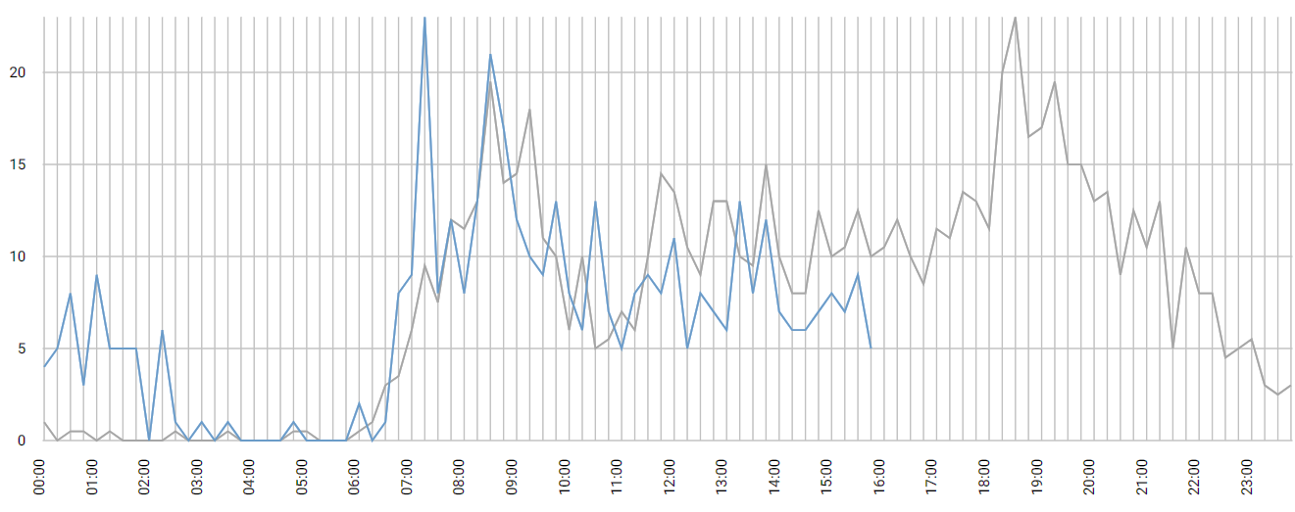
WIREFRAMES
Home page
Statistics
Map
Stations list
Station details
Home Map Stations
Home Map Stations
Home Map Stations
Home Map Stations
Home Favorites Map Stations
Main features
Today’s global statistics
List of stations
Stations name
Statistics
Last station changes
Stations details
Global activity vs expected
Activity vs expected
About
GET /stations
GET / activity
GET /stations
GET /stations
GET /stations
GET /activity
GET /prediction
GET /activity/by-station
GET /state-changes
GET /predictions/by-station
: link to a station’s details page
: underlying API

Slide 30
BASIC REST API STRUCTURE
Method | Path | Details
GET | /stations | Get all stations informations and current states
GET | /state-changes | Get the recent station’s changes of state (locked vs ok)
GET | /activity | Get today’s activity for the whole network
GET | /activity/by-station | Get today’s activities for each station
GET | /prediction | Get today’s prediction for the whole network
GET | /prediction/by-station | Get today predictions for each station

Slide 31
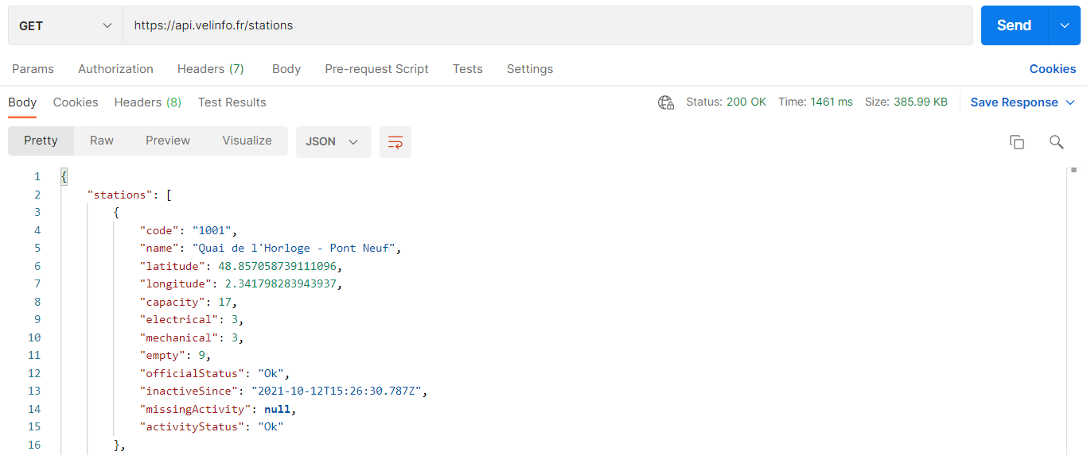

Slide 32
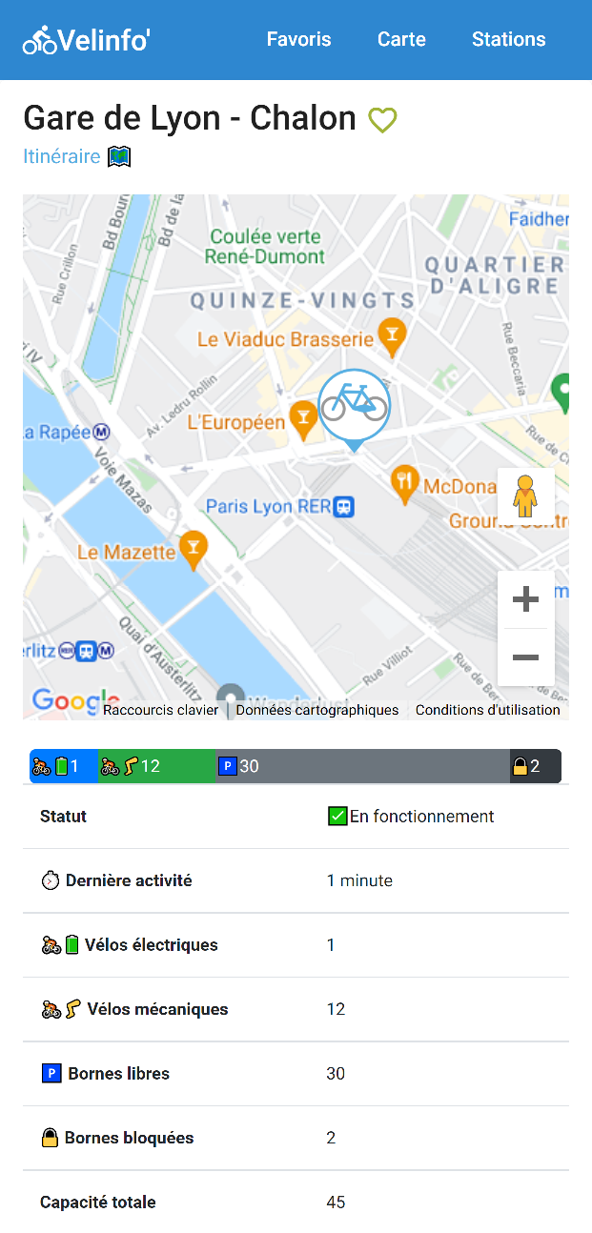

Slide 33
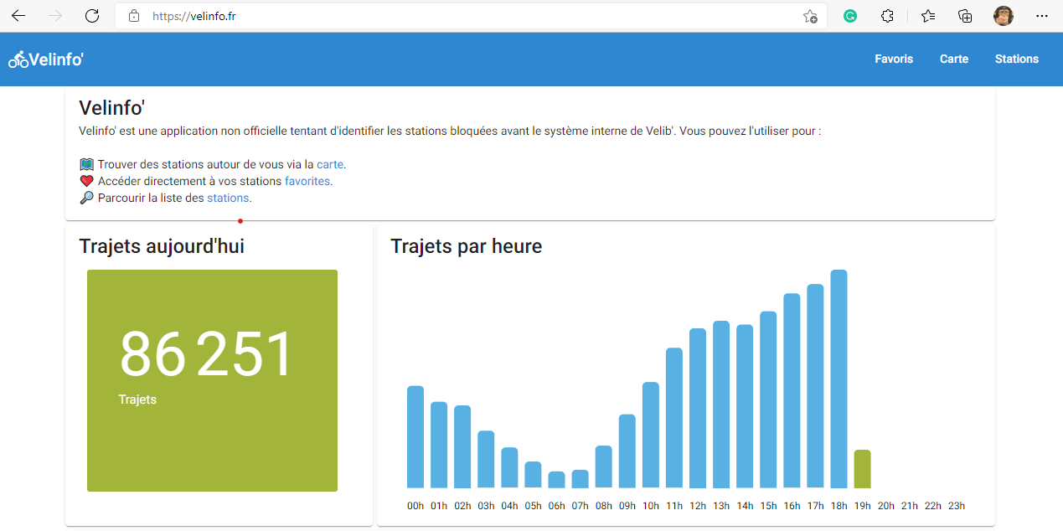



Slide 34
API ENDPOINTS
DNS api.velinfo.fr
Route 53
Public API
API Gateway
GET /stations
GET /state-changes
GET /activity
GET /activity/by-station
GET /prediction
GET /prediction/by-station
GetStations
Get the current content and characteristics of all stations
GetStateChanges
Get the last 10 station state changes
GetNetworkActivity
Get today’s ‘10 minutes by 10 minutes’ activity for the whole network
GetActivityByStation
Get today’s ‘10 minutes by 10 minutes’ activity for each station
GetNetworkPrediction
Get today’s ‘10 minutes by 10 minutes’ prediction for the whole network
GetPredictionByStation
Get today’s ‘10 minutes by 10 minutes’ prediction for each station
StationStateChanges
Change in a station’s state
StationUsageStatistics
The past activity of each station with a 10 minutes window accuracy
MedianUsage
The median activity for each station on a given weekday and 10 minutes window
StationContent
The current available bikes and docks of each station
DailyNetworkUsageStatistics
Today’s 10 minutes by 10 minutes activity for the whole network
DailyNetworkUsagePredictions
Today’s 10 minutes by 10 minutes prediction for the whole network
StationCharacteristics
The current name and geolocation of each station
StationState
The current state (locked, cold or in use) of each station
Depends on

