Slide 1
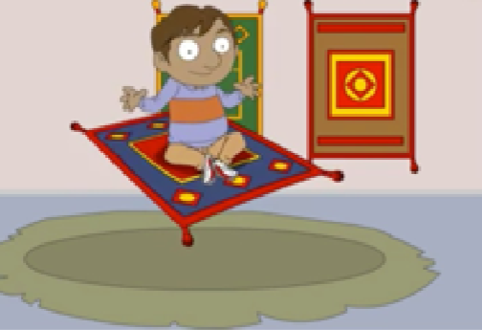
Ali and the Magic Carpet

Slide 2
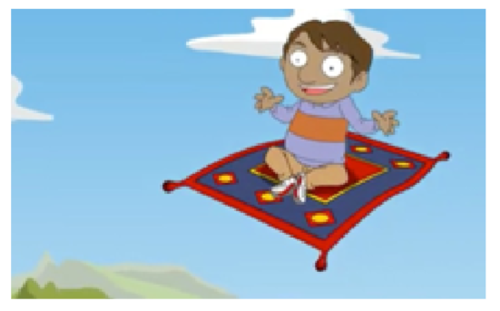
One very hot day Ali finds a carpet in his uncle’s shop. “What’s this？”
Suddenly the carpet jumps! It moves and flies off into the air.
“Hey! What’s happening?”
A loud booming voice comes from the carpet.
“Welcome, O master. I am a magic carpet.”
Notes:
Where does Ali ﬁnd a carpet? What can the carpet do ?

Slide 3
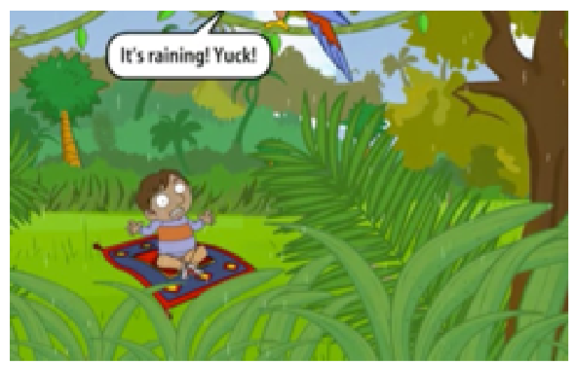
First they fly high up into the sky and then they land in a jungle. It is hot and wet and it’s raining.
Notes:
What does Ali feel about the weather in the jungle?

Slide 4
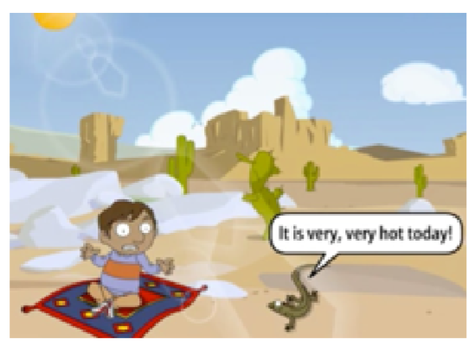
Then they fly to the desert. It is very, very hot and dry.
“It is very, very hot today!”
Notes:
What does Ali feel about the weather in the desert?

Slide 5
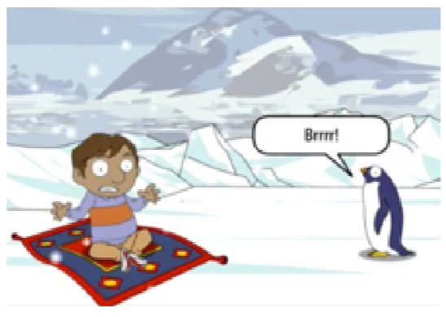
After that they fly to the South Pole. There is lots of ice and snow. It’s freezing.
“Brrr!”
Notes:
What can you see in the South Pole?

Slide 6
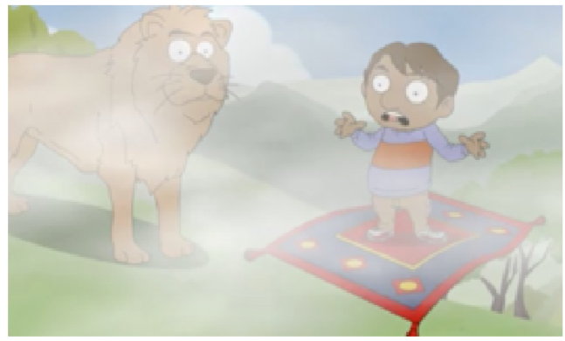
“Where are we now? I can’t see!”
“In the mountains. Can you see me?”
“It’s very foggy.”
Notes:
Why can’t Ali see in the mountains? What animal can you see in the picture?

Slide 7
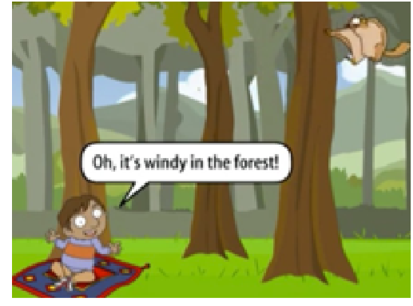
Then they fly to a forest. It’s very windy there.
“Oh, it’s windy in the forest!”
Notes:
What does Ali feel about the weather in the forest？

Slide 8
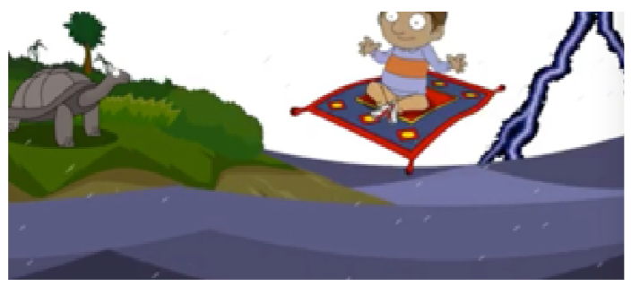
Then they fly to an island in the sea. There is thunder and lightning.
“Aaagh! Let’s go home!
“What a storm!”
Notes:
Why does Ali want to go home? What does Ali feel about the weather on the island?

Slide 9
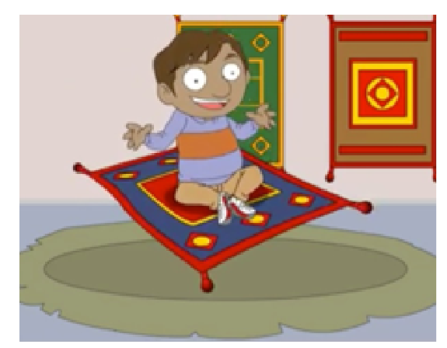
Finally they fly back home. The carpet lands in the shop and Ali gets off.
“Wow! What an adventure!”
Notes:
The teacher explains the word “adventure”. What adventure did you have?
More in-class questions from the teacher Imagine you ﬁnd a magic carpet and it will ﬂy anywhere you want to go! • Where do you go? • What do you see when you get there? • What's the weather like?

Slide 10
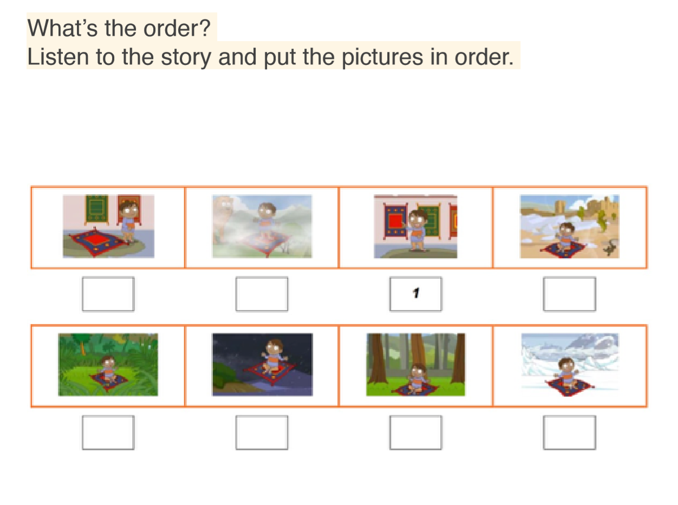
Notes:
8,5,1,3,2,7,6,4

Slide 11
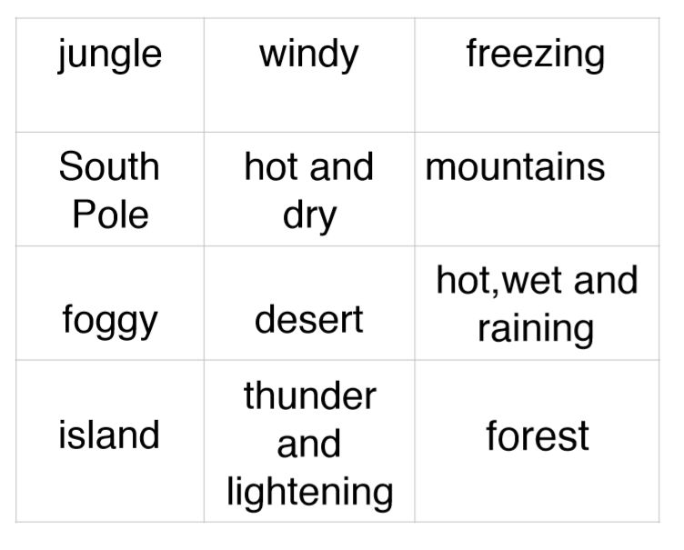
Finish the following matching as fast as you can.

Slide 12
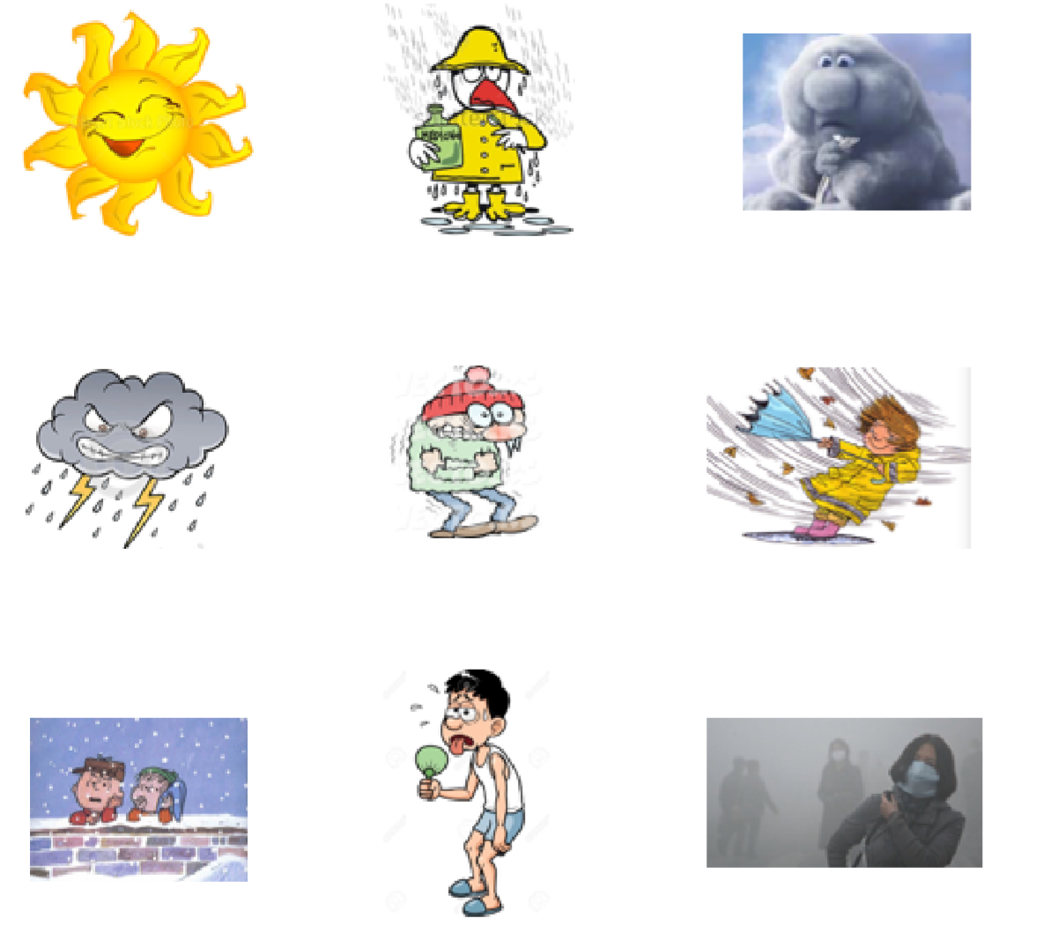
What’s the word?
Write the word to describe the weather in the picture.
Notes:
sunny, raining, cloudy, stormy, freezing, windy, snowy, hot, smoggy

Slide 13
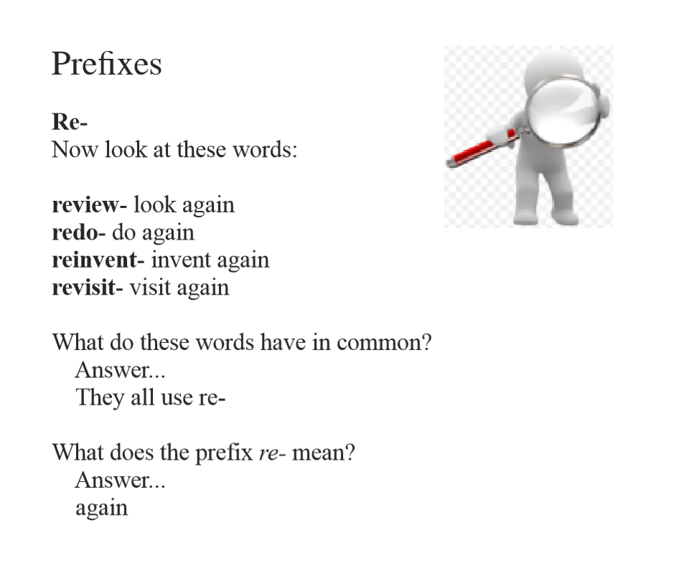

Slide 14
