Slide 1
Programming with Golang
shyangyong 2021/09

Slide 2
History
Pre-go 1
r56, r57, r58, r59, r60 (Year 2011)
Go 1.0
Go1.0 released 2012-03-28
Go 1.1 ->Go 1.17
Go1.17 released 2021-08-16

Slide 3
Installation
Cross platform
windows, linux ,macos
Environment(version 1.17)
export GOROOT="/usr/local/go" (bin, pkg, src ..)
export GOPATH="/home/xxx/go“ (third-party software directory, including bin,pkg,src ..)

Slide 4
IDE
vscode
plugin of go-delve supports local debug/attach, remote debug/attach
goland
Jetbrains Corp (not Free)
visible profiler on cpu, memory, mutex, blocking
LiteIDE X
made in china (https://github.com/visualfc/liteide)
eclipse, sublime , and so on ..

Slide 5
Variable
keywords
package, import, func, chan, select, defer, fallthrough, range ..
const
true, false, nil, iota
basic types
(u)int, (u)int(8/16/32/64), float(32/64), complex64(128)
bool, byte(uint8), string, rune(int32), error(interface)

Slide 6
Variable
assignment
<1> var x int // assign x to default value 0
<2> x := 1, x := foo() // the same as c++11 auto
<3> x := 1, y := int32(1), if ( x == y ) {} // compile error, x == (int)y
<4> type ConnState int
const(
StateInit ConnState = iota // value of 0
StateConnected // value of 1
StateClosed // value of 2
)
<5> assign map/slice/channel is through reference, while array though value.

Slide 7
Function
global function
make, new, len/cap, append, copy, delete, close
complex/real/imag
panic/recover
function defer
func process(a int)(int, error){
defer func(){ r := recover() … }()
defer m.Unlock()
m.Lock()
}

Slide 8
New vs Make
new allocates zeroed memory storage
f := File{param : 1} // OK
f := new(File) // OK
f := new(File{param : 1}) // compile error
make can only initialize the slice, map, channel types
arr := make([]int, length, capacity)
m := make(map[int]int, capacity)
ch := make(chan int, buffLen)

Slide 9
Memory escape
Each variable in Go exists as long as there are references to it.
When possible, the Go compilers will allocate variables that are local to a function in that function's stack frame.
If the compiler cannot prove that the variable is not referenced after the function returns, then the compiler must allocate the variable on the garbage-collected heap.
If a local variable is very large, it might make more sense to store it on the heap rather than the stack.

Slide 10
Struct
composition vs inheritance literals
type A struct { x int}
type B struct { x int }
type C struct { A \n B }
c.A.foo() // call A.foo()
c.foo() // call C.foo(), or explicit foo method of A or B, or build ambiguous error
no constructor, no destructor
func NewFile(name string) *File{
return &File{name:name}
}

Slide 11
Struct method
define on value or pointer
func (f File) valueMethod{} // called with a copy of file
func (f *File) pointerMethod{} // caller will see the changes
f :=File{}
f.pointerMethod() // OK

Slide 12
Interface
interface implement
type Reader interface{ read() }
type Writer interface{ write() }
type File struct{}
func (c File) read(){}
func (c File) write(){}

Slide 13
Nil interface
how to return nil ?
func foo1() *File{
var f *File =nil
return f }
func foo2() FileInterface{
var f *File =nil
return f }
if (foo1() == nil) // ok
if (foo2() == nil) // fail, need just return nil
Under the covers, interfaces are implemented as two elements, a type T and a value V. An interface value is nil only if the V and T are both unset.

Slide 14
Conversion
<1>a := b.(int64) // may course panic
<2>a, ok := b.(*A), if(ok){}
<3>switch b.(type):{
case *B:{}
}
<4>a := int64(1)
b := (*[8]byte)(unsafe.Pointer(&a))

Slide 15
Goroutine
goroutine creation
go doAction()
go func(param int){}(value)
sync.WaitGroup
Add, Done, Wait
GOMAXPROCS
Environment variable of GOMAXPROCS affects how many goroutines can actually execute at once.
Default value equals to the number of cpu cores available.

Slide 16
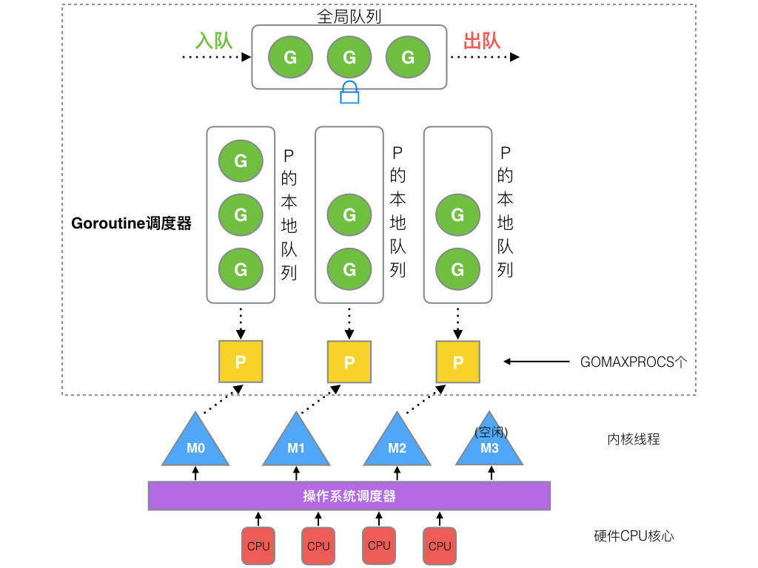
Goroutine
GMP model

Slide 17
Goroutine
There is no goroutine ID. All goroutines are anonymous for user.
Go scheduler may make context switching on four events:
<1>the use of keyword go
<2>garbage collection
<3>system calls
<4>synchronization
Compilers and processors may reorder the reads and writes executed within a single goroutine only when the reordering does not change the behavior within that goroutine as defined by the language specification.

Slide 18
Channel
safe communication over goroutines
src/runtime/chan.go :
type hchan struct{
…
buf unsafe.Pointer
closed uint32
…
recvq waitq // list of recv waiters
sendq waitq // list of send waiters
lock mutex // lock protects all fields in hchan
}

Slide 19
Channel
channel creation
ch := make(chan int) // blocks until others read
ch := make(chan int, len) // blocks if reached the threshold
var readCh <-chan int = ch // read only channel
var writeCh chan<- int = ch // write only channel

Slide 20
Channel
channel read
data <- ch // blocks until data arrived or channel closed
data, ok <- ch // ok is false if channel closed
for data := range ch {} // loop read
select{
case data := <- ch:{}
case <-time.After(1000):{} // blocks until timeout
default:{} // not blocks if the default case existed
}

Slide 21
Channel
channel write
ch <- data // panic if channel closed , // panic(plainError("send on closed channel"))
select{
case ch <- data:{}
case <-time.After(1000):{} // blocks until timeout
default:{} // not blocks if the default case existed
}

Slide 22
Channel
channel close
close(ch) // panic if closed already
// panic(plainError("close of closed channel"))
There is not build-in function nor universal way to check a channel status. By reading from a channel can get the status, and it’s not usefull as it’s not atomic.
Closing channel principles :
<1>Writer side closes the channel.
<2>Choose one writer to do the job.
<3>Use sync.Once/Mutex to avoid race condition error.
<4>Recover can help to avoid crash but not graceful.

Slide 23
Go tools
go fmt
go fmt xx.go
It is pretty printer to enforce your codes layout. Everyone is in one style.
go mod
go mod init moduleName
It helps to organize the package import.
go race
go build –race
It helps to detect the race condition error.

Slide 24
Go tools
go pprof
go tool pprof xx xx.prof
A slight variant of Google’s pprof c++ profiler. It helps to profile the cpu, blocking, memory.

