Slide 1

Recycle 2 Mike’s summer camp
PEP小学英语五年级下册

Slide 2

Warming up
sing a song school days!

Slide 3
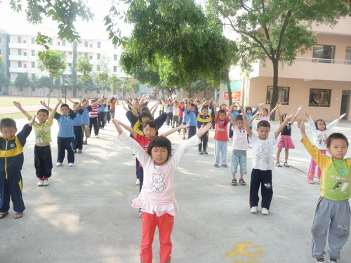
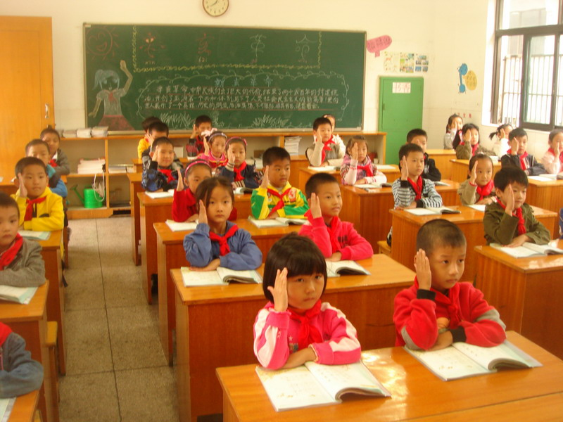

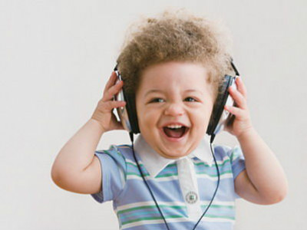
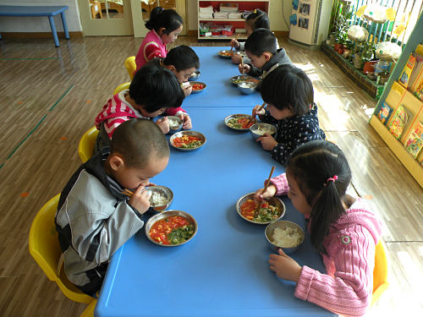
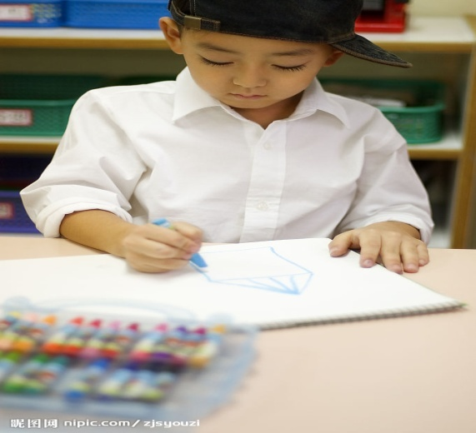

Slide 4
listening to music
doing morning excerise
eating lunch
having class
reading a book
speaking Chinese
cooking rice
drawing pictures.

Slide 5
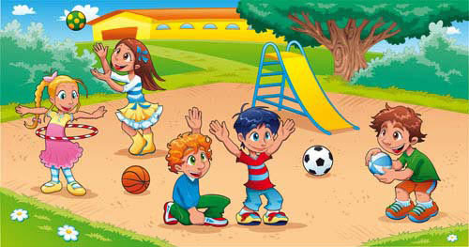
Where are they …？
They're in/on….
What are the children doing?
They are ….

Slide 6
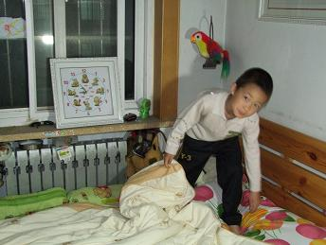
Where is the …？
He is in/on….
What is the child doing?
He is ….

Slide 7
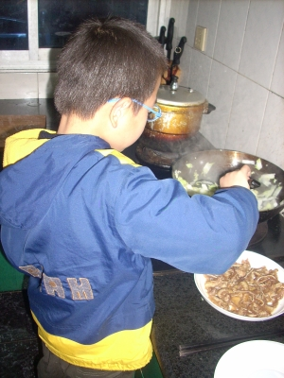
What is the child doing?
He is ….
Where is the …？
He is in/on….

Slide 8
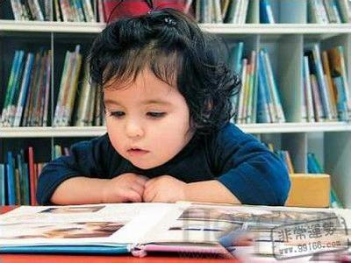
Where is the …？
She is in/on….
What is the child doing?
She is ….

Slide 9




January (Jan.)
February (Feb.)
March (Mar.)
April (Apr.)

Slide 10




May
June
July
August (Aug.)

Slide 11




September (Sept.)
October (Oct.)
November (Nov.)
December (Dec.)

Slide 12
Match, ask and answer.
When is...?
It’s in...
Tree-planting Day
New Year’s Day
Children’s Day
Army Day
National Day
Christmas Day
My partner’s birthday
My birthday
My mother’s birthday
My father’s birthday
January
February
March
April
May
June
July
August
September
October
November
December

Slide 13
Homework.
⑴仿照66页的听力对话画一画你的假期活动。
⑵仿照34页的小游戏设计一个小表格展示一下家人的生日。

