Slide 1

PROJECT 06 payLOCATOR Project
Yanis BENNEOUALA
Ouykhy QUACH
Maher ZEGHIDA

Slide 2
PROCESS
Understanding Data
Planing project on Trello
Data preparation
Task Repartitions
Tableau dashboard

Slide 3
Understanding the dataset
Understanding what makes one transaction: one ref + one amount
The status flow and the banks actions

Slide 4
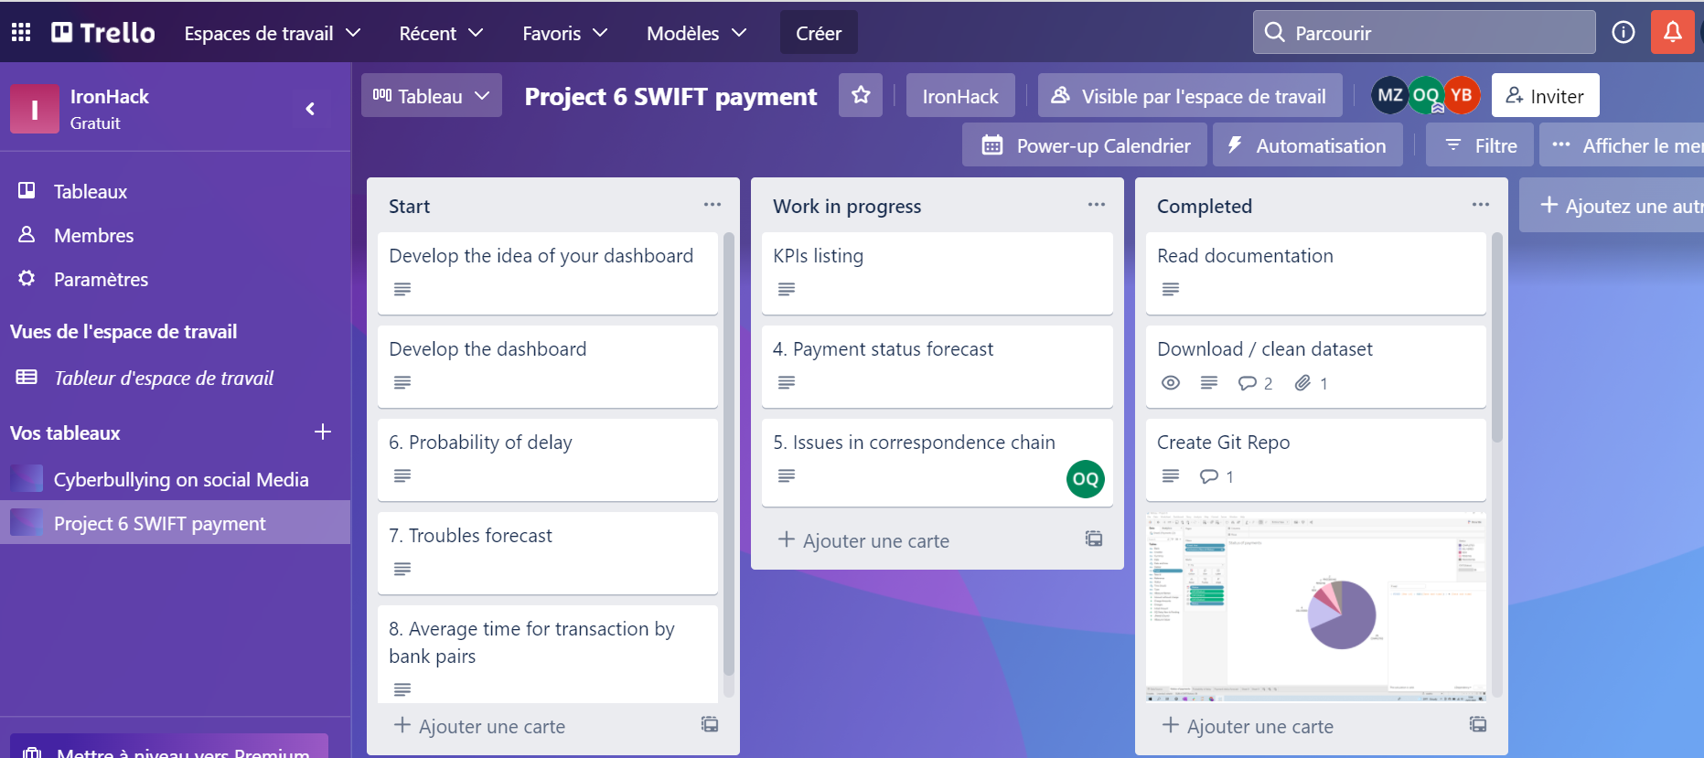
DEMO : TRELLO WORK PLAN

Slide 5
Challenges
KPI development/creation took most of the time
Merging tableau sheets from different files

Slide 6
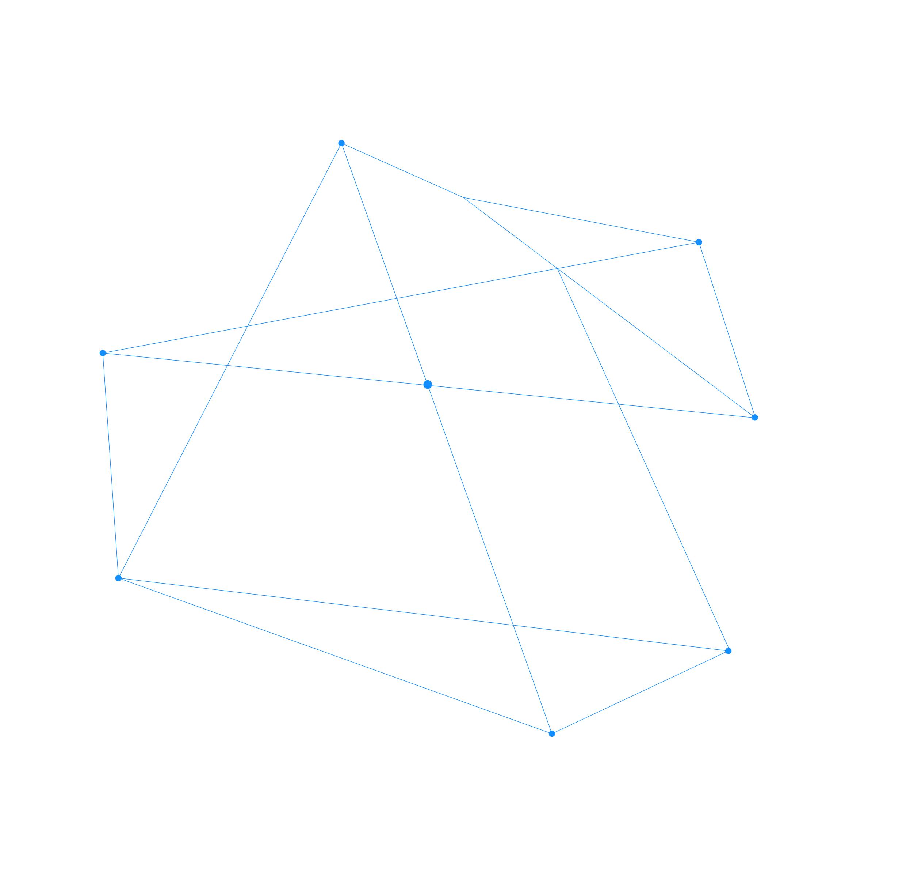
THANK YOU

