Slide 1
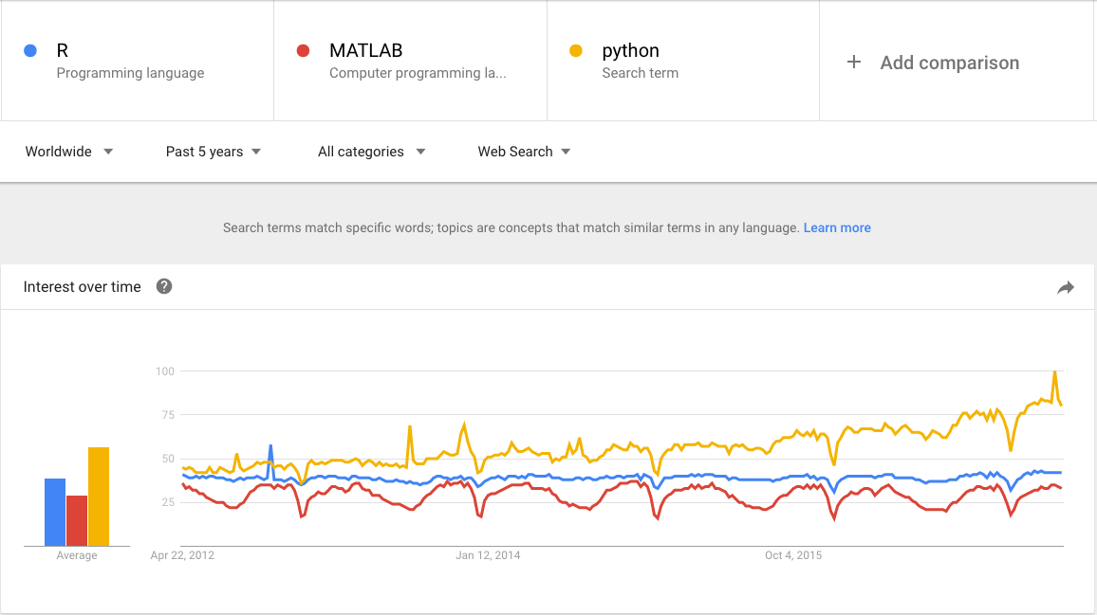
Data Analytic Methods Using R
openERP
an introduction
In my opinion, the R language has become the most common language for communication in the fields of Statistics and and Data Analysis.
Notes:
In my opinion, the Rlanguage has become the most common language for communication in the fields of Statistics and and Data Analysis.

Slide 2
Data Analytic Methods Using R
Use basic analytics methods such as distributions, statistical tests and summary operations to investigate a data set.
Use R as a tool to perform basic data analytics, reporting and basic data visualization.
Notes:
These are the objectives for this module.
Specifically, after completing this module, you should be able to:
Use the R package as a tool to perform basic data analytics, reporting, and apply basic data visualization techniques to your data.
Apply basic analytics methods such as distributions, statistical tests and summary operations, and differentiate between results that are statistically sound vs. statistically significant.
Identify a model for your data and define the null and alternative hypothesis.

Slide 3
Data Analytic Methods Using R
Putting the Data Analytics Lifecycle into Practice
Use a strategy to approach any data analytics problem:
Discovery and Data Preparation
Model Building and Evaluation
To begin to analyze the data you need:
1. A tool that allows you to look at the data – that is “R”.
2. Skill in basic statistics.
Notes:
Module 2 presented the data analytics lifecycle. The first three phases represent our initial exploration of our data and the results of that exploration.
In order to begin to analyze the data, you need a way to “look” at the data and a tool to work with and present the data. What does “look” mean here? You need a way to “look” both in terms of basic statistical measure and in creating graphs and plots of that data in order to visualize relationships and patterns. Our tool of choice for this activity is the statistical package, R.

Slide 4
Data Analytic Methods Using R
Introduction to R
Using the R Graphical User Interface
Getting Data into (and out of) R
Data Types Used in R
Basic R Operations
Basic Statistics
Notes:
This lesson covers the topics listed above. The techniques you learn here will allow you to handle your data and get to know it: that is, acquire, parse, and filter your data.
We’ll be using R to process the data and as well as to create basic summary statistics and datasets for analysis.
These processes will allow you to understand what you have, and apply these techniques to any data analytics project.

Slide 5
Introduction to R
open-source: R is a free software environment for statistical computing and graphics.
oers tools to manage and analyze data.
standard and many more statistical methods are implemented.
possibility to write personalized code and to contribute new packages.
From: www.r-project.org

Slide 6
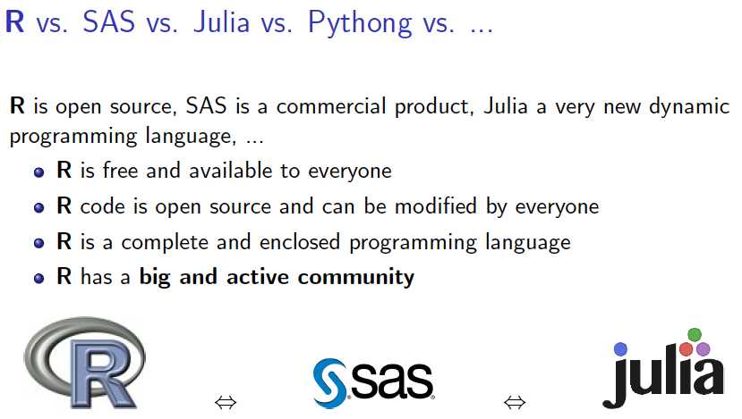


JUPYTER

Slide 7
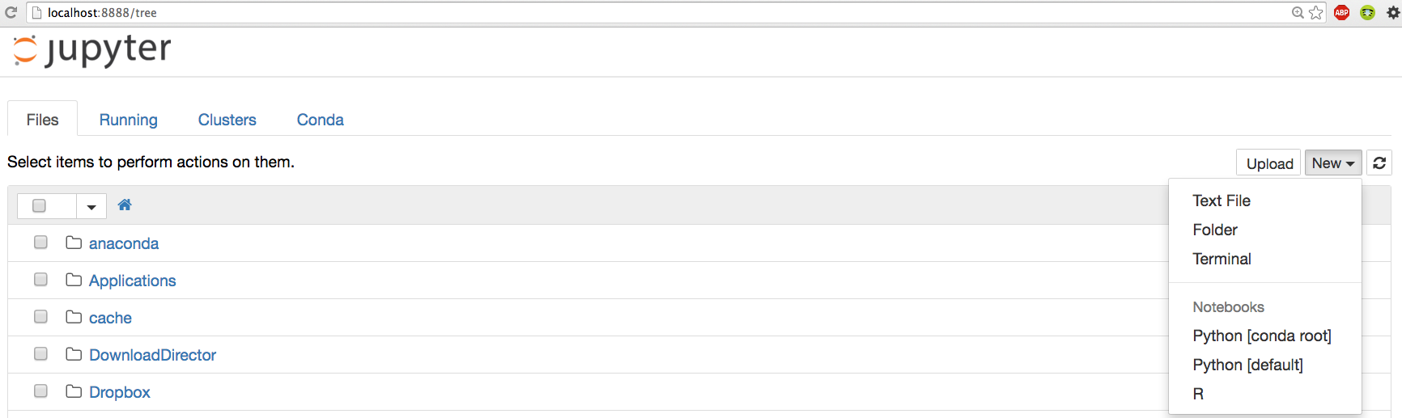
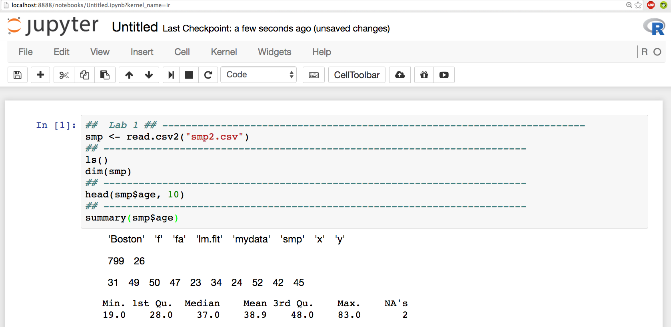
JUPYTER

Slide 8
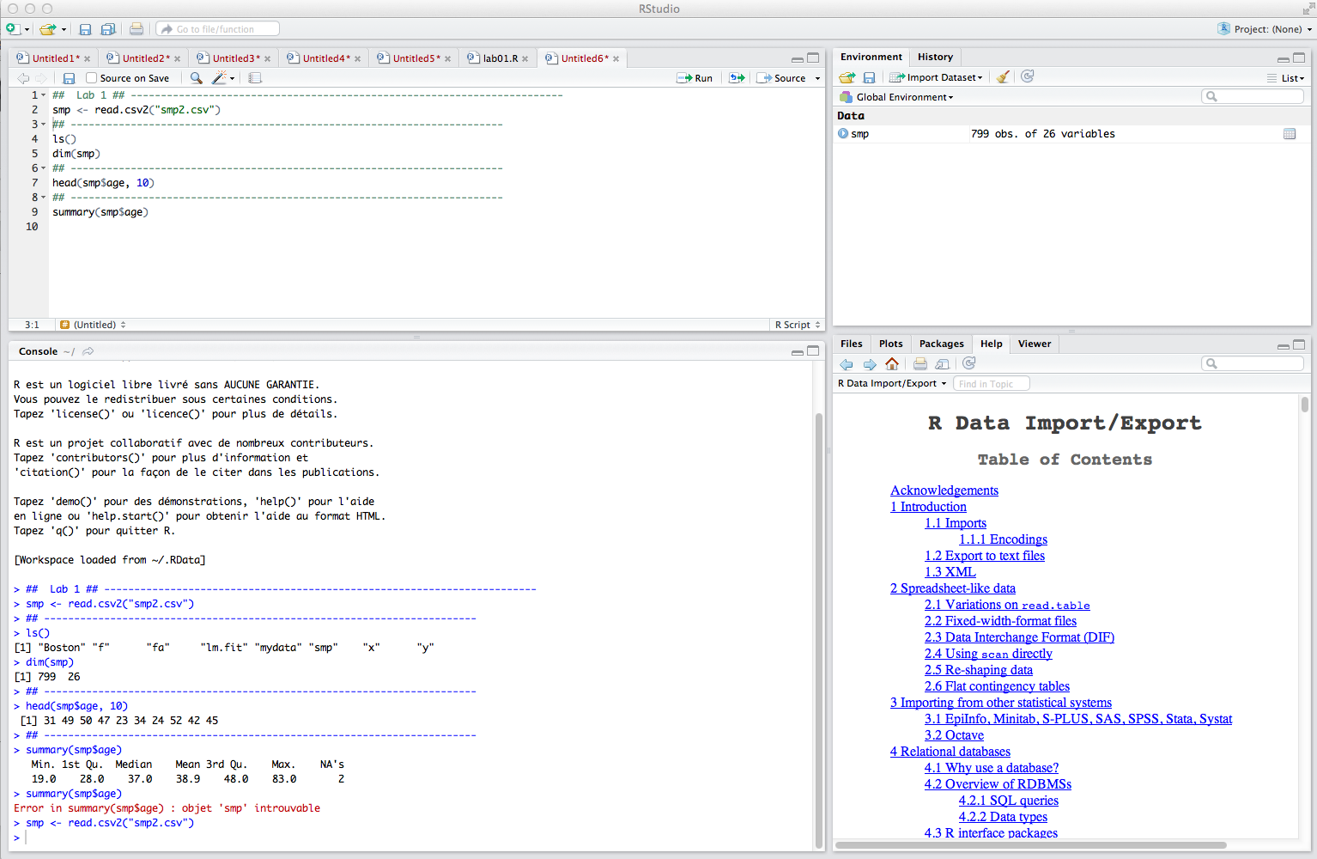
Using the RStudio Graphical User Interface
Script
Workspace
Console
Plot

Slide 9
Overview: Getting Data Into (and Out of) R
Getting Data Into R
Type it in (if it’s small)!
Read from a data file
Read from a database
Getting Data Out of R
Save in a workspace
Write a text file
Save an object to the file system
You can save plots as well!
Notes:
How do we input data into R? The first method, and sometimes the simplest, is: type the data in! This is a good method for small data sets.
You can always read raw data from a data file using read.table(). There are several help functions for reading delimited data as well as fixed length fields; the scan() function permits reading fields of variable length.
You can also read data in from a database. Both DBI (Java) and ODBC (Microsoft) interfaces are supported. Drivers are available for most popular databases.
Once in, there are several ways to save data from an R workspace. You can save the entire workspace and restore it in a later session. You can also write a R data object (usually a data frame) as a text file with field delimiters. Finally, you can save an R object or objects as a binary file, which can be loaded back into another session.
R also allows you to specify a particular output device, which is the standard way to save the results of a graph or a plot. RStudio allows you to save the graph as an image (.jpg, etc.) directly from the plot window.

Slide 10
Getting Data Into R: External Sources
Getting and Setting the Working Directory
# Get and print current working directory.
print(getwd())
# Set current working directory.
setwd("/desktop/stats")
# Get and print current working directory.
print(getwd())
Notes:
R has the ability to read in data in many different formats. The read.table() function is the most used, although there are multiple helper functions such as read.csv(), read.delim() and read.fwf() for reading fixed-length fields. Multiple import functions also exist, including reading in data from SPSS, SAS, Sysstat, and other statistical packages. The file name argument to read.table() can also be a URL: this is useful in reading a data file from the Internet. Consult the help subsystem ( help(read.table) for more options).
R always uses a forward slash “/” as the separator character in full pathnames for files. A file in your documents directory in Windows would be written as “C:/users/janedoe/My Documents/Newscript.R”. This makes script files somewhat more portable at the expense of some initial confusion on the part of Windows users.

Slide 11
Getting Data Into R: External Sources
# Create a data file: input.csv
data <- read.csv("input.csv”)
retval <- subset( data, dept == "IT")
R supports multiple file formats
id,name,salary,start_date,dept
1,Rick,623.3,2012-01-01,IT
2,Dan,515.2,2013-09-23,Operations
3,Michelle,611,2014-11-15,IT
4,Ryan,729,2014-05-11,HR
5,Gary,843.25,2015-03-27,Finance
6,Nina,578,2013-05-21,IT
7,Simon,632.8,2013-07-30,Operations
8,Guru,722.5,2014-06-17,Finance
# Write filtered data into a new file.
write.csv(retval,"output.csv")
Notes:
R has the ability to read in data in many different formats. The read.table() function is the most used, although there are multiple helper functions such as read.csv(), read.delim() and read.fwf() for reading fixed-length fields. Multiple import functions also exist, including reading in data from SPSS, SAS, Sysstat, and other statistical packages. The file name argument to read.table() can also be a URL: this is useful in reading a data file from the Internet. Consult the help subsystem ( help(read.table) for more options).
R always uses a forward slash “/” as the separator character in full pathnames for files. A file in your documents directory in Windows would be written as “C:/users/janedoe/My Documents/Newscript.R”. This makes script files somewhat more portable at the expense of some initial confusion on the part of Windows users.

Slide 12
Getting Data Into R: External Sources
R supports multiple file formats
File name can be a URL
file <- read.table(“http://www.data.org/file.csv”, sep=“,”)
is the same as read.csv(…)
car <- read.csv("http://win-vector.com/dfiles/car.data.csv")
Can read directly from a databas via ODBC interface
library(RODBC)
Db <- odbcConnect("world", uid="root", pwd="")
.TXT and .XLSX
data<-read.csv(file.choose(),header = T)
# file.choose() used to point that file
Notes:
install.packages("xlsx")
# Verify the package is installed.
any(grepl("xlsx",installed.packages()))
# Load the library into R workspace.
library("xlsx")
# Read the first worksheet in the file input.xlsx.
data <- read.xlsx("input.xlsx", sheetIndex = 1)
print(data)
# Read the first worksheet in the file input.xlsx.
data <- read.xlsx("input.xlsx", sheetIndex = 2)
print(data)

Slide 13
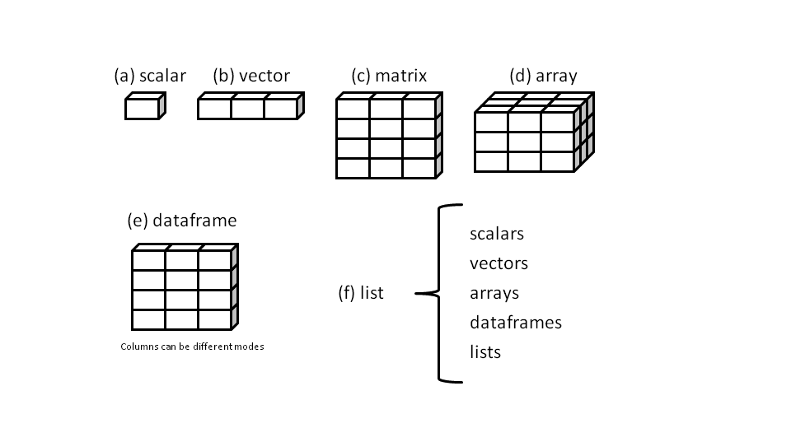
Data Types Used in R
in R, the variables are not declared as some data type.
The variables are assigned with R-Objects.
The data type of the R-object becomes the data type of the variable.
There are many types of R-objects. The frequently used ones are:
Scalar
Vector
Matrice
Array
Data Frame
List
Notes:
The workhorse data types of R are the vector and the data frame. Recall that (almost) everything in R is an object and a vector. Numbers and strings are 1 element vectors (that is length(n) == length(s) is true). Vectors can be numeric (c(1,2,3)) or character (c(“WoW”, “Good”, “Bad”)) or mixed (c(1, “two”, 3)). Mixed vectors are always considered to be character.
Factors are categorical variables. If the available data doesn’t include a particular label, it can be supplied as the 2nd argument to the factor() command. Lists are comprised of a set of named vectors. In the example above, we have defined two character vectors, levels and ratings. We create a factor, f, using ratings as our values and levels as the allowed levels, and then create a list structure using our ratings vector and a new vector for critics.
You can write your own functions in R. You can alias an existing R function as demonstrated in the example above: std(x) simply calls the R function sd() to compute the standard deviation of a vector, or your function can be arbitrarily complex. See help(“function”) in the on-line help for more details.

Slide 14
Data Types Used in R
# Create data type.
v <- 23.5
print(class(v))
v <- TRUE
print(class(v))
rep (1,10) # repeats the number 1 : 10 times
seq(0,20, by=4) # sequence of integers between 0 and 20 by step =4
# Create a vector.
apple <- c('red','green',"yellow")
print(apple)
# Get the class of the vector.
print(class(apple))
# Create a list.
list1 <- list(c(2,5,3),21.3,sin)
print(list1)
print(class(list1))
"numeric"
"logical"
"red" "green" "yellow"
"character"
” list "
Notes:
> v <- 23.5
> print(class(v))
[1] "numeric"
>
> v <- TRUE
> print(class(v))
[1] "logical"
>
> # Create a vector.
> # When you want to create vector,
> # you should use c() function.
> apple <- c('red','green',"yellow")
> print(apple)
[1] "red" "green" "yellow"
>
> # Get the class of the vector.
> print(class(apple))
[1] "character"
>
> # A list is an R-object
> # which can contain many different types of elements inside it
> # like vectors, functions and even another list inside it.
>
> # Create a list.
> list1 <- list(c(2,5,3),21.3,sin)
> # Print the list.
> print(list1)
[[1]]
[1] 2 5 3
[[2]]
[1] 21.3
[[3]]
function (x) .Primitive("sin")
> # Get the class of the list.
> print(class(list1))
[1] "list"
>
> # Create a matrix.
> M = matrix( c('a','a','b','c','b','a'), nrow = 2, ncol = 3, byrow = TRUE)
> print(M)
[,1] [,2] [,3]
[1,] "a" "a" "b"
[2,] "c" "b" "a"
> # Get the class of the Matrix.
> print(class(M))
[1] "matrix"
>
> # Create an array.
> a <- array(c('green','yellow'),dim = c(3,3,1))
> print(a)
, , 1
[,1] [,2] [,3]
[1,] "green" "yellow" "green"
[2,] "yellow" "green" "yellow"
[3,] "green" "yellow" "green"
> # Get the class of the array.
> print(class(a))
[1] "array"
>
> # Create a vector.
> apple_colors <- c('green','green','yellow','red','red','red','green')
>
> # Create a factor object.
> factor_apple <- factor(apple_colors)
>
> # Print the factor.
> print(factor_apple)
[1] green green yellow red red red green
Levels: green red yellow
> # applying the nlevels function we can know the number of distinct values
> print(nlevels(factor_apple))
[1] 3
> # Get the class of the Factor.
> print(class(factor_apple))
[1] "factor"
>
> # Create the data frame.
> BMI <- data.frame(
+ gender = c("Male", "Male","Female"),
+ height = c(152, 171.5, 165),
+ weight = c(81,93, 78),
+ Age = c(42,38,26)
+ )
> print(BMI)
gender height weight Age
1 Male 152.0 81 42
2 Male 171.5 93 38
3 Female 165.0 78 26
> # Get the class of the Factor.
> print(class(BMI))
[1] "data.frame"

Slide 15
Data Types Used in R
# Create an array.
a <- array(c('green','yellow'),dim = c(3,3))
print(a)
print(class(a))
# Create a matrix.
M = matrix( c(1,2,80,85,67,56), nrow = 2, ncol = 3)
print(M)
print(class(M))
# Create a vector.
apple_colors <- c('green','green','yellow','red','red','red','green’)
# Create a factor object.
factor_apple <- factor(apple_colors)
# Print the factor.
print(factor_apple)
print(nlevels(factor_apple))
# Create the data frame.
BMI <- data.frame(gender = c("Male", "Male","Female"),
height = c(152, 171.5, 165),
weight = c(81,93, 78),
Age = c(42,38,26))
print(class(BMI))
” array "
"matrix"
Levels: green red yellow
print(BMI)
gender height weight Age
1 Male 152.0 81 42
2 Male 171.5 93 38
3 Female 165.0 78 26
"data.frame"
Notes:
> v <- 23.5
> print(class(v))
[1] "numeric"
>
> v <- TRUE
> print(class(v))
[1] "logical"
>
> # Create a vector.
> # When you want to create vector,
> # you should use c() function.
> apple <- c('red','green',"yellow")
> print(apple)
[1] "red" "green" "yellow"
>
> # Get the class of the vector.
> print(class(apple))
[1] "character"
>
> # A list is an R-object
> # which can contain many different types of elements inside it
> # like vectors, functions and even another list inside it.
>
> # Create a list.
> list1 <- list(c(2,5,3),21.3,sin)
> # Print the list.
> print(list1)
[[1]]
[1] 2 5 3
[[2]]
[1] 21.3
[[3]]
function (x) .Primitive("sin")
> # Get the class of the list.
> print(class(list1))
[1] "list"
>
> # Create a matrix.
> M = matrix( c('a','a','b','c','b','a'), nrow = 2, ncol = 3, byrow = TRUE)
> print(M)
[,1] [,2] [,3]
[1,] "a" "a" "b"
[2,] "c" "b" "a"
> # Get the class of the Matrix.
> print(class(M))
[1] "matrix"
>
> # Create an array.
> a <- array(c('green','yellow'),dim = c(3,3,1))
> print(a)
, , 1
[,1] [,2] [,3]
[1,] "green" "yellow" "green"
[2,] "yellow" "green" "yellow"
[3,] "green" "yellow" "green"
> # Get the class of the array.
> print(class(a))
[1] "array"
>
> # Create a vector.
> apple_colors <- c('green','green','yellow','red','red','red','green')
>
> # Create a factor object.
> factor_apple <- factor(apple_colors)
>
> # Print the factor.
> print(factor_apple)
[1] green green yellow red red red green
Levels: green red yellow
> # applying the nlevels function we can know the number of distinct values
> print(nlevels(factor_apple))
[1] 3
> # Get the class of the Factor.
> print(class(factor_apple))
[1] "factor"
>
> # Create the data frame.
> BMI <- data.frame(
+ gender = c("Male", "Male","Female"),
+ height = c(152, 171.5, 165),
+ weight = c(81,93, 78),
+ Age = c(42,38,26)
+ )
> print(BMI)
gender height weight Age
1 Male 152.0 81 42
2 Male 171.5 93 38
3 Female 165.0 78 26
> # Get the class of the Factor.
> print(class(BMI))
[1] "data.frame"

Slide 16
Analyzing and Exploring the Data
Examining Analyzing a single or pairs of variables
Examining the distribution of a single variable
Analyzing the relationship between two variables
Data exploration versus data presentation
Notes:
In a previous lesson, we’ve looked at how you can characterize your data by using traditional statistics. But we also showed how datasets could appear identical when using descriptive statistics, and yet look completely different when visualizing the data via a plot.
Using visual representations of data is the hallmark of exploratory data analysis: letting the data speak to us rather than necessarily imposing an interpretation on the data a priori. In the rest of this lesson, we are going to examine ways of displaying data so that we can better understand the underlying distributions of a single variable or the relationships between two or more variables.
Although data visualization is a powerful tool, the results we obtain may not be suitable when it comes time for us to “tell a story” about the data. Our last slide will discuss what kind of presentations are most effective.

Slide 17
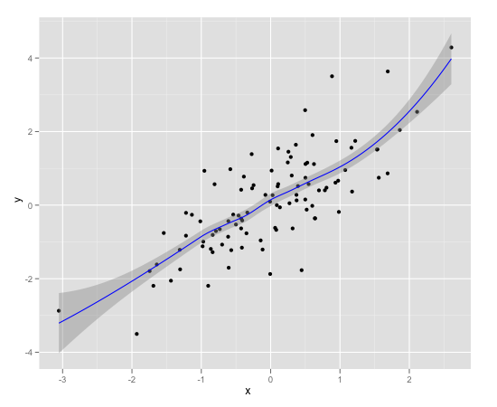
Visualization
Summary statistics give us some sense of the data:
Mean vs. Median.
Standard deviation.
Quartiles, Min/Max.
Correlations between variables.
summary(data)
x y
Min. :-3.05439 Min. :-3.50179
1st Qu.:-0.61055 1st Qu.:-0.75968
Median : 0.04666 Median : 0.07340
Mean :-0.01105 Mean : 0.09383
3rd Qu.: 0.56067 3rd Qu.: 0.88114
Max. : 2.60614 Max. : 4.28693
Visualization gives us a more holistic sense
Notes:
In the previous lesson, we saw how to examine data in R, including how to generate the descriptive statistics: averages, data ranges, and quartiles (which are included in the summary() report).
We also saw how to compute correlations between pairs of variables of interest. These statistics do give us a sense of a data: an idea of its magnitude and range, and some obvious dirty data (missing values, values with obviously wrong magnitude or sign).
Visualization, however, gives us a succinct, more holistic view of the data that we may not be able to get from the numbers and summaries alone. It is an important facet of the initial data exploration. Visualization helps you assess data cleanliness, and also gives you an idea of potentially important relationships in the data before going on to build your models.

Slide 18
Visualization
ADD EXAMPLEs summary and plots
THEME 3: GRAPHICS page 347:The essential R reference
Chap2ggplot.pdf
Chapter 2 R ggplot2 Examples
Bret Larget
http://www.cookbook-r.com/Graphs/Plotting_distributions_(ggplot2)/
https://www.tutorialspoint.com/r/r_scatterplots.htm
https://www.tutorialspoint.com/r/r_bar_charts.htm

Slide 19
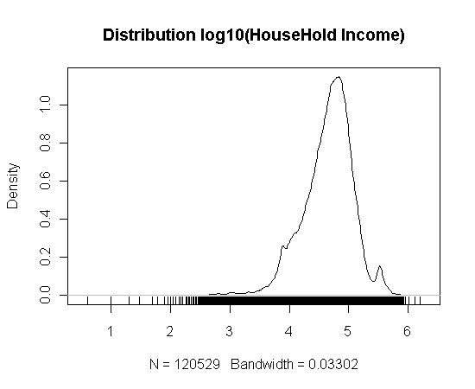
Examining the Distribution of a Single Variable
Graphing a single variable
plot(sort( )) – for low volume data
Hist( ) – a histogram
plot(density()) – densityplot
A "continuous histogram“
Example
Frequency table of household income
Notes:
R has multiple functions available to examine a single variable. Some of them are listed above. See the R documentation for each of these. Some other useful functions are barplot(), dotplot() and stem().
The example included is a frequency table of log10 of household income. We can certainly see a concentration of households in the rightmost portion of the graph. The rug() function creates a 1-dimensional density plot as well: notice how it emphasizes the area under the curve.

Slide 20
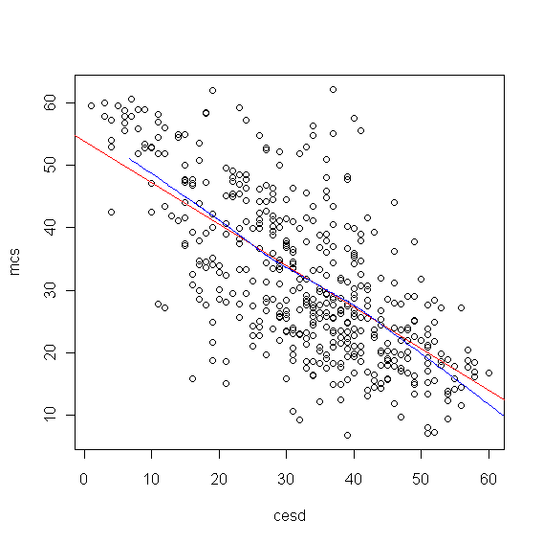
Two Variables: What are we looking for?
Is there a relationship between the two variables?
Linear? Quadratic?
Exponential?
Try semi-log or log-log plots
Is it a cloud?
Round? Concentrated? Multiple Clusters?
How?
Scatterplots
Example
Red line: linear fit
Blue line: LOESS
Fairly linear relationship,
but with wide variance
{
plot(mcs ~ cesd)
abline(lm(mcs ~ cesd), lcol=“red”)
lines(lowess(mcs ~ cesd), lcol=“blue”)
}
Notes:
We are looking for a relationship between the two variables. If the functional relationship between the variables is somewhat pronounced, the data lies roughly along a curve: a straight line, a parabola, or an exponential curve. If y is related exponentially to x, then the plot of (x, log(y)) will be approximately linear. If the data is more like a cloud, the relationship is weaker.
In the example here, the relationship seems approximately linear; we've plotted the regression line in red. There are times when a standard regression line just doesn’t capture the relationship. In this case, the loess() function in R (also lowess()) will fit a non-linear line to the data. Here we've drawn the loess curve in blue.
R-Code
Assume a dataset named ds with variables cesd and mcs. The R code to generate the above plot is as follows.
with(ds,
{
plot(mcs ~ cesd)
abline(lm(mcs ~ cesd), lcol=“red”)
lines(lowess(mcs ~ cesd), lcol=“blue”)
} )

Slide 21
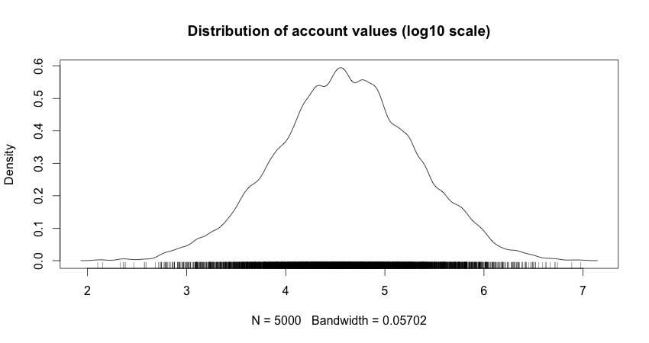
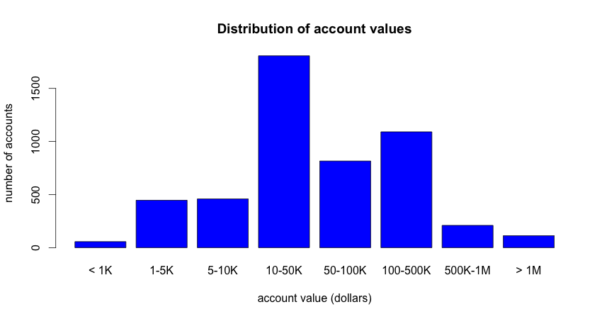
Data Exploration vs. Presentation
Data Exploration:
This tells you what you need to know.
Presentation:
This tells the stakeholders what they need to know.
Notes:
Finally, we want to touch on the difference between using visualization for data exploration, and for presenting results to stakeholders. The plots and tips that we've discussed try to make the details of the data as clear as possible for the data scientist to see structure and relationships. These technical graphs don't always effectively convey the information that needs to be conveyed to non-technical stakeholders. For them, we want crisp graphics that focus on the message we want to convey.
We will touch more on this topic in Module 6, but for right now we'll share a small example. The top graph shows the density plot of logged account values for our bank. This graph gives us, as data scientists, information that can be relevant to downstream analysis. The account values are distributed approximately lognormally, in the range from 100 to 10M dollars. The median account value is in the area of $30,000 (10^4.5), with the bulk of the accounts between $1000 US and $1M US dollars.
It would be hard to explain this graph to stakeholders. For one thing, densityplots are fairly technical, and for another, it is awkward to explain why you are logging the data before showing it. You can convey essentially the same information by partitioning the data into "log-like" bins, and presenting the histogram of those bins, as we do in the bottom plot. Here, we can see that the bulk of the accounts are in the 1000-1M range, with the peak concentration in the 10-50K range, extending out to about 500K. This gives the stakeholders a better sense of the customer base than the top graphic would.
[Note – the reason that the lower graph isn't symmetric like the upper graph is because the bins are only "log-like". They aren't truly log10 scaled. Log10 scaled bins would be closer to: 1-3K, 3K-10K, 10K-30K..... As an exercise, we could try splitting the bins that way, and we would see that the resulting bar chart would be symmetric. The bins we chose, however, might seem more "natural" to the stakeholders.]

Slide 22
Data Exploration vs. Presentation
Data Exploration:
This tells you what you need to know.
Presentation:
This tells the stakeholders what they need to know.
Notes:
[generating the data used in the graph]
income = rlnorm(5000, meanlog=log(40000), sdlog=log(5))
Plot for the top graphic:
plot(density(log10(income), adjust=0.5), main="Distribution of account values (log10 scale)")
rug(log10(income))
Plot for the bottom graphic:
# create "log-like bins"
breaks = c(0, 1000, 5000, 10000, 50000, 100000, 5e5, 1e6, 2e7)
# bin and label the data
bins = cut(income, breaks, include.lowest=T,
labels = c("< 1K", "1-5K", "5-10K", "10-50K", "50-100K", "100-500K", "500K-1M", "> 1M"))
# plot the bins.
plot(bins, main = "Distribution of account values", xlab = "account value (dollars)", ylab = "number of accounts", col="blue")

Slide 23
Statistics for Model Building and Evaluation
A statistical analysis may be descriptive, simply reporting, visualizing and summarizing a data set, but usually it is also inferential.
Statistics in the Analytic Lifecycle
Descriptive Statistics
Linear Regression
Hypothesis Testing
Anova
Correlations
Notes:
In this lesson, we’ll be concentrating on model building and evaluation, using the topics described.

Slide 24

Statistics in the Analytic Lifecycle
Understand Data Using Descriptive Statistics
Model Building and Planning
Can I predict the outcome with the inputs that I have?
Which inputs?
Model Evaluation
Is the model accurate?
Does it perform better than "the obvious guess"
Does it perform better than another candidate model?
Model Deployment
Do my predictions make a difference?
Are we preventing customer churn?
Have we raised profits?
Notes:
As Data Scientists. we use statistical techniques not only within our modeling algorithms but also during the early model building stages, when we evaluate our final models, and when we assess how our models improve the situation when deployed in the field. In this section we'll discuss techniques that help us answer questions such as those listed above? Visualization will help with the first question, at least as a first pass.

Slide 25
Descriptive Statistics
https://www.tutorialspoint.com/r/r_mean_median_mode.htm
Function | R Code
View the data | head(x); tail(x)
View a summary of the data | summary(x)
Compute basic statistics | sd(x); var(x); range(x)
Correlation | cor(x, y)
Notes:
One of the first things to consider when receiving a dataset is to validate your assumption. Is the data clean? Does it make sense? I personally use head(ds) and tail(ds) to look at the 1st and last values.
The next command is summary() that provide the minimum, maximum, median, mean and the 1st and 3rd quartile values. (Compare this against the values returned from the fivenum(ds) function.)
Other functions include sd (standard deviation), var (variance), range (low value and high values), and IQR that displays the interquartile range (difference between 1st and 3rd quartiles). The cor() function computes the correlation between variables in the dataset, or, more specifically, the vectors provided as the values of x and y.

Slide 26
Using summary statistics to explore data
Data exploration uses a combination of summary statistics “means and medians, variances, and counts” and visualization , or graphs of the data.
In R, you’ll typically use the summary command to take your first look at the data.
EXAMPLE
Suppose your goal is to build a model to predict which of your customers don’t have health insurance;
1- You’ve collected a dataset of customers whose health insurance status you know.
2- identified some customer properties that you believe help predict the probability of insurance coverage: age, employment status, etc..
3- put all your data into a single data frame called custdata that you’ve input into R

Slide 27
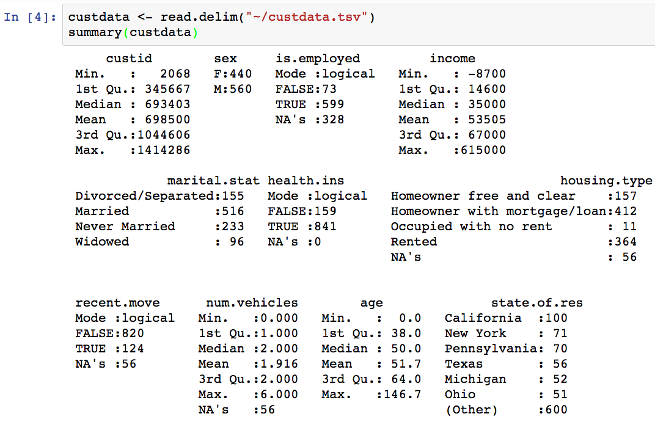
Descriptive Statistics
Notes:
We have a copy of this synthetic dataset available for download from https://github.com/WinVector/
zmPDSwR/tree/master/Custdata, and once saved, you can load it into R with the command custdata
<- read.table('custdata.tsv',header=T,sep='\t').
custdata <- read.delim("~/custdata.tsv")
sapply (PimaIndiansDiabetes[,1:8], sd )

Slide 28
Descriptive Statistics
you’re looking for several common issues: missing values, invalid values and outliers, and data ranges that are too wide or too narrow.
1: The variable is.employed is missing for about a third of the data. NA's :328
The variable income has negative values, which are potentially invalid. -8700
2: About 84% of the customers have health insurance. TRUE :841/1000
3: The variables housing.type, recent.move, and num.vehicles are each missing: 56 values.
4: The average value of the variable age seems plausible, but the minimum and maximum values seem unlikely. age -> min : 0.0

Slide 29
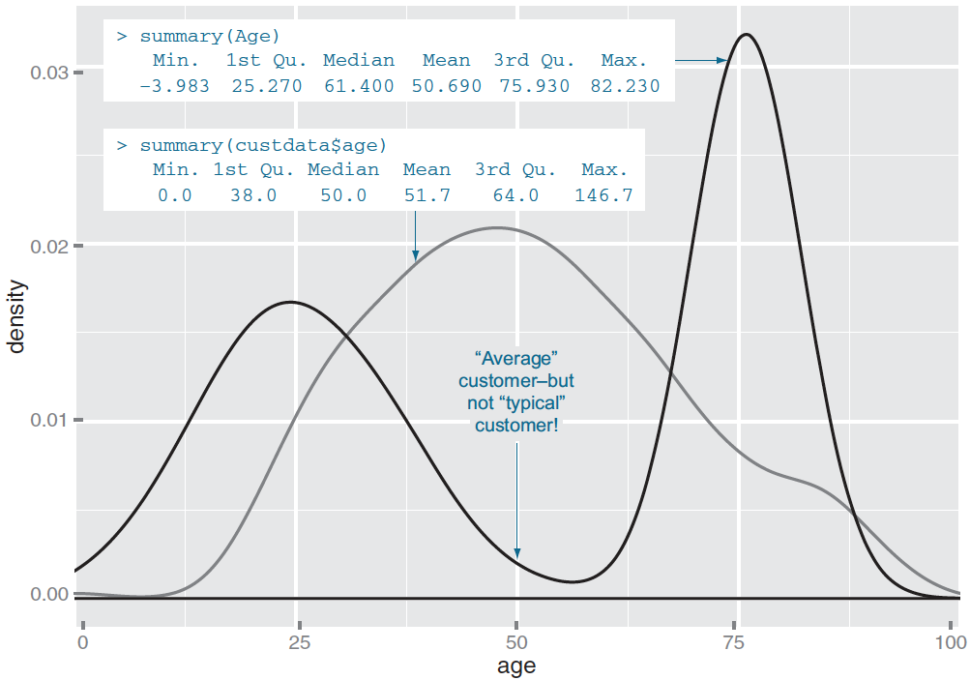
Spotting problems using graphics
Notes:
The visualizations in this section help you answer questions like these:
What is the peak value of the distribution?
How many peaks are there in the distribution (unimodality versus bimodality)?
How much does the data vary? Is it concentrated in a certain interval or in a certain
category?
Find the right aspect ratio and scaling to properly bring out the details of the
data.
– Avoid having the data all skewed to one side or the other of your graph.

Slide 30
R - Linear Regression
Regression analysis is a very widely used statistical tool to establish a relationship model between two variables.
y = ax + b
In R we create Relationship Model & get the Coefficients
x <- c(151, 174, 138, 186, 128, 136, 179, 163, 152, 131)
y <- c(63, 81, 56, 91, 47, 57, 76, 72, 62, 48)
# Apply the lm() function.
relation <- lm(y~x)
print(relation)
print(summary(relation))
anova(relation)
Notes:
x <- c(151, 174, 138, 186, 128, 136, 179, 163, 152, 131)
y <- c(63, 81, 56, 91, 47, 57, 76, 72, 62, 48)
# Apply the lm() function.
relation <- lm(y~x)
print(summary(relation))
# Find weight of a person with height 170.
a <- data.frame(x = 170)
result <- predict(relation,a)
print(result)
# Plot the chart.
plot(y,x,col = "blue",main = "Height & Weight Regression",abline(lm(x~y)),cex = 1.3,pch = 16,xlab = "Weight in Kg",ylab = "Height in cm")
# Save the file.
dev.off()

Slide 31
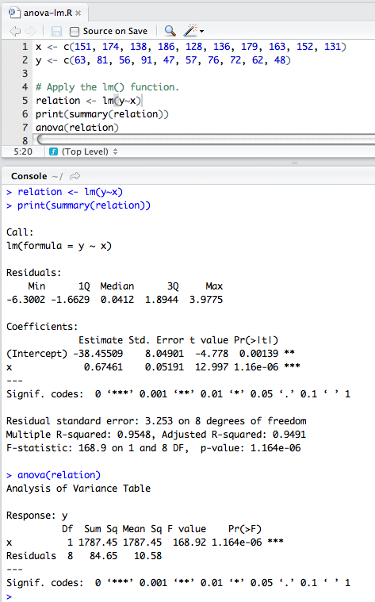
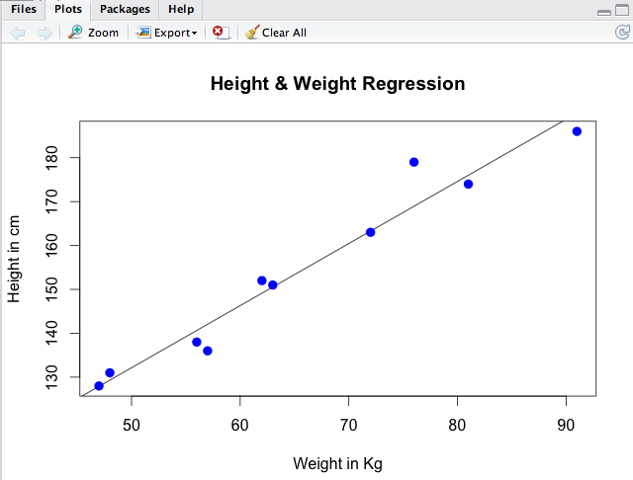
R - Linear Regression
# Find weight of a person with height 170.
a <- data.frame(x = 170)
result <- predict(relation,a)
print(result)
plot(y,x,col = "blue",main = "Height & Weight Regression",
abline(lm(x~y)),cex = 1.3,pch = 16,xlab = "Weight in Kg",ylab = "Height in cm")
> a
x
1 170
> result
1
76.22869

Slide 32
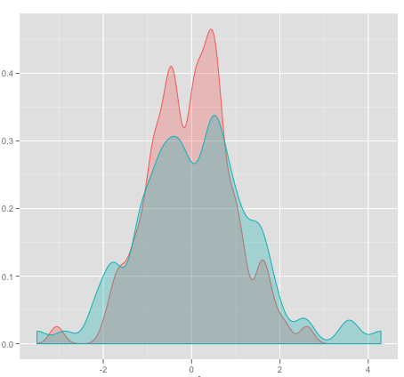
Statistical Methods for Evaluation
Hypothesis Testing
Fundamental question: "Is there a difference between the populations based on samples?“
Examples : Mean, Variance
Null hypothesis : There is no difference
Alternate hypothesis : There is a difference
Notes:
When conducting statistical tests, such as a model or benchmarking the difference between two populations of data, a common technique to assess the difference or significance is Hypothesis Testing.
The basic concept is to come up with ideas that can be proved or disproved with data. When performing these tests, the operating assumption is that there is no difference between two samples or populations. Statisticians refer to this as "the null hypothesis".
The “alternate hypothesis” is that there is a difference between two models, samples, or populations.

Slide 33
One sample Student’s t-test
Here is an example concerning daily energy intake in kJ for 11 women
(Altman, 1991, p. 183). First, the values are placed in a data vector:
intake <- c(5260,5470,5640,6180,6390,6515,6805,7515,7515,8230,8770)
t.test(intake, mu=7725)
One Sample t-test
data: intake
t = -2.8208, df = 10, p-value = 0.01814
alternative hypothesis: true mean is not equal to 7725
95 percent confidence interval:
5986.348 7520.925
sample estimates:
mean of x
6753.636
We can immediately see that p < 0.05 and thus that (using the customary 5% level of significance) data deviate significantly from the hypothesis that the mean is 7725.

Slide 34
One sample Student’s t-test
Comparison of the sample mean with a known value, when the variance of the population is not known and n <30.
It was made an intelligence test in 10 subjects.
The average result of the population, is equal to 75.
The sample mean is significantly similar (in 95%) to the average population ?
the Student’s t-test for a single sample have a pre-set function in R we can apply immediately.
It is the t.test (a, mu), we can see below applied.

Slide 35
One sample Student’s t-test
It was made an intelligence test in 10 subjects.
The average result of the population, is equal to 75.
The sample mean is significantly similar (in 95%) to the average population ?
A < - c(65, 78, 88, 55, 48, 95, 66, 57, 79, 81)
t.test (a, mu=75)
One Sample t-test
data: A
t = -0.78303, df = 9, p-value = 0.4537
alternative hypothesis: true mean is not equal to 75
95 percent confidence interval:
60.22187 82.17813
sample estimates:
mean of x
71.2

Slide 36
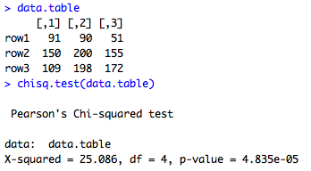
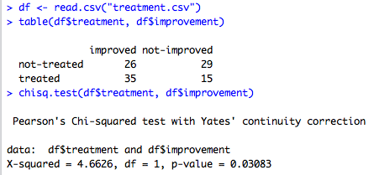
R - Chi Square Test
Chi-Square test is a statistical method to determine if two categorical variables have a significant correlation between them.
# Chi-sq test
row1 = c(91,90,51)
row2 = c(150,200,155)
row3 = c(109,198,172)
data.table = rbind(row1,row2,row3)
chisq.test(data.table)
# Chi-sq test
setwd("/Users/ouzarf")
df <- read.csv("treatment.csv")
table(df$treatment, df$improvement)
chisq.test(df$treatment, df$improvement)
# If we get a p-Value less than the significance level of 0.05,
# we reject the null hypothesis and conclude that the two variables are in fact dependent.
# which indicates a string correlation.
Notes:
# Chi-sq test
setwd("/Users/ouzarf")
df <- read.csv("treatment.csv")
table(df$treatment, df$improvement)
chisq.test(df$treatment, df$improvement)
# We have a chi-squared value of 5.55. Since we get a p-Value less than the significance level of 0.05,
# we reject the null hypothesis and conclude that the two variables are in fact dependent. Sweet!

Slide 37
Summary
Key points covered in this part:
How to use basic analytics methods such as distributions, statistical tests and summary operations to investigate a data set
How to use R to apply visualization patterns to better understand the data, help develop a model and derive hypotheses, and determine if our actions had a practical affect.
Notes:
These are the main points covered in the module. Please take a moment to review them.
In addition, pause and consider what you learned from the lab exercises in this module.

Slide 38
THANK YOU

Slide 39
Hypothesis Testing
In this Hypothesis testing we use :
"t-test","z-test","Anova","F-test","chi-square”
to prove whether Ho is correct (or) H1 is correct.
5.1 One-sample t tes page 97
https://www.youtube.com/watch?v=RlhnNbPZC0A
https://www.r-bloggers.com/one-sample-students-t-test/
How PACKAGE in R
http://lumimath.univ-mrs.fr/~broglio/
Notes:
http://www.sthda.com/french/wiki/test-t-de-student-pour-un-echantillon-unique-avec-r

