Slide 1
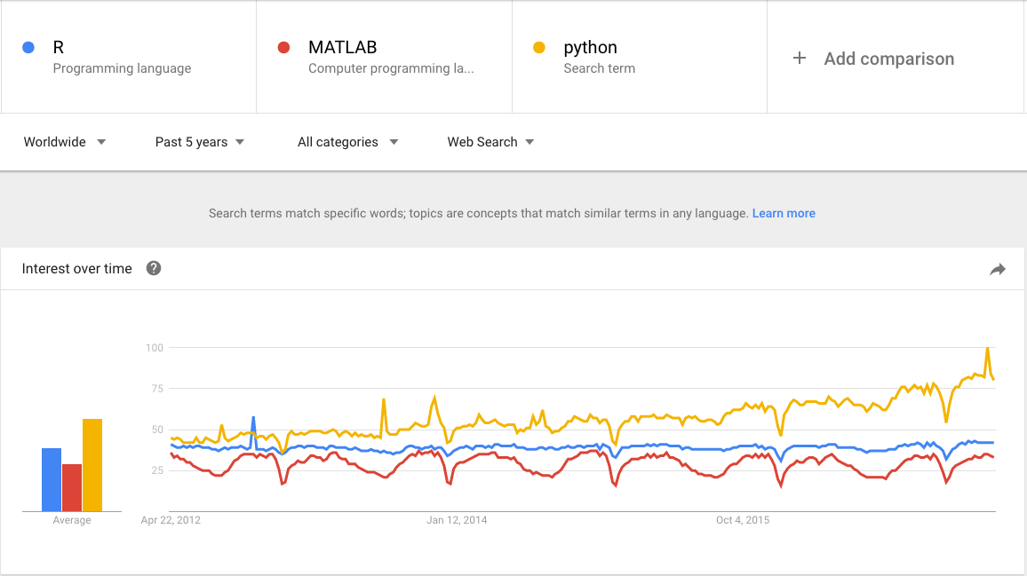
Data Analytic Methods
openERP
an introduction
In my opinion, the Python language still the most common language in the fields of Machine Learning and Data Analysis.

Slide 2
Plan
Introduction : Types of machine learning
Downloading, Installing and Starting Python and Libraries
2. Load The Data and libraries
3. Data Exploration
3.1 View of the dataset
3.2 Statistical description
4. Data Visualization
5 Developing a Model
5.1 Create a Validation Dataset
5.2 Build Model: Linear regression in scikit-learn
5.3 Model evaluation metrics for regression
6. Make Predictions
Summary

Slide 3
Introduction to Machine Learning in Python
Definition :
“Machine Learning is a collection of algorithms and techniques used to create computational systems that learn from data in order to make predictions and inferences.”

Slide 4
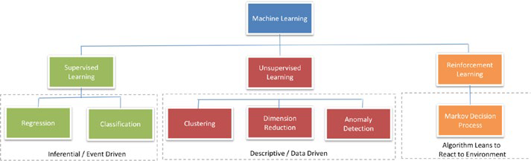
Types of Machine Learning
Supervised learning: making predictions using data
This is also called predictive modelling
Notes:
the regression was an major milestone for statisticians
8p67
Regression Metrics
In this section will review 3 of the most common metrics for evaluating predictions on regression
machine learning problems:
. Mean Absolute Error.
. Mean Squared Error.
. R2.

Slide 5
Types of Machine Learning
1) Regression
The output to be predicted is a continuous number in relevance with a given input dataset.
Notes:
the regression was an major milestone for statisticians
8p67
Regression Metrics
In this section will review 3 of the most common metrics for evaluating predictions on regression
machine learning problems:
. Mean Absolute Error.
. Mean Squared Error.
. R2.

Slide 6
Types of Machine Learning
2) Classification
The output to be predicted is the actual or the probability of an event/class and the number of classes to be predicted can be two or more.
The algorithm should learn the patterns in the relevant input of each class from historical data and be able to predict the unseen class or event in the future considering their input.
Notes:
the regression was an major milestone for statisticians
8p63
Classication Metrics
Classication problems are perhaps the most common type of machine learning problem and as
such there are a myriad of metrics that can be used to evaluate predictions for these problems.
In this section we will review how to use the following metrics:
. Classication Accuracy.
. Logarithmic Loss.
. Area Under ROC Curve.
. Confusion Matrix.
. Classication Report.

Slide 7
Building supervised learning machine learning models
Building supervised learning machine learning models has three stages:
1. Training: The algorithm will be provided with historical input data with the mapped output. The algorithm will learn the patterns within the input data for each output and represent that as a statistical equation, which is also commonly known as a model.
2. Testing or validation: In this phase the performance of the trained model is evaluated, usually by applying it on a dataset
(that was not used as part of the training) to predict the class or event.
3. Prediction: Here we apply the trained model to a data set that was not part of either the training or testing. The prediction will be used to drive business decisions.
Notes:
32p67/68
--------------------------------------------------------------------
20p26Generalization, Overfitting, and Underfitting
In supervised learning, we want to build a model on the training data and then be
able to make accurate predictions on new, unseen data that has the same characteristics
as the training set that we used. If a model is able to make accurate predictions on
unseen data, we say it is able to generalize from the training set to the test set. We
want to build a model that is able to generalize as accurately as possible.

Slide 8
Exploratory Data Analytic Methods Using Python
Use EDA methods and Modeling processes to investigate a data set and make prediction with certain accuracy.
Use Python as a tool for programming.

Slide 9
Exploratory Data Analytic Methods Using Python
Putting the Data Analytics Lifecycle into Practice
Use a strategy to approach any data analytics problem:
Discovery and Data Preparation
Model Building and Evaluation
To begin to analyze the data you need:
1. A tool that allows you to look at the data – that is “python library”.
2. Skill in basic statistics.

Slide 10
1. Downloading, Installing and Starting Python and Libraries
1.1 install Python version 2.7 or 3.5.
1.2 There are 5 key libraries that you will need to install.
scipy
numpy
matplotlib
pandas
sklearn
I would recommend installing the free version of Anaconda that includes everything you need.
Notes:
https://www.continuum.io/downloads

Slide 11
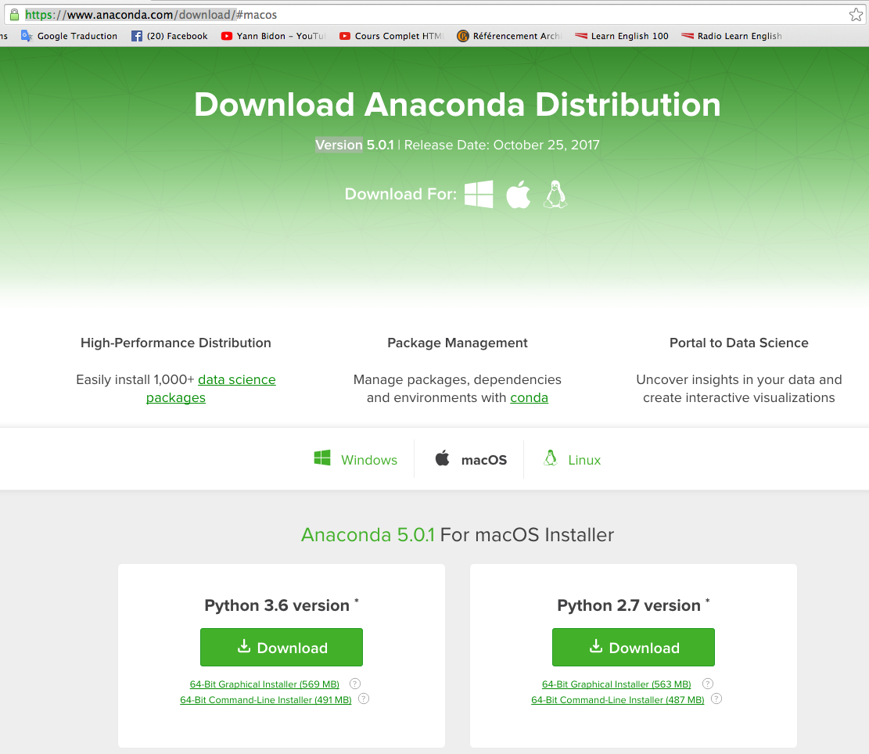

Slide 12
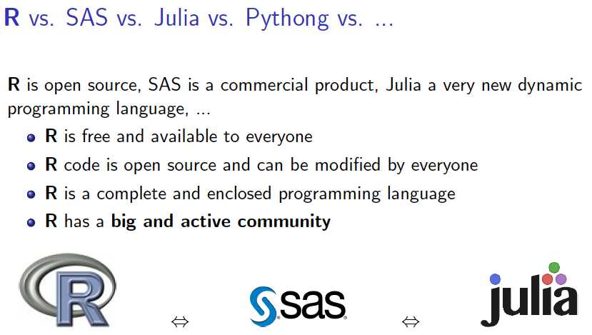


JUPYTER

Slide 13
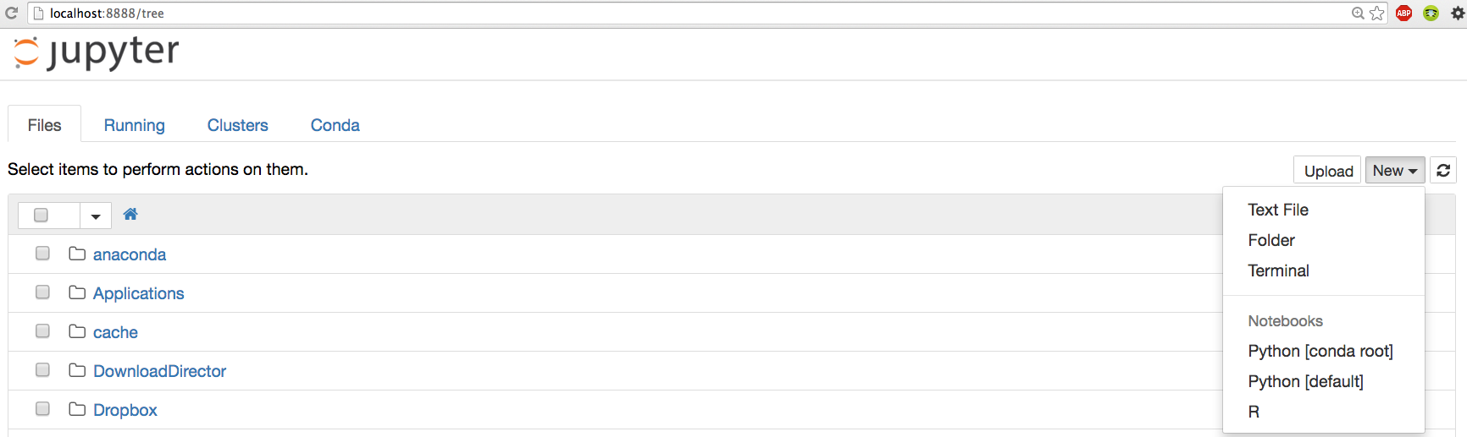
JUPYTER

Slide 14
Define Problem for case study
Prediction housing price
Goal: Model Evaluation and Validation for the Prediction of Boston Housing Prices.
For this project we will investigate the Boston House Price dataset.
Each record in the database describes a Boston suburb or town.
The data was drawn from the Boston Standard Metropolitan Statistical Area (SMSA) in 1970.
https://archive.ics.uci.edu/ml/machine-learning-databases/housing/

Slide 15
Load The Data
We are going to use the Boston House Price dataset.
This dataset is used in machine learning and statistics by pretty much everyone.
The dataset contains 506 Instances 14 of Attributes
https://archive.ics.uci.edu/ml/machine-learning-databases/housing/

Slide 16
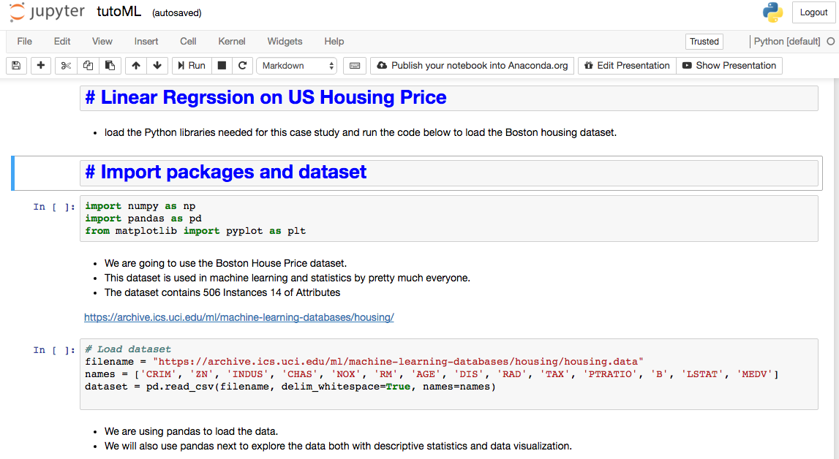
Import packages and dataset
The dataset should load without incident.
If you do have network problems, you can download the “ housing.data “ file into your working directory and load it using the same method, changing URL to the local file name. (you must change .data to .csv format file )

Slide 17
Analyzing and Exploring the Data
In this step we are going to take a look at the data a two different ways:
1- View of the dataset.
2- Statistical summary of all attributes.
# Dimension and Descriptive statistics
dataset.shape
(506, 14)
# display the forst 10 and the last 5 rows
dataset.head(10)
dataset.tail()
Notes:
In a previous lesson, we’ve looked at how you can characterize your data by using traditional statistics. But we also showed how datasets could appear identical when using descriptive statistics, and yet look completely different when visualizing the data via a plot.
Using visual representations of data is the hallmark of exploratory data analysis: letting the data speak to us rather than necessarily imposing an interpretation on the data a priori. In the rest of this lesson, we are going to examine ways of displaying data so that we can better understand the underlying distributions of a single variable or the relationships between two or more variables.
Although data visualization is a powerful tool, the results we obtain may not be suitable when it comes time for us to “tell a story” about the data. Our last slide will discuss what kind of presentations are most effective.

Slide 18
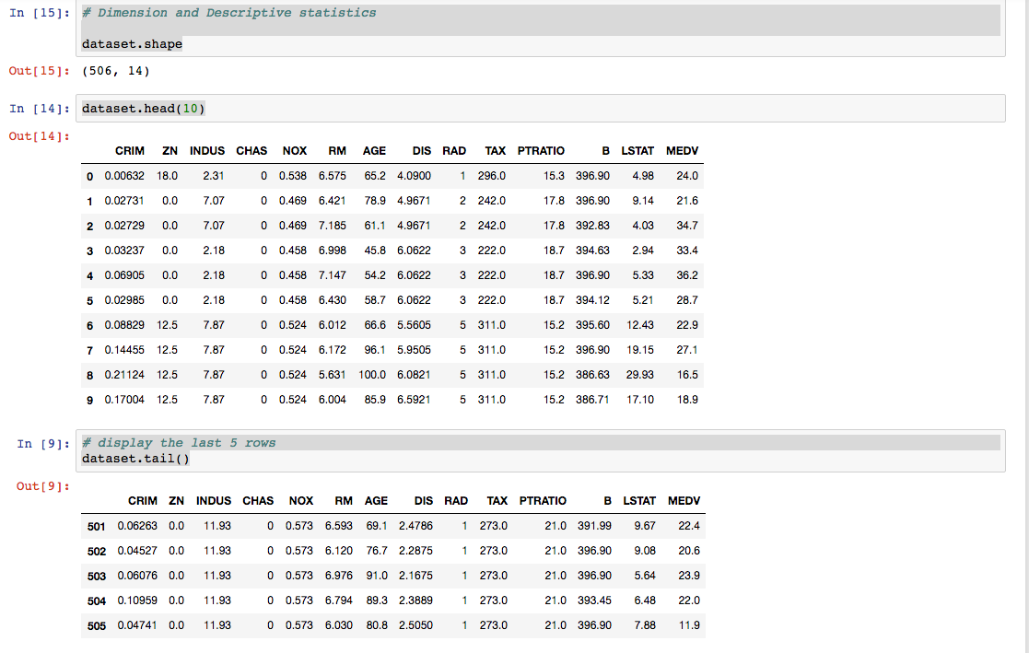
1- View of the dataset

Slide 19
Statistics for Model Building and Evaluation
A statistical analysis may be descriptive, simply reporting, visualizing and summarizing a data set, but usually it is also inferential.
Descriptive Statistics
Linear Regression
Metrics
Notes:
In this lesson, we’ll be concentrating on model building and evaluation, using the topics described.

Slide 20
Descriptive Statistics
Now we can take a look at a summary of each attribute.
This includes the count, mean, the min and max values as well as some percentiles.
'describe( )' ; is a method to get the statistical summary of the various features of the data set
dataset.describe()
Notes:
We have a copy of this synthetic dataset available for download from https://github.com/WinVector/
zmPDSwR/tree/master/Custdata, and once saved, you can load it into R with the command custdata
<- read.table('custdata.tsv',header=T,sep='\t').
custdata <- read.delim("~/custdata.tsv")
sapply (PimaIndiansDiabetes[,1:8], sd )

Slide 21
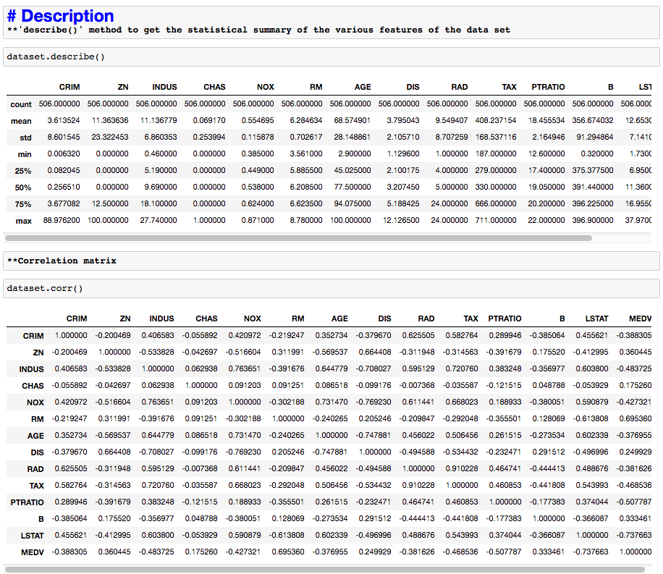

Slide 22
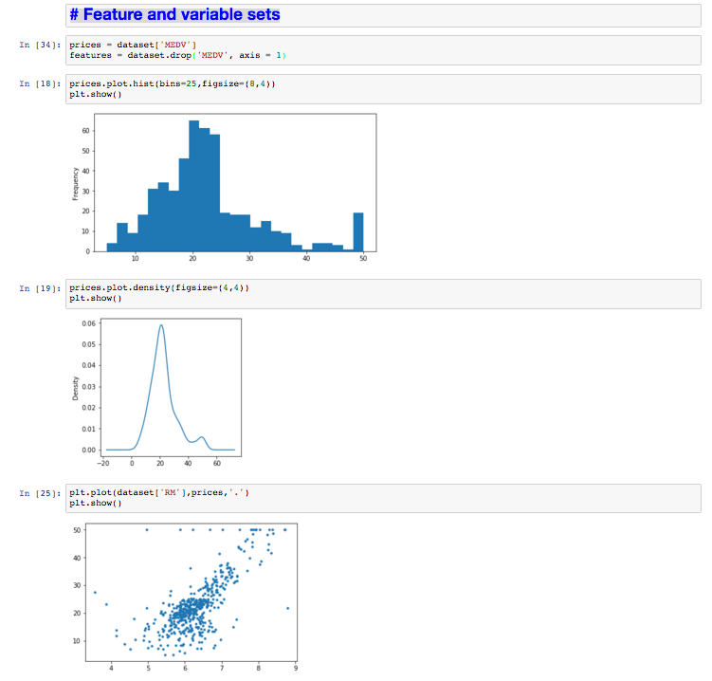
Visualization : Feature and variable sets
Histogram of the prices: Is a fast way to get an idea of the distribution of attribute.
Density of the prices; Density plots are another way of getting a quick idea of the distribution of attribute.
prices vs RM: A scatter plot shows the relationship between two variables as dots in two dimensions, one axis for each attribute.

Slide 23
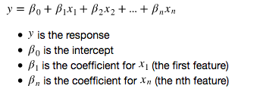
Developin a Model : Linear Regression
Regression analysis is a very widely used statistical tool to establish a relationship model between variables.
We develop the tools and techniques necessary for a model to make a prediction and estimate their accuracy on unseen data.
steps:
Shuffle and Split Data and use 10-fold cross validation.
Build and Select the best models to predict Selling Prices
Notes:
x <- c(151, 174, 138, 186, 128, 136, 179, 163, 152, 131)
y <- c(63, 81, 56, 91, 47, 57, 76, 72, 62, 48)
# Apply the lm() function.
relation <- lm(y~x)
print(summary(relation))
# Find weight of a person with height 170.
a <- data.frame(x = 170)
result <- predict(relation,a)
print(result)
# Plot the chart.
plot(y,x,col = "blue",main = "Height & Weight Regression",abline(lm(x~y)),cex = 1.3,pch = 16,xlab = "Weight in Kg",ylab = "Height in cm")
# Save the file.
dev.off()

Slide 24
Create a Validation Dataset
we take the Boston housing dataset and split the data into training and testing subsets.
We will split the loaded dataset into two, 80% of which we will use to train our models and 20% that we will hold back as a validation dataset.
Typically, the data is also shuffled into a random order when creating the training and testing subsets to remove any bias in the ordering of the dataset.

Slide 25
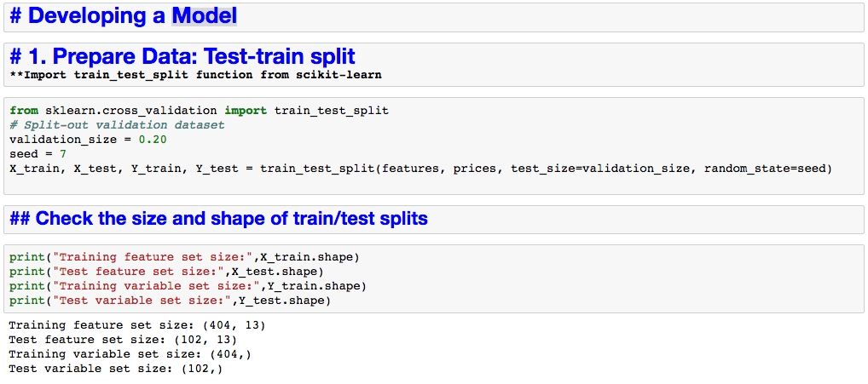
Developin a Model : Linear Regression

Slide 26
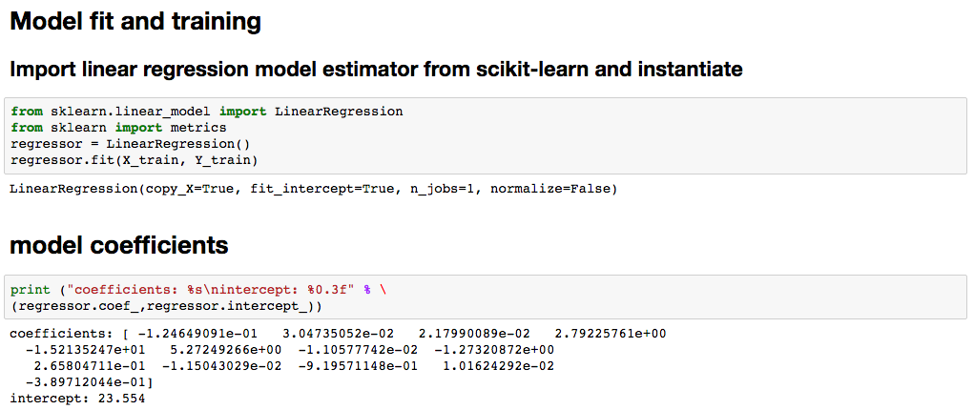
Developin a Model : Linear Regression

Slide 27
Make Predictions
Evaluation Metrics
For regression metrics, the Boston House Price dataset is used as demonstration. this is a regression problem where all of the input variables are also numeric.
Regression Metrics:
We will review 3 of the most common metrics for evaluating predictions on regression machine learning problems:
. Mean Absolute Error.
. Mean Squared Error And (RMSE)
. R2.

Slide 28
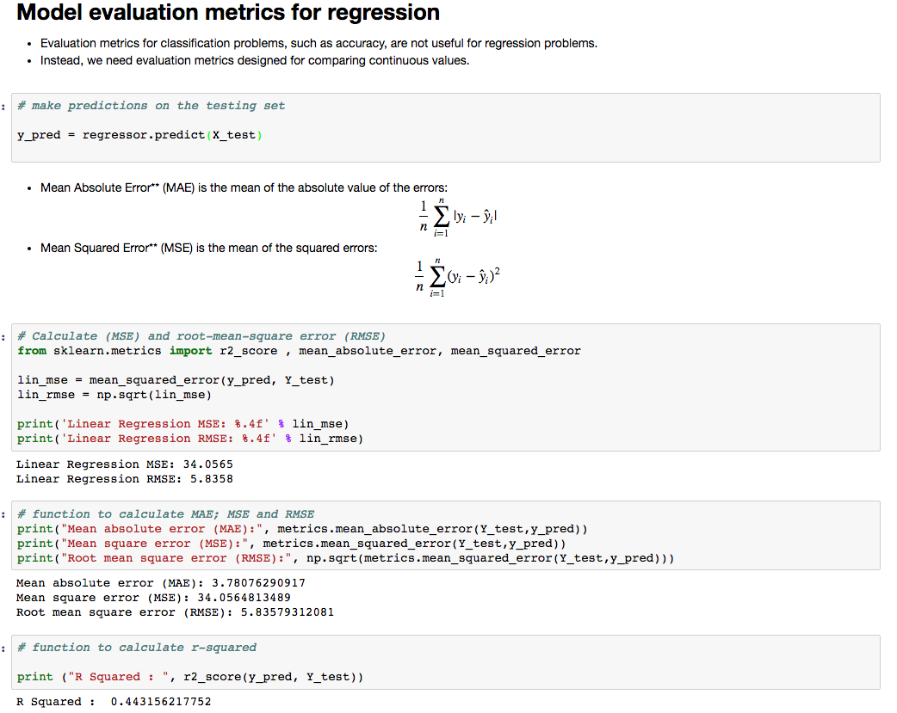

Slide 29
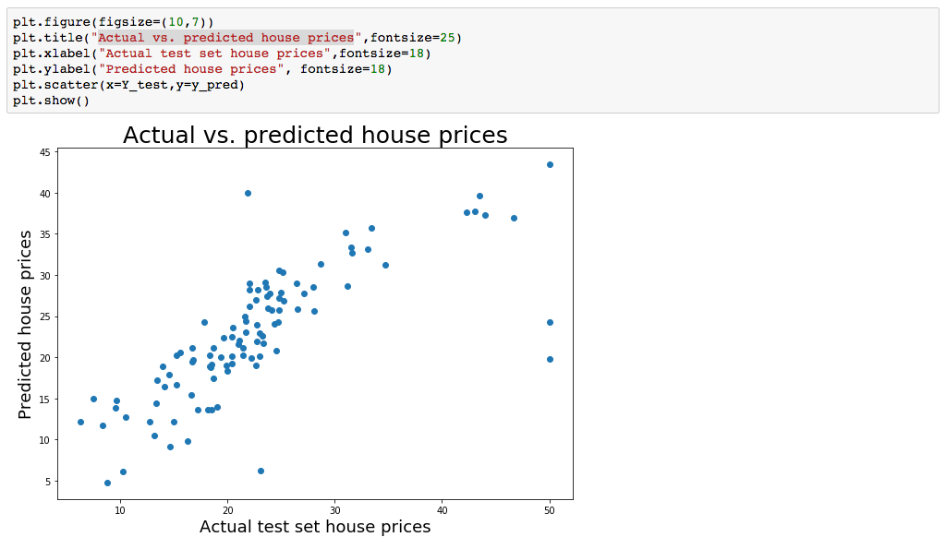
Actual vs. predicted house prices

Slide 30
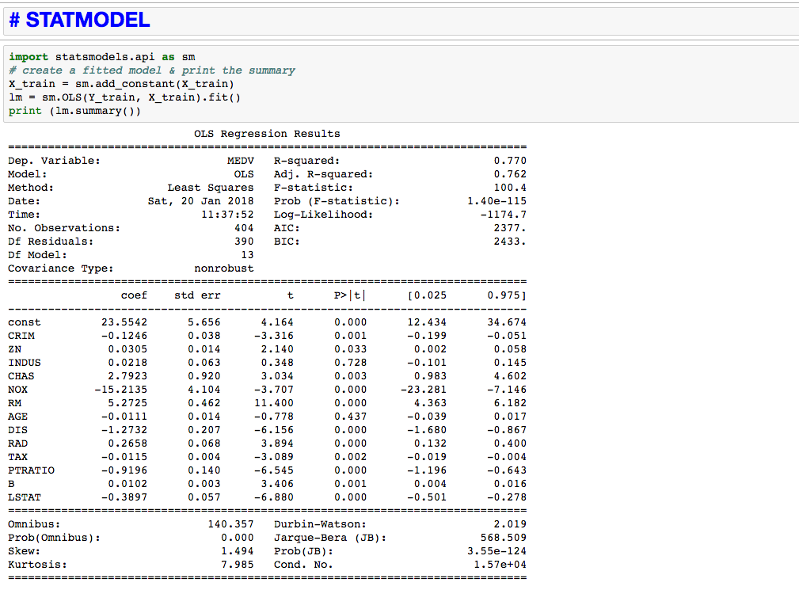
Notes:
If our p-value is <.05, then that variable is statistically significant. This is a useful tool to tune your model.
p-value less than 0.05 is one way to decide whether there is likely a relationship between the feature and the response.
In this case, the p-value is less than 0.05:
Reject null hypothesis
There is a relationship

Slide 31
Summary
Key points covered in this part:
How to use step-by-step machine learning to investigate a dataset in Python.
How to discover a small end-to-end project from loading the data to making predictions in the best way with a new platform.
Notes:
These are the main points covered in the module. Please take a moment to review them.
In addition, pause and consider what you learned from the lab exercises in this module.

Slide 32
THANK YOU

