Slide 1
Data Analytic Methods with Python and Machine Learning
Pr. Mohamed OUZARF
@FST
University Sidi Mohamed Ben Abdellah
Fes Morocco
April: 2019 @Uminho

Slide 2
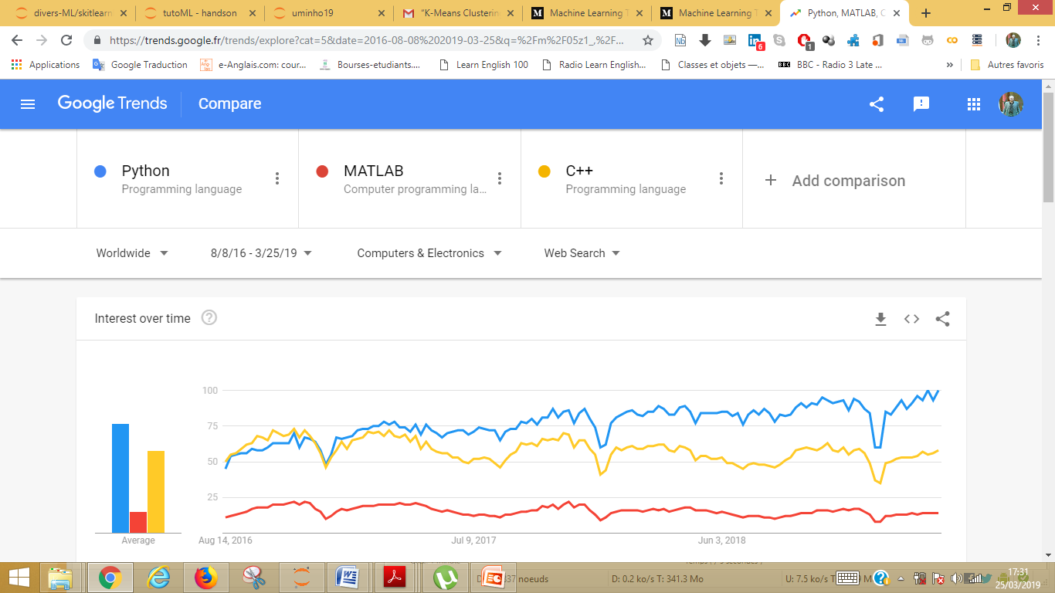
Data Analytic Methods
In my opinion, the Python language still the most common language in the fields of Machine Learning and Data Analysis.

Slide 3
Outline & Content
Introduction :
What is Machine Learning, Types of machine learning , Terms to describe DATA
1.Downloading, Installing and Starting Python and Libraries
2. End-to-End Machine Learning Project
3. Exploratory Data Analysis with Python: Steps processing
4. Case study : Prediction housing price
5. Load The Data and Analyzing and exploring Data 6. Statistics for Model Building and Evaluation
7. Developing a Model : Linear Regression
8. Make prediction and Metrics
9. Statmodel
10. Evaluate Algorithms
Summary
Conclusion

Slide 4
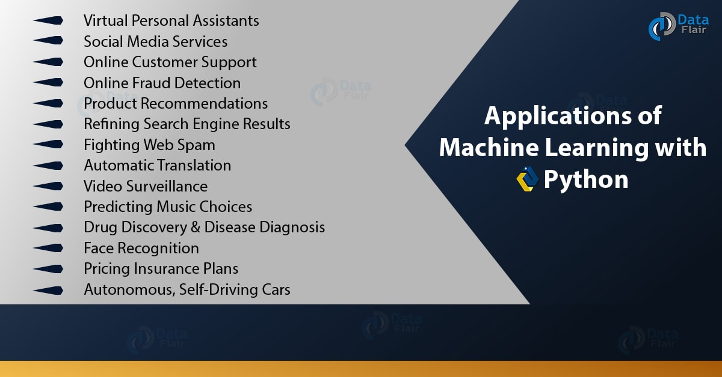
What is machine learning?
A branch of artificial intelligence.
Machine Learning is the science (and art) of programming computers so they can learn from data.
https://data-flair.training/blogs/applications-of-machine-learning/

Slide 5
What is machine learning?
Terminology Related to Machine Learning
Describe what a feature is and how it relates to a sample
Terms to Describe Data

Slide 6
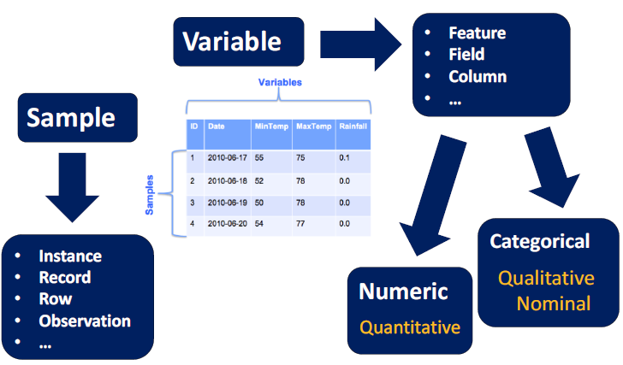
Terms to Describe DATA

Slide 7
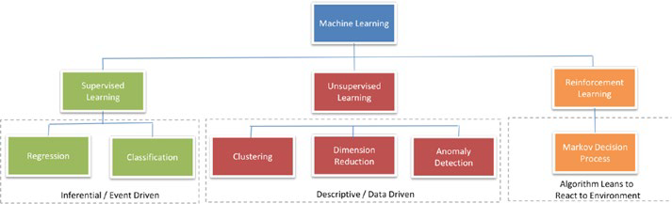
Types of Machine Learning
Supervised learning : making predictions using data
This is also called predictive modelling

Slide 8
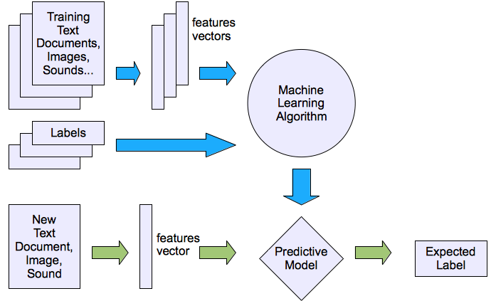
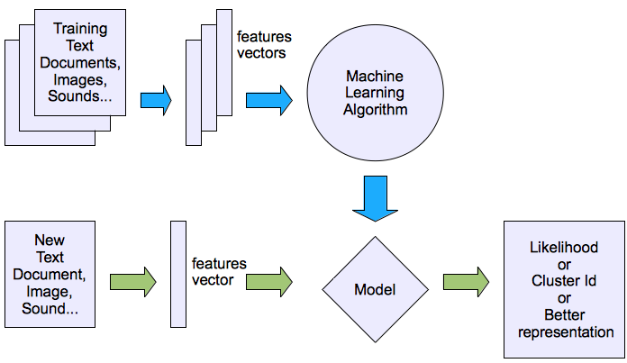
Machine learning structure
Supervised learning
Unsupervised learning

Slide 9
Types of Machine Learning
Supervised learning :
making predictions using data, called predictive modelling.
1) Regression;
The output to be predicted is a continuous number in relevance with a given input dataset.
2) Classification:
The output to be predicted is the actual or the probability of an event/class and the number of classes to be predicted can be two or more.
The algorithm should learn the patterns in the relevant input of each class from historical data and be able to predict the unseen class or event in the future considering their input.

Slide 10
Building supervised learning machine learning models
Building supervised learning machine learning models has three stages:
1. Training: The algorithm will be provided with historical input data with the mapped output. The algorithm will learn the patterns within the input data for each output and represent that as a statistical equation, which is also commonly known as a model.
2. Testing or validation: In this phase the performance of the trained model is evaluated, usually by applying it on a dataset
(that was not used as part of the training) to predict the class or event.
3. Prediction: Here we apply the trained model to a data set that was not part of either the training or testing. The prediction will be used to drive business decisions.

Slide 11
End-to-End Machine Learning Project
In a nutshell, a machine learning project has two main parts:
1- Exploratory Data Analysis : step of Preprocessing
Data Understanding, Data Cleaning,
Target Variable Selection, Feature Extraction,
Scaling, Dimensionality Reduction.
2 - Modeling and Prediction
Training,
Performance Metrics,
Evaluation,
Deployement.
~ 60%
Of The Time.

Slide 12
Exploratory Data Analysis with Python
Use EDA methods and modeling processes to analyze a data set and make prediction with certain accuracy.
Use Python as a tool for programming.
To begin to analyze the data you need:
i) A tool that allows you to look at the data = that is “python library”.
ii) Skill in basic statistics.

Slide 13
Exploratory Data Analysis with Python
Tools and Creating the Work Environement
Downloading, Installing and Starting Python and Libraries
First you will need to have Python installed. It is probably already installed on your system. https://www.python.org/
1.1 There are 5 key libraries that you will need to install.
scipy
numpy
pandas
sklearn
matplotlib
seaborn
1.2 I would recommend installing the free version of Anaconda that includes everything you need.

Slide 14
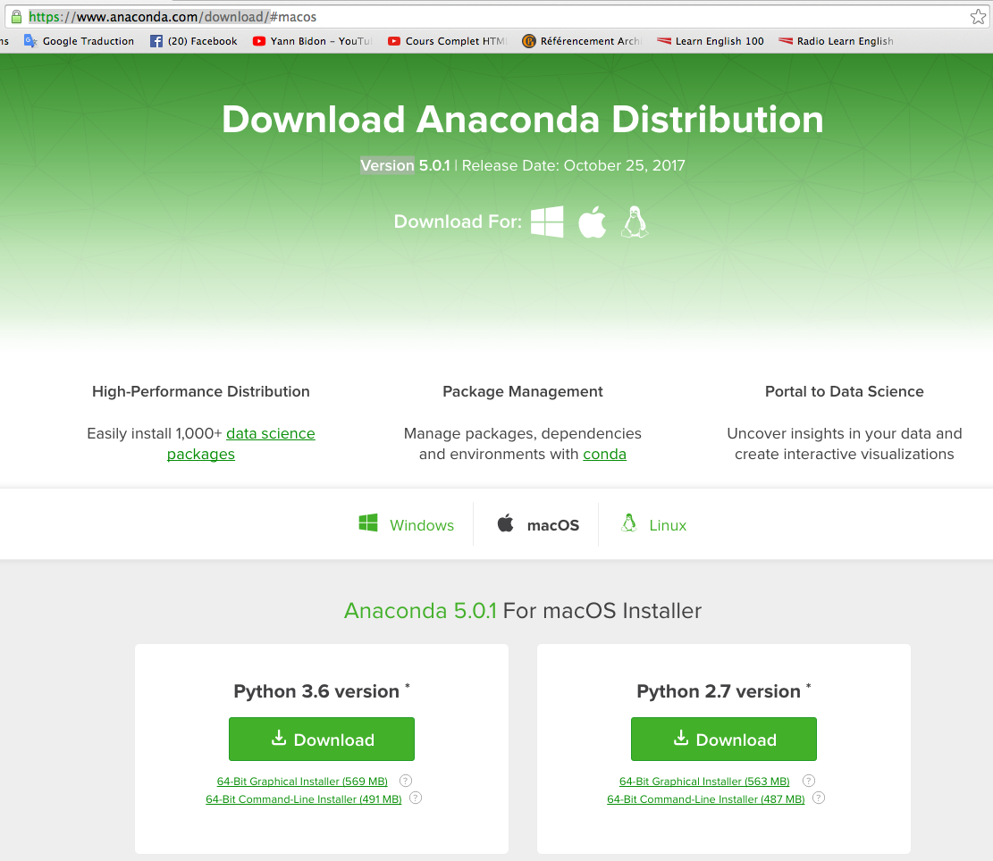
Exploratory Data Analytic Using Python
Tools and Creating the Work Environement
Downloading, Installing and Starting Python and Libraries
First you will need to have Python installed. It is probably already installed on your system. https://www.python.org/
1.1 There are 5 key libraries that you will need to install.
scipy
numpy
pandas
sklearn
matplotlib
seaborn
1.2 I would recommend installing the free version of Anaconda that includes everything you need.

Slide 15
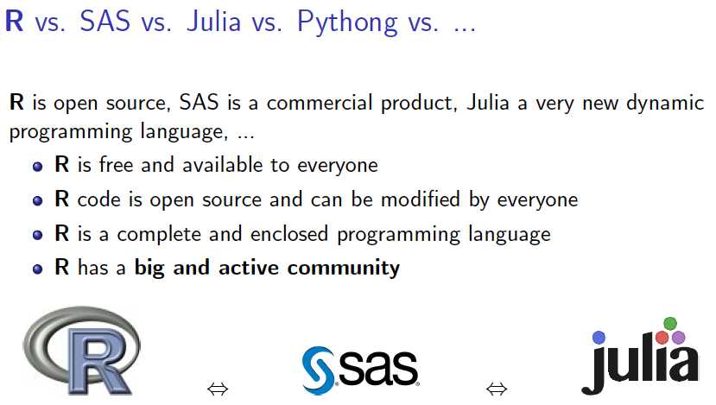


JUPYTER

Slide 16
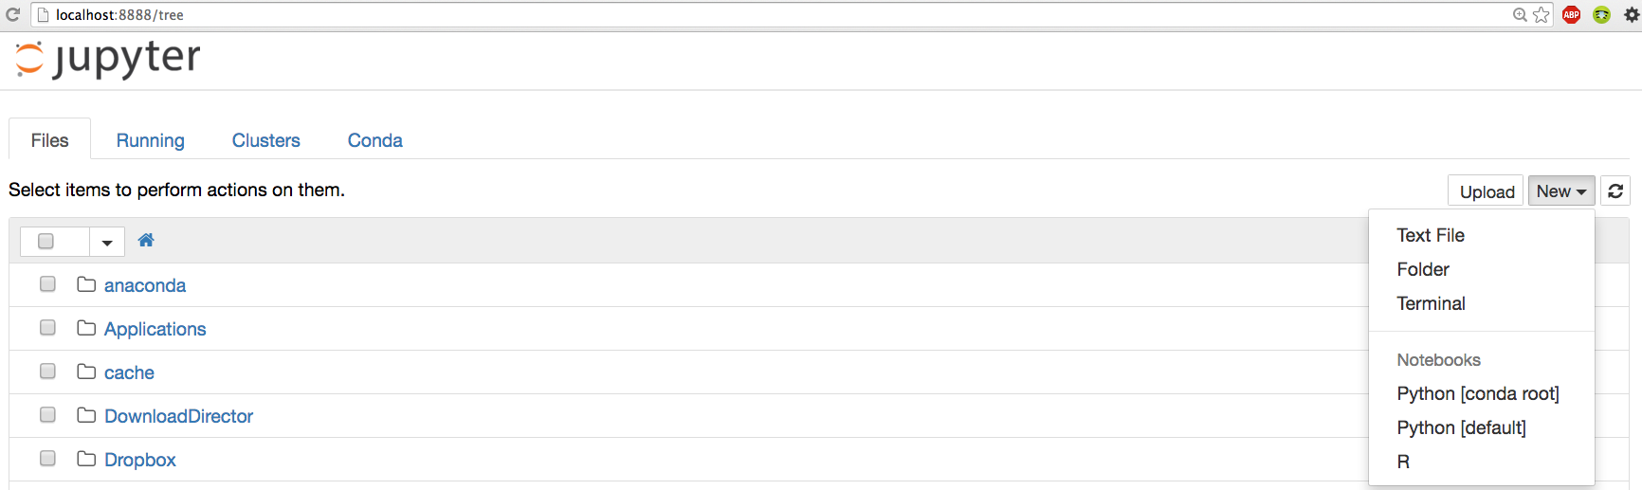
JUPYTER
To check your installation, try to import every module.
To launch Jupyter by typing:
$ jupyter notebook
A Jupyter server is now running in your terminal, listening to port 8888. You can visit this server by opening your web browser to http://localhost:8888/

Slide 17
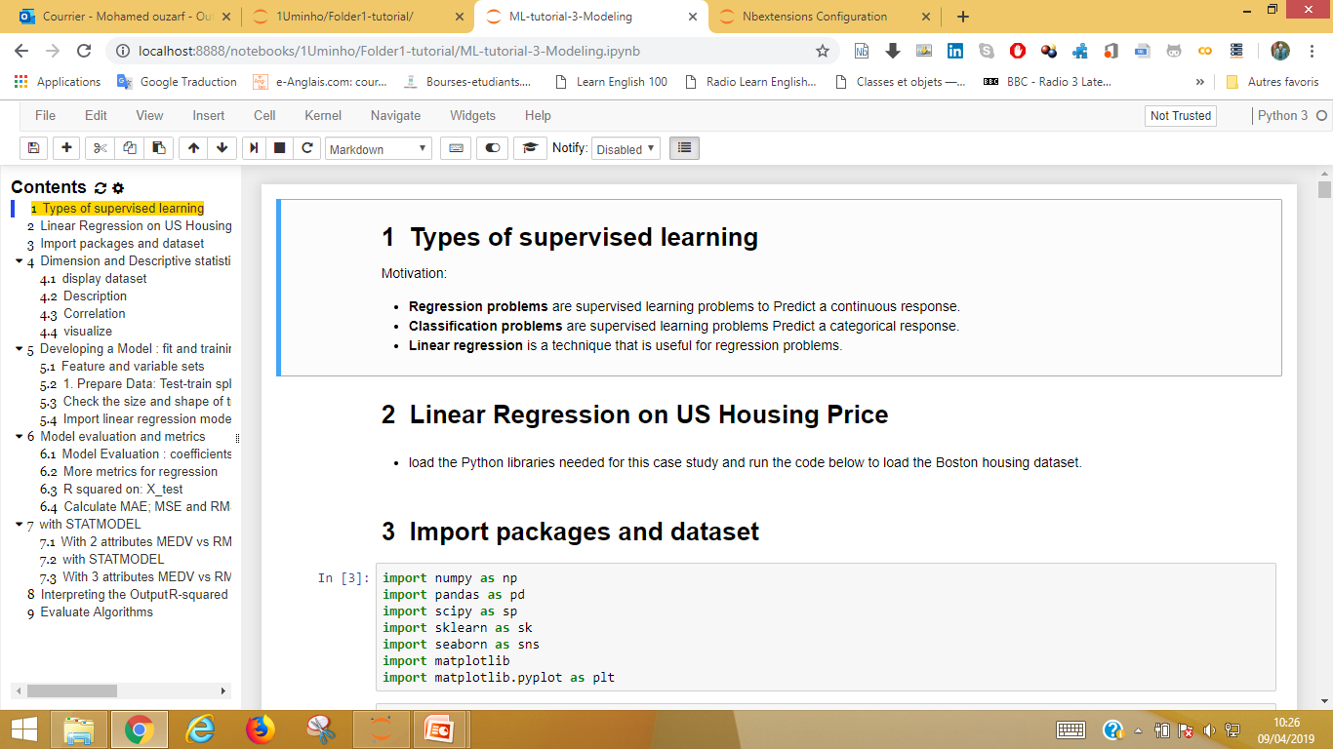
JUPYTER
To launch project on Jupyter by selecting file .ipynb :

Slide 18
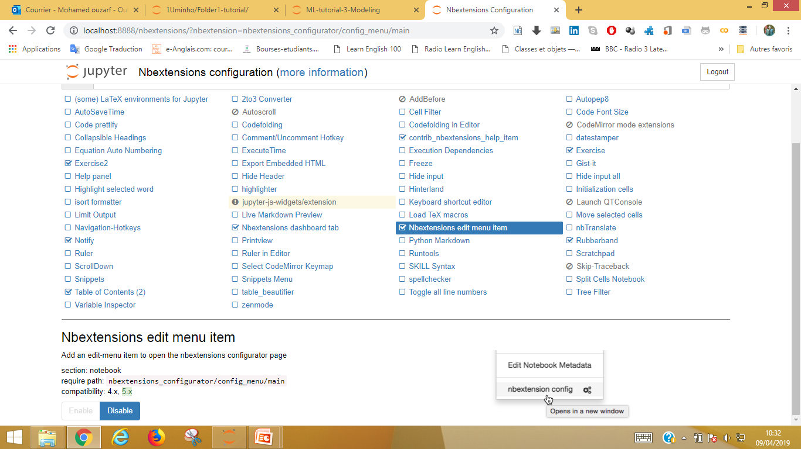
JUPYTER
Configure Jupyter by : nbextensions config in EDIT menu item :

Slide 19
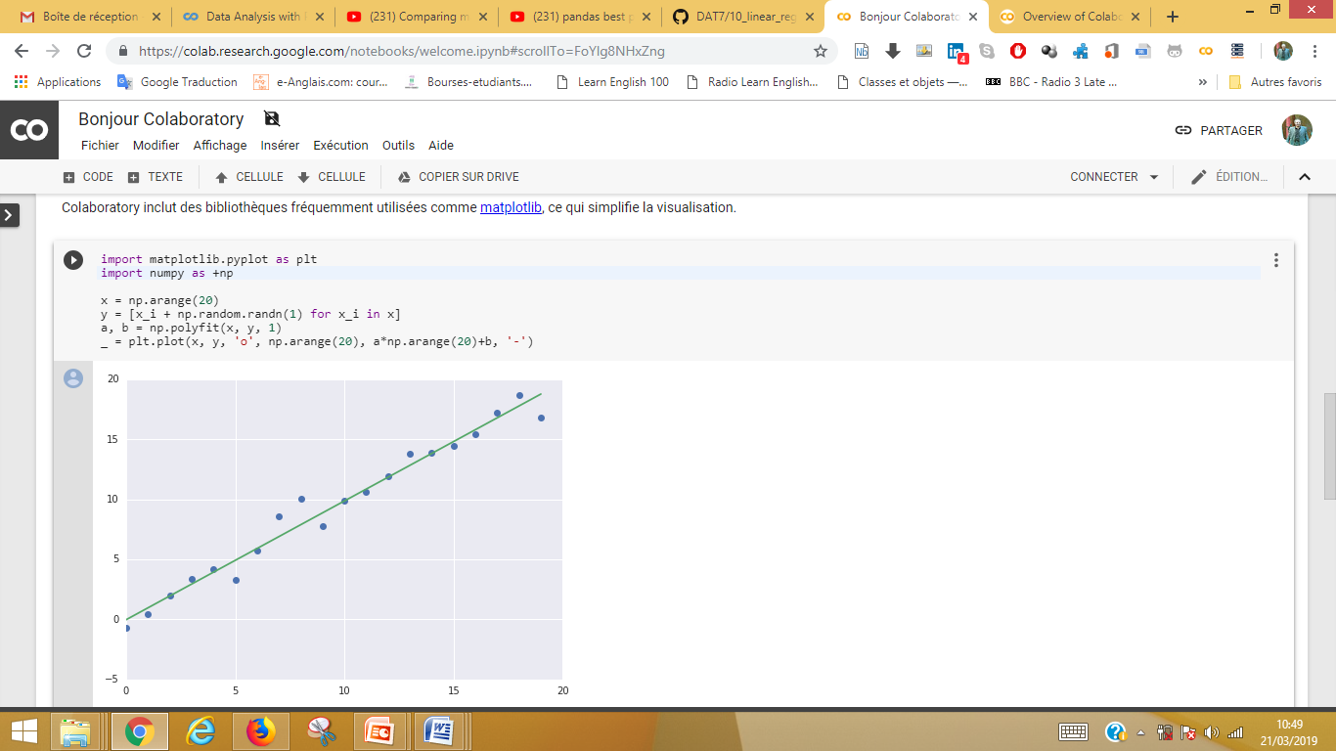
JUPYTER https://colab.research.google.com

Slide 20
Exploratory Data Analysis with Python
1- Exploratory Data Analysis : step of Preprocessing
i) Data Understanding, Data Cleaning,
ii) Target Variable Selection, Feature Extraction, Scaling,.
The dataset can be easily downloaded from multiple sources.
Dimensions of your dataset.
Review the data types: info()
Data Cleaning
Missing values
Outliers
Described by tools of Statistics and Visualization :
Data Relationships : correlation

Slide 21
Exploratory Data Analysis with Python
1- Exploratory Data Analysis : step of Preprocessing
i. import Libraries
For loading data and making EDA operations, we’ll use the numpy and pandas modules and for visualising we “ll use Seaborn and Matplotlib packages
scipy
numpy
pandas
sklearn
matplotlib
seaborn

Slide 22
Exploratory Data Analysis with Python
ii. import DATA
The dataset can be easily downloaded from multiple sources with multiple formats.
Loading data in Python by using functions like read_csv from pandas library.
We can also use other formats like JSON, HTML, HDF, EXCEL, STATA, SAS, SQL .. etc
The datasets can be to get from popular open data repositories:
UC Irvine Machine Learning Repository: http://archive.ics.uci.edu/ml/
Kaggle datasets : https://www.kaggle.com/datasets
Amazon’s AWS datasets: http://aws.amazon.com/fr/datasets/
http://dataportals.org/
http://opendatamonitor.eu/
http://quandl.com/
Wikipedia’s list of Machine Learning datasets: https://goo.gl/SJHN2k
Datasets subreddit : https://www.reddit.com/r/datasets

Slide 23
Exploratory Data Analysis with Python
Download the Data
In general your data would be available in a relational database and spread across multiple tables/documents/files. Reading data:
Reading data:
The easiest way to get data into your Python program is the Pandas library. The obvious way to go is to read a CSV file which you can generate from any spreadsheet or database system.
import pandas as pd
df = pd.read_csv(filename.csv')
This operation returns a pandas DataFrame object, in the form of a table called df for DataFrame.

Slide 24
Exploratory Data Analysis with Python
Data Exploration and Understanding
Once the data is loaded in the memory,
one needs to see what it contains and how is described by tools of Statistics and Visualization :
Using of the following methods for :
# Displays statistics of each column : df.describe()
# Dimensions of your dataset : df.shape
# Review the data types : info()
# Data Cleaning
# Missing values
# Outliers
Described by tools of Statistics and Visualization :
Data Relationships : correlation

Slide 25
Exploratory Data Analysis with Python
1- Exploratory Data Analysis : step of Preprocessing
i) Data Understanding, Data Cleaning,
ii) Target Variable Selection, Feature Extraction, Transformations
Described by tools of Statistics and Visualization :
Data Relationships : correlation
Selecting Data
Feature Extraction
Statistical tests can be used to Select or Extract those features that have the strongest relationship with the output variable.
Data Transforms
Rescale data.
Standardize data.
Normalize data.

Slide 26
Exploratory Data Analysis with Python
tutorials
http://localhost:8888/notebooks/1Uminho/Folder1-tutorial/ML-tutorial-1-Intro.ipynb
http://localhost:8888/notebooks/1Uminho/Folder1-tutorial/ML-tutorial-2-EDA.ipynb
http://localhost:8888/notebooks/1Uminho/Folder1-tutorial/ML-tutorial-3-Modeling.ipynb

Slide 27
End-to-End Machine Learning Project
2 - Modeling and Prediction
Training,
Performance Metrics,
Evaluation,
Deployement.
Training,
Training is the process of making the system able to learn.
Modeling , Evaluation and Prediction need four datasets:
training features,
testing features,
training variables,
and testing variables.

Slide 28
End-to-End Machine Learning Project
2 - Modeling and Prediction
Training,
Performance Metrics,
Evaluation,
Deployement.
Performance Metrics,
We are focused on regression algorithms so I will consider 3 most often used performance metrics
Mean Absolute Error (MAE)
Mean Squared Error (MSE)
R²

Slide 29
End-to-End Machine Learning Project
Performance Metrics,
There are several factors affecting the performance:
The learning algorithms used
Modeling
Types of training provided
Evaluation
Optimization

Slide 30
Case study : Prediction housing price
Goal:
Model Evaluation and Validation for the Prediction of Boston Housing Prices.
For this project we will investigate the Boston House Price dataset.
Each record in the database describes a Boston suburb or town.
The data was drawn from the Boston Standard Metropolitan Statistical Area (SMSA) in 1970.
https://archive.ics.uci.edu/ml/machine-learning-databases/housing/

Slide 31
Case study : Prediction housing price
dataset
We are going to use the Boston House Price dataset.
This dataset is used in machine learning and statistics by pretty much everyone.
The dataset contains 506 Instances 14 of Attributes
https://archive.ics.uci.edu/ml/machine-learning-databases/housing/

Slide 32
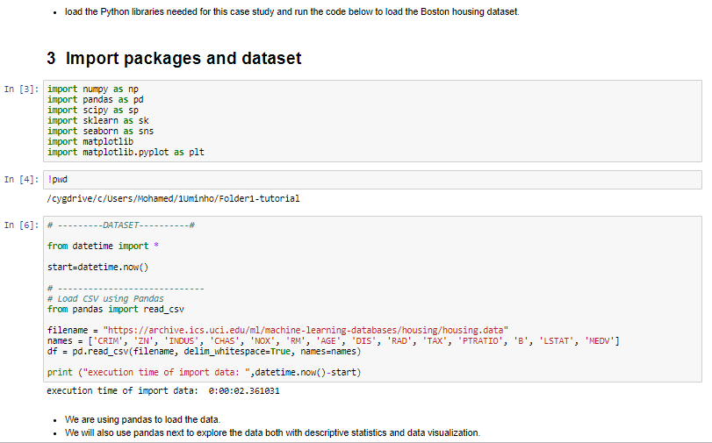
Load The Data
Import packages and dataset
The dataset should load without incident.
If you do have network problems, you can download the “ housing.data “ file into your working directory and load it using the same method, changing URL to the local file name. (you must change .data to .csv format file )

Slide 33
Analyzing and Exploring the Data
In this step we are going to take a look at the data a two different ways:
1- View of the dataset.
2- Statistical summary of all attributes. Correlation & visualization
# check the shape of the DataFrame (rows, columns)
df.shape
df.head(10)
dataset.tail()
df.isnull().values.any()
df.describe(include="all")
describe() method to get the statistical summary of the various features of the data set
df.info()
Notes:
In a previous lesson, we’ve looked at how you can characterize your data by using traditional statistics. But we also showed how datasets could appear identical when using descriptive statistics, and yet look completely different when visualizing the data via a plot.
Using visual representations of data is the hallmark of exploratory data analysis: letting the data speak to us rather than necessarily imposing an interpretation on the data a priori. In the rest of this lesson, we are going to examine ways of displaying data so that we can better understand the underlying distributions of a single variable or the relationships between two or more variables.
Although data visualization is a powerful tool, the results we obtain may not be suitable when it comes time for us to “tell a story” about the data. Our last slide will discuss what kind of presentations are most effective.

Slide 34
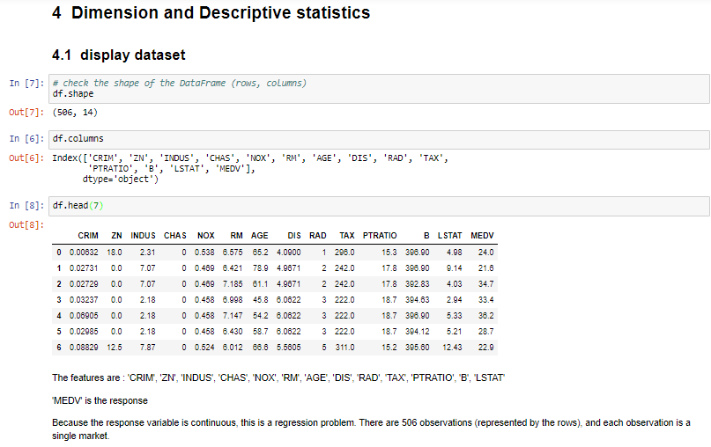
1- View of the dataset

Slide 35
Statistics for Model Building and Evaluation
A statistical analysis may be descriptive, simply reporting, visualizing and summarizing a data set, but usually it is also inferential.
Descriptive Statistics
Linear Regression
Metrics
Notes:
In this lesson, we’ll be concentrating on model building and evaluation, using the topics described.

Slide 36
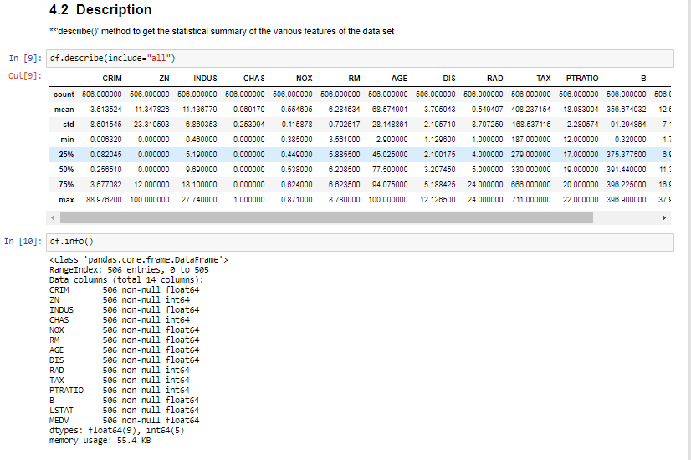
Descriptive Statistics
Now we can take a look at a summary of each attribute.
This includes the count, mean, the min and max values as well as some percentiles.
Notes:
We have a copy of this synthetic dataset available for download from https://github.com/WinVector/
zmPDSwR/tree/master/Custdata, and once saved, you can load it into R with the command custdata
<- read.table('custdata.tsv',header=T,sep='\t').
custdata <- read.delim("~/custdata.tsv")
sapply (PimaIndiansDiabetes[,1:8], sd )

Slide 37
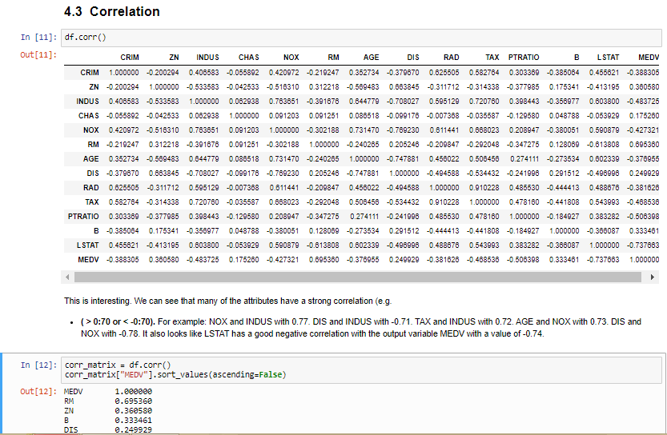
Descriptive Statistics

Slide 38
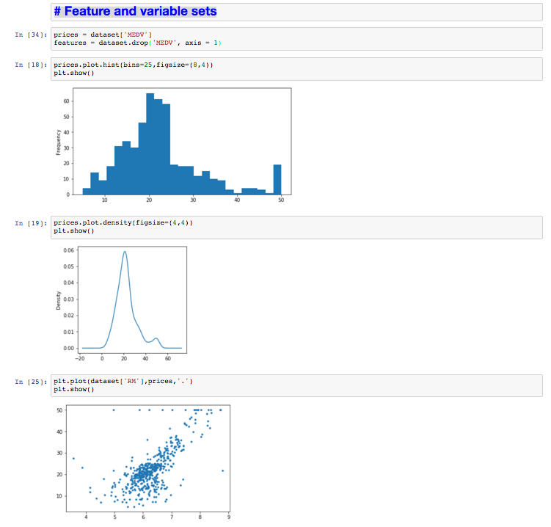
Visualization : Feature and variable sets
Histogram of the prices: Is a fast way to get an idea of the distribution of attribute.
Density of the prices; Density plots are another way of getting a quick idea of the distribution of attribute.
prices vs RM: A scatter plot shows the relationship between two variables as dots in two dimensions, one axis for each attribute.

Slide 39
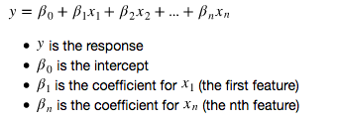
Developing a Model : Linear Regression
Regression analysis is a very widely used statistical tool to establish a relationship model between variables.
We develop the tools and techniques necessary for a model to make a prediction and estimate their accuracy on unseen data.
steps:
Shuffle and Split Data and use 10-fold cross validation.
Build and Select the best models to predict Selling Prices
Notes:
x <- c(151, 174, 138, 186, 128, 136, 179, 163, 152, 131)
y <- c(63, 81, 56, 91, 47, 57, 76, 72, 62, 48)
# Apply the lm() function.
relation <- lm(y~x)
print(summary(relation))
# Find weight of a person with height 170.
a <- data.frame(x = 170)
result <- predict(relation,a)
print(result)
# Plot the chart.
plot(y,x,col = "blue",main = "Height & Weight Regression",abline(lm(x~y)),cex = 1.3,pch = 16,xlab = "Weight in Kg",ylab = "Height in cm")
# Save the file.
dev.off()

Slide 40
Developing a Model : Linear Regression
Create a Validation Dataset
we take the Boston housing dataset and split the data into training and testing subsets.
We will split the loaded dataset into two, 80% of which we will use to train our models and 20% that we will hold back as a validation dataset.
Typically, the data is also shuffled into a random order when creating the training and testing subsets to remove any bias in the ordering of the dataset.

Slide 41
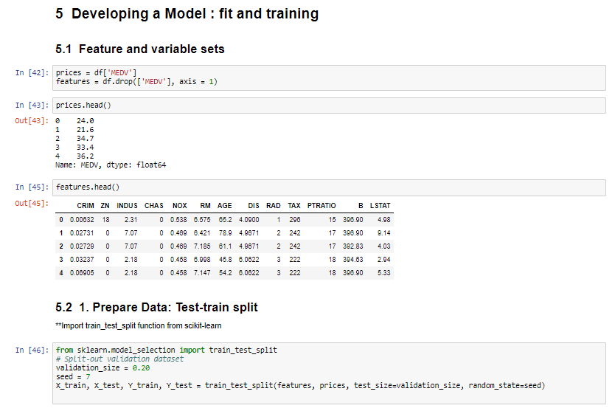
Developing a Model : Linear Regression

Slide 42
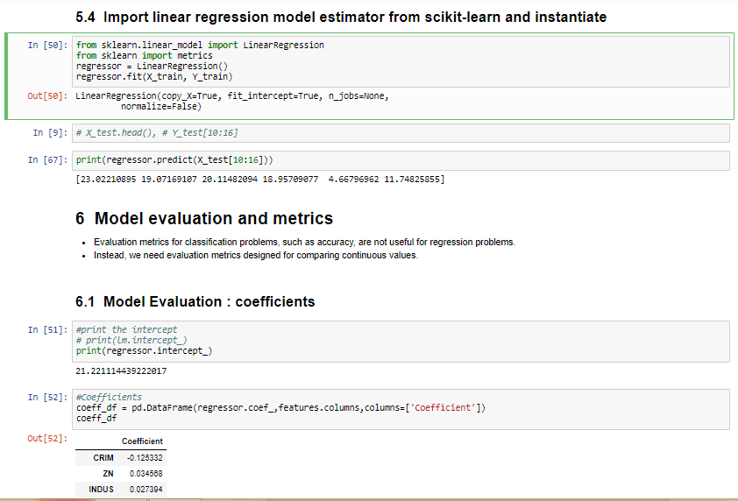
Developing a Model : Linear Regression

Slide 43
Make Predictions
Evaluation Metrics
For regression metrics, the Boston House Price dataset is used as demonstration. this is a regression problem where all of the input variables are also numeric.
Regression Metrics:
We will review 3 of the most common metrics for evaluating predictions on regression machine learning problems:
. Mean Absolute Error.
. Mean Squared Error And (RMSE)
. R2.

Slide 44
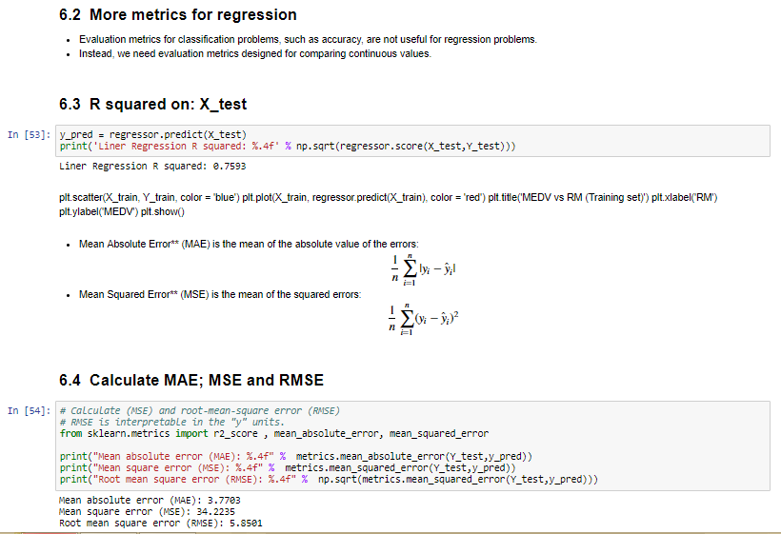
Make Predictions

Slide 45
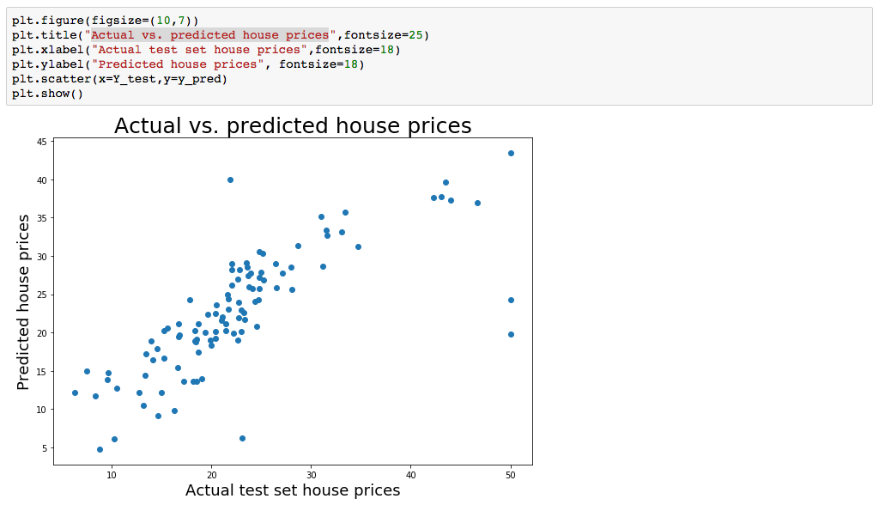
Actual vs. predicted house prices

Slide 46
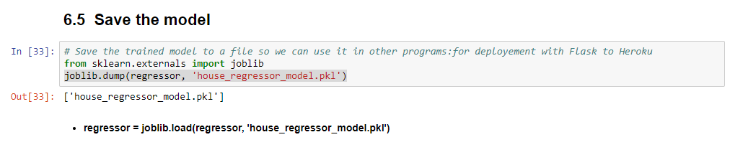
Model serialization
Save the result of predictions

Slide 47
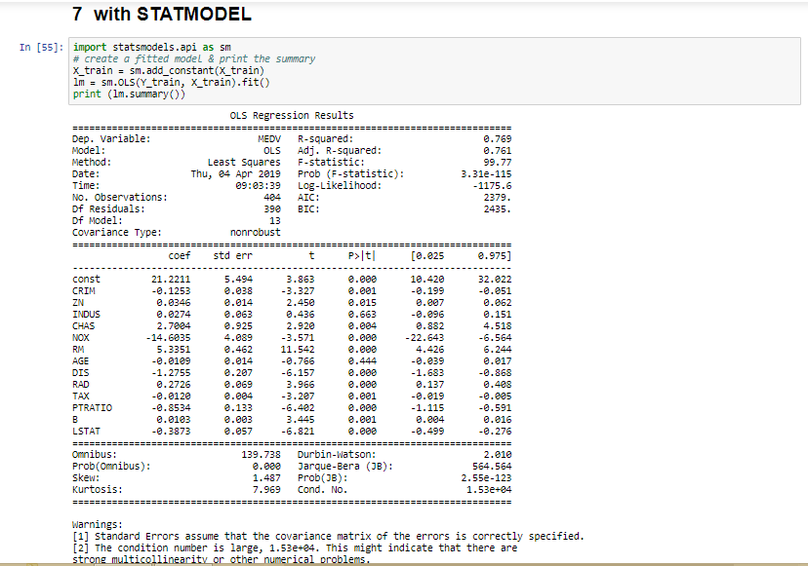
R2-squared on training, 0.77
Notes:
If our p-value is <.05, then that variable is statistically significant. This is a useful tool to tune your model.
p-value less than 0.05 is one way to decide whether there is likely a relationship between the feature and the response.
In this case, the p-value is less than 0.05:
Reject null hypothesis
There is a relationship

Slide 48
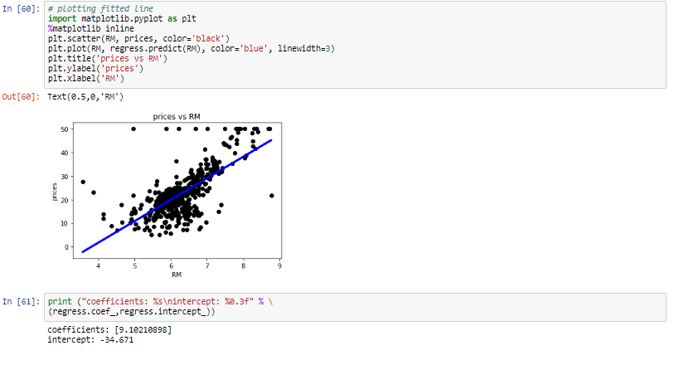
7.1 With 2 attributes MEDV vs RM
R2-squared on training, 0.48

Slide 49
7.1 With 2 attributes MEDV vs RM
R2-squared on training, 0.48
7.2 With 3 attributes MEDV vs RM
R2-squared on training, 0.64
8 Interpreting the Output R-squared
We can see here that this model (with 3 attributes) has a good R-squared value — 0.64 meaning that this model explains 64% of the variance in our dependent variable. Whenever we add variables to a regression model, R² will be higher.
This was the example of both single and multiple linear regression in Statsmodels. We could have used as little or as many variables we wanted in our regression model(s):
— up to all the 13 attributes: R-squared value = 0.770.
— for 2 attributes: R-squared value = 0.484.

Slide 50
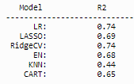
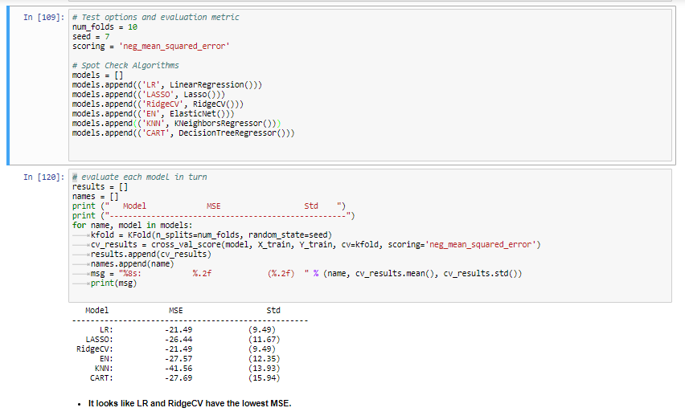
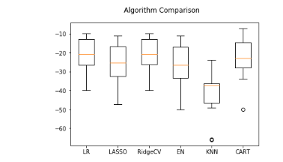
Evaluate Algorithms
# Evaluate with R2
# Evaluate with MSE

Slide 51
Summary
Key points covered in this part:
How to use step-by-step machine learning to investigate a dataset in Python.
How to discover a small end-to-end project from loading the data to making predictions in the best way with a new platform.
Notes:
These are the main points covered in the module. Please take a moment to review them.
In addition, pause and consider what you learned from the lab exercises in this module.

Slide 52
Conclusion
We have a simple overview of some techniques of Exploratory Data Analysis with Python and algorithms in machine learning.
We describe the tools and techniques necessary for a model to make a prediction and estimate their accuracy and evaluate some algorithms of supervised machine learning.
Furthermore, there are more and more techniques apply machine learning as a solution.

Slide 53
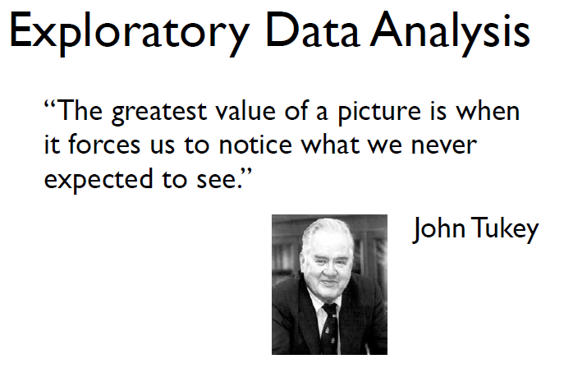
THANK YOU

