Slide 1

World Happiness Project
Team members:
Mirta Lucic
Maham Afzal
Trong Nguyen
Oz Garip

Slide 2
Contents
Aims
Source of Data
Technologies
Outcomes
Strengths and weaknesses

Slide 3



Aims
Analyzing data from years from the World Happiness Report.
Research where in the world people are happiest and how this changes throughout time.
What factors contribute to the happiest and least happiest regions in the world, specifically from years 2015-2019
With machine learning model, we wanted to know what factor or factors contribute to the most happiest regions in the world.

Slide 4

Source of Data
CSV data came from Kaggle which originally came from The World Happiness Report.
They've been conducting a global survey of over 150 countries for the past ten years.

Slide 5
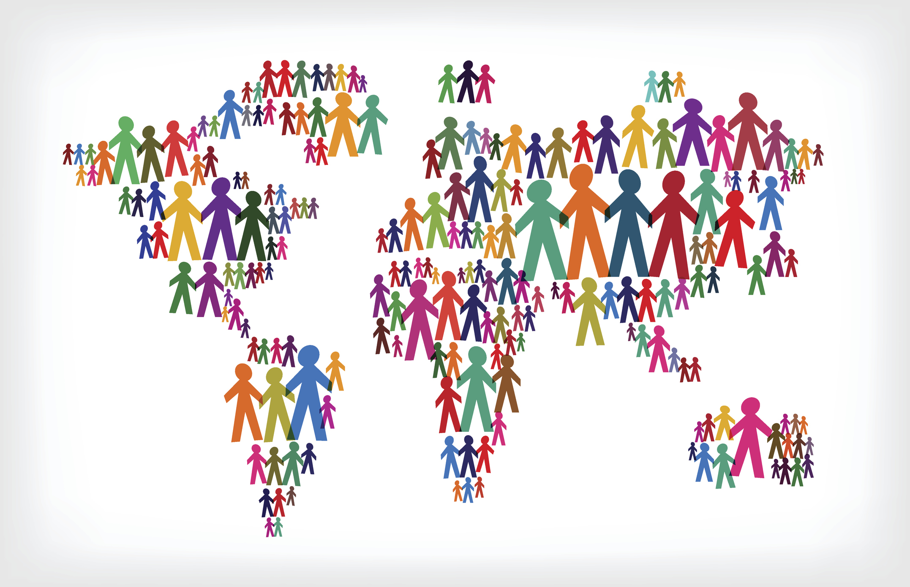
Questions we hope to answer
From 2015 - 2019, what is the happiest region in the world?
What feature weighs the heaviest in the happiness score?
What feature is the least important to the happiness score?

Slide 6
Technologies
Python
Jupyter Notebook
Tableu
PostGres, PGAdmin
SQLAlchemy

Slide 7
Jupyter Notebook
Before we could start building our model, we had to clean our data.
Using Jupyter Notebook, we read in each of our files (2015-2019) and removed unnecessary columns, and changed column names so that each year's columns would align.
Next, for 2015 specifically, we assigned a number (1-10) to each region.
Lastly, we converted the column 'Happiness Score' from a range of 0-10 to 0 (low) and 1 (high)

Slide 8
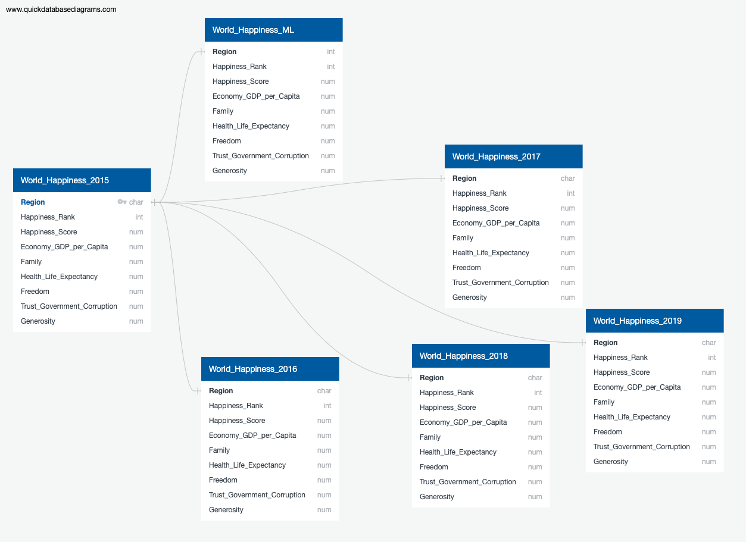
SQL
After we had cleaned our data, we created our SQL database in Postgres

Slide 9
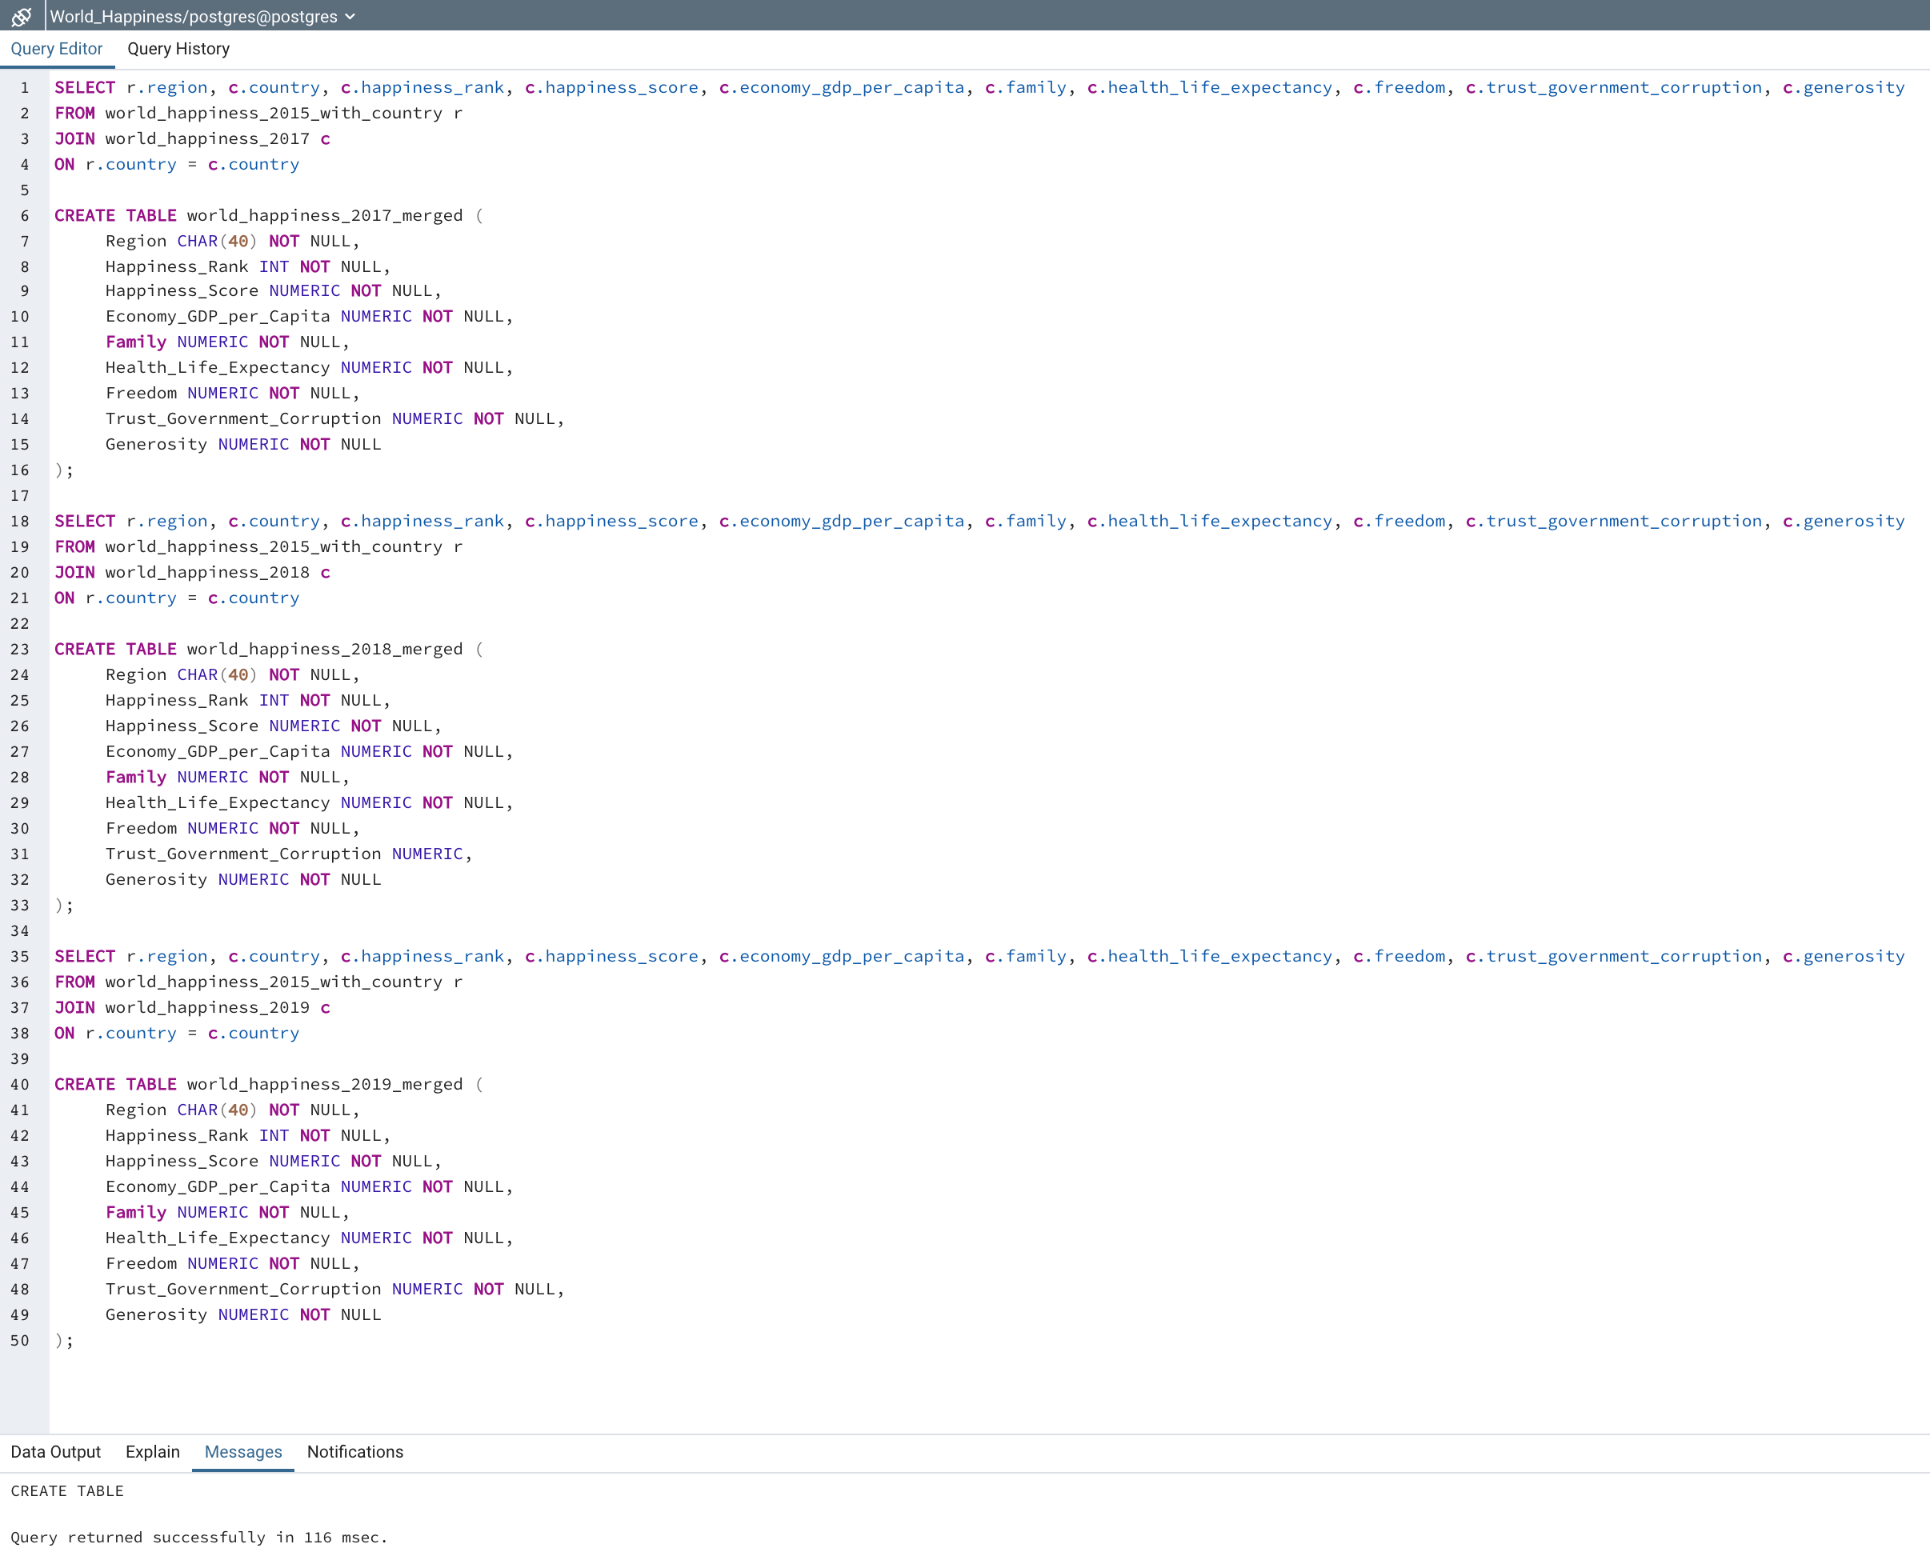
SQL

Slide 10
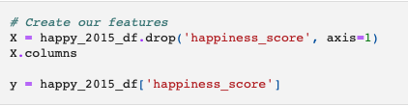
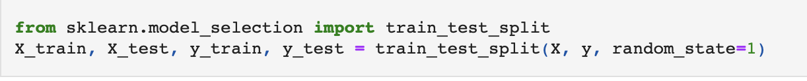
Machine Learning
After we had cleaned our data and created our SQL database in Postgres, we reuploaded our data using SQLAlchemy. Once that was complete, we started building our machine learning model using out 2015 dataset. For our features, we are using 'Happiness Score' as our Y value as that is the factor we are trying to predict. We would like to see how our other columns, including GDP, life expectancy, and family affect different region's happiness scores.

Slide 11
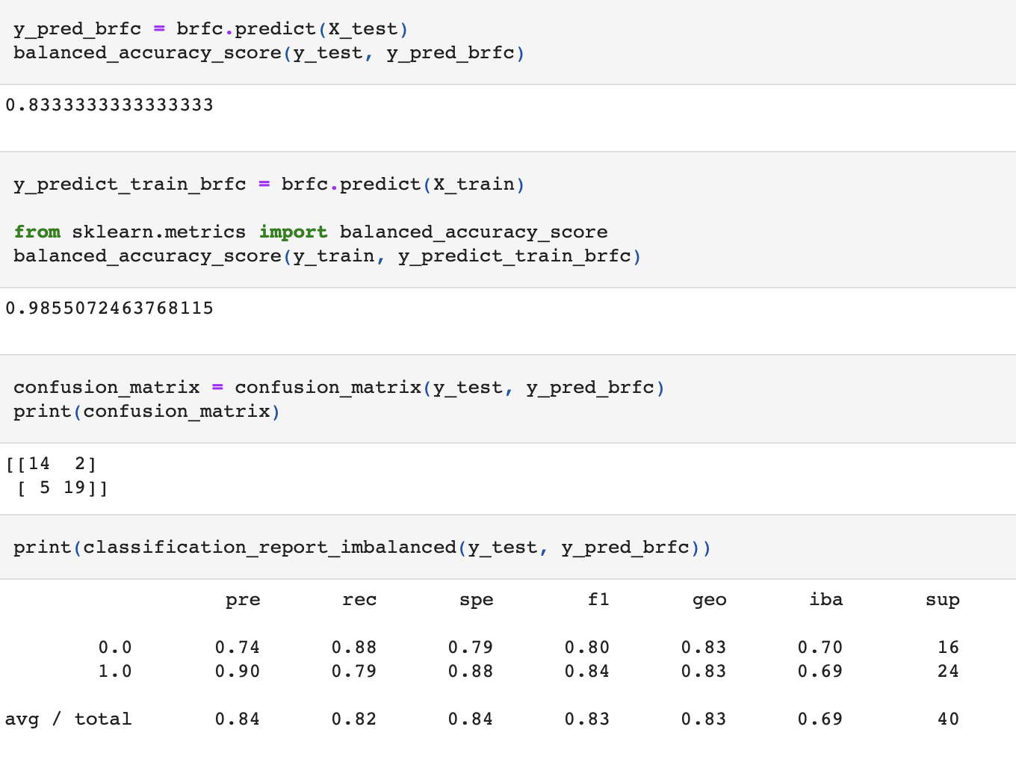
Machine Learning

Slide 12
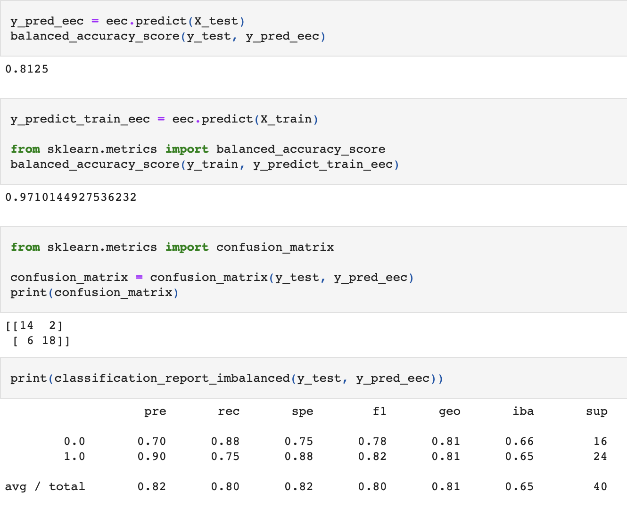
Machine Learning

Slide 13
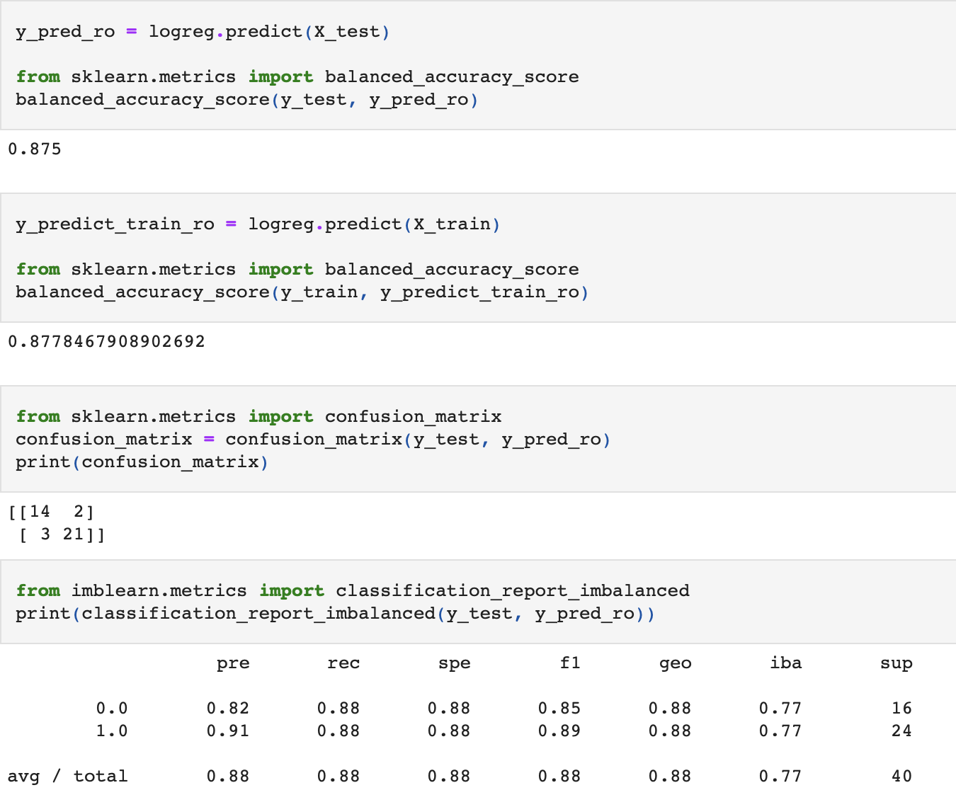
Machine Learning

Slide 14
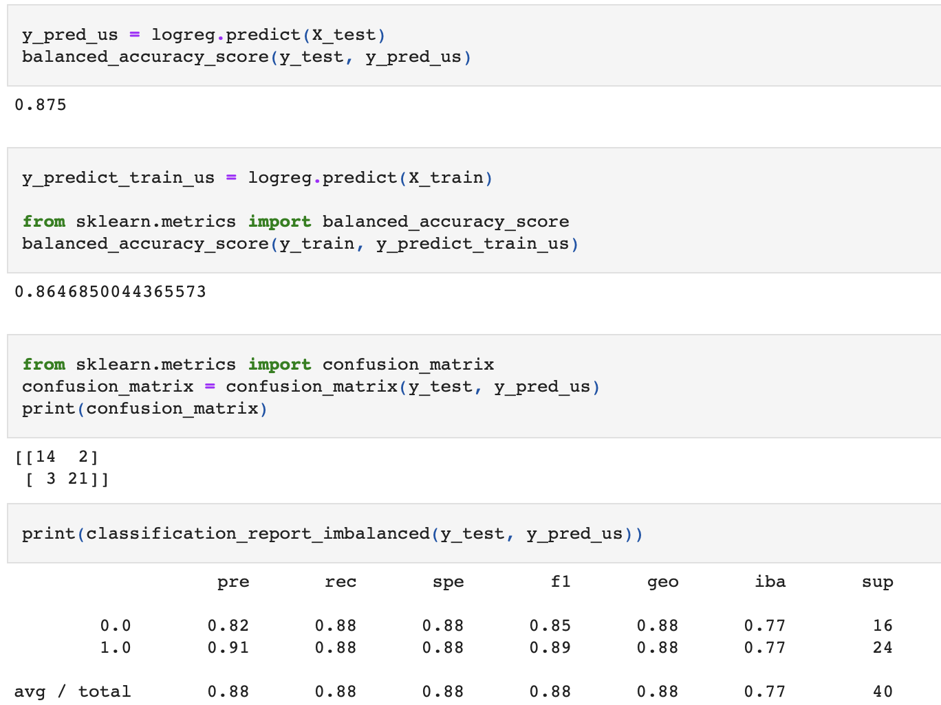
Machine Learning

Slide 15
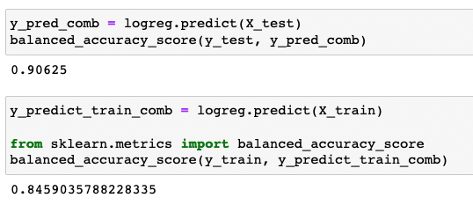
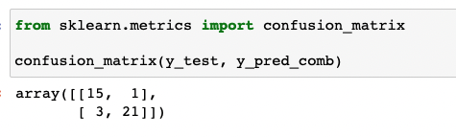
Machine Learning

Slide 16
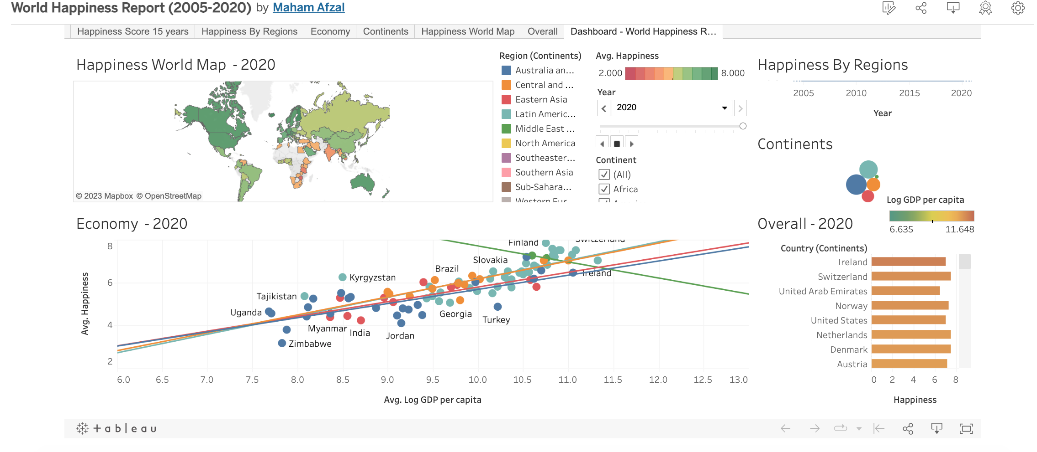
Notes:
Our data will be displayed using Tableau Public.
Our dashboard contains visualizations using data from Kaggle's 2006-2020 World Happiness Report dataset.
We chose to visualize data for the Happiness Score, Happiness Rank, Trust, Freedom to make life choices, Generosity, Perceptions of Corruption, Social Support and GDP per capita from the data sets. These data are consistent over time, and can be used to show trends in Happiness.

Slide 17
Outcome
Results of Analysis
The results of our analysis showed that Australia and New Zealand were consistently the happiest region based on the 2015-2019 dataset. We also found that GDP was the most important feature based off our machine learning model. We also found that trust in government and freedom were the least important features to the happiness score.
Recommendation for future analysis.
We recommended using additional years for the machine learning model.
Anything the team would have done differently.
Given more, it would have been ideal to make an interactive website using FLASK.

