Slide 1

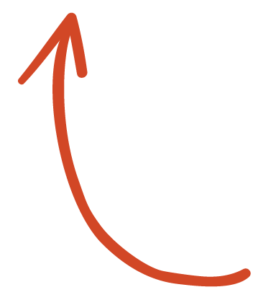
Here's your outline to get started
Key facts about your topic
The World Database of Happiness is a web-based archive of research findings on subjective appreciation of life. The database contains both an overview of scientific publications on happiness and a digest of research findings. The database contains information on how happy people are in a wide range of circumstances and in 165 different nations. Happiness is defined as the degree to which an individual judges the quality of his or her life as a whole favorably. Two 'components' of happiness are distinguished: hedonic level of affect and contentment.
See more: Open the Notes below for more information.
Notes:
QuickStarter has created an outline to help you get started on your presentation. Some slides include information here in the notes to provide additional topics for you to research.

Slide 2
World Happiness Project
Team members:
Oz Garip
Mirta Lucic
Maham Afzal
Trong Nguyen

Slide 3
Contents
Aims
Source of Data
Technologies
Outcomes
Strengths and weaknesses

Slide 4
Aims
Analyzing data from years from the World Happiness Report.
Research where in the world people are happiest and how this changes throughout time.
Some questions we hoped to answers are what the overall happiest region is from years 2015-19 and what factors contribute to the happiest and least happiest regions in the world.
With machine learning model, we wanted to know what factor or factors contribute to the most happiest regions in the world.

Slide 5
Source of Data
CSV data came from Kaggle which originally came from The World Happiness Report. They've been conducting a global survey of over 150 countries for the past ten years.

Slide 6
Technologies
Python
Jupyter Notebook
Tableu
PostGres, PGAdmin
SQLAlchemy

Slide 7
Jupyter Notebook
Before we could start building our model, we had to clean our data.
Using Jupyter Notebook, we read in each of our files (2015-2019) and removed unnecessary columns, and changed column names so that each year's columns would align.
Next, for 2015 specifically, we assigned a number (1-10) to each region.
Lastly, we converted the column 'Happiness Score' from a range of 0-10 to 0 (low) and 1 (high)

Slide 8
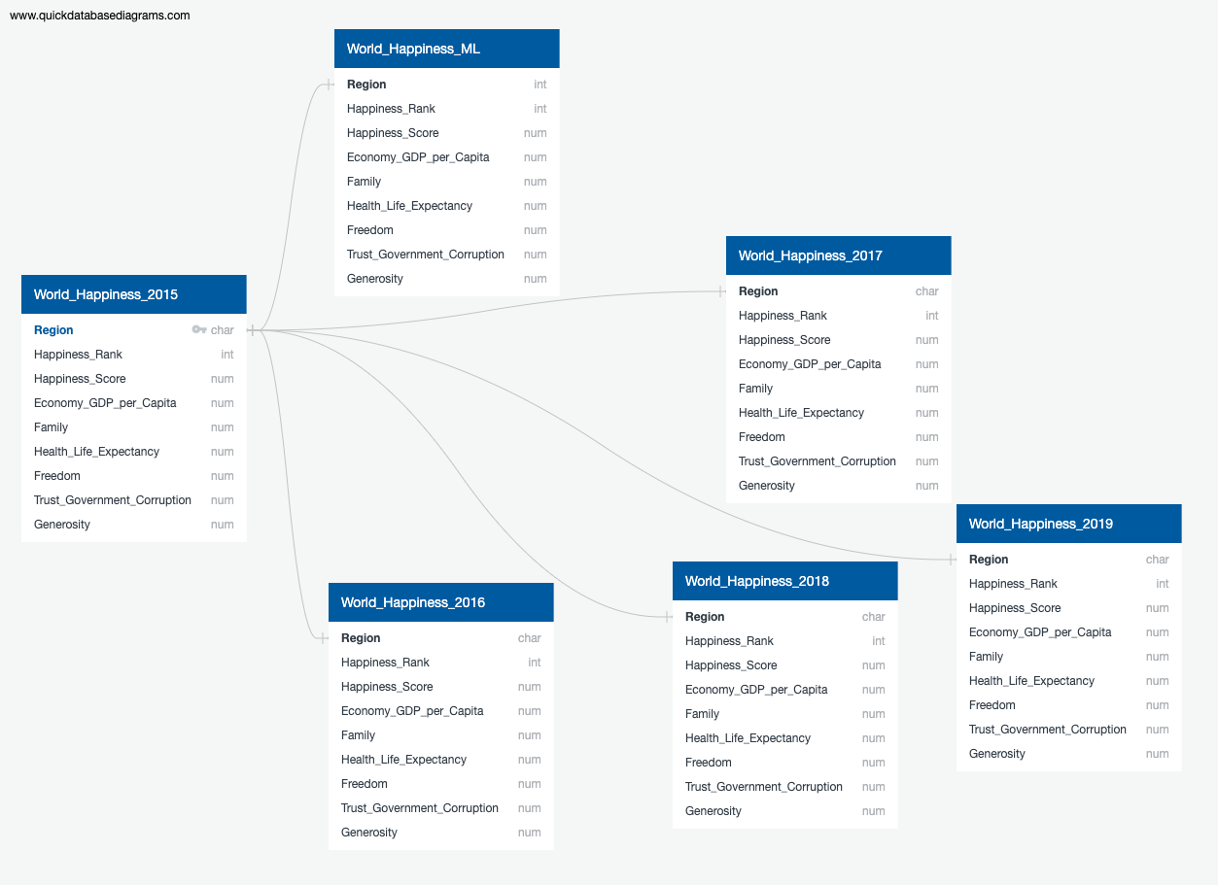
SQL
After we had cleaned our data, we created our SQL database in Postgres

Slide 9
Machine Learning

Slide 10
Tableau Dashboard

Slide 11
Outcome
The results of our analysis showed that Australia and New Zealand were consistently the happiest region based on the 2015-2019 dataset. We also found that GDP was the most important feature based off our machine learning model; and that trust in government and freedom were the least important features to the happiness score.

Slide 12
Strengths and weaknesses

Slide 13
Works cited

