Slide 1
Spotless clean frontend code with BDD, DSL and Storyboards
Frans Overbeek
Capgemini

Slide 2
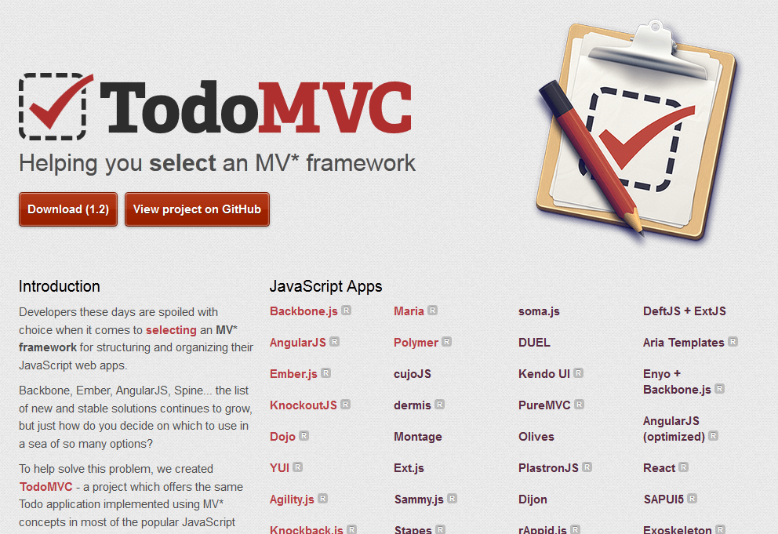
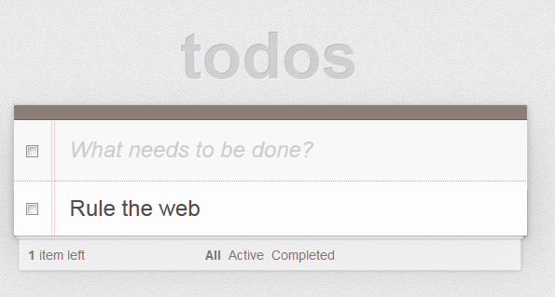

Slide 3
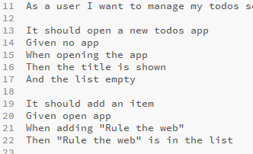
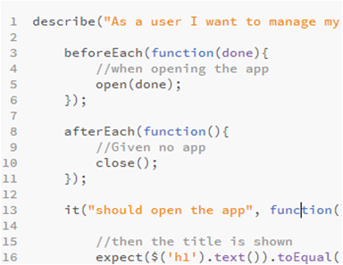
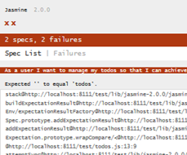
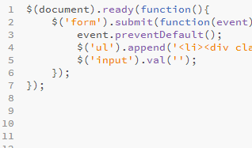
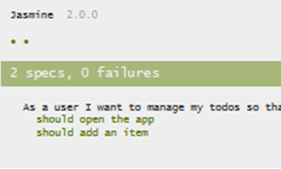
Behaviour Driven Development
Write Specs
Write Tests
Make it red
Write code
Make it green

Slide 4
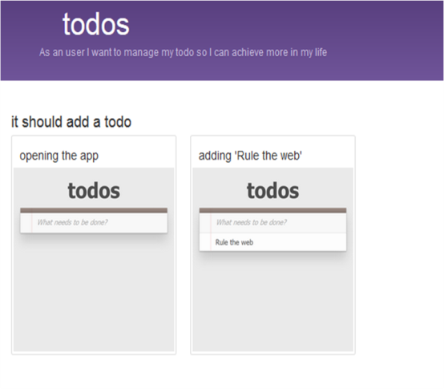
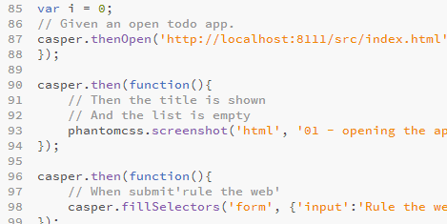
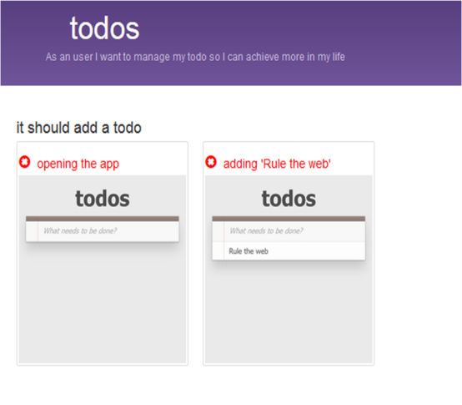
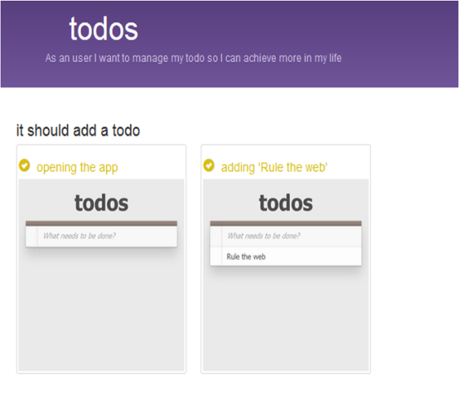
Storyboards
Write Specs
Create Storyboard
Write Tests
Make it red
Write code
Make it green
5

Slide 5
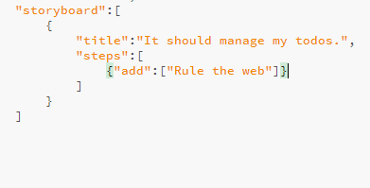
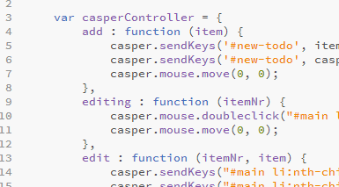
Domain Specific Language
Write Specs
Create DSL
Create Storyboard
Write Tests
Make it red
Write code
Make it green

Slide 6
@
https://github.com/ov0364/cleancodedays
frans.overbeek@capgemini.com

Slide 7
Very Special Thanks
Jasmine
PhantomCSS
CasperJs
PhantomJs
Bootstrap
Mustache
JQuery
TodoMVC

