Slide 1

Apache Active Message Queuing (Active MQ)
An overview and usage in the industry

Slide 2
Uthpala diagram

Slide 3
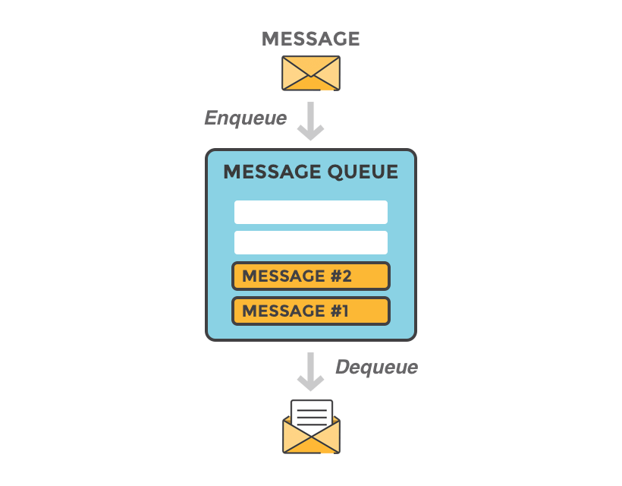
What is message queuing
Imagine that you have a web service that receives many requests every second, where no request can get lost

Slide 4
ActiveMQ by Apache
Developed by the Apache Software Foundation
Message-oriented middleware (MOM)
Allows loose coupling of the elements
Java based-makes use of the Java Message Service (JMS) API

Slide 5
Organizations :

Slide 6
Advantages and disadvantages

