Slide 1

Apache Active Message Queuing (Active MQ)
An overview and usage in the industry

Slide 2
What is Apache ActiveMQ
Apache ActiveMQ translates messages from sender to receiver. It can connect multiple clients and servers and allows messages to be held in queue, instead of requiring both the client and server to be available simultaneously in order to communicate

Slide 3
ActiveMQ by Apache
Developed by the Apache Software Foundation
Message-oriented middleware (MOM)
Allows loose coupling of the elements
Java based-makes use of the Java Message Service (JMS) API

Slide 4
Uthpala diagram

Slide 5
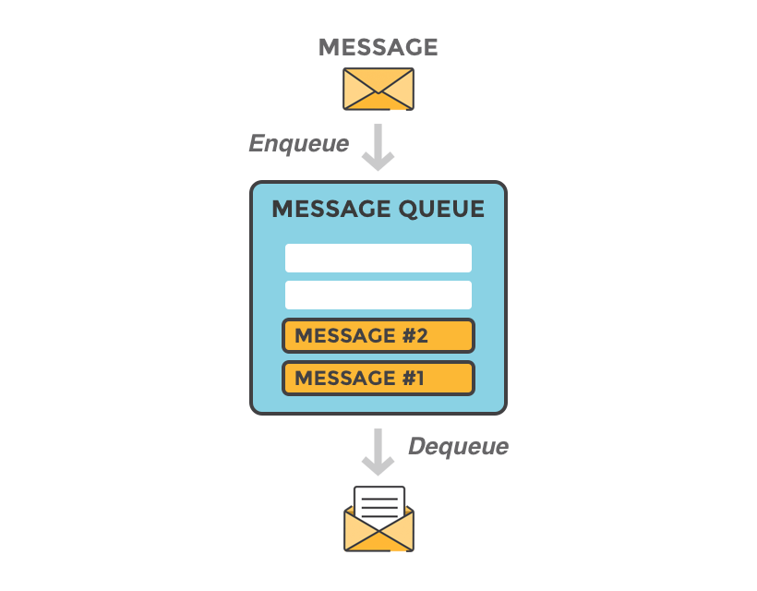
What is message queuing
Imagine that you have a web service that receives many requests every second, where no request can get lost

Slide 6
How does ActiveMQ work?

Slide 7
Organizations :

Slide 8
Advantages and disadvantages

