Slide 1
Communication gana lassana wadana

Slide 2

Apache Active Message Queuing (Active MQ)
An overview and usage in the industry

Slide 3
ActiveMQ by Apache
Developed by the Apache Software Foundation
Message-oriented middleware (MOM)
Allows loose coupling of the elements
Java based-makes use of the Java Message Service (JMS) API

Slide 4

Normal message passing:
Producer
Consumer

Slide 5
What if the message gets lost?
Producer
Consumer
Producer
Consumer

Slide 6
?
Producer
Consumer
?

Slide 7
What is message queuing
Imagine that you have a web service that receives many requests every second, where no request can get lost

Slide 8

Example by scenario: The creation of whatsapp if done with activemq:

Slide 9
1.Client send requirements to Lead dev
Active MQ:
LeadDeveloper
Client 1
Developer 2
Client 2
Developer 3

Slide 10

Lead dev asking requirements from sep.clients
Active MQ queue:
LeadDeveloper
Client 1
Can store messages in queue
Developer 2
Client 2
Developer 3

Slide 11
<not done properly>
Active MQ queue:
LeadDeveloper
Client 1
Can store messages in queue
Developer 2
Client 2
Developer 3

Slide 12

How does ActiveMQ work?

Slide 13
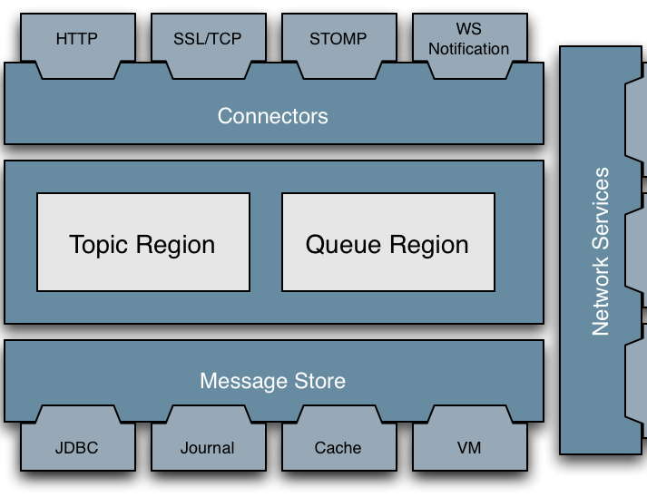
Architecture:

Slide 14
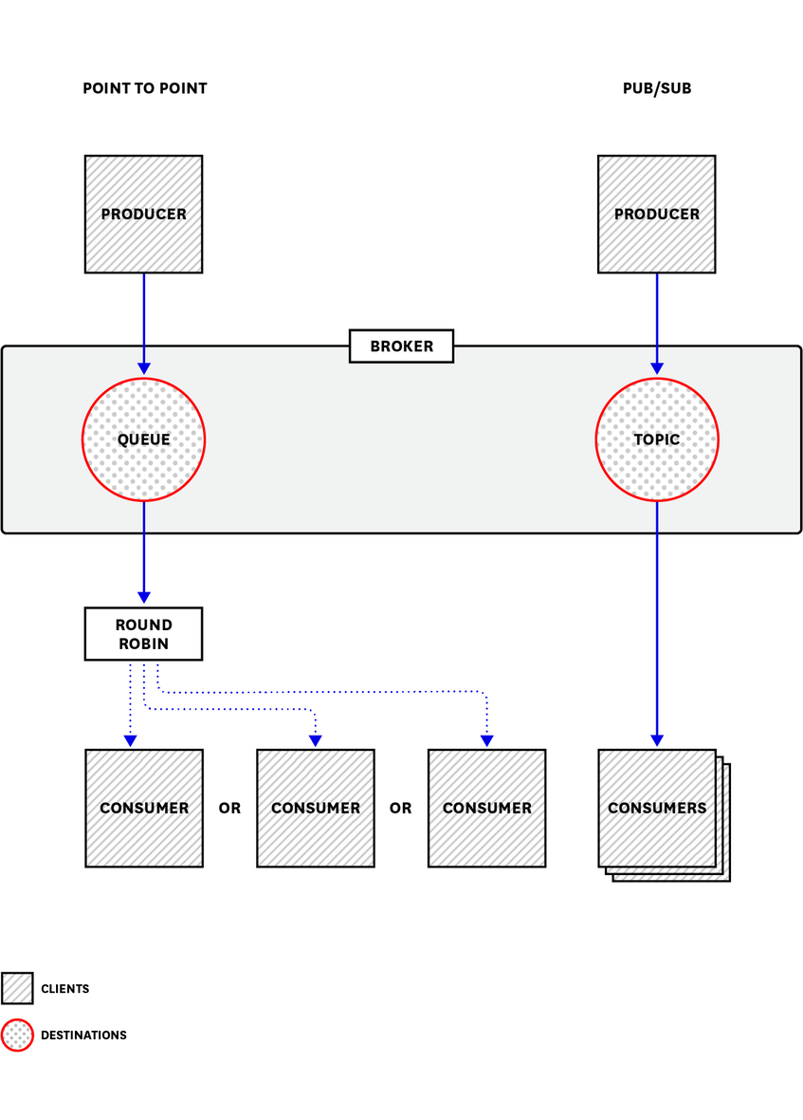
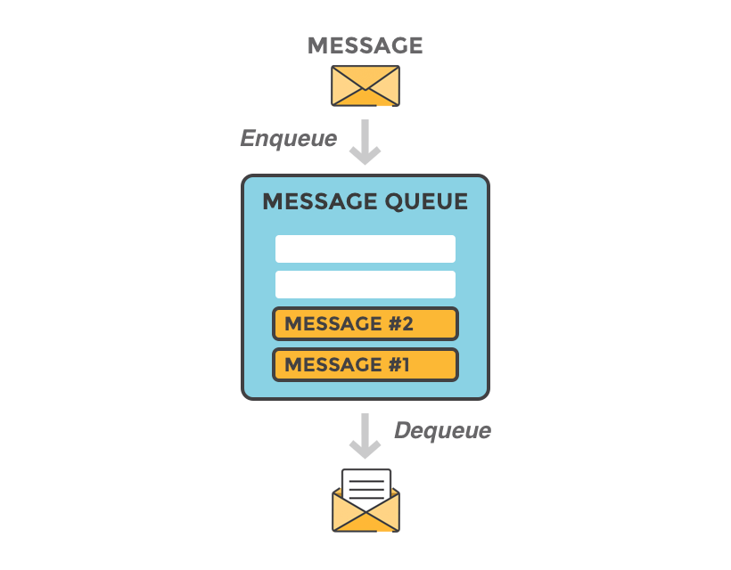
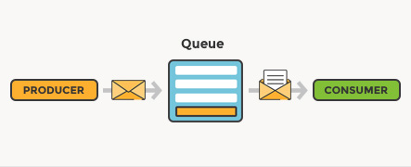
sends messages between client applications—producers, which create messages and submit them for delivery.
consumers receive and process messages.
The ActiveMQ broker routes each message through a queue

Slide 15


Organizations that use ActiveMQ
Lockheed :
perform COTS integrations
Trimble
to fulfill the need to perform the messaging between and the servers.
Caterpillar:
as a Message broker

Slide 16
What is Apache ActiveMQ
Apache ActiveMQ
It translates messages from sender to receiver. It can connect multiple clients and servers and allows messages to be held in queue, instead of requiring both the client and server to be available simultaneously in order to communicate

Slide 17
Advantages and disadvantages

Slide 19
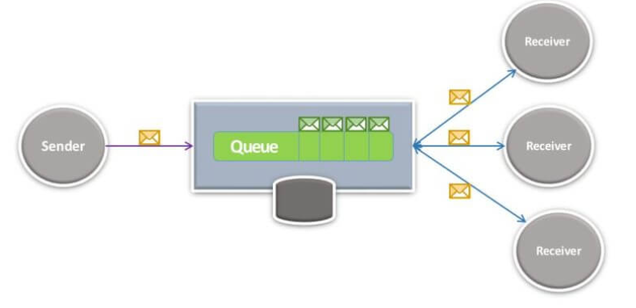
One-to many

Slide 20
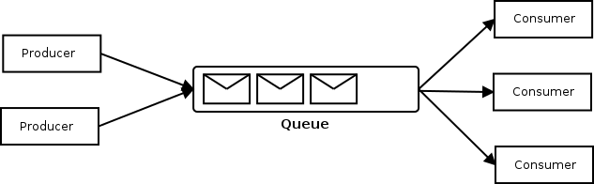
Many-to-many

