Slide 1

Apache Active Message Queuing (Active MQ)
An overview and usage in the industry

Slide 2


Slide 3
ActiveMQ by Apache
Developed by the Apache Software Foundation
Message-oriented middleware (MOM)
Allows loose coupling of the elements
Java based-makes use of the Java Message Service (JMS) API

Slide 4

Normal message passing:
Producer
Consumer

Slide 5
What if the message gets lost?
Producer
Consumer
Producer
Consumer

Slide 6
?
Producer
Consumer
?

Slide 7
Consumer 1
?
Producer
Consumer 2
Consumer 3

Slide 8
What is message queuing
Imagine that you have a web service that receives many requests every second, where no request can get lost

Slide 9

Example by scenario: The creation of whatsapp if done with activemq:

Slide 10
1.Client send requirements to Lead dev
Active MQ:
LeadDeveloper
Client 1
Developer 2
Client 2
Developer 3

Slide 11

Lead dev asking requirements from separate clients
Active MQ broker:
LeadDeveloper
Client 1
Queue 1
Developer 2
Client 2
Queue 2
Developer 3
Can store messages in queue

Slide 12

Lead dev assigning tasks to other developers
Active MQ broker:
LeadDeveloper
Client 1
Queue 1
Developer 2
Client 2
Developer 3
Queue 2
Developer 4

Slide 13
<not done properly>
Active MQ queue:
LeadDeveloper
Client 1
Can store messages in queue
Developer 2
Client 2
Developer 3

Slide 14

How does ActiveMQ work?

Slide 15
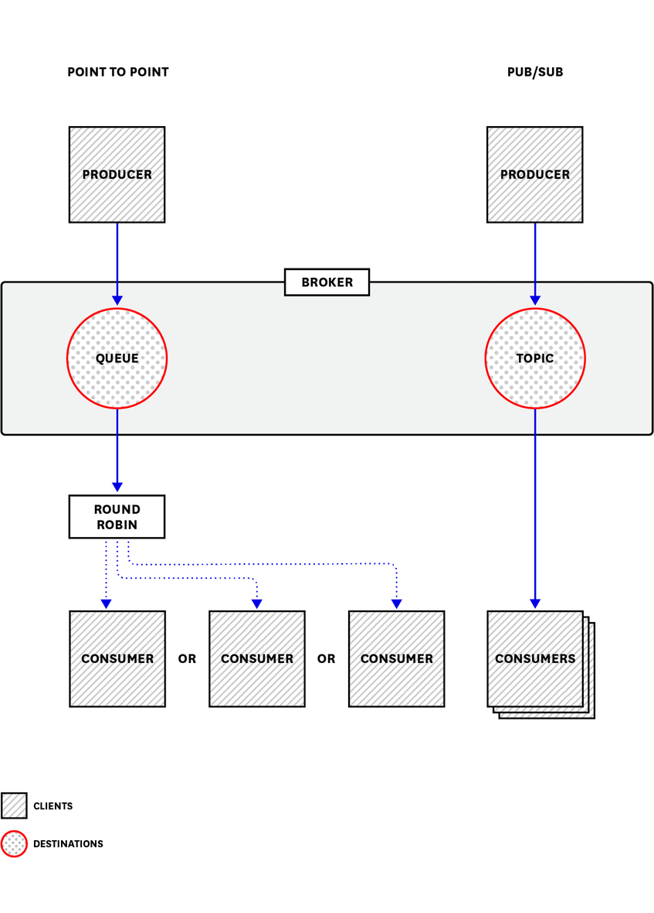
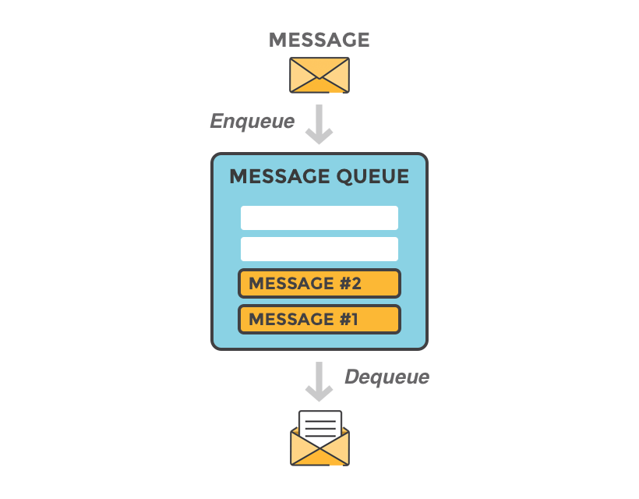

sends messages between client applications—producers, which create messages and submit them for delivery.
consumers receive and process messages.
The ActiveMQ broker routes each message through a queue

Slide 16
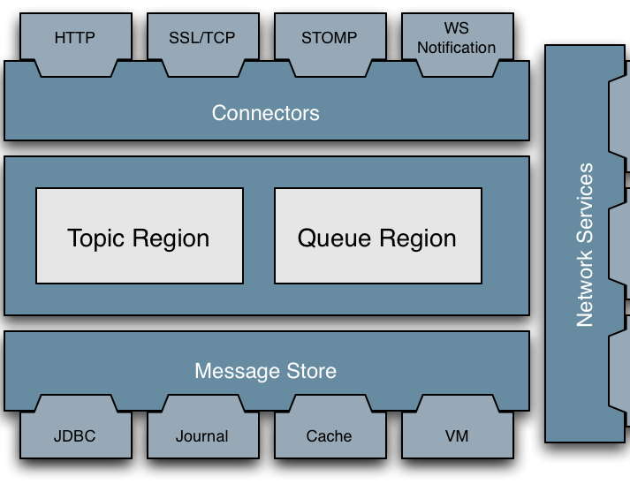
Architecture:

Slide 17
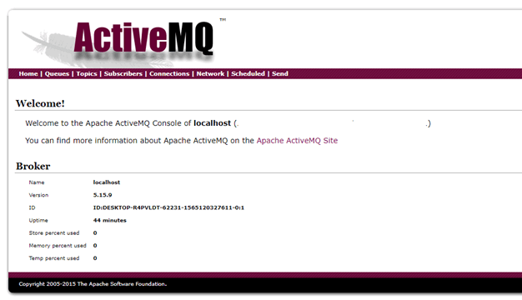
Once you have installed, the ActiveMQ server it should be available at http://localhost:8161/admin

Slide 18
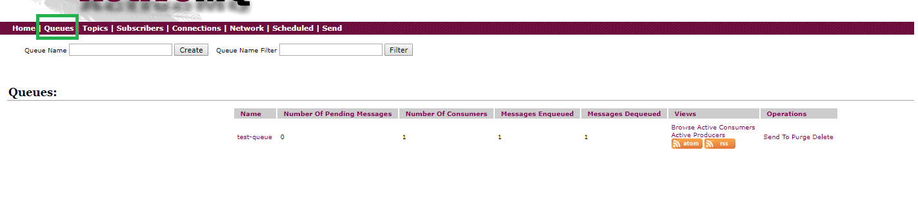
Dashboard stats:

Slide 19
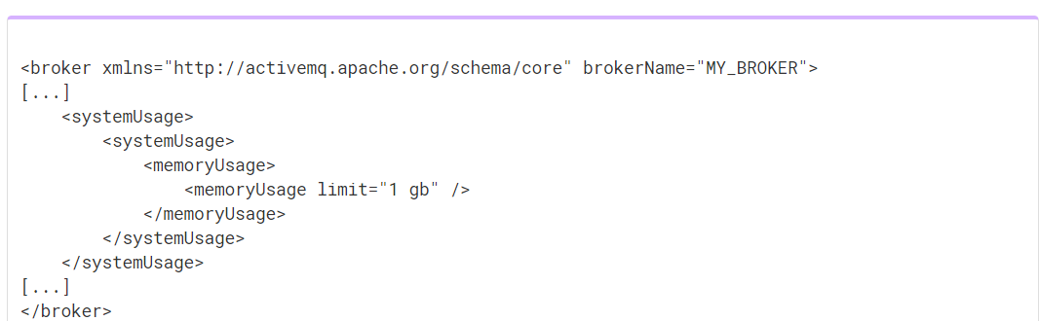
Memory and storage
Each message occupies some of the available memory until it is dequeued.
How much memory depends on the size of the message.

Slide 20
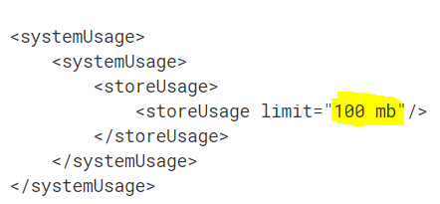
Storage:
KahaDB is ActiveMQ’s default message storage mechanism. It stores both persistent and non-persistent messages.

Slide 21
ActiveMq metrics:
ActiveMQ metrics is a unique feature which can
help you proactively maintain your messaging infrastructure
provide you with information you need to investigate,
errors
missing messages
unexpected latency.

Slide 22


Slide 23


Organizations that use ActiveMQ
Lockheed :
perform COTS integrations
Trimble
to fulfill the need to perform the messaging between and the servers.
Caterpillar:
as a Message broker

Slide 24
Advantages and disadvantages

