Slide 1





Agentic AI for Document Analysis Systems
Tutorial – ICDAR 2026 TU Wien, Vienna, August 30th

Slide 2





USE CASE
HAL_9000_AG Reimbursement Assistant
From raw business documents to evidence-based reimbursement decisions
Goal : Build an assistant that helps HAL 9000 AG employees make accurate reimbursement decisions based on company policy, with clear supporting evidence.
Document pack
HAL 9000 AG Expense Policy
User request
“Is my flight ticket reimbursable?”
Flight Ticket
Answer with Evidence:
Hotel Invoice
1) Decision (Reimbursable / Partially / Not reimbursable)
Restaurant Receipt
2) Evidences (Policy clause, ticket information’s, …)
2) Source (Document snippet)

Slide 3
TIMELINE
Tutorial Timeline
LLM
RAG
Agent
MCP
Guardrails
We build the reimbursement assistant by adding one capability at a time.
13:30 – 15:00
Part 01: Foundations
LLM basics, first PydanticAI app
RAG introduction
15:00 – 15:30 Coffee Break
15:30 – 16:30
Part 02: Agents and MCP protocol
Simple tool calling, Connect tools through MCP
First prototype: Document tool agent
16:30 – 16:35 Break
16:35 – 17:00
Optional Support
Guardrails
Q&A

Slide 4
GITHUB
Tutorial Repository
LLM
RAG
Agent
MCP
Guardrails
Github: https://github.com/ovaccarelli/tutorial_ICDAR
tutorial_ICDAR/
├ data/
├ exercises/
├ part_01/
├ part_02/
├ part_02_BONUS/
├ presentation/ ← this presentation
├ solutions/ ← all the solutions to the exercises
├ src/ ← utils
├ README.md

Slide 5
PART 01 | LLM
What is an LLM?
LLM
RAG
Agent
MCP
Guardrails
AI system trained on vast amounts of text that can understand context and generate human-like language.
May the force be …
May the force be with you
Tokenizer
Decoding
Core Idea
Context in
Tokenizer Encoding
Tokenize
70%
20%
10%
Predict (next-token probabilities)
May the force be
with you
in your heart
during this tutorial
Decode & repeat
9059, 10139, 290, 59
8872
8350
39492
Good at
Limits
Summarization/
Translation
Question
Answering
Text
Generation
Reasoning over Context
Hallucinations
Context Limit
No native access to external data
Need tools to act

Slide 6




PART 01 | RAG
RAG: Retrieval Augmented Generation
LLM
RAG
Agent
MCP
Guardrails
The model answers using retrieved document chunks instead of guessing.
Offline Data Preprocessing
Query
Documents
Chunks
Embedding
Vector Database
Embedding
User
Response
Prompt
+
+
Similarity
Search
Relevant
Context
Generative LLM
Online Semantic Retrieval

Slide 7
PART 01 | RAG
RAG: Offline Data Preprocessing
LLM
RAG
Agent
MCP
Guardrails
PDF Extractor
Extract text from PDF
Text Segmentation
Divide the text in chunks
Chunk 1
Embedding Model
Transform the chunks in vectors
Vector
Database
Store the vectors in a database

Slide 8

PART 01 | RAG
RAG: Online Semantic Retrieval
LLM
RAG
Agent
MCP
Guardrails
Query : also transform into a vector.
We search the K=3 chunks ”similar” to the query.
Metric: Cosine similarity
query
System Prompt + User prompt + Relevant Context
Response
LLM
User

Slide 9



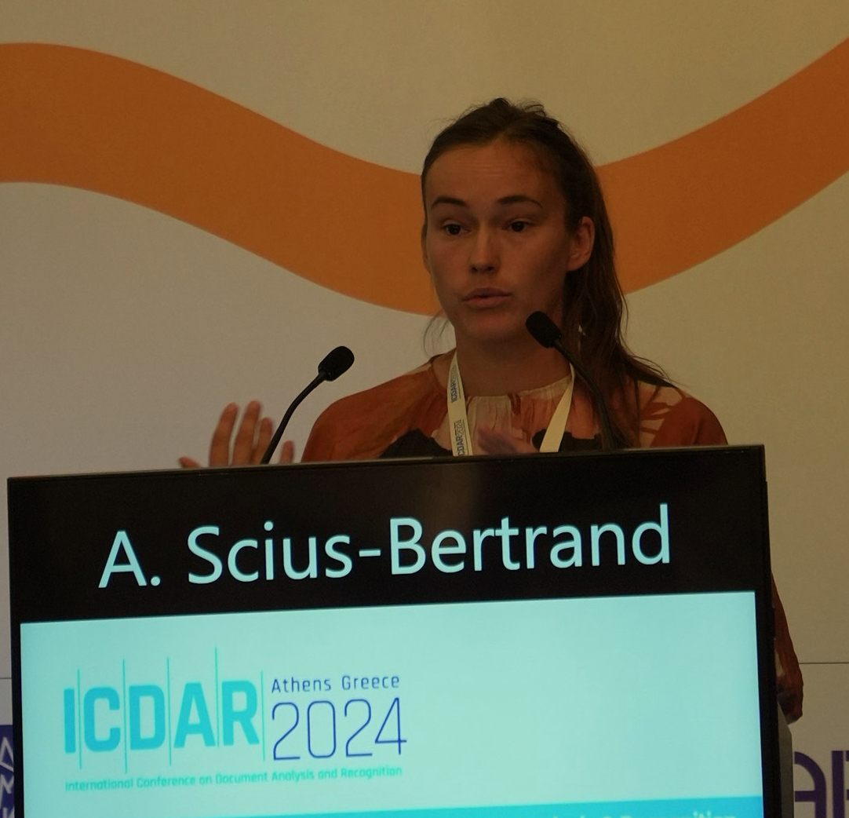
Agentic AI for Document Analysis Systems
COFFEE BREAK
Ornella Vaccarelli
Lead Scientist
ornella.vaccarelli@hefr.ch
Olivier D’Ancona
PhD Student
olivier.dancona@hefr.ch
Tim Hallyburton
PhD Student
tim.hallyburton@tu-dortmund.de
Anna Scius-Bertrand
Senior Researcher
anna.scius-bertrand@hefr.ch

Slide 10
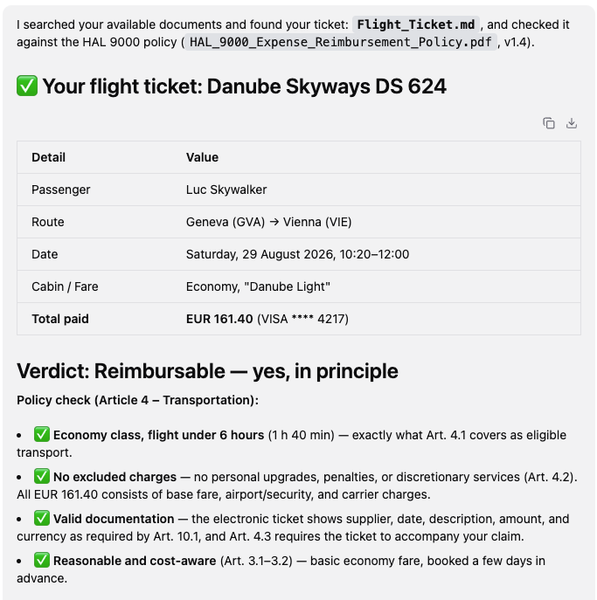
PART 02 | AGENT
Agent
LLM
RAG
Agent
MCP
Guardrails
LLM-based system that can reason, choose tools, and act to complete a task.
User request
Answer with Evidence
Think & plan
Act with tools
Observe & Think
Reason about the user needs and the internal knowledge
Chose the right tools
Loop over the user request and the output of the selected tools
“Is my flight ticket reimbursable under HAL9000 policy?”
System prompt:
“You are a helpful assistant. Use the available tools to answer the question accurately and provide supporting evidence.”
Text extractor
Tool results:
Output from the selected tools
OCR extractor
Reasoning:
Evaluate results and decide next step based on the user requests and the updated context
Policy retrieval
Context:
(User request, conversation history, uploaded documents…)
Web search
Agentic Loop: Thought (Reason about what to do) + Action (Use tools) + Observation (Reflects on the response from the tool)

Slide 11
PART 02 | AGENT
Tools
LLM
RAG
Agent
MCP
Guardrails
Tools give the agent capabilities beyond the model
Definition
Good tools
A tool is a function or service that the agent can call to get information or perform an action.
The agent decides when to call which tool based on the user's request and available tools.
Have clear, specific name (e.g., search_relevant_context_from_HAL_9000_policy)
Have clear description (When to use, what it does, what it returns)
Have a well-defined input scheme (Parameters the model can fil)
Return structured, useful results (Help the agent to reason)
Think & plan
Tool calling
Tool execution
Answer
Based on the user request and available tools the model decides to call a tool
The model call the selected tools
The system runs the tool and returns the result
The results are added to the conversation. The model uses them to produce an answer

Slide 12
PART 02 | MCP
Model Context Protocol (MCP)
LLM
RAG
Agent
MCP
Guardrails
Connect Tools Through a Standard Protocol
Definition
Client
MCP protocol
MCP server
Open standard that allows AI applications (clients) to discover and use tools provided by external servers in a secure, consistent way,
AI application
Standardized communication between client and server
Servers expose tools through an MCP endpoint
Responsibilities:
Discover available tools
Choose the right tool
Call the tool
Use results
Discover: list tools
Responsibilities:
Expose tools
Execute calls
Return Results
Reuse: Build once, use in many agents
Call: tools name, arguments
Secure: Controlled and centralized management
Result: Structured data
Separation of concerns: Tools on separate servers; client focus on reasoning
Scalability: Add/Update tools without changing the client
Key Idea: MCP lets the client discover and use external tools through a standard interface, regardless of how or where the selected tools run.

Slide 13
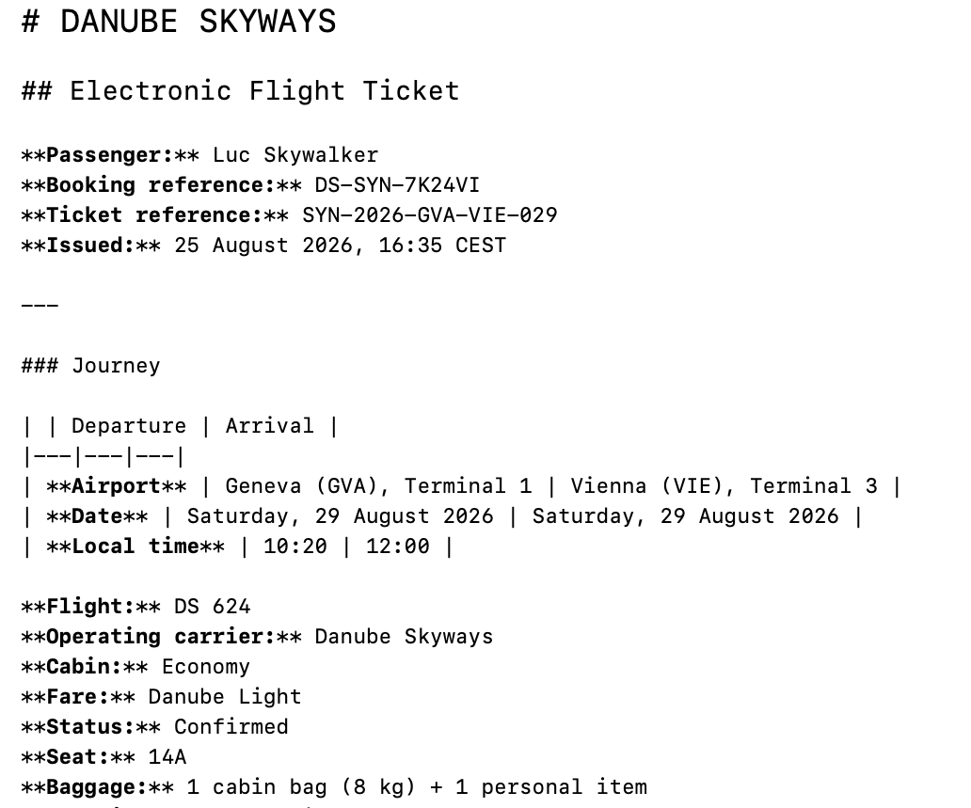
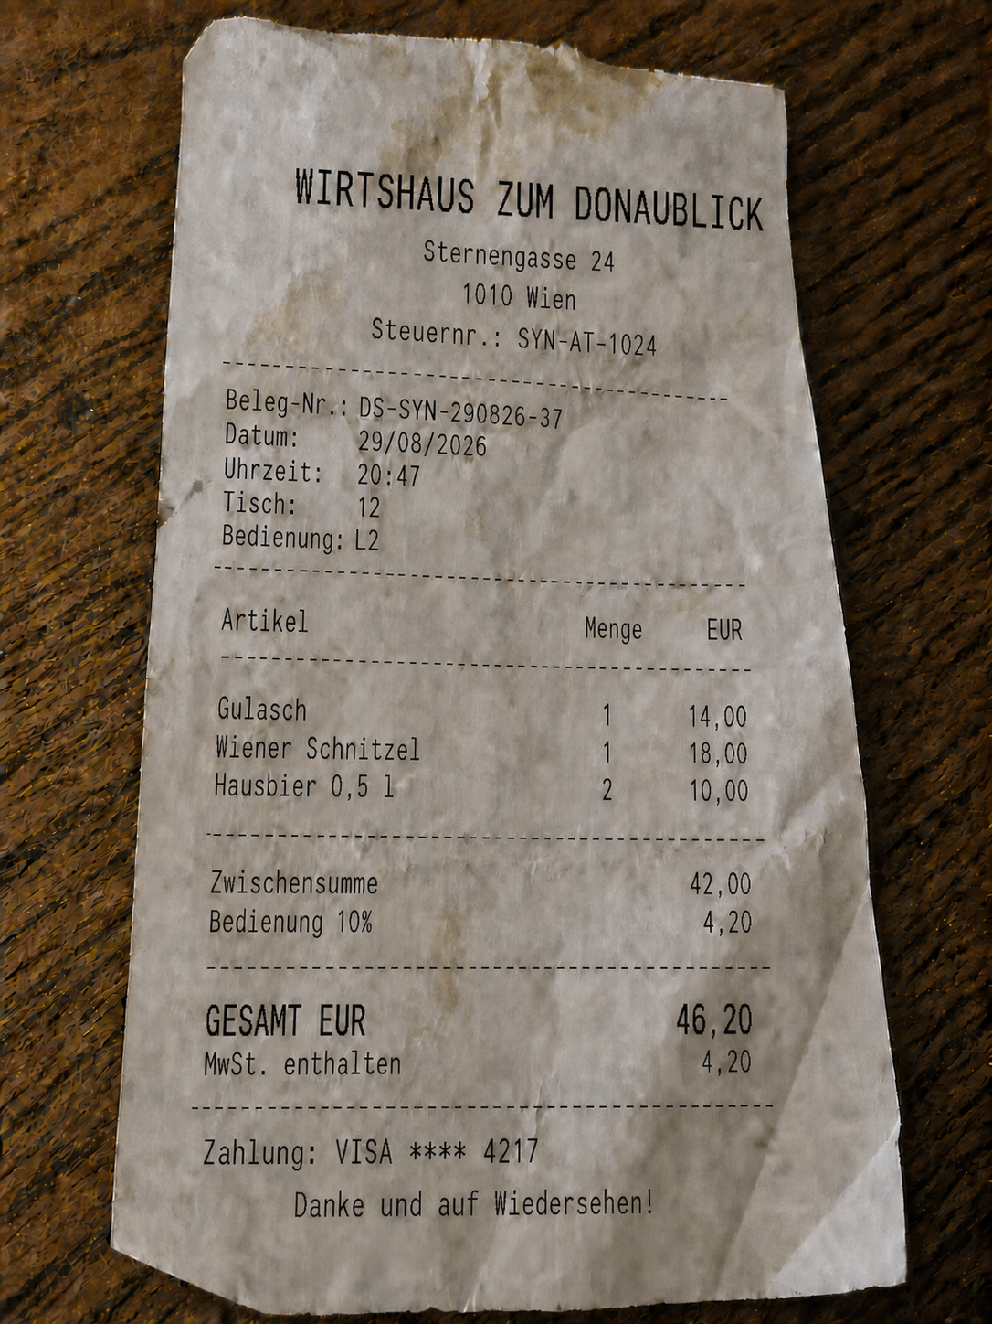
PART 02 | REIMBURSEMENT ASSISTANT
HAL_9000_AG Reimbursement Assistant
LLM
RAG
Agent
MCP
Guardrails
From raw business documents to evidence-based reimbursement decisions
HAL_9000_AG Expense Policy
Flight ticket
Hotel Invoice
Restaurant Receipt
User request
Think & plan
Act with tools
Answer
Is my ticket reimbursable?
Reason about the user needs and the internal knowledge
Chose the right tools
Decision + Extracted fields + Cited documents
Goal : Combine extraction, retrieval, and useful tools to support reimbursement decisions

Slide 14
PART 02 - BONUS | GUARDRAILS
Guardrails
LLM
RAG
Agent
MCP
Guardrails
Keep the AI assistant safe and reliable
Input
Reasoning
Tools
Answer
Detect, filter and validate user input
Steer the model with policies and rules
Control which tools can be used and how
Check, filter and sanitize responses
Examples of Guardrails
Safety Block harmful, unsafe or inappropriate content
Access control
Limit actions and data based on roles and permissions
Compliance
Enforce policies, standards and legal requirements
Data protection
Prevent leakage of sensitive or private information
Hallucination control
Encourage grounded answers and cite sources
Operational limits
Rate limits, timeouts, cost and resources constraints

Slide 15
Agentic AI for Document Analysis Systems
THANK YOU !!
Ornella Vaccarelli
Lead Scientist
ornella.vaccarelli@hefr.ch
Olivier D’Ancona
PhD Student
olivier.dancona@hefr.ch
Tim Hallyburton
PhD Student
tim.hallyburton@tu-dortmund.de
Anna Scius-Bertrand
Senior Researcher
anna.scius-bertrand@hefr.ch

