Slide 1
EDA Presentation and Proposed modelling technique
Group Name: DataLex
Name: Ovbude Uankhehi
Email: ovatedom@gmail.com
Country: Nigeria
Specialization: Data Science

Slide 2
Problem description
One of the challenges for all pharmaceutical companies is to understand the persistency of drug as per the physician prescription. To solve this problem ABC pharma company approached an analytics company to automate this process of identification.

Slide 3
PROJECT LIFECYCLE
Data gathering
Exploratory Data Analysis
Data preprocessing
Feature selection
Model selection
Model training
Model optimization
Model evaluation

Slide 4


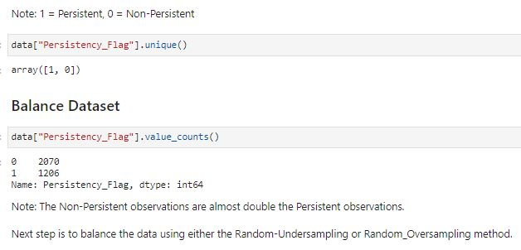

Exploratory Data analysis
This model was built with data containing 3428 observations.
There is no missing values
The data set is imbalanced, as there is unequal distribution of classes.
Problem resolved with random oversampling.

Slide 5
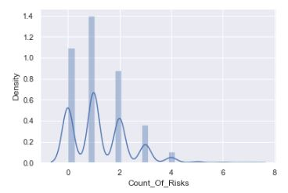
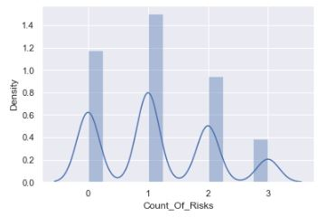
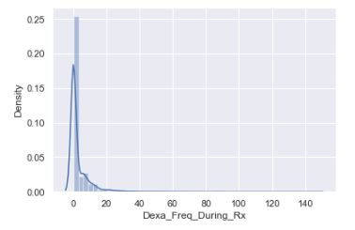
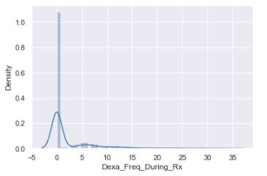
EDA – Handling outliers
BEFORE
AFTER

Slide 6
Modelling technique
Data pre-processing
Ensuring the data is well prepared for training on machine learning models.
Evaluation metric
Choosing the metric to assess the correctness of models on test data.
Model selection
Choosing the best performing algorithm on the dataset.
Hyperparameter tuning
Modifying the hyperparameters to get optimal result.

Slide 7
GITHUB REPOSITORY LINK:
https://github.com/ovated/Persistency-of-a-drug-prediction

