Slide 1

Internship Oscar Veldman
At VI Company

Slide 2
Table of contents
Evaluation of my work
Result of my work
Contribution to the company
Evaluation of my personal learning goals
Evaluation of my competences
Additional information

Slide 3
Evaluation of my work
Interview
Requirements
Design
Creating UML diagrams
Programming
Test plan
Testing

Slide 4
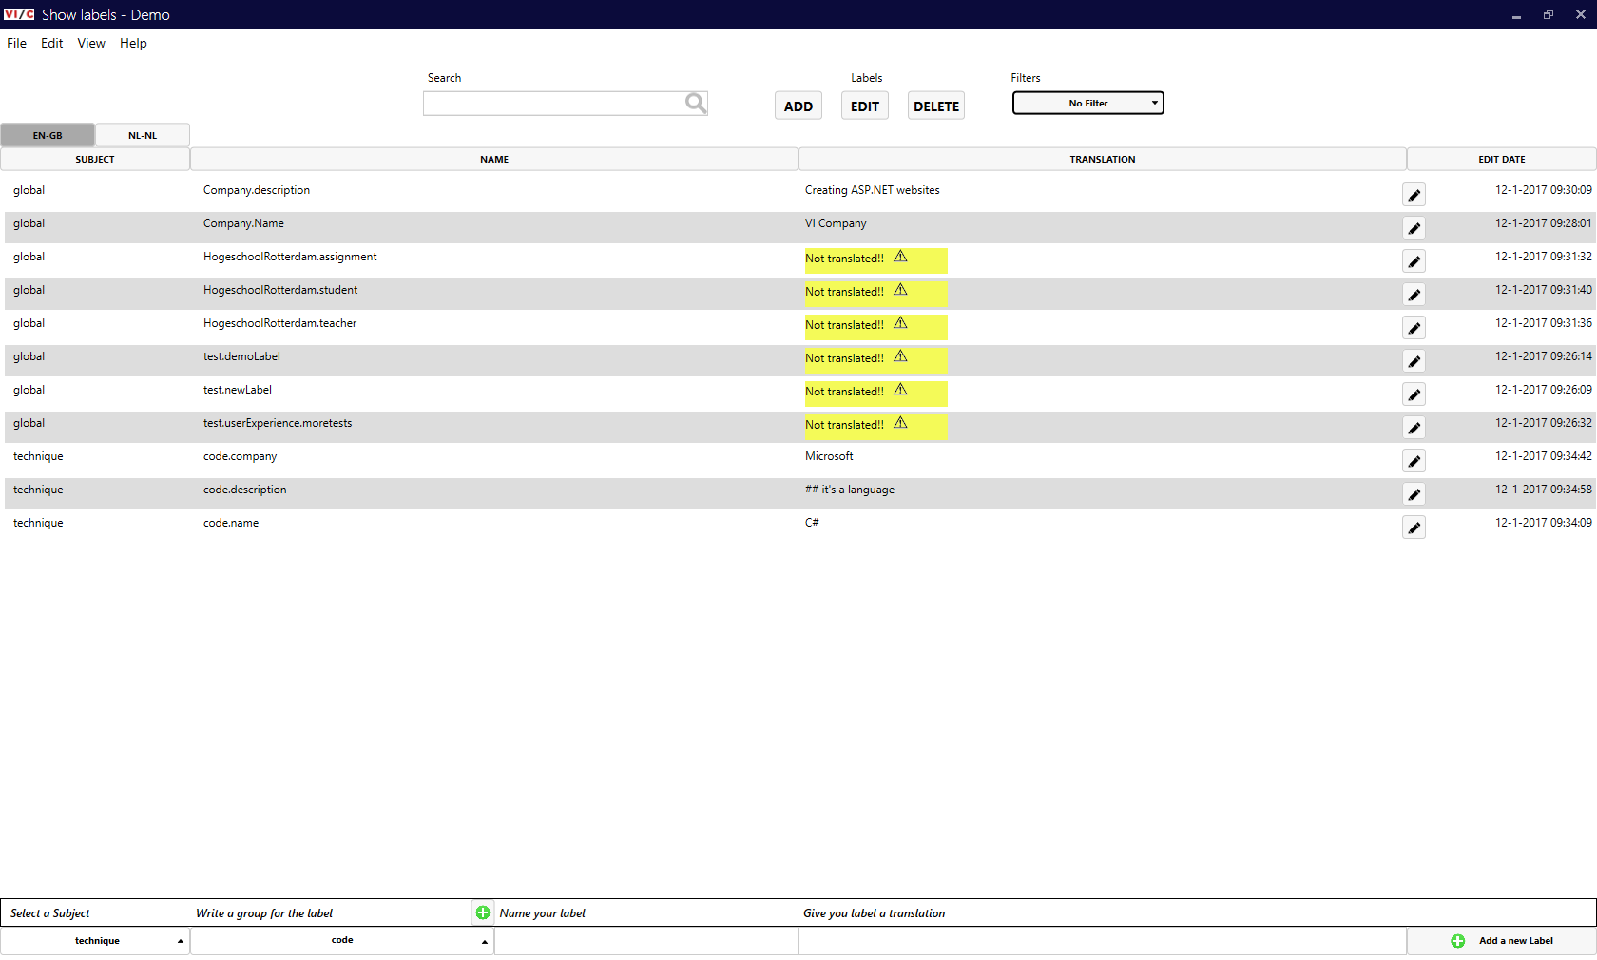
Result

Slide 5
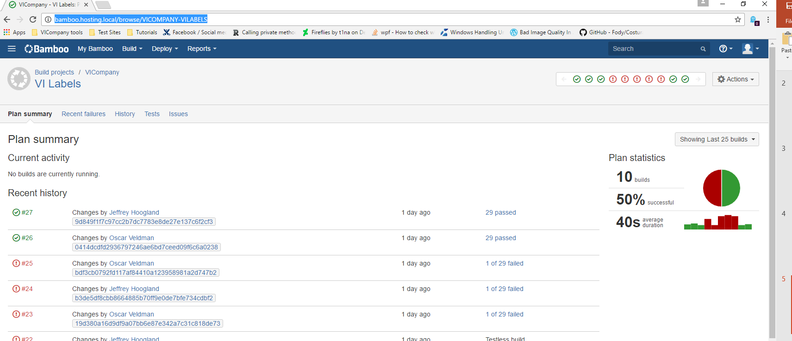
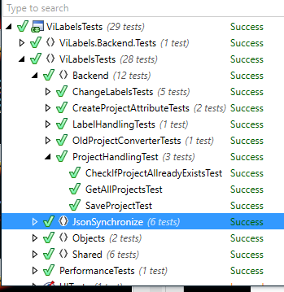
Result - Test

Slide 6
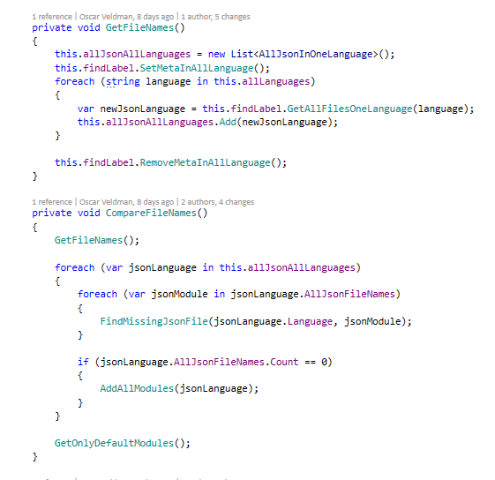
Result - code

Slide 7
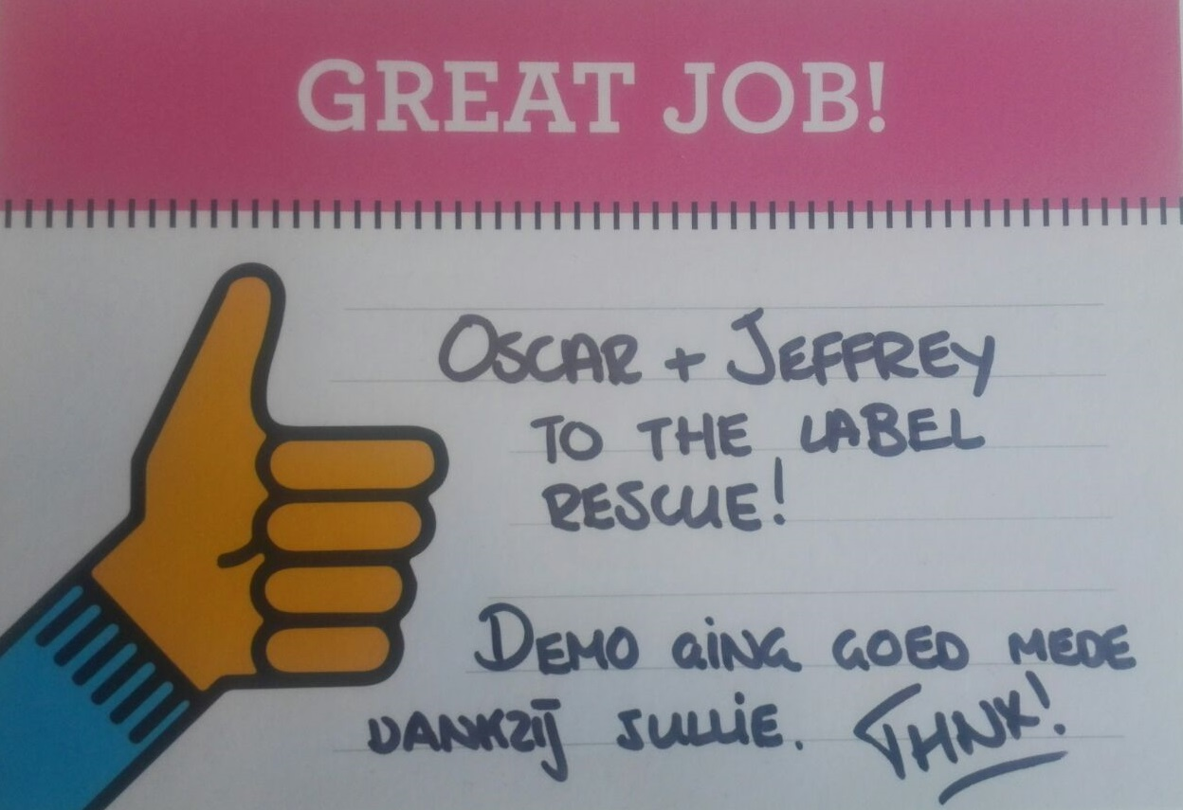
Contribution to the company
Process translation labels automatic
New program to edit labels

Slide 8
personal learning goals
In the end of my internship I know where I’m good at programming and what I like about it.
In the end of my internship I know the rules of the company.
In the end of my internship I can programming clean and good per the rules of VI Company.
In the end of my internship I can create write good and automatic tests.
In the end of my internship I can work well with version control.
In the end of my internship I can write good and writeable rapport .

Slide 9
competences

Slide 10
Additional information

Slide 11
The end
Questions or comments?

