Slide 1
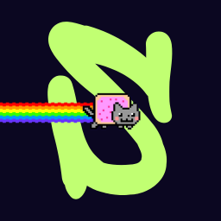
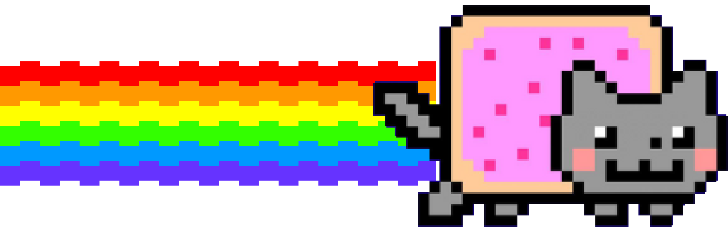
SCRAWL
Draw your futures. Sketch the next 60 seconds of SOL, stake it on Solana, get scored on every move.
SOLANA MOBILE HACKATHON / MOBILE TRACK / ANDROID / DEVNET

Slide 2
THE PROBLEM
Perps look like a cockpit. Most people never try one
Order books
Limit, stop, reduce-only. Three tabs before you place a bet on a price.
Liquidation maths
Margin, funding, maintenance. A wrong number and the position is gone.
Built for a desk
Tiny charts and dense tables, on a screen you hold in one hand.
Phones are where people already have a wallet and a minute to spare. Nobody has made a market view that is native to that.

Slide 3
THE IDEA
A futures trade, expressed as a drawing
1
Draw
Trace where you think SOL goes over the next minute, with your finger.
2
Stake
Pick 0.01 SOL or more and leverage up to 100x. Approve once in your wallet.
3
Score
Every second's move is checked against your line. Call the direction right more than half the time and you profit.
No order types, no liquidation price, no guessing where to click. One gesture, one minute, one number.

Slide 4
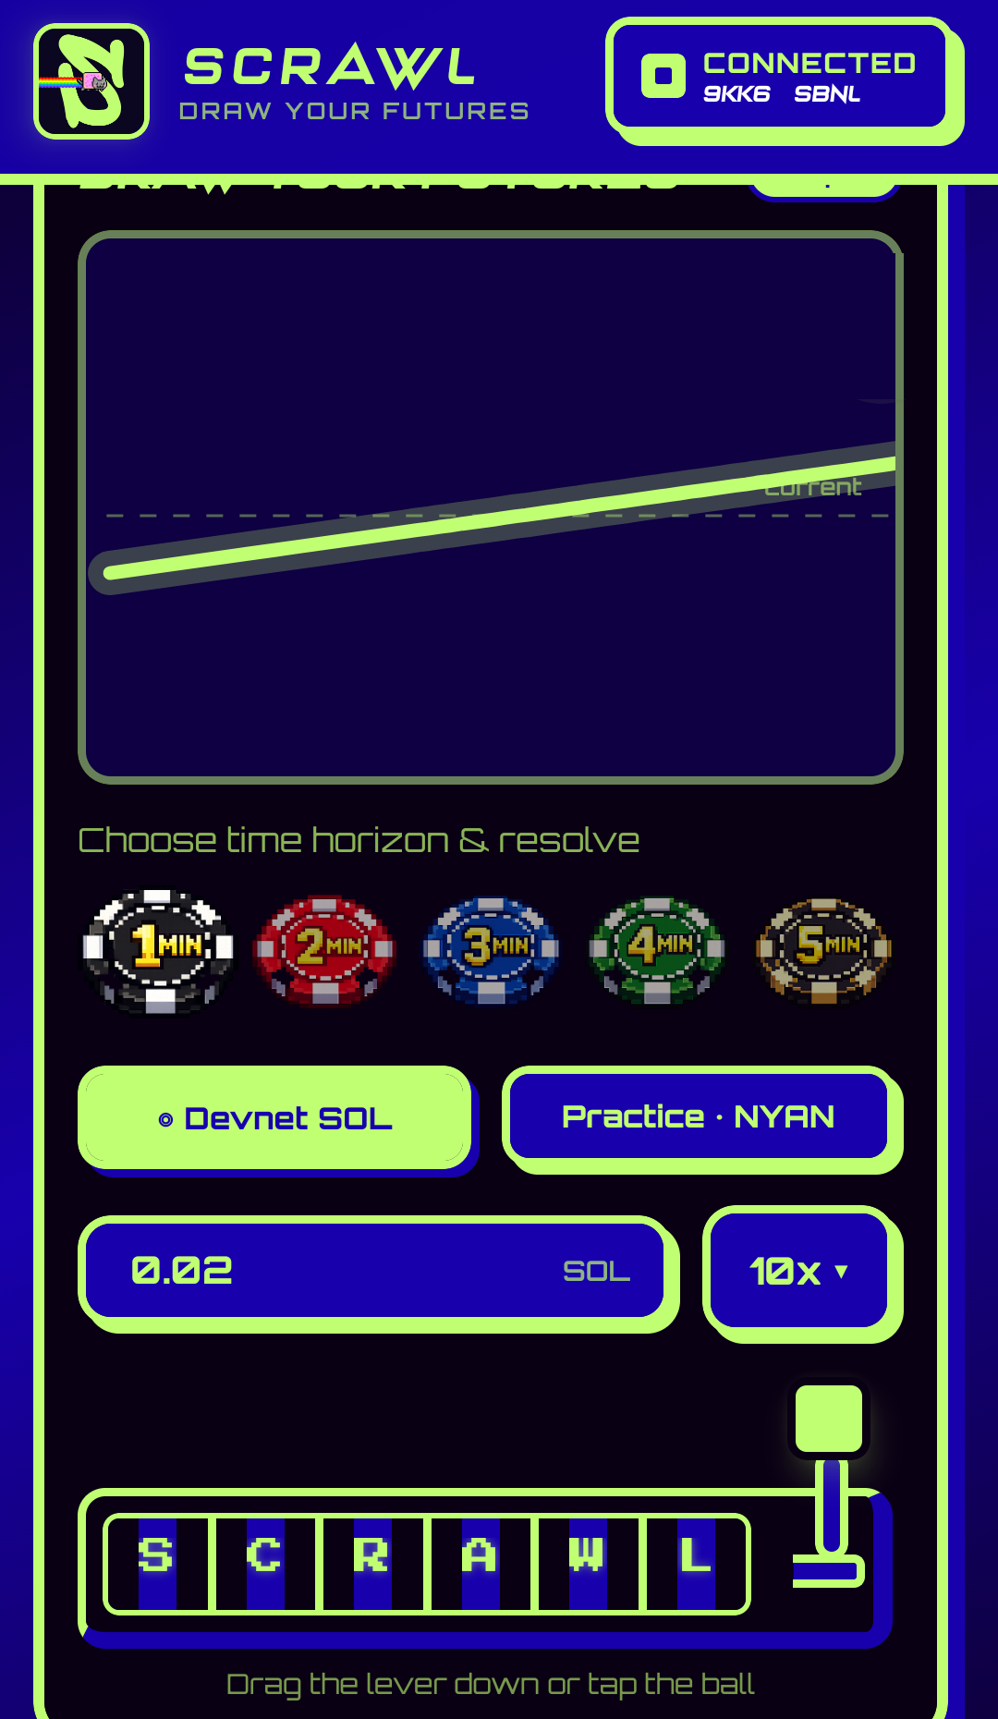
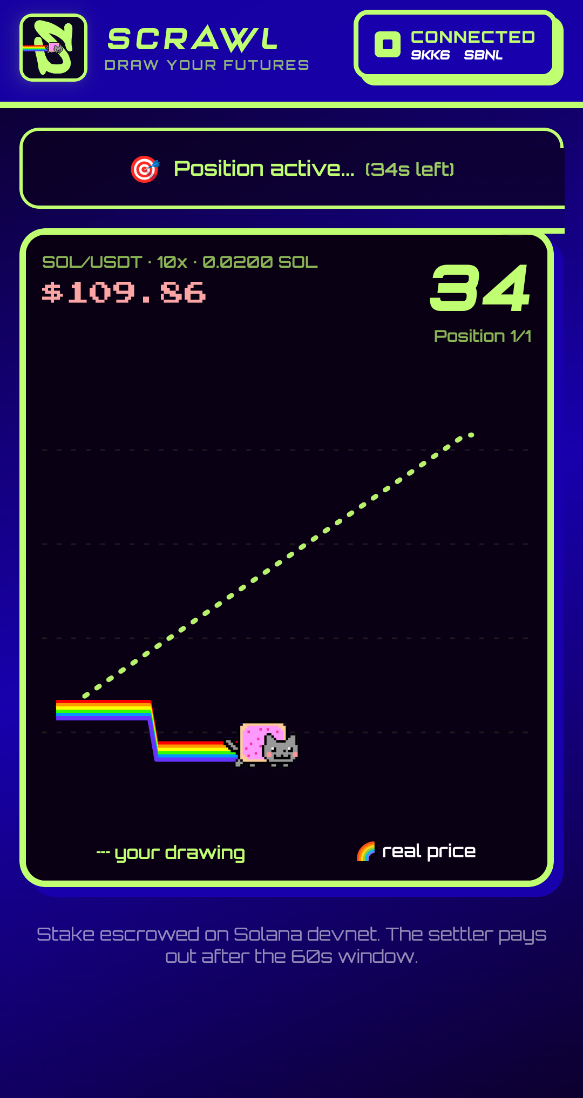
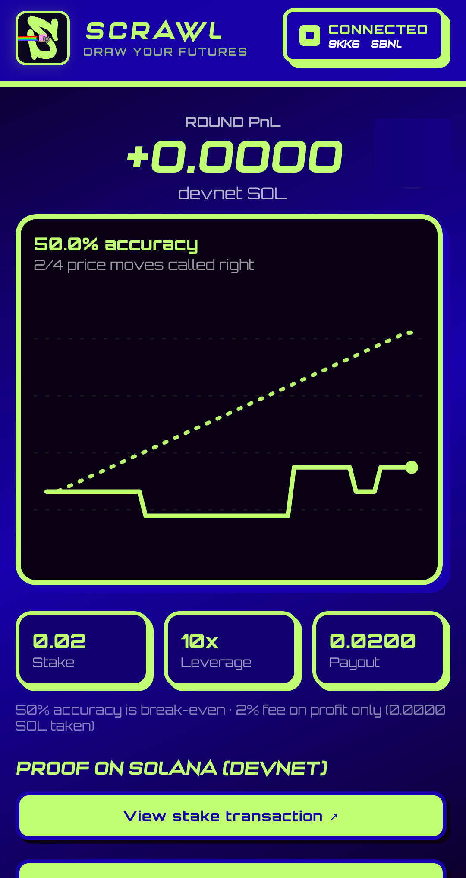
THE APP / CAPTURED ON A PHONE, DEVNET
Draw. Watch. Settle
DRAW & PULL
WATCH THE CLOCK
SETTLED ON-CHAIN

Slide 5
HOW A ROUND IS SCORED
Direction, second by second
The round has 60 samples, one per second. At each step we compare which way your line moved with which way the real price moved. Steps where the price did not tick are skipped.
EXAMPLE / ILLUSTRATIVE
Stake 0.50 SOL at 10x
SOL move $109.00 to $109.05
Max profit 0.0025 SOL
Accuracy 70%
PnL +0.0010 SOL
accuracy = right calls / compared steps
PnL = (2 x accuracy - 1) x max profit
max profit = |price move| x stake / start price x leverage
Loss is floored at your stake. Fee is 2% of profit only.
The pink mark is 50%: break-even. Right of it you win, left of it you lose.

Slide 6
BUILT FOR SOLANA MOBILE
The whole loop fits in a thumb and a minute
Mobile Wallet Adapter 2.0
Connect, authorize and sign through the wallet already on the phone. The auth token is cached in secure storage and refreshed silently.
Sign here, submit from the app
The wallet only signs. The app checks what came back (only fee instructions may be added), then sends it through its own RPC.
Made for a small screen
A finger-drawn canvas, a slot-machine lever, haptics on every pull and result, and the screen stays awake during a round.
Wallet errors that make sense
Backing out of the wallet is a retry, not a failure. A fresh blockhash is fetched after approval so devnet's short expiry does not bite.

Slide 7
ON-CHAIN DESIGN
Stakes in a vault. Results written by a settler
Scrawl app
draw, hash, stake
SIGN
Futures program
Vault PDA holds SOL. Position PDA per bet. open / close, pause, fee, pnl bounds
Wallet
Mobile Wallet Adapter
STAKE
CLOSE
Settler
scores and closes
PRICES
Price feed
SOL/USDT, per second
Program FYHebuyTZwg2JWaHTHtRY7xCYgEHpiX1Frq98Awzkhtu Cluster Solana devnet

Slide 8
TRUST MODEL
What is checked, and what is still trusted
Enforced on-chain
Only the settler key can close a position, and only after 60 seconds
PnL is bounded to between your stake lost and stake x leverage
The drawing's hash is stored before the round starts; a different drawing is rejected
Fee on profit only, pause switch, a vault that cannot go below rent
Trusted today
The settler records prices from a public exchange feed and scores the round
One settler key, held off-device
Emergency withdraw exists, as a demo-stage switchNext: read prices from an on-chain oracle so the score can be checked by anyone.

Slide 9
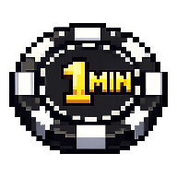
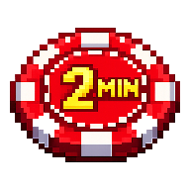
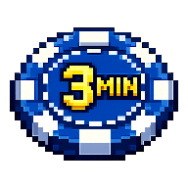
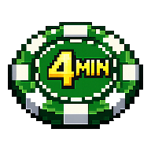
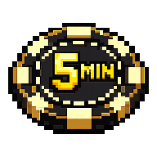
WHY PEOPLE COME BACK
One minute at a time. Easy to do twice
A loop you can finish on a bus
Every position is 60 seconds. Stack up to five back to back with one approval.
PICK YOUR HORIZON
Streaks and a daily bonus
Play on consecutive days to build a streak and claim play currency.
A 3-minute pick is three 60-second positions, staked in one transaction and settled one by one.
Practice with NYAN
No wallet or funds needed to learn the feel. Switch to devnet SOL when ready.

Slide 10
WHERE IT STANDS
What has been run, and what has not
DONE
Anchor program deployed to devnet, with 19 passing tests covering every instruction and failure path
DONE
Settler verified end to end on devnet: stake, drawing registered, scored, position closed, tampered drawing rejected
DONE
Full rounds played on a physical Android phone with a real wallet, stake and payout visible on the explorer
NEXT
Multi-minute batches and a winning-payout round on device
NEXT
Release APK with an https settler so anyone can install and play
NEXT
A shared leaderboard read from program events (today it is on the device)

Slide 11
ROADMAP
From a one-phone demo to a game people share
NOW
Hackathon build
Release APK
Demo video
Hosted settler
NEXT
Fair and social
On-chain price oracle
Global leaderboard
Push for settled rounds
LATER
Open game
More assets and timeframes
Seasons and rewards
Verified app identity in wallets

Slide 12
SCRAWL
Draw. Stake. Get scored.
A futures game that fits in one thumb, on Solana Mobile.

