Slide 1
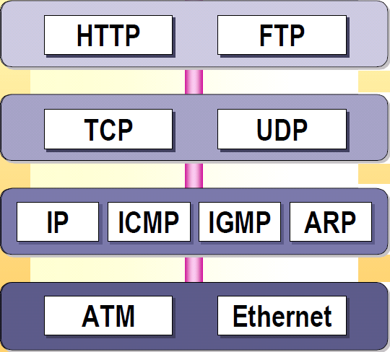
Protocolo IP

Slide 2
Protocolo IP
Internet Protocol (RFC 791)
Es un protocolo de la capa 3 (red) del modelo OSI
Entre sus funciones se encuentran:
  Dividir paquetes grandes en paquetes más pequeños
  Encontrar la ruta necesaria para enviar un paquete individual
  Determinar si un paquete recibido es correcto

Slide 3
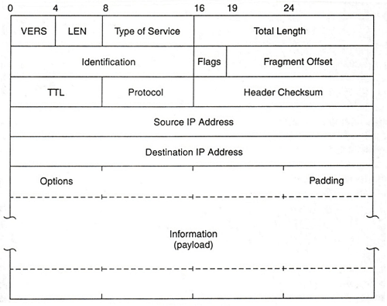
Estructura paquete IP
Longitud total del paquete (bytes)
Índice del fragmento de paquete
Longitud de la cabecera IP
Protocolo de nivel superior
Identificación del paquete (por si fragmenta)
Código de redundancia
Time to Live
Datos (paquete de nivel superior)
Notes:
A summary of the contents of the internet header follows:
Version: 4 bits
The Version field indicates the format of the internet header. This document describes version 4.
IHL: 4 bits
Internet Header Length is the length of the internet header in 32 bit words, and thus points to the beginning of the data. Note that the minimum value for a correct header is 5.
Type of Service: 8 bits
The Type of Service provides an indication of the abstract parameters of the quality of service desired. These parameters are to be used to guide the selection of the actual service parameters when transmitting a datagram through a particular network. Several networks offer service precedence, which somehow treats high precedence traffic as more important than other traffic (generally by accepting only traffic above a certain precedence at time of high load). The major choice is a three way tradeoff between low-delay, high-reliability, and high-throughput.
Bits 0-2:Precedence.Bit 3:0 = Normal Delay, 1 = Low Delay.Bit 4:0 = Normal Throughput, 1 = High Throughput.Bit 5:0 = Normal Relibility, 1 = High Relibility.Bit 6-7:Reserved for Future Use.Precedence111 -Network Control011 -Flash110 -Internetwork Control010 -Immediate101 -CRITIC/ECP001 -Priority100 -Flash Override000 -Routine
The use of the Delay, Throughput, and Reliability indications may increase the cost (in some sense) of the service. In many networks better performance for one of these parameters is coupled with worse performance on another. Except for very unusual cases at most two of these three indications should be set.
The type of service is used to specify the treatment of the datagram during its transmission through the internet system. Example mappings of the internet type of service to the actual service provided on networks such as AUTODIN II, ARPANET, SATNET, and PRNET is given in "Service Mappings" [8].
The Network Control precedence designation is intended to be used within a network only. The actual use and control of that designation is up to each network. The Internetwork Control designation is intended for use by gateway control originators only. If the actual use of these precedence designations is of concern to a particular network, it is the responsibility of that network to control the access to, and use of, those precedence designations.
Total Length: 16 bits
Total Length is the length of the datagram, measured in octets, including internet header and data. This field allows the length of a datagram to be up to 65,535 octets. Such long datagrams are impractical for most hosts and networks. All hosts must be prepared to accept datagrams of up to 576 octets (whether they arrive whole or in fragments). It is recommended that hosts only send datagrams larger than 576 octets if they have assurance that the destination is prepared to accept the larger datagrams.
The number 576 is selected to allow a reasonable sized data block to be transmitted in addition to the required header information. For example, this size allows a data block of 512 octets plus 64 header octets to fit in a datagram. The maximal internet header is 60 octets, and a typical internet header is 20 octets, allowing a margin for headers of higher level protocols.
Identification: 16 bits
An identifying value assigned by the sender to aid in assembling the fragments of a datagram.
Flags: 3 bits
Various Control Flags.
Bit 0:reserved, must be zeroBit 1:(DF) 0 = May Fragment, 1 = Don't Fragment.Bit 2:(MF) 0 = Last Fragment, 1 = More Fragments.
Fragment Offset: 13 bits
This field indicates where in the datagram this fragment belongs. The fragment offset is measured in units of 8 octets (64 bits). The first fragment has offset zero.
Time to Live: 8 bits
This field indicates the maximum time the datagram is allowed to remain in the internet system. If this field contains the value zero, then the datagram must be destroyed. This field is modified in internet header processing. The time is measured in units of seconds, but since every module that processes a datagram must decrease the TTL by at least one even if it process the datagram in less than a second, the TTL must be thought of only as an upper bound on the time a datagram may exist. The intention is to cause undeliverable datagrams to be discarded, and to bound the maximum datagram lifetime.
Protocol: 8 bits
This field indicates the next level protocol used in the data portion of the internet datagram. The values for various protocols are specified in "Assigned Numbers" [9].
Header Checksum: 16 bits
A checksum on the header only. Since some header fields change (e.g., time to live), this is recomputed and verified at each point that the internet header is processed.
The checksum algorithm is:
The checksum field is the 16 bit one's complement of the one's complement sum of all 16 bit words in the header. For purposes of computing the checksum, the value of the checksum field is zero.
This is a simple to compute checksum and experimental evidence indicates it is adequate, but it is provisional and may be replaced by a CRC procedure, depending on further experience.
Source Address: 32 bits
The source address. See section 3.2.
Destination Address: 32 bits
The destination address. See section 3.2.
Options: variable
The options may appear or not in datagrams. They must be implemented by all IP modules (host and gateways). What is optional is their transmission in any particular datagram, not their implementation.
In some environments the security option may be required in all datagrams.
The option field is variable in length. There may be zero or more options. There are two cases for the format of an option:
Case 1: A single octet of option-type.
Case 2: An option-type octet, an option-length octet, and the actual option-data octets.
The option-length octet counts the option-type octet and the option-length octet as well as the option-data octets.
The option-type octet is viewed as having 3 fields:
1 bit copied flag,
2 bits option class,
5 bits option number.
The copied flag indicates that this option is copied into all fragments on fragmentation.
0 = not copied
1 = copied
The option classes are:
0 = control
1 = reserved for future use
2 = debugging and measurement
3 = reserved for future use
The following internet options are defined:
CLASSNUMBERLENGTHDESCRIPTION00-End of Option list. This option occupies only 1 octet; it has no length octet.01-No Operation. This option occupies only 1 octet; it has no length octet.0211Security. Used to carry Security, Compartmentation, User Group (TCC), and Handling Restriction Codes compatible with DOD requirements.03var.Loose Source Routing. Used to route the internet datagram based on information supplied by the source.09var.Strict Source Routing. Used to route the internet datagram based on information supplied by the source.07var.Record Route. Used to trace the route an internet datagram takes.084Stream ID. Used to carry the stream identifier.24var.Internet Timestamp.
End of Option List
+--------+ |00000000| +--------+ Type=0 This option indicates the end of the option list. This might not coincide with the end of the internet header according to the internet header length. This is used at the end of all options, not the end of each option, and need only be used if the end of the options would not otherwise coincide with the end of the internet header.
May be copied, introduced, or deleted on fragmentation, or for any other reason.
No Operation
+--------+ |00000001| +--------+ Type=1 This option may be used between options, for example, to align the beginning of a subsequent option on a 32 bit boundary.
May be copied, introduced, or deleted on fragmentation, or for any other reason.
Security
This option provides a way for hosts to send security, compartmentation, handling restrictions, and TCC (closed user group) parameters. The format for this option is as follows:
+--------+--------+---//---+---//---+---//---+---//---+ |10000010|00001011|SSS SSS|CCC CCC|HHH HHH| TCC | +--------+--------+---//---+---//---+---//---+---//---+ Type=130 Length=11
Security (S field): 16 bits
Specifies one of 16 levels of security (eight of which are reserved for future use).00000000 00000000 - Unclassified 11110001 00110101 - Confidential 01111000 10011010 - EFTO 10111100 01001101 - MMMM 01011110 00100110 - PROG 10101111 00010011 - Restricted 11010111 10001000 - Secret 01101011 11000101 - Top Secret 00110101 11100010 - (Reserved for future use) 10011010 11110001 - (Reserved for future use) 01001101 01111000 - (Reserved for future use) 00100100 10111101 - (Reserved for future use) 00010011 01011110 - (Reserved for future use) 10001001 10101111 - (Reserved for future use) 11000100 11010110 - (Reserved for future use) 11100010 01101011 - (Reserved for future use)
Compartments (C field): 16 bits
An all zero value is used when the information transmitted is not compartmented. Other values for the compartments field may be obtained from the Defense Intelligence Agency.
Handling Restrictions (H field): 16 bits
The values for the control and release markings are alphanumeric digraphs and are defined in the Defense Intelligence Agency Manual DIAM 65-19, "Standard Security Markings".
Transmission Control Code (TCC field): 24 bits
Provides a means to segregate traffic and define controlled communities of interest among subscribers. The TCC values are trigraphs, and are available from HQ DCA Code 530.
Must be copied on fragmentation. This option appears at most once in a datagram.
Loose Source and Record Route
+--------+--------+--------+---------//--------+ |10000011| length | pointer| route data | +--------+--------+--------+---------//--------+ Type=131 The loose source and record route (LSRR) option provides a means for the source of an internet datagram to supply routing information to be used by the gateways in forwarding the datagram to the destination, and to record the route information.
The option begins with the option type code. The second octet is the option length which includes the option type code and the length octet, the pointer octet, and length-3 octets of route data. The third octet is the pointer into the route data indicating the octet which begins the next source address to be processed. The pointer is relative to this option, and the smallest legal value for the pointer is 4.
A route data is composed of a series of internet addresses. Each internet address is 32 bits or 4 octets. If the pointer is greater than the length, the source route is empty (and the recorded route full) and the routing is to be based on the destination address field. If the address in destination address field has been reached and the pointer is not greater than the length, the next address in the source route replaces the address in the destination address field, and the recorded route address replaces the source address just used, and pointer is increased by four.
The recorded route address is the internet module's own internet address as known in the environment into which this datagram is being forwarded.
This procedure of replacing the source route with the recorded route (though it is in the reverse of the order it must be in to be used as a source route) means the option (and the IP header as a whole) remains a constant length as the datagram progresses through the internet.
This option is a loose source route because the gateway or host IP is allowed to use any route of any number of other intermediate gateways to reach the next address in the route.
Must be copied on fragmentation. Appears at most once in a datagram.
Strict Source and Record Route
+--------+--------+--------+---------//--------+ |10001001| length | pointer| route data | +--------+--------+--------+---------//--------+ Type=137 The strict source and record route (SSRR) option provides a means for the source of an internet datagram to supply routing information to be used by the gateways in forwarding the datagram to the destination, and to record the route information.
The option begins with the option type code. The second octet is the option length which includes the option type code and the length octet, the pointer octet, and length-3 octets of route data. The third octet is the pointer into the route data indicating the octet which begins the next source address to be processed. The pointer is relative to this option, and the smallest legal value for the pointer is 4.
A route data is composed of a series of internet addresses. Each internet address is 32 bits or 4 octets. If the pointer is greater than the length, the source route is empty (and the
recorded route full) and the routing is to be based on the destination address field.
If the address in destination address field has been reached and the pointer is not greater than the length, the next address in the source route replaces the address in the destination address field, and the recorded route address replaces the source address just used, and pointer is increased by four.
The recorded route address is the internet module's own internet address as known in the environment into which this datagram is being forwarded.
This procedure of replacing the source route with the recorded route (though it is in the reverse of the order it must be in to be used as a source route) means the option (and the IP header as a whole) remains a constant length as the datagram progresses through the internet.
This option is a strict source route because the gateway or host IP must send the datagram directly to the next address in the source route through only the directly connected network indicated in the next address to reach the next gateway or host specified in the route.
Must be copied on fragmentation. Appears at most once in a datagram.
Record Route
+--------+--------+--------+---------//--------+ |00000111| length | pointer| route data | +--------+--------+--------+---------//--------+ Type=7 The record route option provides a means to record the route of an internet datagram.
The option begins with the option type code. The second octet is the option length which includes the option type code and the length octet, the pointer octet, and length-3 octets of route data. The third octet is the pointer into the route data indicating the octet which begins the next area to store a route address. The pointer is relative to this option, and the smallest legal value for the pointer is 4.
A recorded route is composed of a series of internet addresses. Each internet address is 32 bits or 4 octets. If the pointer is greater than the length, the recorded route data area is full. The originating host must compose this option with a large enough route data area to hold all the address expected. The size of the option does not change due to adding addresses. The intitial contents of the route data area must be zero.
When an internet module routes a datagram it checks to see if the record route option is present. If it is, it inserts its own internet address as known in the environment into which this datagram is being forwarded into the recorded route begining at the octet indicated by the pointer, and increments the pointer by four.
If the route data area is already full (the pointer exceeds the length) the datagram is forwarded without inserting the address into the recorded route. If there is some room but not enough room for a full address to be inserted, the original datagram is considered to be in error and is discarded. In either case an ICMP parameter problem message may be sent to the source host [3].
Not copied on fragmentation, goes in first fragment only. Appears at most once in a datagram.
Stream Identifier
+--------+--------+--------+--------+ |10001000|00000010| Stream ID | +--------+--------+--------+--------+ Type=136 Length=4 This option provides a way for the 16-bit SATNET stream identifier to be carried through networks that do not support the stream concept.
Must be copied on fragmentation. Appears at most once in a datagram.
Internet Timestamp
+--------+--------+--------+--------+ |01000100| length | pointer|oflw|flg| +--------+--------+--------+--------+ | internet address | +--------+--------+--------+--------+ | timestamp | +--------+--------+--------+--------+ | . | . . Type = 68 The Option Length is the number of octets in the option counting the type, length, pointer, and overflow/flag octets (maximum length 40).
The Pointer is the number of octets from the beginning of this option to the end of timestamps plus one (i.e., it points to the octet beginning the space for next timestamp). The smallest legal value is 5. The timestamp area is full when the pointer is greater than the length.
The Overflow (oflw) [4 bits] is the number of IP modules that cannot register timestamps due to lack of space.
The Flag (flg) [4 bits] values are
0 -- time stamps only, stored in consecutive 32-bit words,
1 -- each timestamp is preceded with internet address of the registering entity,
3 -- the internet address fields are prespecified. An IP module only registers its timestamp if it matches its own address with the next specified internet address.
The Timestamp is a right-justified, 32-bit timestamp in milliseconds since midnight UT. If the time is not available in milliseconds or cannot be provided with respect to midnight UT then any time may be inserted as a timestamp provided the high order bit of the timestamp field is set to one to indicate the use of a non-standard value.
The originating host must compose this option with a large enough timestamp data area to hold all the timestamp information expected. The size of the option does not change due to adding timestamps. The intitial contents of the timestamp data area must be zero or internet address/zero pairs.
If the timestamp data area is already full (the pointer exceeds the length) the datagram is forwarded without inserting the timestamp, but the overflow count is incremented by one.
If there is some room but not enough room for a full timestamp to be inserted, or the overflow count itself overflows, the original datagram is considered to be in error and is discarded. In either case an ICMP parameter problem message may be sent to the source host [3].
The timestamp option is not copied upon fragmentation. It is carried in the first fragment. Appears at most once in a datagram.
Padding: variable
The internet header padding is used to ensure that the internet header ends on a 32 bit boundary. The padding is zero.

Slide 4
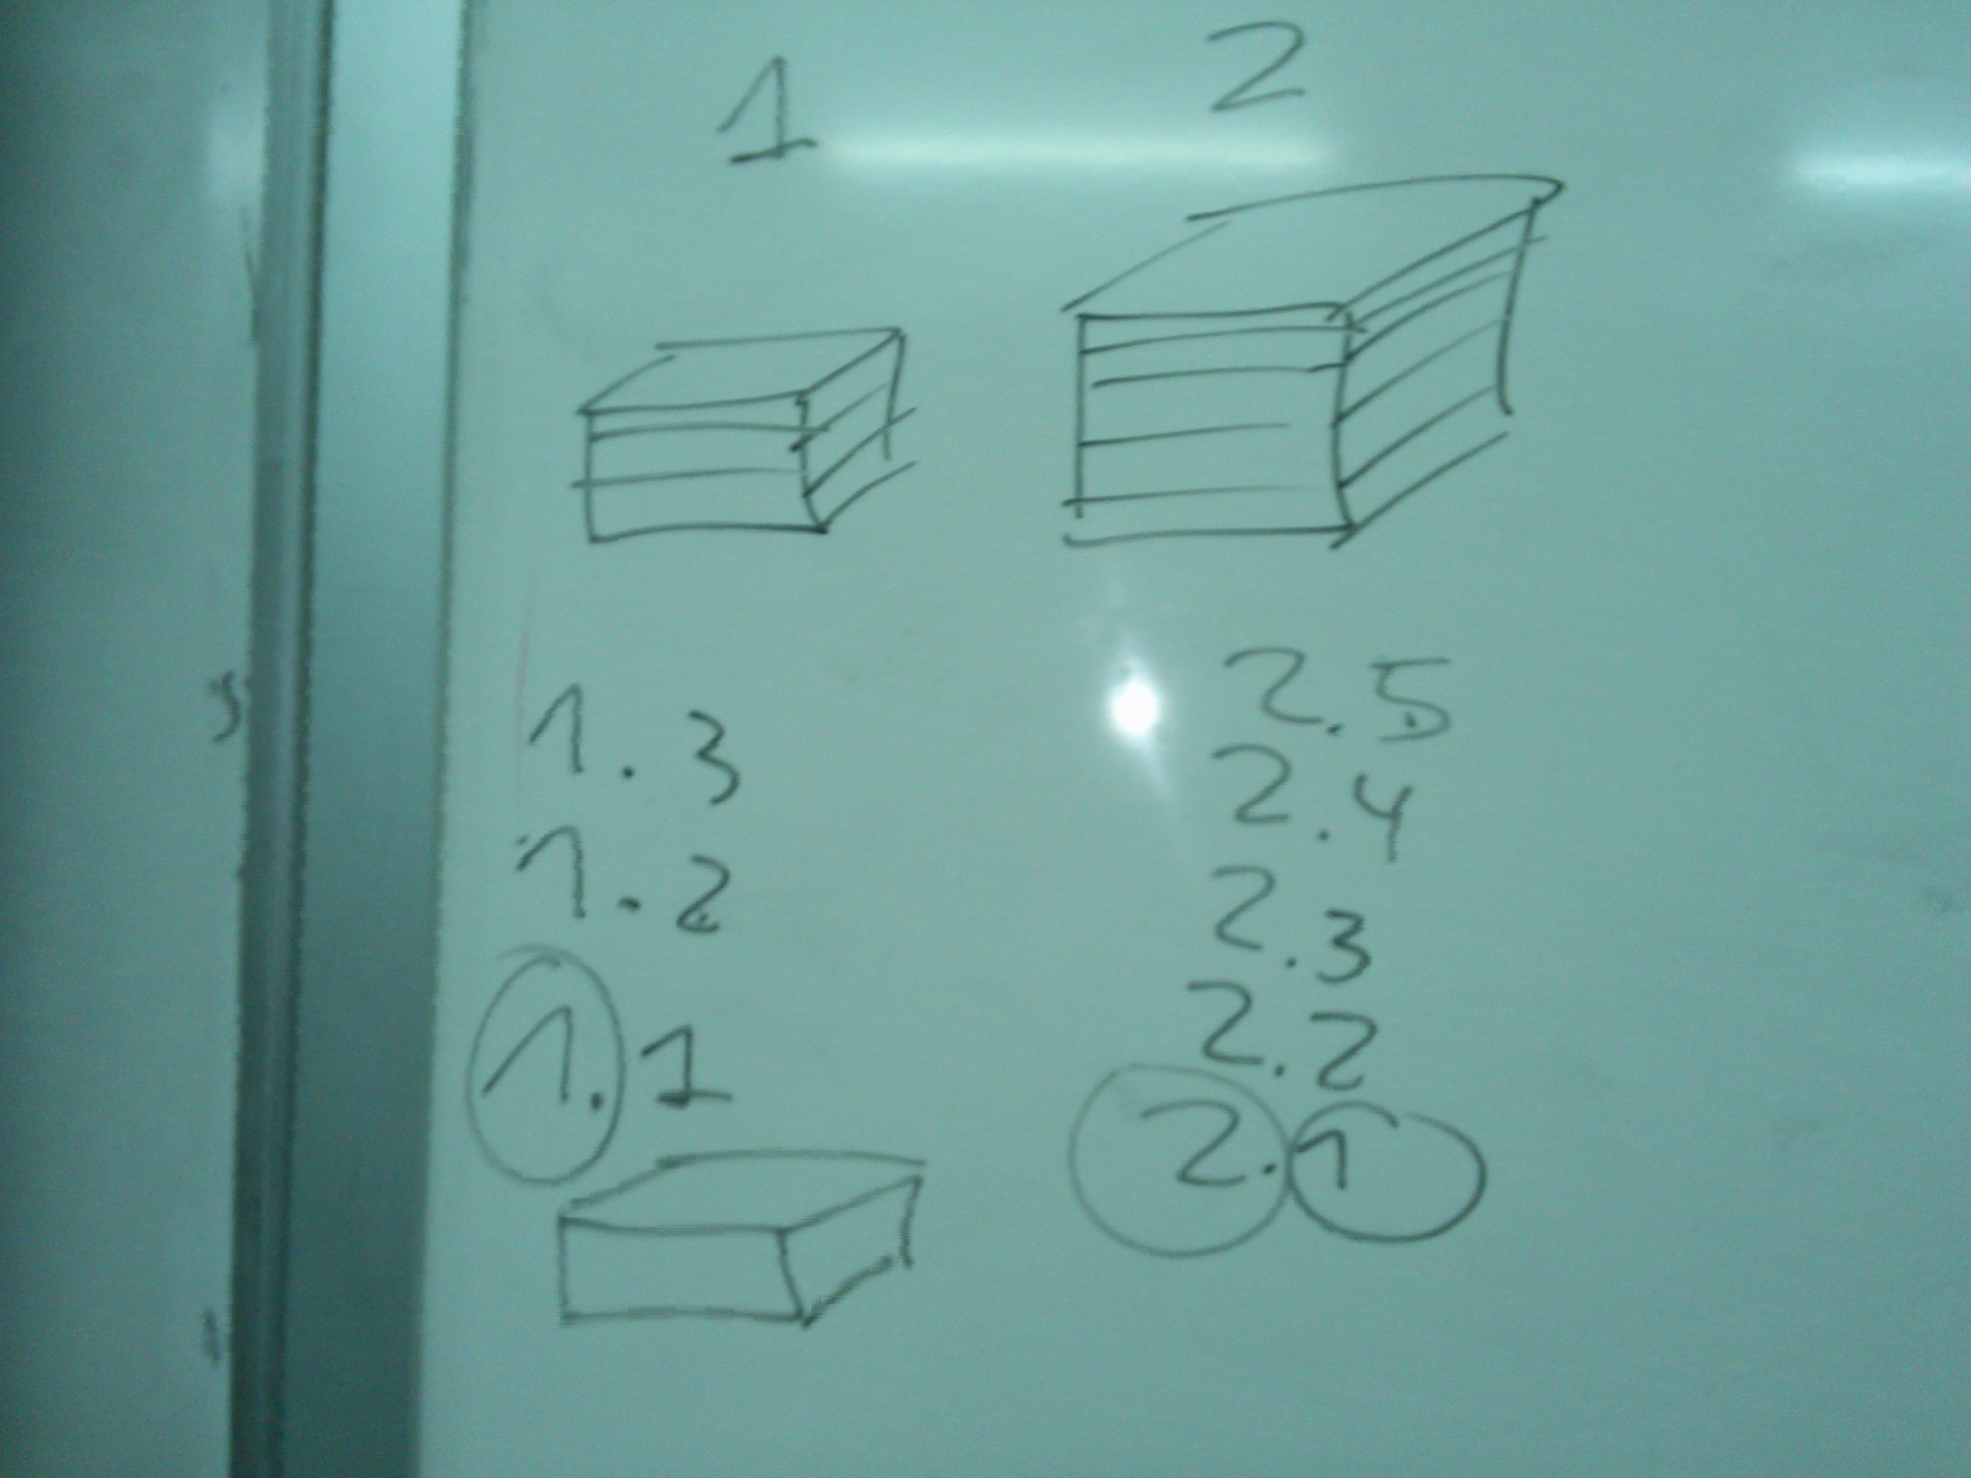


Slide 5
Direcciones IP
Una dirección IP consta de 32 bits
Por convenio, se representa como 4 números decimales, uno por cada byte
11000000101010000000000100000001
192.168.1.1

Slide 6
Direcciones IP
Las direcciones IP se asignan al montar la red, no como las MAC
  Las direcciones MAC se asignan por el fabricante de la tarjeta, quedando distribuidas casi aleatoriamente
  Las direcciones IP se estructuran de una forma jerárquica
La dirección IP contiene dos partes
  Una parte identifica a la red
  Otra parte identifica al host/enlace dentro de la red
192.168.1.1
Red
Red
Host
Host

Slide 7
Direcciones IP ¿qué identifican?
Las direcciones no se asignan por host. Por ejemplo, un equipo con tres enlaces a la red tendrá tres direcciones IP
192.168.20.1
192.168.20.2
192.168.2.1
192.168.3.1
192.168.20.3
192.168.1.1

Slide 8
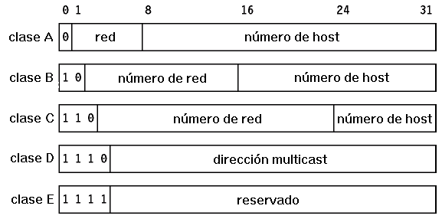
Clases IP
En las primeras versiones de IP había unas normas fijas para definir qué parte de la dirección era host y qué parte red
Los primeros bits de la dirección definen la clase a la que pertenece
192.168.1.1
11000000101010000000000100000001
Clase C

Slide 9
Clases IP
¿De qué clases son las siguientes direcciones IP?
  192.168.20.1
  127.0.0.1
  169.254.12.9
  241.82.9.9
  216.239.59.147 (Google)
  85.112.7.243 (Tuenti)
  199.16.156.198 (Twitter)

Slide 10
Direcciones de red y host
La clase define qué bits de la dirección son parte de la red y qué parte es del host
  Ejemplo: La clase C tiene 24 bits para la red y 8 para el host
Red 192.168.1
192.168.1.1
Host 1

Slide 11
Direcciones de red y host
¿Cuáles son las direcciones de red y de host de las siguientes direcciones IP?
  192.168.20.1
  127.0.0.1
  169.254.12.9
  241.82.9.9
  216.239.59.147 (Google)
  85.112.7.243 (Tuenti)
  199.16.156.198 (Twitter)

Slide 12
Direcciones de red y host
La red IP tiene una dirección propia, que no puede ser utilizada por un host dentro de la red
Esta dirección es la dirección de la red que tiene la parte del host a ceros.
Red 192.168.1
192.168.1.0
192.168.1.1
Host 1

Slide 13
Direcciones de red y host
El host tiene una dirección propia, que es su dirección de host con la parte de la red a ceros
No puede haber una red con todos sus bits a cero
Red 192.168.1
192.168.1.0
192.168.1.1
Host 1
0.0.0.1

Slide 14
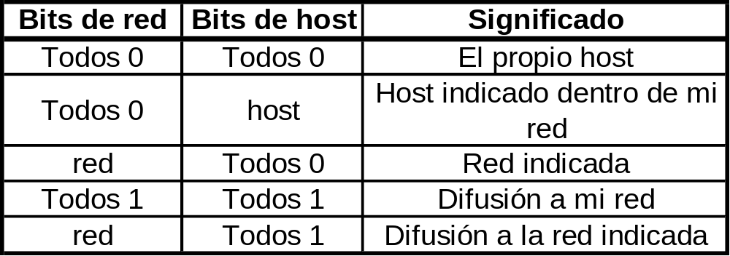
Direcciones de red y host
Las división en parte red y parte de host tienen funciones especiales en IP
*
*
*
* En las últimas versiones ya no

Slide 15
Direcciones de red y host
En la Internet original, las tramas IP se llevaban hasta la red a la que pertenecían
La red de destino se suponía un gran bus. Una vez la trama llegaba a la red, el host de destino recibía la trama

Slide 16
Problemas de las clases IP
En un principio, IP tenía suficientes direcciones y redes para todo el mundo
La creciente demanda de direcciones IP supuso problemas
  Ejemplo: Una empresa con 3000 hosts debe reservar una red de clase B, con más de 65000 direcciones (muchas direcciones desperdiciadas)
  Si reserva más de una red de clase B (unas 12), hay que configurar muchas redes en los routers intermedios.
Últimamente (desde 1985) las direcciones IP ya no se dividen en clases, utilizándose el CIDR (Classless Internet Domain Routing)

Slide 17
CIDR
Classles Internet Domain Routing
La dirección IP ya no da información acerca de los bits reservados para red y para host
Las redes se identifican por la dirección de la red y el número de bits destinado a la misma
  172.16.0.0/12
  198.18.0.0/15

Slide 18
CIDR
Con CIDR las parte de la dirección red y host se calcula mediante las máscaras de red
La máscara de red es un número binario:
  Tantos 1’s como el tamaño de la red CIDR
  Los 0’s necesarios para completar hasta los 32 bits
Las máscaras de red también se expresan como 4 números decimales separados por puntos.

Slide 19
CIDR
¿Qué máscaras de red tienen las siguientes redes?
  172.16.0.0/12
  198.18.0.0/15
  198.18.0.0/30
  192.168.255.0/24
  172.31.0.0/16

Slide 20
CIDR: Máscaras de red
Con CIDR, la dirección de red sigue siendo la que tiene todos los bits del host a 0, y la de broadcast a 1.
Sin embargo, ya no es tan fácil como con clases
  Los bits de la red no son múltiplos de 8
Se utiliza una máscara de red, realizando la operación AND con la dirección IP para encontrar la dirección de red

Slide 21
CIDR: Máscaras de red
Ejemplo
  La dirección IP es 192.168.20.100/26
  La máscara de red son 26 1’s
  La dirección pertenece a la red 192.168.20.64/26
255.255.255.192
AND 192.168.020.100
192.168.020.064

Slide 22
CIDR
Utilizando máscaras de red pueden saltarse los límites de las clases IP
  Una red grande puede dividirse en varias redes pequeñas
  Varias redes pequeñas pueden reunirse en una red más grande

Slide 23
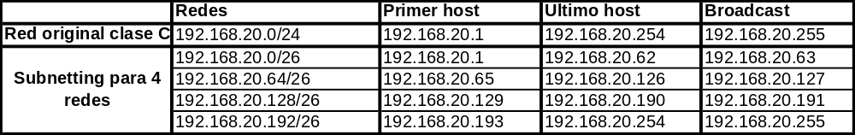
CIDR Subnetting
Consiste en crear subredes pequeñas dentro de una red de clase A, B o C
Ejemplo
  Conseguir 4 redes a partir de una red clase C
  192.168.20.0: Red clase C
  Máscara de red: 255.255.255.0
  192.168.20.0/24 (CIDR)
  Ampliando la máscara 2 bits tenemos
  192.168.20.0/26 (CIDR)
http://www.aprendaredes.com/cgi-bin/ipcalc/ipcalc_cgi

Slide 24
CIDR Supernetting
A partir de varias redes pequeñas (generalmente clase C), conseguir una más grande
Ejemplo
  Conseguir una red con más de 1000 hosts a partir de redes clase C
  192.168.0.0/19
  Tenemos las 32 redes 192.168.0.0 a la 192.168.31.0
  Reducimos la máscara en 5 bits

Slide 25
CIDR: Redes reservadas
En el estándar CIDR se reserva la primera y última red de cada partición
  Por ejemplo, al dividir la red de clase C 192.168.20.0/24 en 4 redes (pasando a máscara /26), las redes 192.168.20.0/26 y 192.168.20.192/26 quedan reservadas
  La mayoría de routers e implementaciones de IP pueden trabajar con ellas, pero es mejor no utilizarlas para no tener problemas con equipos antiguos o quisquillosos.

Slide 26
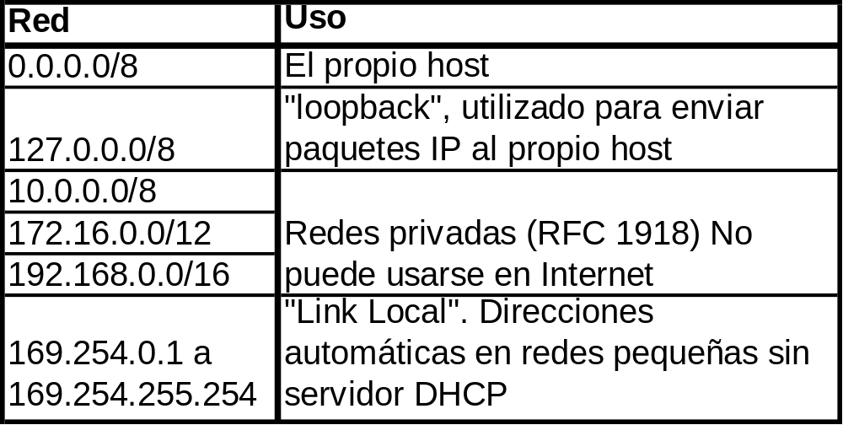
Otras redes reservadas
IANA, por medio de RFC’s, ha reservado varias redes para usos concretos. Algunos ejemplos son:
Notes:
http://www.infocellar.com/networks/ip/reserved-ip-addresses.htm
0.0.0.0/8 - Addresses in this block refer to source hosts on "this" network. Address 0.0.0.0/32 may be used as a source address for this host on this network; other addresses within 0.0.0.0/8 may be used to refer to specified hosts on this network [RFC1700, page 4].
10.0.0.0/8 - This block is set aside for use in private networks. Its intended use is documented in [RFC1918]. Addresses within this block should not appear on the public Internet.
14.0.0.0/8 - This block is set aside for assignments to the international system of Public Data Networks [RFC1700, page 181]. The registry of assignments within this block can be accessed from the "Public Data Network Numbers" link on the web page at http://www.iana.org/numbers.html. Addresses within this block are assigned to users and should be treated as such.
24.0.0.0/8 - This block was allocated in early 1996 for use in provisioning IP service over cable television systems. Although the IANA initially was involved in making assignments to cable operators, this responsibility was transferred to American Registry for Internet Numbers (ARIN) in May 2001. Addresses within this block are assigned in the normal manner and should be treated as such.
39.0.0.0/8 - This block was used in the "Class A Subnet Experiment" that commenced in May 1995, as documented in [RFC1797]. The experiment has been completed and this block has been returned to the pool of addresses reserved for future allocation or assignment. This block therefore no longer has a special use and is subject to allocation to a Regional Internet Registry for assignment in the normal manner.
127.0.0.0/8 - This block is assigned for use as the Internet host loopback address. A datagram sent by a higher level protocol to an address anywhere within this block should loop back inside the host. This is ordinarily implemented using only 127.0.0.1/32 for loopback, but no addresses within this block should ever appear on any network anywhere [RFC1700, page 5].
128.0.0.0/16 - This block, corresponding to the numerically lowest of the former Class B addresses, was initially and is still reserved by the IANA. Given the present classless nature of the IP address space, the basis for the reservation no longer applies and addresses in this block are subject to future allocation to a Regional Internet Registry for assignment in the normal manner. 169.254.0.0/16 - This is the "link local" block. It is allocated for communication between hosts on a single link. Hosts obtain these addresses by auto-configuration, such as when a DHCP server may not be found.
172.16.0.0/12 - This block is set aside for use in private networks. Its intended use is documented in [RFC1918]. Addresses within this block should not appear on the public Internet.
191.255.0.0/16 - This block, corresponding to the numerically highest to the former Class B addresses, was initially and is still reserved by the IANA. Given the present classless nature of the IP address space, the basis for the reservation no longer applies and addresses in this block are subject to future allocation to a Regional Internet Registry for assignment in the normal manner.
192.0.0.0/24 - This block, corresponding to the numerically lowest of the former Class C addresses, was initially and is still reserved by the IANA. Given the present classless nature of the IP address space, the basis for the reservation no longer applies and addresses in this block are subject to future allocation to a Regional Internet Registry for assignment in the normal manner.
192.0.2.0/24 - This block is assigned as "TEST-NET" for use in documentation and example code. It is often used in conjunction with domain names example.com or example.net in vendor and protocol documentation. Addresses within this block should not appear on the public Internet.
192.88.99.0/24 - This block is allocated for use as 6to4 relay anycast addresses, according to [RFC3068].
192.168.0.0/16 - This block is set aside for use in private networks. Its intended use is documented in [RFC1918]. Addresses within this block should not appear on the public Internet.
198.18.0.0/15 - This block has been allocated for use in benchmark tests of network interconnect devices. Its use is documented in [RFC2544].
223.255.255.0/24 - This block, corresponding to the numerically highest of the former Class C addresses, was initially and is still reserved by the IANA. Given the present classless nature of the IP address space, the basis for the reservation no longer applies and addresses in this block are subject to future allocation to a Regional Internet Registry for assignment in the normal manner. 224.0.0.0/4 - This block, formerly known as the Class D address space, is allocated for use in IPv4 multicast address assignments. The IANA guidelines for assignments from this space are described in [RFC3171].
240.0.0.0/4 - This block, formerly known as the Class E address space, is reserved. The "limited broadcast" destination address 255.255.255.255 should never be forwarded outside the (sub-)net of the source. The remainder of this space is reserved for future use. [RFC1700, page 4]

