Slide 1
The Imitation Game: Tracking Botnet Activity
Alexander Eremin
Junior Malware Analyst, Kaspersky Lab
Alexander.Eremin@kaspersky.com
Notes:
Hi, everyone! My name is Alexander Eremin, I am Junior malware analyst at Kaspersky Lab. And today I’ll told you about the imitation game we play at Kaspersky Lab. As you see, I call tracking botnets activity by this and today I’ll try to explain this caption.
So, let’s move. Feel free to ask any questions during my speech, if you have any. Also, there will be time for questions after my presentation. Let’s begin.

Slide 2
Agenda
What are botnets?
Why do they exist?
Types of botnets
The Imitation Game in Kaspersky Lab
Case from practice
Notes:
Here’s how I will structure this speech. First I’ll start with a lite introduction on what’s it all about, what are botnets and what can we do with it. Then I tell you how we in Kaspersky lab track their activity, what is helpful and what you should know to maybe build your own tracker. Next, we’ll see some interesting examples of botnets on the rise.

Slide 3
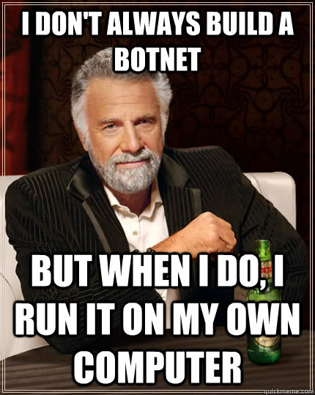
What’s it all about
What are botnets?
A collection of compromised computers running malicious programs that are controlled remotely by cybercriminals. Since the whole process occurs without the knowledge or consent of the computer user, botnets are sometimes referred to as zombie networks.
Notes:
So, once again let’s start. First of all, let me ask you, do you know what a botnet is? I almost sure you know. Yes, botnet is a collection of compromised computers running malicious programs that are controlled remotely by cybercriminals. Cybercriminals exercise remote control through automated processes (bots) in public IRC channels or web sites (such web sites may either be run directly by the ‘bot herder’, or they may be legitimate web sites that have been subverted for this purpose). Since the whole process occurs without the knowledge or consent of the computer user, botnets are sometimes referred to as zombie networks.

Slide 4



What’s it all about
Botnet structure
Bot
Bot
Bot
Bot
C&C
Bot
Bot
Notes:
Botnets are usually described like this, their organizational structure is as follows: the center or nuclear of a botnet is a command and control center (or CnC). But what is command and control center when it has no one to command and to control? Here the victims appear.

Slide 5
What’s it all about
Botnet structure
Hi, I’m bot #666! I’m here to serve you AHAHA!
Hi, bot #666! Download and exec file: hxxp://evil.com/miner.exe
Done! What’s next?
Bot
Nothing, ask again later!
C&C
Notes:
When a malware infiltrates on a victims machine, it knocks the CnC like “Hi! I’m bot number 666 and I’m here to serve you, AHAHAHA!” So, CnC sends the commands the operator of the botnet wants to run on victims machine. Bot receives them and tries to execute. These commands can be different, depending on the type of the malware: download new file, execute shell commands, start ddos, send files to CnC, inject code into web pages, intercept traffic, redirect it, etc… After that, another request is sent and so on…

Slide 6
What’s it all about
Bot
C&C #1
1st stage C&C
Bot
Bot
Bot
Bot
Bot
C&C #2
2nd stage C&C
Multiple С&C servers
Peer-to-peer botnet
Multiple stages С&C servers
Notes:
We should notice that not all botnets should be highly centralized like this. First of all they can have multiple CnC’s, even different CnC’s for different stages of their operation. In the end they can be decentralized, or peer-to-peer, but we’ll focus on a simple scheme for the ease of the explanation.

Slide 7

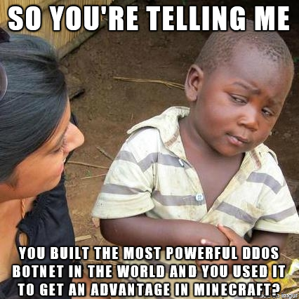
Why do they exist?
Money
Money
Revenge and fame
Money
Notes:
And why are botnets exist? I have several reasons. First, of course, money. There is no difference in what is the type of botnet, it is operated by a botnet master to raise some easy money (they think). And the next, what are you guesses? No, it’s money, again. It’s all about the money, guys. And third? Here I placed revenge and fame. This is typically can be addressed to ddos botnets, whose operators can ddos someones’ public servers just to pay back some previous offenses. And the last but not the least… money. C’mon, guys, it’s simple ☺

Slide 8

Botnets types
DDoS botnet
Bot
Bot
Bot
Bot
Bot
Bot
Bot
Bot
Notes:
Having outlined what the botnets are, we can have a brief overview of the types of the botnets. What is the first type on your mind? I guess it is ddos botnet. That is rather obvious because this is why first botnets appeared. Such widely distributed net is a good source of garbage traffic that can break down even a strong servers and companies. Everyone I think heard of Mirai, and it keeps evolving, not letting us to forget about ddos botnets.

Slide 9


Botnets types
Spam botnet
Bot
Notes:
Another popular type of botnet is spam botnet. Usually it does nothing but mass-sending spam e-mail messages. These messages can be either harmless advertisement or it can include malicious link or attachment, allowing further spreading of the malware.

Slide 10




Botnets types
Bankers
If URL like https://*bank*.com – collect!
Bot on user’s device
C&C
https://mybank.com
User
Bank
Notes:
Next, we will remember the reasons why botnets operate. Money. Here is the next type, bankers’ botnets. They consist of computers that are infected with a banking malware, collecting and sending all the banking information of the infected user to the CnC. How does it understand, that this particular site is of the interest for the operator? It is rather simple. As a command, the malware receives a configuration file with targets and code to inject from CnC. When a user navigates to a banking site from the list, malware notices it and injects the received code to the site page. User enters the credentials and press “Sign in”. The injected code reads the login and password and sends it to the CnC with the URL of the banking site. That’s it, the cybercriminals have full access to user’s account. That is not the only technique, but one of the most widely used.

Slide 11

Botnets types
Stealers
Cryptowallets files
Configuration files for different messengers
User files (text, presentations, photos, even audio and video)
All files from a specified location (like Desktop)
etc.
Bot
Bot
C&C
Bot
Notes:
Another type that is on a rise today is stealers. These are malware samples that usually do nothing except gathering specified files on the infected machine and sending them to the CnC. These files are but not limited to:
Cryptowallets files;
Configuration files for different messengers;
user files (text, presentations, photos, even audio and video) Like torrents are blocked and you build a botnet to find a rare audio of Elvis or fresh video memes
all files from a specified location
etc.
As you see, it’s all about the money as all these data can be used directly by the owner of the botnet or sold to someone else.

Slide 12

Botnets types
Backdoor/RAT
Open folder!
Done!
Move the mouse!
Done!
Bot
Delete all the saved memes!
Uhmmm… Done!
C&C
Notes:
I’d also outline backdoors as one the mightiest types of botnet as it gives almost full control over an infected machine. Once the machine is infected, the operator can execute commands remotely, control the keyboard, mouse – in short words, he gains full remote control.

Slide 13

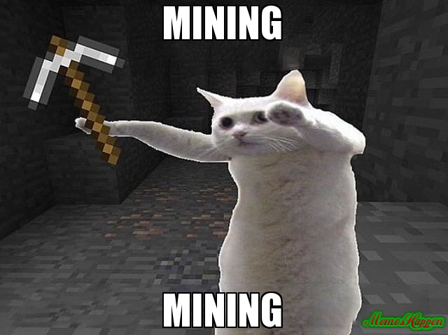
Botnets types
Miners
Mining bot
Mining bot
C&C
Mining bot
Mining bot
Notes:
What is more, as a separate type, I’d outline mining botnets. Usually it is another botnet downloading a miner and running it but many operators use their botnets to download and install miners, as it also gains them… respect? No, money.

Slide 14

Why would we monitor botnets?
Tracking the botnets activity, we can:
intercept the downloading commands and receive fresh samples of the malware within the hours after their release
intercept attack commands and notify the targets via our service
finding out the C&C and distribution centers and block them
monitor the activity and see the trends of malware distribution
Notes:
But let’s move on. Now you have an overview of botnets landscape today. And so what? Why would we monitor them?
Because it is rather profitable. Tracking the botnets activity, we can:
intercept the downloading commands and receive fresh samples of the malware within the hours after their release;
intercept the attack commands and notify the targets via our service;
finding out the CnC and distribution centers and block them;
monitor the activity and see the trends of malware distribution;
In the end, it is so fun!

Slide 15
What we do in the shadows How we track botnets
Notes:
Now I’ll start the main part of my presentation about what do we do to track the botnets activity.

Slide 16
Boring numbers
Up to 4 million of samples are processed by Kaspersky Lab systems everyday.
50 thousands of malware samples are processed by our Botnet Tracking system everyday.
> 150 malware families and their modifications are tracked, constantly adding newly appeared families and keeping track of changes in already known malware.
Notes:
First I’ll start with brief numbers:
Everyday Kaspersky Lab systems process up to 4 million of samples.
Everyday our Botnet Tracking system process about 50 thousands malware samples.
We track more than 150 malware families and their modifications, constantly adding newly appeared families and keeping track of changes in already known malware.
The process of botnet tracking is highly automated, but as every automation it can not be done without some analysis and expert work before.

Slide 17

What do we need?
Create detection for distinction
AZORult
Auto processing #1
Trojan-PSW.Win32.Stealer
KPOT
Auto processing #2
Vidar
Auto processing #3
Notes:
When an analyst encountered a new botnet family, he should do several things:
Create some service detection, if this family is detected as generic by its behavior, for example. It is necessary to distinguish it in future from other malware samples and to autoprocess it properly.

Slide 18
What do we need?
Analyze the sample
Metadata – information from the sample, connected to the C&C server and the protocol of communication
C&C (ip, port, URL, whatever) – full list!
Communication key
Bot identificators
Other special information (hardcoded constants, command names, specific separators, etc.)
Notes:
Analyze the sample. This is the most complicated part, as the analyst should understand, what the malware do, how it communicates with the CnC, what is the metadata. Here by metadata I mean the information connected to the CnC server and the protocol of communication. It can be (but as always not limited to):
The CnC (ip, port, URL, whatever) and of course, the full list of it. We should get the entire list of CnCs the malware uses
Communication key if any. Usually the communication between the bot and CnC is encrypted. The algorithm can be widely known like AES, RSA or simple XOR, or it can be some proprietary algorithm. All of this should be investigated by the analyst
Some bot identificators. To proper imitate the infected machine, we should understand what is bot id in terms of this particular malware family. Some botnets use unique random combinations based on infected machine info, some use hardcoded constants to check the authenticity of the bot.
Some other special information that is necessary to properly communicate with CnC. It can be some hardcoded constants, command names, specific separators, etc.

Slide 19
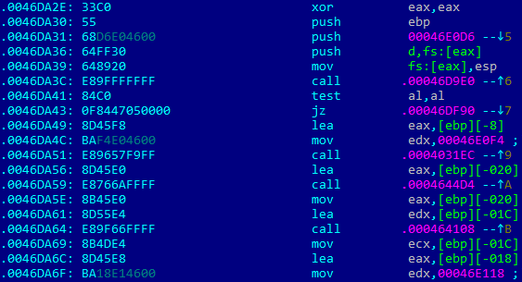
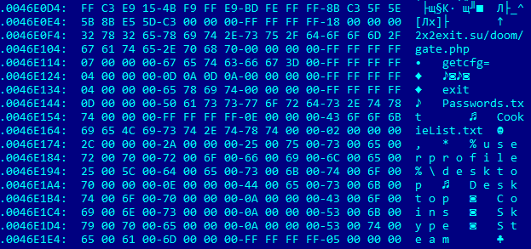
What do we need?
Auto-processing samples
Example: AZORult stealer
Notes:
So, at this point analyst has analyzed the sample, understood, where the metadata can be found. Time to automate this process! Here is the simple example of this process. At the screen you see a part of the Azorult stealer malware code. You can see, that some address is placed in EDX register, then there is some call. Let’s see, what is by the address… yeah, it’s a CnC address! Now we can simply find out this place in the sample file by regular expression, get the address and get the data located by this address.

Slide 20

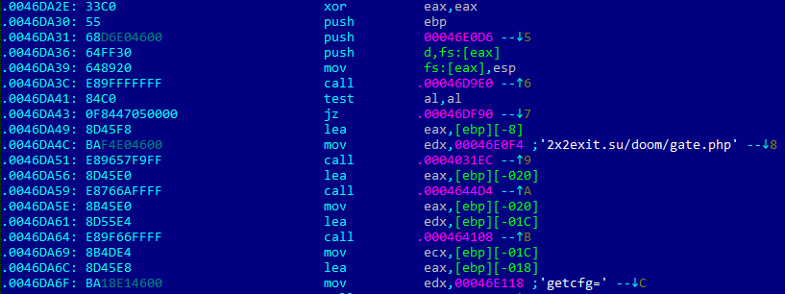
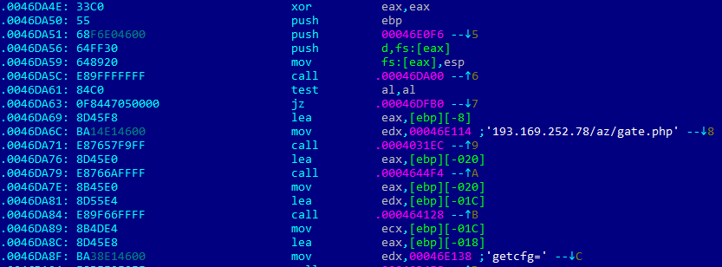
What do we need?
Auto-processing samples
Example: AZORult stealer
Notes:
Having checked more samples we can understand that this part of the code is static and can be easily referenced to.

Slide 21
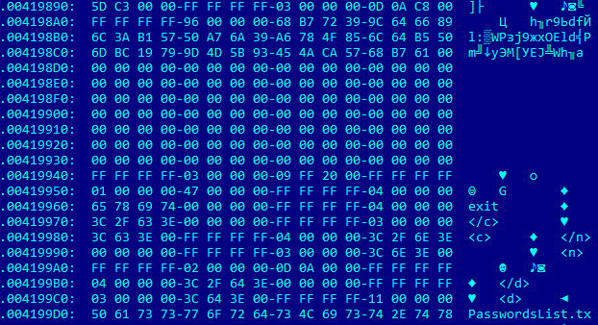
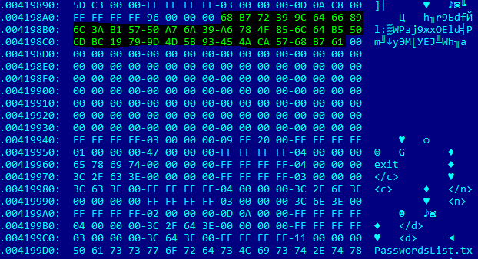
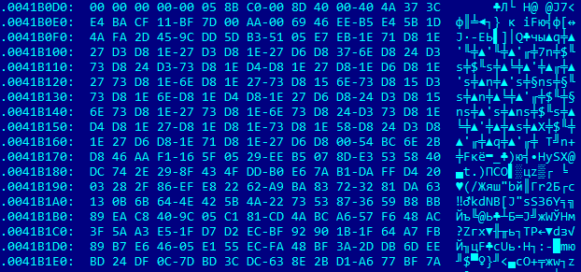
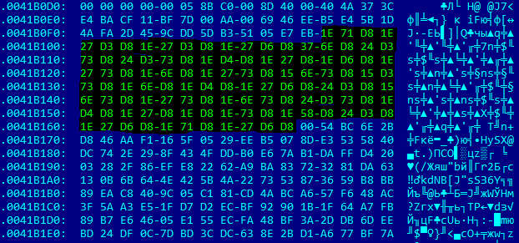
What do we need?
Auto-processing samples
Example: AZORult stealer
AZORult v3.*
AZORult v3.3
Notes:
Sometimes it’s not so easy. Here are some samples where you also have a CnC. But it is crypted. So, you have to find out the algorithm, the key, understand, what is CnC in this pile of garbage and decrypt it.
The analyst writes some script that automates the extraction process. In the end we have the system that filters the necessary files and processes them with a special script trying to extract the metadata.

Slide 22
What do we need?
Activity tracking – The Imitation Game
Botfarm
Hi, I’m bot #666!
New file!
OK, download file!
Bot
C&C #1
DDoS command!
Hi, I’m bot #777!
Botnet Tracking
OK, start DDoS!
Bot
C&C #2
Nothing to do
Hi, I’m bot #999!
OK, sleep!
Bot
C&C #3
Notes:
What’s for? The analyst not only wrote an autoprocessing script. We can’t just ping the CnC to check, whether it’s alive. To analyze the activity of the botnet we need to play the imitation game: we imitate an infected machine that knocks the CnC saying “I’m the bot, control me!” Of course, it should be done in a proper manner according to a communication protocol. Here we need the metadata extracted on the previous step. Having the CnC, knowing crypto algorithm and communication protocol we can craft a packet like a real infected machine without an infection itself. The commands received also are not really executed on the machine (except downloading), they are logged and analyzed by our Botnet Tracking system.

Slide 23
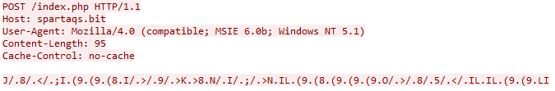
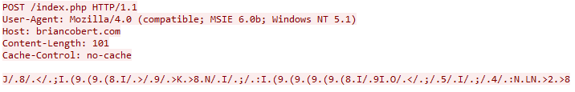
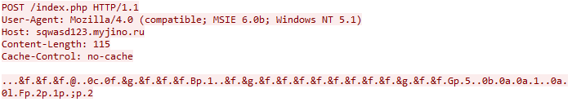
Activity tracking – The Imitation Game
Problems?
Botfarm
Not a solution!
Bot
C&C #1
Bot
C&C #2
Bot
C&C #3
Notes:
But if it was easy, it will be automated. Like what’s more simple than take a pcap file with traffic to CnC, cut out first packet and send it periodically to check CnC (ps, we have one bot like this). Yeah, with some simple bots that’s of course a solution. But the situation is much more complicated: newly appeared malware families have really sophisticated communication protocols. Older families also keep evolving adding cryptography or multiple stages.

Slide 24
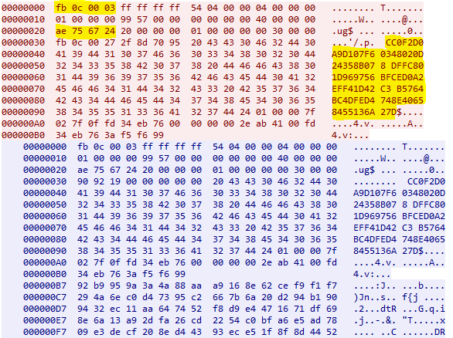
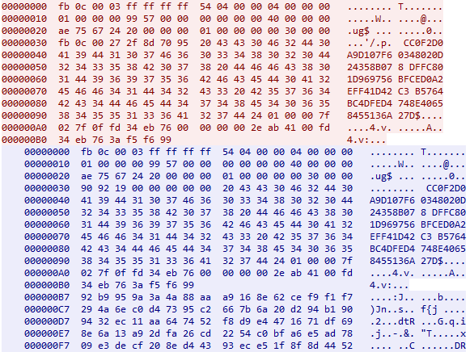
Activity tracking – The Imitation Game
Problems? DanaBot example
Request 2nd stage
2nd stage DLL
DanaBot 1st stage
1st stage C&C
Request configs and modules
Configs and modules
DanaBot 2nd stage
2nd stage C&C
Notes:
Let’s check it on the example. Danabot, appeared in 2018. It is a classic banking Trojan, receiving its configuration files from CnC. But not all so simple. The process of communication in first versions was like this: in the beginning 1st stage infects the victim machine. Having some CnC list, it downloads the second stage with different list of CnCs which receives configuration itself. So, we have to monitor all this steps, as we want to receive fresh samples of second stage (and fresh CnC list as well) and fresh configuration files.
Packets were like this: some hex digits (probably hash sums), some constants… Replaying this traffic we got only empty responses, that means we need to reconstruct the whole communication protocol.

Slide 25
Activity tracking – The Imitation Game
Problems? DanaBot example
Notes:
Analyzing the samples, we understand that these are actually hashsums (MD5), and they cannot be random as they are like checksums and the packet is referred as broken by CnC if the MD5 are not as expected. Then we have data encrypted with AES and one of this MD5 as a key. Not that easy, but ok, isn’t it? We can implement it

Slide 26
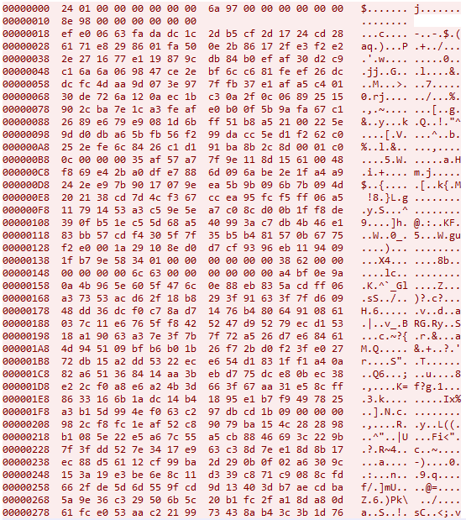

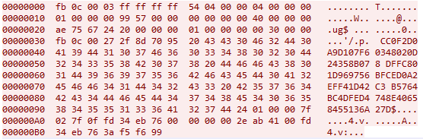
Activity tracking – The Imitation Game
DanaBot updates protocol
1st packet – old version
1st packet – new version
Notes:
But here comes the update. We notice that fresh samples are processed, the metadata is extracted, but we have no proper answers from the CnC. Probably, the protocol changed. And yes, it changed. Here you see 1st packets of old and new versions, you see, the stuff got a little more complicated

Slide 27

Activity tracking – The Imitation Game
DanaBot updates protocol
DanaBot
Create RSA session key
Encrypt new RSA session key with random AES key
Encrypt random AES key with hardcoded RSA key
C&C
Decrypt RSA session key and store it
“We had two bags of RSA keys, seventy-five pellets of random AES keys, five sheets of C&Cs, a salt shaker half full of unknown dword constants... and also a MD5, a MD5 of MD5, a MD5 of bot id and two dozen packets of AES under RSA.
Not that we needed all that for the trip, but once you get locked into a serious botnet, the tendency is to push it as far as you can. “
Create “hello” packet
Encrypt data with new random AES key
Encrypt random AES key with hardcoded RSA key
Create response
Encrypt data with new random AES key
Encrypt random AES key with stored RSA session key
Create next packets
Encrypt data with new random AES key
…
Notes:
Now we deal with constantly changing AES keys, two pairs of RSA keys (one for encryption, one for digital signature) and lots of surprises in how this hashsums are calculated.
The structure of the data sent to the CnC server changed not so much but new version added more layers of cryptography to communication protocol. Now it looks like:
Generate RSA session key
Encrypt new public RSA key with AES and new random key
Encrypt AES key with hardcoded RSA key
Send encrypted new public RSA key and encrypted AES key to CnC
Then it stores it
Meanwhile bot creates hello packet and also encrypts it with hybrid scheme
Also the server does the same
And so on, and so on

Slide 28
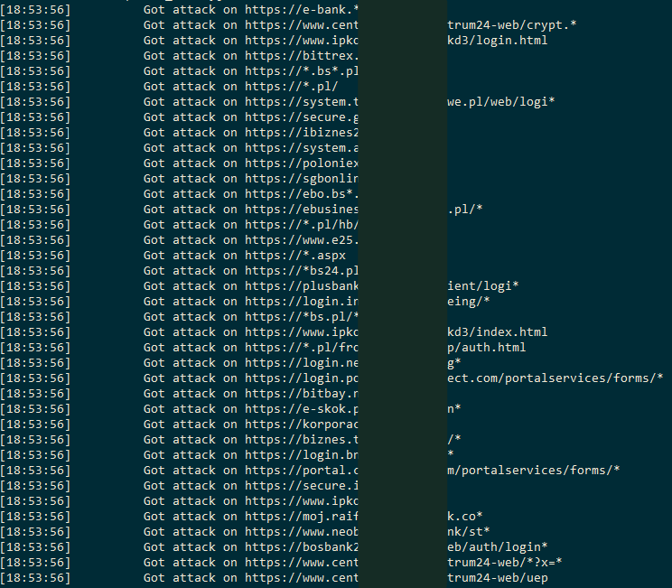
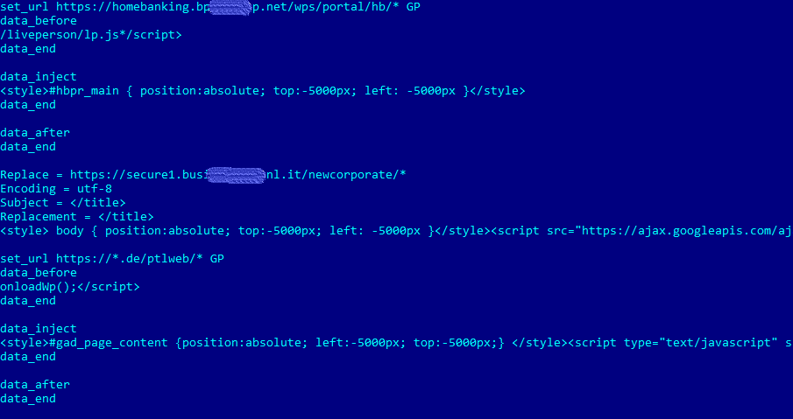
Activity tracking – The Imitation Game
Nailed it? Just chill and watch!
Notes:
But, once you nailed to understand the communication protocol, you can implement it with a script and take a rest watching your bots communicating with the CnCs. Here are logs of bot emulation and received decrypted config for banker’s attacks

Slide 29

Activity tracking – The Imitation Game
More problems
DGA – Domain Generation Algorithm
Algo (example):
Today is 27th of April
Get hex(2704) = 0xA90
Got parts = [‘qwert’, ‘zxcvb’, ‘asdfg’, ‘hjklp’]
Get parts[2704/1000] = ‘asdfg’
‘asdfg’ + ‘a90’ + ‘.xyz’ = ‘asdfga90.xyz’
26-04-2019
Bot
xxxyyy.com
Good news: we can “ban” domains for future ☺
27-04-2019
Bot
yyyxxx.com
Notes:
Another problem can be “oh, I saw that yesterday there was xxxyyy.com in traffic as CnC, but today is yyyyxxx.com. What the heck? That is DGA, Domain Generation Algorithm. It helps operators to longer the life of the botnet as the CnC address keeps changing and blocking one today is not the solution as tomorrow will be another one. However, everything you need to do is simply understand the algo and implement it. Usually, these algos are based on the timestamp and some dictionary of domain parts. For example, today is 27th of April, lets get hex of 2704, add .xyz, and find 2704/100 th sequence of chars. So todays domain will be like asdfga90.xyz. All the operator have to do is to control this domain on 27th of april. But since we know the algo we can generate all the possible domains and ban it for future ☺

Slide 30

The Imitation Game – sum it up!
Metadata
Source of new samples
Metadata
Filter system
Auto-processing system
Botfarm
Commands
Events analysis system
Notes:
So, to sum it up, what do we need to track this huge variety of botnet families? First of all, we need a source of new samples. These could be some public sandboxes, Virus Total, why not, or something like this. As I’ve already said, we at Kaspersky Lab don’t have problem with it: lots of samples are processed everyday.
Next we need some filtration system. We can’t afford to process every sample like “this is probably a botnet sample, let’s try to find some info about it!” It costs lots of time and money, so we need to filter the samples. That is where our very own autoprocessing system starts working. Having the sample with some verdicts previous autoprocessing systems has labled it, our system decides, whether this particular samples worth processing. If so, a special task is created and the next step is performed, autoprocessing itself.
The sample is autoprocessed with a special script written by analyst and metadata is extracted. Then the bot is hooked up meaning a special script, imitating an infected machine is launched with this metadata. This script implements the communication protocol and is also written by analyst.
The commands received are analyzed and logged. So this whole system forms our Botnet Tracking service.

Slide 31
Bonus part Case from a practice
Notes:
In this part I’d like to show you some interesting case from our practice. This one was connected with Azorult Trojan stealer

Slide 32

AZORult
Stealer with long history
Translation:
Arkei 4k rubles (~60$)
AZORult Stealer 6k rubles (~100$)
I have both, but AZORult is better
Abilities:
grab browsers history, cookies, saved passwords
steal files from specific directories
take screenshot
steal cryptowallets files
download and execute files
steal Skype, Telegram, Steam files
use of .bit domains
etc.
Notes:
The AZORult Trojan is one of the most commonly bought and sold stealers in Russian forums. Despite the relatively high price tag ($100), buyers like AZORult for its broad functionality (for example, it can use .bit domains as C&C servers to ensure owner anonymity and to make it difficult to block the C&C server).

Slide 33
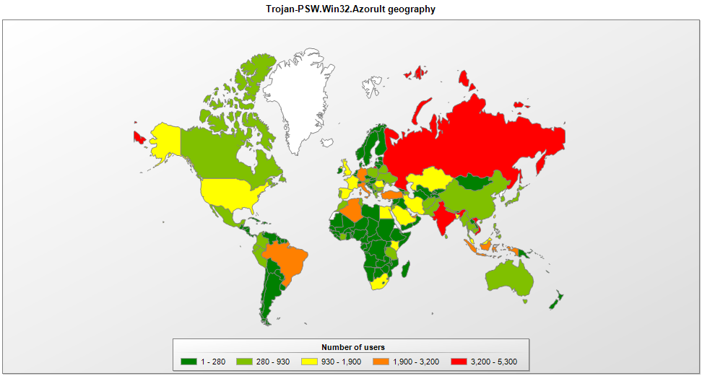
AZORult
Geography of users attacked by Trojan-PSW.Win32.Azorult, 01.01.2019 — 04.23.2019
Notes:
Our statistics show that since the start of 2019, users in Russia and India are the most targeted.

Slide 34
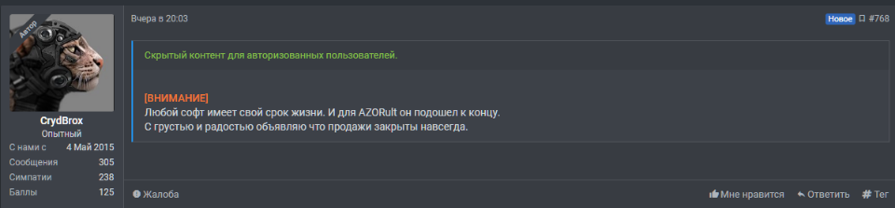
AZORult
The King is dead. Long live the King!
“All software has a shelf life. It’s run out for AZORult. It is with joy and sadness that I announce that sales are closed forever.”
CrydBrox
Notes:
But at the back end of 2018, the main seller, known as CrydBrox, stopped selling the malware:
Some connect this with the leakage of source panels, someone says that it is because previous versions were patched and also leaked. However, despite these facts, the story of AZORult does not end there.

Slide 35
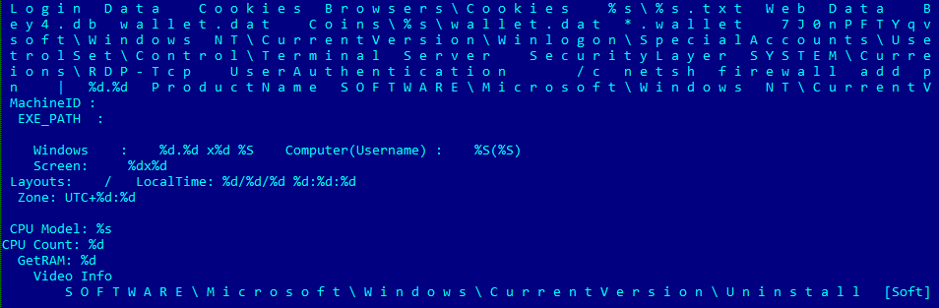
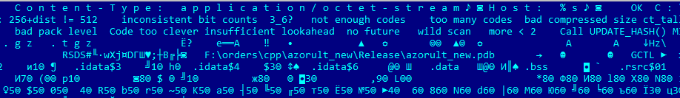
AZORult
The King is dead. Long live the King!
Notes:
In early March 2019, a number of malicious files detected by our products caught the eye. It has strings and behavior like Azorult, but unlike the original malware, it was written not in Delphi, but in C/C++. A clear hint at the link between them comes from a section of code left by the developer.

Slide 36
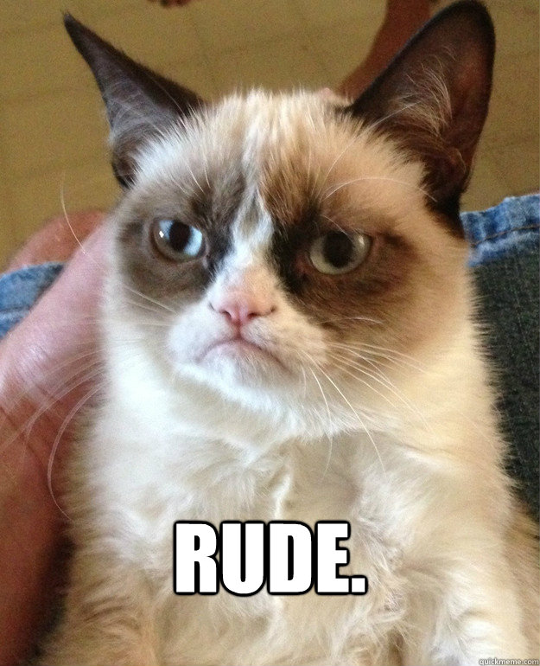
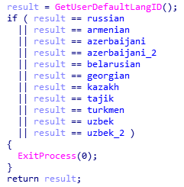
AZORult++
Not for everyone
Notes:
This version we call AZORult++. It’s interesting that Azorult++ will work not on all systems. If AZORult++ is running on a system where the language is identified as Russian, Armenian, Azerbaijani, Belarusian, Georgian, Kazakh, Tajik, Turkmen, or Uzbek, the malware stops executing.

Slide 37
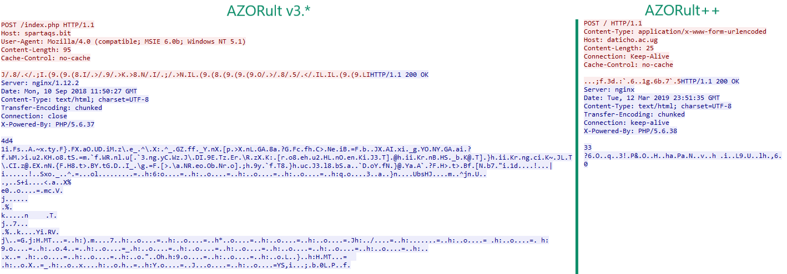
AZORult++
Looking in the mirror
Notes:
A more detailed analysis shows that new version is somehow cutted version of AZORult 3.3. There are lots of similarities, including the algorithm for communication with the C&C server, the command format, the structure and method of storing harvested data, and encryption keys. However, there is no loader functionality and no support for stealing saved passwords from many of the browsers.
Like AZORult 3.3, AZORult++ uses an XOR operation with a 3-byte key to encrypt data sent to the C&C server. This key we had already encountered in various modifications of version 3.3.

Slide 38
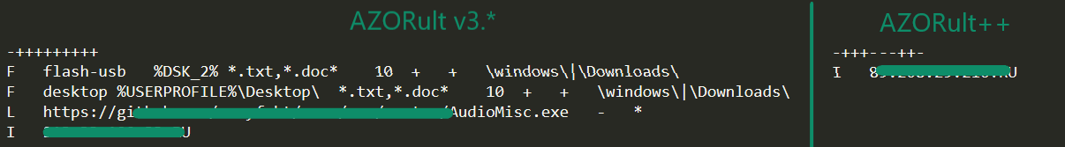
AZORult++
Looking in the mirror
Configuration string
Grab files on this settings
Download and execute file
IP information
Notes:
The server response also contains far less data. In version 3.3, the response contained a command in the form “++++-+–+-“, specifying the bot configuration and a link for downloading additional malware, plus several binary files needed for the stealer to work. The string “++++-+–+-” is parsed by the Trojan character-by-character; “+” in a specific position signifies a command to execute certain actions (for example, harvesting of cryptowallet files). The current version of AZORult++ employs a shorter, yet similar command

Slide 39



AZORult++
Who cares about configuration?
Configuration: “-++---++-”
Notes:
However, the resulting configuration string is not processed correctly; the code execution does not depend on the value “+” or “-” in the string, since the characters are checked against zero byte for a match. In other words, the resulting command does not affect the stealer’s behavior.
This seems to be an error on the part of the developer, which suggests again that the project is in the very early stages of development.

Slide 40
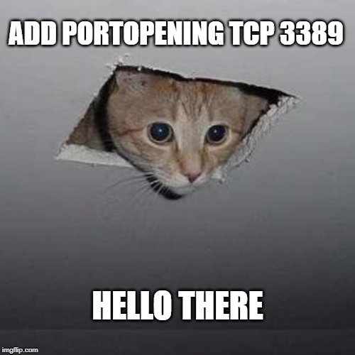
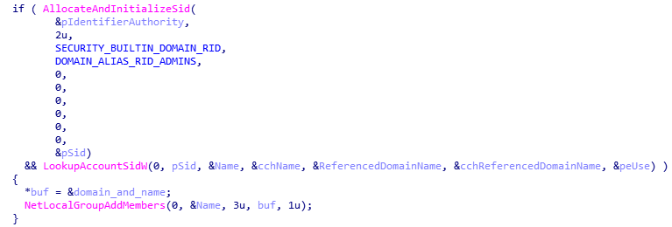
AZORult++
Still mighty one
Notes:
Despite all its flaws, AZORult++ could actually be more dangerous than preveious versions due to its ability to establish a remote connection to the desktop. To do so, AZORult++ creates a user account using the NetUserAdd() function (username and password are specified in the AZORult++ code), before adding this account to the Administrators group.
Next, AZORult++ hides the newly created account by setting the registry keys. Likewise, through setting registry key values, a Remote Desktop Protocol (RDP) connection is allowed.
The malicious cherry on the cake is a call to ShellExecuteW() to open a port to establish a remote connection to the desktop:
After that, the infected computer is ready to accept the incoming RDP connection, which allows the cybercriminal — armed with the victim’s IP address and account information — to connect to the infected computer and seize complete control of it.

Slide 41
AZORult++
OK, what that gives us?
Metadata
Source of new samples
Metadata
Filter system
Auto-processing system
Botfarm
Commands
Events analysis system
Notes:
OK, what that gives us? What do we need to change to proper track new samples? Since the protocol hasn’t changed much, we need just to change autoprocessing script and tune our filter system a little.

Slide 42
AZORult++
OK, what that gives us?
Metadata
Source of new samples
Metadata
Filter system
Auto-processing system
Botfarm
Commands
Events analysis system
Notes:
That’s it, we are ready to monitor new version just a few time after its release!

Slide 43
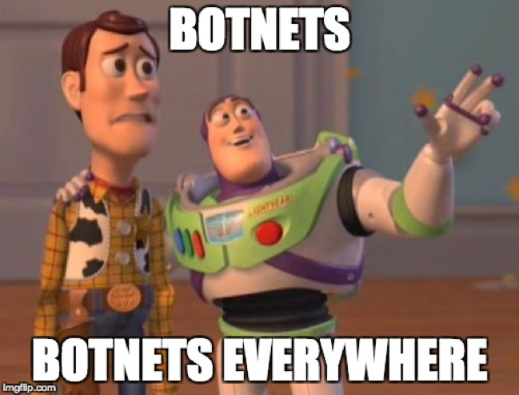
Conclusion
Botnet Tracking is fun!
Understand trends of malware distribution
Targets cybercriminals are on
We have to keep an eye on botnets!
Notes:
In my presentation, I tried to show that Botnet Tracking is fun. Really, you infiltrate a hidden net and monitor all the activity it performs. Isn’t it fun?
But in serious terms, tracking botnets really helps to understand the latest trends in malware distribution and targets the cybercriminals are on. Unfortunately, malware keeps evolving, so we have to keep a pulse and be ready for upcoming changes.

Slide 44

Let’s Talk?
Kaspersky Lab HQ
39A/3 Leningradskoe Shosse
Moscow, 125212, Russian Federation
Tel: +7 (495) 797-8700
www.kaspersky.com
Notes:
That is the end of my speech and I’ll be glad to answer your questions if any

