Slide 1
Hotel Reservation Framework
CS 321 Spring 2016
Han Tsung Liu
Last Modified: Mar 24, 2016

Slide 2
Hotel Reservation System (HRS)
Design, Coding and Testing assignments for
Server side of the Hotel Reservation System
Implement HRS as one Java program
HRS Framework assists with your implementation
You will be provided with two .class files:
Framework.class
Parser.class
Your team will then implement the rest of the system based on the assignment description

Slide 3
Hotel Reservation System Framework
Framework provides
Access to system parameters
Functionality for reading instructions from input files
Correspond to inputs from
Customer
Front-desk Clerk
Manager
Timer
Functionality for
Storing, retrieving, updating, and deleting
Reservation and Customer data

Slide 4
Overview of Framework
1) Take in input files with sequence of instructions (6 sub-types)
2) Maintain the hotel reservation system for a total of 31 days in January.
3) Output messages for execution per instruction (3 types)
4) System is going to be built with Java

Slide 5
High level Scope of System
Parser.class
Framework.class
Input File Instruction
(Handle by Parser)
Make Reservation
Check In
Check Out
Management Report
Next Day Signal
6 PM Signal
Hotel Reservation System
Framework
Database for storing customer and reservation objects
Still Need
Managing different types of instructions (keep track of date, room availability, store customer and reservation information)
Output Messages
Still Need
Execution trace
Management Report
Error Messages

Slide 6
Parser.class (similar to an Iterator)

Slide 7
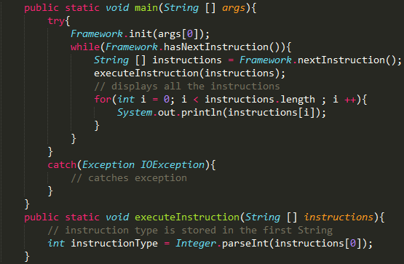
Example Usage

Slide 8
Standard Input File Format
1. Make a Reservation
2. Check in
3. Check out
4. Print Management Report
5. Day Change (move to next day)
6. 6pm alarm (automatic cancellation for non-guaranteed)

Slide 9
Make A Reservation “@1”
String | Content | Range or Example
0 | 1 | 1
1 | Name | George Mason
2 | Address | 4400 University Drive, Fairfax,VA 22030
3 | Check In Date | (1-31)
4 | Check Out Date (1-31) | (1-31)
5 | Room Type (1 or 2) | (1 or 2)
6 | Number of Occupants (1-4) | (1-4)
7 | Guaranteed | (0=No, 1=Yes)
8 | Credit Card Info | (Visa, MasterCard...etc)
9 | Credit Card Expiration Date | 3/2016
10 | Credit Card Number | 1234 1234 1234 1234 12

Slide 10
Check In “@2”
Line | Content | Range/Example
0 | 2 | 2
1 | Name | George Mason
2 | Update Credit Card Information | MasterCard
3 | Credit Card Expiration Date | 3/2016
4 | Credit Card Number | 1234 1234 1234 1234 12
Check Out “@3”
Line | Content | Type/(Range/Example)
0 | 3 | 3
1 | Name | George Mason

Slide 11
Print Management Report “@4”
Line | Content | Example
0 | 4 | 4
1 | Date | 25
Day Change “@5”
Line | Content | Example
0 | 5 | 5
6PM Signal “@6”
Line | Content | Example
0 | 6 | 6

Slide 12
Example Input File
Make Reservation
@1
Bernard L. Silver
3777 Franklin Avenue, Austin, TX 78401
2
3
1
2
1
Visa
2/2016
4716001921994146670
@5
@2
Bernard L. Silver
@3
Bernard L. Silver
Associated Data
Next Day
Check In
Check Out

Slide 13
More Information
Each set of instructions starts with “@#”
Each line is separate by “\n”
There can be multiple “\n” between two instruction sets.
The system you build should validate user input if required by your professor.

Slide 14
Framework.class
Manage customer and reservation data
(Customer and Reservation Objects)
Update 2016: Data Encapsulation and Validation
----- Getting Started -----
First step is to create a Customer and Reservation Java Class.
(Code all Instance Variables and Define “Setters” and “Getters”)

Slide 15
Framework Class Variables - FINAL

Slide 16
Customer Methods in Framework

Slide 17
Reservation Methods in Framework

Slide 18
Step 2: Class Instance Variables
Reservation | Customer
reservationID - INTEGER | customerID - INTEGER
status - INTEGER (1-5) | name - STRING
startDate – INTEGER (1-31) | Address – STRING
endDate – INTEGER (1-31) | ccType – STRING
roomType – INTEGER (1-2) | ccNumber – STRNIG
numOccupants – INTEGER (1-4) | ccExpiration – STRING
guaranteed – INTEGER (0-1)
roomNum – INTEGER (10 rooms total)
customerID - INTEGER

Slide 19
Customer: Setters and Getters
Setters | Getters
setCustomerID(int id): void | getCustomerID(): int
setName(String name): void | getName(): String
setAddress(String address): void | getAddress(): String
setCCType(String ccType): void | getCCType(): String
setCCNumber(String ccNumber): void | getCCNumber(): String
setCCExpiration(String ccExpiration): void | getCCExpiration(): String

Slide 20
Reservation: Setters and Getters
Setters | Getters
setReservationID(int reservationID): void | getReservationID(): int
setStatus(int status): void | getStatus(): int
setStartDate(int startDate): void | getStartDate(): int
setEndDate(int endDate): void | getEndDate(): int
setRoomType(int roomType): void | getRoomType(): int
setNumOccupants(int numOccupants): void | getNumOccupants(): int
setGuaranteed(int guaranteed): void | getGuaranteed(): int
setRoomNumber(int roomNum): void | getRoomNumber(): int
setCustomerID(int customerID): void | getCustomerID(): int

Slide 21
System Setup Environment
Github/Blackboard: download a copy of framework.class and parser.class
CMD: Setup environment variables to include java sdk.
Eclipse: create new project and copy over framework.class and parser.class

Slide 22
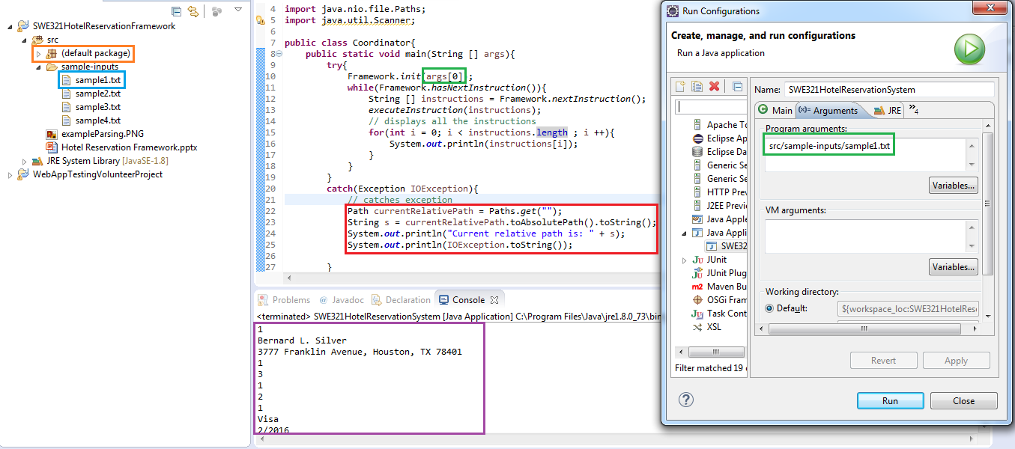
Eclipse Input File Example

Slide 23
General Tips
Follow user guide instructions
Correct setter and getter names!
Keep your own list of reservationIDs for search and retrieve
Framework “deep copies” all data
Get started early and come to my office hours for any questions
(better before than after grading!)

Slide 24
Contact Me
Name: Han Liu
Email: hliu10@gmu.edu
Subject Line: SWE321-section00X_YourFullName_TeamNumber
Tuesday 1:30 – 3:30pm or by appointment
Questions?

