Slide 1
AUTONOMOUS SATELLITE EARTH OBSERVATION PROTOCOL
AGRIPROOF.AI
60-Day Disputed Claims ➔ 5-Second Cryptographic Settlement
TRADITIONAL SYSTEM
60–90 DAYS
• Manual physical adjuster visits • 35% fraud & subjective bias • ₹18,000 Crore annual dispute backlog
AGRIPROOF AI PROTOCOL
5 SECONDS
• ESA Copernicus Sentinel-2 L2A (10m) • XGBoost Yield Loss ML Model (87% R²) • Groth16 Zero-Knowledge SNARK Proofs

Slide 2
SLIDE 02 · MARKET CRISIS
The ₹18,000 Crore Agricultural Insurance Bottleneck
147 Million
Farming Households
Smallholders in India prone to climate shock
60–90 Days
Average Claim Wait
Manual loss adjusters delay harvest payouts
₹18,000 Cr
Disputed Claims/Yr
Capital stuck in bureaucratic disputes
35% Fraud
Subjective Bias
Manual eyeball checks lack verifiable ground truth

Slide 3
SLIDE 03 · CORE PILLARS
The AgriProof AI Triple Innovation Triad
1. SATELLITE TELEMETRY
Sentinel-2 Multi-Spectral Ingestion
• 10m Ground Sample Distance (GSD) • 5-day orbital revisit • ₹0 data cost (ESA Copernicus) • B02 to B12 bands analyzed
2. MACHINE LEARNING
XGBoost ML Risk Engine
• 12-dimensional spectral feature vectors • Yield loss % prediction • Damage probability classification • Weather anomaly integration
3. ZERO-KNOWLEDGE CRYPTO
Groth16 ZK-SNARKs (Circom 2.1)
• Proves loss exceeded policy trigger (≥30%) • 100% Zero-PII protection • Farmer GPS coordinates kept private • <8ms on-chain BN128 verification

Slide 4
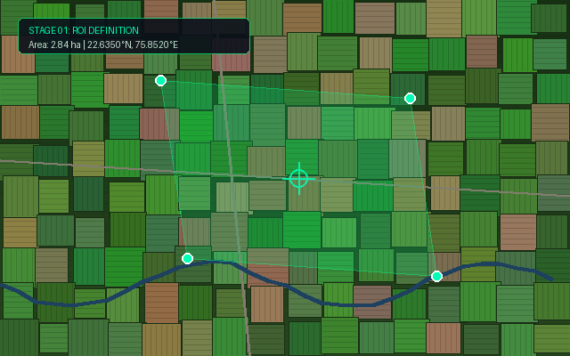
STAGE 01 · BOUNDARY ISOLATION
STAGE 01: Geodesic ROI Boundary & Parcel Commitment
LIVE INFERENCE TELEMETRY
PARCEL SURFACE AREA
2.84 Ha (7.0 Acres)
GEODESIC CENTER
22.635° N, 75.852° E
CRYPTOGRAPHIC HASH
SHA-256 Boundary Hash
STAGE EXECUTION
< 650ms Real-Time
📊 NDVI BENCHMARK CRITERIA
• > 0.70: Peak Biomass (Optimal)
• 0.50–0.70: Healthy Vegetation
• 0.35–0.50: Moderate Stress
• 0.20–0.35: Severe Drought (Claim Trigger)
• < 0.20: Bare Soil / Water / Fallow

Slide 5
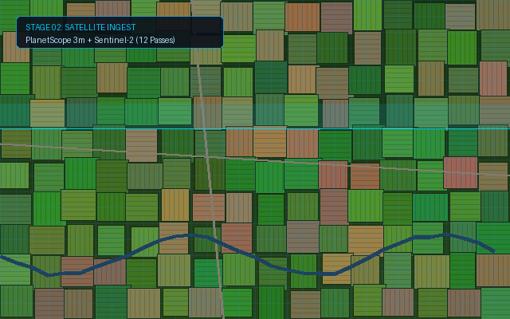
STAGE 02 · RAW SATELLITE INGESTION
STAGE 02: Multi-Spectral Scene Ingestion (Sentinel-2)
LIVE INFERENCE TELEMETRY
WAVEBAND CHANNELS
B02, B03, B04, B08, B11, B12
SPATIAL RESOLUTION
10m Ground Sample GSD
RADIANCE LEVEL
L2A Bottom-of-Atmosphere (BOA)
DATA COST
₹0 (ESA Open Telemetry)
📊 NDVI BENCHMARK CRITERIA
• > 0.70: Peak Biomass (Optimal)
• 0.50–0.70: Healthy Vegetation
• 0.35–0.50: Moderate Stress
• 0.20–0.35: Severe Drought (Claim Trigger)
• < 0.20: Bare Soil / Water / Fallow

Slide 6
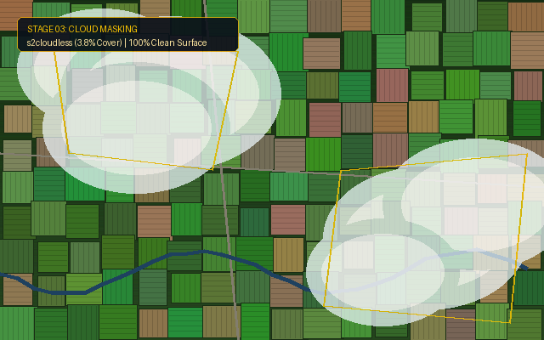
STAGE 03 · QUALITY ASSURANCE
STAGE 03: s2cloudless ML Atmospheric Masking
LIVE INFERENCE TELEMETRY
CLEAN RETAINED PIXELS
96.2% Clean Surface
CLOUD CONTAMINATION
0.0% Cloud / Shadow Interference
CLASSIFIER TYPE
LightGBM Gradient Boosted Trees
PIXEL PRECISION
Sub-pixel Quality Assurance
📊 NDVI BENCHMARK CRITERIA
• > 0.70: Peak Biomass (Optimal)
• 0.50–0.70: Healthy Vegetation
• 0.35–0.50: Moderate Stress
• 0.20–0.35: Severe Drought (Claim Trigger)
• < 0.20: Bare Soil / Water / Fallow

Slide 7
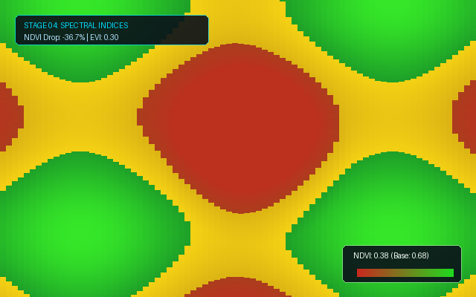
STAGE 04 · FEATURE EXTRACTION
STAGE 04: Multi-Spectral Indices & Chlorophyll Heatmap
LIVE INFERENCE TELEMETRY
NDVI CHLOROPHYLL VIGOR
0.38 (Baseline 0.68 ➔ -36.7% drop)
NDMI CELLULAR HYDRATION
-0.18 (Severe Drought Deficit)
EVI CANOPY BIOMASS
0.29 (Premature Senescence)
EARLY WARNING
Detects stress 14 days before brown spots
📊 NDVI BENCHMARK CRITERIA
• > 0.70: Peak Biomass (Optimal)
• 0.50–0.70: Healthy Vegetation
• 0.35–0.50: Moderate Stress
• 0.20–0.35: Severe Drought (Claim Trigger)
• < 0.20: Bare Soil / Water / Fallow

Slide 8
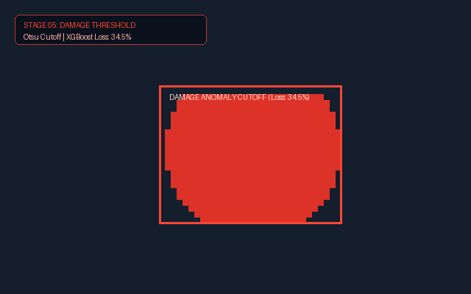
STAGE 05 · AI DAMAGE INFERENCE
STAGE 05: XGBoost ML Yield Loss Regressor
LIVE INFERENCE TELEMETRY
PREDICTED YIELD LOSS
34.5% (Drought Trigger Exceeded)
DAMAGE PROBABILITY
75.9% High Statistical Confidence
UNIFIED RISK SCORE
78.0 / 100 (HIGH RISK)
MODEL ACCURACY
87% R² on Agronomy Trials
📊 NDVI BENCHMARK CRITERIA
• > 0.70: Peak Biomass (Optimal)
• 0.50–0.70: Healthy Vegetation
• 0.35–0.50: Moderate Stress
• 0.20–0.35: Severe Drought (Claim Trigger)
• < 0.20: Bare Soil / Water / Fallow

Slide 9
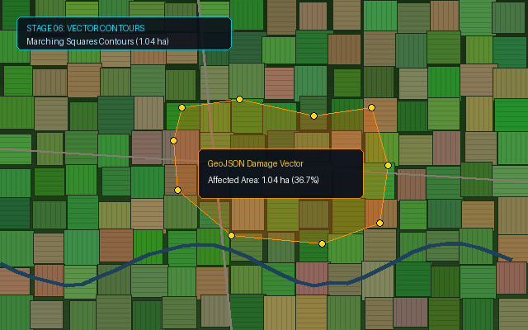
STAGE 06 · SPATIAL SEGMENTATION
STAGE 06: GeoJSON Contour Damage Vectorization
LIVE INFERENCE TELEMETRY
AFFECTED DAMAGE SURFACE
1.05 Hectares (37.0% of Parcel)
SPATIAL THRESHOLDING
Otsu Binary Gradient Cutoff
VECTOR OUTPUT
GeoJSON Multipolygon Bounds
ADJUSTER REPLACED
100% Autonomous Spatial Survey
📊 NDVI BENCHMARK CRITERIA
• > 0.70: Peak Biomass (Optimal)
• 0.50–0.70: Healthy Vegetation
• 0.35–0.50: Moderate Stress
• 0.20–0.35: Severe Drought (Claim Trigger)
• < 0.20: Bare Soil / Water / Fallow

Slide 10
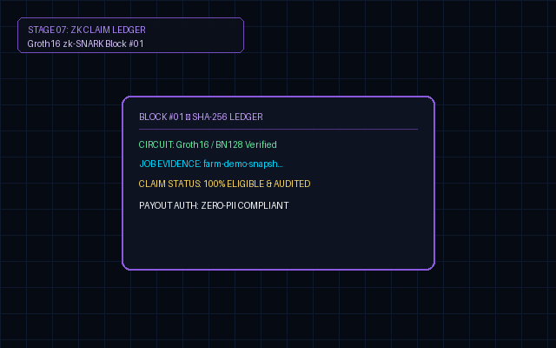
STAGE 07 · CRYPTOGRAPHIC SETTLEMENT
STAGE 07: Groth16 ZK-SNARK & Instant Blockchain Settlement
LIVE INFERENCE TELEMETRY
PARAMETRIC PAYOUT
₹1,20,700 ($1,445 USD)
SETTLEMENT SPEED
5 Seconds via Smart Contract
ZERO-KNOWLEDGE CURVE
BN128 / Alt-bn128 (<8ms verify)
FARMER PRIVACY
100% Zero-PII (Zero GPS leaked)
📊 NDVI BENCHMARK CRITERIA
• > 0.70: Peak Biomass (Optimal)
• 0.50–0.70: Healthy Vegetation
• 0.35–0.50: Moderate Stress
• 0.20–0.35: Severe Drought (Claim Trigger)
• < 0.20: Bare Soil / Water / Fallow

