Slide 1
Final Year Project 2011-2012
StackOverflow Analysis and Summarization System for Python Language
By Yuxiang JIANG
Advised by Fangzhen LIN

Slide 2
Presentation Layout
Introduction
Topic Selection and Design
Implementation
  Knowledge Graph Building
  Document Fetching
  Subgraph Generation and Scoring
Demonstration
Q&A

Slide 3
Introduction
Community question-answering (CQA) websites are great knowledge sources for people.
  High quality questions and answers are contributed from people coming from all over the world.
  Number of the posts (questions and answers) grows rapidly.
However, the amount of the posts has caused a problem.
  Hard to find the answer that you really need.
  Need a summarization method.

Slide 4
Without summarization...

Slide 5
Topic Selection
We choose to focus on Python-related posts in StackOverflow.
  Good popularity
  StackOverflow provides a set of public API for querying its posts
  Comprehensive analyzing tools for Python language

Slide 6
Design
StackOverflow
posts
Commonly used
Python libraries
Knowledge
graph
Code
segments
and
keywords
Knowledge
graph builder
Document
fetcher and
preprocessor

Slide 7
Design
Subgraph
builder
Code
segments
and
keywords
Subgraph
Knowledge
graph
Scorer

Slide 8
Knowledge Graph
The graph itself contains dependency information about commonly used Python libraries. This is vital for latter processes like subgraph generation and scoring.
  Each python library treated as a node in the graph.
  Dependencies are represented by directed edges.

Slide 9
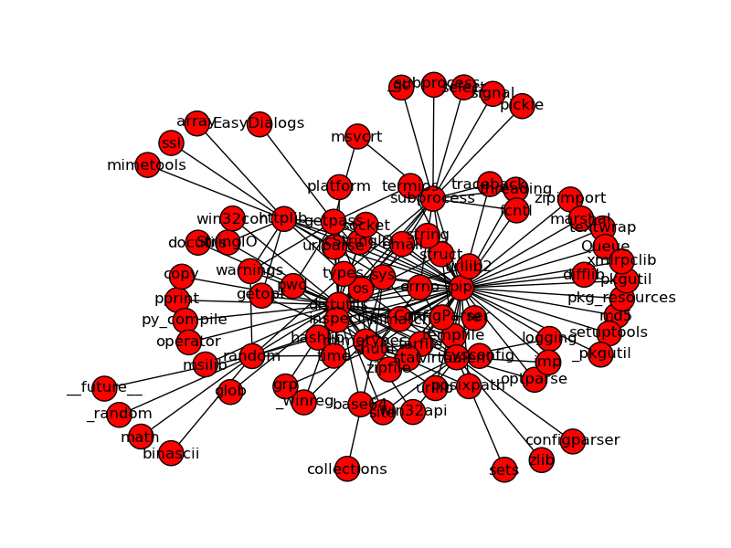
Sample graph with node limit = 100

Slide 10
Knowledge Graph Building
Using classical breadth-first search
  Each Python source file is parsed into an AST.
  Any ImportNode in the AST will be counted as a library dependency.
  Download new libraries when needed.
  A node limit is set to prevent the graph from being too large.

Slide 11
Document Fetching
StackOverflow posts are fetched from the StackOverflow website.
  StackOverflow provides a SQL API for querying its posts.
  The result is in a tree-like JSON format.

Slide 12
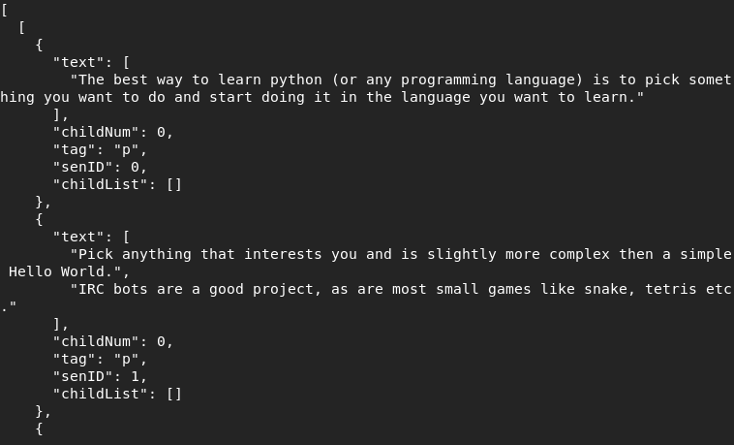
Example Post Data

Slide 13
Document Preprocessing
Raw JSON post is preprocessed before being sent to the subgraph generator.
  Sentences tagged as 'code' in the JSON data are extracted since only those code segments will be needed to build subgraphs.
  Keywords in the question are extracted by simply removing the stopwords.

Slide 14
Subgraph Generation
Subgraphs are built by similar breath-first search method as knowledge graph generation does.
  Dependency libraries that are not in the knowledge graph will be ignored.
  There is no node limit.
Each code segment will be used to generate a subgraph.
The keyword list from the question will also be used to generate a subgraph.

Slide 15
Scoring
Scoring is done by calculating the graph similarity degree between the code segment generated subgraphs and the question keyword generated subgraph.
  The similarity degree is calculated by weighted normalized average node distance and normalized node similarity.
  Code segments are then sorted by their score and the highest scoring segments are considered as the summarization.

Slide 16
Demonstration

Slide 17
Q&A

Slide 18
Thank you

