Slide 1
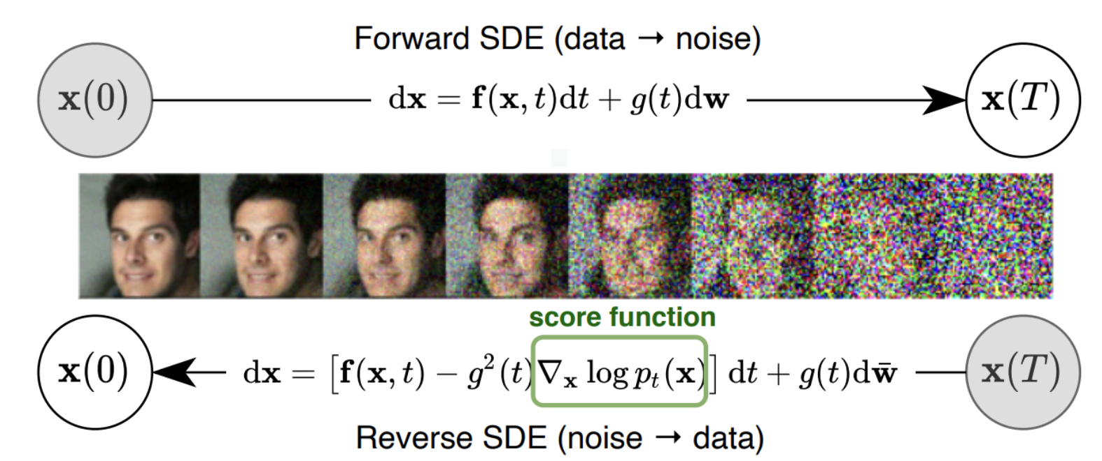
Mimic the Diffusion

Slide 2
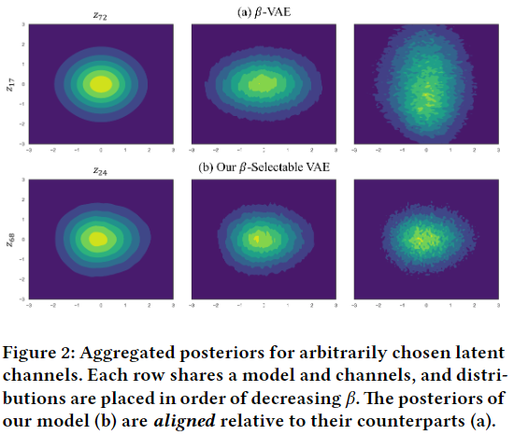
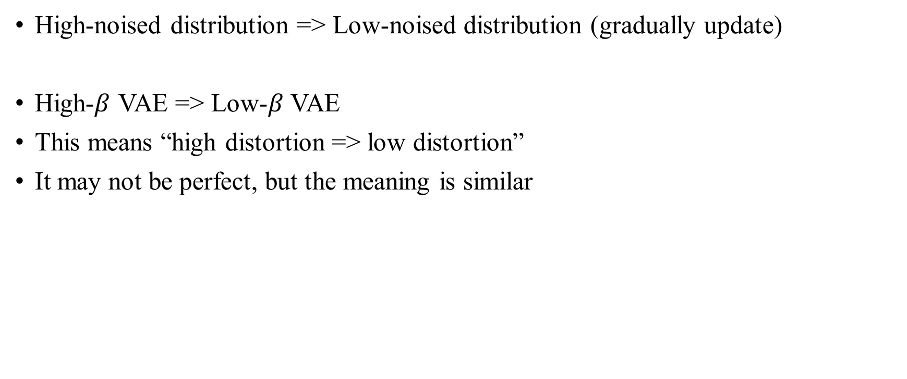
Feature 1.
High-noised distribution => Low-noised distribution (gradually update)
High-$β$ VAE => Low-$β$ VAE
This means “high distortion => low distortion”
It may not be perfect, but the meaning is similar

Slide 3
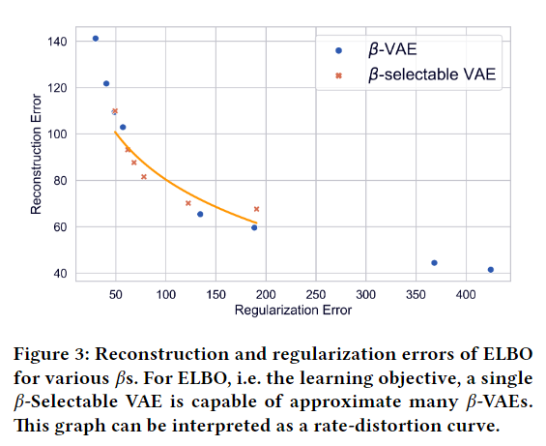

Feature 2.
Iterative refinement with “very small step”
$β$-Selectable VAE has the power to perform it
It can represent continuous $β$ intervals,
With the same model capacity

Slide 4
Mimic the Diffusion
Randomness!
Model’s target
Not random

Slide 5
Feature 3.
“Randomness”
Recursively re-input to VAE
I think the latent variables on the posteriors with very close beta values,
Would maintain its meaning on the other side well
There will be a small loss of information, i.e. acceptable randomness
This is a logical leap though

Slide 6
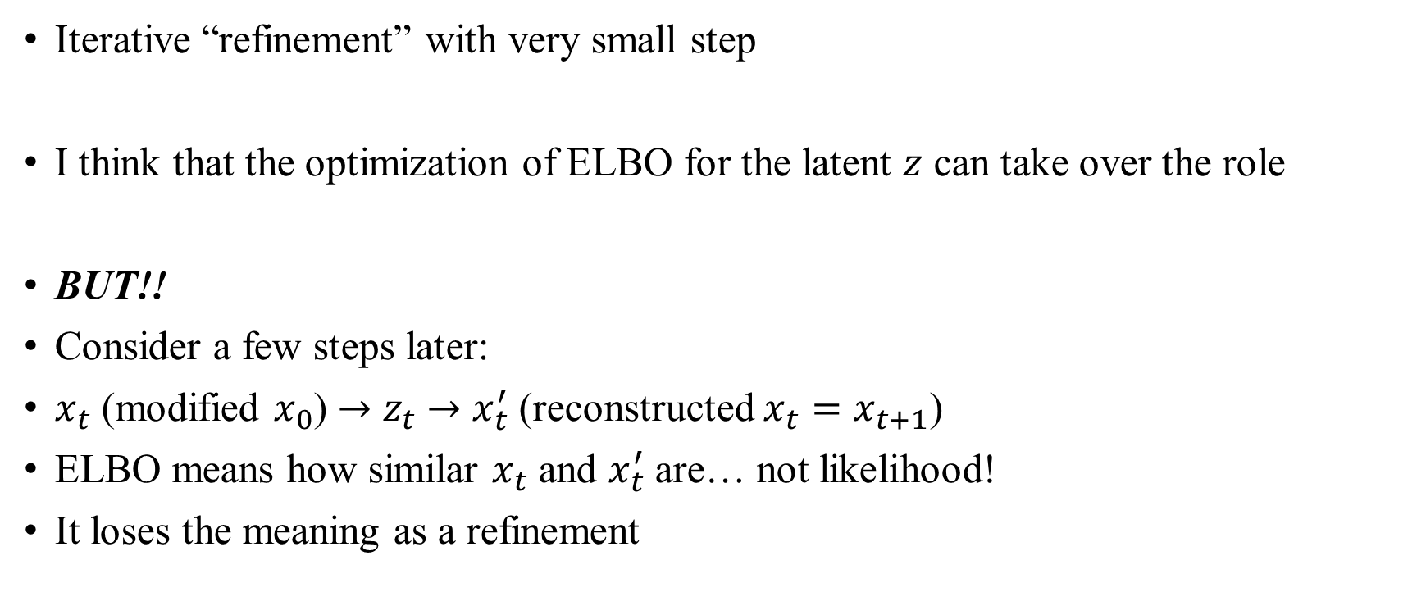
Feature 4.
Iterative “refinement” with very small step
I think that the optimization of ELBO for the latent $z$ can take over the role
BUT!!
Consider a few steps later:
$x_{t}$ (modified $x_{0}$) $→$ $z_{t}$ $→$ $x_{t}^{′}$ (reconstructed $x_{t}=x_{t+1}$)
ELBO means how similar $x_{t}$ and $x_{t}^{′}$ are… not likelihood!
It loses the meaning as a refinement

Slide 7
Reflection
This is a huge problem that is easy to spot
I accepted it as the right method
Because some experimental results came out good (e.g. MNIST)
Of course, one need to experiment with various variables, but
There is a complacent attitude because that were good in one or two…

Slide 8
Features (all)
Iterative “refinement” with “very small step”
With “gradually noised distribution” and “Randomness”
If there is a good way to refine a sample, it could be done again

