Slide 1
VisionZip: Longer is Better but Not Necessary in Vision Language Models
Presenter: Kim Seung Hwan (seunghwan.kim@snu.ac.kr)

Slide 2
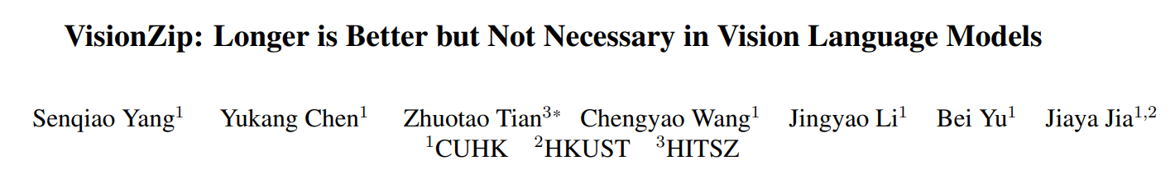
CVPR 2025, citation 250

Slide 3
Problem
Recent VLMs rely on extremely long visual tokens
e.g. LLaVA-1.5 (576 tokens), LLaVA-NeXT (672*672 image to 2880 tokens)
Even combining system prompts and queries in VQA, there are only a few dozen tokens
Computation complexity of transformer is bound by token dimension and sequence length:

Slide 4
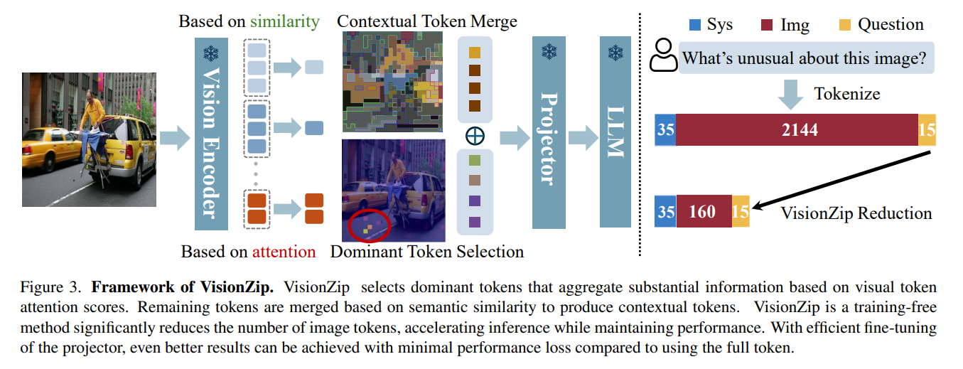

Slide 5
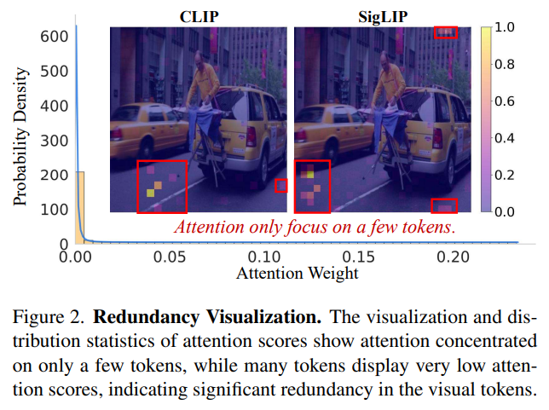
Redundancy Observation
Redundancy is observed in CLIP and SigLIP, which are commonly used vision encoders
If we look at the -2 layer primarily used by VLM,
Attention is entirely taken by a very small number of tokens

Slide 6
VisionZip
The method consists of (1) dominant token selection and (2) contextual token merging
First, select the important tokens as they are, and merge the rest
Additional fine-tuning may be performed

Slide 7
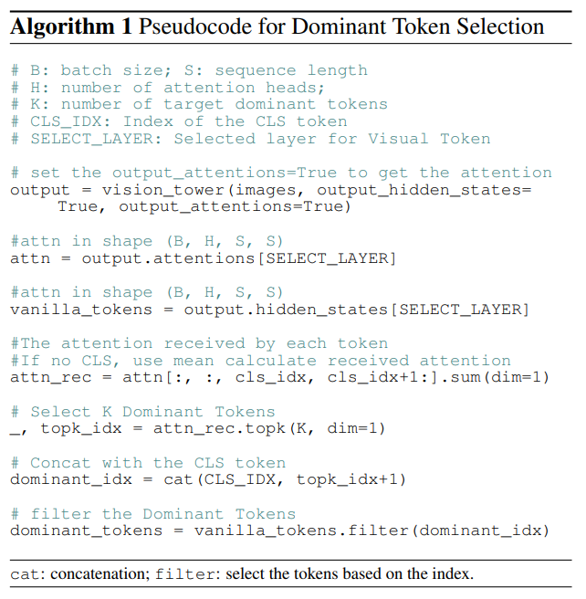
Dominant Token Selection
In the -2 layer, weights are calculated using the attention for CLS token (or the average of all attention if CLS is not present)
Choose Top-K there

Slide 8
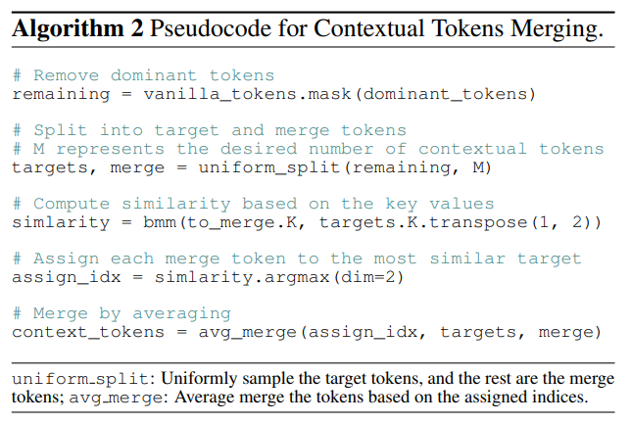
Contextual Token Merging
For the remaining unchosen tokens,
Select a target (representative) from the uniform sample,
And absorb the rest into a target with a similar key

Slide 9
Efficient Tuning
Since everything has been training-free until now, there may be significant distribution shifts for VLMs designed to use thousands of tokens
This can be resolved simply by training multimodal projector briefly using only 10% of the LLaVA-1.5 dataset
They strongly emphasized that this can be completed in 30 minutes with 8 A800s,
And can also be trained with 3090s

Slide 10
Experimental Results
In LLaVA-1.5, 576 => 192 tokens 98.5% performance
576 => 64 tokens 94.0% and 95.2% with tuning
In LLaVA-NeXT, 2880 => 640 tokens 97.6% and 98.9% with tuning
2880 => 160 tokens 92.0% and 95.2% with tuning
In Video-LLaVA, 2048 => 136 tokens 93.2%
Inference time 3.0x, prefilling latency 7.8x
LLaVA-NeXT 13B with VisionZip is better and faster than LLaVA-NeXT 7B

Slide 11
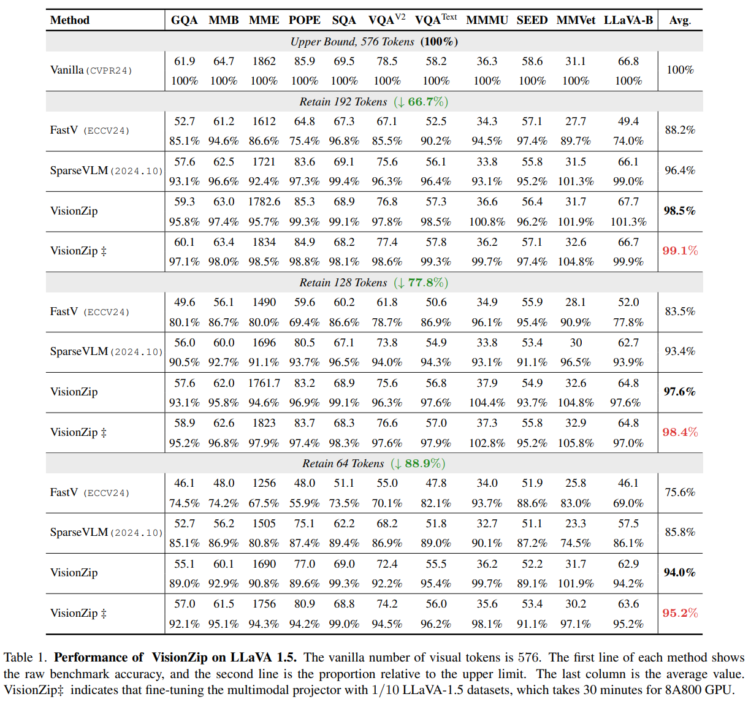
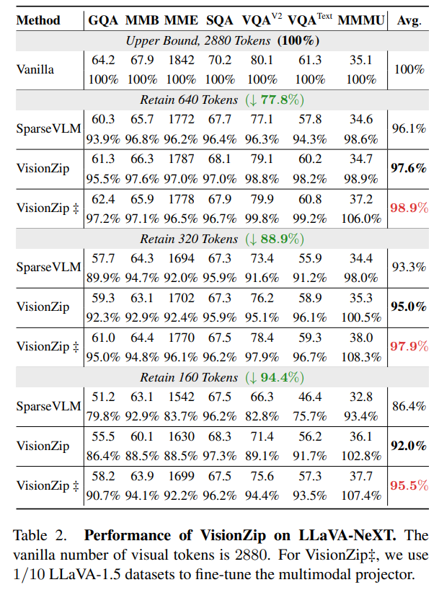
Experimental Results

Slide 12
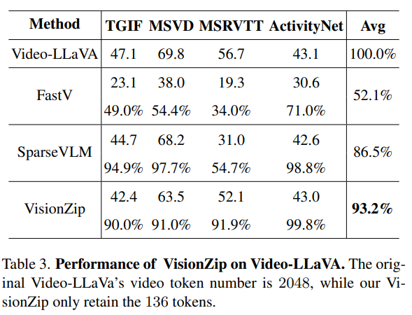
Experimental Results

Slide 13
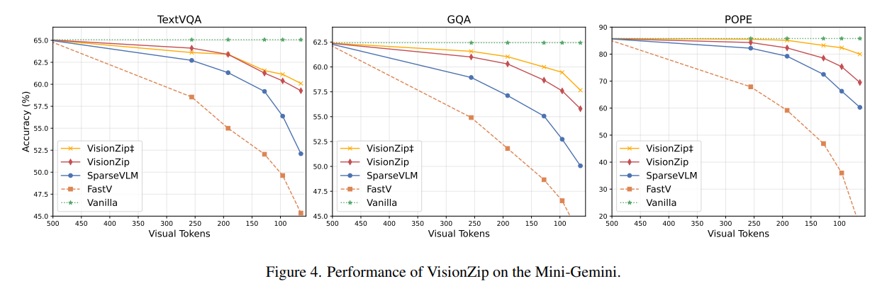
Experimental Results

Slide 14
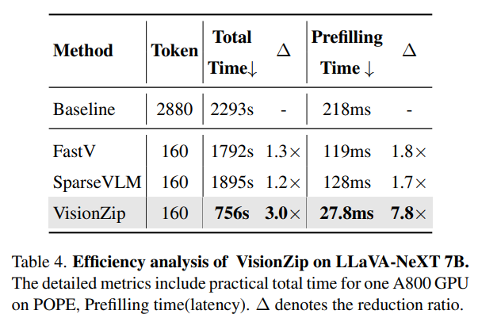
Experimental Results

Slide 15
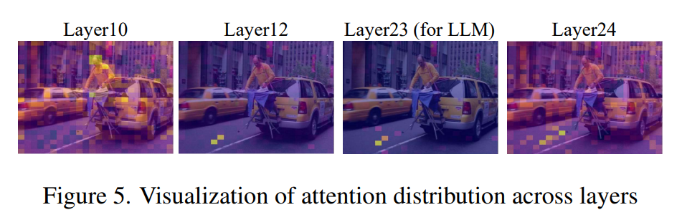
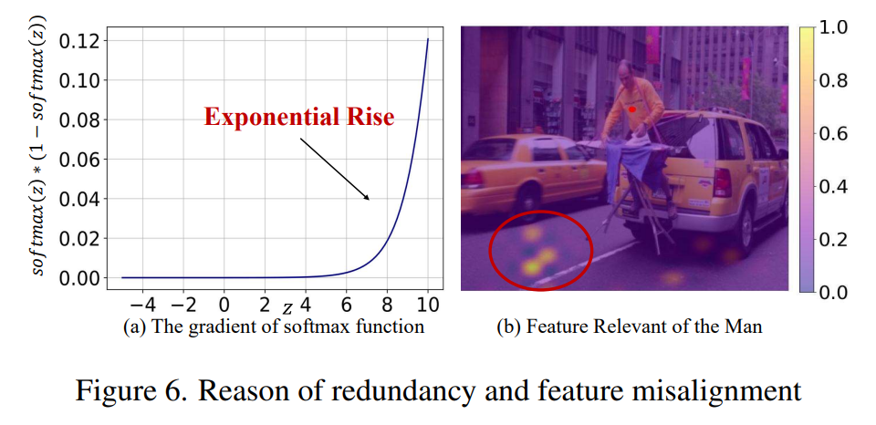
Analysis - Redundancy
-2 layer has unbiased information (and this is why VLM often uses -2)
Deep transformers tend to shortcut by concentrating inform into a few
Softmax also induces selection action
Many related prior studies

Slide 16
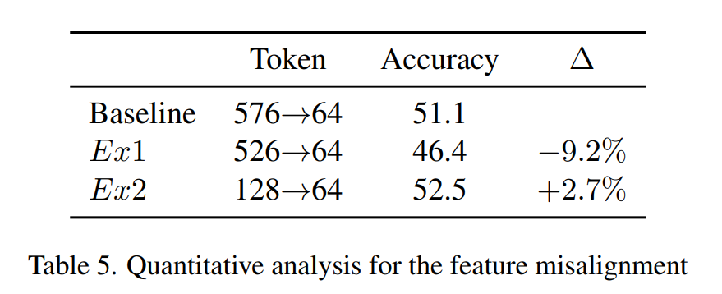
Analysis - Outperform
Why does this simple vision-only token diet works?
Previous studies leave behind tokens associated with the text (query)
However, as revealed, tokens where information is concentrated are more important,
and the remaining tokens are not devoid of information; they merely contain a lot of redundant information

Slide 17
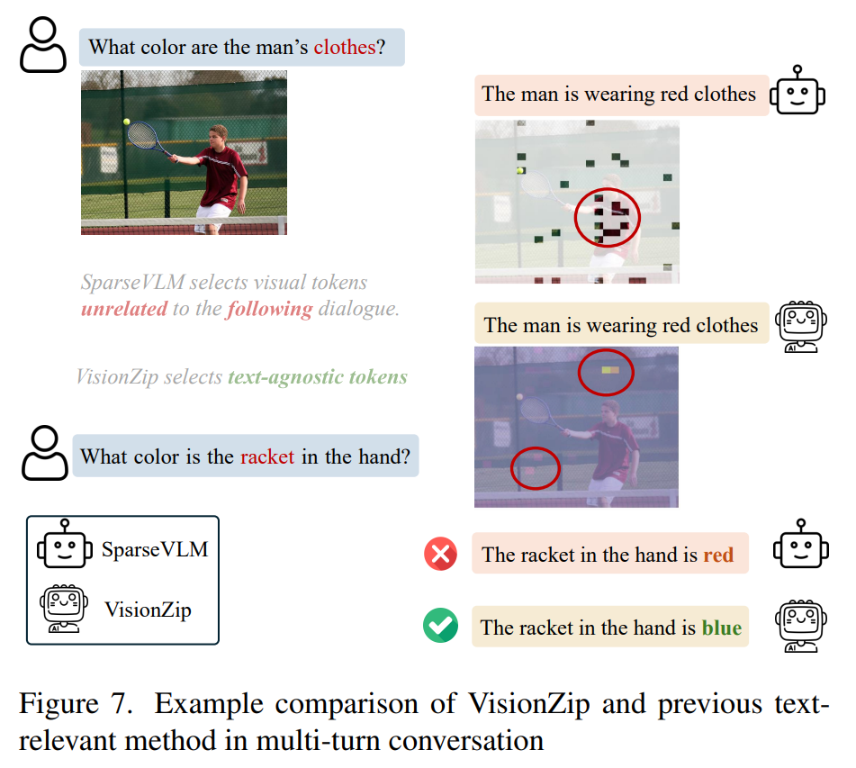
Analysis - Novelty
Easy to deploy (plug-and-play, etc.)
Fast and memory-efficient
Multi-turn conversation

Slide 18
Thank you for listening
Presenter: Kim Seung Hwan (seunghwan.kim@snu.ac.kr)

