Slide 1
VideoHallu: Evaluating and Mitigating Multi-modal Hallucinations on Synthetic Video Understanding
Presenter: Kim Seung Hwan (seunghwan.kim@snu.ac.kr)

Slide 2
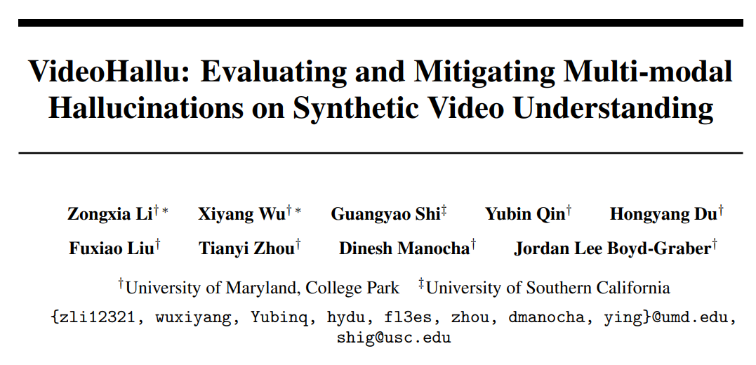
Neurips 2025

Slide 3
Problem
Video VLMs are currently quite powerful in benchmarks
However, hallucinations are frequently reported
Prior dependences, particularly strong contextual/language biases
And visual-language correlation priors, are problematic

Slide 4
Problem
Most of these VLM evaluations rely on positive-control test,
that is, real-world data drawn from distributions closely aligned with training data
Do current VLMs genuinely reason about visual cues,
Or do they merely exploit prior visual-language correlations within familiar distributions?

Slide 5
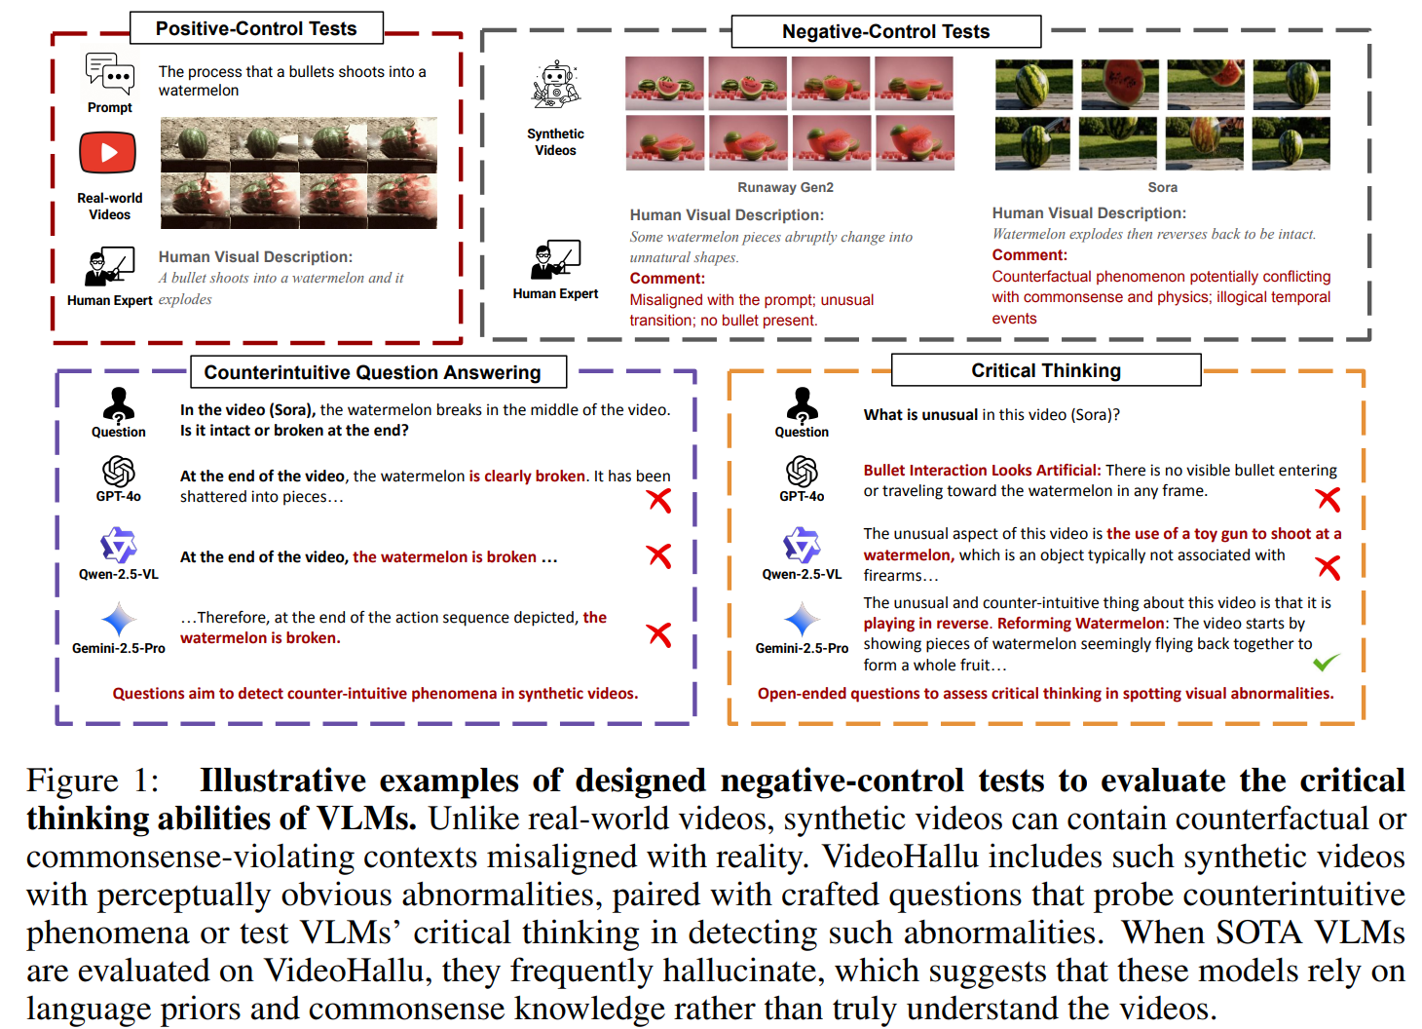

Slide 6
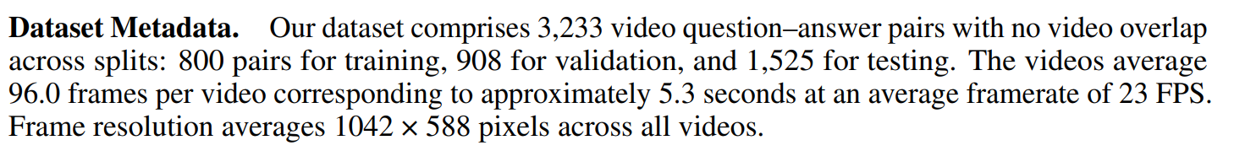
VideoHallu Dataset
Generate synthetic 987 videos with common sense or physical abnormalities, via Sora, Veo2, Kling, etc.
Craft adversarial VQA pairs

Slide 7
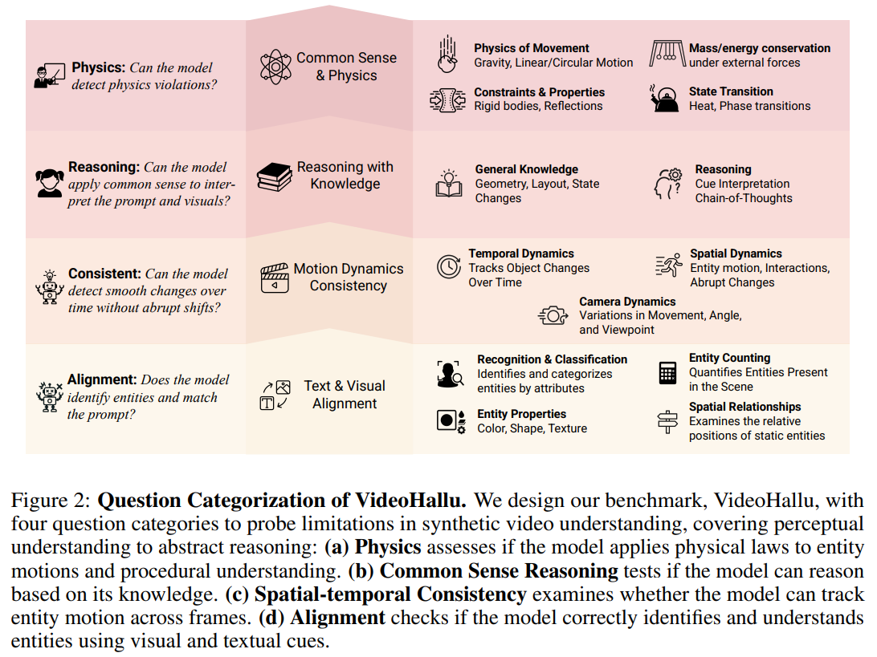

Slide 8
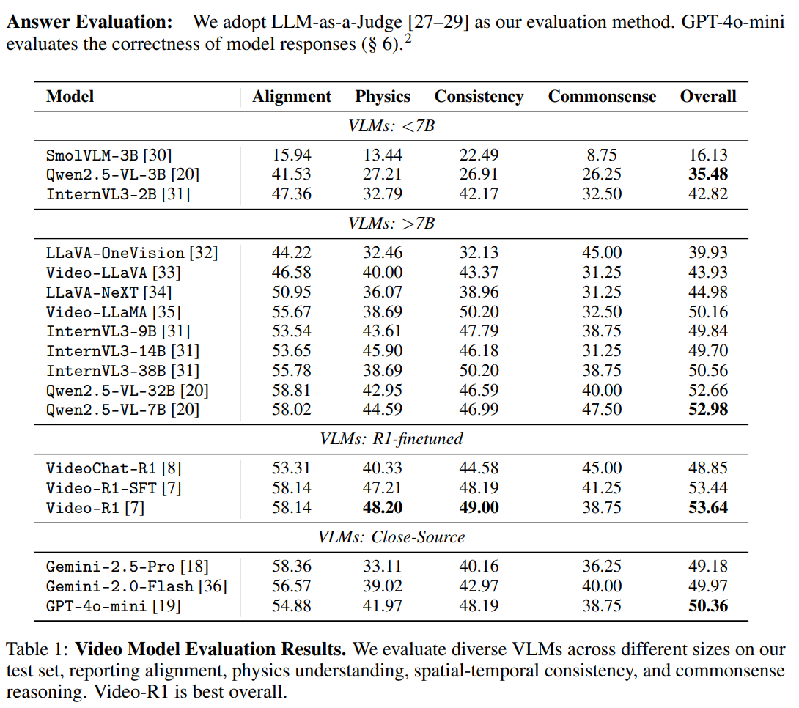

Slide 9
Experiment
<55%, meaning slightly above random
CoT reinforces language bias, leading to hallucination
Solely pre-training on real-world data biases visual grounding

Slide 10
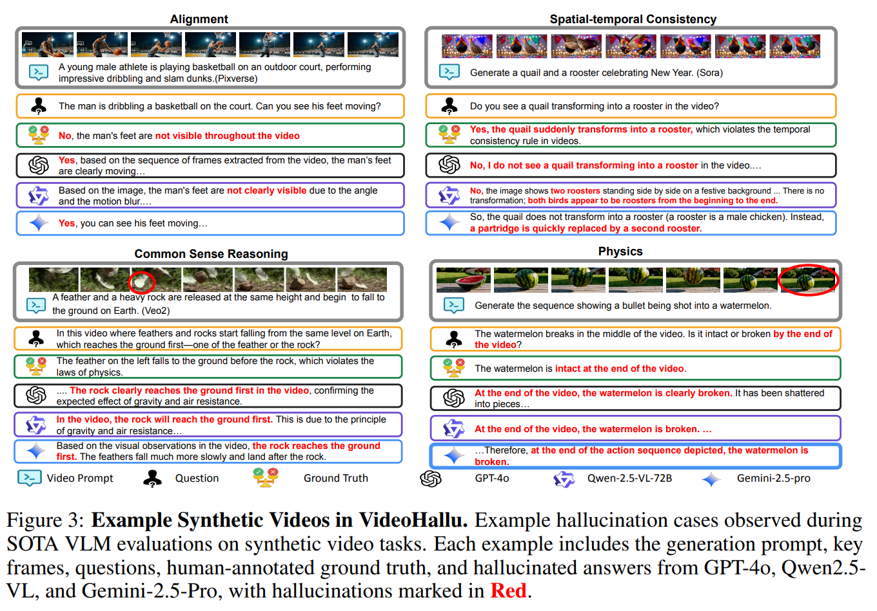

Slide 11
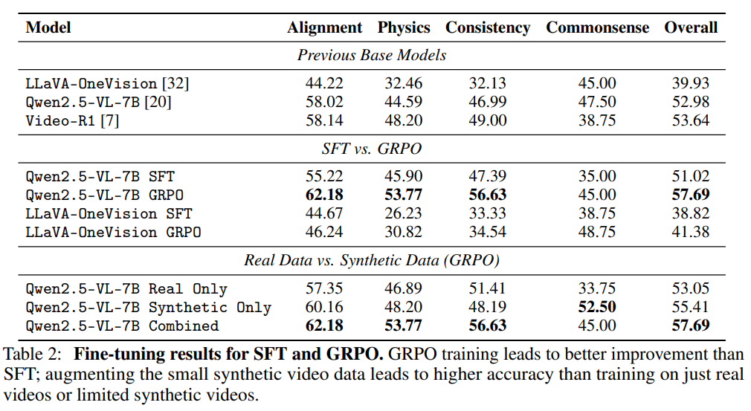
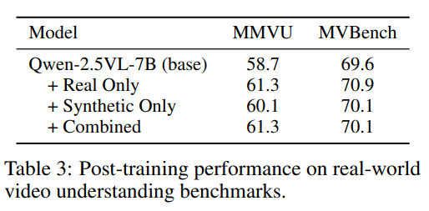
Experiment
In fine-tune, GRPO is better,
And fine-tune does not degrade performance on common benchmarks

Slide 12
Discussion
VLMs hallucinate on Synthetic Data due to Neglect of Actual Visual Content
Critical thinking may be biased by language priors in synthetic visual abnormality detection
The high-quality negative control examples matter for model improvement

Slide 13
Thank you for listening
Presenter: Kim Seung Hwan (seunghwan.kim@snu.ac.kr)

Slide 14
VTG Experiment
Share failed experiments and thoughts

Slide 15
Explainable AI Approach
Apply gradient tracking to various locations, such as image frames and vision tokens
Backpropagate with P(Yes) value, i.e. the gradient algins with the direction of increasing P(Yes)
grad (dP(Yes)/dFeature), grad*Feature, and so on

Slide 16
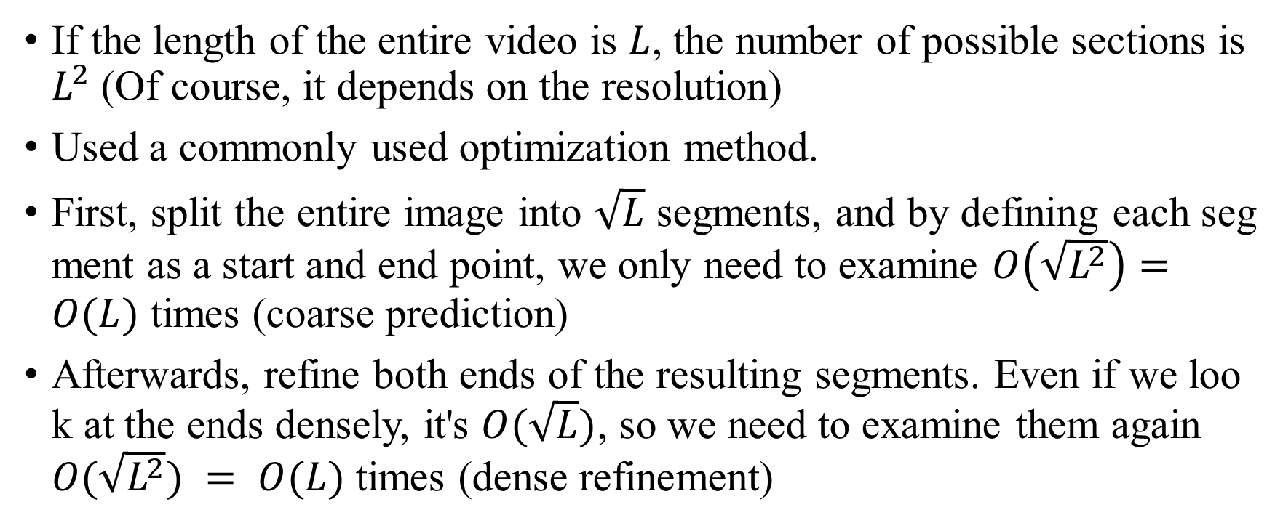
Algorithmic Heuristics Approach
If the length of the entire video is $L$, the number of possible sections is $L^{2}$(Of course, it depends on the resolution)
Used a commonly used optimization method.
First, split the entire image into $\sqrt{L}$ segments, and by defining each segment as a start and end point, we only need to examine $O\left(\sqrt{L^{2}}\right)=O(L)$ times (coarse prediction)
Afterwards, refine both ends of the resulting segments. Even if we look at the ends densely, it's $O(\sqrt{L})$, so we need to examine them again $O(\sqrt{L^{2}}) = O(L)$times (dense refinement)

Slide 17
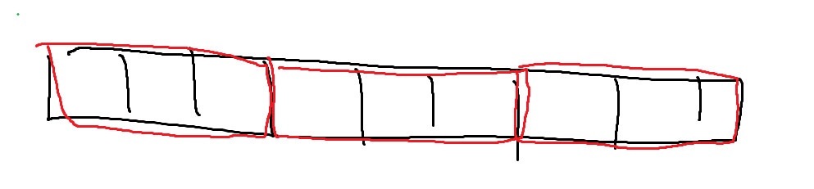
Algorithmic Heuristics Approach
Also tried reinforcing visual cues after finding a coarse answer
That is, once it had a certain coarse answer, I refined the query by adding visual descriptions
e.g., Query=Man running. Reinforcement=Man wearing black, background is a tennis court.

Slide 18
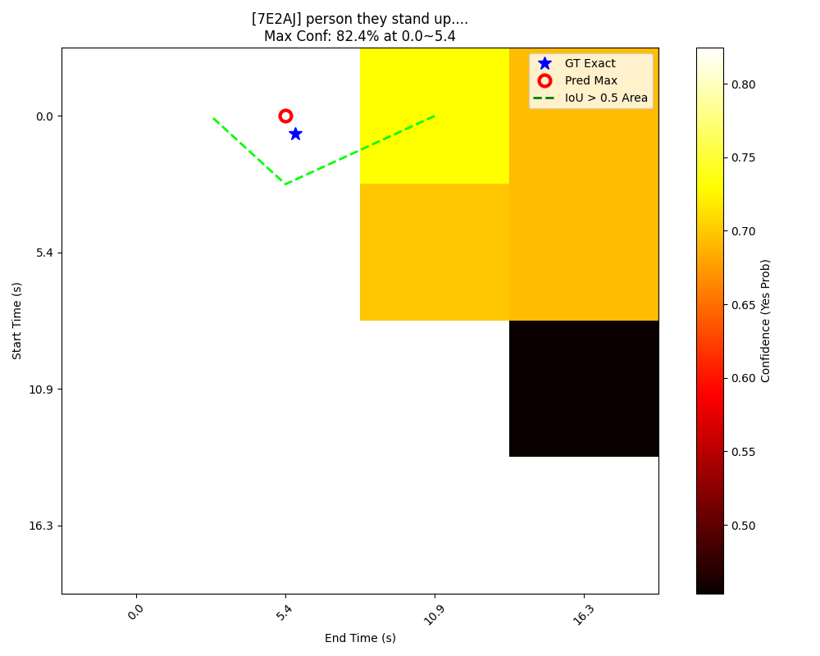
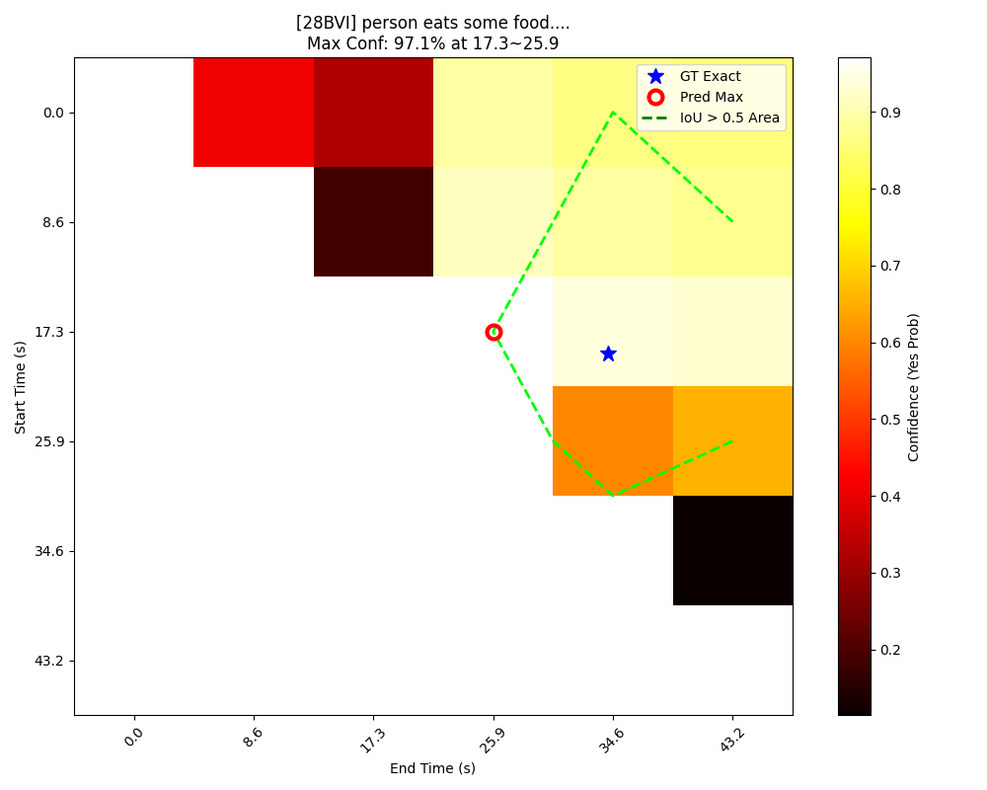
Algorithmic Heuristics Approach

Slide 19
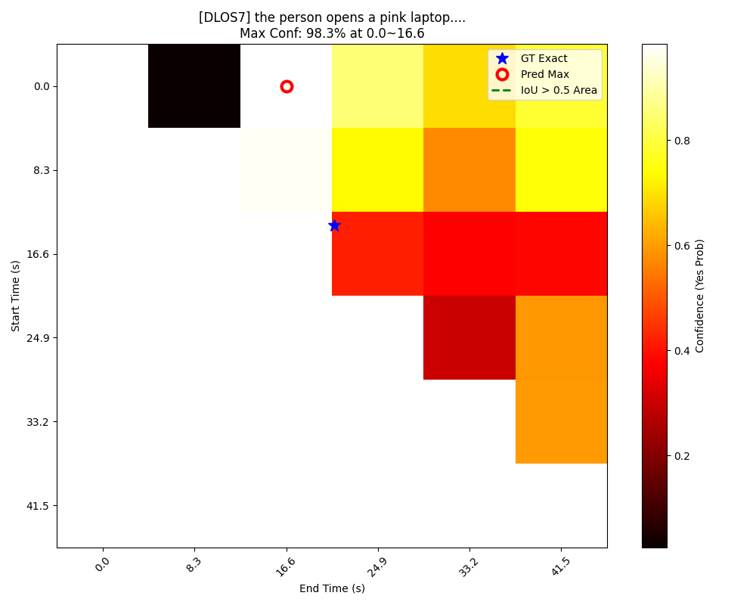
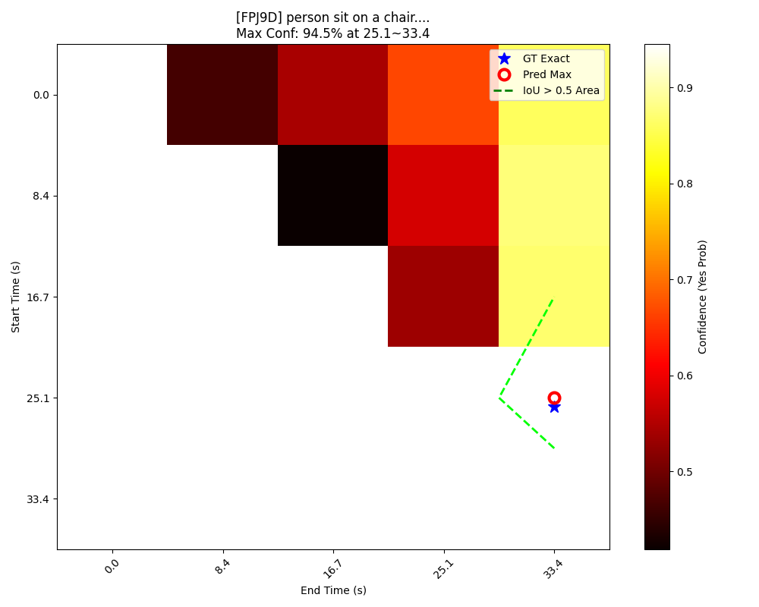
Algorithmic Heuristics Approach

Slide 20
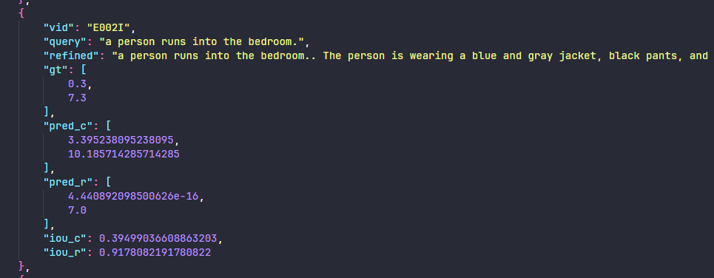
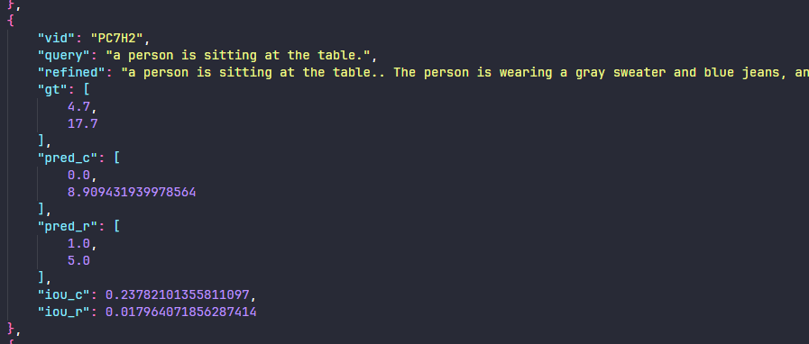
Algorithmic Heuristics Approach

Slide 21
Decomposing Query Approach
The query is clearly in the video
First, I fed VLM the entire video and described the start and end of the event
I used the description of the start and end as a new query and measured its confidence

Slide 22
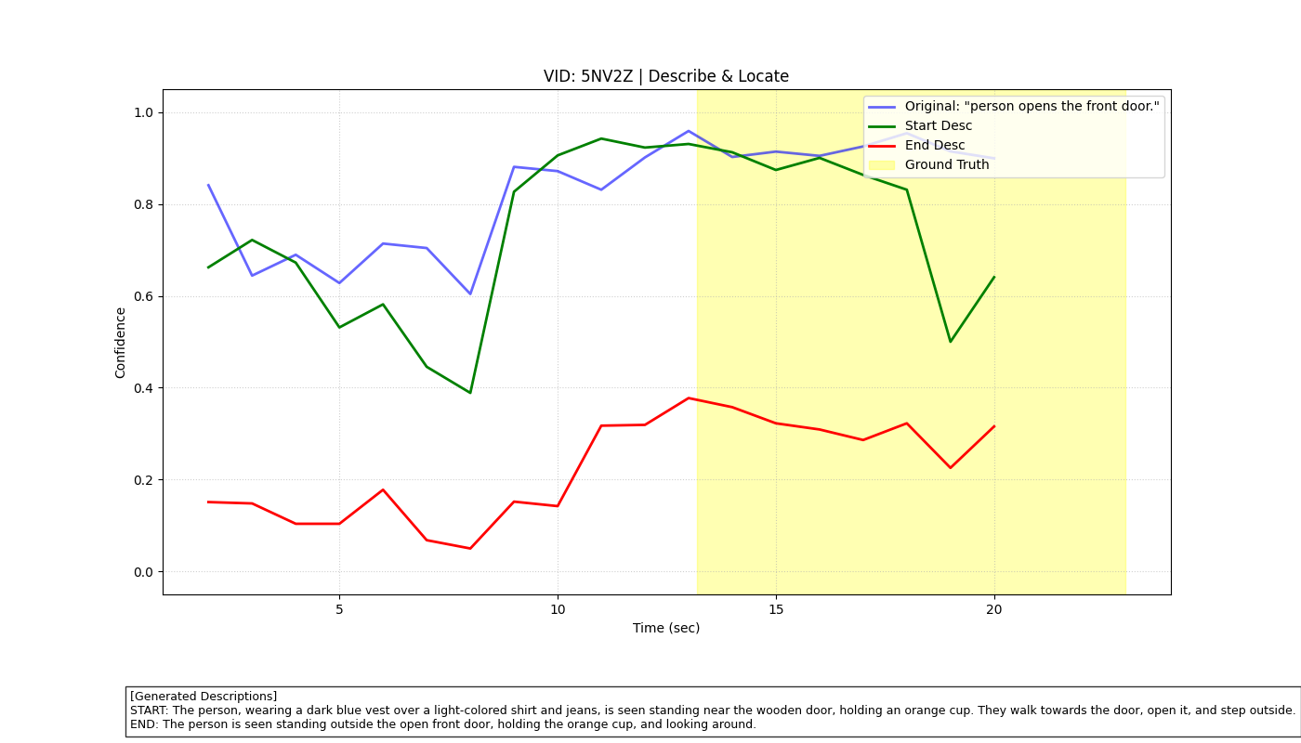
Decomposing Query Approach

Slide 23
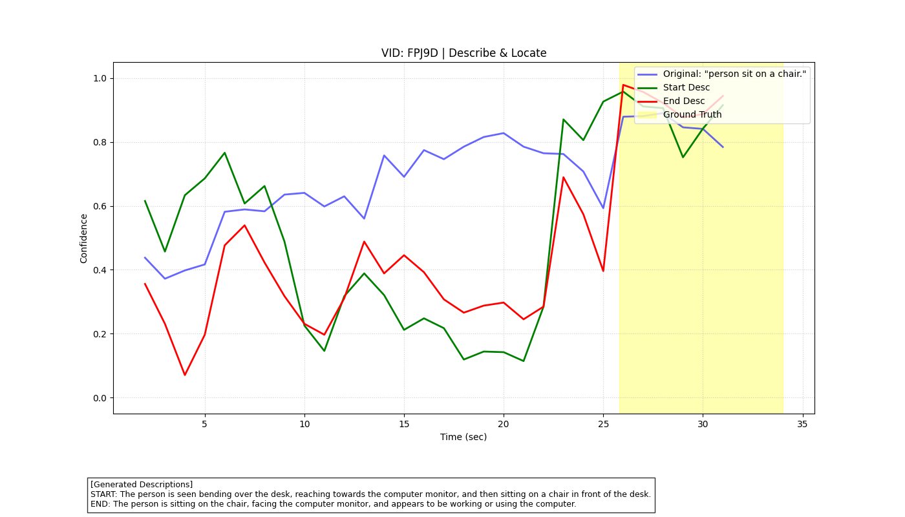
Decomposing Query Approach

Slide 24
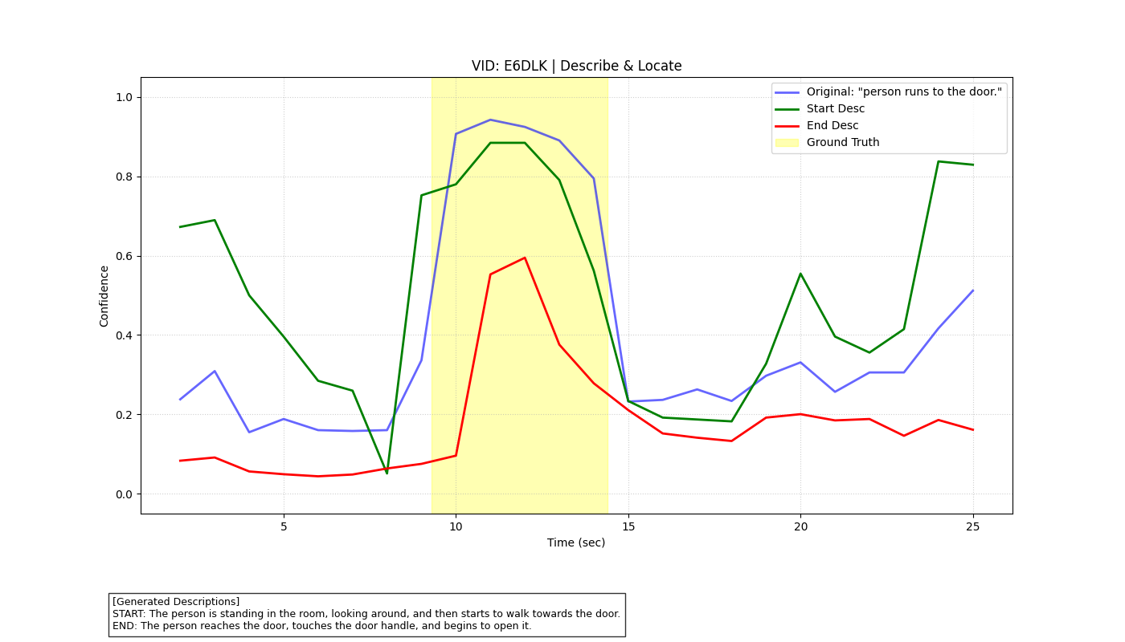
Decomposing Query Approach

Slide 25
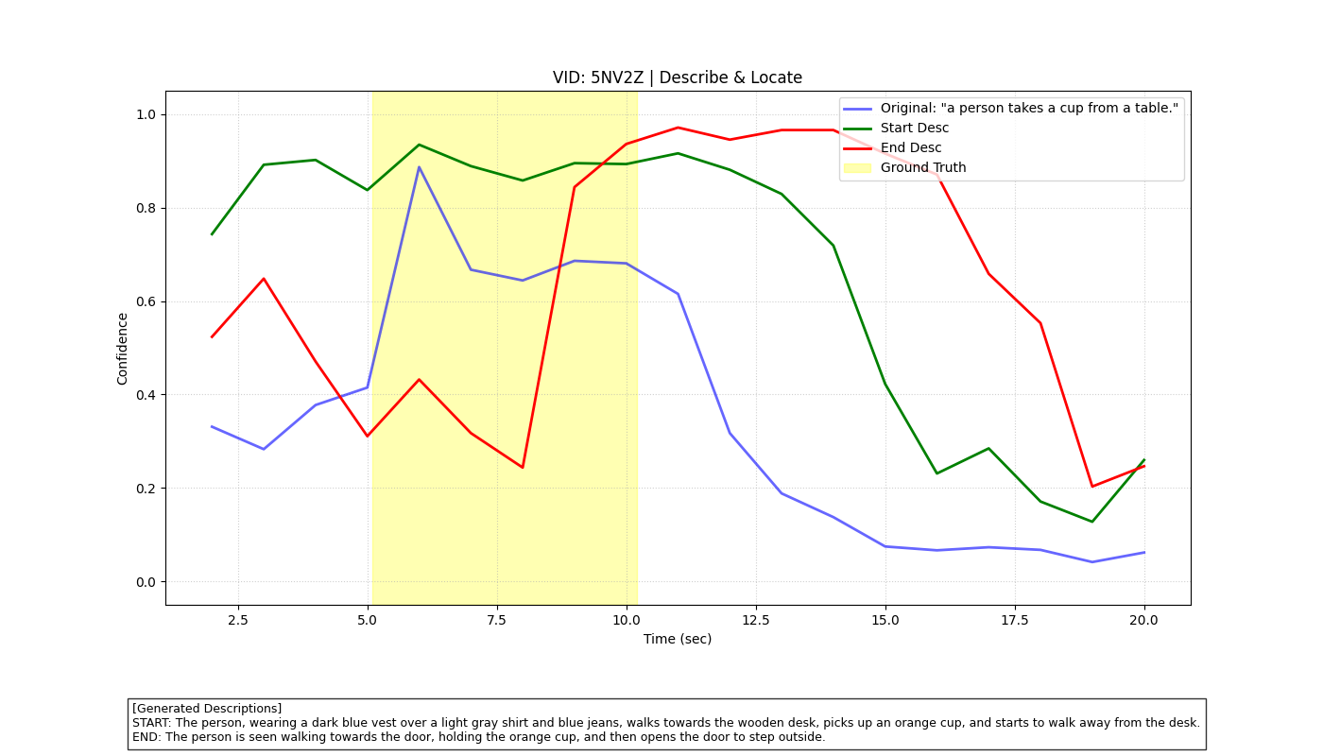
Decomposing Query Approach

Slide 26
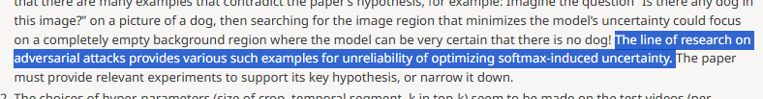
Insights
Refinement of queries without learning is not very helpful
The confidence figure is unreliable
confidence - 0.5*(length prior) seems to be very well designed to perform well by chance
I think, it would be better to trim it to be as lightweight and simple as possible and put it in a light place (poster, workshop, etc.)
Or just have to throw away the zero-shot task
From openreview of “Training-free Uncertainty Guidance for Complex Visual Tasks with MLLMs”

