Slide 1
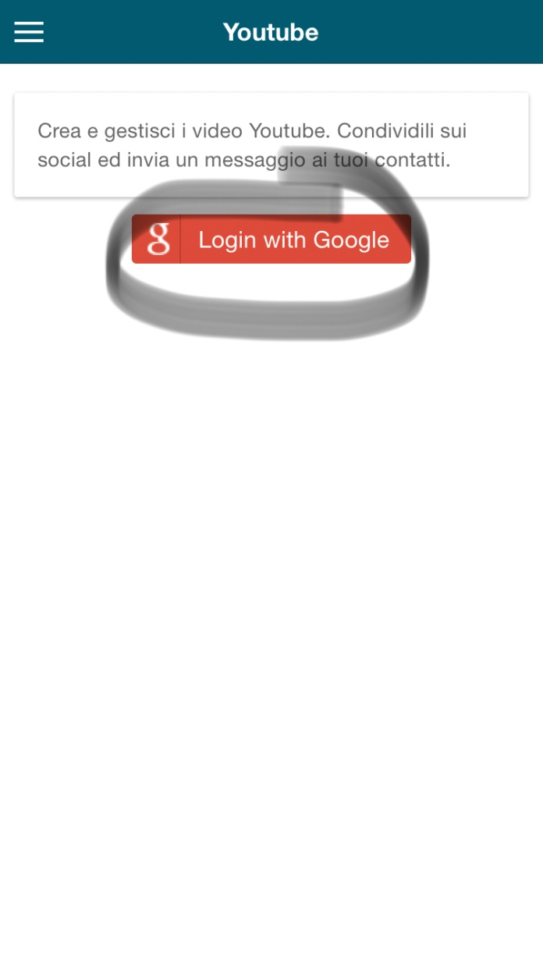
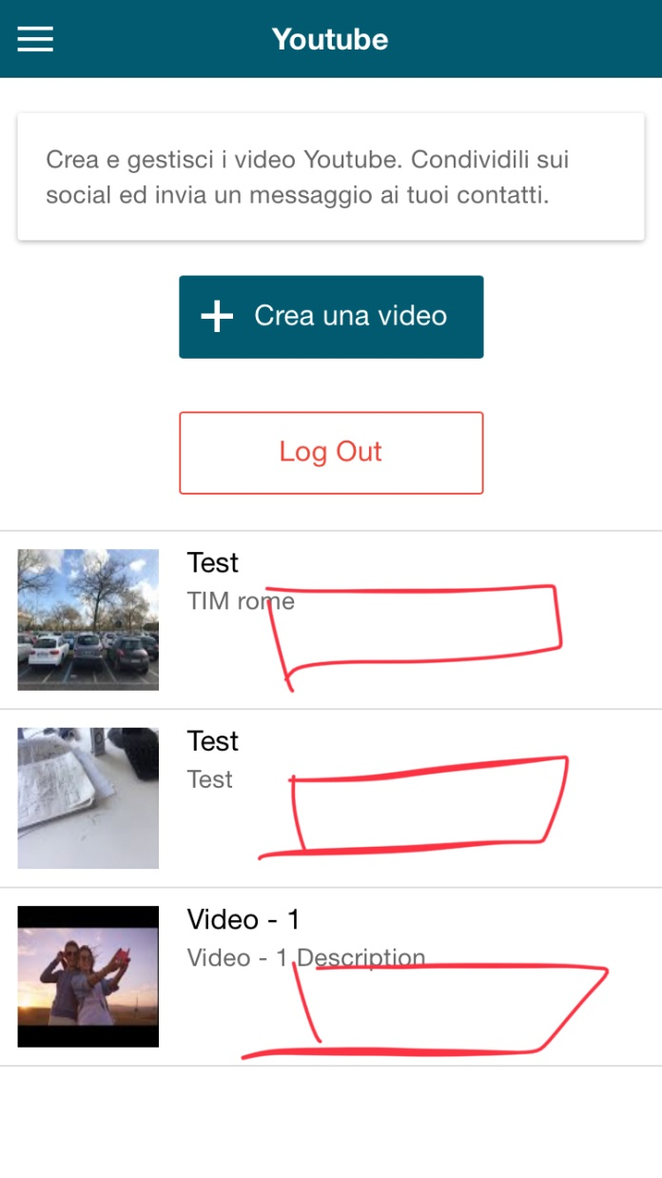
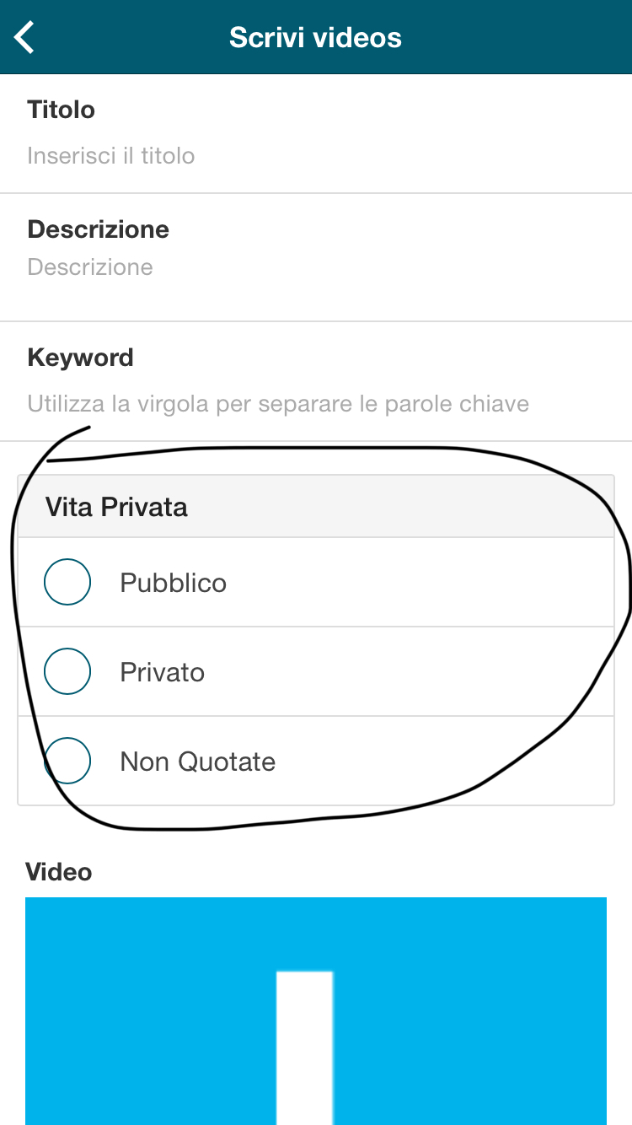
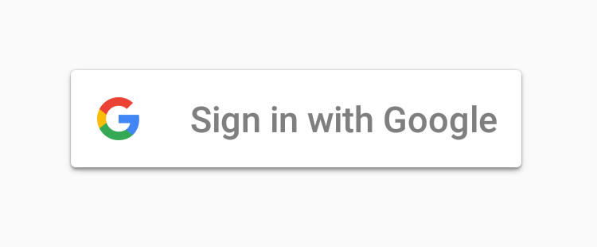

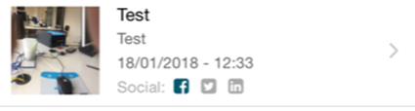
Crea un video
un
Privacy
Pubblica
Delete section
Pubblica
Use new google logo!
Writing in Italian!
Pubblica
Privacy settings:
Videos must always be uploaded with PUBLIC privacy! Remove section and impose this in app code.
Data pubblicazione: (publication date)
Ora pubblicazione: (publication time)
Social: add youtube icon

Slide 2
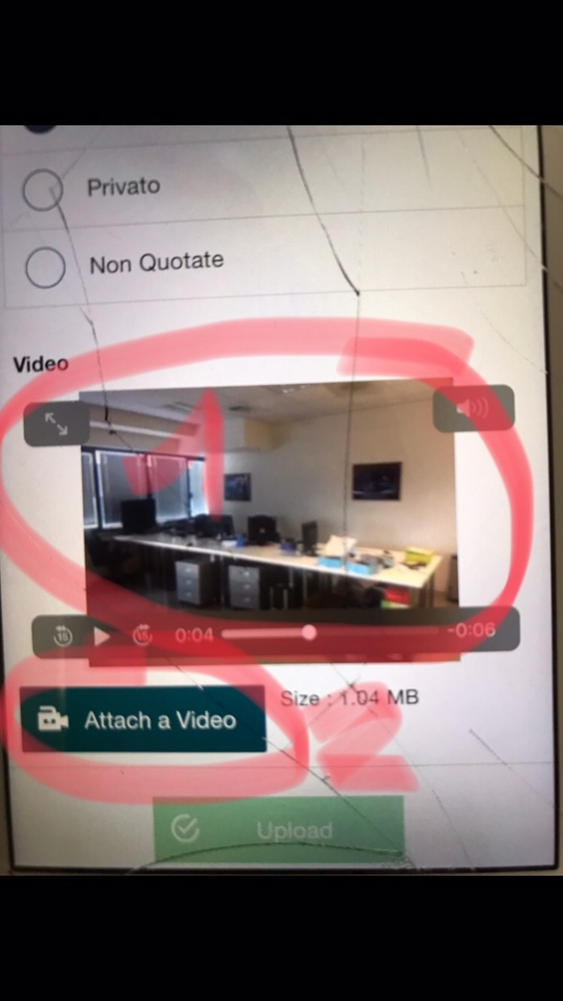

This is unacceptable!
you must only see the video, like the photos section in news section
Crea un video
Please note spelling

Slide 3
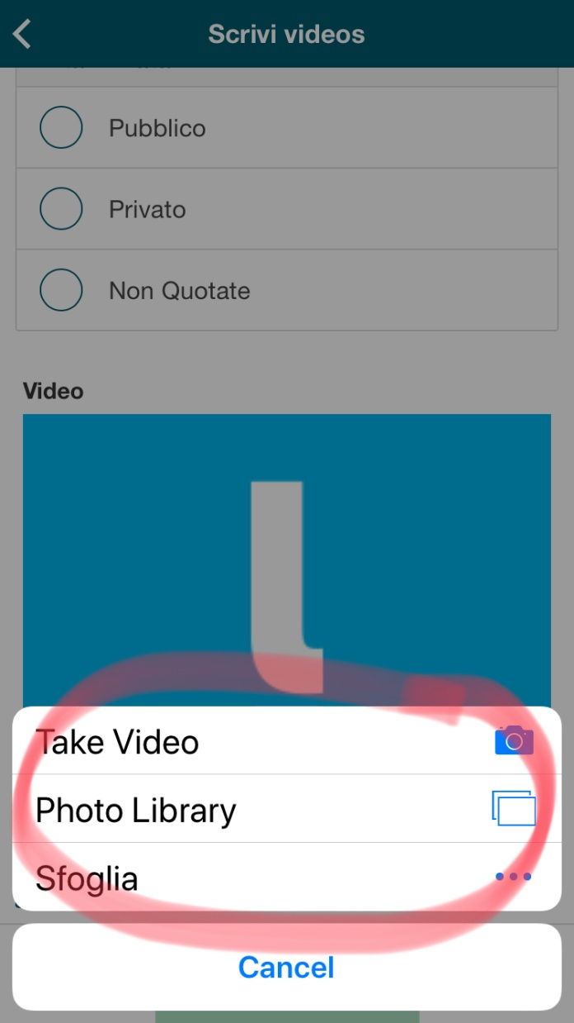
Delete section
Crea Video (use video icon!)
Video Gallery
Sfoglia
Annulla

Slide 4
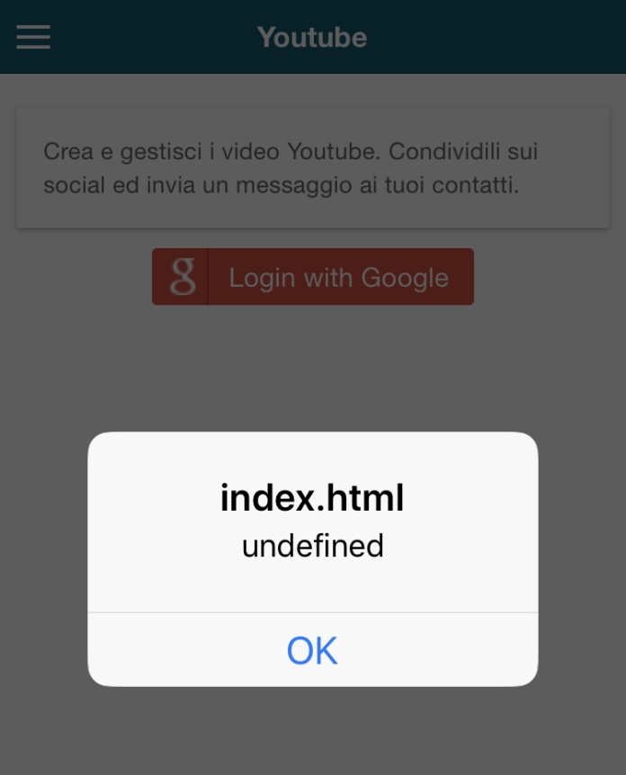
Debug this error!

